Slide 1
PVPaw Link 101
Administrative Staff Workshop

Slide 2
Agenda
Space Reservations Process
CORQ / Campus Labs Event Check In
Questions

Slide 3
Space Reservations
Google Chrome
Log On – pvpawlink.pvamu.edu
Use your PV credentials (Like Panther Tracks)
Must enter your space reservations no less than 15 business days in advance of your event. Major Events no less than 30 business days;
Listing of all Spaces on the form with locations and capacity
Notes:
Advisors will need to fill this out to receive a password that Jay will email. You will need this to reserve any and all MSC rooms and student parks. Please do not give out your password to fill out paperwork advisors.

Slide 4
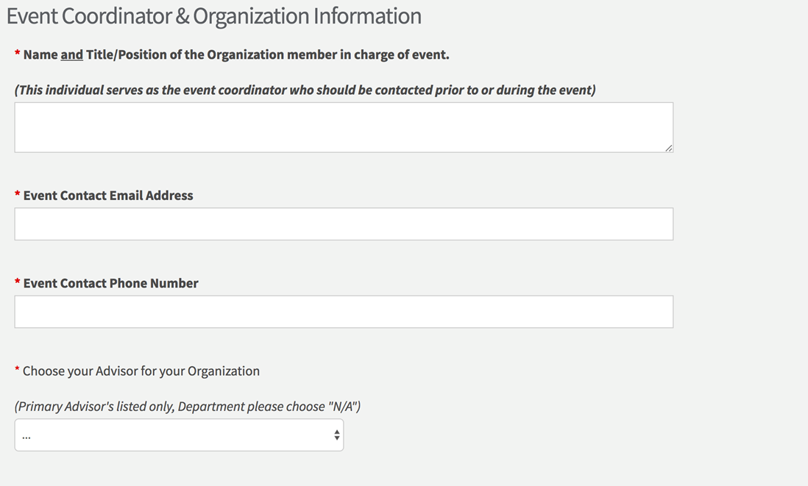
Space Reservations
On this page you will Add your Advisor to the Request, this will notify them that they have to review the request.
Contact Ms. Wright if you do not see your Advisor’s name listed
Notes:
Advisors will need to fill this out to receive a password that Jay will email. You will need this to reserve any and all MSC rooms and student parks. Please do not give out your password to fill out paperwork advisors.

Slide 5
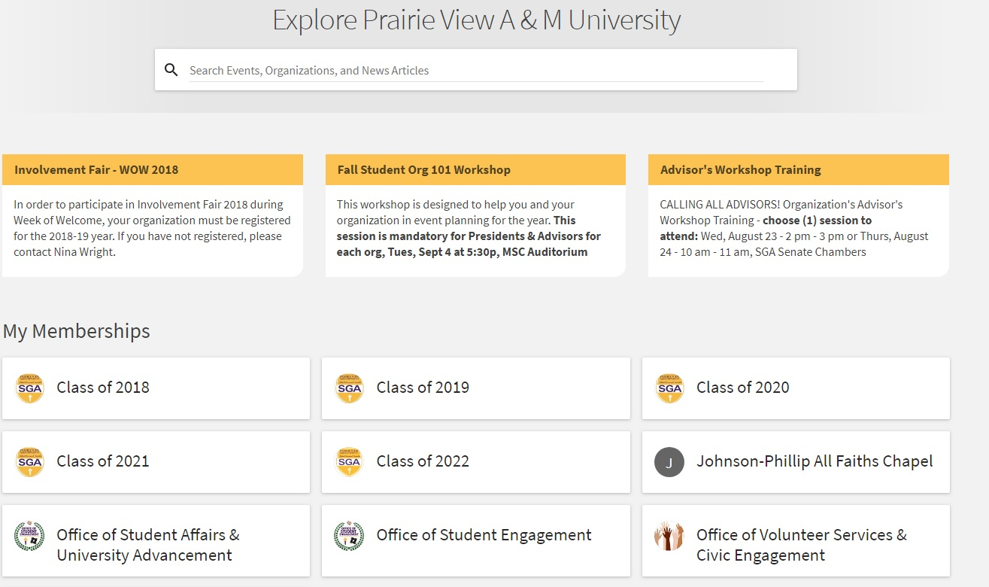
Space Reservations
Choose your Department or Organization page
Then click on “Manage”
Notes:
Advisors will need to fill this out to receive a password that Jay will email. You will need this to reserve any and all MSC rooms and student parks. Please do not give out your password to fill out paperwork advisors.

Slide 6
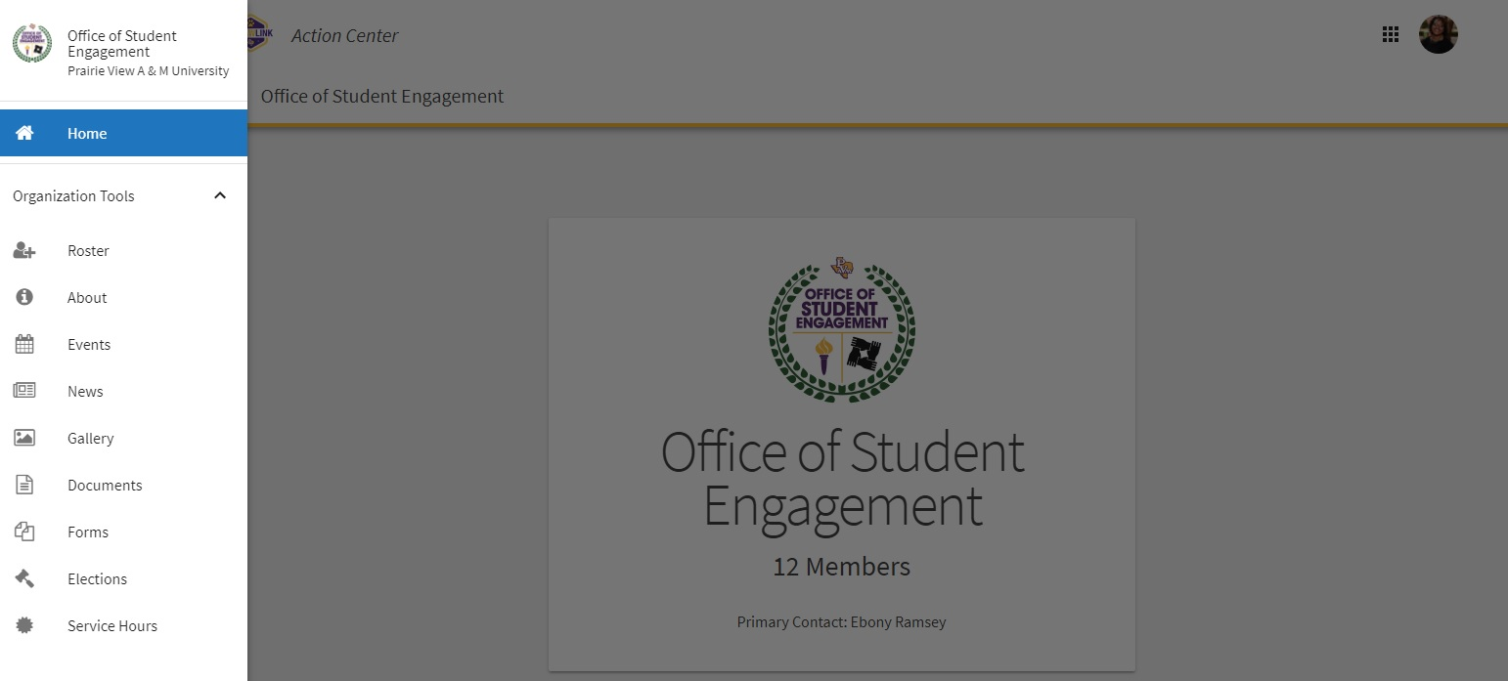
Space Reservations
Hamburger Drawer
Roster
Events
Documents
Forms
Notes:
Advisors will need to fill this out to receive a password that Jay will email. You will need this to reserve any and all MSC rooms and student parks. Please do not give out your password to fill out paperwork advisors.

Slide 7
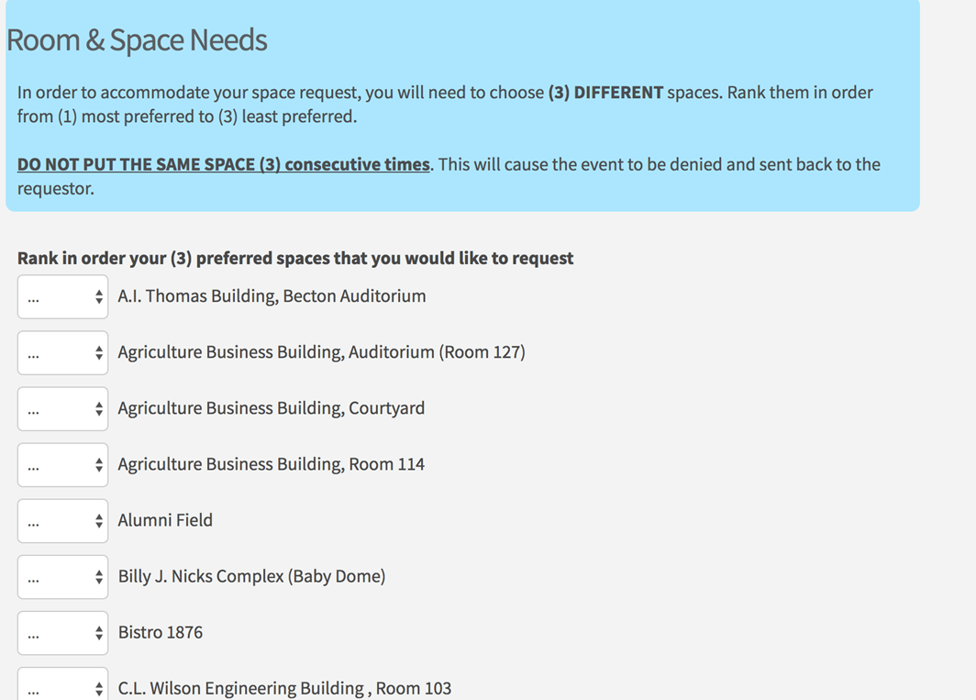
Space Reservations
Choose your (3) different choices of space request
All available spaces are listed
If your desired space is not listed, that means we do not reserve that space
Notes:
Advisors will need to fill this out to receive a password that Jay will email. You will need this to reserve any and all MSC rooms and student parks. Please do not give out your password to fill out paperwork advisors.

Slide 8
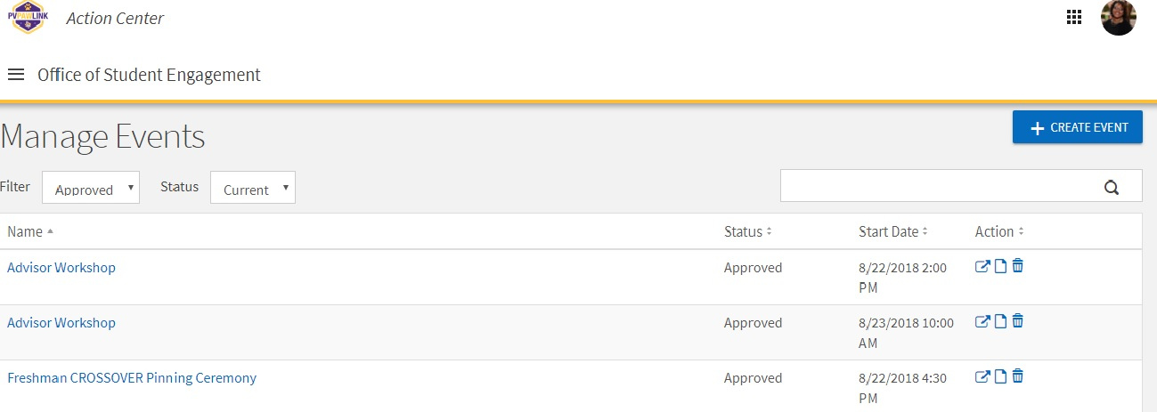
Space Reservations
Choose “Create Event”
Notes:
Advisors will need to fill this out to receive a password that Jay will email. You will need this to reserve any and all MSC rooms and student parks. Please do not give out your password to fill out paperwork advisors.

Slide 9
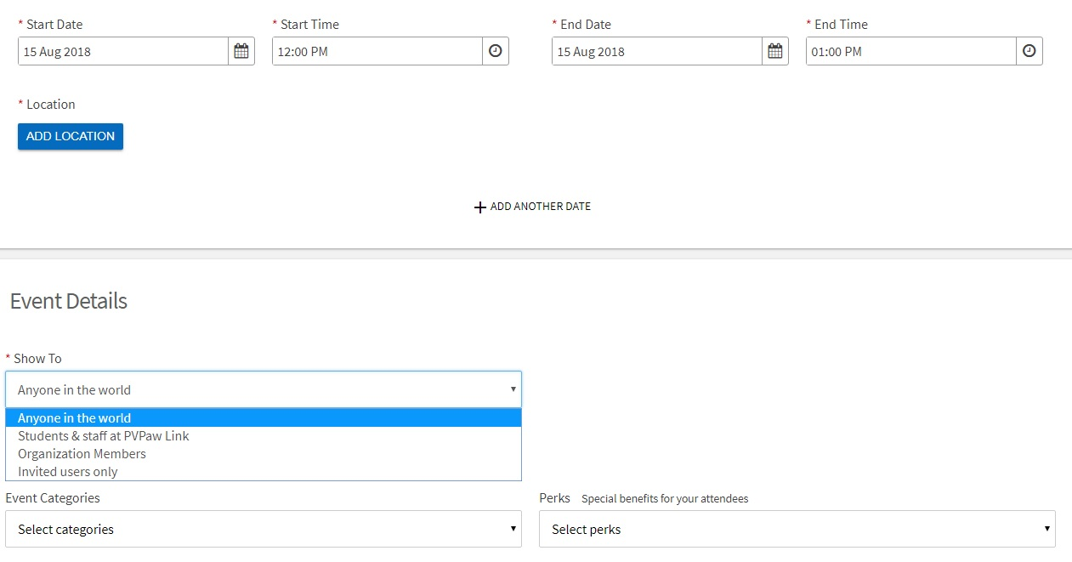
Space Reservations
Insert “TBD”
Enter up to 11 dates (Reoccurring Events)
1st & 2nd Choice put your event on the main calendar 3rd & 4th do not
Notes:
Advisors will need to fill this out to receive a password that Jay will email. You will need this to reserve any and all MSC rooms and student parks. Please do not give out your password to fill out paperwork advisors.

Slide 10
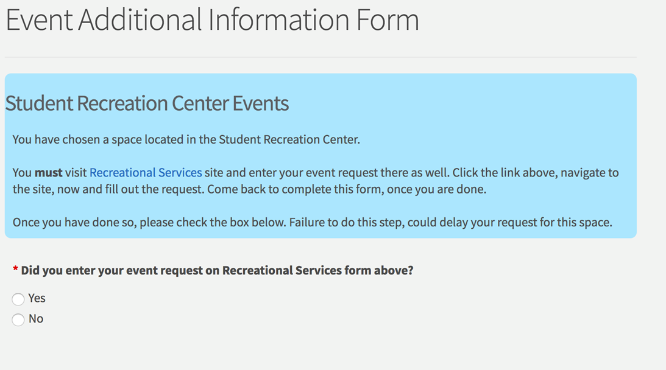
Rec Center & MSC Spaces
If you choose any space in the Rec Center or MSC you MUST fill out there form online in addition to PVPaw Link. Once you fill out the form, navigate back to PVPaw Link and click “Yes” you submitted the request
Notes:
Advisors will need to fill this out to receive a password that Jay will email. You will need this to reserve any and all MSC rooms and student parks. Please do not give out your password to fill out paperwork advisors.

Slide 11
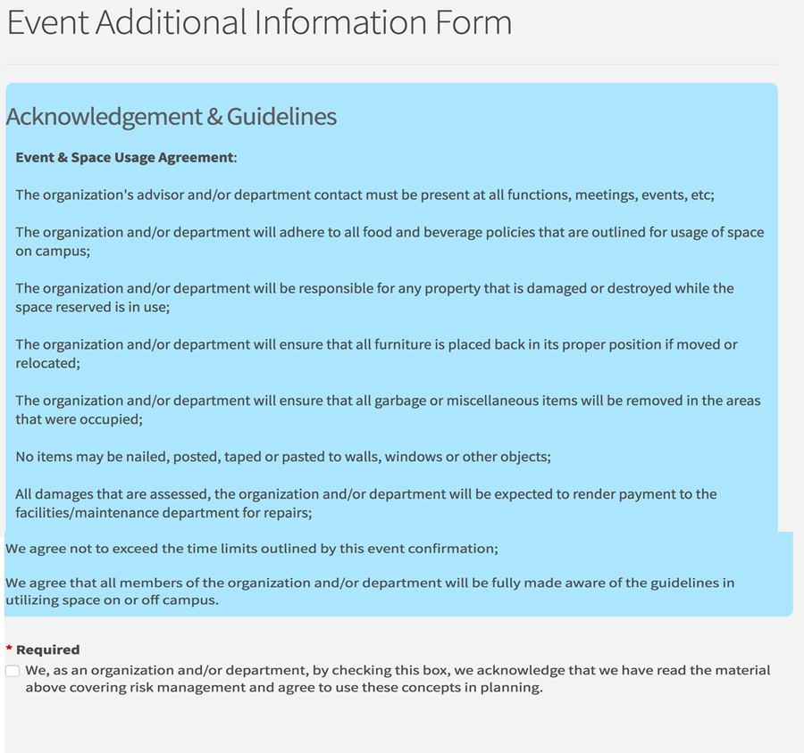
Signature Page
In lieu of a signature, you will click that you acknowledge the guidelines around space usage
Notes:
Advisors will need to fill this out to receive a password that Jay will email. You will need this to reserve any and all MSC rooms and student parks. Please do not give out your password to fill out paperwork advisors.

Slide 12
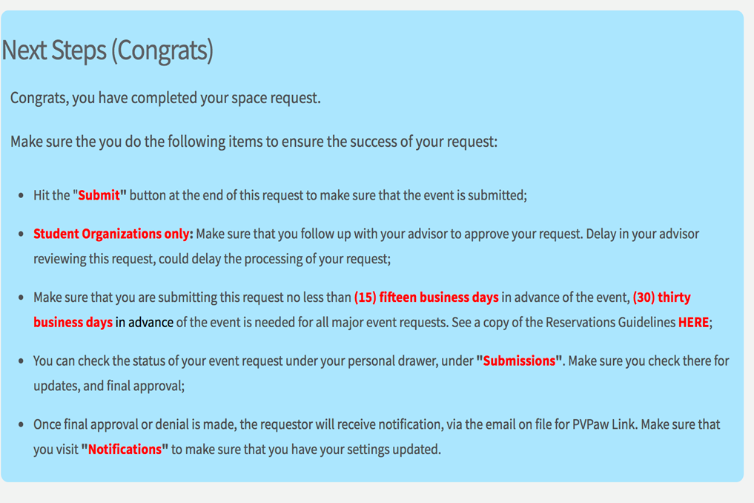
Next Steps
Submit button
Advisors must Approve
15 Business Days/30 Business Days
Submissions
Notifications
Notes:
Advisors will need to fill this out to receive a password that Jay will email. You will need this to reserve any and all MSC rooms and student parks. Please do not give out your password to fill out paperwork advisors.

Slide 13
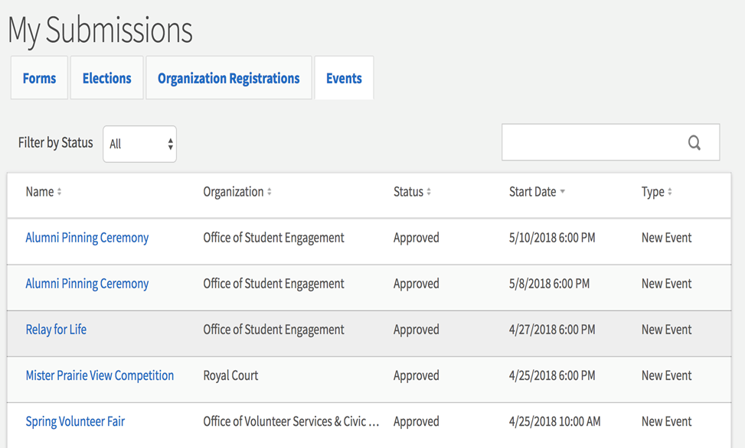
Space Reservations
To check the status of a space request:
Click on your Picture/Initial to open your personal drawer
Scroll to “Submissions” then click the “Events” tab
Notes:
Advisors will need to fill this out to receive a password that Jay will email. You will need this to reserve any and all MSC rooms and student parks. Please do not give out your password to fill out paperwork advisors.

Slide 14
Managing the Event
PVPaw Link 101

Slide 15
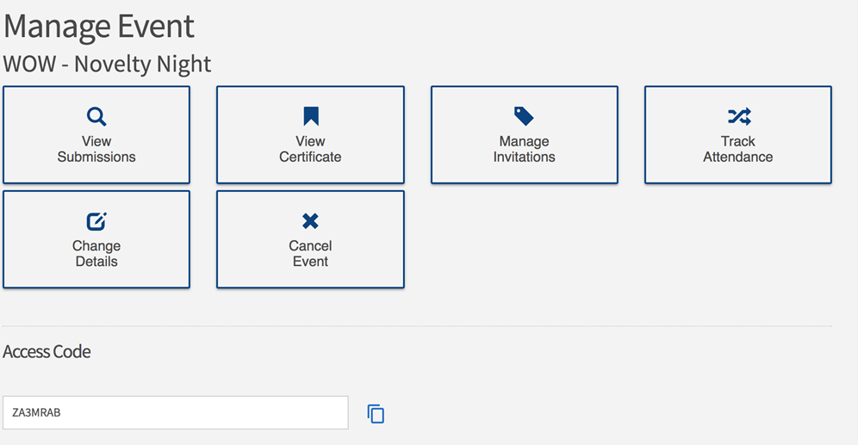
Mange Event View
Event Certificate – Proof that your event is Approved and reserved
Manage Invitations – Add email addresses to invite people to the event
Track Attendance – Use the access code to swipe students into the event
Cancel Event – 72 business hours needed to cancel and event
Notes:
Advisors will need to fill this out to receive a password that Jay will email. You will need this to reserve any and all MSC rooms and student parks. Please do not give out your password to fill out paperwork advisors.

Slide 16
CORQ / Check In
PULL OUT YOUR CELL PHONE!
Notes:
Advisors will need to fill this out to receive a password that Jay will email. You will need this to reserve any and all MSC rooms and student parks. Please do not give out your password to fill out paperwork advisors.

Slide 17
CORQ / Check In
Access Code ZJY5DMN
Notes:
Advisors will need to fill this out to receive a password that Jay will email. You will need this to reserve any and all MSC rooms and student parks. Please do not give out your password to fill out paperwork advisors.

Slide 18
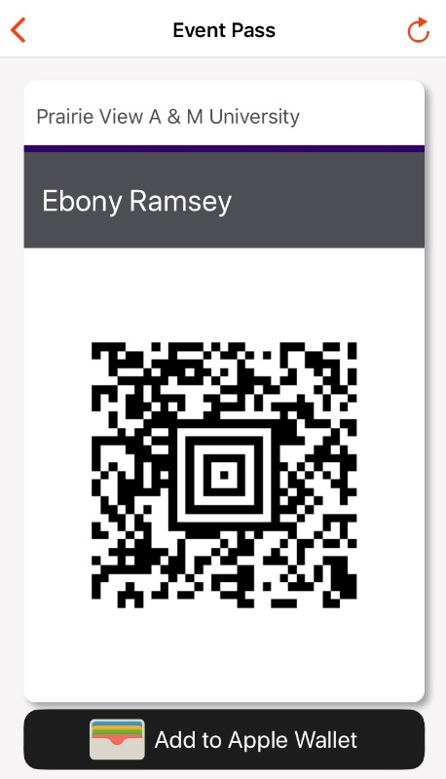
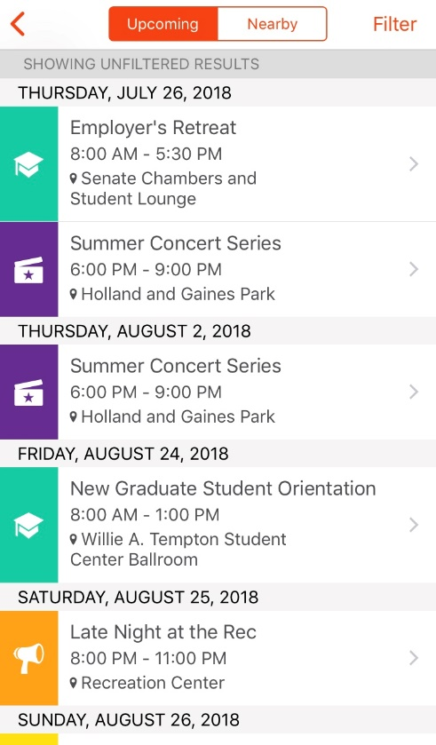
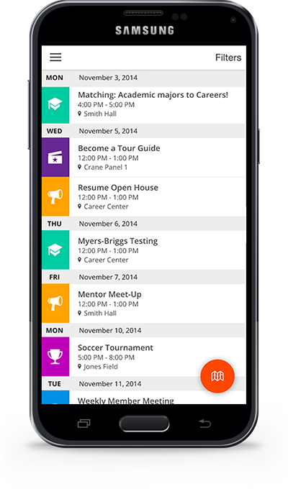
CORQ / Mobile Check In
Allows Access to Paw Pass
Use for attendance/Tracking
Path
Get the Details
Find Your Way
Share your experience

Slide 19
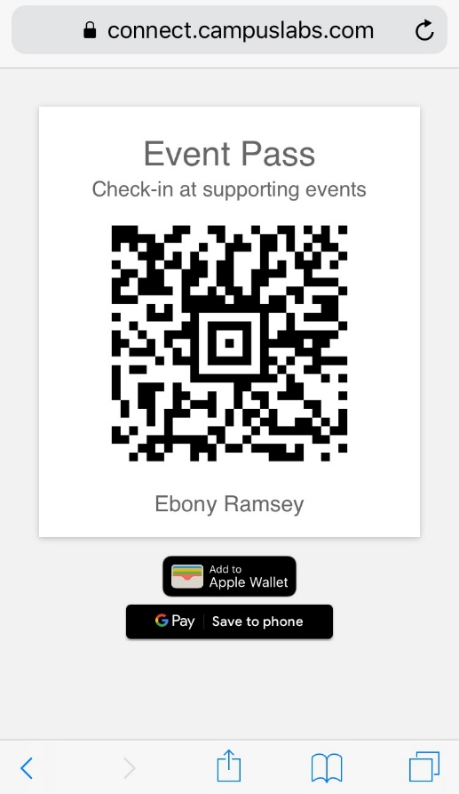
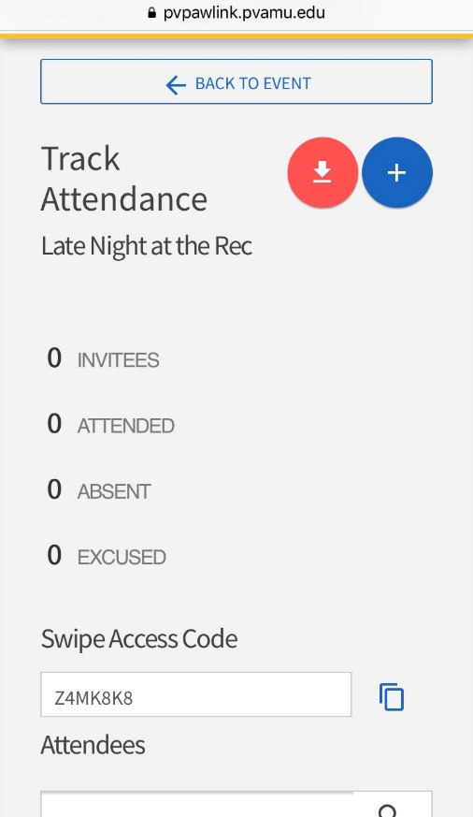
CORQ / Mobile Check In
USAGE:
Enter Event Code
Start Scanning
Manually (Guests, Forgetful, etc.)
Reporting
Events, Meetings, Workshops, etc.

Slide 20
Questions!
(936) 261-1340
Studentengagement@pvamu.edu
@PVAMU_OSE

