Slide 1
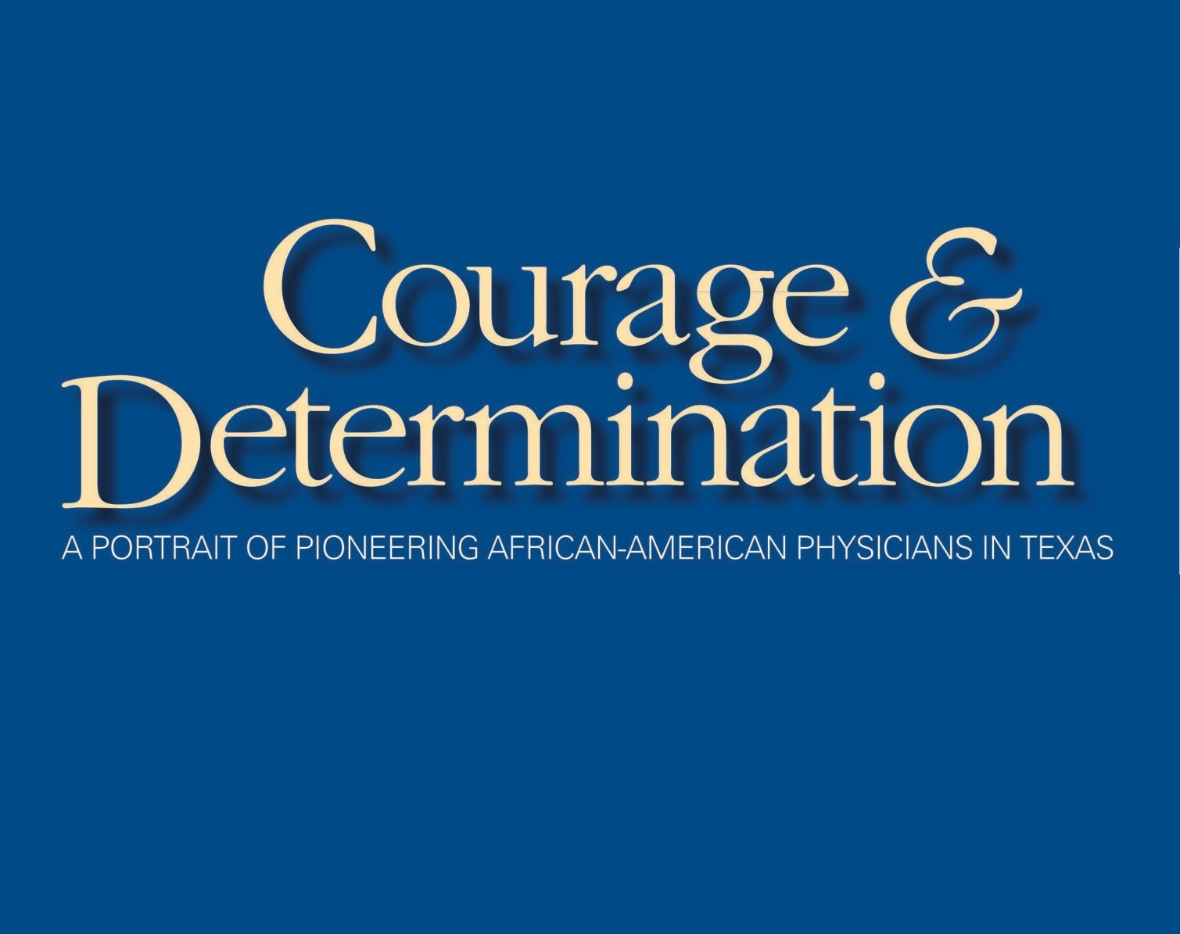
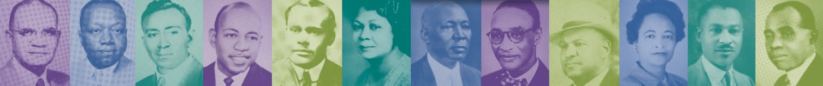

Slide 2
For more than 300 years, most Africans reached Texas as slaves of the Spanish colonists or as slaves immigrating with their Southern owners. No African-American physician would come to Texas to practice medicine until 1882, almost 20 years after the Civil War ended.
This is the story of many brave doctors, their migration, and how they sought to change the practice of medicine while serving their community and caring for patients in the Jim Crow South.

Slide 3
The first African-American physician earned his medical degree in Glasgow, Scotland, in 1837.
Ten years later David J. Peck of Pittsburgh, Pa., was the first to gain the coveted degree in America at Rush Medical College in Chicago.
When the Civil War began, at least 10 medical schools in the North accepted African-American applicants, though few graduated.
Fourteen medical schools were established after the Civil War for slaves or their children to become much-needed physicians. Only Howard University and Meharry Medical College survive today.

Slide 4
Early Medical Education

Slide 5
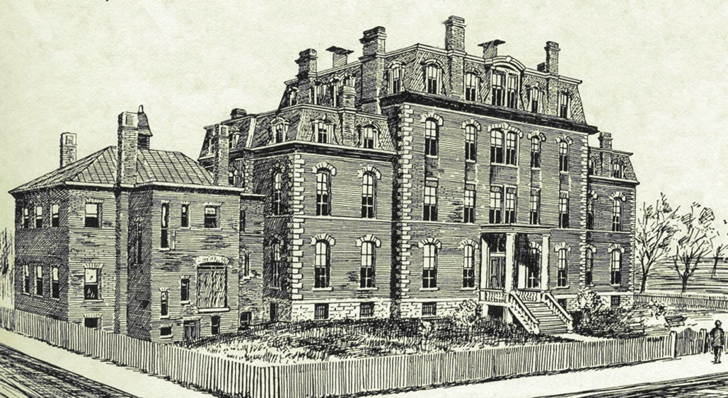
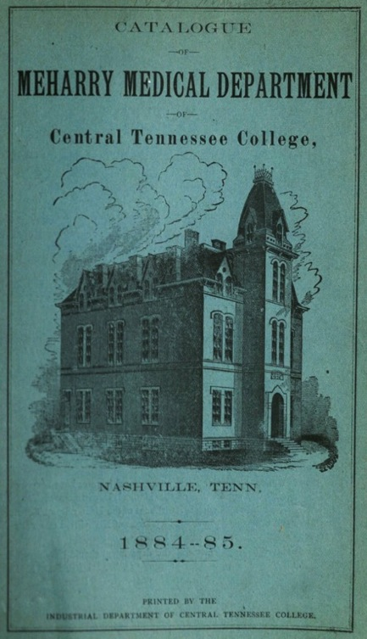
Meharry Medical College was established in 1876 in Nashville by the Methodist Episcopal Church and the Freedman’s Aid Society.
Howard University was established in 1867 in Washington, D.C., and named for the commissioner of the Freedman’s Bureau, established primarily to help freed slaves. Its Medical Department was one of two original departments established that year.
Between 1910-47, Howard and Meharry accounted for 90 percent of the African-American medical school graduates. Among their 3,439 graduates were 101 women. Most of the pioneers who settled in Texas graduated from Meharry. Its annual catalogue and graduate updates helped pioneers in Texas keep track of new arrivals and moves.

Slide 6
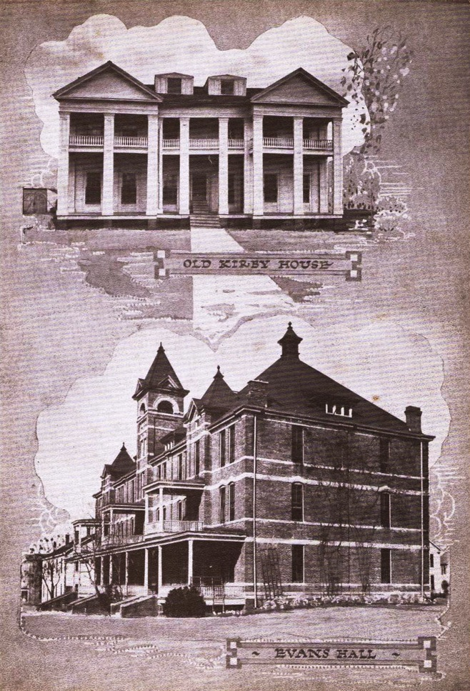
In 1876, the same year Meharry opened, the Texas Legislature established the first state college for African-Americans in Texas. Alta Vista Agricultural and Mechanical College for Colored People is known today as Prairie View A&M University.

Slide 7
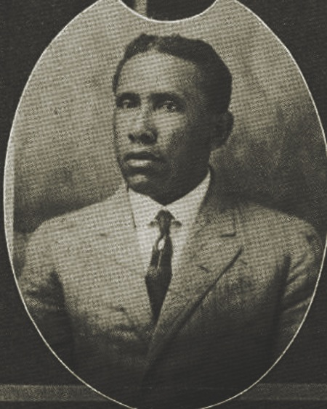
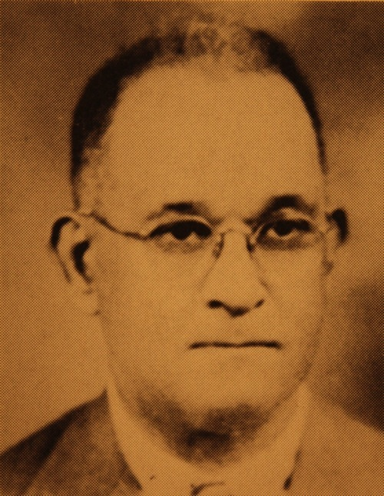
John Granville Osborne, MD, (1872-?) added premed training and a nurses division while serving as the sixth principal (aka president) at Prairie View. In 1918, he hired James Madison Franklin, MD, and asked him to build a new modern hospital at Prairie View.
James Madison Franklin, MD, (1884-1967). As resident physician (1919-45) and superintendent of the new hospital that opened in 1929, he established a needed medical internship program with slots sought by medical students nationwide. He also helped establish needed post-graduate medical training for Texas physicians at Prairie View.

Slide 8
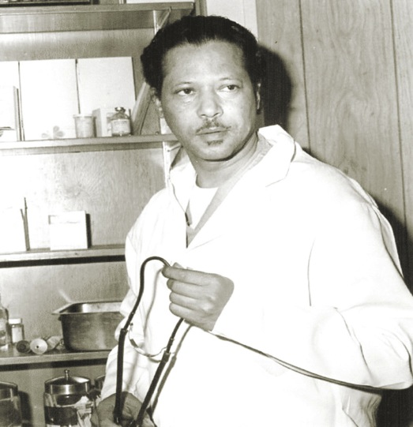
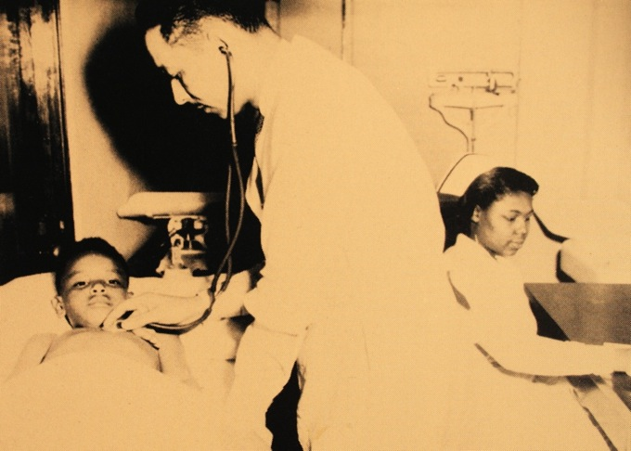
John Brady Coleman, MD, (1929-94). The Houston civic leader was the first African-American appointed to the Texas A&M System Board of Regents, serving 1977-89. He saw to it that for the first time, Prairie View received a share of the Permanent University Fund.
Emery R. Owens, MD, (1913-1999), was resident physician and director of college health services at Prairie View A&M. In 1971, Dr. Owens was named the health officer for Waller County.

Slide 9
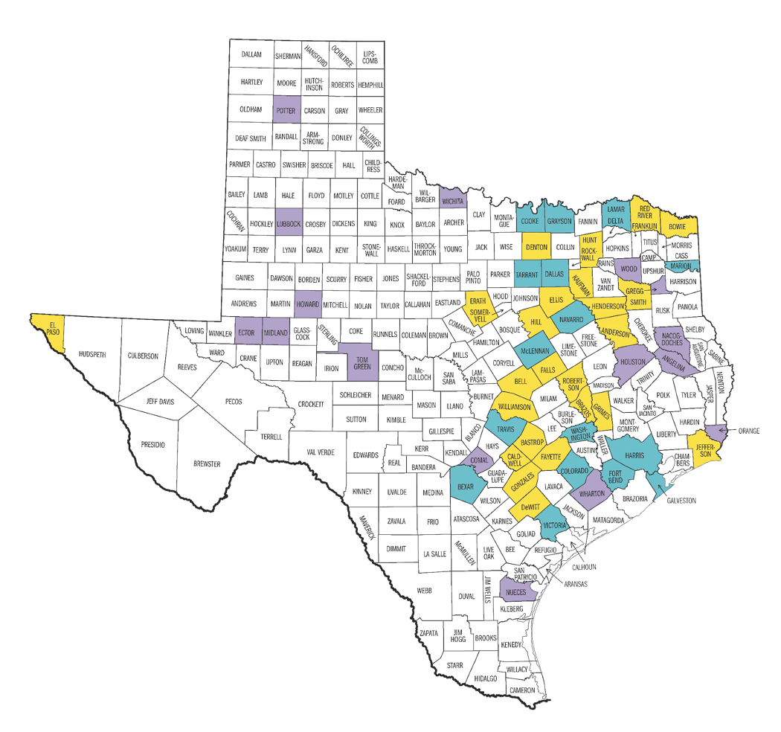

Trained Physicians Come to Texas
^{Movement of Black Physicians}
1890 At least 24 were practicing in Austin, Columbus, Corsicana, Dallas, Denison, Galveston, Houston, Marshall, San Antonio, and Waco.
1914 At least 104 were practicing in Austin, Bastrop, Bryan, Calvert, Chappell Hill, Clarkesville, Columbus, Corsicana, Cuero, Dallas, Denison, and Denton. Also, Dublin, El Paso, Ennis, Fort Worth, Gainesville, Galveston, Greenville, Hearne, Houston, Hubbard, Jefferson, LaGrange, LaRue, Luling, Marlin, Marshall, and Mexia, as well as Navasota, Palestine, Port Arthur, San Antonio, Sherman, Smithville, Taylor, Temple, Terrell, Texarkana, Tyler, Victoria, Waco, Waxahachie, and Yoakum.
1954 At least 138 African-American physicians were practicing in Texas, compared with 7,012 physicians total. They were practicing in Amarillo, Austin, Beaumont, Big Spring, Bryant, Calvert, Clarkesville, Corpus Christi, Corsicana, Crockett, Dallas, and Dennison. Also, El Paso, Fort Worth, Gainesville, Galena Park, Galveston, Hawkins, Houston, Jefferson, Longview, Lubbock, Lufkin, Marlin, Marshall, Midland, Nacogdoches, and Odessa, as well as Orange, Palestine, Paris, Port Arthur, San Angelo, San Antonio, Seguin, Smithville, Taylor, Temple, Terrell, Texarkana, Tyler, Victoria, Waco, Wharton, and Wichita Falls.
2004 There were 1,617 African-American physicians practicing compared with 40,373 physicians in Texas total.
¹⁸⁹⁰
¹⁹¹⁴
¹⁹⁵⁴

Slide 10
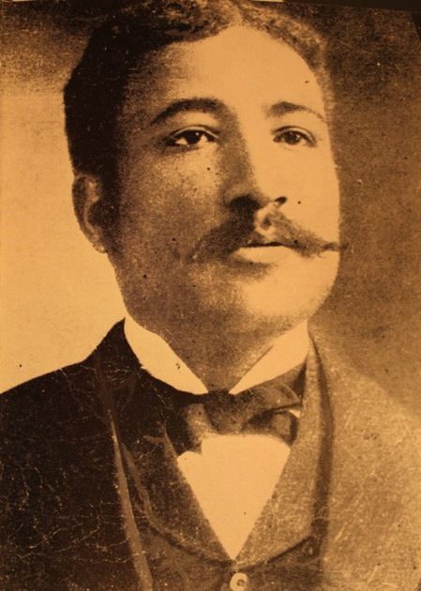
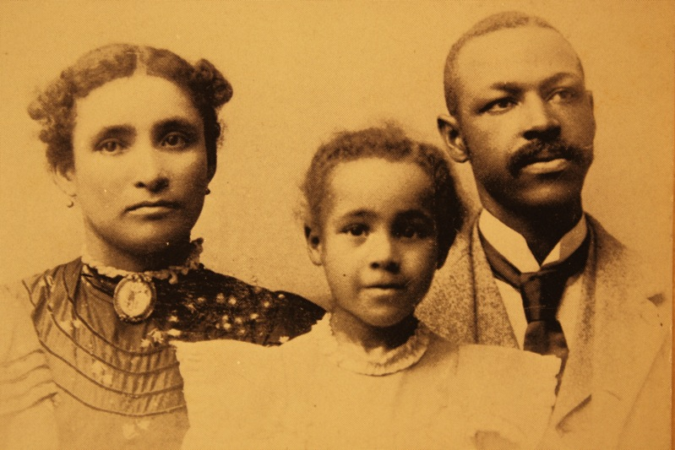
In 1882, the first African-American physician opened a medical practice in Texas. Quinton Belvedere Neal, MD, relocated from Goliad to Austin a year later, the same year Edwin B. Ramsey, MD, was first to open a medical practice in Houston. Both were Meharry graduates.
Thomas Everett Speed, MD, (?- 1924) in 1894 opened his medical practice in Jefferson after graduating from Flint Medical School (New Orleans) in 1894. He was possibly the first in Texas to train the nurses needed to assist African-American physicians. Dr. Speed was also surgeon of Sheppard’s Sanitarium and Hospital in Marshall.
Monroe Alpheus Majors, MD, (1864-1960) was the first Texas native to obtain a medical degree. The 1886 Meharry graduate practiced in Brenham, Calvert, and Dallas. He left Texas in 1888 after being warned his name was on a list of those to be lynched, and opened a practice in California. When Dr. Majors returned to Texas to practice in Waco, he opened one of the first black hospitals in Texas.

Slide 11
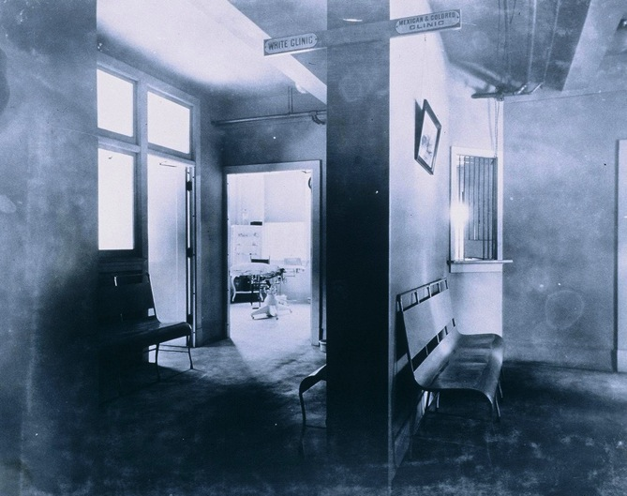
By the late 1950s, African-Americans were in only 35 of the 254 counties in Texas.
Some settled in larger cities but most early pioneers settled in counties in East Texas, where the largest concentration of African-Americans lived.
These physicians faced obstacles, indignities, and dangers in the Jim Crow South, where law and custom dictated behavior. A physician asked to come to the home of a white patient entered through the back door. Separate waiting rooms were the norm when doctors of either race treated both black and white patients.
In 2004, there were 1,617 African-American physicians out of the total 40,373 licensed to practice medicine in Texas.

Slide 12
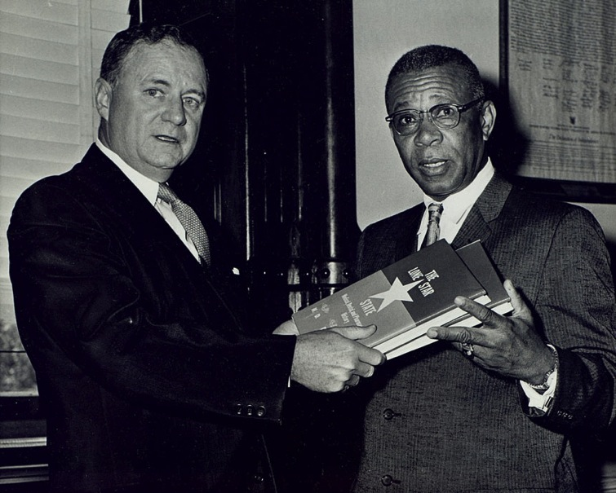
Joseph Alvin Chatman, MD, (1901-67), graduated from Meharry in 1926. Dr. Chatman wrote two important books, The History of Negroes of Limestone County, and The Lone Star State Medical, Dental, and Pharmaceutical History. Dr. Chatman is shown presenting the latter, a history of the African-American state medical society, to Texas Gov. Price Daniel. It provided many images and much important background on these pioneering doctors.
Dr. Chatman established Chatman Medical Clinic in Mexia in 1935 and in 1945 opened Chatman Hospital and Clinic in Lubbock.
In 1960, President Dwight Eisenhower appointed Dr. Chatman to the President’s White House Conference on Youth. The next year President John Kennedy asked him to join the White House Conference on the Aged. In 1963, Gov. John Connally appointed Dr. Chatman to the board of directors of Texas Southern University.

Slide 13
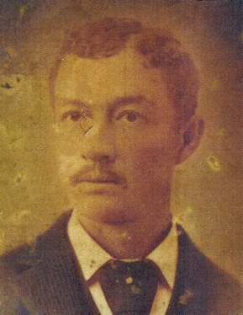
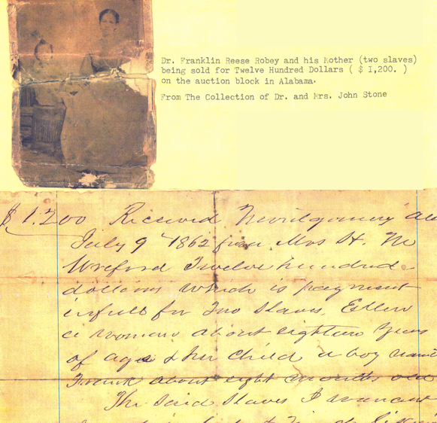
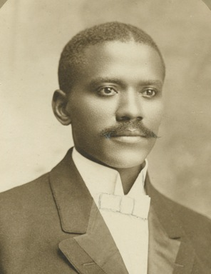
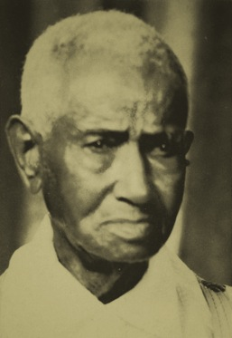
Franklin Reese Robey, MD, (?-1904). Born a slave in Alabama, he and his mother were sold for $1,200 when he was a young boy. After graduating from Meharry in 1883, he became the second African-American to open a medical practice in Houston.
Edwin Donerson Moten, MD, (1875-1955) was born in Bastrop County to a family with nine children. The 1906 Leonard Medical School (North Carolina) graduate opened his practice in Denton in 1907. He served as secretary to the Lone Star State Medical Association and was a second lieutenant in the Officers’ Reserve Corps of the U.S. Army during World War I.
Henry Lewis Smith, MD, DDS, (1860-1955) was born a slave in Bastrop. Dr. Smith opened his office in Grimes County in 1888, the year he graduated from Meharry. He practiced in Houston for 10 years and then in Waco for 55 years.

Slide 14
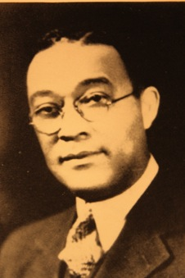
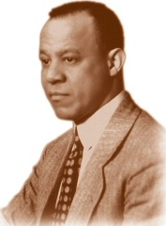
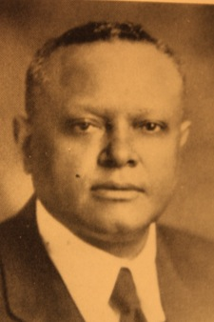
Charles Rolston Yerwood, MD, (1882-1940) was born in Austin. He earned his medical degree from Meharry in 1907 and first opened his practice in Indian Territory (later Oklahoma) before practicing in Gonzales and finally Austin.
Lawrence Aaron Nixon, MD, (1883-1966). The 1906 Meharry graduate first opened his medical practice in Cameron, but after a lynching there, he moved to El Paso. In 1923, the Texas Legislature established the all-white election primary. After being denied the right to vote, Dr. Nixon filed suit, and in 1927 the U.S. Supreme Court unanimously declared the white primary unconstitutional. Despite this ruling, other barriers were established, and it was not until 1944 that Dr. and Mrs. Nixon were allowed to vote in El Paso.
George Murray Munchus, MD, (1887-1952) was born in Ellis County. His parents were slaves who had traveled from Alabama to Texas after being freed. The 1909 Meharry graduate opened the first black hospital in Clarksville in Red River County in 1911. After the Ku Klux Klan burned it down, Dr. Munchus moved to Fort Worth and established Negro Community Hospital.

Slide 15
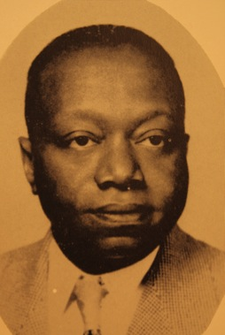
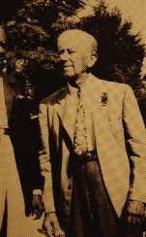
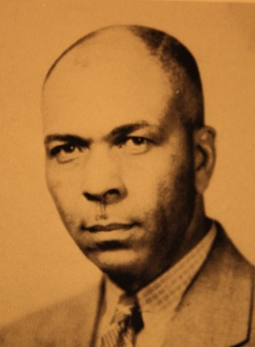
Martin Luther Edwards, MD, (1900-70). Born in Mississippi, he interned at Prairie View Hospital after graduating from Meharry in 1931. Dr. Edwards opened a medical practice in Hawkins (north of Longview), where he served as college physician for Jarvis Christian College without a salary. He was a long-time member of the Texas Biracial Committee appointed by Texas Govs. Beauford Jester, Allan Shivers, and Price Daniel Sr.
George Thomas Coleman, MD, (?-?). Born in Fort Worth, he graduated from Jenner Medical College (Chicago) in 1908 and practiced medicine in Marshall.
Lafayette Dewitt Cook, MD, (1870-1955). After graduating from Flint Medical College in 1897, Dr. Cook practiced medicine in Navasota, Seguin, and Yoakum before settling in La Grange, where he practiced medicine for 58 years.

Slide 16
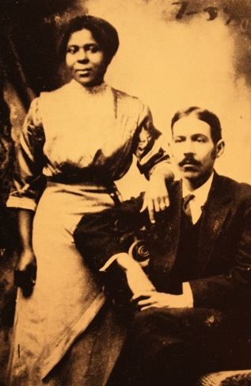
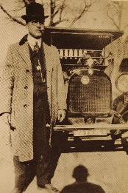
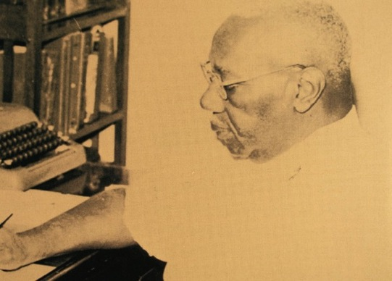
George Melton Wilkins, MD, (1890-1969) passed the Kentucky medical examination while a junior at Meharry because he could no longer afford medical school. As a World War I volunteer soldier, Dr. Wilkins fell seriously ill with flu and complications during the 1918 epidemic. An army colleague, C. Austin Whittier, MD, of San Antonio was given a 30-day furlough to attend to his friend and save his life. Dr. Wilkins treated patients of all races in his practice in Victoria.
Charles Clifton Owens, MD, (1888-1958). Born in South Carolina, he graduated from Meharry in 1910. After first practicing in Oklahoma, he moved to Smithville in 1912. During World War II, Dr. Owens was honored by Presidents Roosevelt and Truman for work on the local selective service board.
Clarence Claude Bausselle Friday, MD, (1896-1958). Born in Yoakum, the 1926 graduate of Howard College of Medicine practiced briefly in San Antonio before opening a practice in Seguin.

Slide 17
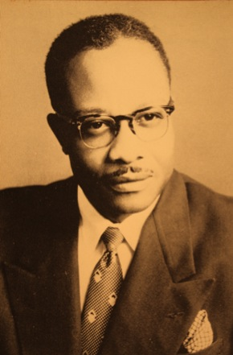
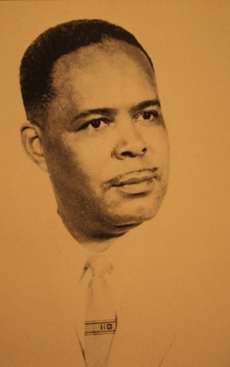
Hannibal Lavern Brownlow, MD, (1915-83) was born in Yoakum. After graduating from high school and junior college in Oakland, Calif., he earned a degree at Prairie View in 1937. After graduating from Meharry in 1944, Dr. Brownlow opened his medical practice in Corpus Christi in 1945, where he remained except for military service in 1951-53 during the Korean War.
James Odis Wyatt, MD, (1906-58) was born in Victoria. The 1931 Meharry graduate specialized in obstetrics and gynecology. He practiced in San Angelo, Kerrville, and Amarillo, where he established Wyatt Memorial Medical Clinic and Hospital after being denied hospital privileges. Dr. Wyatt was the first African-American to run for office in Amarillo. A cross was burned on his lawn soon after the announcement, an act he considered a “cowardly stunt” and “not worthy of notice.”

Slide 18
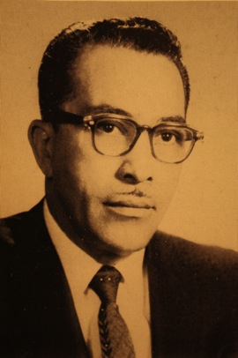
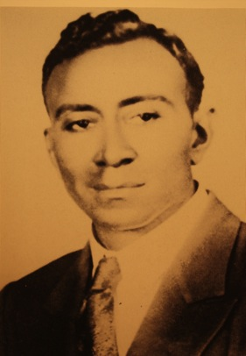
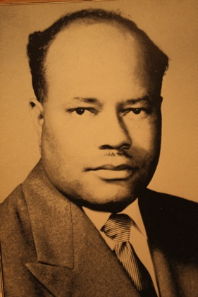
Edward Daniel Sprott Jr., MD, (1908-70). The 1935 Meharry graduate was born in Beaumont and practiced medicine there for 33 years. He opened Sprott Hospital with his brothers. Dr. Sprott was the first African-American to run for the Beaumont City Council. He also sought a place on the Beaumont School Board in 1967. He served as state president of the National Association for the Advancement of Colored People (NAACP).
Mississippi native William Knox Flowers Sr. MD, (?-?). The 1913 Meharry graduate practiced in Sulphur Springs and Dallas.
Mattice Farnandis Harris Sr., MD, (1914-1994) was born in Mississippi. The 1944 graduate of Meharry completed his residency in surgery at John Andrew Hospital at Tuskegee Institute (Alabama) before returning to Mississippi, where he practiced until 1951. After a tour of duty with the U.S. Army Medical Corps in Orleans, France, he opened his medical practice in Orange in 1953. In 1971, Dr. Harris was elected president of the Orange County Medical Association.

Slide 19
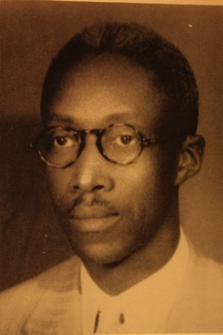
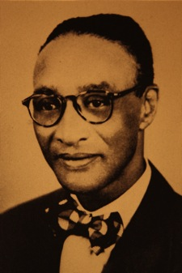
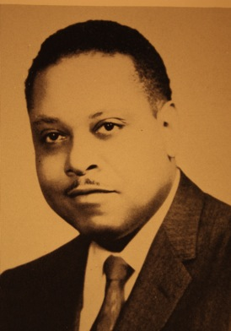
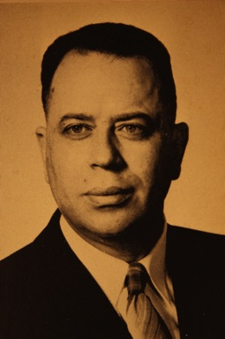
Ulysses Grant Gibson, MD, (1904-75) was born in Louisiana. He graduated from Meharry in 1926 and practiced medicine in Port Arthur.
Richard Lawrence Perkins, MD, (1910-?). After earning his degree from Meharry in 1942, Dr. Perkins spent 30 months of military service in Europe during World War II. He opened his medical practice in Paris, Texas, in 1946.
Joseph Mack Mosely, MD, (1899-1946). Born in Texarkana, he graduated from Meharry in 1913 and opened his medical practice in Galveston in 1916. His son and namesake, Joseph Mack Moseley II, MD, (?-?) a specialist in internal medicine, joined his father’s medical practice in Galveston.

Slide 20
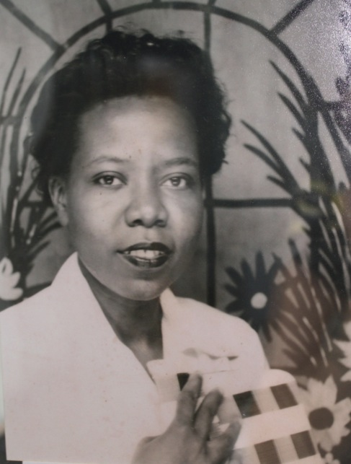
Viola Johnson Coleman, MD, (1919-2005) was born in New Iberia, La. In 1946, she applied to Louisiana State University (LSU) Medical School in New Orleans and received the following reply: “As you no doubt know, the State of Louisiana maintains separate schools for its white and colored students. Southern University, located in Scotslandville … is the principle Louisiana university for negroes.” With the help of the NAACP and its lead attorney, Thurgood Marshall, she sued for admission to LSU but the 19th District Court in Baton Rouge denied her request. By the time the court decision was rendered, she had enrolled at Meharry, graduating in 1949. Dr. Viola Johnson Coleman and her husband, Raymond, a teacher, returned to Louisiana where she tried unsuccessfully to open her medical practice. The Colemans traveled to Fort Worth 1951, where Dr. Coleman was told there was an opening at a new hospital in Midland. She practiced medicine there and also was involved in efforts to integrate Midland schools and hospitals.

Slide 21
A Medical Society of Their Own
Traditional county, state, and national medical associations were closed to African-American physicians. Undaunted, these pioneering doctors established their own. The first was the Medico-Chirurgical Society founded in 1884 in Washington, D.C.
The second was the Lone Star Medical Club established in Galveston in the office of Meharry graduate John J. Wilkins, MD, in 1886. Other founders present, all Meharry classmates, were Greene J. Starnes, MD, of San Antonio as president; Reed Townsend, MD, Victoria; Ernest M. Blakney, MD, Columbus; N. Hill Middleton, MD, Oakland; William H. Scott, MD, Helinora; Edwin B. Ramsey, MD, Houston; and Monroe Majors, MD, Brenham.
The club grew to include other health professionals and was renamed the Lone Star State Medical, Dental, and Pharmaceutical Association It is known today as the Lone Star State Medical Association (LSSMA).

Slide 22
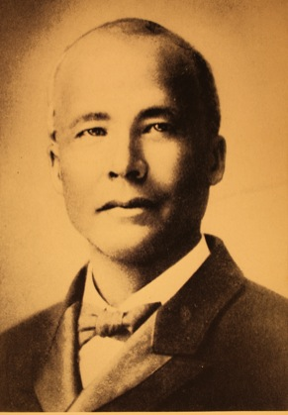
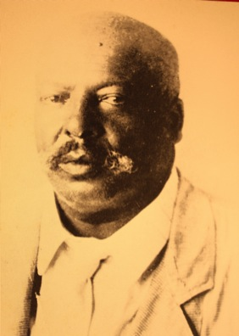
John Henry Wilkins, MD, (1853-1917) was first African-American to open a medical practice in Galveston in 1884 after graduating in 1880 from Meharry. After the Galveston Hurricane of 1900, Dr. Wilkins moved to Victoria. His brother, Lewis Melton Wilkins, MD, (1859-1928) who had graduated from Meharry in 1887, remained in Galveston. When John Henry Wilkins died, his son George Melton Wilkins, MD, took over the practice, the first second-generation practitioner in Texas. He appears earlier in this exhibit.

Slide 23
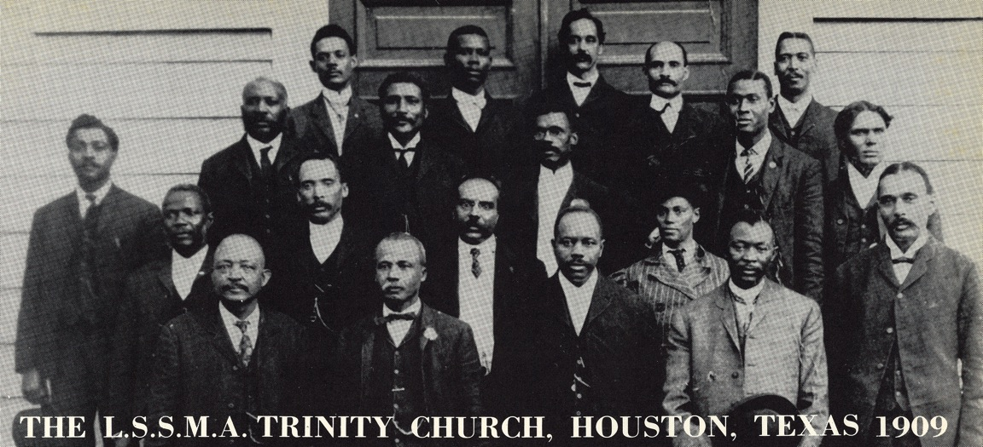
You have image
The earliest known photograph of the Lone Star State Medical members. All but six have been identified: Edwin B. Ramsey, MD, Houston; John H. Wilkins, MD, Galveston; Russell F. Ferrill, MD, Houston; Benjamin Covington, MD; Mary Susan Moore, MD, Galveston (in the striped dress standing) was the first African-American female physician in Texas. Also T.V. Overton, MD, Houston; Samuel N. Lyons, MD, Houston; Fountain L. McDavid, MD, Houston; Richard T. Hamilton, MD, Dallas; Benjamin R. Bluitt, MD, Dallas; J.T.M, Lindsay, MD, Houston; Emory A. Durham, MD, Houston and ? Barlow, MD (first name and city unknown).

Slide 24
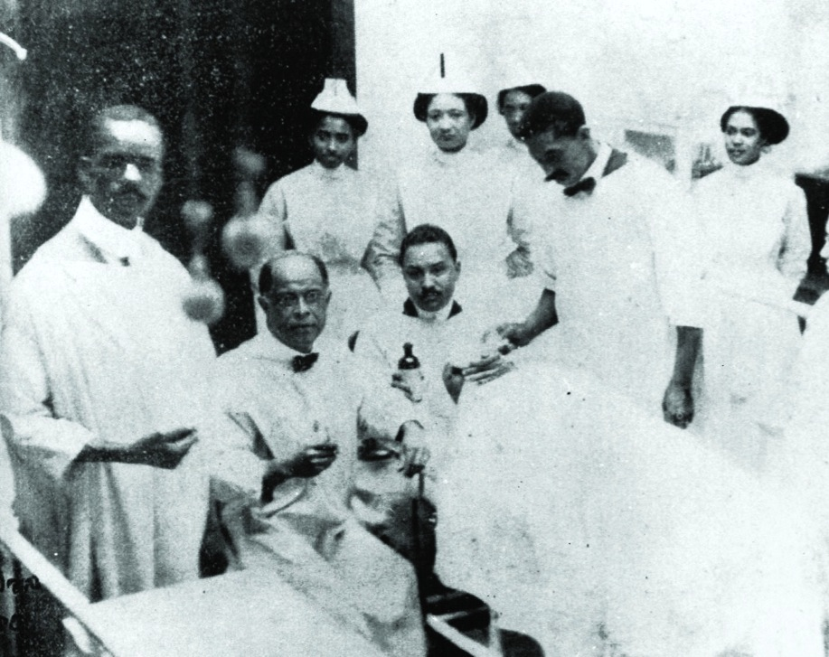
In 1895, the National Medical Association (NMA) was founded in Georgia because the American Medical Association was segregated. Charles Victor Roman, MD, (1864-1934) was practicing medicine in Dallas when in 1904 he became the fifth president and first from Texas. During his presidency, the 1890 Meharry graduate joined the faculty at his alma mater, where he established the Department for Diseases of the Eye, Ear, Nose, and Throat. In 1909, he became the first editor of the Journal of the National Medical Association. The C.V. Roman Medical Society of Dallas was named in his honor.

Slide 25
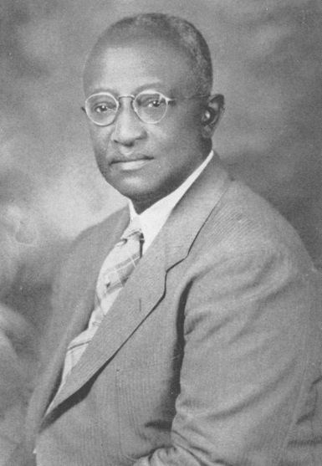
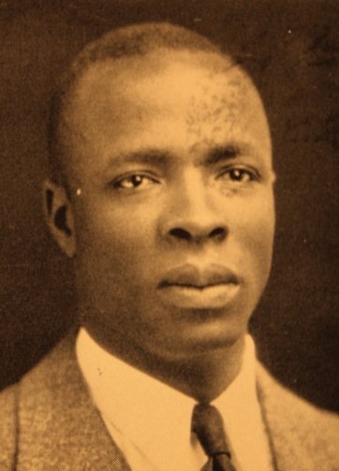
Henry E. Lee, MD, (?-?). He opened his medical practice in 1910 in Houston and in 1915 wrote “The Negro Health Problem” for inclusion in The Red Book of Houston: A Compendium of Social, Professional, Religious, Educational, and Industrial Interests of Houston’s Colored Population. Dr. Lee explained how Jim Crow laws undermined the health of African-Americans Houstonians. He was the first native Texan to serve as president of NMA in 1943.
Charles Austin Whittier, MD, of San Antonio (1891-1969) was the second native Texan to lead NMA in 1948. He moved to San Antonio after graduating and opened the Whittier Clinic in 1927. Bexar County physicians established the C. Austin Whittier Medical Society in his honor. During World War I, Dr. Whittier nursed his friend, Dr. George Melton Wilkins, back to health. Dr. Wilkins was suffering from flu during the flu pandemic of 1918.

Slide 26
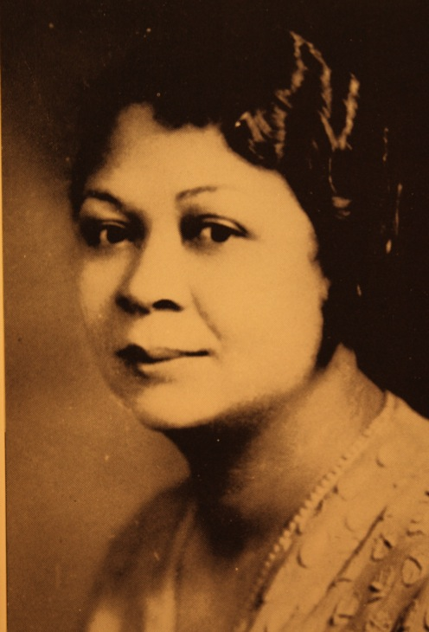
Thelma Patten-Law, MD, (1900-68) was the first woman physician to lead the Lone Star State Medical Association, serving in 1939-40. During her term as president, the National Medical Association held its annual meeting for the first time in Texas (in Houston). She was the first African-American woman to practice medicine in Houston and the first female obstetrics-gynecology specialist in the state. In 1934, she joined the medical staff at the Maternal Health Center in Houston in the Third Ward. It became Planned Parenthood.

Slide 27
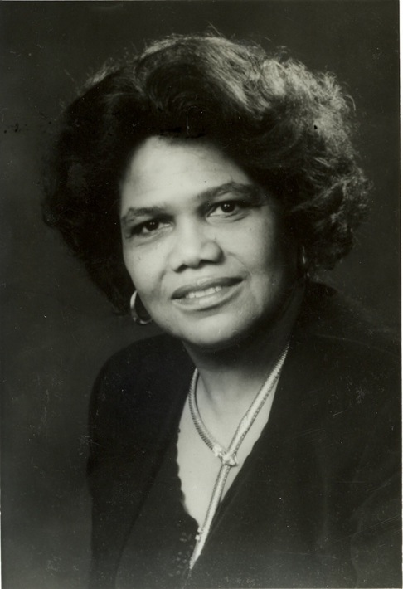
Edith Irby Jones, MD,* of Houston (1927-) became the first woman to lead the NMA in 1985. In 1948 she was the first African-American to integrate a medical school in the South when she was admitted to the University of Arkansas Medical School in Little Rock, graduating in 1952. She moved to Houston to participate in a residency program in internal medicine at Baylor University College of Medicine. Dr. Jones spent most of her residency at a Veterans Administration hospital in Houston because segregation was banned at military and federal hospitals. She established the Dr. Edith Irby Jones Health Clinics in Vera Cruz, Mexico, and Vaudreuil, Haiti. She is a charter member of the Physicians for Human Rights, which won the Nobel Peace Prize in 1997. Dr. Jones continues to practice medicine in Houston.
* Indicates membership in the Texas Medical Association. All African-Americans portrayed in this exhibit were members of LSSMA
and NMA. After integration, some held dual memberships.

Slide 28
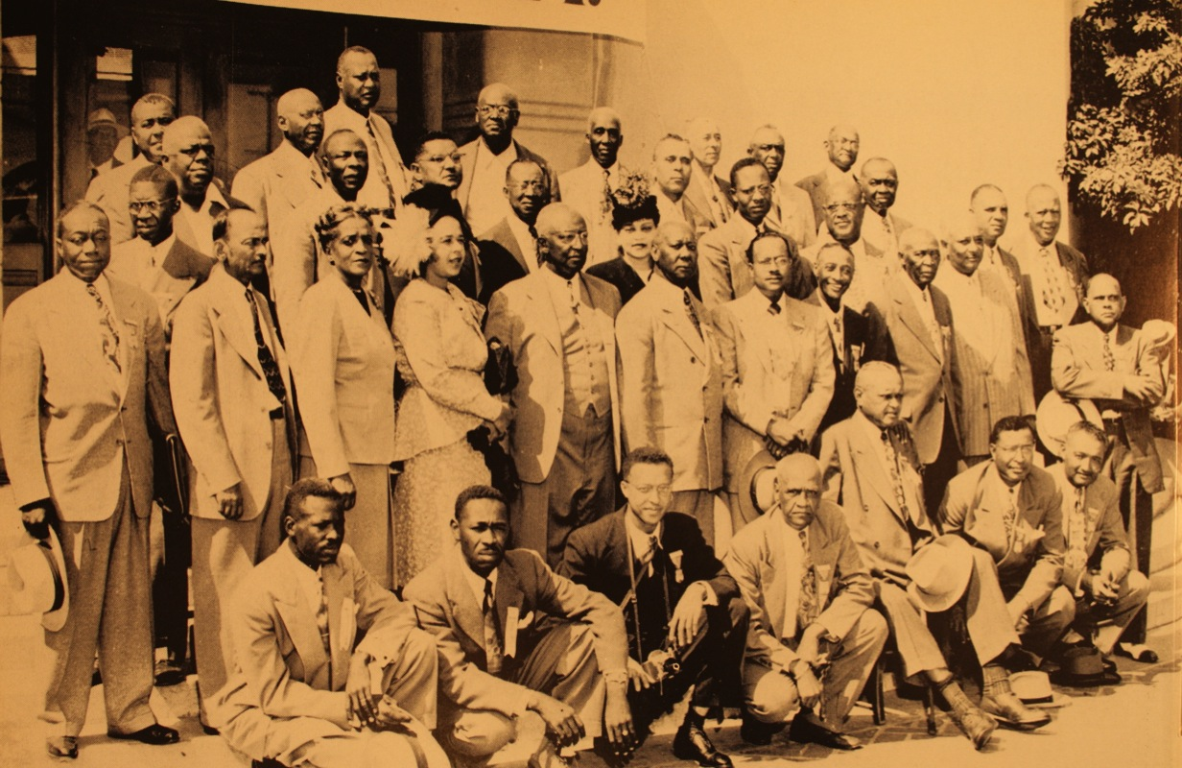
LSSMA members at the 1947 NMA meeting in Los Angeles

Slide 29
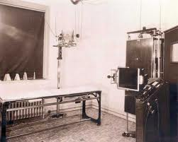
The Black Hospital Movement
When hospitals opened in Texas, African-American physicians and their patients were not welcome. If admitted, these patients were placed in separate wards, often in the basement or even less desirable location. George S. Conner, MD, (1864-1939) the fourth African-American to practice medicine in Waco, recalled having to pay a doctor with hospital privileges $75 in 1939 to operate on his patient.
Segregation and the need to provide clinical training to medical students denied hospital privileges led to the black hospital movement. Jim Crow laws prevented physicians in the South from utilizing modern medical services offered in the hospitals not open to them, such as x-ray machines and clinical laboratories.

Slide 30
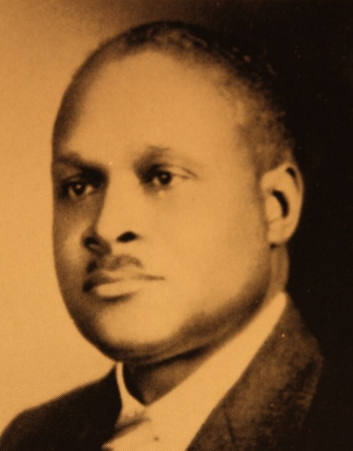
Arthur Elbert Jones, MD, (1888-1969) graduated from Meharry in 1916 and opened a medical practice in Houston. As Lone Star State Medical Association president in 1925-26, Dr. Jones told members, “We must build hospitals … for our own protection … our own advancement and for the best for our patients … until such a time when we can attract help from outside.”

Slide 31
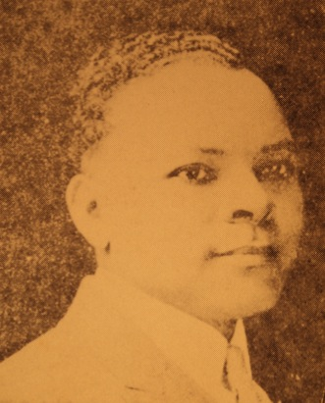
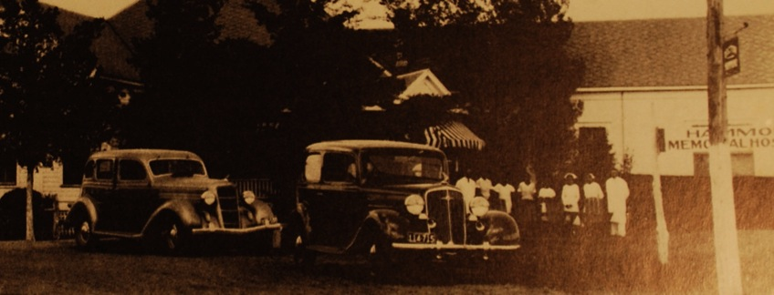


One of the earliest black hospitals in Texas was opened in 1916 by William Arthur Hammond Sr., MD, (1891-1973) who was born in Calvert. He attended Bishop College and Prairie View, and graduated from Meharry in 1916. He opened his practice and Hammond Hospital in Bryan that same year.
Homer Leroy Williams, MD, (?-?) was born and educated in Milam County. After graduating from Meharry in 1926, he opened a medical office. He later opened Williams Health Center in Marlin, where physiotherapy was his specialty.

Slide 32

You have image
In 1918 Union Hospitals the first black hospital opened in Houston. When more space was needed, founders Benjamin Jesse Covington, MD; Rupert O. Roett, MD; Henry E. Lee, MD; French F. Stone, MD; and Charles A. Jackson, MD, were helped by Houston oilman-philanthropist Joseph S. Cullinan. He made a large donation in memory of his son, who was impressed by the African-American troops he led in World War I. Houston Negro Hospital opened in 1926 with 50 beds. It became Riverside General Hospital.

Slide 33



Benjamin Jesse Covington, MD, (1869-1961). Born in Marlin, the son of former slaves, he taught school, then entered Meharry where he graduated in 1900. Dr. Covington practiced in Yoakum and Wharton before settling in Houston in 1903, where he practiced general medicine for 58 years.
French F. Stone, MD, (?-?) graduated from the University of Illinois College of Medicine in 1906 and may have been the first African-American eye, ear, nose, and throat specialist in Houston.
Rupert O. Roett, MD, (1887-1970s). Born in Barbados, he graduated from Meharry in 1915 and completed further study in surgery at Tuskegee Institute and the Institute of Surgery in Chicago. He came to Houston in 1918 and practiced medicine there into the 1960s. His daughter Catherine Roett-Reid, MD, was the first African-American pediatrician in Houston.

Slide 34




Dr. A. L. Hunter, MD, (?-?) was born in Hearne. After graduating from Bishop College, he attended Meharry, graduating in 1906. He established the Hunter Clinic and Hospital in Marlin.
Nathaniel Tolbert Watts, MD, (1893-1977). Born in Atlanta, Ga., he graduated from Meharry in 1926. His internship and first residency were at Flint-Goodridge Hospital. His second residency was at Prairie View. He established a practice in Dallas in 1930. In the late 1940s, Dr. Watts built one of the earliest medical office buildings for African-American physicians in Dallas.

Slide 35




James Lee Dickey, MD, (1893-1959) was born near Waco. He earned a degree from Meharry in 1921 and opened his practice in Taylor. In 1932-3 he fought to bring safe, clean water to all, ending a deadly local typhoid fever epidemic. In 1935, he established the Dickey Clinic. In 1952, when the Taylor Chamber of Commerce named him Man of the Year, it made national news.
Lee Gresham Pinkston, MD, (1883-1961) of Mississippi opened a practice in Terrell after graduating from Meharry in 1909. He opened Pinkston Clinic Hospital in Dallas in 1927. This was after a local hospital’s administrator had extended privileges to all but revoked them after several white doctors complained. Dr. Pinkston was a member of the boards of the Texas Commission on Interracial Cooperation and Wiley College, and publisher of the Star Post newspaper.

Slide 36


Beadie Eugene Conner, MD,* (1902-94) was born in Arkansas. The 1930 Meharry graduate practiced in Waco with his uncle, George Conner, MD, then Cameron, before settling in Austin. The only black hospital there, Holy Cross, was inadequate. As part of the rebuilding drive, Dr. Conner placed a call to Austin’s congressman, Lyndon Johnson, in Washington. This led to $164,000 in federal dollars through the Hill-Burton Hospital Construction Act. A new, modern hospital opened in 1951. Dr. Conner also fought to gain full staff privileges for African-American physicians at Brackenridge Hospital.

Slide 37

Fighting TB to Improve Public Health
The major cause of death in the United States in 1900 was tuberculosis (TB). This dreaded disease killed African-Americans at three times the rate that it killed whites. In regions with large African-American populations, like East Texas, the death rate was higher.
Treatment was limited to the few public or municipal facilities with separate wards like the Colored Unit of the Jefferson County Tuberculosis Hospital in Beaumont, the Negro Ward at the Houston Tuberculosis Hospital, the public hospital in El Paso where a cottage was “reserved for Negroes,” and a “separate shack” at Bexar County Tuberculosis Sanatorium. For those who could afford it, treatment could be found at the few available black-owned clinics and hospitals.
From 1900 to 1937, the Lone Star State Medical Association directed much of its effort toward controlling tuberculosis. It established tuberculosis education programs, arranged for tuberculosis testing, and lobbied the Texas government for a state-supported sanatorium.

Slide 38
Excerpts from a 1933 letter signed by Drs. Rupert Roett, Benjamin Covington, and F. F. Stone of Houston to the Speaker of the Texas House and members of the Texas Legislature on the urgent need for a Tubercular Hospital for Negroes. The original is part of the Lone Star State Medical Association Archives and Joseph A. Chatman papers at Texas Tech University.
It will be a means of helping to prolong and in many instances save the lives of human beings …
Negroes all over this state act as servants to white people …
… it is almost a matter of impossibility for a disease as easily transmitted as is Tuberculosis to be hovered in the body of a nurse or cook and for the family, or especially the children with whom they are associated not to become a victim of the disease …

Slide 39



Some of the LSSMA Presidents Who Fought for a Needed Tubercular Hospital
John Richard Moore, MD, (?-?) of Austin graduated from Meharry in 1894 and
practiced in Taylor and San Antonio. At the 1926 annual meeting of the Lone Star State Medical Association in Marshall, members adopted Dr. Moore’s report on the need for a “Negro Tubercular Hospital.” Dr. Moore headed the committee that wrote Gov. Ross Sterling on the urgent need for such a hospital. He was president of the association in 1936-37, when the Kerrville State Sanitarium for Negroes opened.
Napoleon J. Atkinson, MD, (1874-1944). Born in Georgia, he opened his medical practice in Greenville after graduating from Meharry in 1895. He was president of LSSMA in 1909-11.
Riley Andrew Ransom Sr., MD, (1886-1951) was born in Kentucky. After graduating from Louisville National Medical College in 1908, he opened Booker T. Washington Sanitarium in Gainesville. In 1918 he moved to Fort Worth, where he opened the Ethel Ransom Memorial Hospital and served as chief surgeon. He was president of LSSMA in 1924-25.

Slide 40

The Kerrville State Sanatorium for Negroes opened in 1937 with 100 beds. It had been a private tuberculosis hospital, owned and operated since 1918 by Sam Thompson, MD,* and known as the Thompson Sanatorium. Among those on staff were Drs. James Odis Wyatt and W. E. Shallowhorne. Despite promise in the early years, staff support, medical equipment, and funding from the state legislature never matched that of the state sanatorium near San Angelo. The Kerrville sanatorium closed in 1949. Residents were transferred to the segregated East Texas State Tuberculosis Hospital in Tyler. Tuberculosis mortality among African-Americans was again three times that of the white population in Texas.

Slide 41


L. Roy Adams, MD, (1898-1970). Born in Temple, he studied premed at Fisk University in Nashville, then earned his MD from Meharry in 1925. He first practiced medicine in Temple, then in Waco, where he opened Adams Clinic and was part of the lobbying effort. In 1935 Dr. Adams received the telegram from Texas Gov. James V. Allred notifying the Lone Star State Medical Association that the Texas Legislature had approved funds for the Tubercular Hospital for Negroes.
S. J. Sealy, MD, (?-1948) was born in British Guiana, South America. He came to the United States to study medicine and graduated from Meharry in 1926. He practiced medicine in Cameron and Bryan. He was on staff at the Kerrville State Sanatorium for Negroes.

Slide 42


Connie Yerwood (later Conner), MD,* (1908-91). Born in Victoria, she was the oldest daughter of Charles R. Yerwood, MD. A 1925 graduate of Samuel Huston College (now Huston-Tillotson University) in Austin, Dr. Yerwood earned her MD from Meharry in 1933. After completing studies in public health at the University of Michigan, she returned to Austin as the first African-American physician hired by the Texas Public Health Service in 1937. Her early years were spent consulting on well-baby and prenatal care initiatives in rural Texas and working with the postgraduate medical assembly programs. She retired in 1977 as state director of health services. Her sister Joyce Yerwood, MD, was the first African-American woman to practice medicine in Connecticut.
Pansy Nichols (1896-1991) was born in San Antonio. In 1918 she was hired by the Texas Tuberculosis Association and in 1932 became executive director. She was part of the lobbying effort for the Kerrville State Sanitarium. In 1940, Dr. Connie Yerwood of the Texas Health Department, reviewed the history of post-graduate medical education at Prairie View and noted: “It was left to a white woman to make the first serious step toward adequate training of Negro physicians.” The Jan. 16, 1937, meeting convened in Miss Nichols’ office brought together those who would plan and fund the lectures and clinical presentations on current medical thought and suggested treatment of tuberculosis and other public health problems.

Slide 43

Medical Integration
Cracks in the wall separating the races in the Jim Crow South began appearing after World War II. In medicine, medical schools played an important role. In 1948, the University of Arkansas Medical School was the first Southern white medical school to admit an African-American, Edith Irby, who graduated in 1952.
In 1959, Edith Irby Jones, MD,* moved to Houston to pursue a desired residency and remained to practice medicine.

Slide 44


In 1949, The University of Texas (UT) admitted its first African-American student. Herman Aladdin Barnett III, MD,* (1926-73). He graduated in 1952. After an internship and residencies in surgery and anesthesia, he opened his medical practice in Houston.
Born in Austin, Dr. Barnett joined the Army after graduating from high school in 1943 and was trained as a fighter pilot at Tuskegee. He graduated from UT Medical Branch (UTMB) in Galveston in 1952, the first African-American to earn a medical degree in Texas. Dr. Barnett was the first African-American appointed to the Texas State Board of Medical Examiners. Among his professional memberships were the Texas Medical Association and the Lone Star State Medical Association. He died piloting his plane during a severe storm. Dr. Barnett was posthumously awarded the Ashbel Smith Award in 1978. It is the highest honor awarded by (UTMB).

Slide 45


Leo Earsel Orr Jr., MD, Baylor College of Medicine, Houston, 1968
Richard A. Mosby, MD, The University of Texas Health Science Center at San Antonio School of Medicine, 1970

Slide 46


John Lee Henry, MD, The University of Texas Southwestern Medical School at Dallas, 1973
Estella Louise Bryant-Robinson, MD, The University of Texas Medical School at Houston, 1974

Slide 47



Richard White, MD, Texas Tech University Health Sciences Center School of Medicine, Lubbock, 1977
Dralves G. Edwards, DO, the University of North Texas Health Science Center at Fort Worth, Texas College of Osteopathic Medicine, 1980
Phillip Jones, MD, Texas A&M Health Science Center College of Medicine, College Station, 1983

Slide 48

Integration of TMA
In 1950, Tate Miller, MD,* (1892-1982) of Dallas, who served as president of the Texas Medical Association (TMA) in 1948-49, became chair of TMA’s Committee on Negro Medical Facilities and introduced a resolution to remove “white” as a requirement for membership from the TMA constitution.
After repeated attempts by Dr. Miller and his supporters to pass this change, in 1955 the TMA House of Delegates voted 102-32 in favor of integrating membership. In his final, and ultimately successful, speech on the subject of integration, Dr. Miller said that there “is no race or color exception in our oath of Hippocrates. “
Dr. Miller earned his medical degree from Vanderbilt in 1915. He served in World Wars I and II, in the latter as chief of medicine in an Okinawa hospital. One of the first to specialize in gastroenterology in Dallas, he was a clinical professor at Baylor Medical College until the school relocated to Houston. He was known as the “Will Rogers of Texas medicine” for his speaking skills and humanity.

Slide 49

Colonel Bertram Fuller, MD,* (1920-94) of Wichita Falls, was the first African-American to join the Texas Medical Association after “white” was removed as a membership requirement. He later became the first African-American in the Jim Crow South elected to membership in the American Academy of Family Practice. Born in Terrell, Dr. Fuller graduated from Meharry Medical College in 1947. He served on U.S. District Court Sarah T. Hughes’ Biracial Committee on Schools. In 1970, he was elected president of the medical staff of Wichita General Hospital. He received the Wichita County Medical Society’s Distinguished Service Award in 1988.

Slide 50
13 African-American physicians became members of the
Texas Medical Association in 1955, and 11 have been identified:
Harold H. Culmer, MD, Dallas
Osborne English Floyd, MD, Houston
William K. Flowers, MD, Dallas
C.B. Fuller, MD, Wichita Falls
Carolyn J. Long, MD, Austin
John Chester Madison, MD, Houston
Walter Jerome Minor, MD, Houston
Charles Pemberton, MD, Houston
Eugene Perry, MD, Houston
Louis Robey, MD, Houston
Joseph R. Williams, MD, Dallas
At the 1956 TMA annual meeting, it was reported that one year after the change in the membership requirement, 53 African-American physicians from 16 county medical societies had joined TMA.

Slide 51


TMA Leadership Firsts
Frank Bryant Jr., MD,* of San Antonio — elected to the Texas Medical Association House of Delegates, 1983. The general practitioner graduated from The University of Texas Medical Branch in 1956.
Robert Lee Moore Hilliard, MD,* — named president of the Texas State Board of Medical Examiners in 1989. He graduated from The University of Texas Medical Branch in 1956, specializing in obstetrics-gynecology.

Slide 52


William Fleming III MD,* of Houston — president of the Texas Medical Association, 2009-10. A neurologist, Dr. Fleming graduated from the University of St. Louis Medical School in 1975.
Carolyn A. Evans, MD,* of Dallas — named chair of the Texas Medical Association Board of Trustees, 2010-11. The pediatrician was elected to the Texas Delegation to the American Medical Association as an alternate in 1991 and became a full delegate in 1997. She graduated from The University of Texas Health Science Center in San Antonio in 1979.

Slide 53


William Knox Flowers Jr., MD,* (1916-81) was born in Sulphur Springs, where his father, William Knox Flowers Sr., MD, (?-?) had first practiced. He graduated from Meharry in 1942 and joined his father’s practice in Dallas. In 1954, Dr. Flowers became one of five black physicians extended full privileges to all services except obstetrical service at St. Paul’s Catholic Hospital in Dallas. The others were Frank H. Jordan, MD; Joseph R. Williams, MD; William K. Flowers, MD; and George R. Shelton Jr., MD. Seated is Lee G. Pinkston, MD.

Slide 54



Catherine J. Roett, MD, (1923-97). Born in Houston, she graduated from Howard Medical College in 1946 and was the first African American pediatrician in Houston, becoming chief of pediatrics at Riverside and St. Elizabeth’s hospitals. Dr. Roett established the first well-baby clinic at Riverside Hospital and was a charter member of Harris County Children’s Protective Services. In 1986, she was elected to the Texas Black Women’s Hall of Fame.
John Chester Madison, MD,* (1916-1984). Born in Elgin, he graduated from Prairie View in 1937 and Meharry in 1941. He was an army medical officer during World War II and completed a tour of duty in Italy with the 92nd Infantry Division. He settled in Houston, the first black physician to participate in a fellowship program in the Texas Medical Center. He was a clinical instructor at Baylor College of Medicine and director of the Hypertension Clinic at Riverside Hospital.
Obra Jesuit Moore, MD,* (1901-64) was born near Marshall. He graduated from Meharry in 1930 and after his internship at Prairie View Hospital, opened a medical practice in Longview. He was a member of the Council of the Inter-Racial Committee in Gregg County, chief physician for Camp Normal Industrial Hospital, and chief medical examiner for all scout troops.

Slide 55
The exhibit features items from collections held by the TMA, TMA Archives, and other libraries and archives.
Baylor College of Medicine at Houston
Beadie Conner Collection, George Washington Carver Museum and Cultural Center, Austin
Collection of Rep. Garnet F. Coleman
Dr. Edwin D. Moten Collection, Denton County African American Museum
George S. and Jeffie O. A. Conner Papers, Texas Collection, Baylor University
Joseph Alvin Chatman Collection,
Winston Reeves Photographic Collection
Southwest Collection/Special Collections Library, Texas Tech University
Holy Cross Hospital File, Lyndon Baines Johnson Library and Museum
National Library of Medicine
Special Collections, M.D. Anderson Library, University of Houston
Houston Metropolitan Research Center, Houston Public Library
The University of Houston, To Bear Fruit for Our Race website
Special Collections/Archives, Prairie View A&M University
Special Collections, University Archives
The University of Texas Health Science Center at San Antonio
Texas Healthcare Facilities Postcard Collection
John P. McGovern Historical Collections and Research Center
The Meharry Archives and Collections
The Truman G. Blocker History of Medicine Collection, Moody Medical Library
The University of Texas Medical Branch at Galveston
The University of North Texas Health Science Center at Fort Worth,
Texas College of Osteopathic Medicine

