Slide 1
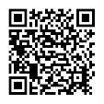
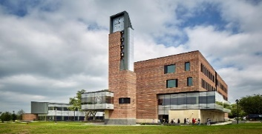
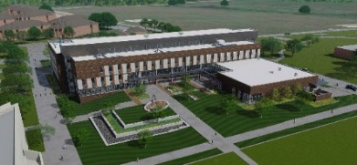
PARKING
POLICIES
REGISTRATION
Student, faculty, and staff vehicles must be registered to park on campus. For more information regarding parking registration please visit:
https://www.pvamu.edu/parking/parking-faqs/vehicle-registration/
PERMIT COSTS (2021-2022 Rates)
Main & Northwest Campus
Students
Faculty and Staff
Nursing Campus (Garage Parking)
Students
Faculty and Staff
Faculty and Staff
Resident Student Parking
Resident housing gated parking lots are reserved 24/7 for residential customers with a current permit.
Commuter Parking
Commuter parking is designated by orange signage.
Visitor Parking
Download the ParkMobile app, available on the AppStore, Google Play, or Windows Store, or those without a smartphone may use the ParkMobile Website (www.parkmobile.io).
Sign up with your email, license plate number, and a payment method. The current rate is $5 daily.
Once registered, you may begin to use ParkMobile immediately to pay on-the-go!
Disability Parking
Anyone parking on campus who has a valid state-issued disabled permit or license plate may park in any designated disabled parking space if available. The state issued hangtag (including DV plate issuance) must be present at all times and must be issued to the driver only. Proof must be submitted and/or verification must be submitted to the Parking Office.
Contractor and Vendor Parking
(SSC, SODEXO and CITE are excluded and can purchase Faculty/Staff permits)
Please visit Parking Management Office located in Harrington Science Rom 117 for a parking pass. (Payment made at Treasury Services in WR Banks Building)
Daily parking (ParkMobile): $5
Monthly parking: $40
Yearly parking: $400
Parking Services for Events
Visitor Parking per Guest $5 Daily
Attendant Fee $25 Hourly
Cart Fee $25 Daily
Late Fee(Less Than 7 days notice) $500
Barricade Fee (50 Minimum) $500
51-100 Barricades $1,000
101-150 Barricades $1,500
151-200 Barricades $2,000
Fall Semester $50 | Spring Semester $50
Summer Term I or II $25 | Summer Term I and II $50
Commuter Lots $158
Purple Lots $190
Presidential Lot $261
Yellow Lots $261
Yearly (starting Fall Semester) $158
Policies continued on the back
Yearly (starting Fall Semester) $158
“Our mission is to provide a safe, well-maintained parking infrastructure ensuring equitable parking for the PVAMU community.”
Parking Management (936) 261-1701
E-Mail: Parking@pvamu.edu
Yearly (starting Fall Semester) $158
University Police Department (936) 261-1375
Thomas Gray Information Center (936) 261-1733

Slide 2
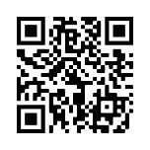
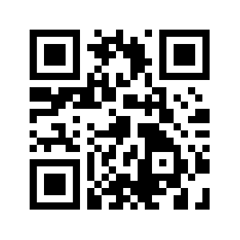
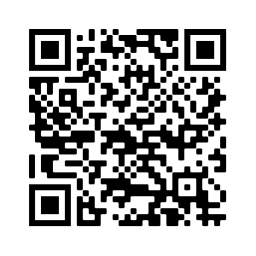
PVAMU CAMPUS PARKING – ONLINE
REGISTER A VEHICLE
https://prairieview.t2hosted.com/Account/Portal
HOW TO USE THE PARKMOBILE APP
https://parkmobile.io
Tips to Avoid Violations
Violations
All parking lots are patrolled daily and fines will be assessed for, but not limited to, the following violations covered under the Schedule of Fines.
Schedule of Fines
Group I - $50
Visitor No Valid Permit – Escalates $10 per additional citation
License plate not visible, obscured, or not properly displayed
More than one vehicle parking on campus at the same time (issued to second vehicle found)
Vehicle not within stall lines of a legal parking space
Parking in a Restricted Area – Escalates $10 per additional citation
Parking after event restrictions begin –Escalates $10 per additional citation
Overstaying permit or parking stall times
Group II - $75
Parking in a non-designated parking area (e.g. on grass, sidewalk, “No Parking” zone, and areas not
Parked in a designated fire lane or adjacent to a fire hydrant – Escalates $50 per additional citation
Deliberately Obscured: Issued to any vehicle which has covered or obscured its license plate to thwart enforcement activities – Escalates $10 per additional citation
Use or display of a fictitious permit (physical or virtual) for which user is not eligible; or purchase of physical/virtual permit by eligible third party for a user who is not themselves eligible for the physical/virtual permit. – Escalates $50 per additional citation
Group V - $500
Parking in a Handicap space when not authorized – Escalates $500 per additional citation. Failure/improper display may be fined at Group II Rate if verifiable.
Parking on campus after parking privileges have been revoked – Escalates $50 per additional citation
Group VI Special
Boot Removal Citation – $75.00
In-Campus Towing Citation – $75.00
Excessive Violator – $100.00
Towing
PVAMU reserves the right to tow any illegally parked vehicle or vehicles with excessive unpaid citations. Visit the following site for more information: https://pvamu.edu/parking/if-your-vehicle is towed/
marked as a parking space) -Escalates $10 per additional citation
Blocking driveway, roadway, bus stops, dumpsters, legally parked vehicles, or restricting the flow of normal traffic – Escalates $10 per additional citation
Unauthorized parking by permit/no permit on file – Escalates $10 per additional citation
Group III - $100
Unauthorized entry to a closed area of campus or parking lot – Escalates $10 per additional citation
Unauthorized storage/abandoned vehicle parked on PVAMU property for more than 30 days without moving(even if a valid permit is displayed).
Unauthorized parking in reserved stall or red zone (automatic tow away) – Escalates $50 per additional citation
Group IV - $125 Non-Appealable
Tampering: issued to any person who tampers with any parking gate, cameras, boots or LPR equipment –Escalates $50 per additional citation
Cost of repair is added to the fine
Please visit the following link to help you avoid costly citations:
https://www.pvamu.edu/parking/citations/avoiding-citations/
Appeals
Appeals must be submitted 14 calendar days from the day of the citation.
Additional supporting information or documentation can be submitted with your appeal.
Appeals submitted after 14 calendar days will not be accepted for review.
The Appeals Committee will review all appeals.
The decision of the committee is final, and no further appeals will be granted.
If an appeal is denied, payment can be made through your account online at the Parking Portal or at Treasury Services, W.R. Banks building.

Slide 3
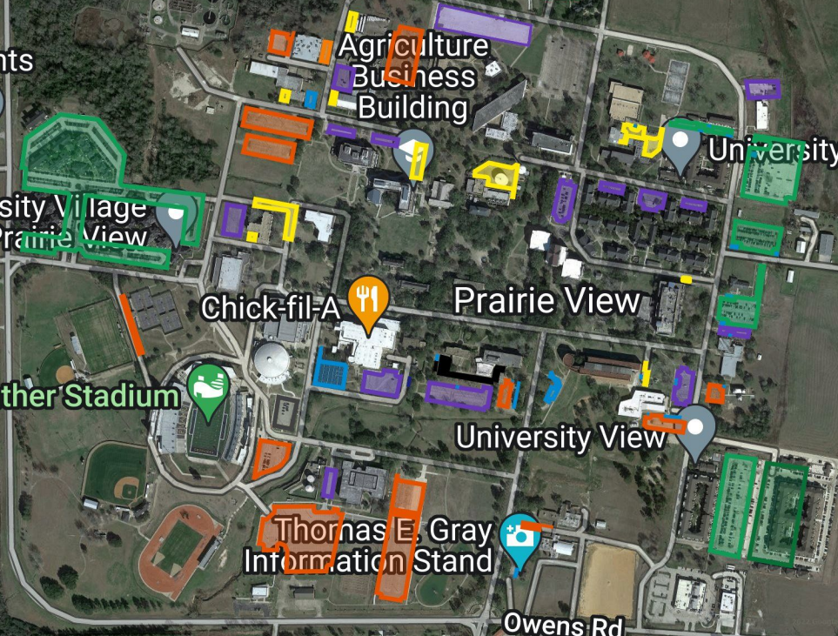
MAIN CAMPUS
PARKING MAP Prairie View, TX
PRESIDENT’S LOT
RESERVED LOTS
VISITOR LOTS
COMMUTER LOTS
RESTRICTED/GATED LOTS
RESIDENTIAL HOUSING
PARKING MANAGEMENT
936-261-1701
UNIVERSITY POLICE
936-261-1375

