Slide 1
1. INTRODUCTION
An electronic portfolio or ePortfolio is a purposeful collection of sample student work, demonstrations, and artifacts that showcase students’ learning progression, achievement, and evidence of what students can do.
The collection can include essays and papers (text-based), blog, multimedia (recording of demonstrations, interviews, presentations, etc.) and graphic.
Student learning:
Student learning has been facilitated, documented, and archived via e-portfolios.
Students may use it as a learning tool to establish their educational objectives, integrate and reinforce their learning through reflections, and highlight their accomplishments to future employers.
Students begin to take charge of their learning by reflecting on what they learned, how they learned it, and how much they learned.
Students begin to make sense of their educational experiences in various courses by choosing exemplary work and focusing on what they have learned.
Assessment:
A portfolio may be a helpful tool for organizing, sampling, and evaluating what students learned from the program in order to measure student accomplishment as a whole for program development.
Faculty can use student reflections in portfolios to discover how students learn in addition to what they know and can do.

Slide 2
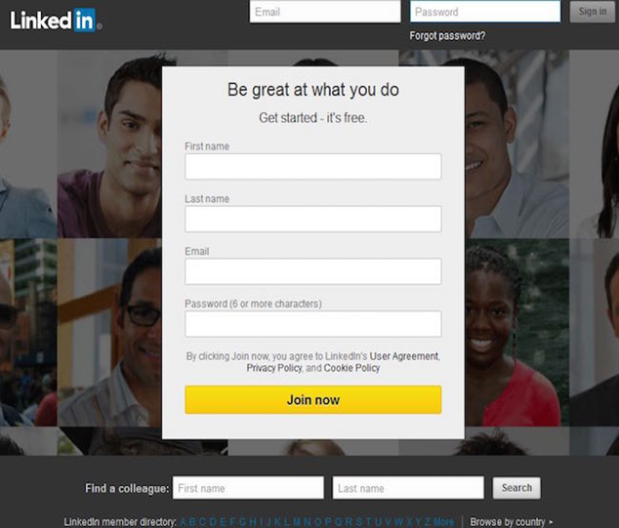
2. HOW TO SETUP A LINKEDIN ACCOUNT
Step 1: Navigate to LinkedIn sign up page.
https://www.linkedin.com
Step 2: Type your first and last name, email address, and a password you’’ll use.

Slide 3
Click
Click Join now.
Complete
Complete any additional steps as prompted.
How to get started on LinkedIn Step-by-Step for Beginners
YouTube link:
https://www.youtube.com/watch?v=qG4NF-2tt4c

Slide 4
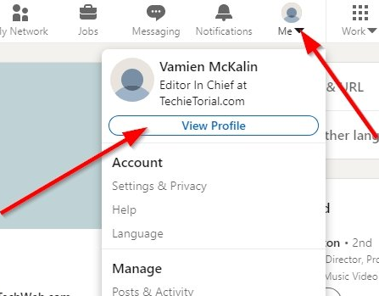
3. HOW TO SETUP BASIC RESUME ON LINKEDIN
Step 1: Click the Me icon at the top of your LinkedIn homepage.
Step 2: Click View profile.

Slide 5
Step 3: Click the More button in the introduction section.
Step 4: Select Build a resume from the dropdown.
Step 5: From the Select a resume popup you can.
YouTube Links:
https://www.youtube.com/watch?v=K3JJgVoU0KY
https://www.youtube.com/watch?v=BFqPxF21TXY

Slide 6
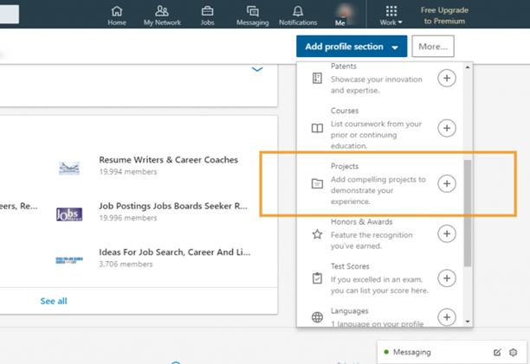
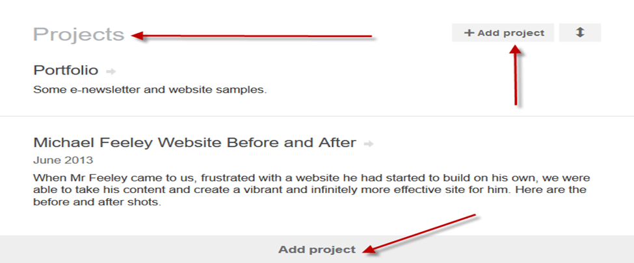
4. HOW TO ADD PROJECT ON LIKEDIN
Step1: From “Add a section to your profile” click on view more”
Step2: look for “Projects and select “Add Projects”:
Link: https://lisamariediasdesigns.com/adding-a-project-to-your-linkedin-profile/

Slide 7
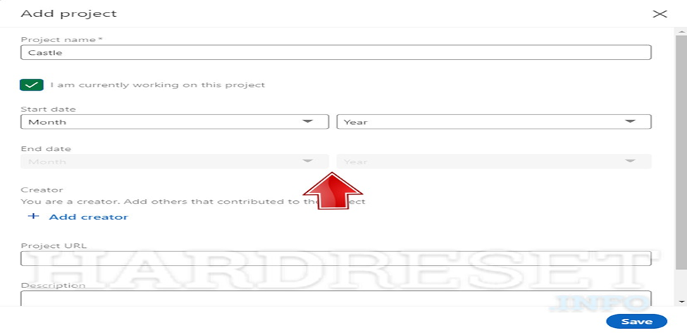
Step 3: Fill in your “Projects” section accordingly: Enter the” Name” of your Project.
Link: https://www.hardreset.info/devices/apps/apps-linkedin/add-project/
Step 4: When you are finished, Click “Save”.

Slide 8
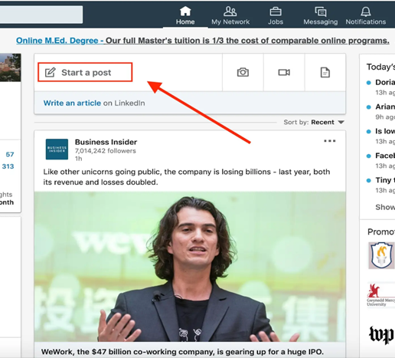
5. HOW TO MAKE A POST ON LINKEDIN
Step1: Tap Write a post > the button with your name in it > the correct LinkedIn Page or Showcase Page.
Step2: Enter your text.
Step3: Tap Camera, Video, Image, or Add a document

Slide 9
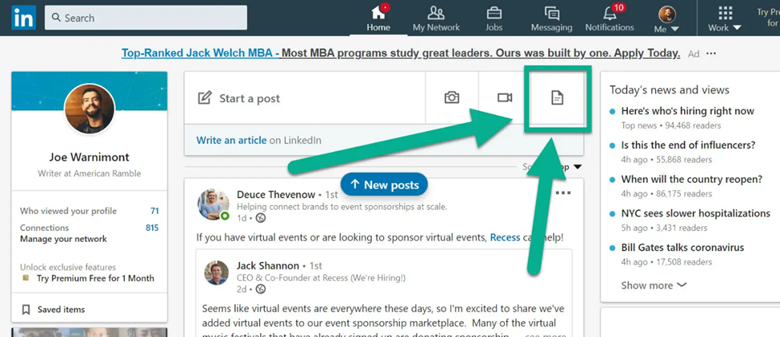
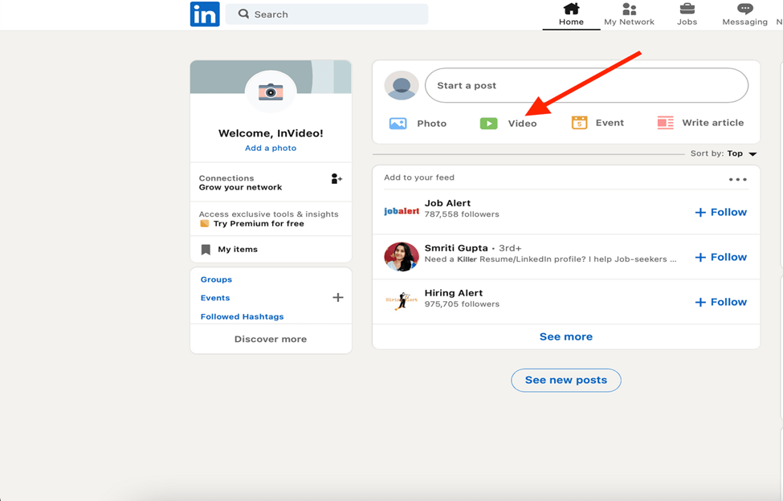
Step4: Select a file from your library or create a new photo or video.
YouTube LINK:
https://www.youtube.com/watch?v=zQwOZCeinTM
Step5: Tap Add hashtag and enter your text.
Step6: Adjust the comment settings.
Step7: Tap Post.

Slide 10
THANK YOU

