Slide 1
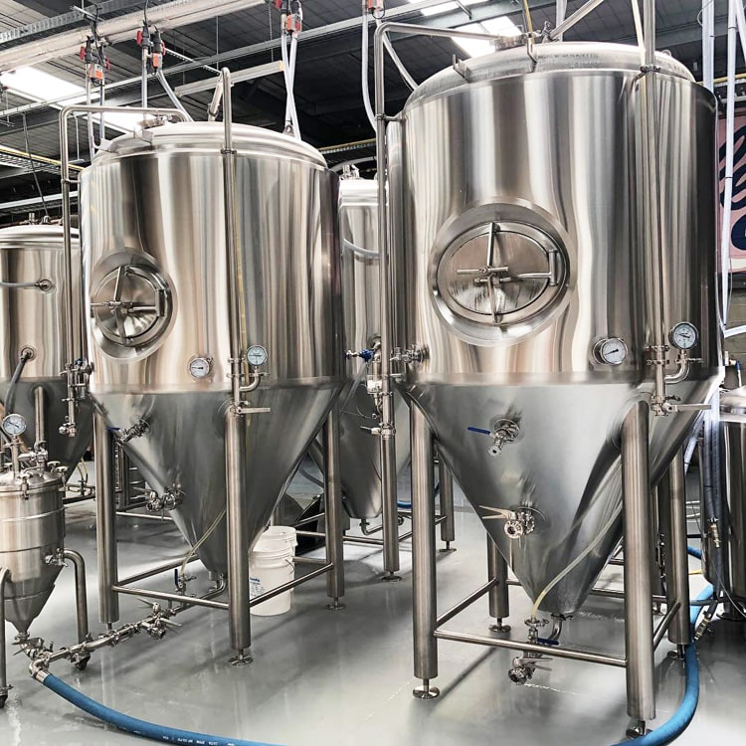
Production of Penicillin G Potassium
Senior Design & Professionalism II
Martin Team 2
Spring 2022
Tiarra Rodrigues
Chiebuka Ejimadu
Caleb Myers
Katelynn Inman

Slide 2
Agenda
Project Scope
Project Goals
Process Selection
Process Description
  Process Chemistry
  Overall Mass Balance
  Process Flow Diagram
  Aspen Simulation
Unit Designs
  Fermenter Design
  Fixed-bed Adsorber Design
Economic Analysis
HAZOP Analysis and Safety
  HAZOP Analysis: Fermenter
  P&ID
  Potiential hazards & Safety Precautions
  Storage & Handling
Recommendations

Slide 3
Project Scope

Slide 4
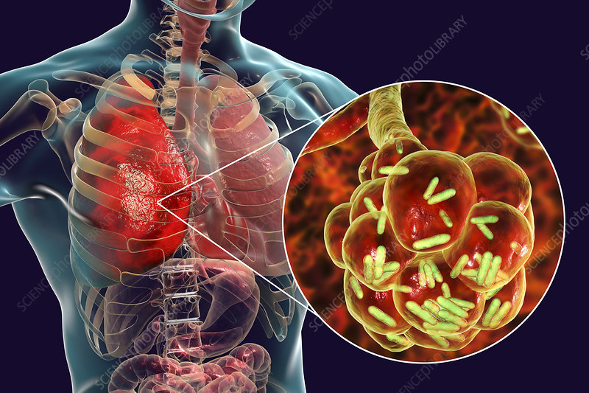
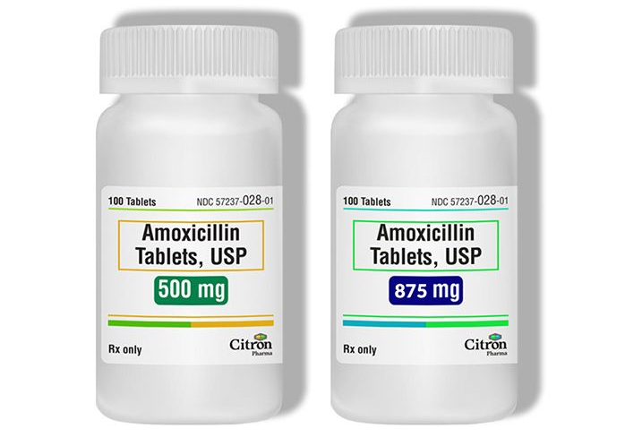
Penicillin G Overview
Penicillin G => Benzylpenicillin, a naturally produced antibiotic discovered in 1928
Derived from Penicillium chrysogeum fungal species but used for;
  Treating various baterical infections (Pneumonia, Strep Throat, Syphilis, etc.)
  A precursor to produce synthetic Penicillin to combat drug-resistant infections
Goal:
Design a Penicillin G Potassium plant
Produce 4% of US Demand at 99.5% purity (1.371 million kg/yr)
Operate 330 days/yr (7920 hrs)
Sell Biomass as a byproduct

Slide 5
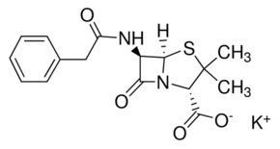
Chemical Properties Physical Properties
Name | Penicillin G Potassium | Color | White
Formula | C₁₆H₁₇KN₂O₄S | Odor | Odorless
Drug Class | Penicillin | Phase | Solid powder
Stability | Stable | Molecular Weight | 372.5 kg/kmol
Solubility | Soluble in Water | Density | 1.36 kg/L
Structure |  | Melting Point | 214-217 ºC

Slide 6
Project Goals

Slide 7
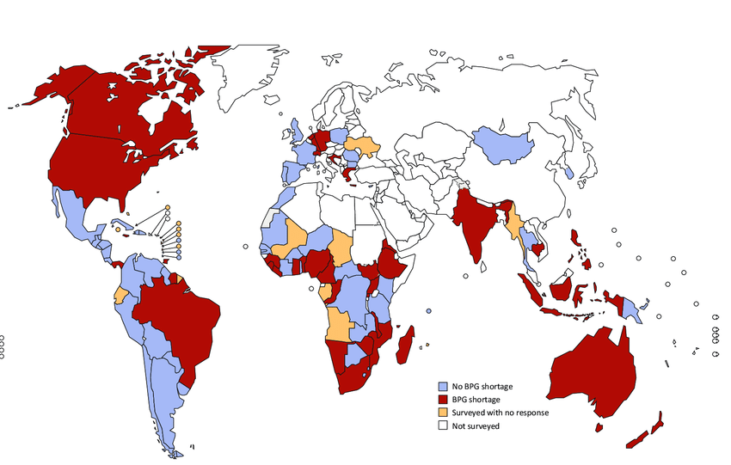
Plant Capacity
World Production – 105,000 Tons/yr (95.3 million kg/yr)
Nearly all of Penicillin G Production is in China (Assumed 90%)
US demand from China (Approximately 40% Import)
Desired Plant Capacity (Assumed 4% of US Demand)
To find Plant Capacity …
(95.3 million kg/yr * 0.9 * 0.4 * 0.04) = 1.37 million kg/yr

Slide 8

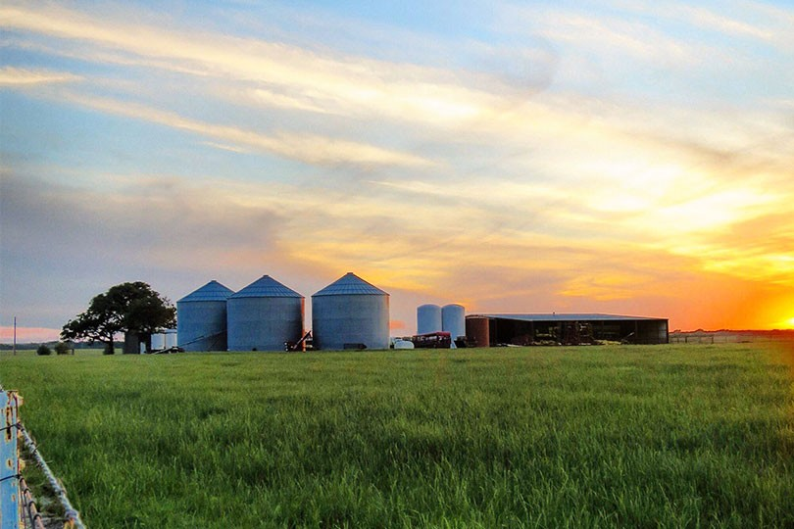
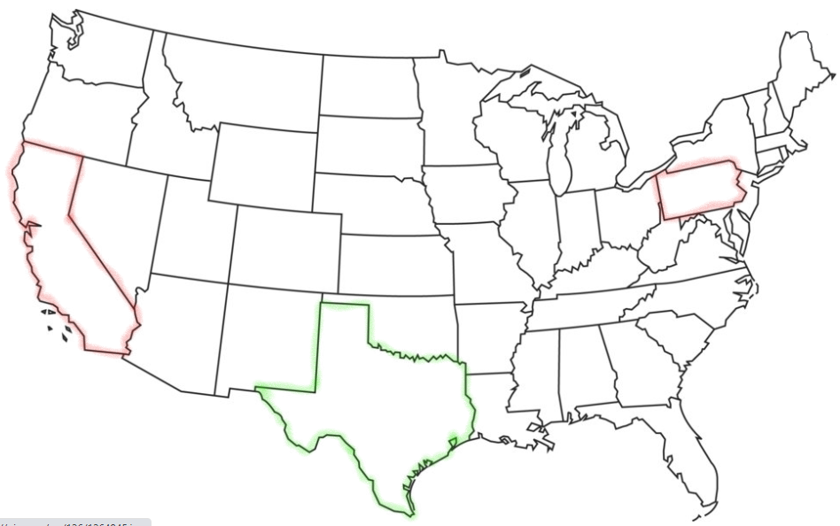


Plant Location
Mid-point for raw materials
Large amount of agriculture and livestock for biomass sale
Average Temperature (25.8 C)
Clients
  Pfizer
  Baxter
  King Pharmaceuticals
  Sandoz

Slide 9
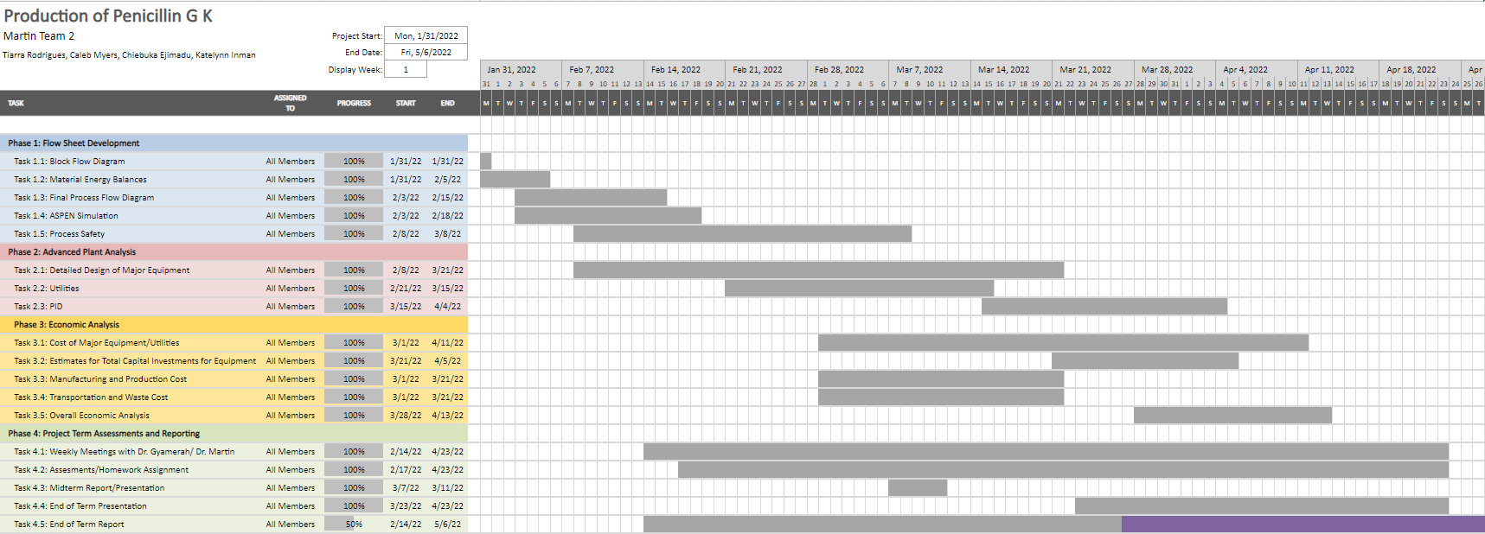
Spring 2022 Gantt Chart

Slide 10
Process Selection

Slide 11
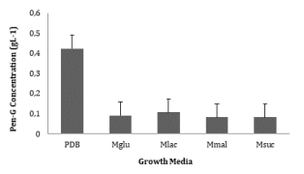
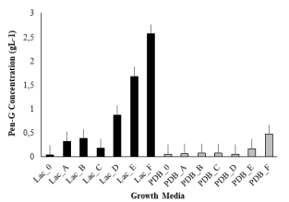
Process Screening: Medium Selection
Graph 1: Pen G Production with Varied Carbon Source Mediums
Graph 2: Pen G Production with Varied Concentration of Phenylacetic Acid in Medium
Lac= Lactose, Glu= Glucose, Suc= Sucrose, Mal= Maltose and PDB = Potato Dextro Agar Broth as standard medium
A= O.1 g/L ; B= 0.2 g/L ; C= 0.3 g/L; D= 0.4 g/L ; E= 0.5 g/L; F= 0.6 g/L

Slide 12
Process Description

Slide 13
Process Chemistry
Reaction 1 - Synthesis of Penicillin G
C₁₂H₂₂O₁₁ _{(s)} + O₂ _{(g)} + 2 C₈H₈O₂ _{(s)} + 4 NH₃ _{(g)} + H₂SO₄ _{(l)}
C₁₆H₁₈N₂O₄S _{(s)} + 8 H₂O _{(l)} + 2 CO₂ _{(g)} + 10 CH_{1.8}O_{.5}N_{.2} _{(s)}
Exothermic (ΔH_{rxn} < 0)
Reaction 2 - Synthesis of Penicillin G K from Penicillin
C₁₆H₁₈N₂O₄S _{(s)} + KC₂H₃O₂ _{(s)} C₁₆H₁₇N₂KO₄S _{(s)} + C₂H₄O₂ _{(l)}
Overall Reaction Mechanism
C₁₂H₂₂O₁₁ _{(s)} + O₂ _{(g)} + 2 C₈H₈O₂ _{(s)} + 4 NH₃ _{(g)} + H₂SO₄ _{(l)} + KC₂H₃O_{2 (s)}
C₁₆H₁₇N₂KO₄S _{(s)} + C₂H₄O_{2 (l)} + 8 H₂O _{(l)} + 2 CO₂ _{(g)} + 10 CH_{1.8}O_{.5}N_{.2} _{(s)}

Slide 14
Overall Mass Balance
C₁₂H₂₂O₁₁ _{(s)} + O₂ _{(g)} + 2 C₈H₈O₂ _{(s)} + 4 NH₃ _{(g)} + H₂SO₄ _{(l)} + KC₂H₃O_{2 (s)}
C₁₆H₁₇N₂KO₄S _{(s)} + C₂H₄O_{2 (l)} + 8 H₂O _{(l)} + 2 CO₂ _{(g)} + 10 CH_{1.8}O_{.5}N_{.2} _{(s)}
INPUT = 10,400 kg/h
OUTPUT = 10,400 kg/h
Lactose = 2,190 kg/h
Oxygen = 7,350 kg/h
Phenylacetic Acid = 90 kg/h
Sulfuric Acid = 60 kg/h
Ammonia Sulfate = 660 kg/h
Potassium Acetate = 50 kg/h
Penicillin G K = 1,380 kg/h
Biomass = 1,265 kg/h
Water = 3,100 kg/h
Carbon Dioxide = 4,625 kg/h
Acetic Acid = 30 kg/h

Slide 15
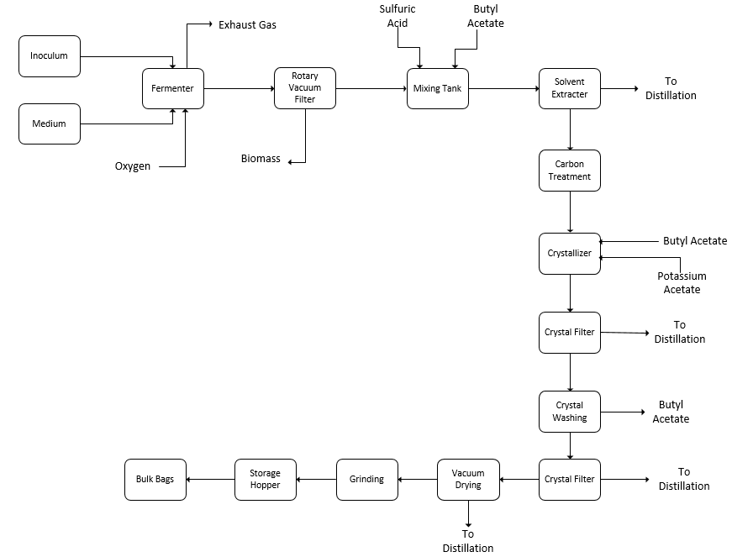
Block Flow Diagram
Freeze Dryer

Slide 16
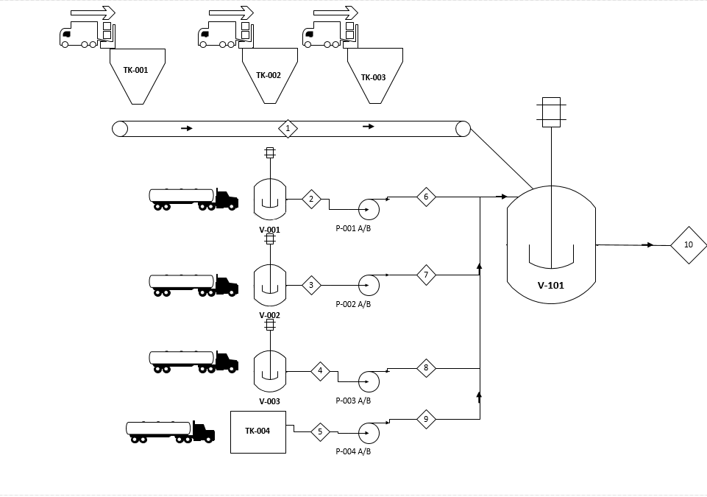
PFD: Raw Material Breakdown
TK-001 KH2PO4 Hopper
TK-002 (NH4)2SO4 Hopper
TK-003 Yeast Extract Hopper
TK-004 Phenylacetic Acid Tank
V-001 MgSO4, 7H2O Tank
V-002 NaSO4, 7H2O Tank
V-003 ZnSO4, 7H2O Tank
V-101 Mineral Tank

Slide 17
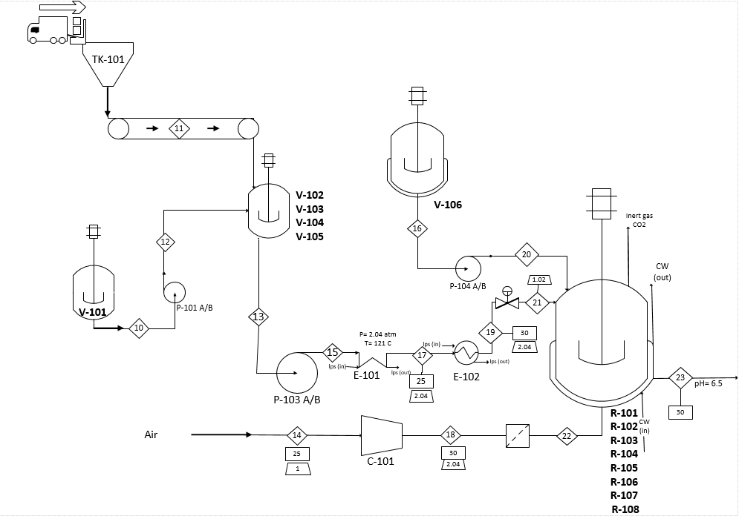
PFD: Fermentation Process
TK-101 Lactose Hopper
V-101 Mineral Tank
V-102- V-105 Medium Tank
V-106 Inoculum Tank
R-101 – R-108 Fermenter
E-101 Heat Sterilizer
E-102 Heat Exchanger
F-101 Air Filter
C-101 Condenser
F-101

Slide 18
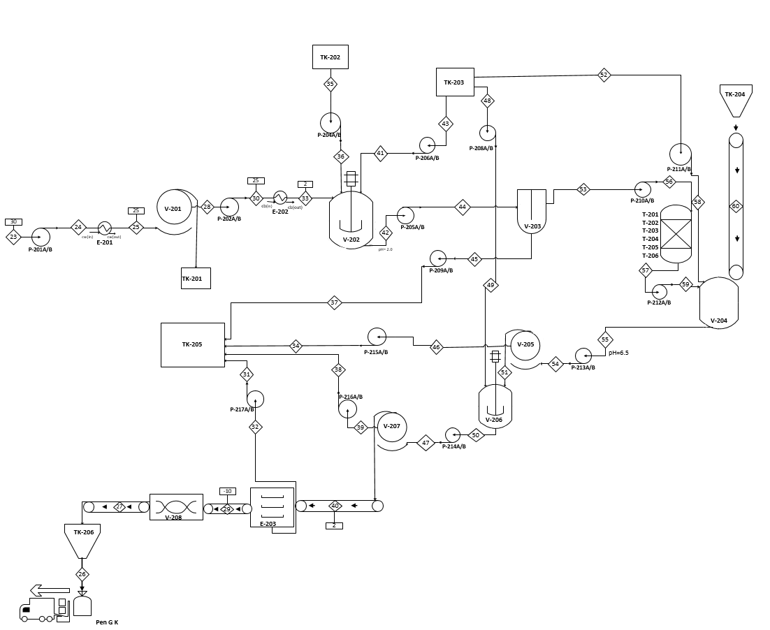
PFD: Extraction Process
V-201 Rotary Vacuum Filter
V-202 Mixing Tank
V-203 Solvent Extractor
V-204 Crystallizer
V-205 Rotary Vacuum Filter
V-206 Crystal Washer
V-207 Rotary Vacuum Filter
V-208 Grinder
TK-201 Biomass Tank
TK-202 Sulfuric Acid Tank
TK-203 Butyl Acetate Tank
TK-204 Potassium Acetate Hopper
TK-205 Waste Treatment Tank
TK-206 Penicillin G Potassium Hopper
T-201 – T-206 Adsorption Tower
E-203 Freeze Dryer

Slide 19
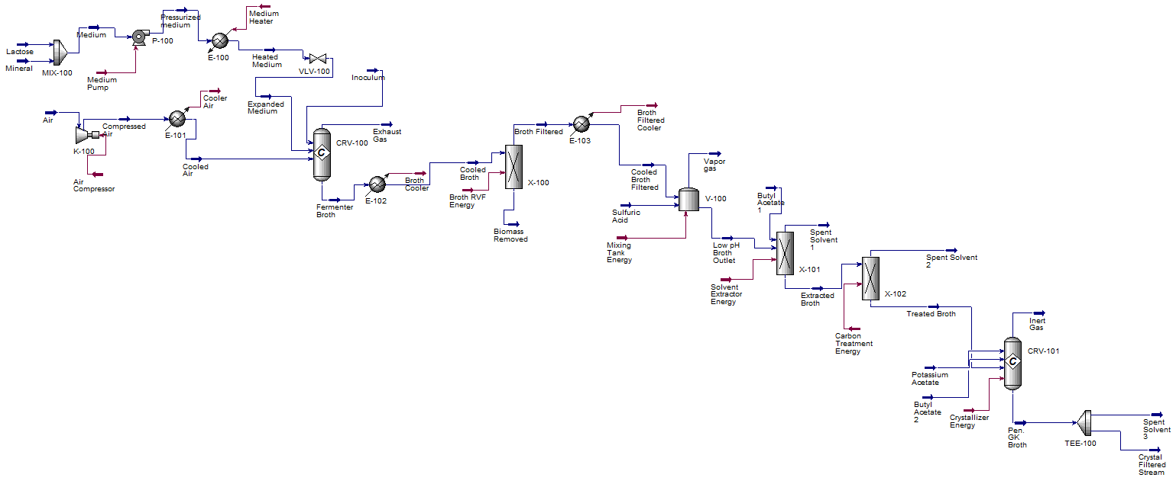
Aspen Simulation

Slide 20
Unit Designs

Slide 21
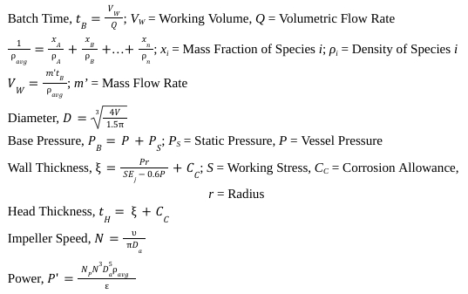

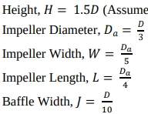

Fermenter: Design Considerations
Rules of Thumb &
Assumptions
Relevant Design Equations

Slide 22
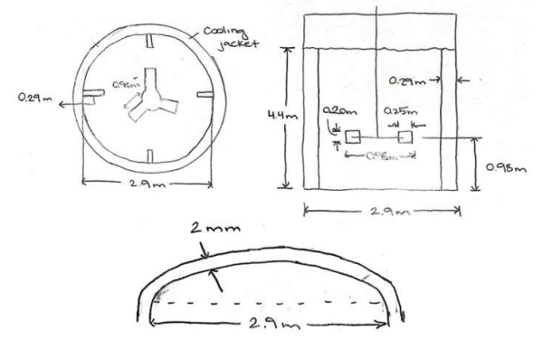
Fermenter Design
Reactor
Material | Stainless Steel
Volume | 30 m³
Pressure | 103 kPa
No. Units | 8
Operating Temperature | 30℃
Head Type | Torispherical
Diameter | 2.94 m
Height | 4.41 m
No. Baffles | 4
Baffle Width | 0.294 m
Impeller
Impeller Type | Rushton
No. Blades | 6
Impeller Diameter | 0.980 m
Impeller Speed | 87.7 rpm
Power | 14.1 kW

Slide 23


Fixed-bed Adsorber: Design Considerations
Design Parameters
Lignite-based Activated Carbon Adsorption Capacity = 0.3 kg adsorbed/ kg adsorbent
Bulk Density of Lignite-based Activated Carbon = 0.55 kg/L
Total Volume =
Porosity =
Rule of Thumb
Length/Diameter = 15
Adsorbent = 80% of Adsorber Length
Maximum Adsorber Diameter = 4 m
Maximum Adsorber Length = 60 m

Slide 24
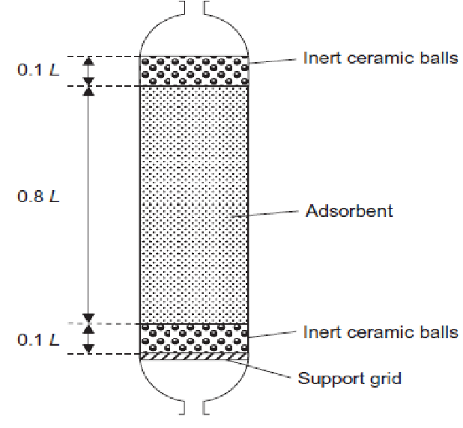
Fixed-Bed Adsorber Design
Design Specification
Material | Stainless Steel
Volume | 450 m³
Packing Volume | 360 m³
Packing Material | Lignite-Based Activated Carbon
Porosity | 0.28
# of Adsorbers | 6
Operating Temperature | 2℃
Pressure | 103.4 kPa
Height of Packing | 40.27 m
Diameter of Column | 3.36 m
Height of Column | 50.33 m

Slide 25
Economic Analysis

Slide 26
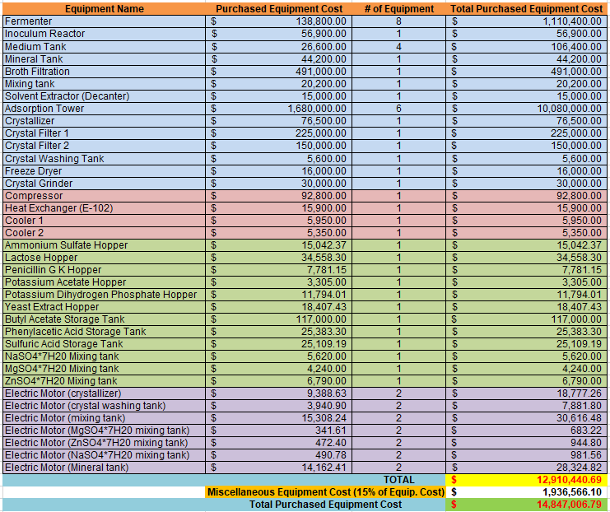
Total Purchased Equipment Cost = $14.82 million

Slide 27
Summary of Economics
Plant Construction = 3 years
  Total Capital Investment = $ 82.2 million
Annual Expectations
  Annual Operating Cost (100% Capacity) = $60.7 million
  Annual Sales (100% Capacity) = $114.2 million
Our plant life will last for 15 years at a capital hurdle rate of 15%, our investors should expect...
  Return on Investment = 24.3 %
  NPV (net present value) = $59.0 million
  Pay Back Period = 2.8 years
  Discounted cash flow rate of return = 23.3%

Slide 28
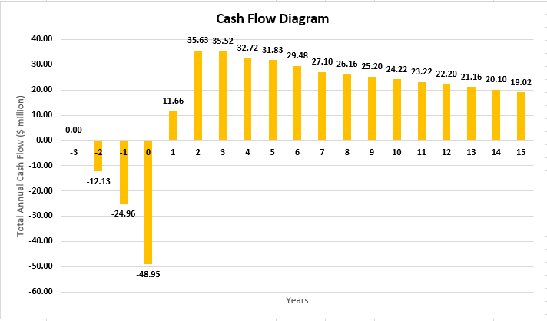
Plant Cash Flow Diagram
Cash Flow in terms of million $
Note:
Operating Plant Capacity at 50% at Year 1 and 90% at Year 2

Slide 29
HAZOP Analysis and Safety

Slide 30
HAZOP Analysis: Fermenter
Part Considered: Fermenter | Property Keyword | Guideword | Deviation | Possible Causes | Consequences | Actions required
Medium feed | Flow | More | Overfilling | Increased Flow | Inconsistent volume | Check system parameters Add Medium consistently
 |  | Less | Underfilling | Decreased flow | Inconsistent volume | Check system parameters Add Medium consistently
Cooled Water Feed | Temperature | More | Temperature fluctuation | Increased temperature | Cooling water failure Fermenter's composition will deteriorate | Temperature controller
 |  | Less | Temperature fluctuation | Decreased temperature | Cooling water failure Fermenter's composition will not grow | Temperature controller
Inoculum Feed | Contamination | Equipment failure | Leak | Exposed to environment | Unsanitary product | Maintenance
 | Flow | No filling occuring | No flow | Equipment failure | No fermentation/growth | Inoculum added consistently

Slide 31
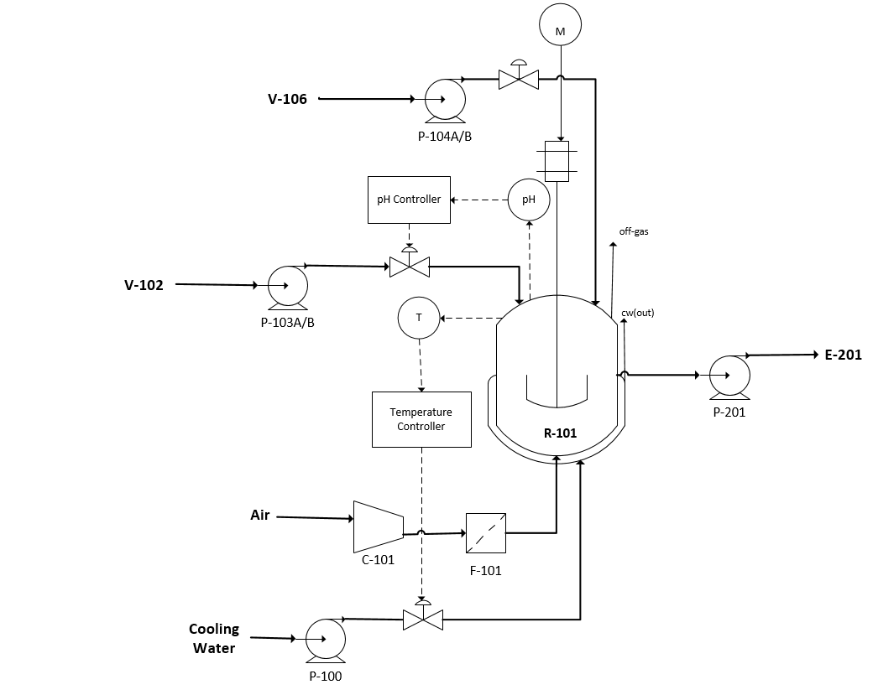
Fermenter: P&ID
V-102 Medium Tank
V-103 Inoculum Tank
R-101 Fermenter (Bioreactor)

Slide 32

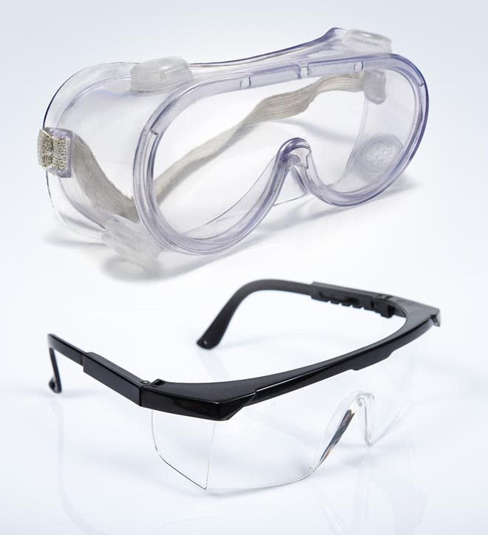

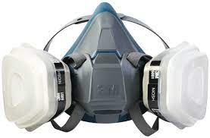
Potential Hazards & Safety Precautions
In the case of:
Inhalation: move to fresh air
Skin contact: wash with soap and water
Eye contact: flush eyes as precaution
Ingestion: rinse mouth with water

Slide 33
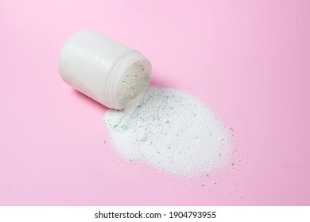
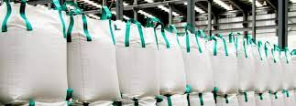
Storage & Handling
Stored in super sacks
Dry and refrigerated room awaiting transportation
7-day shelf life at room temperature
Stored at 4C

Slide 34
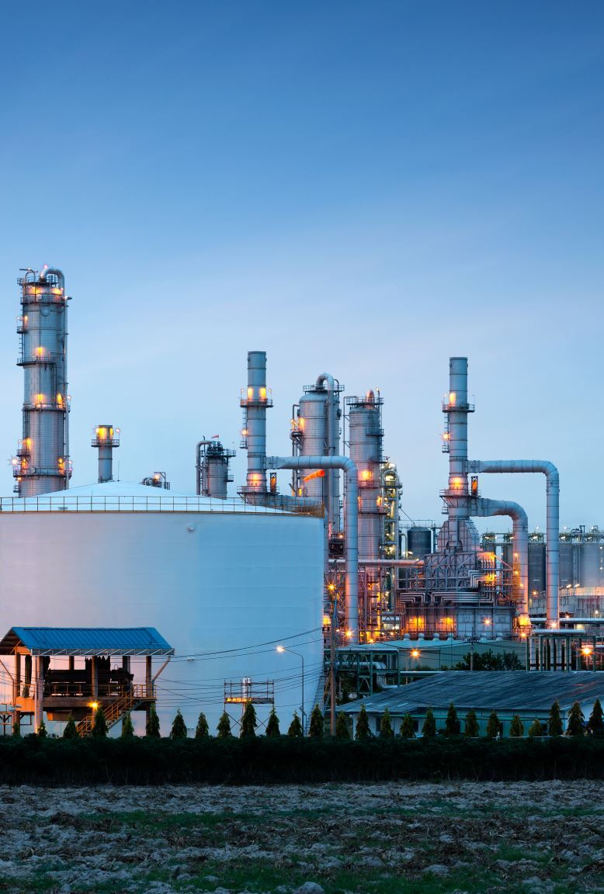

Recommendations
The construction of this plant is proven feasible and is recommended by our team
  The plant’s annual sales ($114.2 million) exceed that of the capital and annual operating costs ($75.9 million)
  The plant is in close proximity to its necessary resources
Next steps and future recommendations
  Evaluate the economic feasibility of treating our own waste
  Explore other blade types for the fermenter that have a higher impeller efficiency

Slide 35
Questions?????

Slide 36
Questions?????

Slide 37
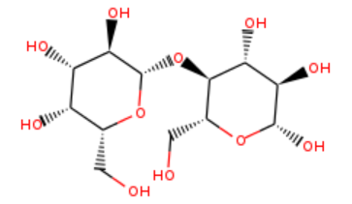
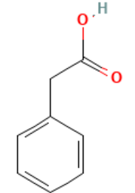
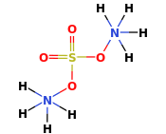
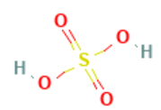
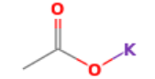
Process Materials
 | Lactose | Phenylacetic Acid | Sulfuric Acid | Potassium Acetate | Ammonium Sulfate
Reactant/Product/Solvent | Reactant | Reactant | Reactant | Reactant | Reactant
Molecular Weight | 342.3 kg/kmol | 136.15 kg/kmol | 98.079 kg/kmol | 98.142 kg/kmol | 132.14 kg/kmol
Chemical Formula | C12H22O11 | C8H8O2 | H2SO4 | C2H3KO2 | (NH4)2SO4
Chemical Structure
Boiling Point | 668.9 C | 265 C | 337 C | 117.1 C | 330 C
Freezing Point | 202.8 C | 76.5 C | 10 C | 292 C | 235 C
Flash Point | 357.8 C | 132 C | - | > 250 C | -
Critical Temperature | - | - | 654 C | - | 250 C
Density | 1.76 kg/L | 1.081 kg/L | 1.83 kg/L | 1.57 kg/L | 1.77 kg/L

Slide 38


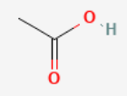
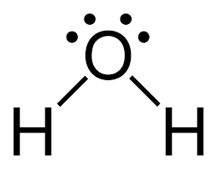

Process Materials
 | Oxygen | Butyl Acetate | Carbon Dioxide | Acetic Acid | Water
Reactant/Product/Solvent | Reactant | Solvent | Product | Product | Product
Molecular Weights | 32 kg/kmol | 116.16 kg/kmol | 44 kg/kmol | 60.052 kg/kmol | 18.02 kg/kmol
Chemical Formula | O₂ | C6H12O2 | CO₂ | CH3COOH | H2O
Chemical Structure
Boiling Point | -183 C | 126 C | -78.46 C | 118 C | 100 C
Freezing Point | -218.79 C | -78 C | -78 C | - | 0 C
Flash Point | - | 22 C | - | 39 C | -
Critical Temperature | -118.5 C | 306 C | 31 C | 320 C | 373.9 C
Density | 1.429 kg/L | 882 kg/L | 1562 kg/L | 1.05 kg/L | 1 kg/L

Slide 39
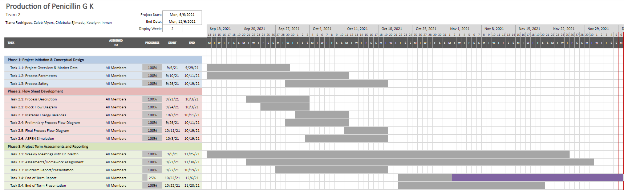
Fall 2021 Gantt Chart

Slide 40
Materials & Labor
Raw Materials
  Lactose ($1.60/kg)
    $27.68 million/ year
  Ammonium Sulfate ($0.37/kg)
    $1.92 million/ year
  Sulfuric Acid ($0.09/kg)
    $0.04 million/ year
  Phenylacetic Acid ($4.60/kg)
    $3.17 million/ year
  Potassium Acetate ($1.32/kg)
    $0.49 million/ year
  Buytl Acetate ($1.12/kg)
    $8.58 million/ year
Products
  Penicillin G K ($35/kg)
    $47.99 million/ year
  Biomass ($6.62/kg)
    $66.20 million/ year
  Operating Labor Cost
    3 operators per shift
    3 shifts per day
    Operator rate, $22/hr

Slide 41
Utilities
Process Air, compressed ($0.45/ 100 m3)
  $0.928 million/ year
Purchased Electricity ($0.045/ kWh)
  $0.129 million/ year
Waste Water Disposal ($0.53/ m3)
  $0.019 million/ year
Cooling Water ($0.08/m3)
  $0.061 million/ year

Slide 42
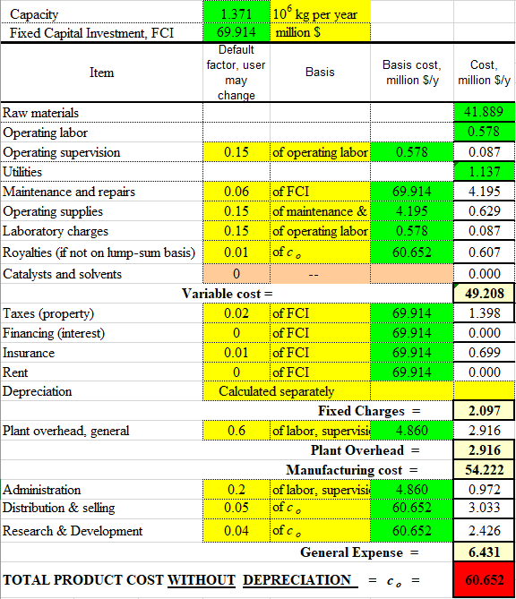
Annual Operating Cost Breakdown

Slide 43
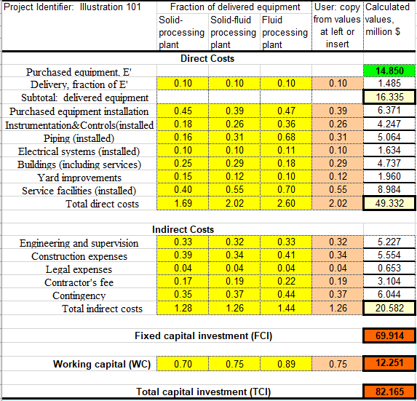
Total Capital Investment Breakdown

Slide 44
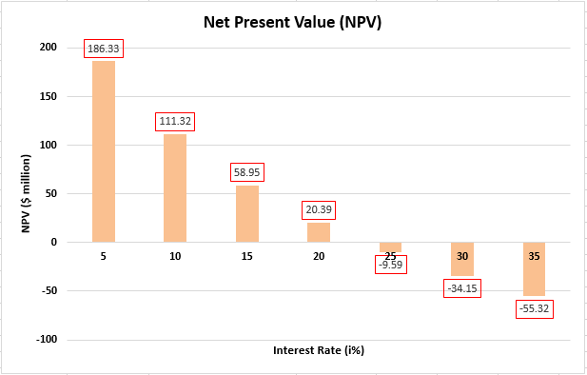
Net Present Value vs. Interest Rate
Discounted Cash Flow Rate of Return = 23.3%

Slide 45
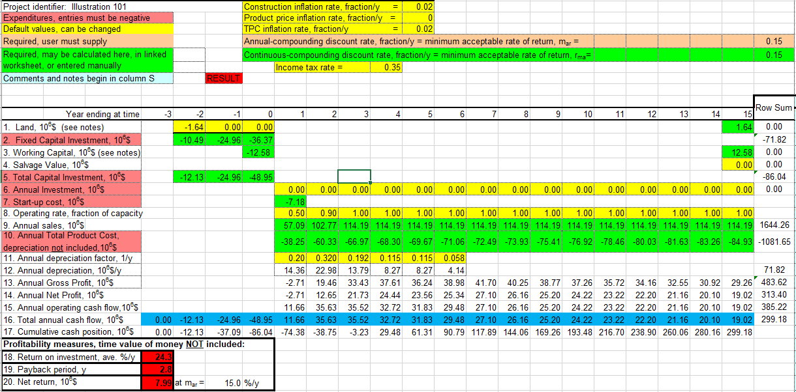
Economic Snapshot

Slide 46
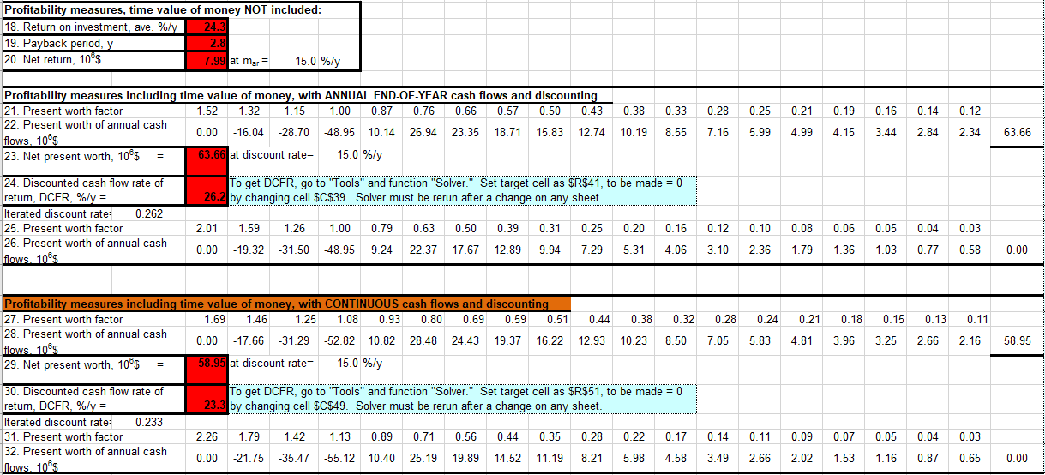
Economic Snapshot

Slide 47
Gross Profitability
Price of Products - Cost of Reactants = Theoretical Process Profit
$14,453.71/hr - $4,214.03/hr = $10,239.68/hr
Components | Market Price (2021) | Mass Flowrate (kg/hr) | $/hr
Lactose | $1.60/kg | 2,188.7 | $3501.92/hr
Phenylacetic Acid | $4.60/kg | 87.4 | $402.04/hr
Ammonium Sulfate | $0.37/kg | 656.8 | $243.02/hr
Potassium Acetate | $1.32/kg | 46.8 | $61.78/hr
Sulfuric Acid | $0.09/kg | 58.5 | $5.27/hr
Oxygen | 0 (Air) | 7336.9 | 0 (Air)
Pen G K | $35.00/kg | 174.1 | $6093.50/hr
Biomass | $6.62/kg | 1262.7 | $8359.07/hr
Acetic Acid | $0.04/kg | 28.6 | $1.14/hr

Slide 48
Energy Balance: Utility Equipment Table
Unit | Inlet Temp [ºC] | Outlet Temp [ºC] | Pressure [atm] | Utility | Heat flow (kJ/h) | Utility flow rate [kg/h]
E-101 (jacketed) | 25 121 | 121 25 | 2.04 | Steam Cooling water | -2.65 x 10⁶ 2.65 x 10⁶ | 1.48 x 10⁴ 6.61 x 10³
E-102 | 25 | 30 | 2.04 | Water | -1.20 x 10⁵ | 5.75 x 10³
R-101 (jacketed) | 27 | 30 | 1.02 | Cooling water | 1.00 x 10⁷ | 5.71 x 10⁵
E-201 | 30 | 25 | 1.02 | Cooling water | 1.89 x 10⁵ | 9.02 x 10³
E-202 | 25 | 2 | 2.04 | Calcium Chloride | 6.06 x 10⁵ | 8.61 x 10³

Slide 49
HAZOP Analysis: Adsorption Tower
Part Considered: Absorption Tower | Property Keyword | Guideword | Deviation | Possible Causes | Consequences | Actions required
Feed from Solvent Extractor | Flow | More | Overfilling | Increased Flow | Inconsistent volume | Valve controller
 |  | Less | Underfilling | Decreased flow | Inconsistent volume | Valve controller
 |  | None | No filling occuring | No flow | Pen G is not extracted | Ensure proper liq-liq extraction takes place
 | Temperature | More | Temperature change | Increased temperature | The volatile components will react Composition deteriorates | Temperature controller
 |  | Less | Temperature change | Decreased temperature | Affects the flowrates Yields a failed production | Temperature controller
 | Contamination | Equipment failure | Leak | Exposed to environment | Unsanitary product | Maintenance

Slide 50
Unit Balance: Fermenter
Q_{CW} = 1.00 x 10⁷ kJ/h
m_{CW} = 5.71 x 10⁵ kg/h
Inoculum
Exhaust Gas
CO2 = 4,621.5 kg/h
N2 = 122,882.7 kg/h
O2 = 22,023.1 kg/h
Biomass = 5.5 kg/h
Medium = 4,829.5 kg/h
Fermenter
KH2PO4 = 583.4 kg/h
(NH4)2SO4 = 656.8 kg/h
MgSO4*7H2O = 72.9 kg/h
Na2SO4*7H2O = 218.8 kg/h
ZnSO4*7H2O = 291.7 kg/h
Yeast Extract = 729.7 kg/h
Phenyl acetic Acid = 87.4 kg/h
Lactose = 2,188.7 kg/h
Output = 4,835.1 kg/h
Biomass = 1,262.7 kg/h
Penicillin G = 199.4 kg/h
Water = 3,373.0 kg/h
Air
O2 = 36,705.2 kg/h
N2 = 122,882.7 kg/h

Slide 51
Composition Balance
Q_{CW} = 1.00 x 10⁷ kJ/h
m_{CW} = 5.71 x 10⁵ kg/h
Exhaust Gas = 149,527.3 kg/h
Inoculum = 5.5 kg/h
X Biomass = 1
XCO2 = 0.031
XN2 = 0.822
XO2 = 0.147
Medium = 4,829.5 kg/h
Fermenter
XKH2PO4 = 0.121
X (NH4)2SO4 = 0.136
X MgSO4*7H2O = 0.015
X Na2SO4*7H2O = 0.045
X ZnSO4*7H2O = 0.060
X Yeast Extract = 0.151
X Phenyl acetic Acid = 0.018
X Lactose = 0.453
Output = 4,835.1 kg/h
X Biomass = 0.261
X Penicillin G = 0.041
X Water = 0.698
Air = 159,588.0 kg/h
XO2 = 0.230
XN2 = 0.770

Slide 52
Unit Balance: RVF
Penicillin G Recovery: 93%
INPUT
Rotary Vacuum Filter
OUTPUT
Biomass = 1,262.7 kg/h
Penicillin G = 199.4 kg/h
Water = 3,373.0 kg/h
Biomass = 88.4 kg/h
Penicillin G = 185.4 kg/h
Water = 3,103.1 kg/h
Biomass = 1,174.3 kg/h
Penicillin G = 14.0 kg/h
Water = 269.8 kg/h

Slide 53
Unit Balance: Mixing Tank
Penicillin G Recovery: 100%
INPUT
Mixing Tank
OUTPUT
Biomass = 88.4 kg/h
Penicillin G = 185.4 kg/h
Water = 3,103.1 kg/h
Butyl Acetate = 844.2 kg/h
Sulfuric Acid = 58.5 kg/h
Biomass = 88.4 kg/h
Penicillin G = 185.4 kg/h
Water = 3,103.1 kg/h
Sulfuric Acid = 58.5 kg/h
Butyl Acetate = 844.2 kg/h

Slide 54
Unit Balance: Solvent Extractor
Penicillin G Recovery: 86%
INPUT
Solvent Extractor
OUTPUT
Butyl Acetate = 844.2 kg/h
Sulfuric Acid = 58.5 kg/h
Biomass = 88.4 kg/h
Penicillin G = 185.4 kg/h
Water = 3,103.1 kg/h
Butyl Acetate = 759.8 kg/h
Biomass = 3.5 kg/h
Penicillin G = 159.5 kg/h
Water = 155.2 kg/h
Butyl Acetate = 84.4 kg/h
Sulfuric Acid = 58.5 kg/h
Biomass = 84.9 kg/h
Penicillin G = 26.0 kg/h
Water = 2948.0 kg/h

Slide 55
Unit Balance: Carbon Treatment
Penicillin G Recovery: 100%
INPUT
Carbon Treatment
OUTPUT
Butyl Acetate = 759.8 kg/h
Biomass = 3.5 kg/h
Penicillin G = 159.5 kg/h
Water = 155.2 kg/h
Butyl Acetate = 3,450.7 kg/h
Penicillin G = 159.5 kg/h
Water = 150.5 kg/h
Butyl Acetate = 38 kg/h
Biomass = 3.5 kg/h
Water = 4.7 kg/h

Slide 56
Unit Balance: Crystallizer
Penicillin G K Recovery: 100%
INPUT
OUTPUT
Crystallizer
Butyl Acetate = 3,450.7 kg/h
Penicillin G = 797.8 kg/h
Water = 754.9 kg/h
Acetic Acid = 143.3 kg/h
Butyl Acetate = 3838.3 kg/h
Penicillin G K = 888.7 kg/h
Water = 752.9 kg/h
Butyl Acetate = 387.7 kg/h
Potassium Acetate = 234.3 kg/h

Slide 57
Unit Balance: Crystal Filter 1
Penicillin G K Recovery: 99%
Crystal Filter
Acetic Acid = 143.3 kg/h
Butyl Acetate = 3838.3 kg/h
Penicillin G K = 888.7 kg/h
Water = 752.9 kg/h
Butyl Acetate = 460.6 kg/h
Penicillin G K = 879.8 kg/h
Water = 37.6 kg/h
Acetic Acid = 143.3 kg/h
Butyl Acetate = 3377.7 kg/h
Penicillin G K = 8.9 kg/h
Water = 715.3 kg/h

Slide 58
Unit Balance: Crystal Washing
Penicillin G K Recovery: 100%
INPUT
Crystal Washing
OUTPUT
Butyl Acetate = 460.6 kg/h
Penicillin G K = 879.8 kg/h
Water = 37.6 kg/h
Butyl Acetate = 690 kg/h​
Penicillin G K = 879.8 kg/h​
Water = 37.6 kg/h
Butyl Acetate = 229.4 kg/h

Slide 59
Unit Balance: Crystal Filter 2
Penicillin G K Recovery: 99%
INPUT
OUTPUT
Crystal Filter
Butyl Acetate = 690 kg/h​
Penicillin G K = 879.8 kg/h​
Water = 37.6 kg/h
Butyl Acetate = 82.8 kg/h​
Penicillin G K = 871 kg/h​
Water = 1.9 kg/h
Butyl Acetate = 607.2 kg/h
Penicillin G K = 8.8 kg/h
Water = 35.8 kg/h

Slide 60
Unit Balance: Freeze Dryer
Penicillin G K Recovery: 100%
INPUT
Vacuum Drying
OUTPUT
Butyl Acetate = 4.1 kg/h
Penicillin G K = 871 kg/h
Water = 0.07 kg/h
Butyl Acetate = 82.7=8 kg/h
Penicillin G K = 871 kg/h
Water = 1.9 kg/h
Butyl Acetate = 78.6 kg/h
Water = 1.8 kg/h

Slide 61
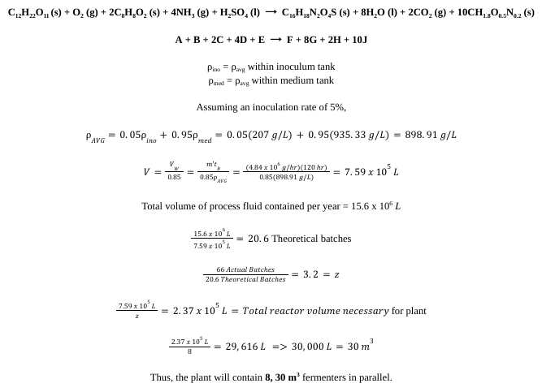
Fermenter Design: Calculating Volume

Slide 62
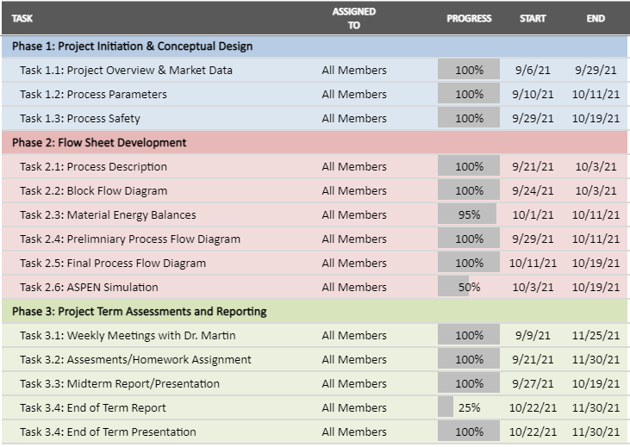
Gantt
Chart

Slide 63
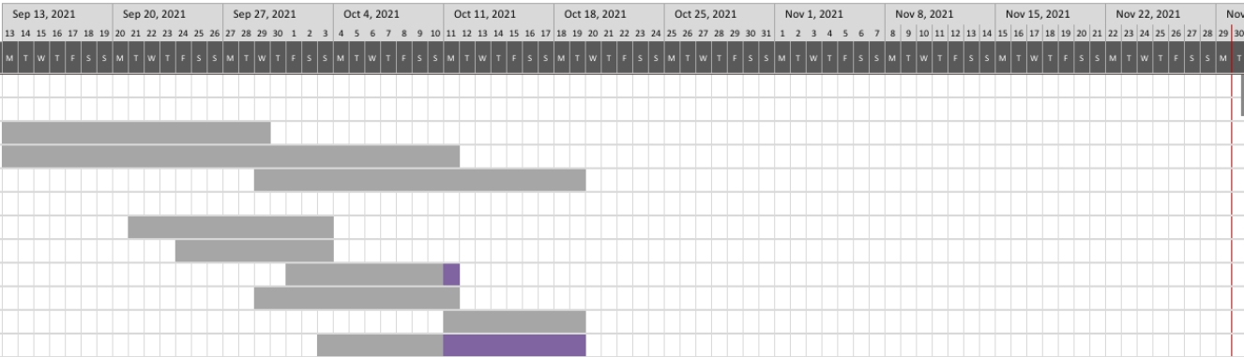

Gantt Chart (Graph)

