Slide 1
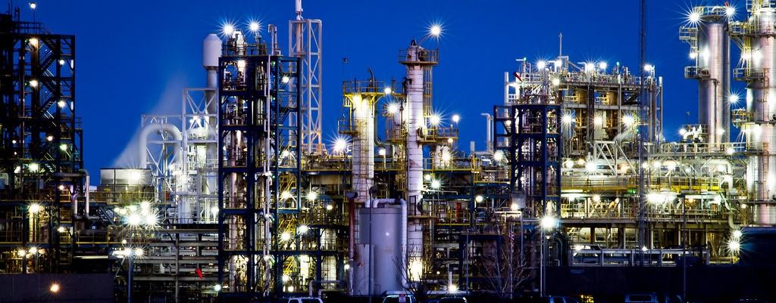
CHEG 4248 Senior Design II
Production of L-Methionine via Immobilized Enzymatic Hydrolysis
By: Tyree Madison, Ebonie Henderson, Jacquelyn Fuller & Ibrahim Arogundade

Slide 2
Agenda Outline
1. Project Scope / Deliverables
2. Background
3. Process Description
4. Material and Energy Balance
5. Economic Analysis
7. HAZOP & Safety
8. ASPEN simulation
6. Equipment Design & Specifications
9. Conclusion

Slide 3

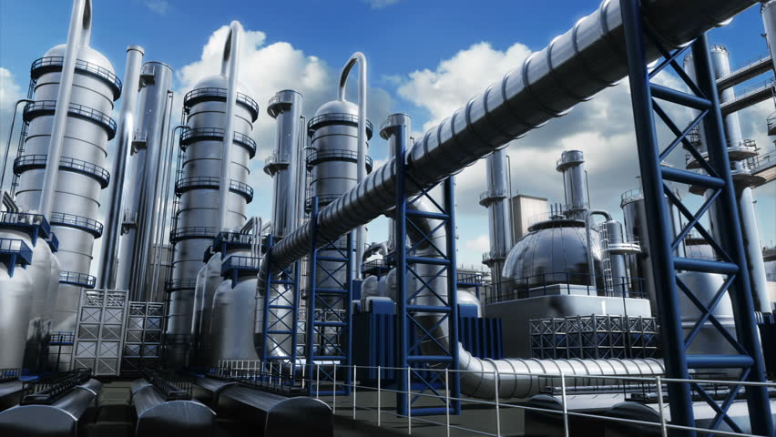
Project Scope

Slide 4
Project Deliverables
Scope:
Design a plant that produces ≥ 98% pure L-Methionine.
Develop methods for production, transportation, and storage of L-Methionine
Deliverables:
Provide Process Flow Diagram
Provide Material and Energy Balance Summary
Prepare Complete Economic Analysis
Complete Engineering design of major equipment
Complete ASPEN Simulation Report

Slide 5
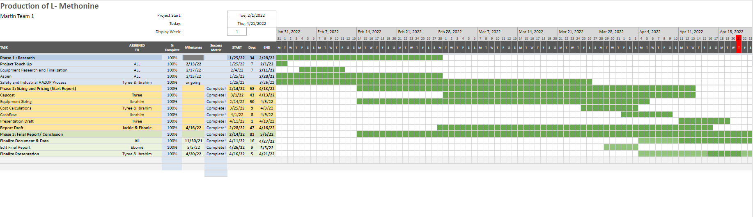
Gantt Chart

Slide 6

Background
This Photo by Unknown author is licensed under CC BY-NC-ND.

Slide 7
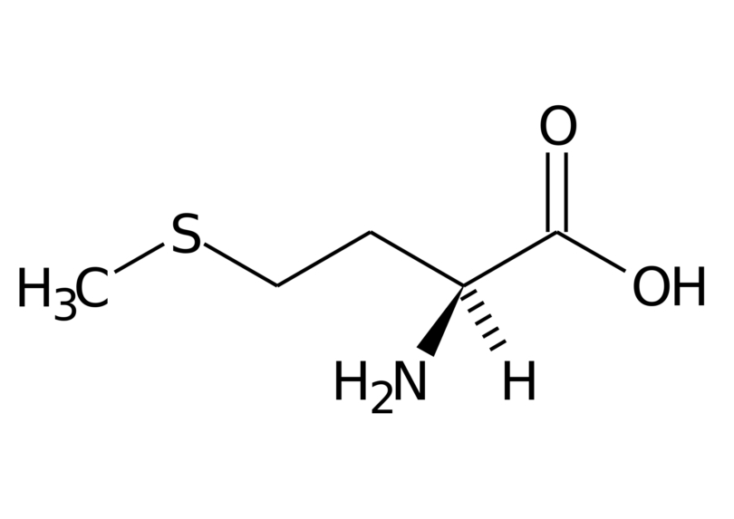
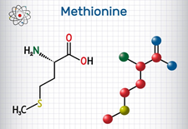
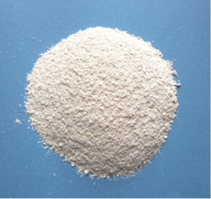
What is L-Methionine?
L-Methionine (C₅H₁₁NO₂S) is an enantiomer of the amino acid Methionine.
L-Methionine is produced is through fermentation or enzymatic hydrolysis
Methionine is an essential amino acid and it’s important for protein growth & development within livestock animals.
Notes:
Ebonie

Slide 8
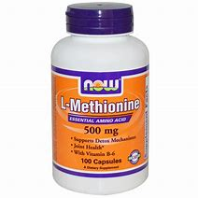
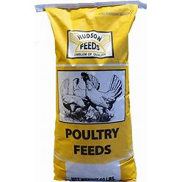
Uses
L- Methionine is primarily used in pharmaceutical and agricultural industries
Agriculture uses include feed additives for livestock animals
Pharmaceutical uses include antidotes, cancer research, and nutritional supplements.
Notes:
Ebonie

Slide 9

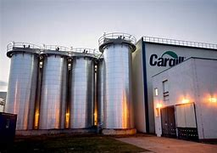
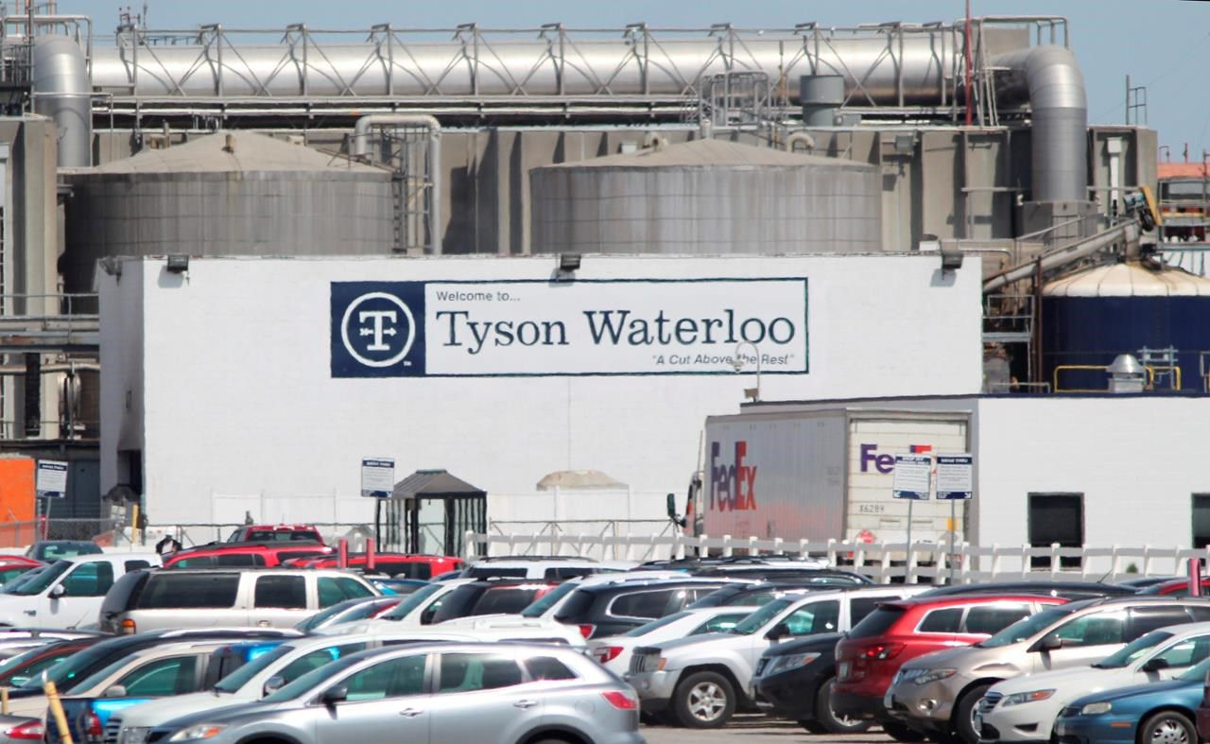
Design Basis
Facility Run Time
320 days per year
(88% of the normal year)
Plant Location
Madison County Illionois , USA
Proximity to the consumers of L-Methionine
Multiple Wastewater treatment plants nearby
N-Acetyl-DL-Methionine will be outsourced
Clients
Companies that produce animal feed ( Tyson Inc. Cargill Inc. Land O’ Lakes Inc)
Notes:
Ibrahim

Slide 10
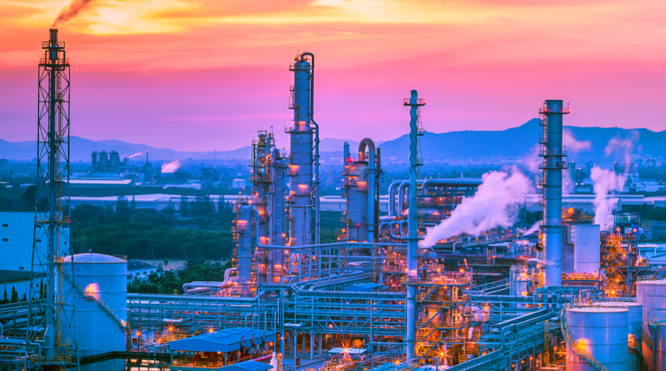
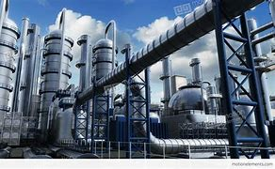
Process Description
Capacity: 50,000 Metric Tons/yr
Process Type: Continuous
Process: Immobilized Enzyme Hydrolysis i.e., Aminoacylase
Crystal Size: 50µm
Conversion of Reactor: 88%
Product Specification: 98% pure L-Methionine
Notes:
Ibrahim

Slide 11
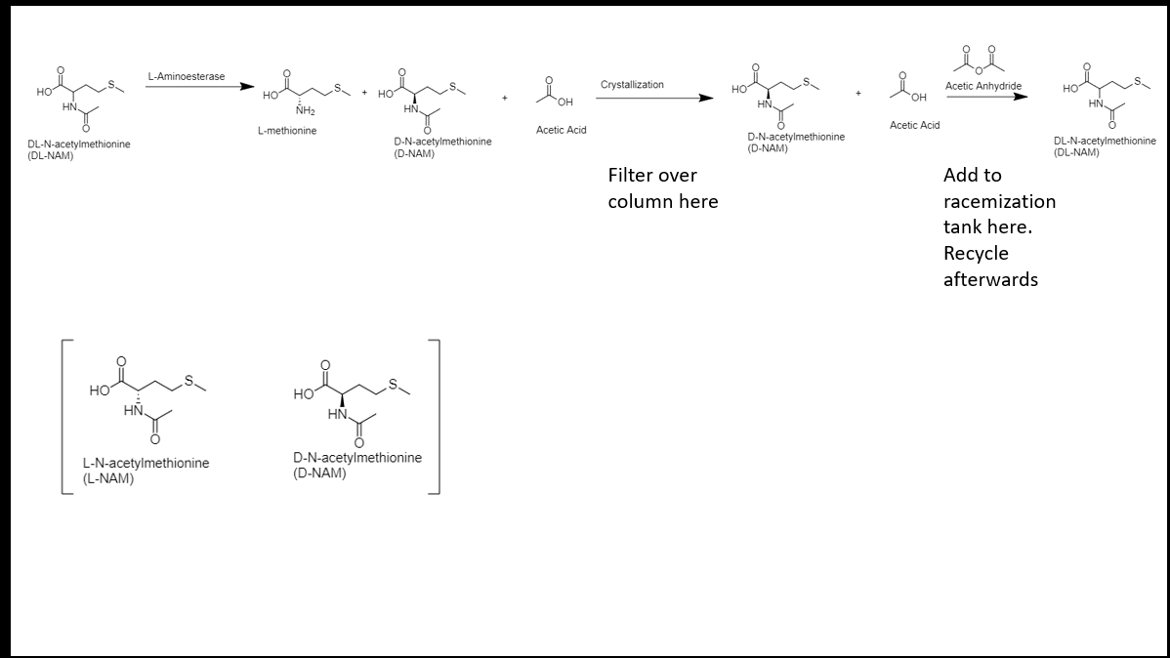
Process Chemistry
Notes:
Ibrahim

Slide 12
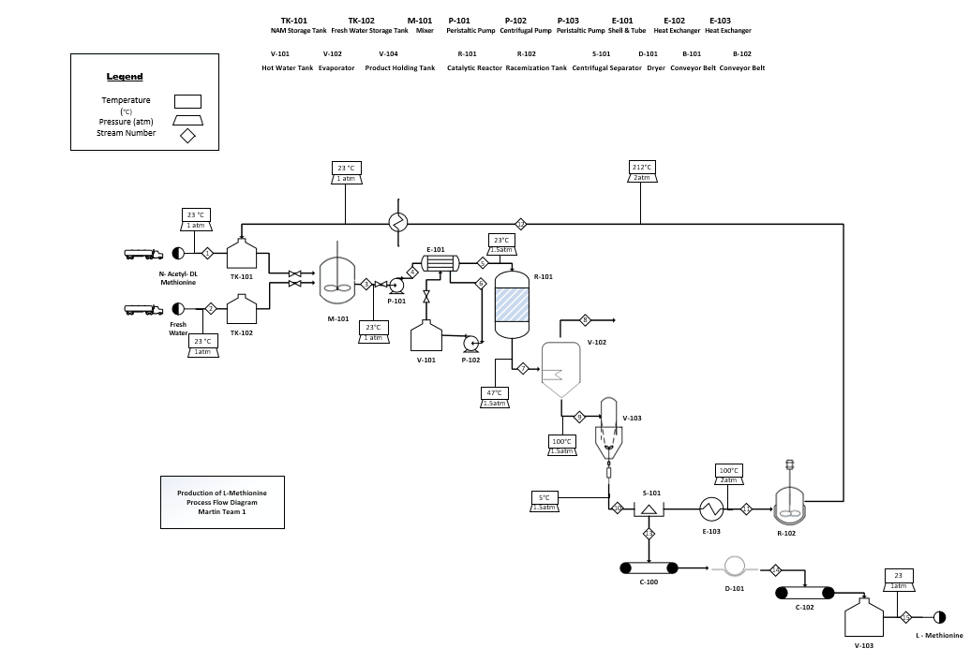
Process Flow
Diagram
47° C
Notes:
Ty

Slide 13
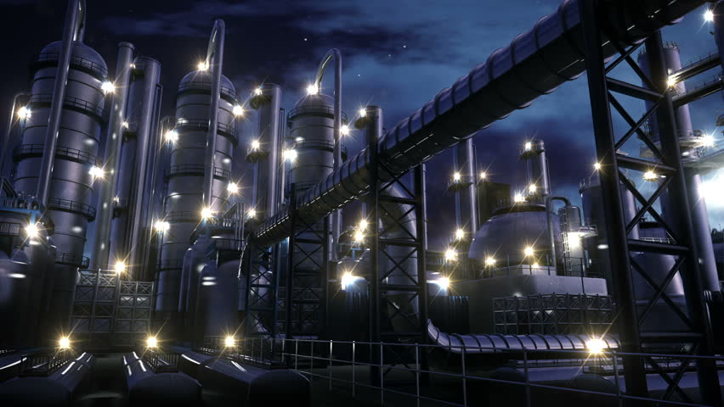
Material & Energy Balance Summary

Slide 14
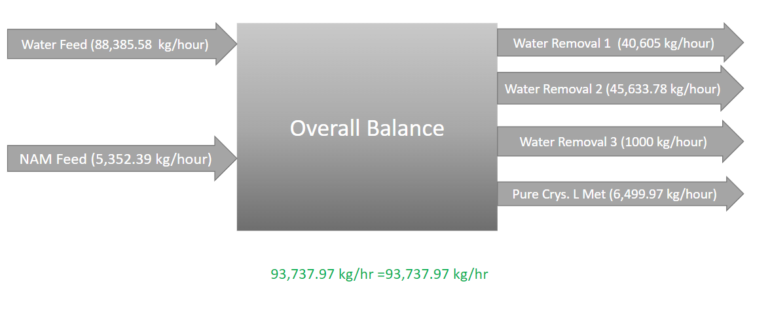
Material Balance Summary
Notes:
Ty

Slide 15
Energy balance Summary
Unit Operations | Power
Heat Exchanger ( Before Reactor) | Power: 2290 kW
Enzyme Reactor | Power: - 8.40 x10⁶ kW
Evaporator | Power: 5.85x10⁵ kW
Crystallizer | Power: -66,800 kW
Evaporator (2) | Power :3.40 x10⁴ kW
Heat Exchanger (Separator & Racemization Tank) | Power: 3.70x 10⁴ kW
Notes:
Ty

Slide 16

Economic Analysis
This Photo by Unknown author is licensed under CC BY-ND.

Slide 17


Summary of the Economic Analysis
- The plant is going to take approximately 3 years of Construction. The product L-Methionine has a price range of $3-5/kg with an annual product rate of 50 million kg/yr
$4.4/kg is selected as the price for L-Methionine
Total Annual Production Cost (C): $155 Million
Total Annual Value of Products/sales (S) : $215 Million
Total Capital Investment (TCI): $31 Million
Payback Period (PBP): 1.6 years
Return on Investment(ROI): 46.5%/yr
Internal Rate of Return: 44.5%/yr

Slide 18
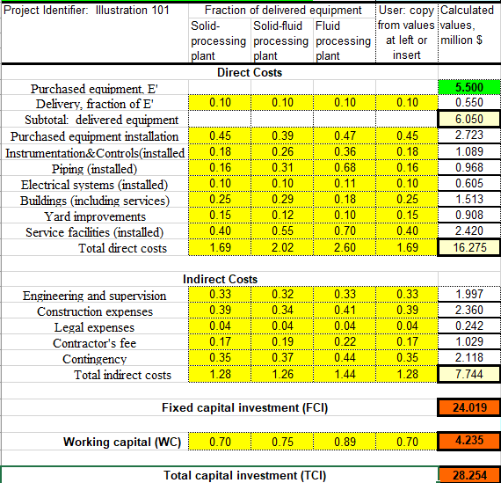
Overview of Capital Investment cost
Notes:
Ty and Ibrahih

Slide 19
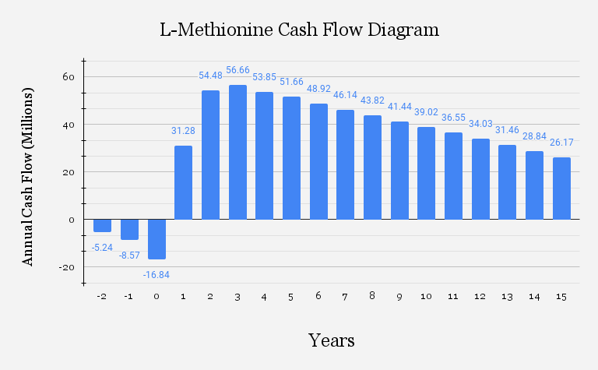
Cash Flow Diagram
Flow

Slide 20

Equipment design and specifications

Slide 21
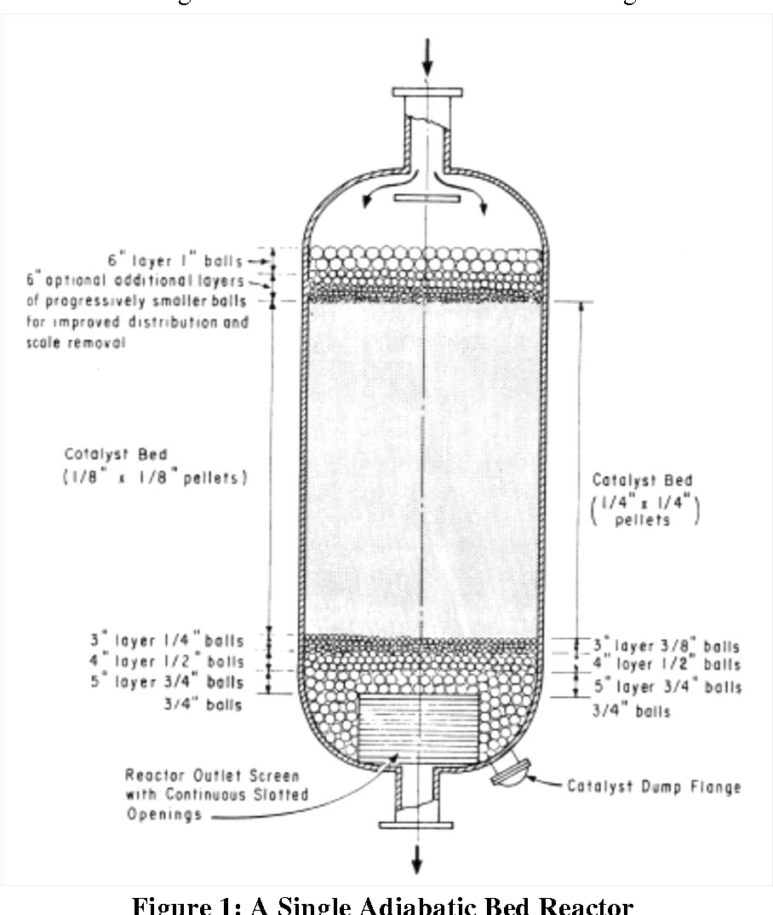
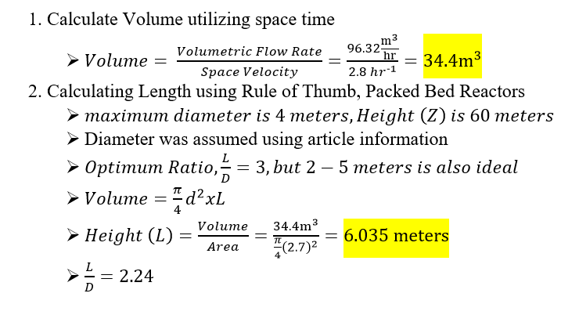
Design Calculations: Enzyme Reactor

Slide 22
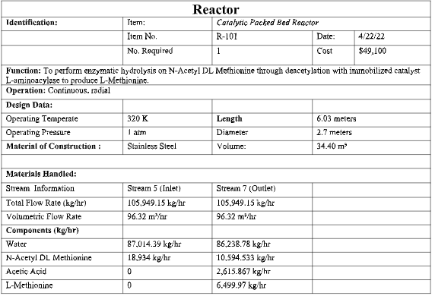
Design Specification: Enzyme Column

Slide 23
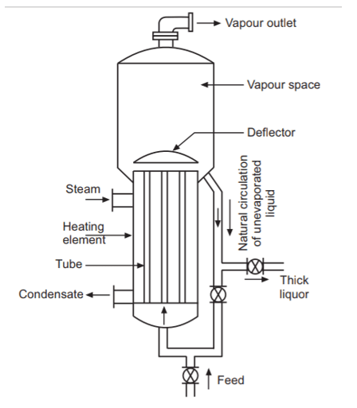
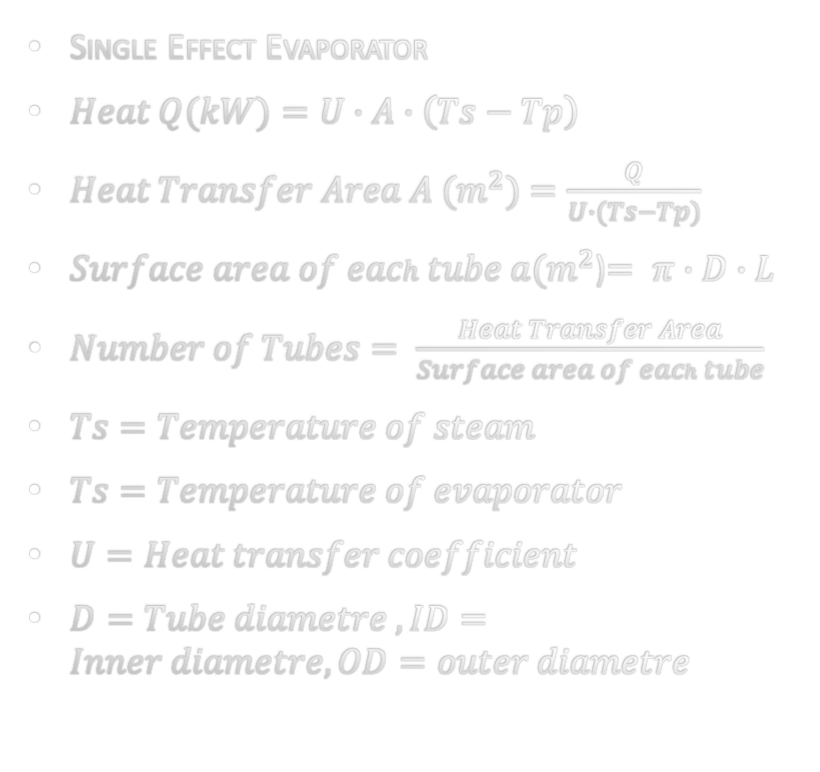
Design: Evaporator
Single Effect Evaporator
$Heat Q(kW)=U∙A∙\left(Ts−Tp\right)$
$Heat Transfer Area A (m^{2})=\frac{Q}{U∙(Ts−Tp)}$
$Surface area of each tube a(m^{2}$)$= π∙D∙L$
$Number of Tubes= \frac{Heat Transfer Area}{Surface area of each tube}$
$Ts=Temperature of steam$
$Ts=Temperature of evaporator$
$U=Heat transfer coefficient$
$D=Tube diametre , ID=Inner diametre, OD=outer diametre$

Slide 24
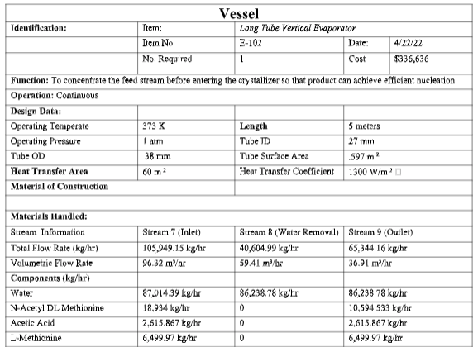
Long Tube Vertical Evaporator: E-102
Notes:
Ibrahim

Slide 25
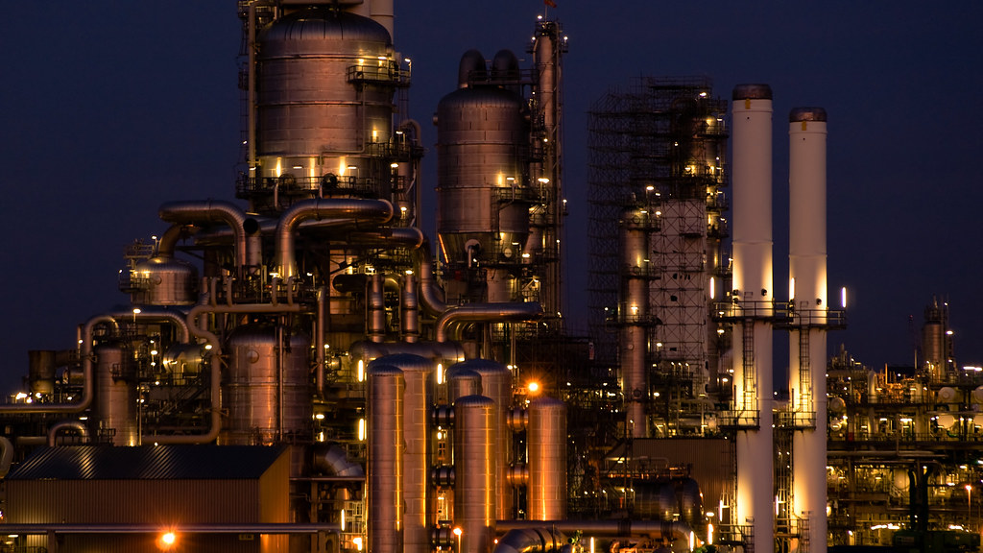
Process Safety
HAZOP & Risk Analysis
This Photo by Unknown author is licensed under CC BY-SA-NC.

Slide 26
HAZOP Analysis: ENZYME COLUMN/REACTOR
Keyword | Deviation | Cause | Consequence | Action
Flow | More | Blockage NAM solution flow rate is too high | Increase in concentration of the substrate(reactants) which causes the Aminoacylase to leak from the column/reactor | 102LC , 102LV Valve opens completely to control the overflow
 | Less | Low flow rate | Inefficient/Incomplete hydrolysis Low conversion | 101FC , 101FV 101FT Valve opens in a manner that corresponds to the decrease in flow
pH (7.0) | More | Very high pH | Enzyme activity decreases Decreases the rate at which our product is formed | 104AT, 104AC, 101PB Pump from HCL from HCL tank to bring pH down
 | Less | Very low pH | Shape of the enzyme is lost | 104AT, 104AC, 102PB Pump NaOH from NaOH tank to bring pH up
Temperature | More | Heat source providing too much heat | Denaturation of the enzyme, it can be permanent and irreversible Instability of the immobilized Aminoacylase | 103TC, 104TV,103TT The system is cooled through 104TV
 | Less | Heat source proving not enough heat | Low enzyme activity, substrate have less kinetic energy so there are fewer collisions. | 103TC, 103TV,103TT 103TV Heat is added to the system through 103TV
Pressure | More | Increase in pressure | Low conversion | 110PT, 110PC, 110PV Pressure relief valve is activated
Notes:
All

Slide 27
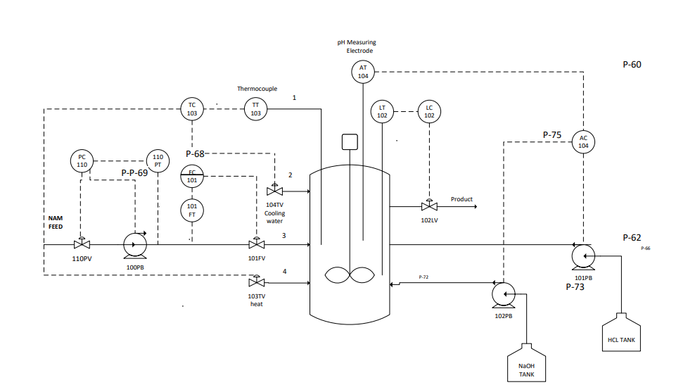
P&ID - Enzyme/Catalytic Membrane reactor
Notes:
Alll + Ty :Lopa

Slide 28
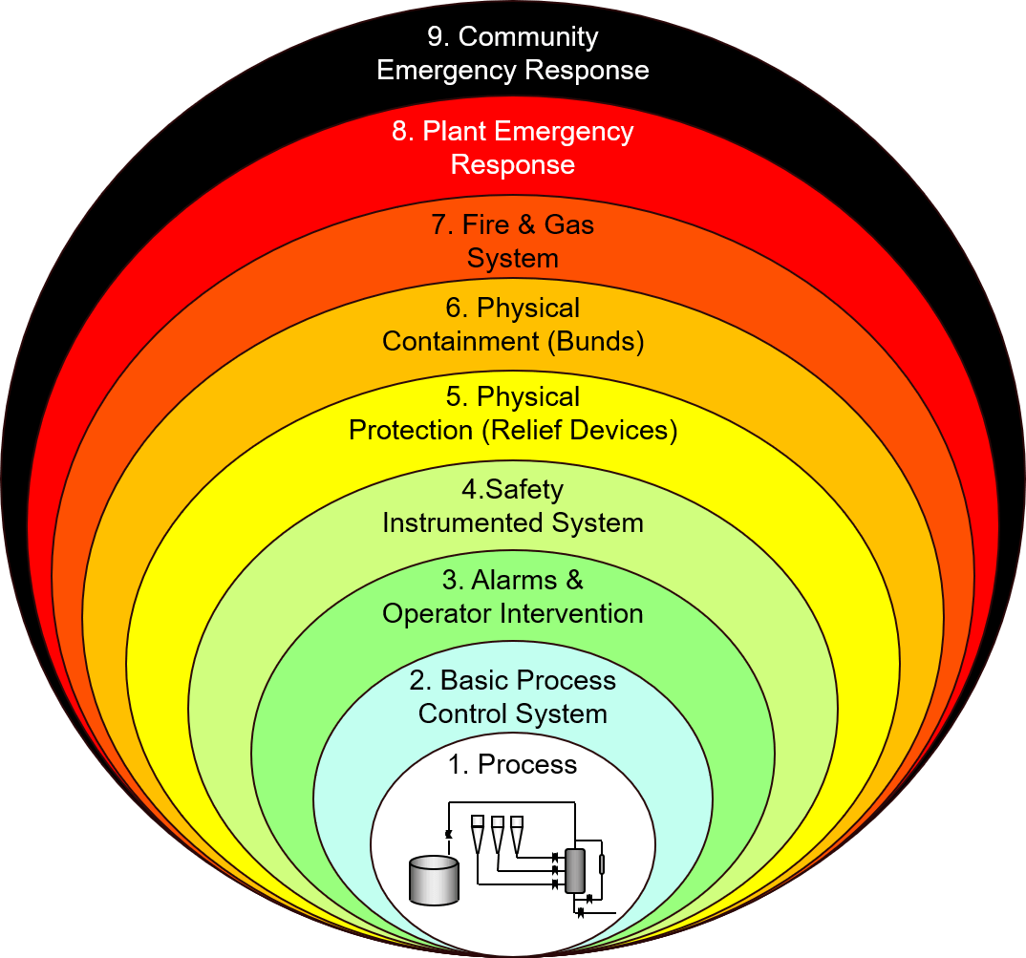
Cont'd : Layers of Protection analysis
LOPA is a form of hazard evaluation and a risk assessment to reduce hazardous events
Steps include identifying the potential hazard, Risk Factor Evaluation, Implementation
Notes:
Alll + Ty :Lopa

Slide 29
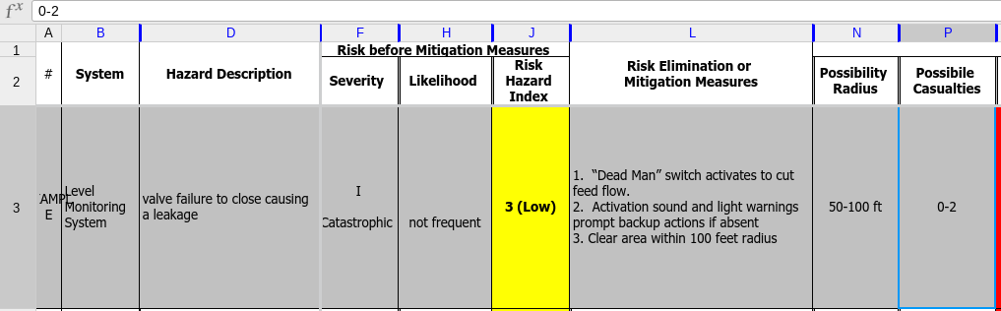
Cont'd : Risk analysis
Notes:
Alll + Ty :Lopa

Slide 30
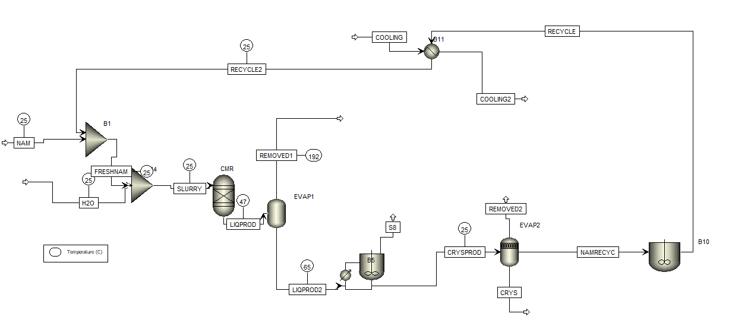
Aspen - Simulation Report
Notes:
Alll + Ty :Lopa

Slide 31
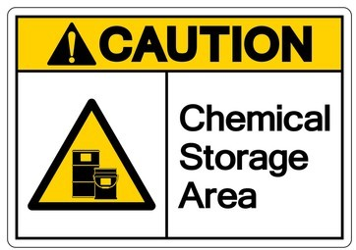

Safety & Hazards
Hazards-
Skin, eye and respiratory irritant
Product Handling-
Provide appropriate exhaust ventilation at places where dust is formed.
Personal Protective Equipment(PPE)-
Eye Protection (Goggles)
Gloves ( Nitrile Rubber)
Respiratory Protection (N95 (US) or type P1 (EN 143))
Storage -
Keep container tightly closed in a dry and well-ventilated places.
Notes:
Alll + Ty :Lopa

Slide 32


Conclusion
We were able to
Calculate our Material & Energy Balances for our current plant capacity
Construct our designated Process Flow Diagram.
Design & size major equipment
Complete a full economic analysis of plant
Notes:
Alll + Ty :Lopa

Slide 33

Extra Slide #3: Different prices
$4.30/kg- L-Methionine, $2.70/kg N-Acetyl-DL-Methionine
Cost of Raw materials: $121.5 Million
Total Annual Production Cost (C): $155 Million
Total Annual Value of Products/sales (S) : $215 Million
Total Capital Investment (TCI): $31 Million
Payback Period (PBP): 1.2 years
Return on Investment(ROI): 59.2%/yr
Internal Rate of Return: 47.6%/yr

Slide 34

Extra slide #3:
$5/kg- L-Methionine, $2.70/kg N-Acetyl-DL-Methionine
Cost of Raw materials: $121.5 Million
Total Annual Production Cost (C): $150 Million
Total Annual Value of Products/sales (S) : $250 Million
Total Capital Investment (TCI): $31 Million
Payback Period (PBP): 0.6yr
Return on Investment(ROI): 130.4%/yr
Internal Rate of Return: 47.6%/yr

Slide 35
Economic Analysis
Product: L-Methionine- Price/kg (P): ,
Annual amount of the product (A): 50,000 Metic tons/yr= 45 Million kg/yr
Total Annual Value of Products/sales (S) : P ($/kg) × A (kg/yr)
Total Annual Cost of Raw Materials: RP ($/kg) × RA (kg/yr)
Total Annual Production Cost (C): Cost of Manufacture (COM) + General Expense (GE)=
Gross earnings or profit= Total Annual Value of Products/sales (S) - Total Annual Production Cost (C)
Operating Labor Cost: Shift Time (hr) * Number of shifts per day * Laborers per shift * Laborer rate ($/hr)
Purchased Equipment Cost: Σ of all Equipment based on size and Power
Total Capital Investment (TCI): Direct cost + Indirect cost + Working Capital:
Notes:
Ty and Ibrahim

Slide 36
Extra slide #2: Plant Location
Land Size
Geography of the Community
Population of the Community
Industrial Water Supply
Climate
Population

Slide 37
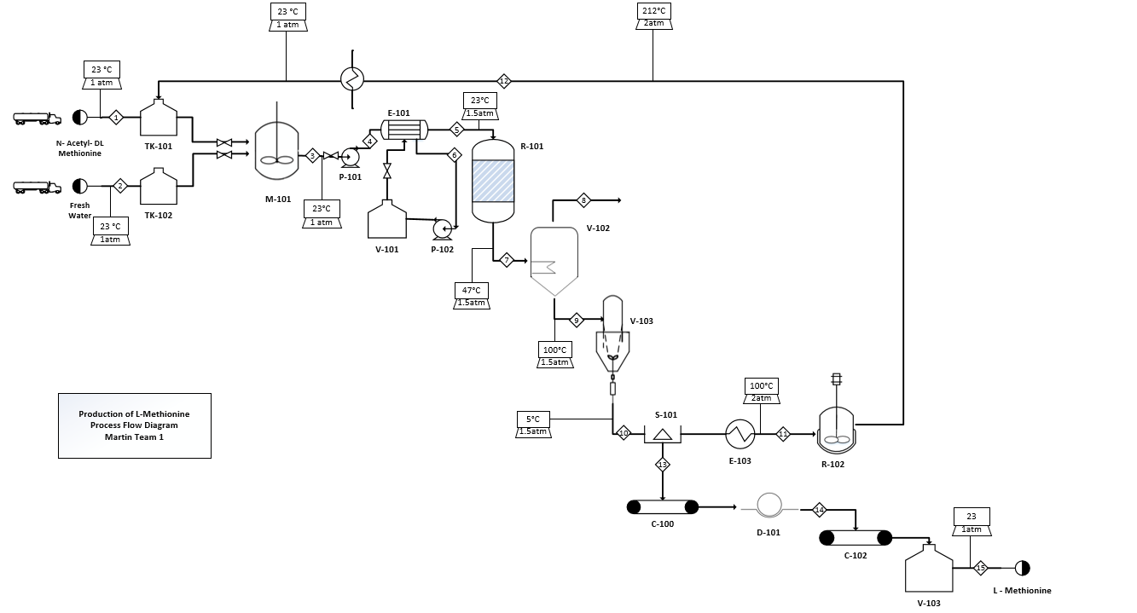
Extra - PFD

Slide 38
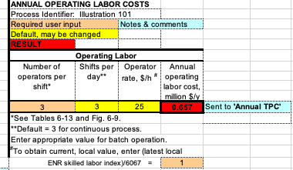
Extra slide #1 Economic Analysis
Cost of Manufacture (COM): Raw materials + utilities + operations (labor) + maintenance + operating overhead + property taxes + Insurance + depreciation
COM=
General Expense (GE): Selling expense + direct research + allocated research + management incentive compensation
GE=
Annual Operating Labor costs:

Slide 39
