Slide 1
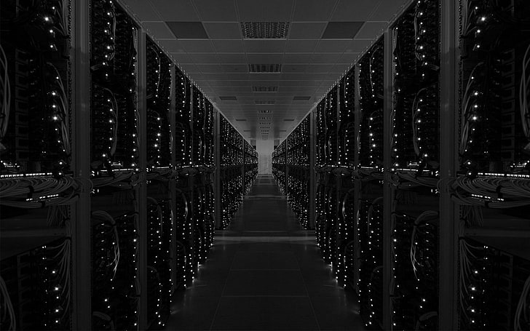

Data Center Design
Course Instructor: Prof. Turner
Course Facilitator: Dr. Musa
Team Sponsor: Dr. Annamalai
Company Sponsors: iMasons
Jeff Omelchuck
Christina Pungerchar
Curt Belusar
Phil Lawson-Shanks
Team 6:
Isaiah Allen
John Barrett
Ahmad Yakuba
Riley Mallett
Angel Randall
Michael Vidales

Slide 2
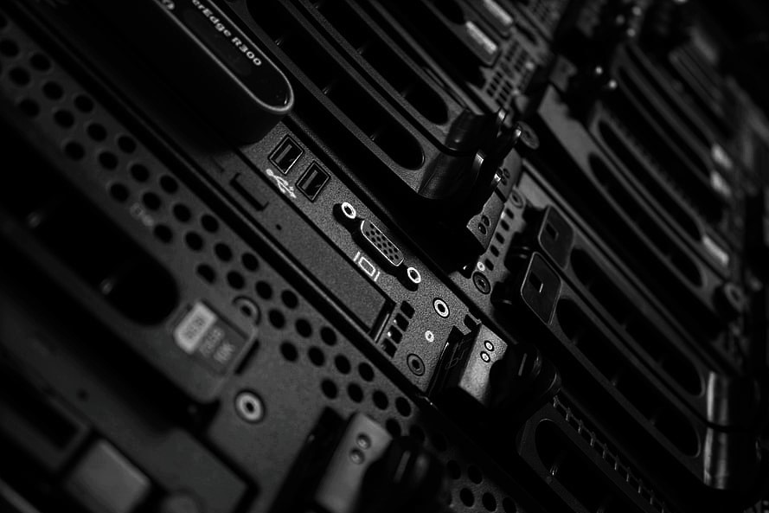
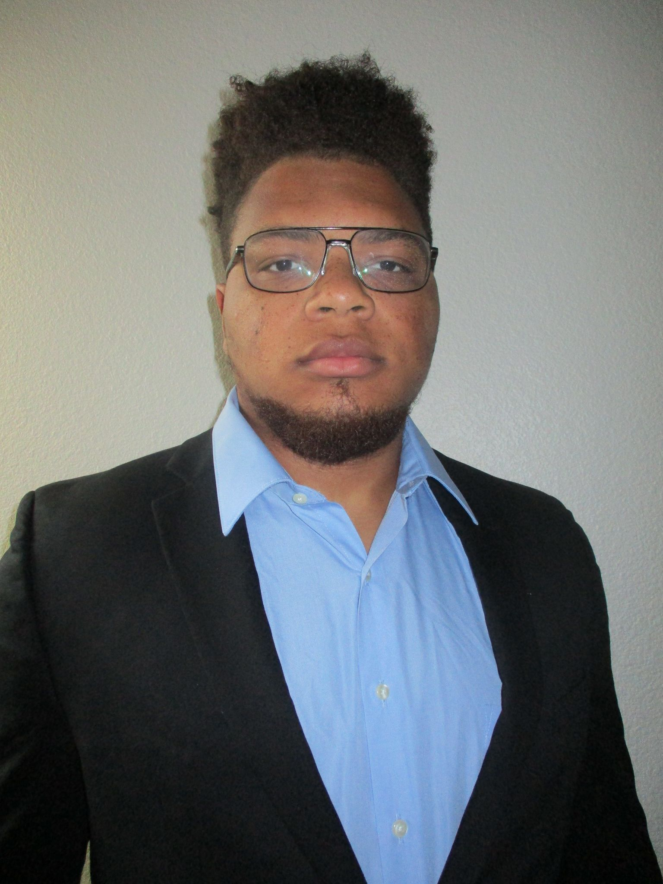


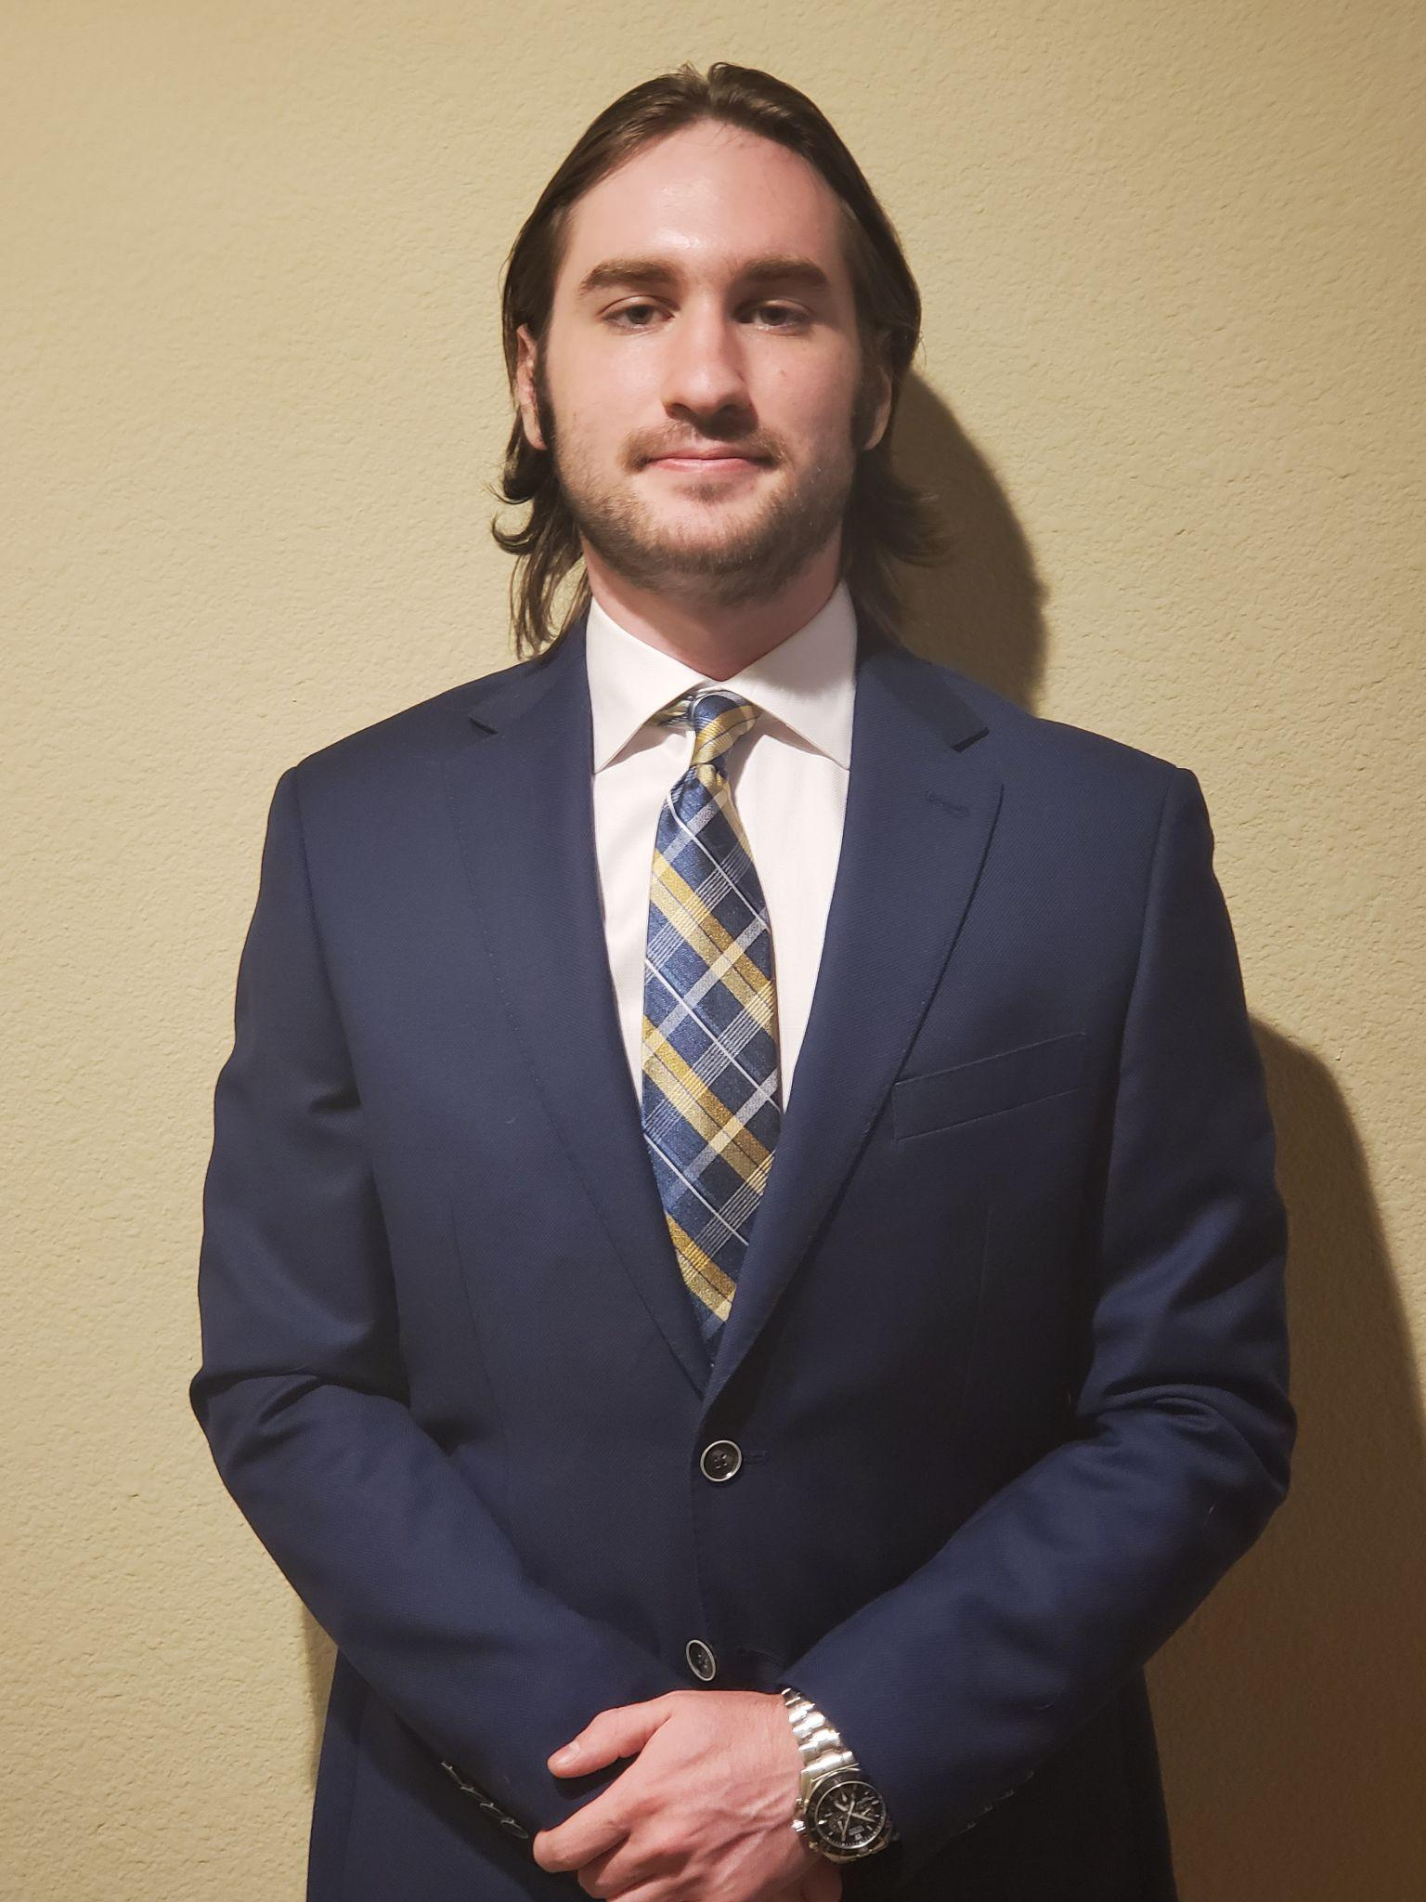

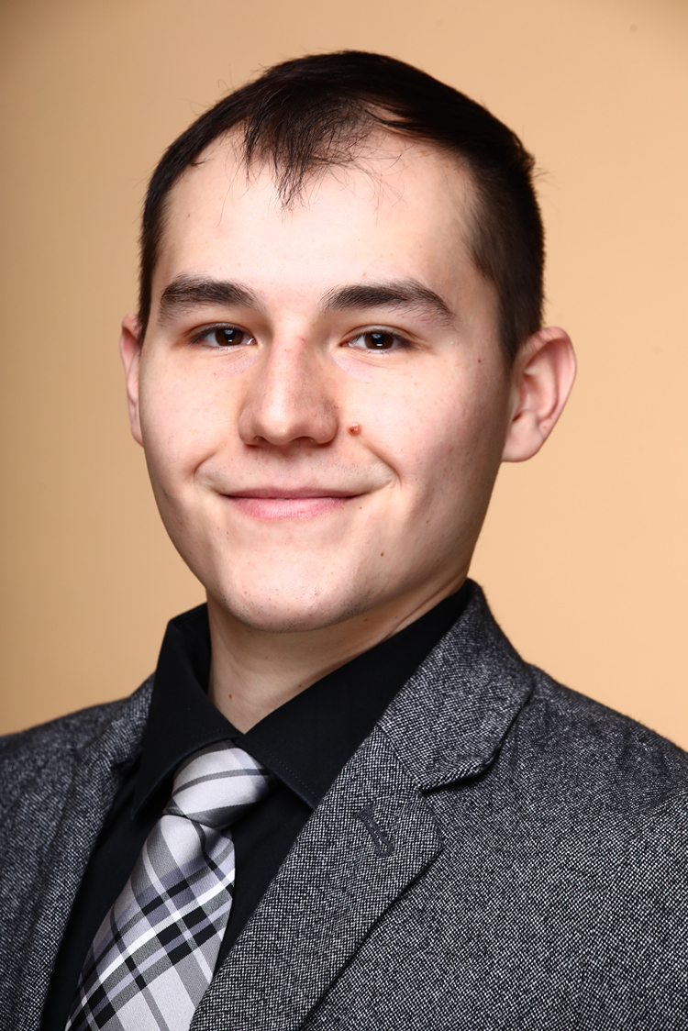
Meet the Team
Isaiah Allen
Team Lead
Computer Engineer
Networking Solutions
Ahmad Yakuba
Project Manager
Electrical Engineer
Power Distribution
Angel Randall
Engineering Partner
Mechanical Engineer
Heat Management
John Barrett
Scribe
Electrical Engineer
Hardware Solutions
Riley Mallett
Data Analyst
Electrical Engineer
Power Distribution
Michael Vidales
Engineering Partner
Mechanical Engineer
Environmental Architecture

Slide 3

This project is a collaborative effort between iMasons and PVAMU College of Engineering.
iMasons is a consortium of industry professionals with the mission of providing infrastructure executives and technical professionals an independent forum to connect, grow, and give back.
Members of iMasons come from partners such as Aligned Energy, Edgeconnex, Google, Switch, and many more.

Slide 4
About this Project?
The Project is Multidisciplinary between Electrical, Computer, and Mechanical Engineering students
Our team is responsible for the Electrical and Computer Engineering aspect of the project

Slide 5
Problem Statement
ACME Paint Company has developed a mobile app that allows their customers to apply different paint schemes to pictures they’ve taken, and purchase paint if they like the results.
The Chief Financial Officer (CFO) has began to question the expenses of the current colocation solution for their data center, due to the expected increase in market user demand.
The CFO wants to see if it would be more cost effective, as well as line up with their carbon neutral goal, for ACME Paint to repatriate and consolidate to a more flexible and sustainable wholesale partner.

Slide 6
Project Objective
The goal of this project is to develop a detailed budget proposal to build the digital infrastructure needed to meet the expected market demand. The design of the data center will take into consideration user experience, while also meeting the company’s environmental goals.

Slide 7
Marketing Requirements: | Engineering Requirements: | Justification:
Low Latency (50 milliseconds or less) | Place data centers in appropriate latency zones | Latency is a function of distance. Data center sites need to be within reasonable range of the user population
Receive and Transmit Data | Data center will source local fiber bandwidth to supply uninterrupted use | With enough user demand, sufficient bandwidth will be needed to supply
Can store user data | Data center will have necessary data storage infrastructure. (9 PB) | Each user needs to be able to store their photos in the “Cloud”, so our data center needs to have enough storage to handle the user data
Supply services to an estimated 60 million by 2024 (starting at 5 million in 2022) | A modular design that is capable of providing easy rollout of data center resources | The modular design simplifies the design process and allows for easy rollout of resources when and where they’re required
99.999% Uptime | Three identical, Tier-III data centers at different points across the U.S. able to back-up data to each other. | Using three smaller data centers with independent power and fiber systems increases reliability
100% Renewable energy by 2025 | Will buy power off of the grid then purchase renewable energy credits | Taking advantage of existing renewable energy resources decreases the cost of the data center

Slide 8
Assumptions:
The user growth data is true and constant
The users are within Wi-Fi or cellular data coverage
Internet Service Provider supplies the coverage it says it can
Constraints:
We cannot physically test the design
We do not have the resources to build the data center
No available software to simulate solutions

Slide 9
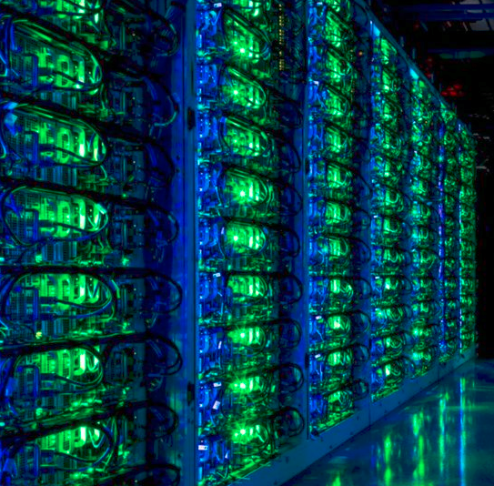
What is a Data Center?
Data Center - A space to house the computer and electrical systems needed to operate a certain workload.
Colocation (Colo) - A data center where space is leased out to multiple individuals or companies.

Slide 10
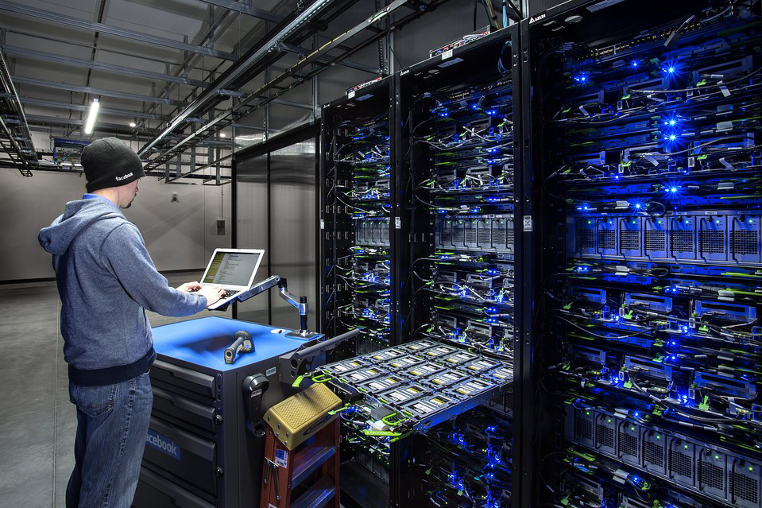
What Goes Into a Data Center
IT Hardware
Mechanical Hardware (Cooling Hardware)
Power Distribution Hardware
Location Planning
[Picture of Operational Data Center Here]

Slide 11
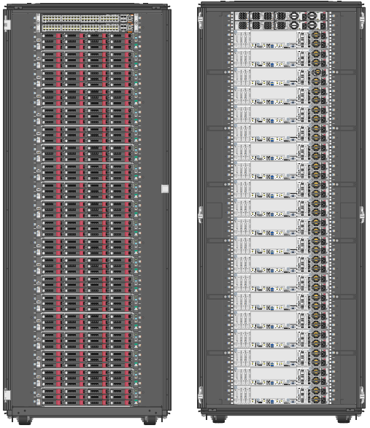
IT Hardware Solution
Using modular building blocks (Clusters) to simplify design and increase ease of implementation of data center resources
Doing so allows rollout of hardware to be done as user demand increases, as well as simplifying overall design requirements.
Notes:
Talk about the picture. Clusters of known components able to service 5 million people each. Rolling out these clusters when capacity needs to be added.

Slide 12
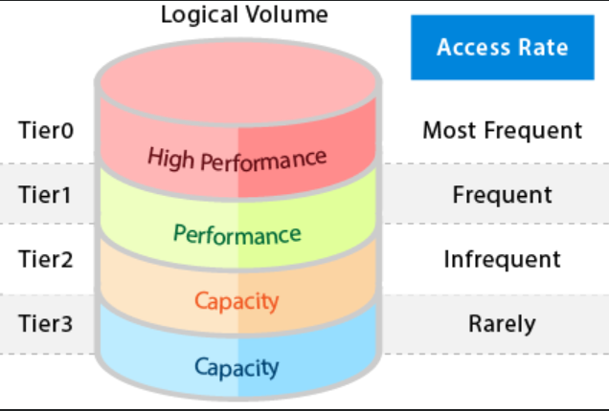
IT Hardware Solution Continued
Off the Shelf Components
(Speed, Ease of Implementation)
Tiered Storage
(2 Tier, Cost, Performance)
Qumulo & Erasure Coding
(Data Redundancy, Speed)
Notes:
Off the shelf helps with speed and ease of data center construction
Tiered storage- talk about cost savings vs all flash. 1st byte lag & cache miss penalty.
Qumulo & erasure coding- talk about how qumulo easily manages data quickly. Briefly explain Erasure coding and how it gives data redundancy. Talk about how Qumulo allows for intersite data backups which gives extra redundancy and allows for a full data center site failover.

Slide 13
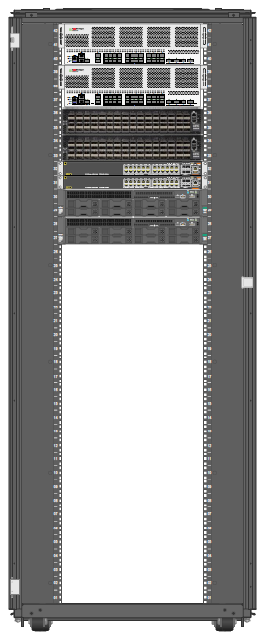
Networking Gear Cabinet

Slide 14
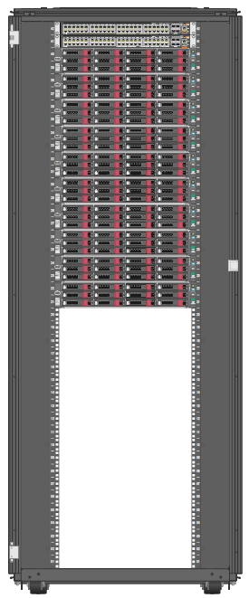
One Cluster Cabinet

Slide 15
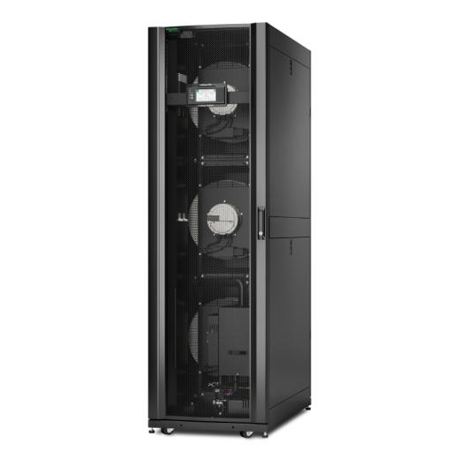
Cooling Solution
APC ACRC 600P
InRow Cooler
Operating Voltage of 200-240Vac
Power Consumed per Unit 14kW

Slide 16
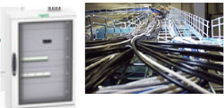
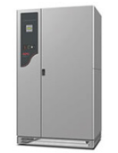
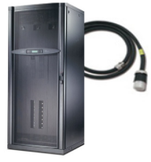
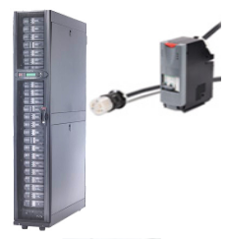
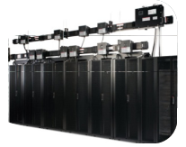
Power Distribution Solutions
Type | Picture | Pros | Cons | Selection
Panel Board |  | Low upfront cost Flexible installation Parts obtained very fast | Increased risk in human error No power monitoring Difficult to scale and upgrade Needs voltage transformation | X
Field-Wired |  | Power monitoring Low upfront cost Flexible installation Parts obtained very fast | Increased risk in human error Difficult to scale and upgrade Limited warranty Cables can impede cooling Takes up floor space | X
Factory Configured |  | Power monitoring Prefabricated components Flexible installation System level warranty | Difficult to scale and upgrade Parts are hard to source Cables can impede cooling Takes up floor space | X
Modular |  | Flexible installation Easy to scale and upgrade Plug and go performance System level warranty | High upfront cost Difficult cable management Cables can impede cooling Takes up floor space | X
Overhead Busway |  | Takes up zero floor space Flexible installation Easy to scale and upgrade Plug and go performance No cables | High upfront cost Constrained by ceiling height Row Busways can impede cooling | ✔

Slide 17
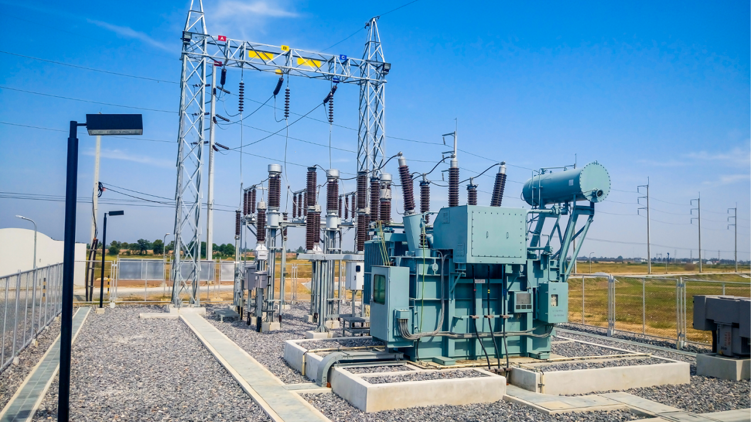
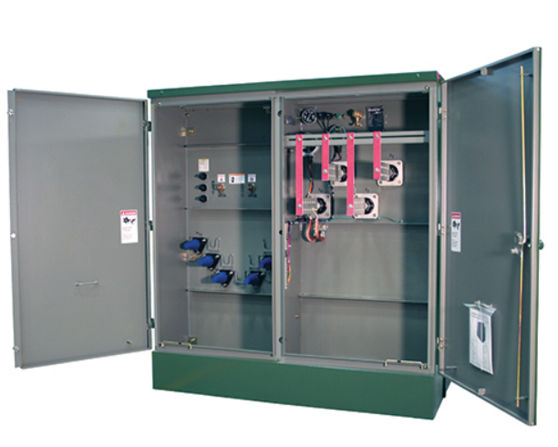
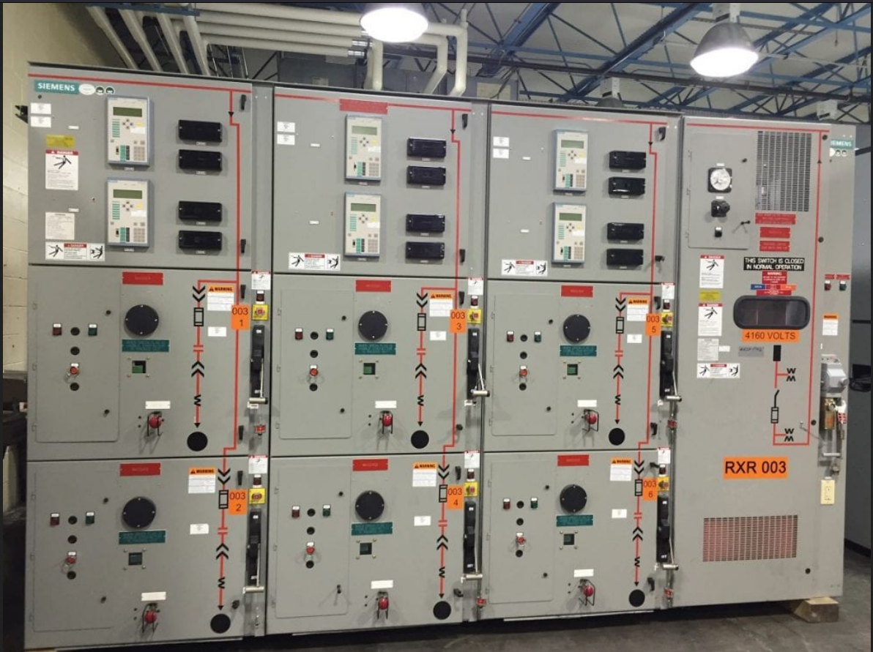
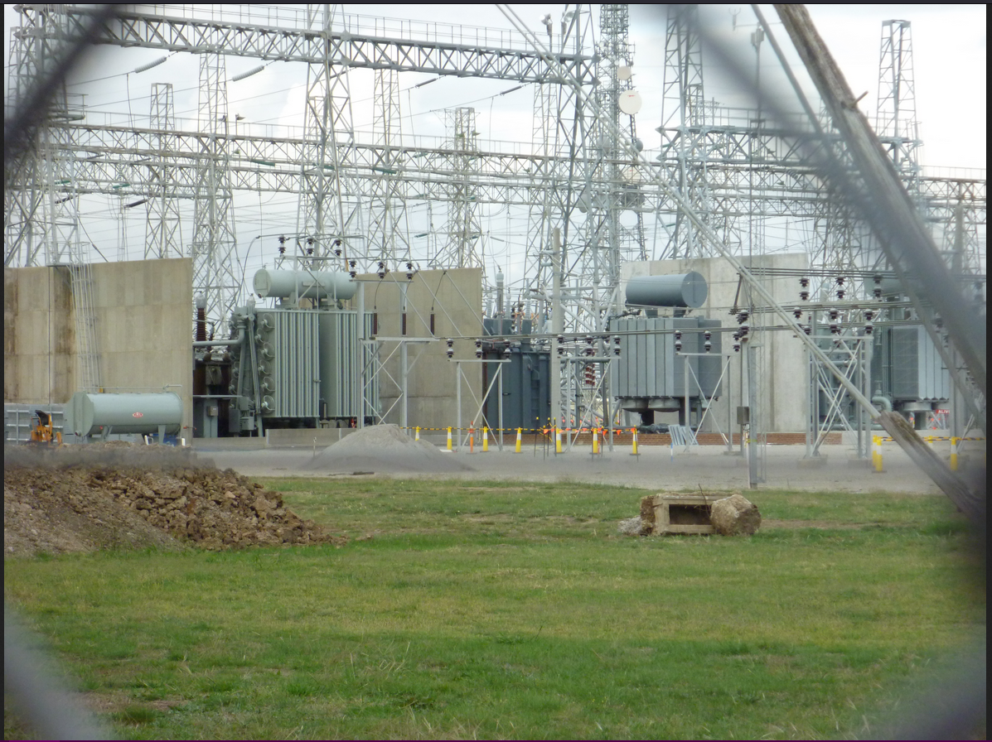
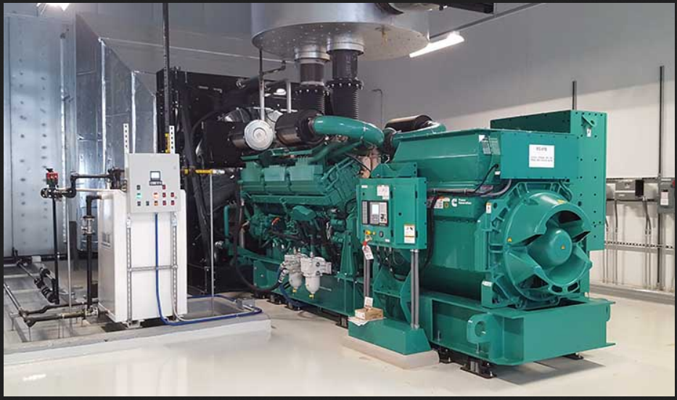
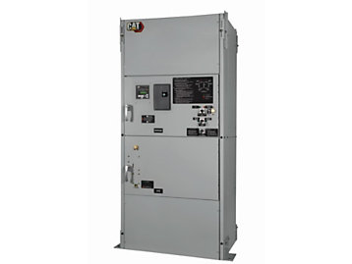
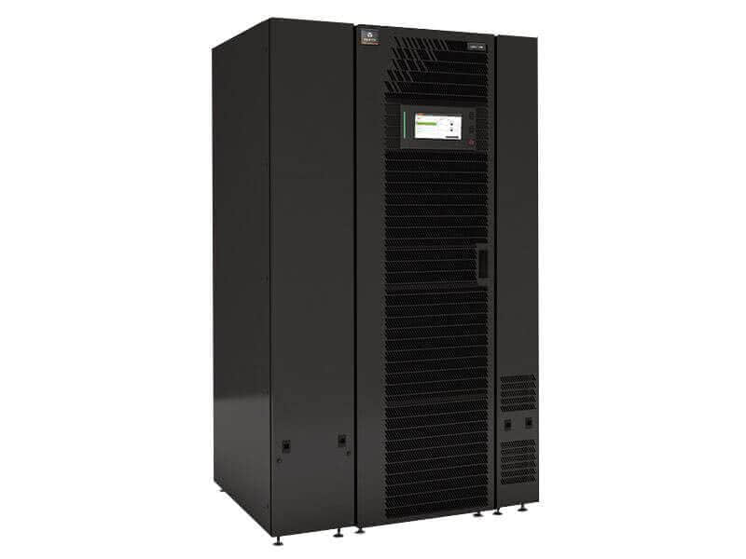
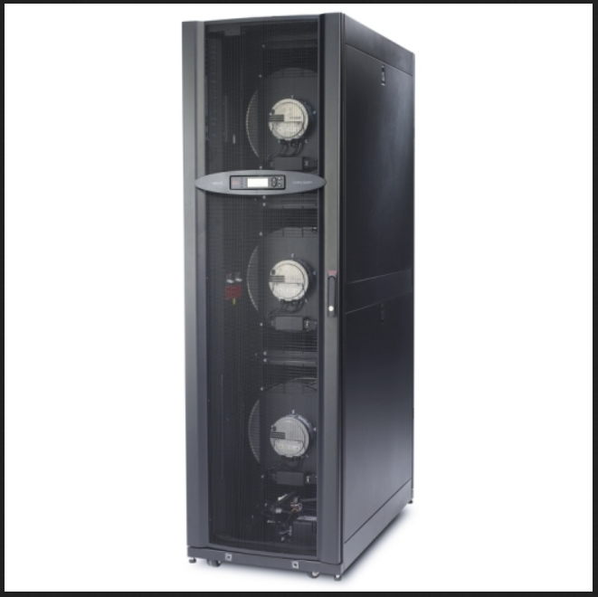
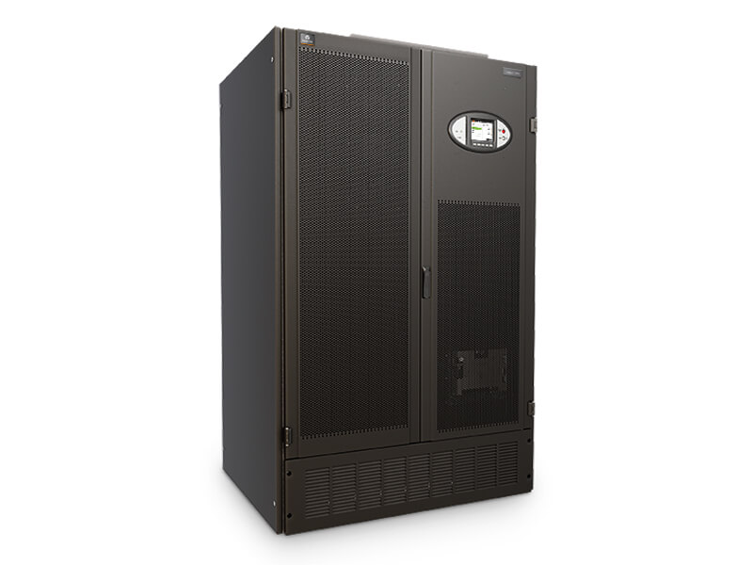
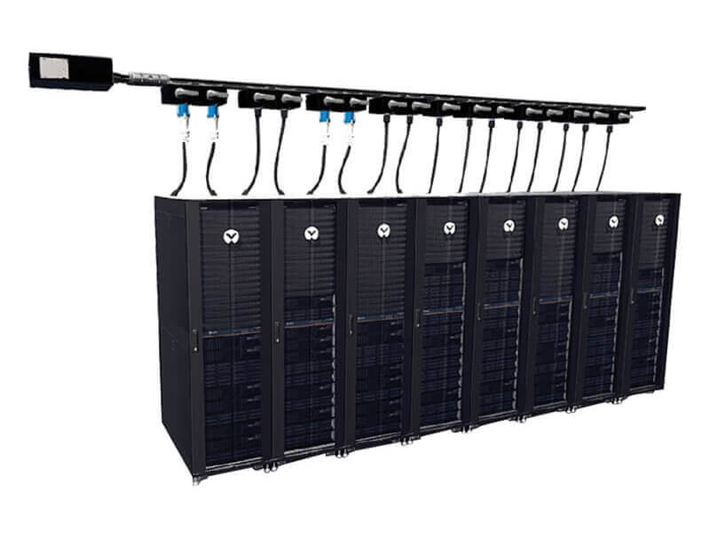
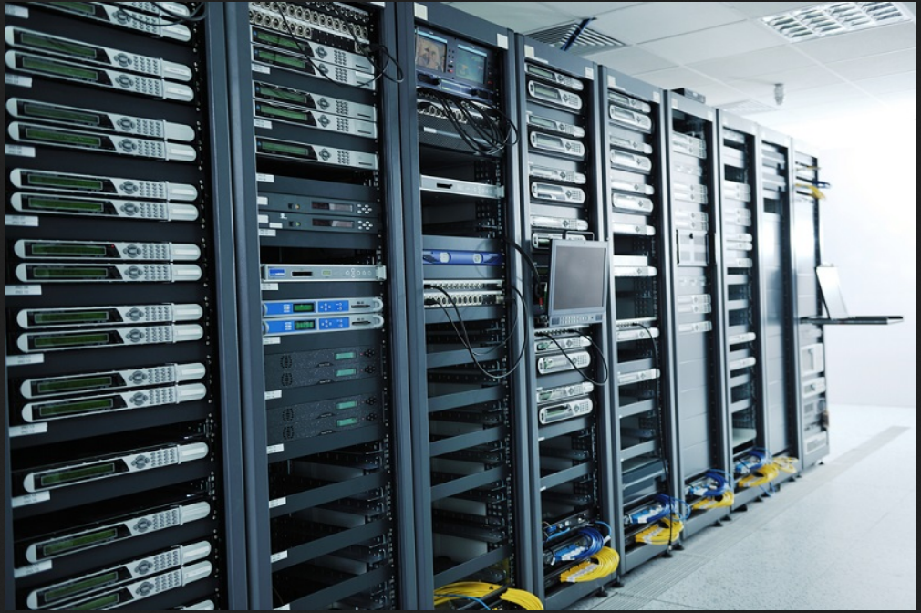
Redundant Power Distribution
Utility Power A
Transformer A
Main Switch Gear
Transformer B
Utility Power B
Back-Up Generator A
Automatic
Transfer
Switch
A
Automatic
Transfer
Switch
B
Back-Up Generator B
Uninterruptible Power Supply A
Mechanical Load
Uninterruptible Power Supply B
Power Distribution Unit A
Power Distribution Unit B
Overhead Busway A
Overhead Busway B
IT Load

Slide 18
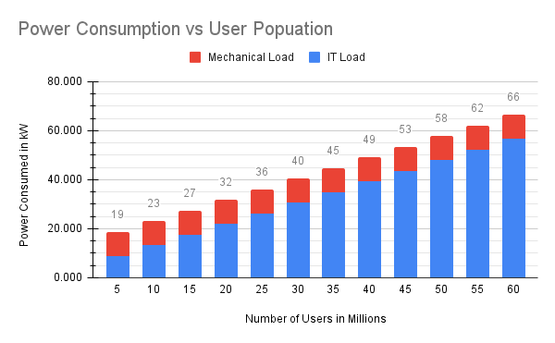
Power Consumption
The projected power consumption of the data center is the sum of power used by both the IT hardware and the Cooling hardware per 5 million users.

Slide 19
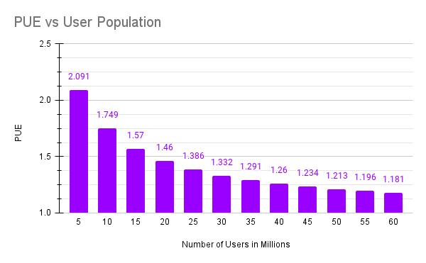
Power Usage Effectiveness
The projected Power Usage Effectiveness is the ratio of the total power consumed to the power used by IT hardware per 5 million users.

Slide 20
Location Slide
Stream Data Centers
Minneapolis
Dual Feed
Tier III
7- 8 cents per Kwh
More information
Switch
Atlanta
Dual Feed
Tier III
Estimated
5 -6 cents per Kwh
More Information
Digital Realty
Los Angeles
Dual Feed
Tier III
11 cents per Kwh
More Information
Notes:
Further Slides in Backup will go more in depth for location info

Slide 21
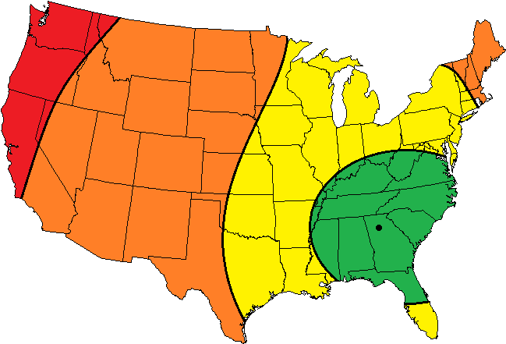
Atlanta Latency
Area Latency:
Green - 0 to 10ms
Yellow - 10 to 30ms
Orange - 30 to 50ms
Red - 50ms+

Slide 22
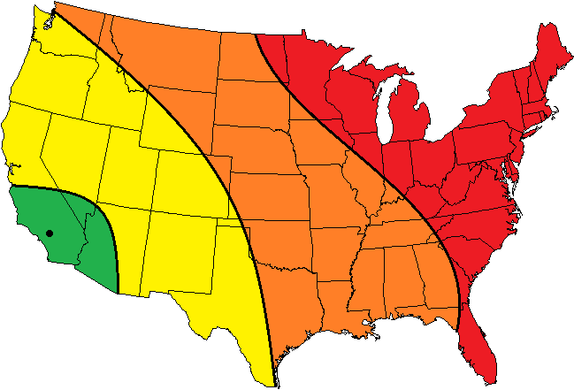
Los Angeles Latency
Area Latency:
Green - 0 to 10ms
Yellow - 10 to 30ms
Orange - 30 to 50ms
Red - 50ms+

Slide 23
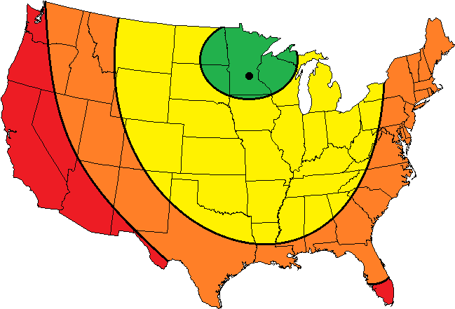
Minneapolis Latency
Area Latency:
Green - 0 to 10ms
Yellow - 10 to 30ms
Orange - 30 to 50ms
Red - 50ms+

Slide 24
Project Comparison
Data Center Type | Pros | Cons | Selection
Tier-1 | Cheapest Solution Available $11,500/kW of redundant UPS capacity | No redundancy 28.8 hours of downtime per year Maintenance | X
Tier-2 | Cheapest Data Center with Redundancy $12,500/kW of redundant UPS capacity | Minimal Redundancy 22.7 hours of downtime per year Maintenance | X
Tier-3 | More redundancy 15.8 hours of downtime per year | $23,000/kW of redundant UPS capacity Maintenance | ✔
Tier-4 | Most Redundancy 23 minutes of downtime per year | High cost $25,000/kW of redundant UPS capacity Maintenance | X

Slide 25
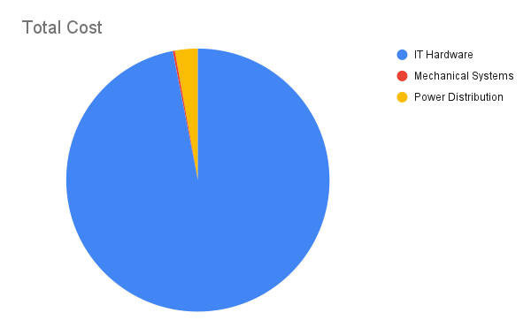
Capex Price Breakdown
Total Cost = $8.5M
IT Hardware = $8.2M
Mechanical = $22K
Power =$237.3K

Slide 26
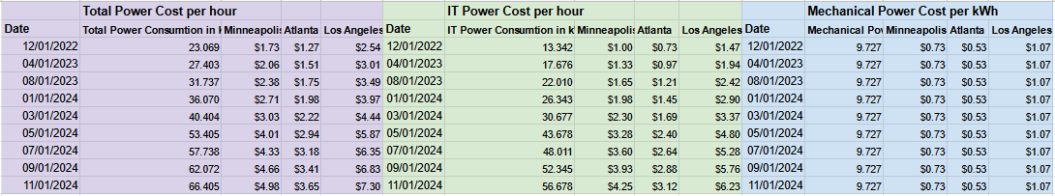
Opex Price Breakdown Power

Slide 27
Opex Price Breakdown (Colo Space)
Colo Rent - $202.55/kW
ISP links - $2.00/Mbps
DDoS protection- $13,896.09 yearly

Slide 28
Project Impact Summary
Category | Project Applicability
Public Health, Safety, and Welfare
Global
Cultural
Social
Environmental | ✔
Economical | ✔
Technical

Slide 29
Environmental Impact
Data centers account for 1% of global electricity demand
Up to 90% of electricity used by a Data center is wasted as heat
Data centers contribute to 0.3% of global CO₂ emissions
Our data center aims to use 100% renewable energy to avoid contributing to those statistics
Source:Forbes, Renewable Energy Alone Can’t Address Data Centers’ Adverse Environmental Impact, Asaf Ezra

Slide 30
Economical Impact
Cloud storage/colocation can be the economical solution for small companies (64% cost saving with colocation vs ownership)
Our data center will focus on the financial benefit of partnering with a wholesale provider.

Slide 31
Schedule
 | Aug |  |  |  | Sep |  |  |  | Oct |  |  |  | Nov |  |  |  | Dec |  |  |  | Jan |  |  |  | Feb |  |  |  | Mar |  |  |  | Apr
 | 1 | 2 | 3 | 4 | 1 | 2 | 3 | 4 | 1 | 2 | 3 | 4 | 1 | 2 | 3 | 4 | 1 | 2 | 3 | 4 | 1 | 2 | 3 | 4 | 1 | 2 | 3 | 4 | 1 | 2 | 3 | 4 | 1 | 2 | 3 | 4
Project Initiation
Planning
Site Selection
Research
Comparison
Data Center Design
Hardware Selection
Heat Management
Power Distribution
Networking Solution

Slide 32
References
R. Asceirto, "The disrupted datacenter: Cloud, colos could become their own electric micro-utilities," June 16 2017,
D. Bizo, "Global Prefabricated Modular Datacenter Forecast 2017-2021," July 2018, www.451reasearch.com
J. Koomey et al., "A Simple Model for Determining True Total Cost of Ownership for Data Centers,"
C. Synesael et al., "Livin' on the Edge, Part 1: Evolving Tomorrow's Internet," May 18 2020, www.cowen.com
Source:Forbes, Renewable Energy Alone Can’t Address Data Centers’ Adverse Environmental Impact, Asaf Ezra
Dobran, Bojana. “Demystifying Data Center Tier Ratings: Make an Educated Choice.” PhoenixNAP Blog, 16 Sept. 2021, https://phoenixnap.com/blog/data-center-tiers-classification

Slide 33
Codes and Standards
IEEE Policies, Section 7 - Professional Activities - Code of Ethics
ANSI /IEEE Standard C37.2 Standard for Electrical Power System Device Function Numbers, Acronyms, and Contact Designations
TUI3026E - Uptime Institute Tier Standards
ANSI/BICSI 002-2014 - Data Center Design and Best Practices
ANSI/TIA 942-A 2014 - Telecommunications Infrastructure Standard for Data Centers

Slide 34
Any Questions
?

Slide 35
Backup Slides

Slide 36
Engineering Design Process
Idea
Concept
Planning
Design
Identify the parts of the problem.
(IT, Cooling, Power, Location)
Requirements
Constraints
Assumptions
Define Objectives & Dependencies
Create Schedule
Prototypes
Validation

Slide 37
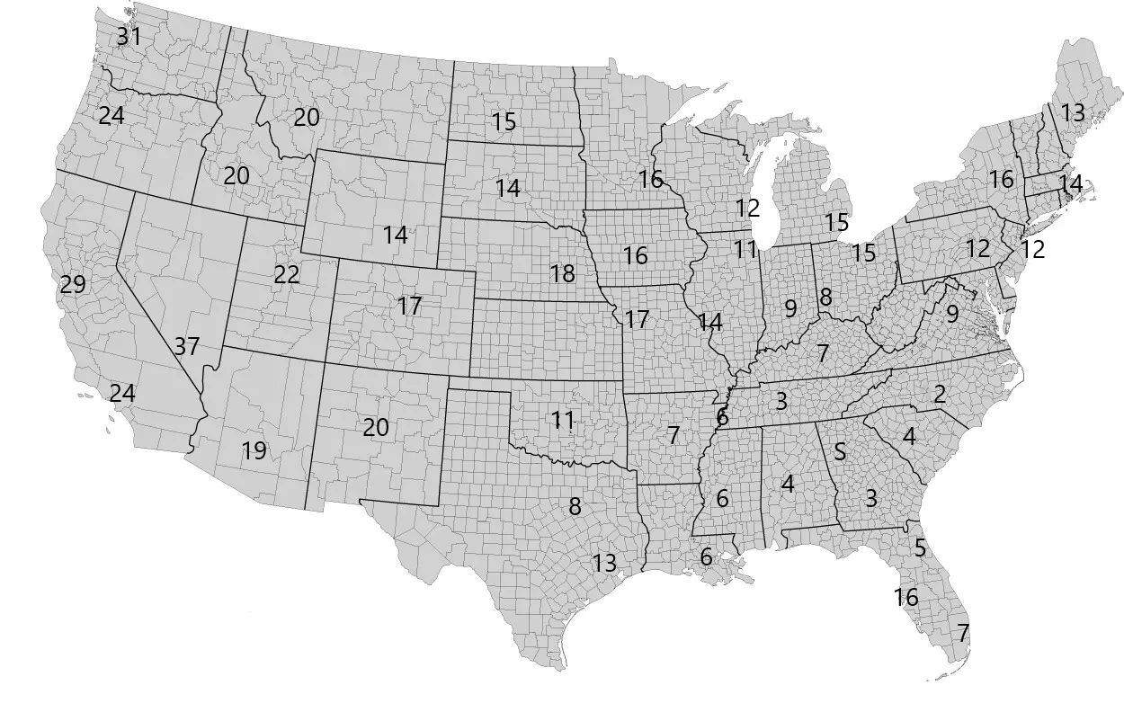
Atlanta Latency in depth

Slide 38
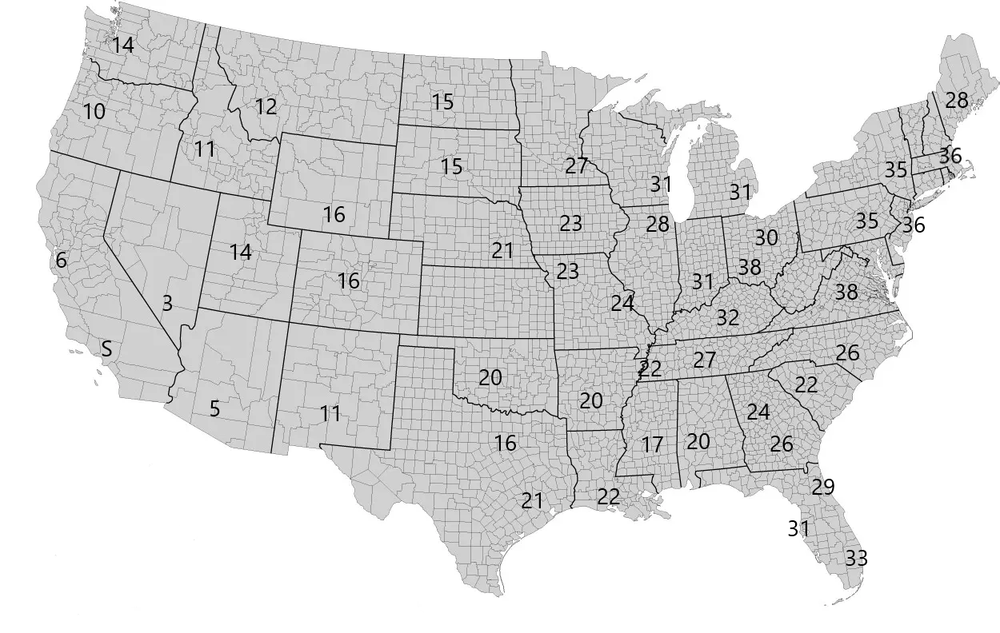
Los Angeles Latency in depth

Slide 39

Minneapolis Latency in depth

Slide 40
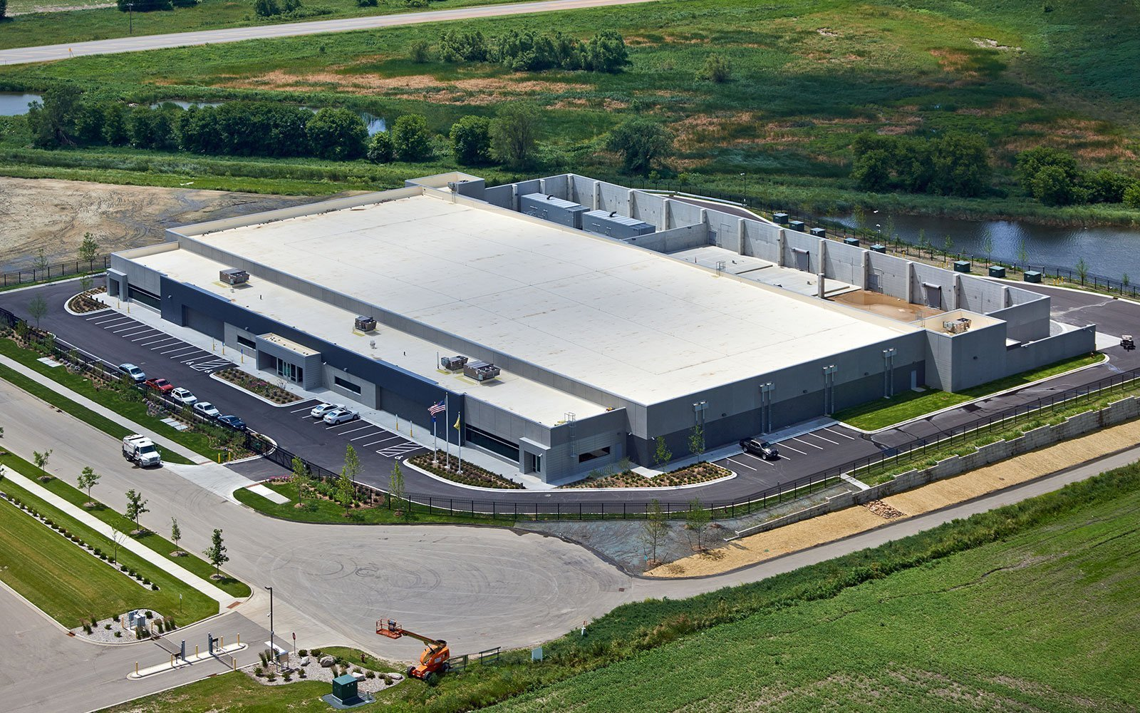
Stream Minneapolis
Tier 3 Data Center with estimated 8 cents/Kwh
ISP providers will be Comcast and Centurylink
Renewable energy options

Slide 41
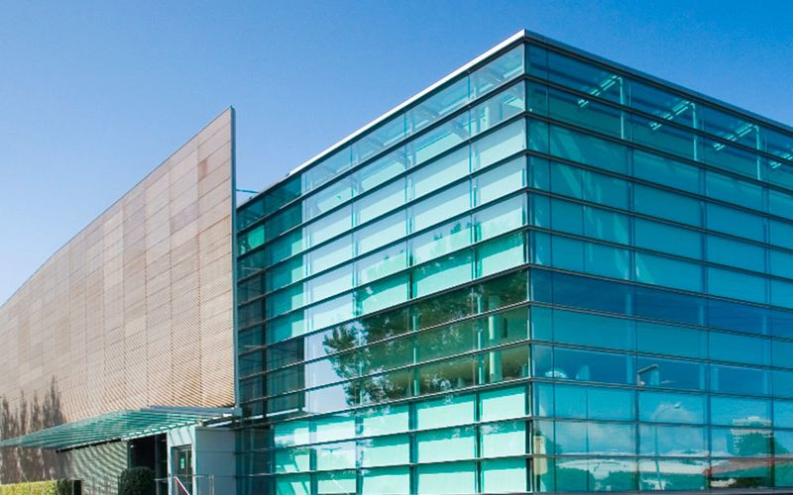
Digital Realty Los Angeles
Tier 3 Data Center with estimated 11 cents/Kwh
ISP providers will be Cogent Communications and AT&T
Energy Star Certified

Slide 42
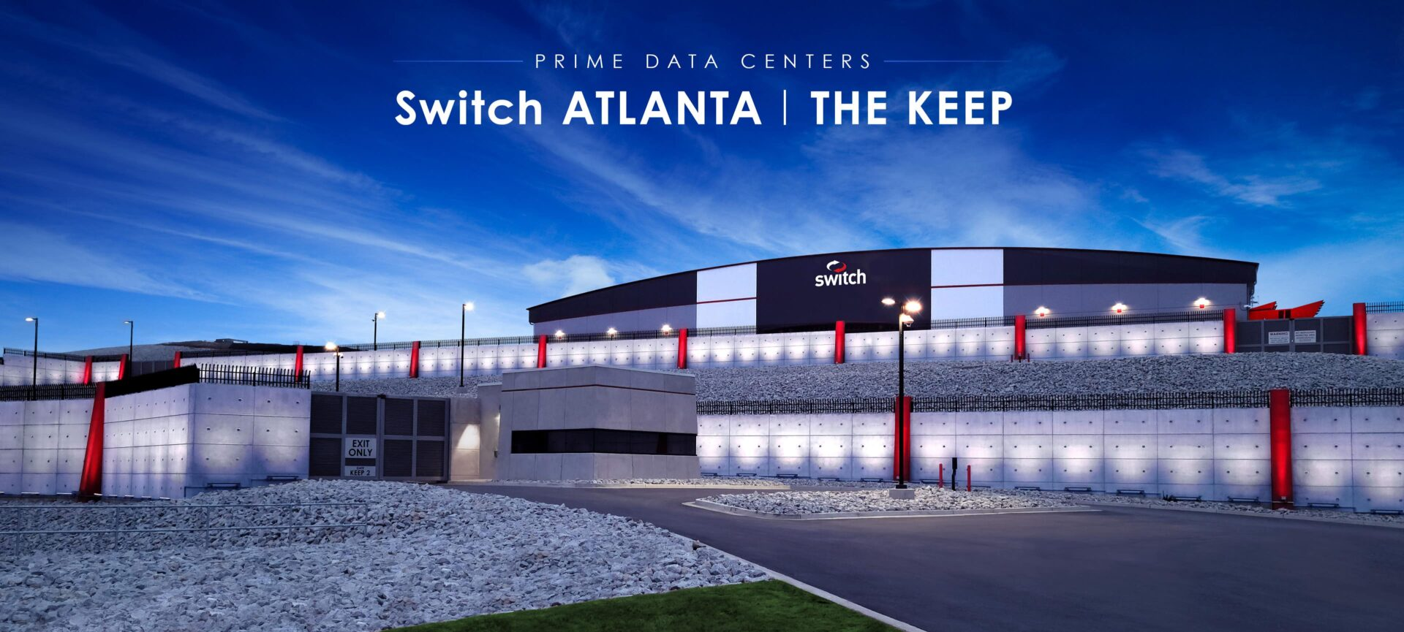
Switch Atlanta
Tier 3 Data Center with estimated 6 cents/Kwh
ISP providers will be Comcast and AT&T with links
100% Green Energy

Slide 43
IT Hardware Selection
Cluster Nodes: HPE Apollo 4200 Gen 10 Node for Qumulo
Out of Band Switch: Aruba 6300F 48-port Switch & Aruba 6300F 24-port Switch
Cluster Switch: HPE SN4600cM Switch
In Rack PDU: Vertive VP8965
Cluster Management Software: Qumulo
Database: HPE Dl380 configured for data storage
Firewall: Fortigate 6500F

Slide 44
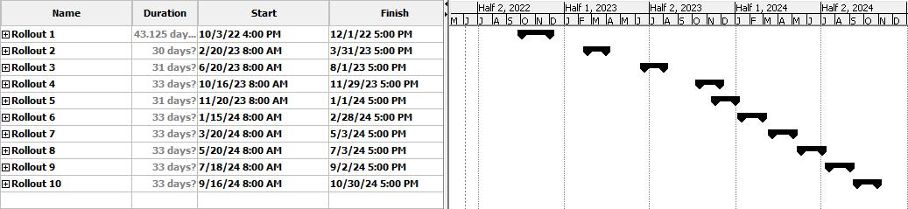
Hardware Implementation Schedule

Slide 45
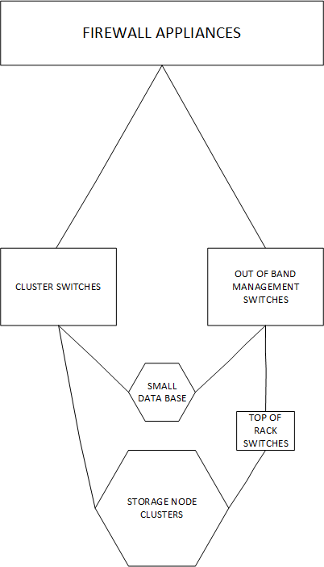
Network Diagram

Slide 46
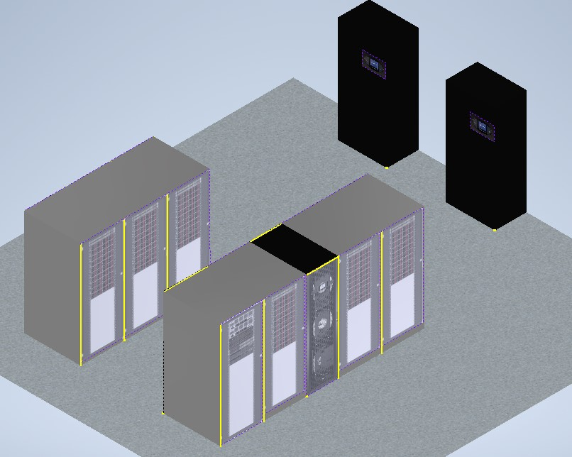
Footprint

Slide 47
Power Distribution Hardware
Row PDU: Vertiv Powerbar iMPB
Room PDU: Vertiv Liebert FPC 15-125kVA
UPS: Vertiv Liebert EXM 480V
ATS: CAT Bypass Isolation Contactor Type ATS

Slide 48
Problem Statement & Mission
Problem Statement:
ACME paint needs to find a more cost effective solution to handle the expanding needs of their smartphone application. Expecting to grow from 5M users to 60M users over 3 years.
Mission Statement:
To create a detailed budget report to build a data center (hardware, power, and cooling systems) that meets the needs of the application. As well as an operational budget to operate the data center.

Slide 49
Proposed Deliverables
Hardware: Create a hardware design to handle the computation and storage workload for the application.
Power: Create a power distribution solution to provide power to both the hardware and the HVAC components.
Cooling: Create an efficient cooling solution that will adequately cool the hardware.
Networking: Create a network diagram that takes into consideration both geolocation and bandwidth needs.
Budget: Both Capex and Opex budgets need to be created for this project.

Slide 50
Requirements & Constraints
Customer Requirements:
50 milliseconds or less of latency to the whole U.S.
Users can store photos and color schemes on the app (In our data center).
99.999% uptime.
100% renewable energy by 2025.
Must be located within the United States.
Constraints:
Some pricing is hard to obtain due to not being published.
Equipment is too costly to buy for use of testing, so this project is a paper design only.

Slide 51
Benefits:
Environmental: By running the data center on 100% renewable resources, it will not contribute to carbon emissions.
Economical: By standardizing data center resources, implementing a timed rollout of equipment is easier, and leads to upfront capital savings, as well as decreased operational costs.
Technical: By strategically locating our data centers across the country we can improve latency and increase the whole systems robustness to any one data center failure.

Slide 52
Recommendation & Conclusion
Recommendation:
Standardize the data center hardware into blocks based on serviceable customers.
Use off the shelf hardware in order to save on time to implementation and obtain support from the hardware producers.
Place one data center on the west coast, one in the midwest, and one on the east coast in order to service the whole United States.
Conclusion:
Doing all of these things will increase the ease with which the data centers can be assembled, as well as the speed with which they can be put together. By placing them strategically across the United States the robustness of the data center system is increased against any one failure.

