Slide 1
Smart Threat Detection System
Team 5:
Joshua Littleton
Tri’Heem Neville
Arthur Quinney
Xavier Dukes
Christopher Rollerson
Faculty Sponsor:
Dr. Dong
Course Facilitators:
V. Turner
Dr. Musa

Slide 2





Prairie View A&M University
Roy G. Perry College of Engineering
Joshua Littleton
Tri’Heem Neville
Arthur Quinney
Christopher Rollerson
Xavier Dukes
Team Leader
E.E.
Scribe
C.E.
Parts Procurement Lead
C.E.
Design Analysis Lead
E.E.
Software Developer
C.E.

Slide 3
https://www.youtube.com/watch?v=9oVsooG3aP8

Slide 4
INTRODUCTION
On average, approximately 4,800 burglaries happen every day. One-third of all robberies result in injury and 39% of the time a weapon is present when an individual is harmed. Arrest rates for Weapon offense have doubled since 1965 including, unlawful possession and trespassing.
Problem Statement
The goal of this project is to design an intelligent monitoring system that will enhance our ability to survey public and private spaces by using object detection to identify various threats that could potentially lead to possible security risks and/or bodily harm.
Objective
Target Audience
Small businesses, Homeowners, Hospitals, Schools/Universities, and Churches

Slide 5
Proposed Deliverables
We will be using a Raspberry Pi attached with a camera to survey the area and identify potential threats
The machine learning (ML) algorithm we implement detects the threatening objects on an individual such as weapons in real time
Once an object defined as a threat is detected, a text notification is sent to the owner/operator’s phone allowing them to determine the course of action

Slide 6
MATRIX
Marketing Requirements | Engineering Requirements | Justification
Mass Producible | Easily obtainable and cost effective parts | Target audience is small businesses, homeowners, hospitals, schools/universities, and churches
Mountable/Lightweight | Lightweight parts sturdy enough to be mounted for long periods | Will be placed in conventional security camera locations
Detect a variety of potential threats | Train machine learning (M.L.) algorithm for weapon detection | Threats come in various forms, and this is an abstract problem with no clear formula. Requiring the flexibility of Artificial Intelligence
Detect potential threats at a distance | Camera has minimum resolution of 1080p | Poor resolution images are more difficult to decipher and can cause inaccuracies
Alert Notification System | Send an alert through a text message | Alerts the home/business owner of the potential threat near the camera
Distinguishable between threat and no threat | M.L. model will be trained to detect items deemed as threats | Camera’s tracking will not focus on low risk individuals and will dismiss them
Real Time Tracking | Use Raspberry Pi for its real time clock (RTC) capabilities | Raspberry Pi utilizes RTC which is essential for real time environments
6

Slide 7
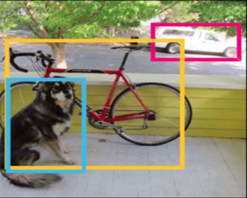
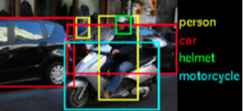
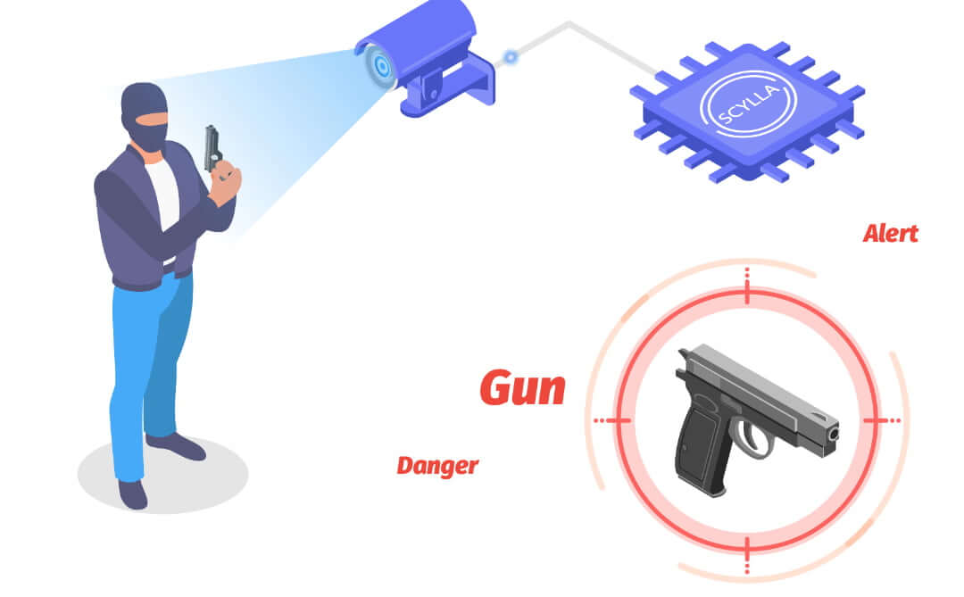
Object Detection
Object detection is the process of detecting instances of visual objects with a certain class (such as airplane, car, or animal) in digital images.
Object detection on edge devices to
identify various threats

Slide 8
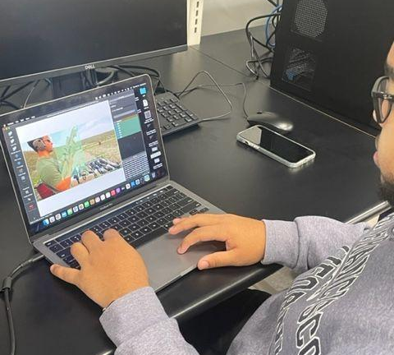
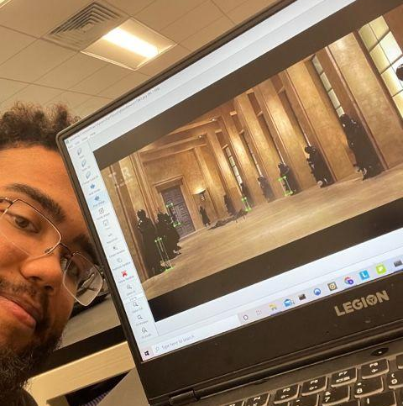
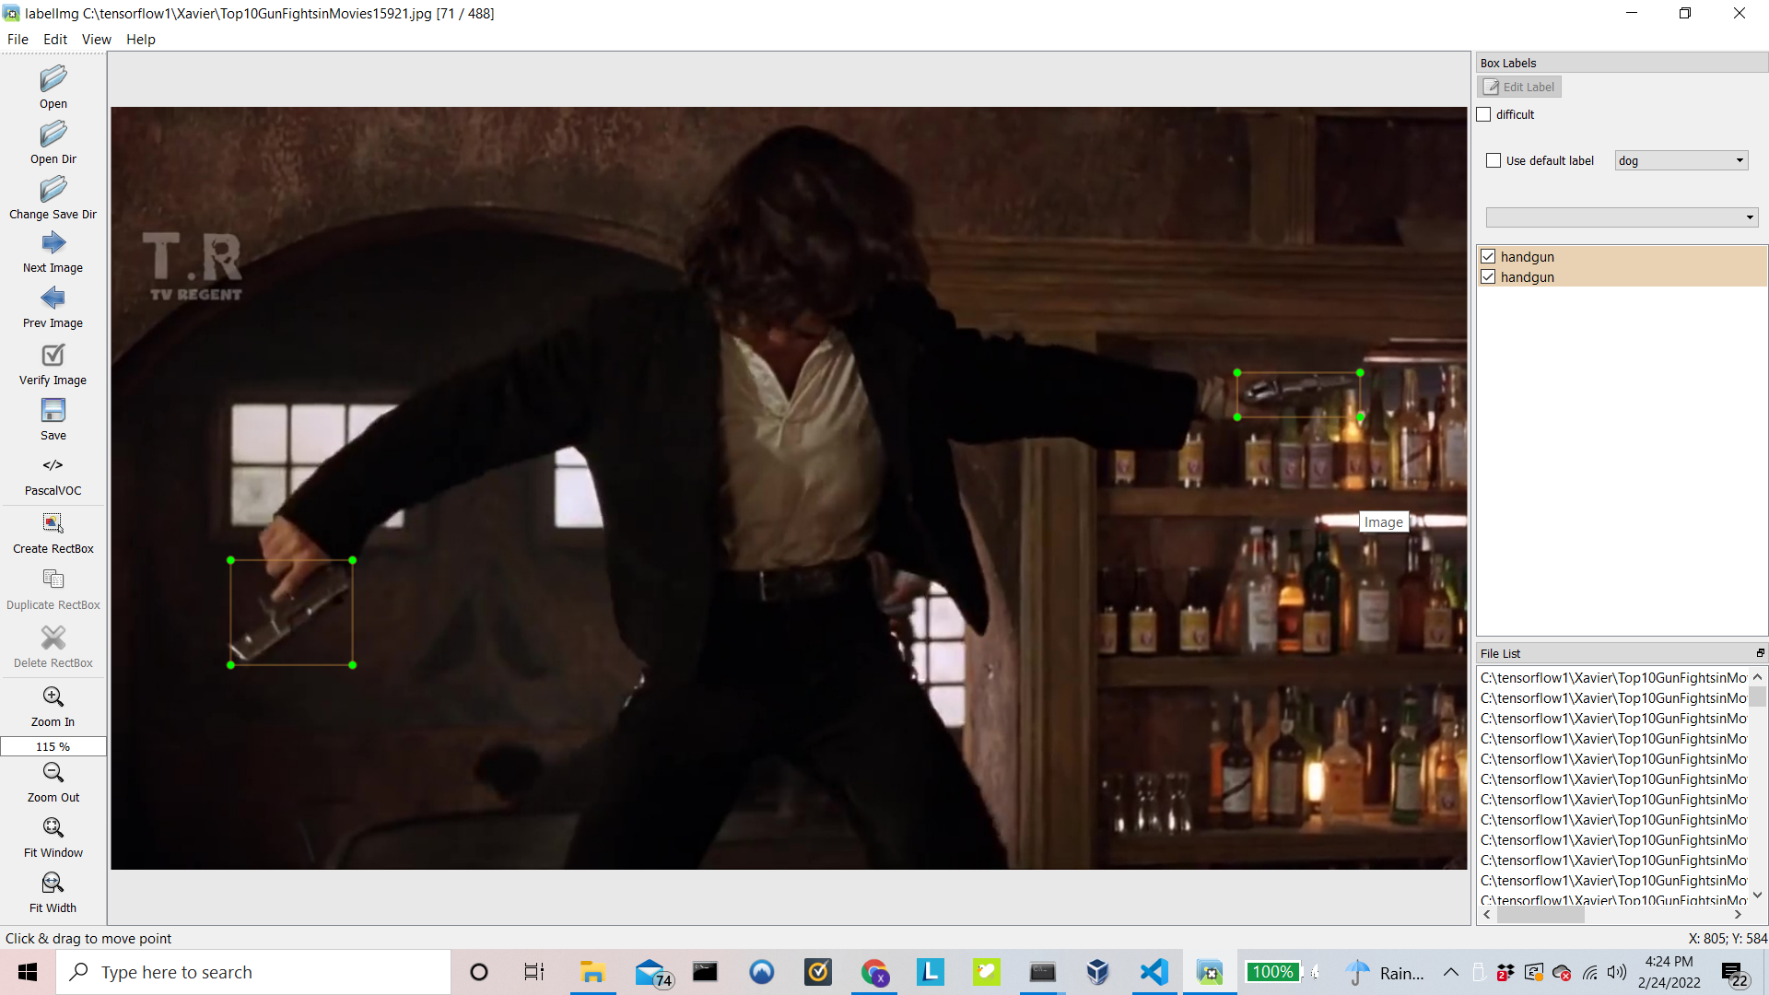
Labeling
Labeling is used to train our machine learning model to accurately detect weapons.
LabelImg is software used
5000+ images labeled
8

Slide 9
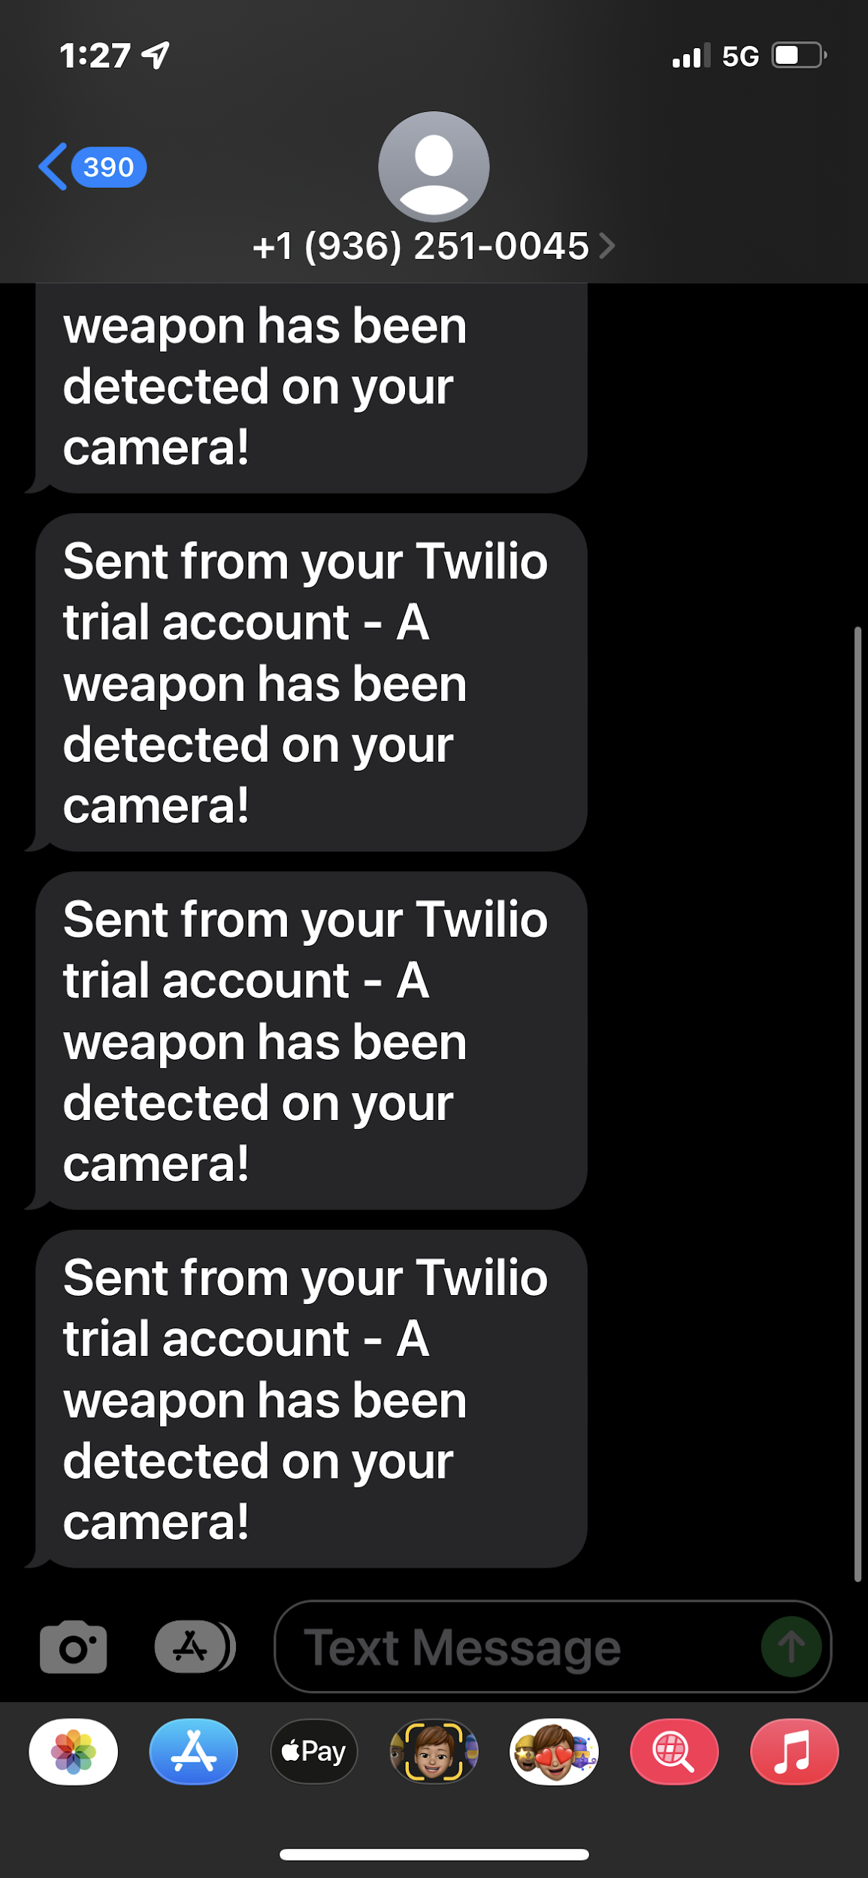
Text Notifications
SMS messages sent via Twilio
Automatically sends message upon detection
Can be sent to any number of people
9

Slide 10

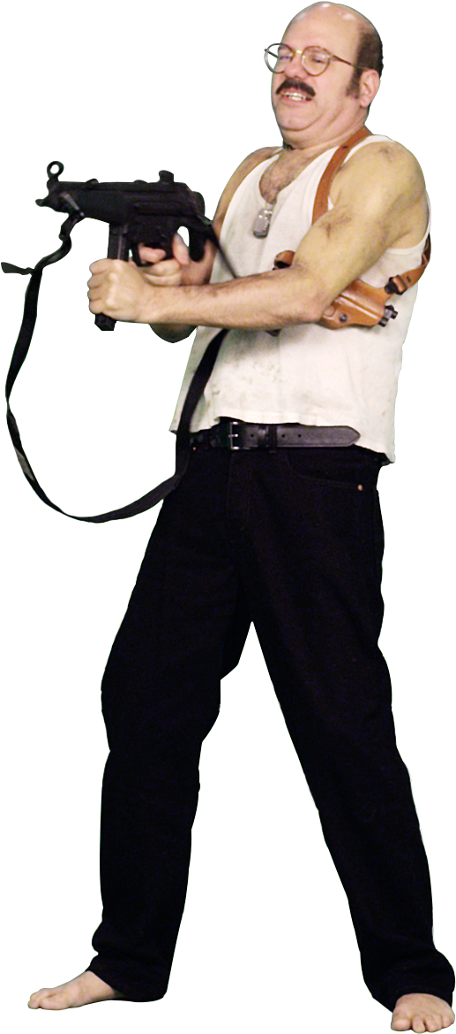
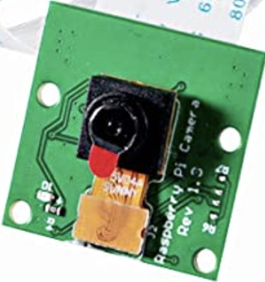

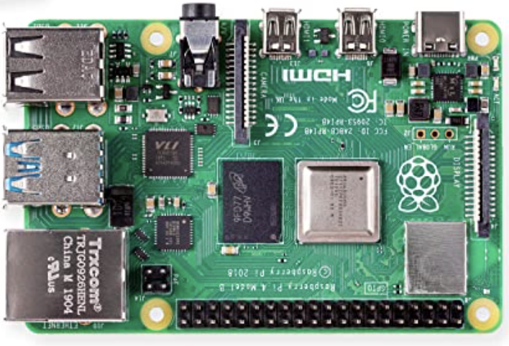
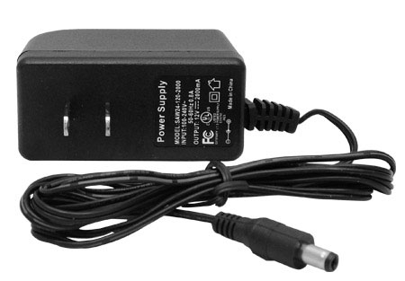

Preliminary Design Concept
120V AC
5 Megapixel 1080p Camera
Threat
Non-Threat
Text
Notification
3 A Power Adapter
Raspberry Pi 4
Internet Connection

Slide 11
Software Flowchart
Start
No
Is it a Weapon?
Camera Input Data
Process Video
Image Acquisition
Image Recognition
Yes
Send a Notification
End

Slide 12
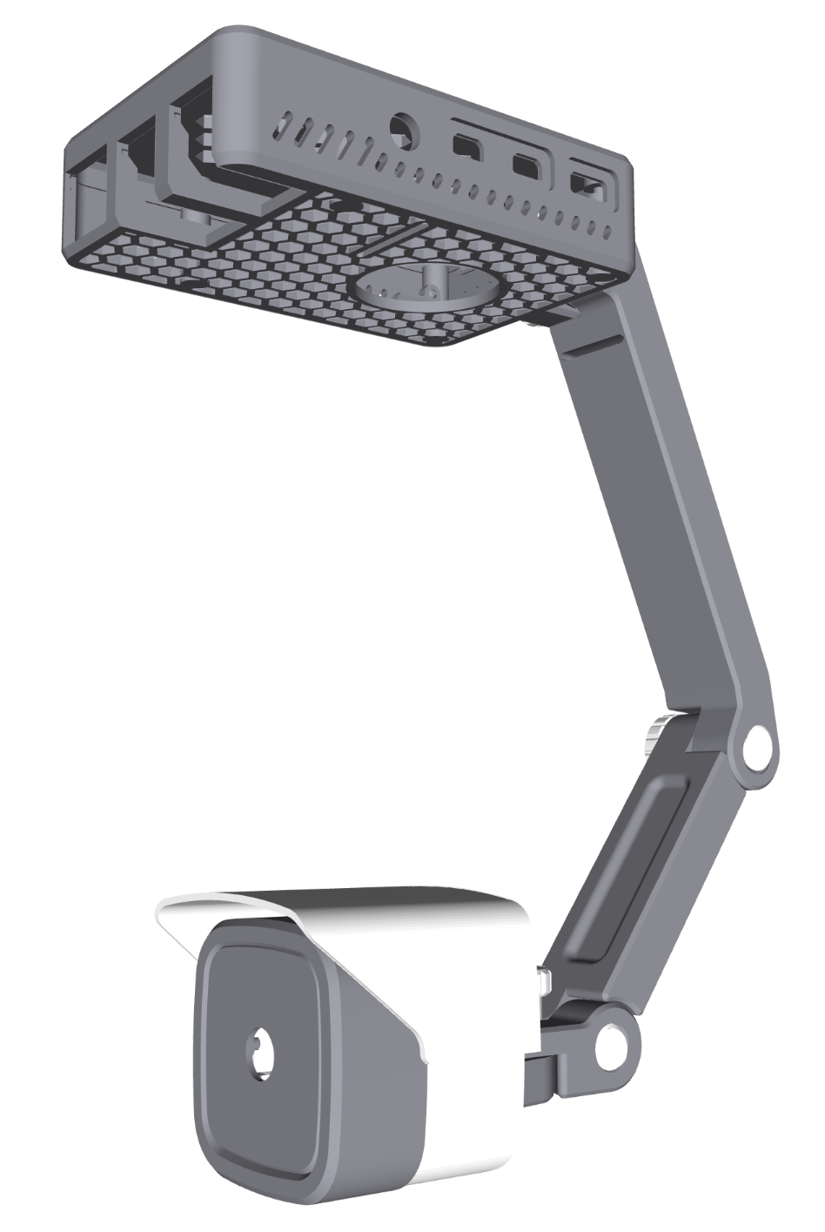
Housing Design
3D Printed
Material: Polylactic Acid (PLA)
Biodegradable
Withstands forces exceeding 130 Newtons

Slide 13
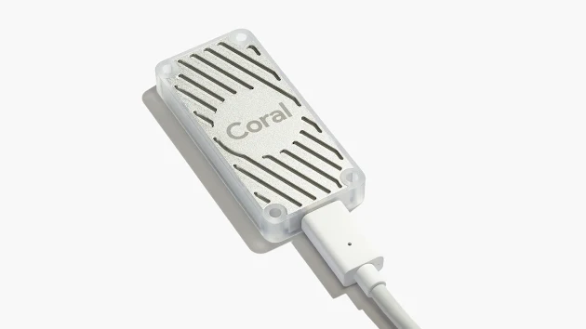
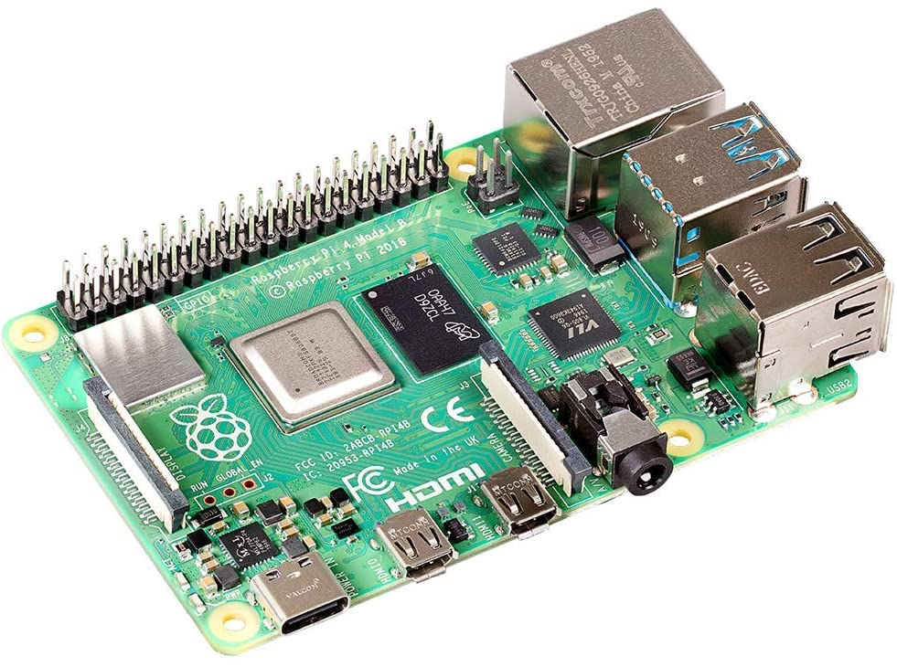
Frame Rate Troubleshooting
Why it matters:
Real Time detection difficult with minimal frames
Edge devices reduce latency
→ brings data storage closer to data source
Affects Twilio alert times as it works via counter of frames with weapon
How to fix:
Implementation of Coral USB accelerator
TFlite → lightweight version of TensorFlow for small mobile devices
Quantization
Hardware Improvements

Slide 14
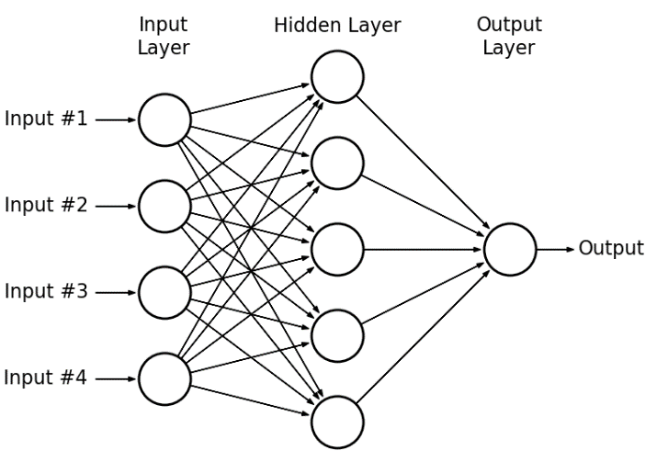
Model
SSD MobileNet V2 Quantized
  Trained on COCO google dataset
single-stage object detection model
straight from image pixels to bounding box coordinates and class probabilities
TFlite compatible & quantizable → optimized for mobile devices
  EX: 2D convolution layer (e.g. spatial convolution over images) → produce a tensor of outputs

Slide 15
Quantization of Model:
Tensor Flow
Model
Relation to edge Devices
Quantization is the process of constraining an input
The quantized models use lower-precision 8-bit inputs
8-bit quantization approximates floating point values
Real_value = (int8_value - zeropoint) x scale
TFlite only supports certain ops each with restrictions to how quantization can be applied
per tensor vs per axis
Needed for Edge TPU coral device and faster frame rate
TF Lite
Model
Quantized

Slide 16
Project Impact Summary
Category | Project Applicability
Public Health, Safety, and Welfare
Global
Cultural
Social
Environmental
Economic Factors
Technical

Slide 17
Societal Impact
Open and constitutional carry in several states could be impacted by this technology
Home and business owners will have greater security due to the threat detection services
30% of U.S. households have home security our system would grant greater security

Slide 18
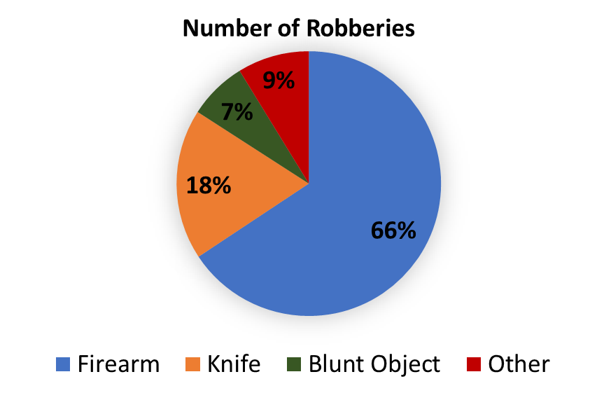
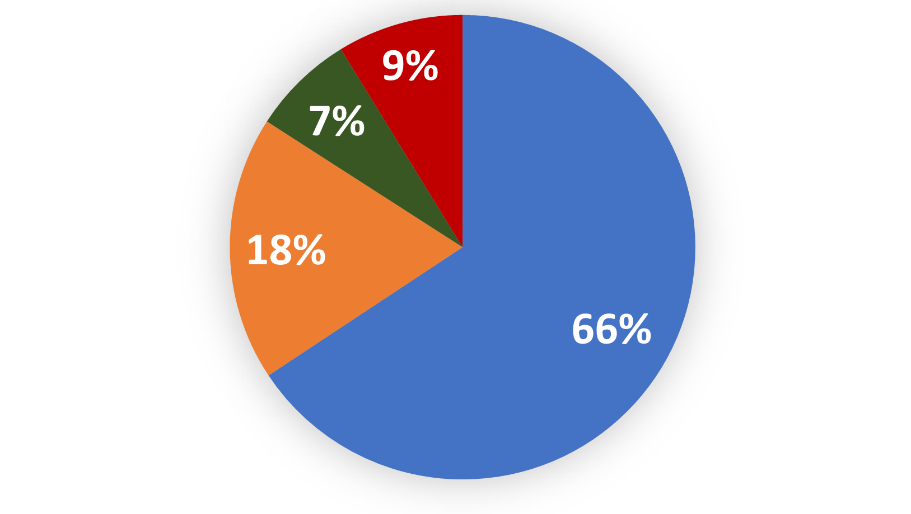
Safety Impact
Our project impacts the safety of home and businesses, by identifying potential threats and alerting the owner to prevent injury.
In 2019, there were ~1,117,696 burglaries in the United States. 62.8% residential properties and 37.2% businesses.
124,381 robberies involved weapons. 66% involved a firearm; 34% involved a knife or some other weapon.
Someone is present at home 27.6% of the time when a burglary is taking place, 7.2% of these burglaries result in injury.
18

Slide 19
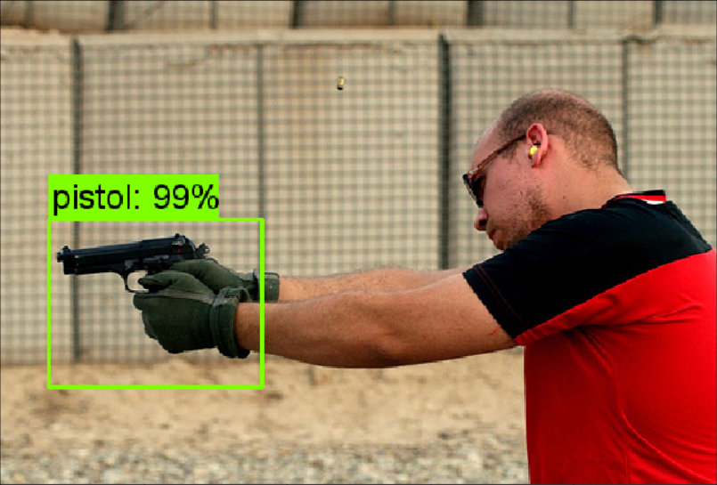
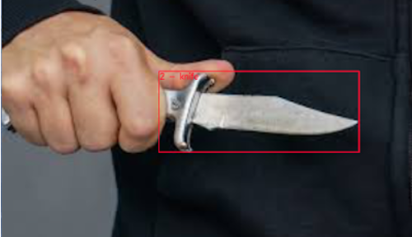
Technical Impact
Utilizes M.L. algorithms in order for the smart detection of weapons
Real time weapon detection has never before been implemented in conventional home and small business security systems
The weapon detection allows for the security system to be more proactive rather than reactive
Video analytic technology enables the security software to learn
knife: 98%

Slide 20
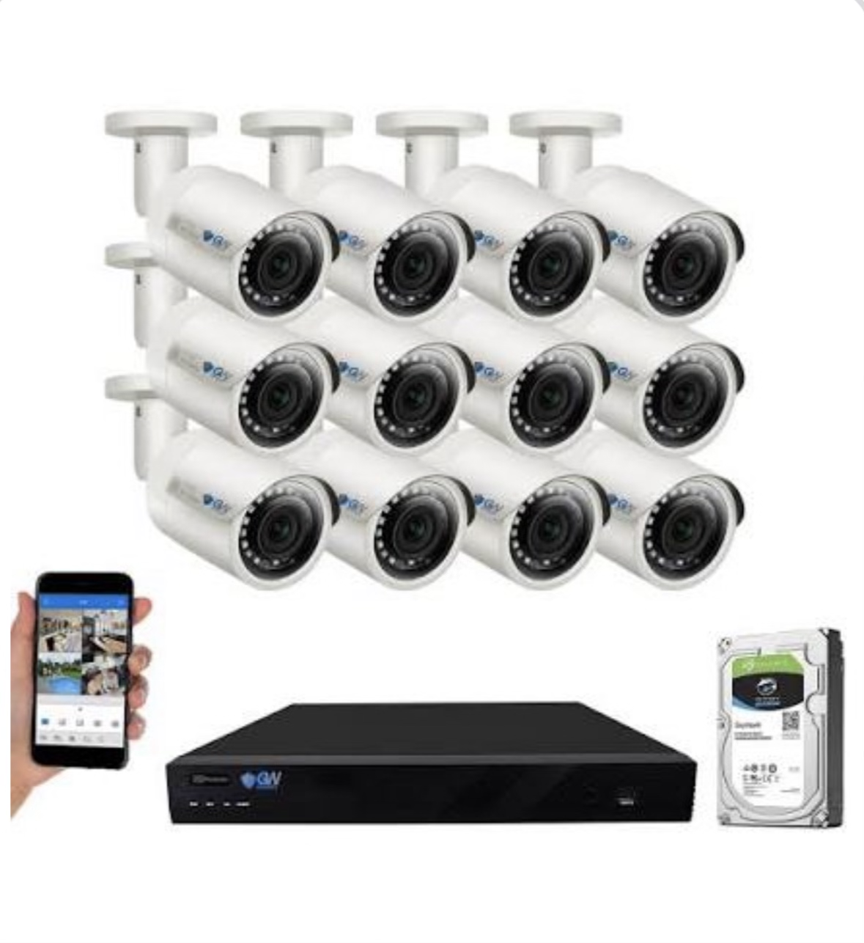
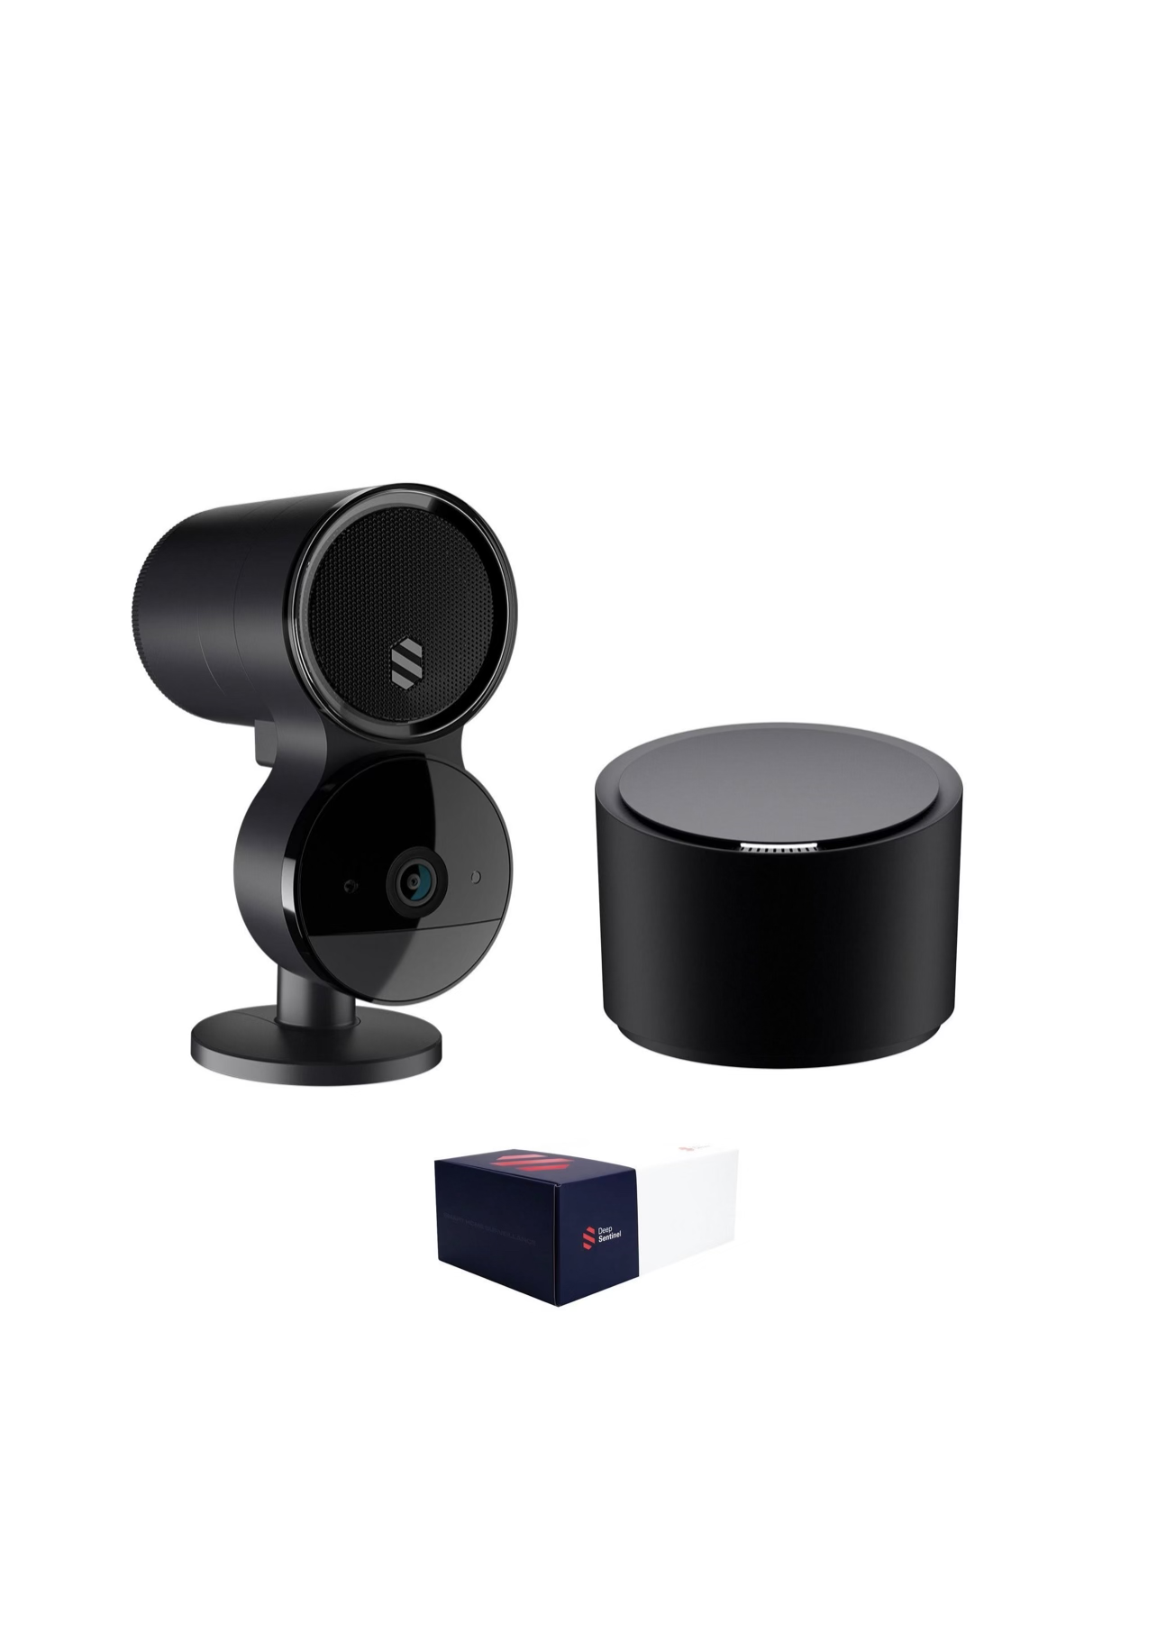
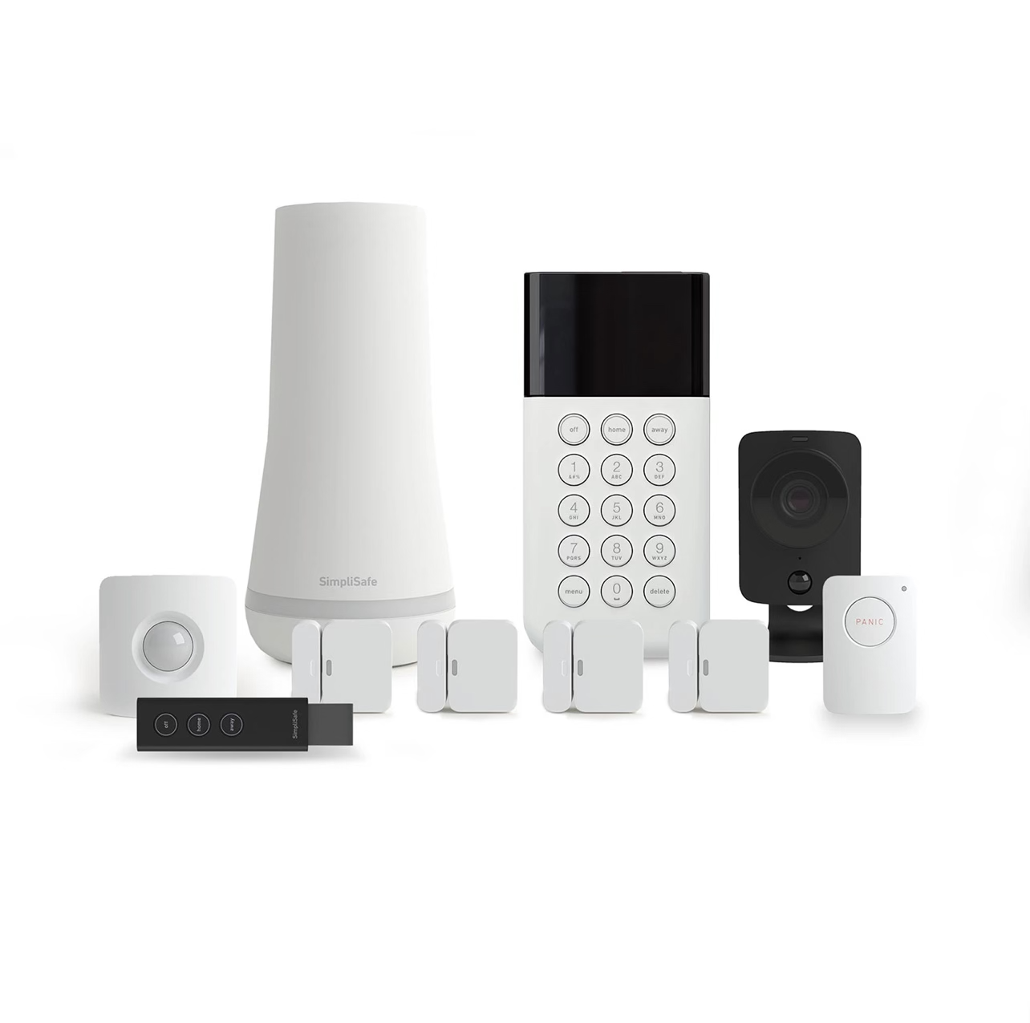
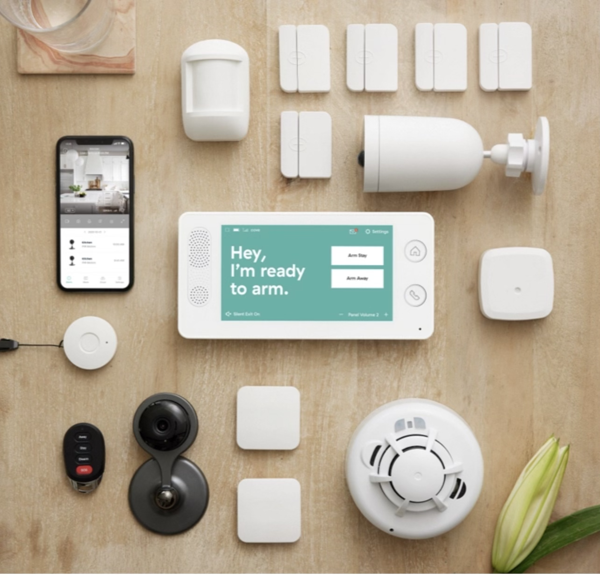
Design Options | Initial Cost | Continuous Fees | Pros | Cons | References
Smart Threat Detection System (Our Design) | $400 | No Monthly Fee | - Weapon Detection - Machine Learning - Real Time Tracking - Light Weight - Text Notifications | - No remote monitoring - Twilio subscription needed | N/A
GW Security | Starts at $1400 to $6000 | No Monthly Fee | - 4k Resolution - Uses ML - Night Vision | - No Remote Viewing -Heavy Camera Equipment - No Weapon Detection | GWsecurityusa.com BBB.com Amazon.com
Deep Sentinel | $400 to $1200 | Monitoring Fee $60 to $200 per month | - Uses ML - Motion Detection - Wi-Fi or Ethernet connection | - No Weapon Detection | Deepsentinel.com
SimpliSafe | Starts at $700 | Monitoring Starts at $15 per month | - Smoke, water, carbon & motion sensors - Smart home integration | - No ML feature to enhance system | Support.simplisafe.com Simplisafe.com
Cove Smart | Starts at $1200 | Monitoring $26 per month | - A+ rating - Environmental Sensors - Text Notifications | - No smart ML features available | Covesmart.com BBB.com

Slide 21
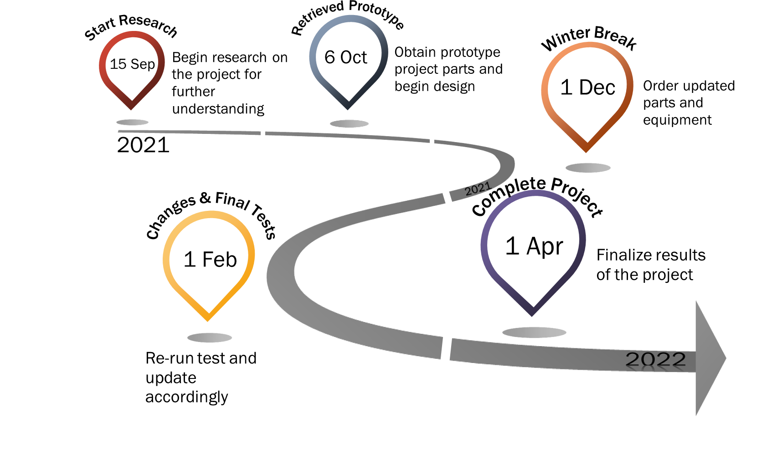
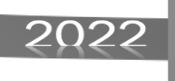
Project Timeline

Slide 22
Application of Engineering Codes and Standards
IEEE 3652.1-2020: Federated Machine Learning - Our machine learning model can constructed from data distributed across various repositories owned by various companies
IEEE P2671: Online detection with machine vision - This standard specifies through the general requirements of online detection based on machine vision
IEEE P2247.3: Recommended Practices for Evaluation of Adaptive Instructional Systems - best practice incorporates and promotes the principles of ethically aligned design for the use of artificial intelligence
IEEE 829-2008: IEEE Standard for Software and System Test Documentation - We used this standard when testing our software for detecting weapons
IEEE 2755.2-2020: Recommended Practice for Implementation and Management Methodology for software Based Intelligent Process Automation
IEEE 7.8: IEEE: Code of Ethics
  3) To be honest and realistic in stating claims or estimates based on available data
  5) To improve the understanding of technology, its appropriate application, and potential consequences

Slide 23
Demo
https://youtu.be/4pJBJ2DViz0

Slide 24
Conclusion
Our design identifies active threats by revealing displayed weapons.
Notifications provide the time for actions to be made to minimize casualties
This artificially intelligent threat detection system will impact many from universities and church organizations, to businesses and homeowners.
24

Slide 25
Questions?

Slide 26
Backup Slides

Slide 27
Future Plans
Concealed Weapons
Combination of infrared and thermal imaging cameras
Looks for items similarly shaped as a weapon that are concealed by the person
Increase Detection Distance
Use more images in the training that have the weapons at a distance.
People Tracking
Once a person is found to have a weapon, that person will be tracked even if the weapon is concealed later on.

Slide 28
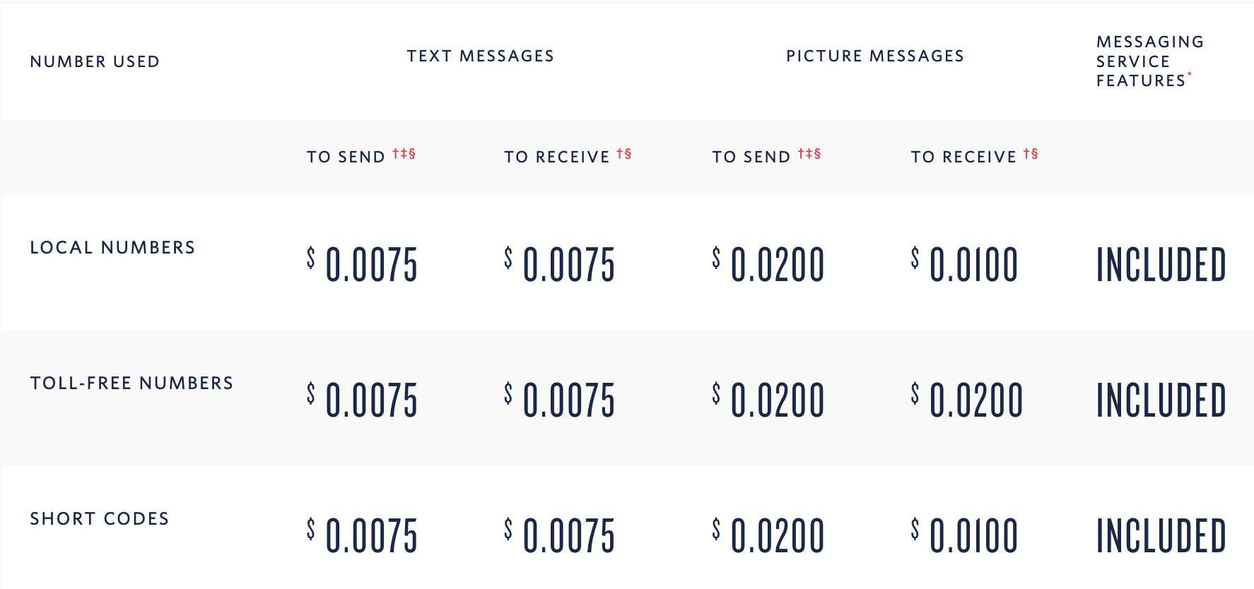
Message Pricing Structure

Slide 29
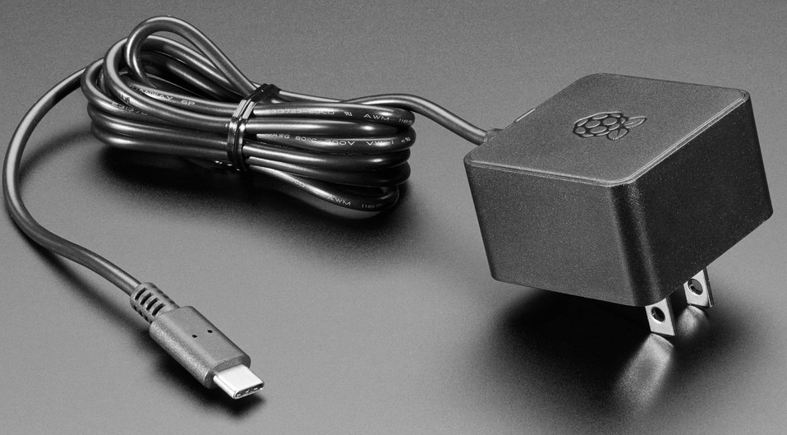
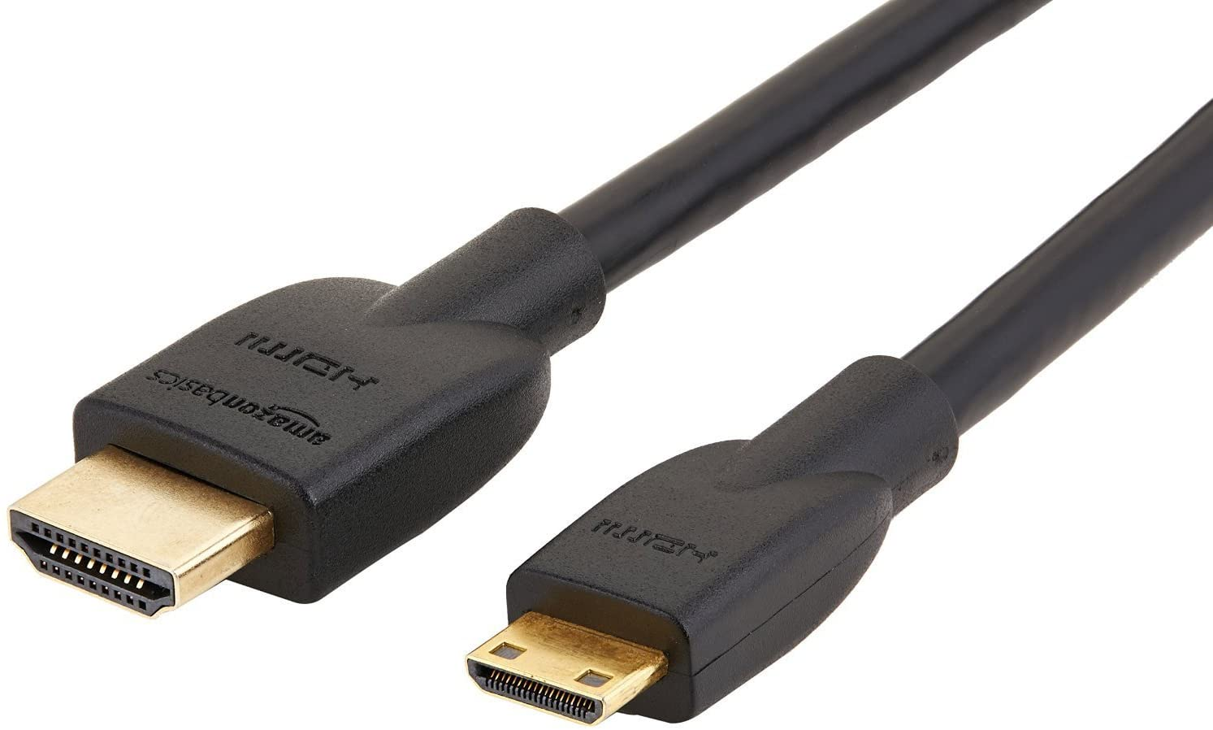
Parts Summary
Raspberry Pi 4 Model B
Power Supply
Raspberry Pi Camera
01
02
03
Mini HDMI to HDMI Cord
Coral USB Accelerator
04
05

Slide 30
Acceptance Criteria
Object Detection
Object detection needs to distinguish objects on a person
Use machine learning to identify objects on a person deemed as a threat
The detection can be done from a distance
Alert Notification
A notification will be sent in the form of a text message to the home or business owner
Housing and Mounting Apparatus
The housing must enclose the Raspberry Pi and camera
The mount will be able to remain on the wall or ceiling for extended periods of time

Slide 31
Assumptions & Constraints
Assumptions:
Active threats will have weapon displayed
Threats will be within the camera’s view
There is a stable power and Wi-Fi supply for the Raspberry Pi
Constraints:
Housing for the Raspberry Pi and the camera has to be mountable
The camera resolution affects detection accuracy and distance
The limited frame rate of the Raspberry Pi camera

Slide 32
Design Methodology
1. Software Design
2. Training & Testing
- Object Detection Model/algorithm selection
- Data collection
- Data preprocessing
- 70% - 80% of data used to train model
- 20% - 30% of data used to test model
- Model is assessed on accuracy
- Model tweaked to improve accuracy
3. Hardware design
- Housing for the Raspberry Pi design
- Mounting apparatus design
- Stress testing

Slide 33
References
“Best Home Security System Company & Security Cameras,” Deep Sentinel, 24-Sep-2021. [Online]. Available: https://www.deepsentinel.com/. [Accessed: 04-Oct-2021].
“Burglary Statistics: The Hard Numbers,” Alarms.org, 19-Dec-2019. [Online]. Available: https://www.alarms.org/burglary-statistics/. [Accessed: 04-Oct-2021].
“Frequently Asked Questions About Small Businesses,” U.S. Small Business Administration Office of Advocacy, Oct-2020. [Online]. Available: https://cdn.advocacy.sba.gov/wp-content/uploads/2020/11/05122043/Small-Business-FAQ-2020.pdf. [Accessed: 04-Oct-2021].
“Home Security Systems,” SimpliSafe, 2021. [Online]. Available: https://simplisafe.com/. [Accessed: 04-Oct-2021].
“Introducing VEDX: GPT-3 For Vision,” Visual one. [Online]. Available: https://www.visualone.tech/index.html#python. [Accessed: 04-Oct-2021].
J. Arora, “Theft Detection Using Machine Learning,” Medium, 25-Sep-2020. [Online]. Available: https://medium.com/analytics-vidhya/theft-detection-using-machine-learning-a4232ea51f1c. [Accessed: 04-Oct-2021].
L. Blain, “Vaak's AI theft-detection system is already 81% accurate,” New Atlas, 11-Apr-2019. [Online]. Available: https://newatlas.com/vaak-vaakeye-ai-theft-detection/59263/. [Accessed: 04-Oct-2021].
“More security with security cameras systems,” GW Security. [Online]. Available: https://www.gwsecurityusa.com/. [Accessed: 01-Oct-2021].
“Product Help,” SimpliSafe. [Online]. Available: https://support.simplisafe.com/hc/en-us. [Accessed: 04-Oct-2021].
“Weapons Offenses and Offenders”, U.S. Department of Justice. [Online]. Available: https://bjs.ojp.gov/content/pub/pdf/woofccj.pdf [Accessed: 29-Mar-2022]

Slide 34
References (cont.)
S. Catalano, “National Crime Victimization Survey: Victimization During Household Burglary ,” Office of Justice Programs, 28-Sep-2010. [Online]. Available: https://bjs.ojp.gov/content/pub/ascii/vdhb.txt. [Accessed: 04-Oct-2021].
S. Cho and N. Tin, "Using infrared imaging technology for concealed weapons detection and visualization," TENCON 2010 - 2010 IEEE Region 10 Conference, 2010, pp. 228-233, doi: 10.1109/TENCON.2010.5685995.
S. K. Bandyopadhyay, B. Datta, and S. Roy, “Identifications of Concealed Weapon in a Human Body,” Arxiv. [Online]. Available: https://arxiv.org/ftp/ arxiv/papers/1210/1210.5653.pdf. [Accessed: 04-Oct-2021].
S. Perkins, “Heating up the search for Hidden Weapons,” Science News for Students, 03-Dec-2019. [Online]. Available: https://www.sciencenewsfor students.org/blog/eureka-lab/heating-search-hidden-weapons.
S. Stasha, “18+ Intriguing Home Ownership Statistics for 2021,” Policy Advice, 13-Sep-2021. [Online]. Available: https://policyadvice.net /insurance/insights/home-ownership-statistics/. [Accessed: 04-Oct-2021].
“Self-installed DIY Home Security Systems,” Cove Security, 04-Oct-2021. [Online]. Available: https://www.covesmart.com/. [Accessed: 04-Oct-2021].
Statista Research Department, “Number of robberies in the United States in 20119, by weapon used,” Statista, 01-Oct-2020. [Online]. Available: https://www.statista.com/statistics/251914/number-of-robberies-in-the-us-by-weapon/. [Accessed: 04-Oct-2021].
T. Covington, “Burglary Statistics, Research, and Facts,” The Zebra, 08-Jul-2021. [Online]. Available: https://www.thezebra.com/resources/research/burglary-statistics/. [Accessed: 04-Oct-2021].
Uniform Crime Reporting Program, “Crime in the U.S. 2019 Table 23,” FBI: UCR, 29-Aug-2019. [Online]. Available: https://ucr.fbi.gov/crime-in-the-u.s/2019/crime-in-the-u.s.-2019/tables/table-23. [Accessed: 27-Sep-2021].

Slide 35
Smart
Threat-Detection System Executive Summary
Team 5:
Joshua Littleton
Tri’Heem Neville
Arthur Quinney
Xavier Dukes
Christopher Rollerson
Faculty Sponsor:
Dr. Dong
Course Facilitators:
V. Turner
Dr. Musa

Slide 36
Prospective Plan
Problem Statement:
On average, approximately 4,800 burglaries happen every day. 66% of burglaries affect residential properties and 34% affect small businesses. One-third of all robberies result in injury and 39% of the time a weapon is present when an individual is harmed.
Budget:
Project budget: $600
Amount Spent: $340
Target Audience:
Small businesses, Homeowners, Hospitals, Schools/Universities, and Churches

Slide 37
Proposed Deliverables
We will be using a Raspberry Pi attached with a camera to survey the area and identify potential threats
The machine learning (ML) algorithm we implement detects the threatening objects on an individual such as weapons in real time
Once an object defined as a threat is detected, a text notification is sent to the owner/operator’s phone allowing them to determine the course of action

Slide 38
Customer Requirements and Engineering Solutions:
Mass producible by using easily obtainable/cost effective parts
Lightweight parts for mounting purposes
Train machine learning algorithm to detect various weapons
Camera resolution of 1080p for increasing range of detection
Text notification alerts of potential threats
Algorithm classifies threats and non-threats
Detects threats in real time
Major Constraints:
Housing for the Raspberry Pi and the camera has to be mountable
The camera resolution affects detection accuracy and distance
The limited frame rate of the Raspberry Pi camera

Slide 39
Benefits
Societal:
This project will offer greater security to those that cannot afford other options. Businesses will be capable of guaranteeing safety of customers without infringing upon a customers 2nd amendment right to carry while within the public space.
Safety:
The primary goal for this project is to create an affordable security system for small businesses and homeowners to proactively respond to potential threats however they see fit.
Technical:
Machine learning has not been utilized within security systems to this day. Our project will pioneer a smart security system that will inform you of potential dangers at the first sighting of a weapon that would provide danger to security or the owner.

Slide 40
Recommendation & Conclusion
Recommendation:
Confirm the unit is mounted to a stable elevated surface
Ensure there is no obstruction of view to the camera lens.
Make sure the Raspberry Pi is located in a well insulated area to prevent overheating the unit.
Electricity is needed in order to operate the Raspberry Pi unit.
To get the best usage out of our product do not forget to set up a Twilio account for all alerts and notifications.
Conclusion:
Our design will identify active threats by revealing displayed weapons. This artificial intelligent threat detection system will impact many from universities and church organizations, to business and homeowners.
40

