Slide 1


Converting a Mechanical Operated System to an Electronic Operated System
Team #4
Armand Feuba Baweu
Eulises Garcia Benito
Francisco Hernandez
Franky Williams Lonfo
Jacqueline Torralba
Instructor: Professor Turner
Team Sponsor: Professor Fuller
Team Facilitator: Professor Musa

Slide 2





Team #4
Scribe
Eulises Garcia
E.E.
Data Analyst
Francisco Hernandez
E.E.
Team Lead
Jacqueline Torralba
E.E
Test Lead & Product Specialist Franky Williams
E.E.
Software Developer
Armand Feuba
C.E.

Slide 3
Introduction
Problem Statement
Golf carts are used in many everyday settings, due to their compact size, and ease of use. Mechanical operated systems such as the mechanical shifter handles are prone to breaking. This issue leads an owner to additional cost for maintenance and potential unsafe situations.
Objective:
The goal of this project is to change the mechanical operated system switch of a golf cart, and design an electric operated system switch. This will reduce maintenance required and help golfers conveniently and safely use the golf cart.

Slide 4
Proposed Deliverable
  Creation of user-friendly electrical switch to control forward and reverse movement of golfcart
  Use same voltage source to power the new introduced electrical system
Target Audience
  Golf cart users
  Elderly People

Slide 5
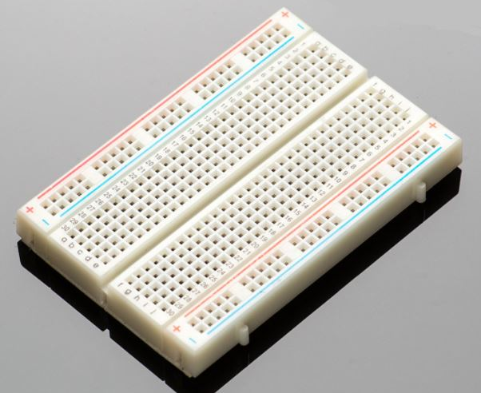
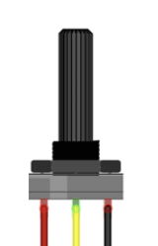
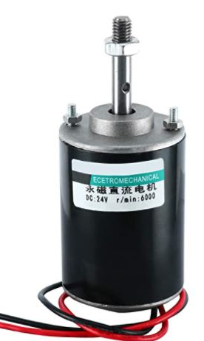
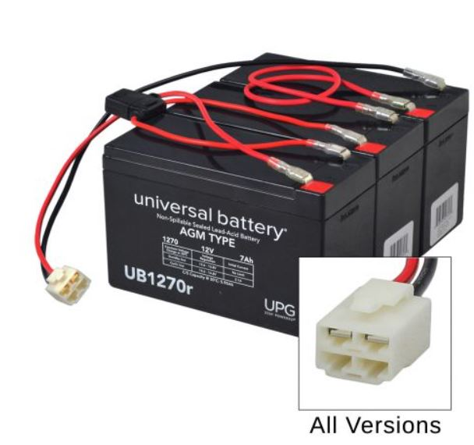
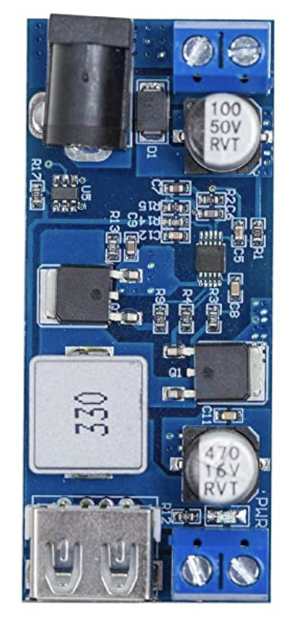

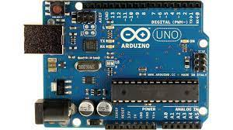
Design Concept
Breadboard
This is where all the electrical components will be connected. Ex: H-Bridge, Power Switch, Resistors, Forward/ Reverse Switch, etc.
24 Volts
DC Permanent Magnet Motor
Electrical energy will be converted to mechanical energy and make golf cart go forward and reverse.
(24V, 6000RPM)
0 – 24 Volts
24 Volts
24V Battery
Supply sufficient voltage and amperage for system to run.
24 Volts
5 Volts
Arduino Uno
Will run software and make thyristors act as switches.
Software (C++)
Software will be used to communicate between hardware and Arduino
Step Down Transformer
Reduces 24 DC Volt to 5 DC Volts. This will power the Arduino
Notes:
Projects Part Summary?

Slide 6
Marketing Requirement | Engineering Requirement | Justification
User friendly | Integrate electric switch into circuit correctly to control polarity contact | The switch will flip polarity contacts by just a click to make the golf cart move forward and backwards
Low cost | Use an affordable microcontroller | Maintenance's electronic or electric equipment is cheaper than the maintenances of mechanical or mechanical's equipment
Use same battery source to power new control system | Arduino will use built in power source of golf cart | By not adding a new power source, will avoid unnecessary cost and materials to be used.
Electronic shifting requires less maintenance | By replacing a mechanical switch to an electronic switch that is controlled by an Arduino, the operated system will last much longer | Mechanical control switches are destined to eventually fail, while an electronic switch would last longer and be easier to change if needed
Low effort-shifting | Electronic shifting is faster than mechanical shifting based on the time response and the frequency of the data transmission | Response time: 0<t<1s T<=450ms (0.450s) f =16MHZ Accel time responding is less than 1s on electronic devices compare to the load-bearing force of mechanical devices.

Slide 7
Advantages
The cost of our design will allow consumers to economically switch from a mechanical switch to an electrical switch.
Easily control forward and reverse movement with simple buttons and reduce time lag
Save cost for needed maintenance of mechanical switch
Disadvantages
Increase chance of selecting incorrect mode (forward/reverse)
Complex wiring, and no possible flame proof areas
Susceptible to line fluctuations of voltage and frequency

Slide 8

Project Impact Summary
Category | Project Applicability
Public Health. Safety, and Welfare
Global
Cultural
Social
Environmental
Economic Factors
Technical

Slide 9
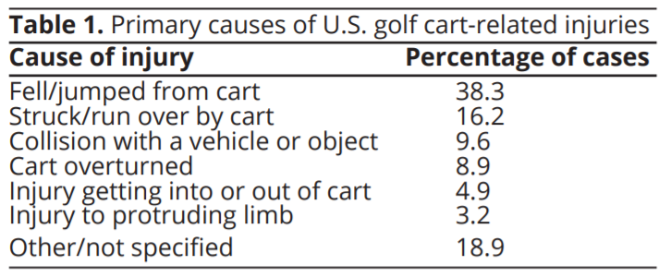
Project Impact - Safety
Golf carts being are a popular mode of transportation in outdoor areas, an increasing level of nonfatal injuries are occurring.
A study done from 1990 to 2015 "U.S. emergency departments visits for golf cart-related injuries tripled from 6,000 in 1990 to 18,000 in 2015".
Of these incidents, 9.6% were when collision occurred with a vehicle or object and could be due to gear shifting issues.
Having an electronic switch shifter would have less failure occurrence and lessen the number of cases.
Notes:
https://www.villages-news.com/wp-content/uploads/2014/10/Golf-Cart-Accident.jpg

Slide 10

Project Impact - Cultural/Social
Due to low effort-shifting elderly will still be able to drive golf carts with no problem.
There is a Village where most of the people are age 55+ and there is 65,000 golf carts reported in residence.
Golf cart users will now be able to focus on enjoying the golf cart rather than getting the shifter fixed.
A Mechanical Shifter on Amazon has 65 reviews for one year. Therefore, we estimate that around 65 - 200 shifters were sold within that year.

Slide 11
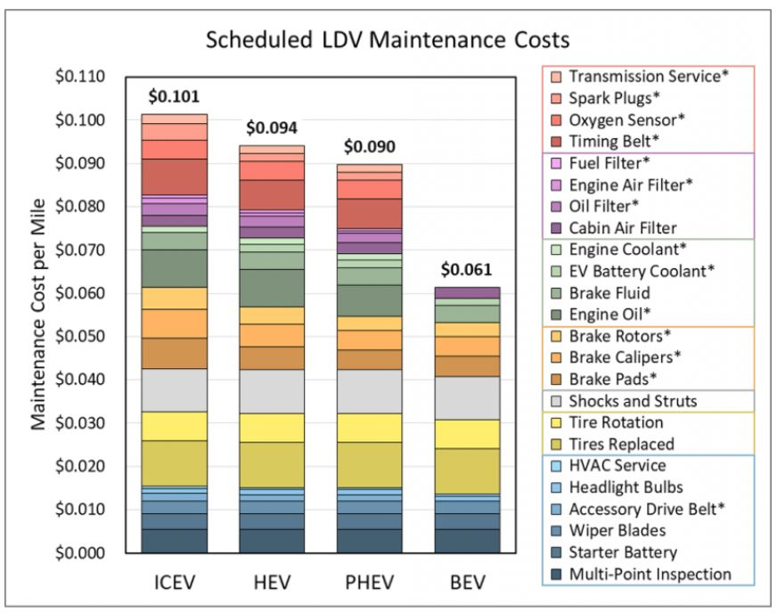
Project Impact - Economical
Maintenance cost for electric vehicles(EV) is lower because of less moving parts:
  no exhaust system
  less need for cooling
  less abrasive braking
According to study by U.S. Department of Energy:
  BEV(battery electric vehicle) are cheaper to maintain by $0.06 per mile
  ICEV (internal combustion engine vehicle) is $0.10 per mile
ICEV ( internal combustion engine vehicle)
BEV (battery-electric vehicle)
PHEV (plug in hybrid vehicle)
HEV (hybrid electric vehicle)
Notes:
https://www.energy.gov/eere/vehicles/articles/fotw-1190-june-14-2021-battery-electric-vehicles-have-lower-scheduled

Slide 12
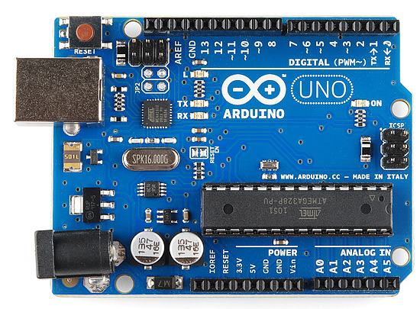
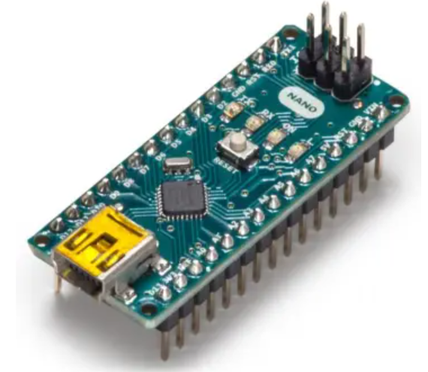
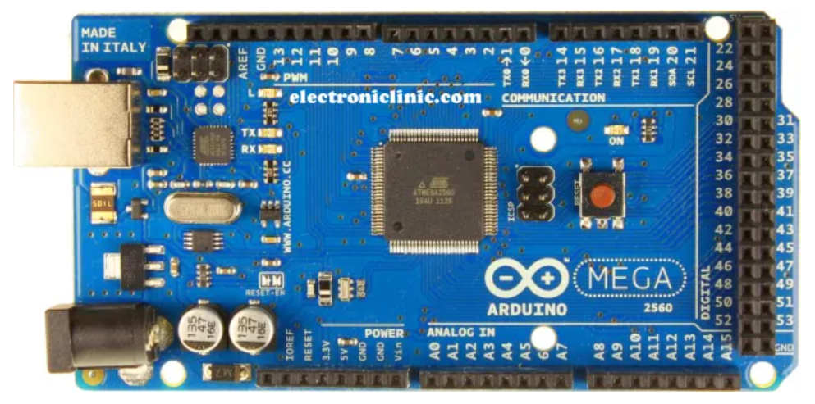
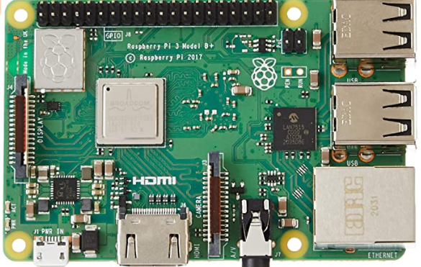
Equipment Comparison (Microcontrollers)
Product | Pros | Cons | Cost | Reference
Arduino Uno | User friendly More efficient within DC series motors | 6 Analog inputs | $23 | “Arduino Uno REV3.” Arduino Online Shop, https://store-usa.arduino.cc/products/arduino-uno-rev3?selectedStore=us.
Arduino Nano | 8 Analog inputs Small profile | Micro USB port Requires other components | $21 | “Arduino Nano.” Arduino Online Shop, https://store-usa.arduino.cc/products/arduino-nano?selectedStore=us.
Arduino Mega | 256 KB of flash memory High I/O requirements 16 Analog Pins | More costly Big profile | $41 | “Arduino Mega 2560 REV3.” Arduino Online Shop, https://store-usa.arduino.cc/products/arduino-mega-2560-rev3?selectedStore=us.
Raspberry Pi 3 | 26 Analog Pins Supports all types of codes Faster Processor | More expensive Tends to overheat | $85 | Amazon.com: Element14 Raspberry Pi 3 B+ Motherboard ... https://www.amazon.com/ELEMENT-Element14-Raspberry-Pi-Motherboard/dp/B07BDR5PDW.

Slide 13
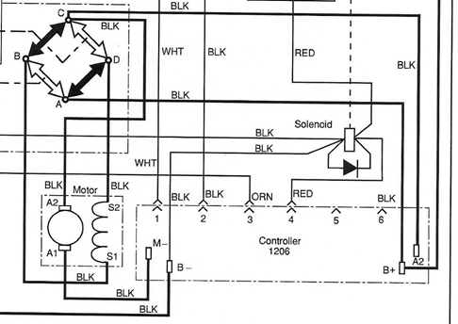
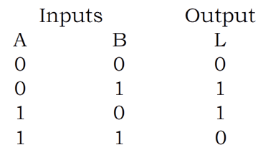
Project Impact - Technical
Based on the data analyst, low cost, safety improvement and low effort-shifting, we believe that controlling the golf cart by an electronic devices will make it cheaper and safe to operate compared to the mechanical operation which request a physical effort and load-bearing force applied on the armature.
00 Stop
B+ A D S2 S1 A C Armature A2 A1 = Forward 01 Motor forward
B+ A B S1 S2 D C Armature A2 A1 =Reverse 10 Motor reverse
11 Ambiguity

Slide 14
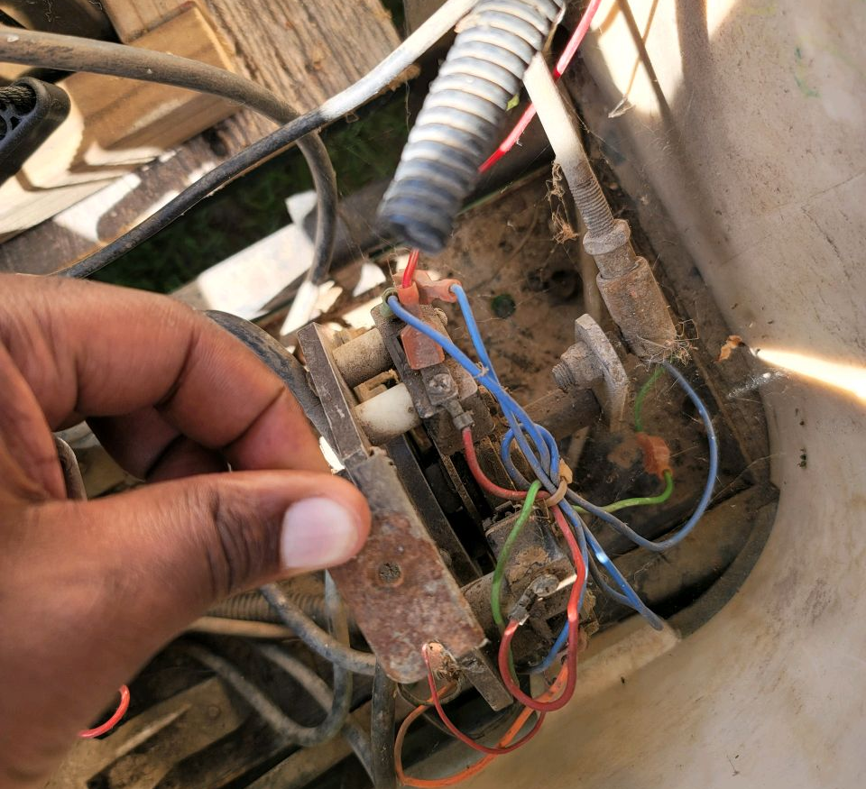
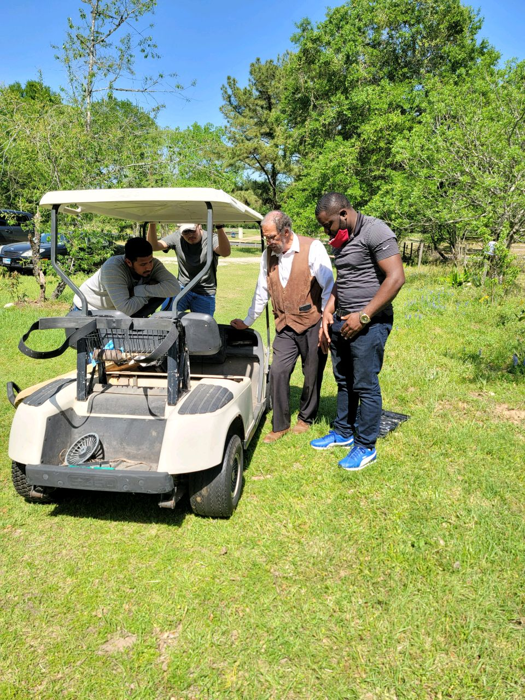
Mechanical H-Bridge of Golf Cart

Slide 15
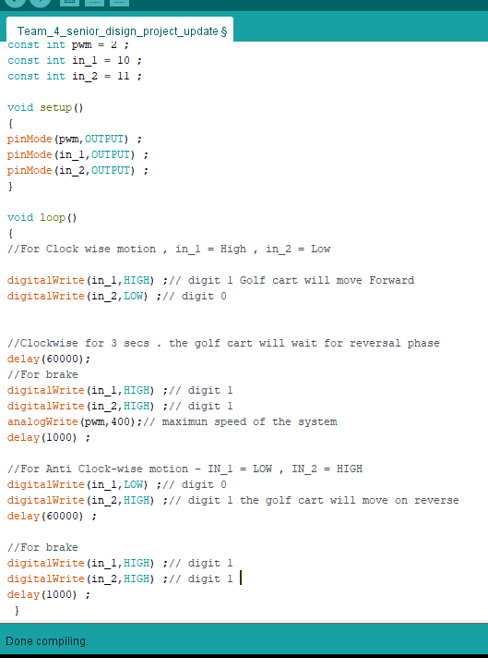
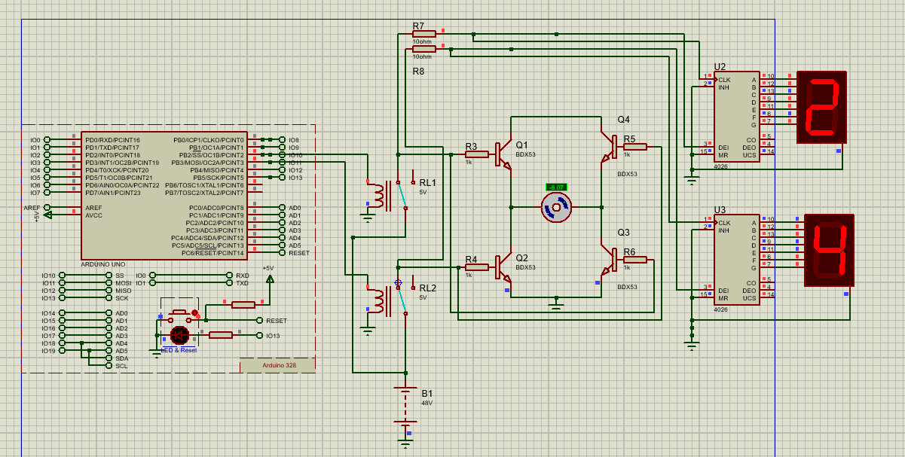
Phase 1 - Software and Circuit Schematic

Slide 16
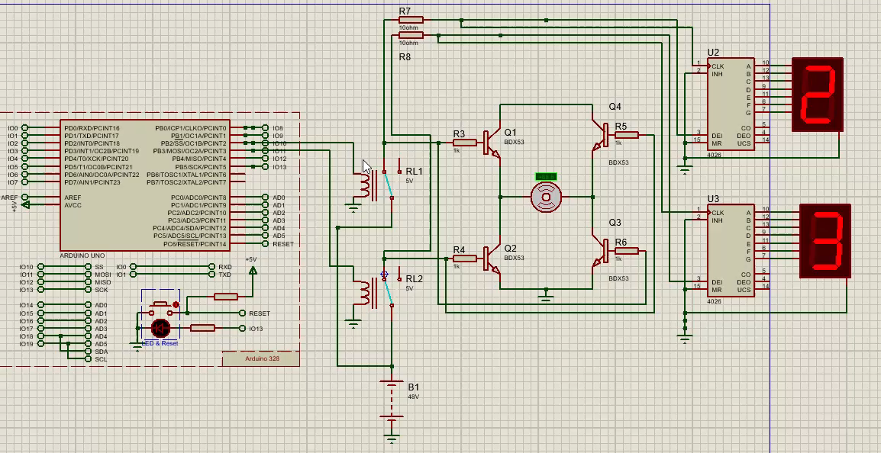
Phase 1 Zoomed in Schematic

Slide 17
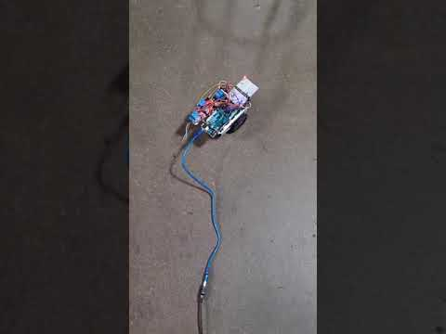
Phase 1: Prototype video

Slide 18
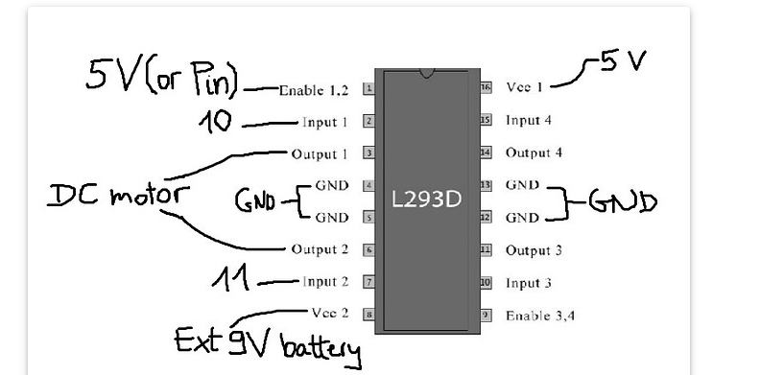
Phase 2: Motor Driver - H Bridge
5V
5V or Pin
10
DC Motor
GND
GND
11
exit 24 V battery

Slide 19
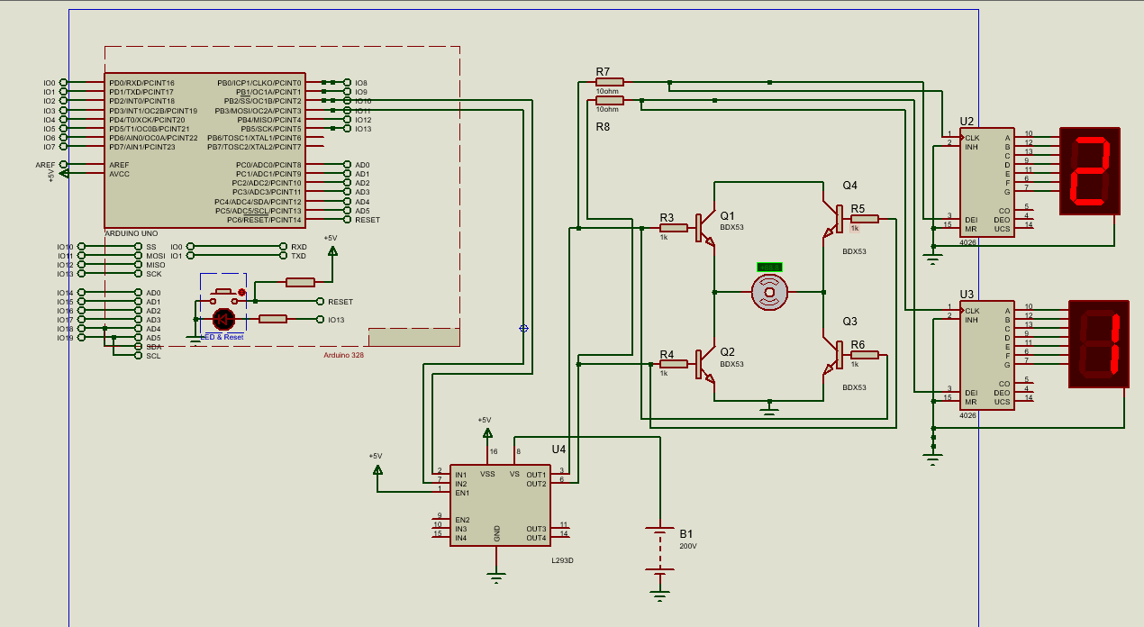
Phase 2: L293D added

Slide 20
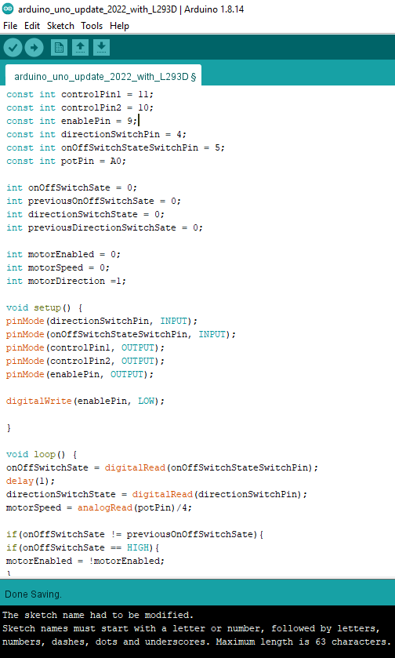
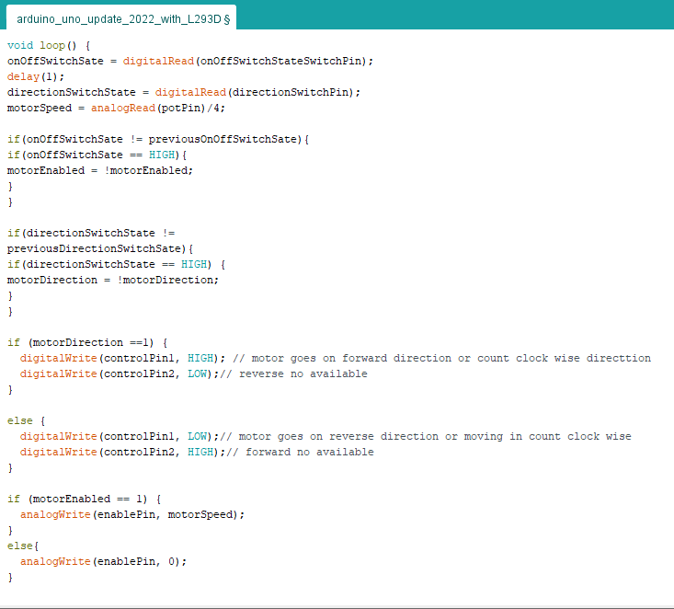
Phase 2: Software

Slide 21
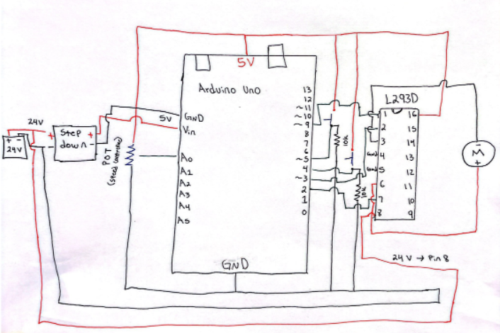
Detailed Final System Design

Slide 22
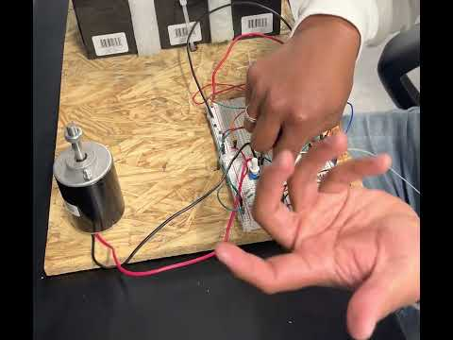
Final Video Prototype

Slide 23
Timeline
 | Aug | Sept | Oct | Nov | Dec | Jan | Feb | Mar | Apr
Project Research
Project Design
Project Testing/Launch
Project Performance Review
Project Close
Phase 1 |  |  |  |  |  | Phase 2
P
R
O
J
E
C
T
E
N
D

Slide 24
Codes & Standards
IEEE/ISO/IEC 24748-3-2020
Life cycle management provides guidance on the application of the software life cycle processes standard.
Establishes guidance to implement a common framework for software life cycle processes, with well-defined terminology.
IEEE 2755.2-2020
Recommended Practice for Implementation and Management Methodology for Software-Based Intelligent Process Automation
IEEE 113-1985
Procedures for Direct-Current Machines
Recommendations are made for conducting and reporting generally acceptable tests to determine the performance characteristics of conventional DC machines.
NESC
National Electrical Safety Code
Implemented to regulate and maintain electrical components used during the creation of this project.
IEEE 7010-2020
Recommended Practice for Assessing the Impact of Autonomous and Intelligent Systems on Human Well-Being
IEEE 485-1997
Recommended Practice for Sizing Lead-Acid Batteries. Methods for defining the dc load and for sizing a lead-acid battery to supply that load for stationary battery applications

Slide 25
References
“Arduino Mega 2560 REV3,” Arduino Official Store. [Online]. Available: https://store.arduino.cc/products/arduino-mega-2560-rev3. [Accessed: 04-Oct-2021].
“Arduino Nano,” Arduino Official Store. [Online]. Available: https://store.arduino.cc/products/arduino-nano. [Accessed: 04-Oct-2021].
“Arduino Uno REV3,” Arduino Official Store. [Online]. Available: https://store.arduino.cc/products/arduino-uno-rev3. [Accessed: 04-Oct-2021].
—, E. F., & says:, L. R. A. (2021, September 14). Arduino Uno vs nano vs mega, pinout, and technical specifications. Electronic Clinic. Retrieved November 28, 2021, from https://www.electroniclinic.com/arduino-uno-vs-nano-vs-mega-pinout-and-technical-specifications/.
“Electronic and pneumatic controls analyzed,” Bright Hub Engineering, 28-Oct-2009. [Online]. Available: https://www.brighthubengineering.com/commercial-electrical-applications/53898-pneumatic-vs-electronic-control-mechanisms/. [Accessed: 04-Oct-2021].
H. Tremura and O. Toker, “Vehicle Level Software Design of the Florida Polytechnic Autonomous Golf-CART,” SoutheastCon 2021, 2021.
K. Z. Horvath, et. al, “Fun Ride or risky transport: Golf cart-related injuries treated in U.S. emergency departments from 2007 through 2017,” Journal of Safety Research, 16-Nov-2020. [Online]. Available: https://www.sciencedirect.com/science/article/abs/pii/S0022437520301237?via%3Dihub. [Accessed: 04-Oct-2021].
Macfos. (2021, February 4). Pros and cons of Raspberry Pi: Detailed guide in 2020. Robu.in | Indian Online Store | RC Hobby | Robotics. Retrieved November 28, 2021, from https://robu.in/5-pros-and-5-cons-of-raspberry-pi/.
S. J. Chapman, Electric Machinery and power system fundamentals. Boston: McGraw-Hill, 2002.
T. Mohn, “The (mostly) safe golf cart,” The New York Times, 04-Mar-2017. [Online]. Available: https://www.nytimes.com/2017/03/04/business/retirement/the-mostly-safe-golf-cart.html. [Accessed: 04-Oct-2021].

Slide 26
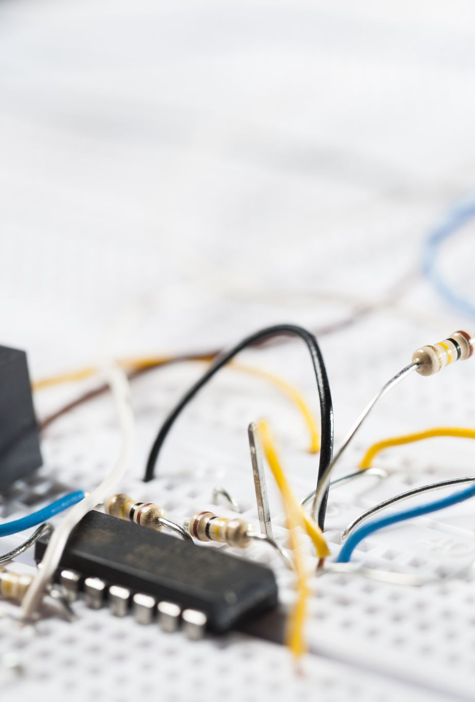
Conclusion
Recommendation
Use electronic based switch instead of mechanical based switch.
Safely control electrical system with aide of Arduino Uno
Use of control system to be within range of set voltage
During this project, our goal was to convert a mechanical operated system into an electronic operated system. This will allow for the user to run into less maintenance issues in future and spend less money.

Slide 27
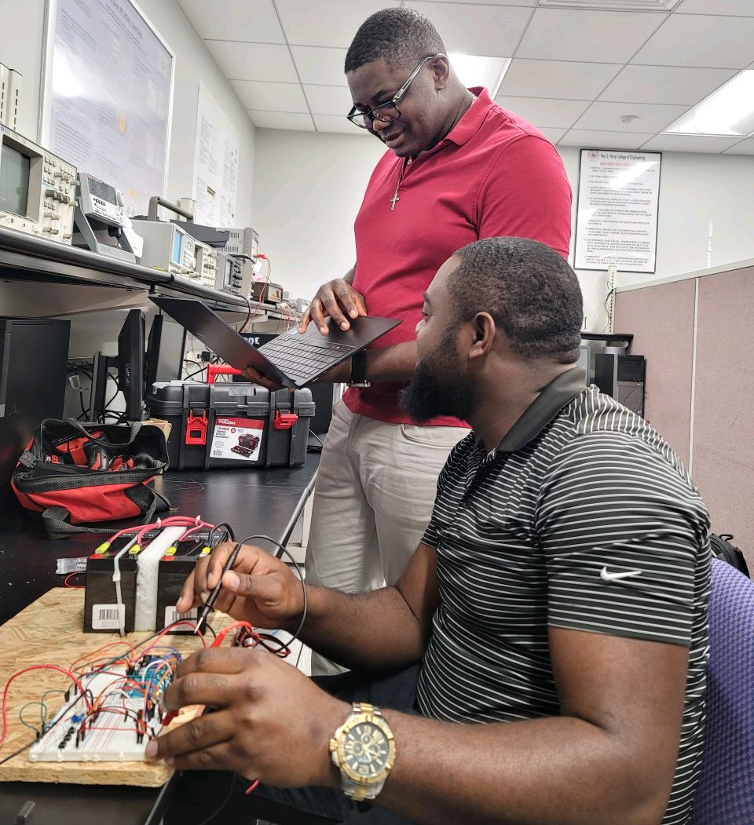
Questions?

Slide 28
Back Up

Slide 29
Acceptance Criteria
Embedded System:
  System must fit within the golf cart engine bay.
  System must be energy efficient and not consume a large amount of battery life
  System must have proper organized connections that can be identified easily.
  System software must communicate with the microcontroller to control the electronic switches.
  Switch:
Switch should make the golf cart go forward and reverse through the help of the electronic embedded system.
Switch should be user friendly, and durable.
Switch should run while other features of the golf cart are in use.

Slide 30
Constraints & Assumptions
Assumptions
No time lag or transmission delay.
Linear and quick response and good accuracy
No entrainment or contamination in control medium
Integrated control system and easier interconnections.
Low Power re-equipment
Speed of response is substantially instantaneous.
Easy Maintenance and test kit re-equipment.
Constraints
Complex Networks
Not possible for flame-proof areas
Skilled maintenance regulations
Expensive layout
Good and safe wiring layout required
Susceptible to line fluctuations of voltage and frequency

Slide 31


Battery
$$Q=Zt$$
$$Q=AH$$
$$Q=7AH$$
$$t=\frac{Q}{I}=\frac{7}{1}=7H$$
$$t=7H for 1 amp$$

Slide 32
Executive Summary
Problem Statement:
  The mechanical shifter handles within a mechanical operated system are prone to breaking. This issue leads an owner to additional cost for maintenance and potential harm to the drivers.
Mission Statement:
  Our mission is to change a mechanical operated system of a golf cart to an electric operated system switch. This will reduce maintenance requirements and ensure safety to the people who drive golf carts.

Slide 33
Prospective Plan
Proposed Deliverable
  Creation of user-friendly electrical switch to control forward and reverse movement of golfcart
  Use same voltage source to power the whole electrical systemtgfh
Budget: $600
  Spend: $200
Target Audience
  Elderly People/Golf cart users

Slide 34
Customer Requirement and Engineering Solution
Automizes the forward/reverse motion of golf cart
  Use of microcontroller Arduino/H-Bridge
Affordable and energy saving design
  Use existing battery source of 24V, and no unnecessary material
Low effort shifting
  Use electronic shifting rather than mechanical shifting
Major Constraints
Size of prototype for class compared to actual golf cart
No prior experience in converting mechanical systems to electrical systems
Design susceptible to line fluctuations of voltage and frequency

Slide 35
BENEFITS
Safety
Having an electronic switch shifter would have less failure occurrence and lessen the number of collisions cases due to switch failure.
Cultural/Social
Due to low effort-shifting elderly will still be able to drive golf carts with no problem. And golf cart users will now be able to focus on enjoying the golf cart rather than getting the shifter fixed.
Economic
Maintenance cost of an electrical shifter is lower than a mechanical. Electrical equipment for a shifter is more affordable than a mechanical one.
Technical
The polarity contacts will control by a programed Arduino making the golf cart move forward and reverse.

Slide 36

Prospective Solution
The using of advanced engineering technology on this project will change the concept and the future of the golf cart.
The implementation of Arduino microcontroller through the golf cart system will change the operation mode of the entire system and making easier for the golfer operator or owner to both operating and performing maintenance.
Engineering design approach will cover everything from analog and power, connectivity, display, lighting, processor, sensor and more.

Slide 37
Engineering Design Methodology
Problem statement
Prospective solution
Research
Simulation design
NO
Prototype
Test
Passed?
Yes
Document Results
Notes:
Show math???

Slide 38

Project Schedule
Project
Assigned
Cont. research of electrical components
Researching about electrical systems
Presenting design to advisor
Ordering Parts
Simulation of Design
Mock Trial in Lab
Putting Design Together

