Slide 1
Geo Location for People with Special Needs
Instructor: Professor Turner,
Dr. Musa
Team Sponsor:
Dr. Annamalai
Team 3 Name: Team G3O

Slide 2
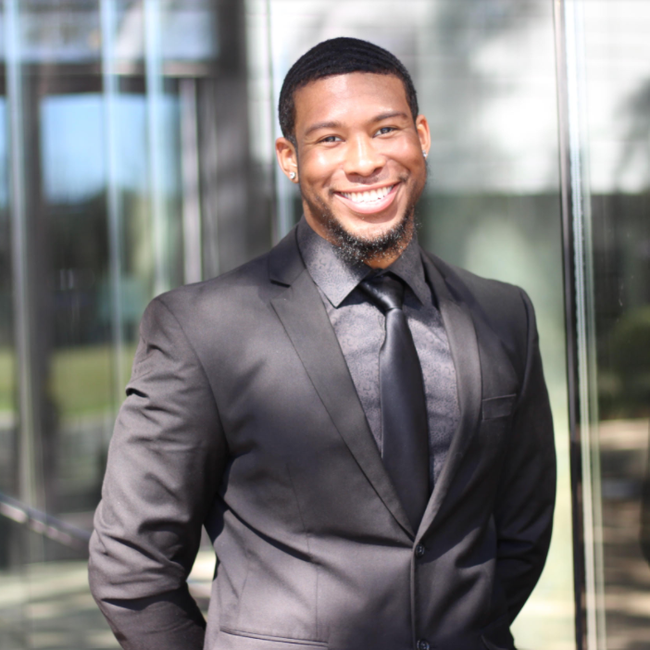
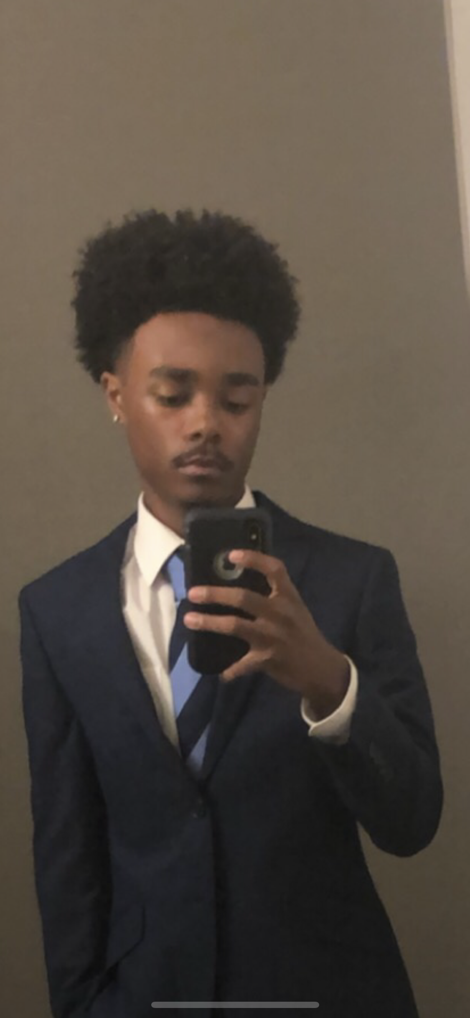
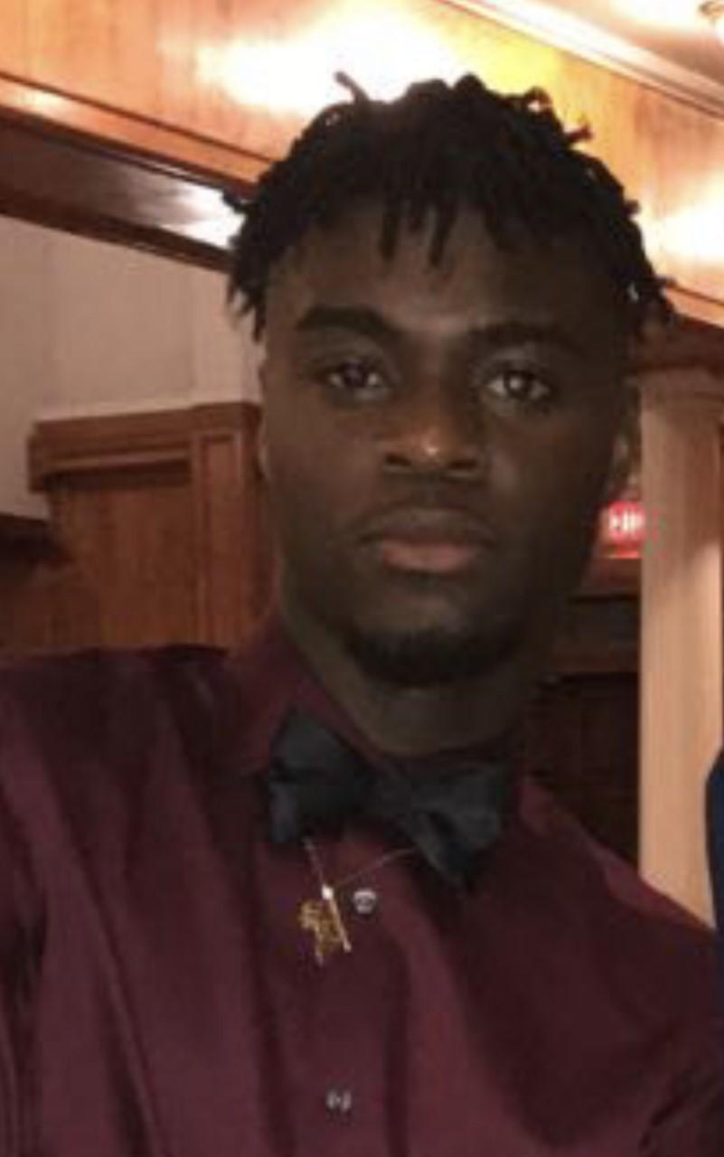
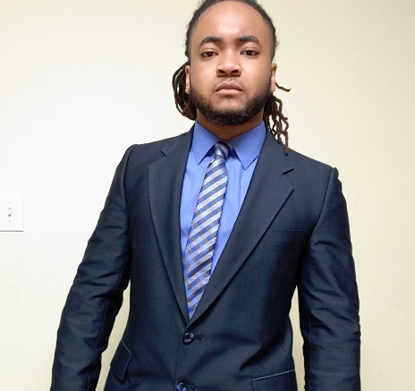

PRAIRIE VIEW A&M UNIVERSITY
ROY G. PERRY COLLEGE OF ENGINEERING
Johnn Owens
Team Leader
Alternate: Test Lead
Electrical Engineering
Adeola Okeowo
Data Analyst
Alternate: Scribe
Electrical Engineering
Trevor Johnson
Software Developer
Alternate: Team Lead
Electrical Engineering
Michael Shepard
Scribe
Alternate: Purchasing Lead
Electrical Engineering
Osesiye Ayeni
Test Lead
Alternate: Data Analyst
Electrical Engineering

Slide 3

Problem Statement:
  One of the major concerns of caregivers who tend to special needs individuals is how to find an affordable solution to prevent them from wandering from their safe environment. According to statistics, "roughly 50 percent of children between the ages of 4 and 10 with autism wander at some point. More than half of these wandering children go missing – often into dangerous situations." (autismspeaks.org)
  Target Audience:
  Parents/Caregivers
Notes:
We recognize the struggle to keep track of people with special needs, so we have designed a prototype to aid caregivers with an affordable solution. One of the biggest concerns of caregivers who tend to people with autism is how to prevent wandering from their safe environment. This is because nearly 50% of children with autism disorder engage in wandering behavior. When a loved one goes missing, even if it is for a short duration, the agonizing moments experienced by family members and caregivers is unimaginable.

Slide 4

Objective:
The main goal of this project is to create an affordable, robust, and effective solution to locate special-needs individuals by investigating viability, performing a feasibility study, and implementing geo-location-based technology in a LoRaWAN (Long Range Wide Area Network) platform.

Slide 5
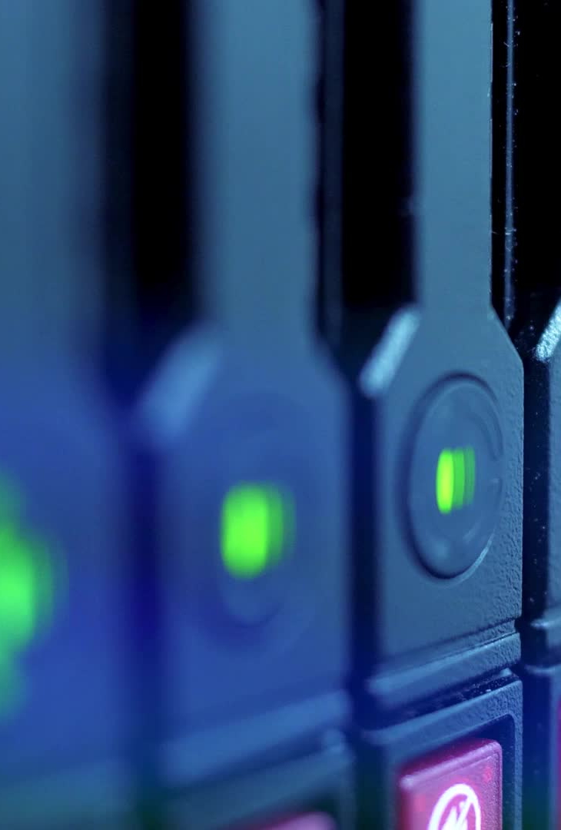
Proposed Solution
Create a LoRa IoT device that is suitable for wireless data communications that sends small amounts of data over long distances at a low data rate periodically.
This is a step into future network servers, with the focus being directed toward expanding a wider network coverage and a safer and secure private server.
Notes:
We will approach this challenge by creating a loRa-based IOT device that sends a signal to the loRaWan gateway which will interface with the IOT tracker which sends an SMS to the mobile device. The goal is to implement a wider network coverage in a safe and secure server.

Slide 6
Marketing and Engineering Requirements
Marketing Requirement | Engineering Requirement | Justification
Reliable and consistent tracking system | Effectively implement LoRaWAN/Cellular technology | Detects individual’s location
Alert System through notifications | Implementing geo fencing | Alerts caregiver through a notification once child is out of range
Lightweight/Portable | Peripheral Interface Controller (PIC) will fit in case | Device should be small enough to fit on a wristband
Low cost and affordable (No recurring monthly fees) | Internet of Things (IoT) Network System | The device prioritizes safety over profit
Wider coverage than Wi-Fi or Bluetooth | Long range communication coverage up to 10-20 meters implementing geo-fencing | LoRaWAN covers up to 2 miles compared to Wi-Fi (less than 100 meters) or Bluetooth (about 10 meters)
Sufficient battery life will last up to a week on single charge | LoRaWAN platform allows Device to be operated with minimal battery power | The device should be discoverable for enough time to be located
Cyber security considerations for all elements of the system | Secure login to the app or cloud server | Only allow specific network devices (Private Network)

Slide 7
Project Impact Summary
Category | Project Applicability
Public Health, Safety, and Welfare | X
Global
Cultural
Social | X
Environmental
Economic factors | X
Technical | X

Slide 8

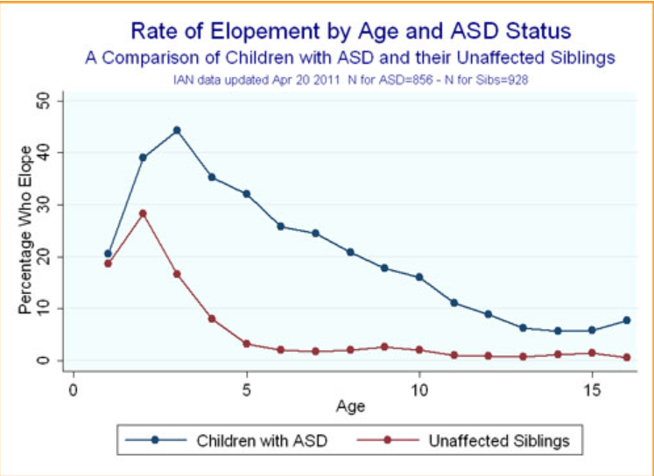
Safety Impact
Statistics show that roughly half of children with autism between the ages of 4 and 10 attempt to elope.
Out of 808 reported autistic missing person cases of wandering in the US (2011-2016), 17% resulted in death.
The goal for this project is to reduce these rates through the implementation of our device

Slide 9
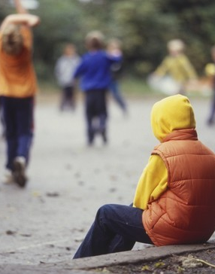
Social Impact
According to Child Mind Institute, various parents stated that wandering is the most stressful autistic behavior
62% of parents of autistic children stated fear of their child wandering prevented them from participating in activities outside the home, increasing their social isolation
40% of these already exhausted parents said they lost sleep while worrying about a potential escape during the night.

Slide 10
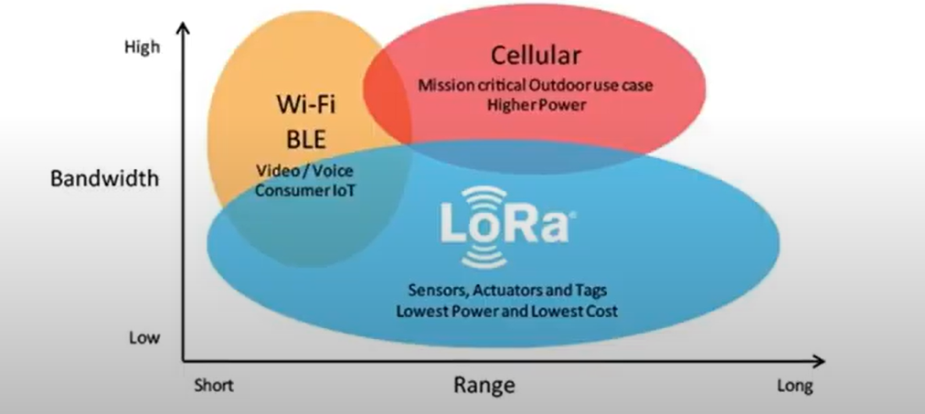
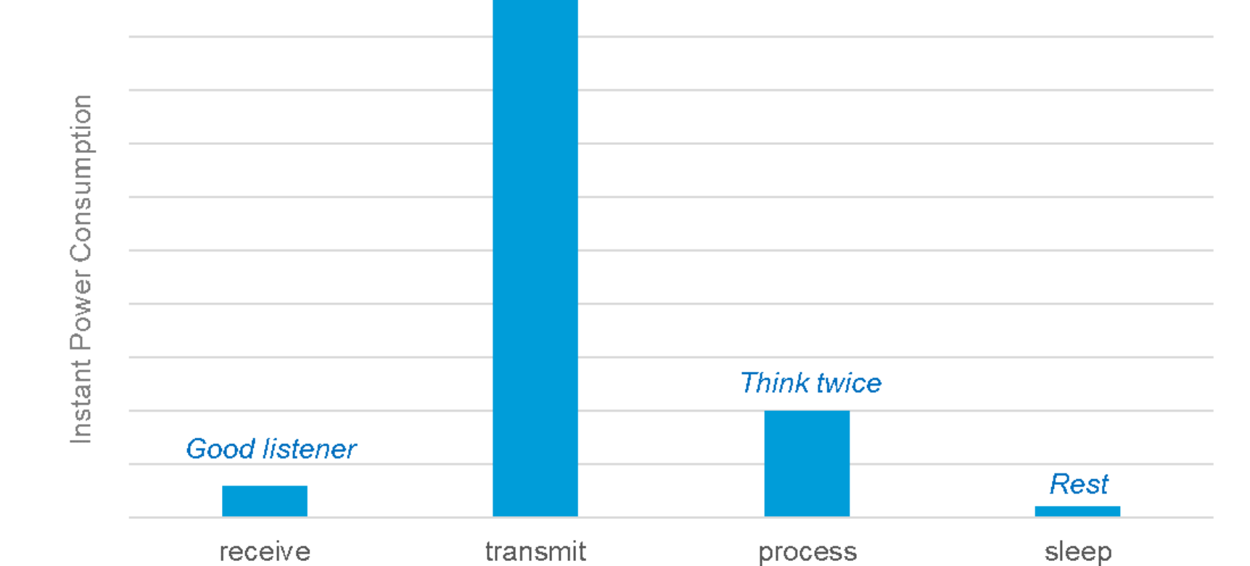
Technical Impact
LoRaWAN based technology creates wider range of coverage.
In an ideal IoT device, data transmission is kept to a minimum to conserve power.
LoRa-based sensors do not need to pair with a gateway before sending data, which further reduces energy use and prolongs battery life.
Notes:
As you can see in the diagram Lora have a wider range, compared to Wi-Fi/ Bluetooth and Cellular networks.
LoRaWAN, uses unlicensed band which provide a highly secure dual encryption to keep data safe during transfer.
Our IoT device minimize the data transmission to conserve power.
Unlike other sensors that transmitting data constantly, LoRa-based sensor does not need to pair with a gateway before sending data, which further reduces energy use and prolongs battery life.
Overall, reducing operational costs and improving efficiency.

Slide 11
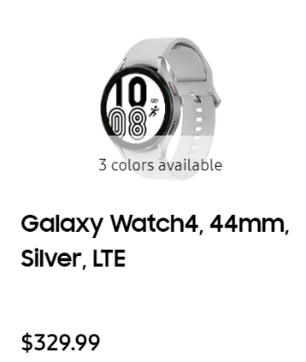
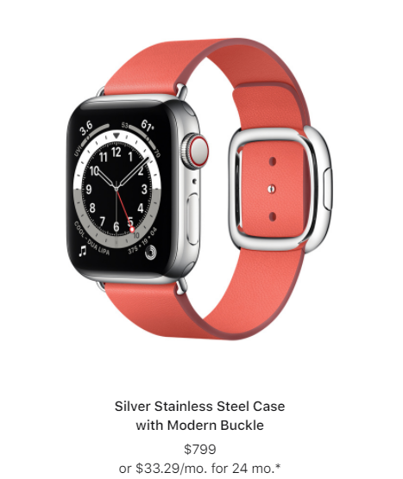
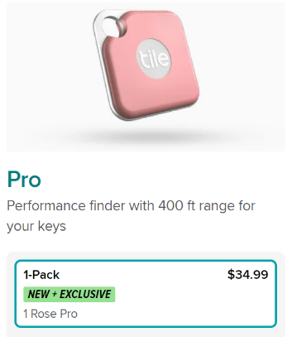
Economic Impact
Device is designed to be an affordable method for tracking autistic children.
Device uses minimal battery power and is made with abundant material.
Will be able to compete with high-tech tracking devices such as Apple or Samsung watches.
Will be marketed at a low cost (less than $100 with no monthly fees).

Slide 12
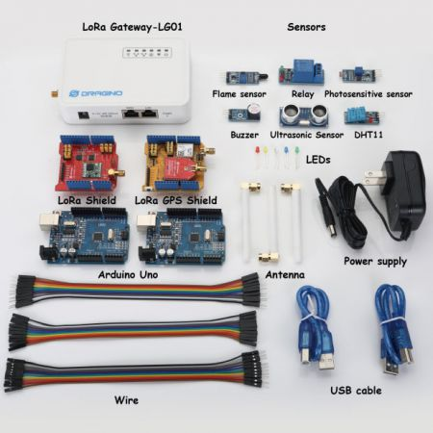
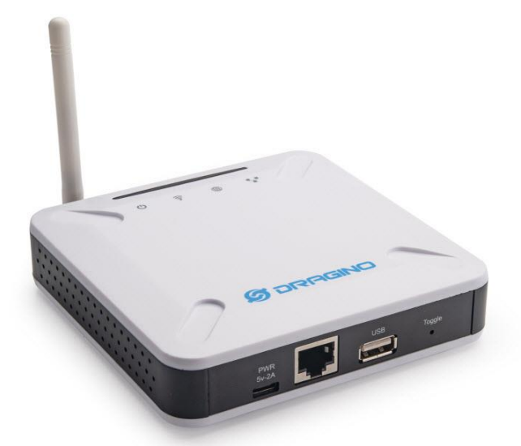
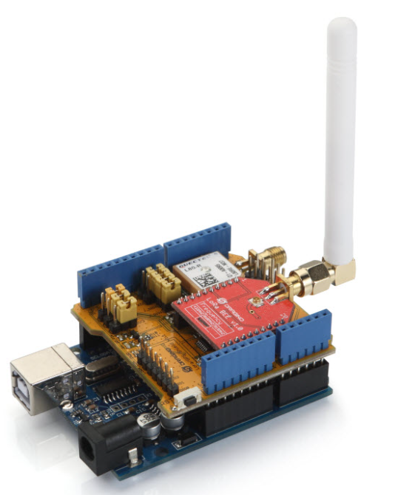
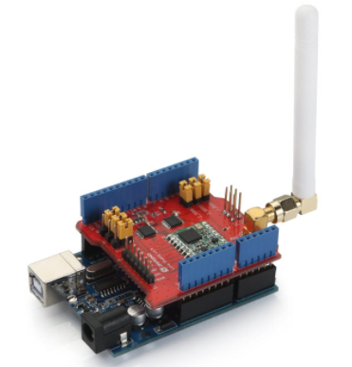
Project PArts Summary
LPS8 LoRaWAN Gateway-The gateway acts as a bridge between the tracker and The Things Network
Arduino Uno + LoRa Shield,
Arduino Uno + LoRa/GPS Shield (915 MHz)-
The shields expand the capabilities of the already powerful Arduino Uno by granting the ability to send and receive data at LoRaWAN frequencies
Dragino LoRa IoT Development Kit (915 MHz)

Slide 13
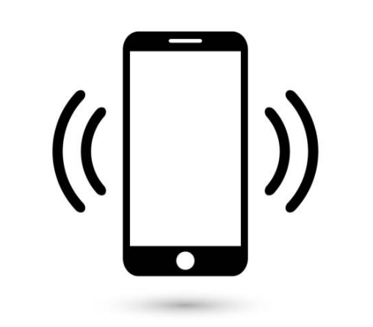

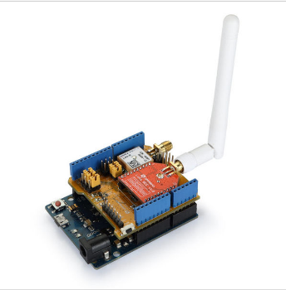

Preliminary Design
The Things Network will receive and decode data from the gateway and send to a cell phone number
(TTN)
Phone will receive GPS coordinates as a SMS message
LoRa Tracker (Arduino Uno + LoRa/GPS Shield) will transmit GPS coordinates to the gateway
LPS8 LoRaWAN gateway will receive message from tracker and forward data to The Things Network

Slide 14
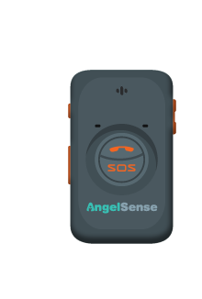
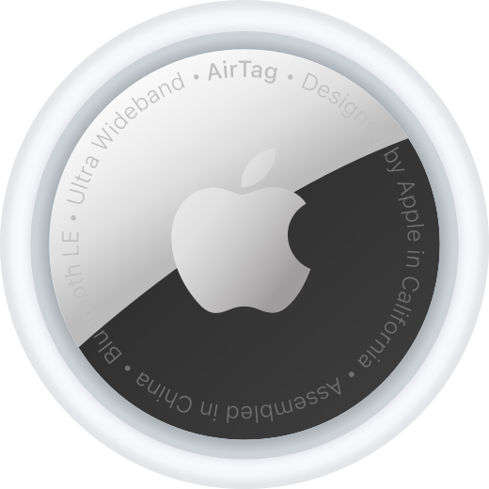

Project COmPARISON
 | Design | Pros | Cons | Cost | Continuous Service Fee | Reference
G3O |  | 1. LoRaWAN Cloud 2. Geofencing 3. Cost-Effective 4. Power- Conservative 5. Range is 2 miles | 1.Decreased performance at a remote location | TBD | No Monthly/ Yearly Fee | https://www.hackster.io/pulsartronic/diy-smartphone-lora-connection-bde258
AngelSense |  | 1. Two-way communication 2. Only parent can remove it. 3. Wi-Fi tracking | 1. Bulky 2. Expensive subscription 3. Battery life lasts less than 24 hours | $59 | $52.99 Monthly | https://gadgets-reviews.com/review/154-best-tracking-devices-for-kids-watching-your-children-with-the-help-of-gadgets.html
Apple AirTag |  | 1. No monthly Fee | Only works on iPhone Uses Bluetooth (30-foot range) | $30 | No Monthly/Yearly Fee | https://ifixscreens.com/apples-airtag-review-pros-and-cons/
Tile Mate |  | 1.Battery life of one year. 2. User-friendly App | 1. Doesn't include Geofencing 2. Range is 400 feet | $30 | $30 yearly | https://www.popularmechanics.com/technology/gadgets/a37245328/best-bluetooth-trackers/

Slide 15
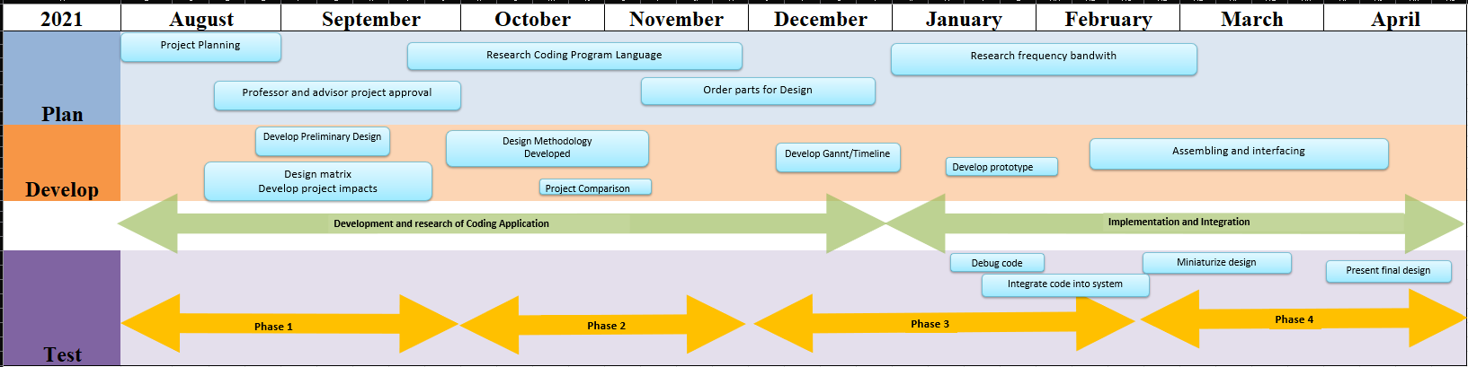
Schedule (Fall 2021 to Spring 2022)

Slide 16
Codes/Standards
IEEE 7.6: IEEE Protection of the Public: To maintain public safety with the creation of our engineering devices
IEEE 802.15.4: IEEE standard for 1` operation of low-rate wireless personal area networks - implemented in the design of the creation of the wireless network aspect of the system
IEEE 730-1998: IEEE Standard for Software Quality Assurance Plans - Implemented briefly during improving the quality of our code through integration.
IEEE 982.1-1988: IEEE Standard Dictionary of Measures to Produce Reliable Software - implemented to determine the reliability of the system.
IEEE 802.15.9-2021: A message exchange framework based on information elements as a transport method for key management protocol (KMP) datagrams and guidelines for the use of some existing KMPs with IEEE Std 802.15.4(TM) is defined in this standard.
IEEE C95.1-2019: IEEE Standard for Safety Levels with Respect to Human Exposure to Electric, Magnetic, and Electromagnetic Fields, 0 Hz to 300 GHz.
FCC 47 CFR Part 15 regulations in the US915 MHz band: The gateways produced under the US915 standards are FCC certified to run in the allowed frequency for our region.
Notes:
These are the codes and standards that we found most applicable to our project.

Slide 17
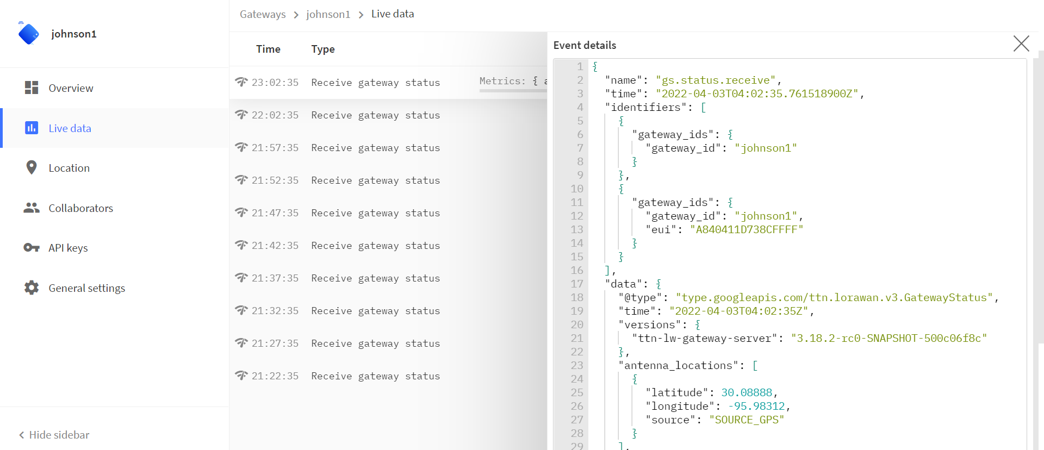
Gateway Application (www.thethingsnetwork.org)

Slide 18
Final Design
The Things Network (TTN)
The Things Network will receive and decode data from the gateway and send to a cell phone number
This is where the notification appears.
LoRa Tracker
(Arduino Uno + LoRa/GPS Shield) will transmit GPS coordinates to the gateway
LPS8 LoRaWAN gateway will receive message from tracker and forward data to The Things Network

Slide 19
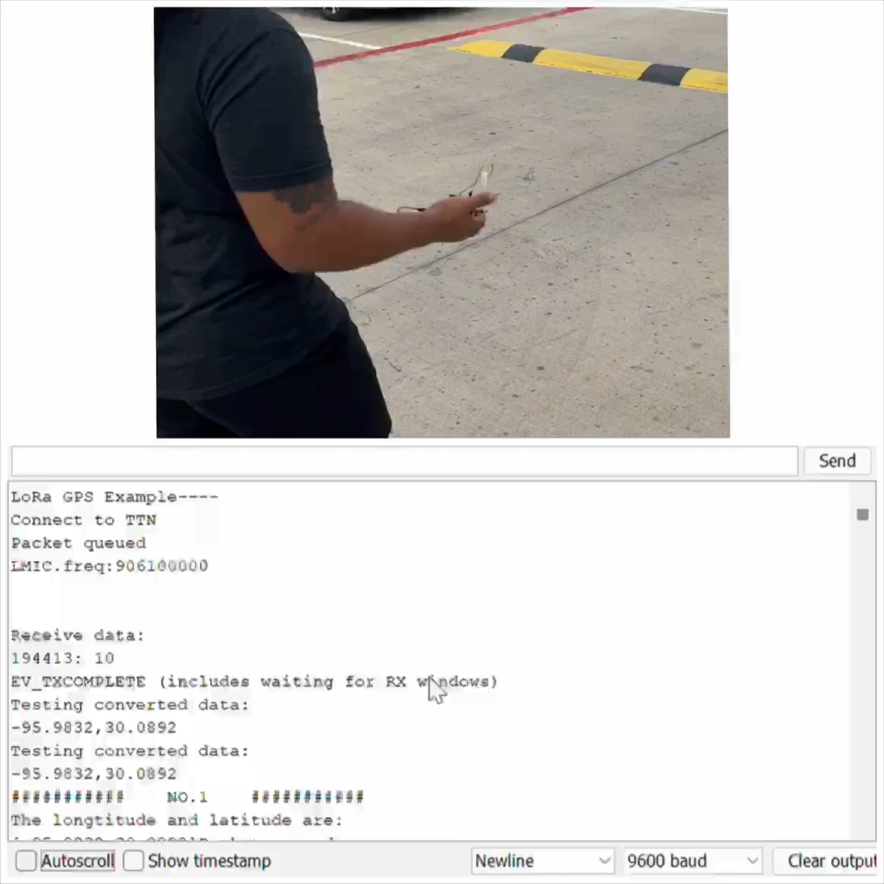
DEMO
Notes:
REMEMBER TO TURN OFF ALL AUDIO

Slide 20










Slide 21
Back Up

Slide 22
Assumptions
This product will work assuming the child does not remove the device from wrist.
Caregiver will be alerted via SMS in the event of the child wandering out of range.
Our cyber security will protect the user's personal information in the event someone tries to hack our system
Constraints
Our group has basic knowledge on coding because we are all Electrical Engineering Majors
We are required to limit the number of features we put on the wristband to save power

Slide 23
Engineering Design
Methodology
Modify/ Improve
Based on Results and data, make design changes, and review new data
Identify
Problem Statement
Requirements
Concepts
Project research
Brain Storming
Existing solution
Planning
Define objective
Plan future steps
Develop/ Create Prototype Solution
As a team, we were introduced to a new platform called LoRaWAN.
Comparison to other products based on functionality, capability and compatibility of the components. A microcontroller with low power consumption rate, global network connectively, and cost effective.
Test Solution
Launch Product

Slide 24
Acceptance Criteria
Embedded System | Software | Network/ Access point
1) The PIC chip must fit on a wristband | 1)Must run smoothly and be efficient | 1) Must effectively send signal between the tracker and transceiver
2) The geofence should detect the individual's movements | 2) Must be user-friendly | 2) Must be able to protect the user's information from third party users/hackers
3) The system must send accurate data to the application | 3) Must receive signals from the microcontroller | 3) Must provide direct access to Internet of things (IoT)
4) Should not consume a lot of battery life | 4) Must be programmed to SMS via text | 4) Will pinpoint the location of the specific individual using geofence.

Slide 25
Work Cited
Mortality & Risk in ASD wandering/elopement 2011-2016. (n.d.). Retrieved October 3, 2021, from https://nationalautismassociation.org/wp-content/uploads/2017/04/NAAMortalityRiskASDElopement.pdf.
Autism plus wandering. Child Mind Institute. (2021, September 26). Retrieved October 3, 2021, from https://childmind.org/article/autism-plus-wandering/.
Law, P. (2011, April 20). Ian Research Report: Elopement and wandering. IAN Research Report: Elopement and Wandering | Interactive Autism Network. Retrieved October 3, 2021, from https://iancommunity.org/cs/ian_research_reports/ian_research_report_elopement.
SX1272. Semtech. (n.d.). Retrieved October 3, 2021, from https://www.semtech.com/products/wireless-rf/lora-core/sx1272.
Griffey-Hill, L. (2020, June 2). ChirpStack - A LoRawan network server to make you sing. Pycom. Retrieved October 3, 2021, from https://pycom.io/chirpstack-a-lorawan-network-server-to-make-you-sing/.

Slide 26
Geo-location for People with Special Needs
Team 3
Instructor: Mr. Turner/ Dr. Musa
Team Sponsor: ​
Dr. Annamalai

Slide 27
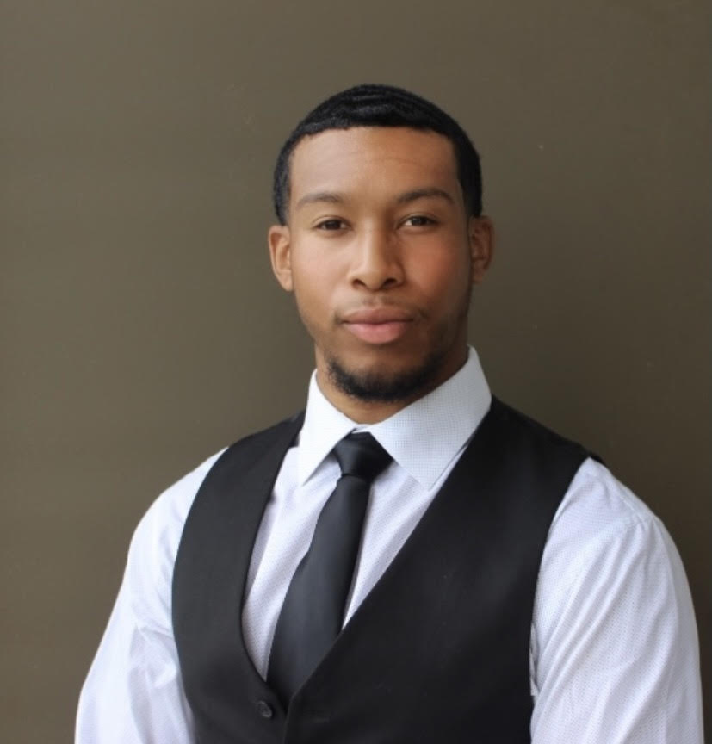
Team Overview
Johnn Owens
Team Leader
Alternate: Test Lead
Electrical Engineering
Adeola Okeowo
Data Analyst
Alternate: Scribe
Electrical Engineering
Trevor Johnson
Software Developer
Alternate: Team Lead
Electrical Engineering
Michael Shepard
Scribe
Alternate: Purchasing Lead
Electrical Engineering
Osesiye Ayeni
Test Lead
Alternate: Data Analyst
Electrical Engineering

Slide 28
Mission Statement:
The main goal of this project is to create an affordable, robust, and effective solution to locate special-needs individuals by investigating viability, performing a feasibility study, and implementing geo-location-based technology in a LoRaWAN (Long Range Wide Area Network) platform.
Target Audience:
Parents/Care-givers of special need Individual
Problem Statement:
One of the major concerns of caregivers who tend to special needs individuals is how to find an affordable solution to prevent them from wandering from their safe environment. According to statistics, "roughly 50 percent of children between the ages of 4 and 10 with autism wander at some point. More than half of these wandering children go missing – often into dangerous situations." (autismspeaks.org)
Notes:
Problem Statement
We recognize the struggle to keep track of people with special needs, so we have designed a prototype to aid caregivers with an affordable solution. One of the biggest concerns of caregivers who tend to people with autism is how to prevent wandering from their safe environment. This is because nearly 50% of children with autism disorder engage in wandering behavior. When a loved one goes missing, even if it is for a short duration, the agonizing moments experienced by family members and caregivers is unimaginable.

Slide 29
Prospective Plan
Budget:
Project Budget: $ 500.00
Amount Spent: $ 260.00
Proposed Deliverables: Creating a LoRa IoT (Internet of Things) device for wireless data communications that will send a small amount of data over a long distance at a low data rate periodically. We will be using LoRa tracker which will transmit a signal to the LoRaWAN gateway. With the influence of Arduino programming, the gateway will convert the coordinates of the tracker’s location into a text message to be sent to a cellular device.
Notes:
We will approach this challenge by creating a loRa-based IOT device that sends a signal to the loRaWan gateway which will interface with the IOT tracker which sends an SMS to the mobile device. The goal is to implement a wider network coverage in a safe and secure server. Which will transmit a signal to the LoRaWAN gateway, with the influence of Arduino programming, the gateway will convert the location into a text message to be sent to an android device.

Slide 30
Customer Requirements and Engineering Solutions:
Reliable and consistent tracking system- Our solution is to effectively implement LoRaWAN technology.
Alert system through notifications- Our solution is to implement geo fencing
Mobile application interface should be user friendly- Our solution is an SMS alert as soon as the individual steps out the boundary.
Lightweight/portable- Our solution Peripheral Interface Controller (PIC) will fit in case
Low Cost and affordable – Our solution is implementing Internet of Things (IoT) to our system.
Sufficient Battery life – Using LoRaWAN provides that for us. Battery should last up to at least a week.
Major Constraints:
Our group has basic knowledge on coding because we are all Electrical engineering majors.
We are required to limit the number of features we put on the wristband to save power.

Slide 31
Benefits/ Impacts
Safety:
This project will reduce the rates of elopement in autistic youth through the implementation of our device
Economical:
Will be able to compete with high-tech tracking devices such as Apple or Samsung watches while being marketed at a low affordable cost.
Technical:
This device uses LoRaWAN/Cellular based technology which creates wider range of coverage.
Social:
This device will help reduce social isolation in autistic youth
Notes:
Statistics show that roughly half of children with autism between the ages of 4 and 10 attempt to elope.
Out of 808 reported autistic missing person cases of wandering in the US (2011-2016), 17% resulted in death.
Device is designed to be an affordable method for tracking autistic children.
Device uses minimal battery power and is made with abundant material.
According to Child Mind Institute, various parents stated that wandering is the most stressful autistic behavior
62% of parents of autistic children stated fear of their child wandering prevented them from participating in activities outside the home, increasing their social isolation
40% of these already exhausted parents said they lost sleep while worrying about a potential escape during the night.
In an ideal IoT device, data transmission is kept to a minimum to conserve power.
LoRa-based sensors do not need to pair with a gateway before sending data, which further reduces energy use and prolongs battery life.

Slide 32
Codes/Standards
IEEE 7.6: IEEE Protection of the Public: To maintain public safety with the creation of our engineering devices
IEEE 802.15.4: IEEE standard for 1` operation of low-rate wireless personal area networks - implemented in the design of the creation of the wireless network aspect of the system
IEEE 730-1998: IEEE Standard for Software Quality Assurance Plans - Implemented briefly during improving the quality of our code through integration.
IEEE 982.1-1988: IEEE Standard Dictionary of Measures to Produce Reliable Software - implemented to determine the reliability of the system.
IEEE 802.15.9-2021: A message exchange framework based on information elements as a transport method for key management protocol (KMP) datagrams and guidelines for the use of some existing KMPs with IEEE Std 802.15.4(TM) is defined in this standard.
IEEE C95.1-2019: IEEE Standard for Safety Levels with Respect to Human Exposure to Electric, Magnetic, and Electromagnetic Fields, 0 Hz to 300 GHz.
FCC 47 CFR Part 15 regulations in the US915 MHz band: The gateways produced under the US915 standards are FCC certified to run in the allowed frequency for our region.

Slide 33
ANY Questions?

