Slide 1
Back Up

Slide 2
Assumptions:
The actuator will be able to control multiple dosers
We will receive most test equipment from Chart Industries
Interface through HMI will be user friendly
We will receive support and documentation from Exor
Constraints:
Learning curve on schematics and PCB design
Due to COVID-19 over sea shipping times have increased
Time-Zone difference with Exor and Chart Industries reps

Slide 3
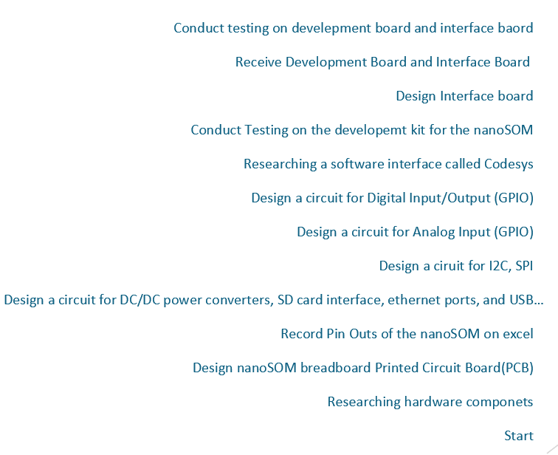
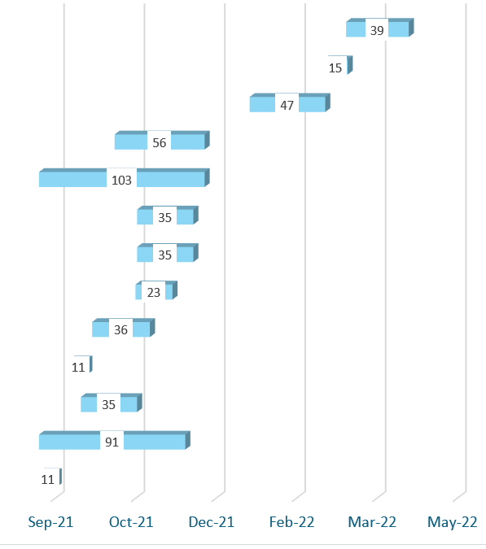
Timeline

Slide 4
Codes & Standards
IEEE: Institute of Electrical and Electronics Engineers
IEEE 829-2008: IEEE Standard for Software and System Test Documentation – This standard was used as the guidelines to follow when testing the performance of our system as well as functionality of individual parts.
7.8 IEEE Code of Ethics: To uphold the highest standards of integrity, responsible behavior, and ethical conduct in professional activities -The IEEE codes of ethics were utilized throughout our design, development, and testing processes.
IEC: International Electrotechnical Commission
IEC 61010-2-202: IEC Safety requirements for electrical equipment for measurement, control, and laboratory use – This standard outlines the safety guidelines to be followed when working on/building our controller for the actuator.
IPC: Interconnecting and Packaging Electronic Circuits
IPC-2221: This is a standard from IPC that outlines what we had to keep in mind regarding design layouts, parts lists, materials, mechanical and physical properties.
IPC-A-600F: This standard outlined the acceptance criteria for building our board as well as what to look for in terms of defects and incident prevention.
IPC-9701A: This specification establishes specific test methods to evaluate the performance and reliability of surface mount solder attachments of electronic assemblies. - This standard outlines guidelines to be followed when placing our NanoSOM chip on the Printed Circuit Board (PCB).
IPC- 7711C/7721C: prescribes the procedural requirements, tools, materials and methods to be used in the rework, repair, modification, overhaul or restoration of electronic products. – This standard outlines standards to be followed if/when we need to make design changes to PCB upon analyzing testing results
IPC-A-610: IPC-A-610 standard includes requirements and guidelines to help PCBA assembly manufacturers ensure that their manufacturing process meets acceptable quality levels.- standard that ensures our PCB will be meet all design inspection guidelines

Slide 5
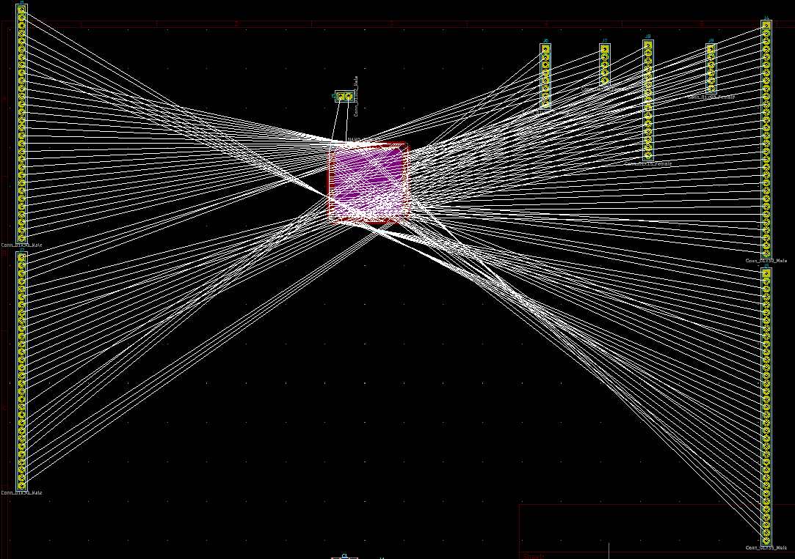
Phase 1
Board View of test board

Slide 6
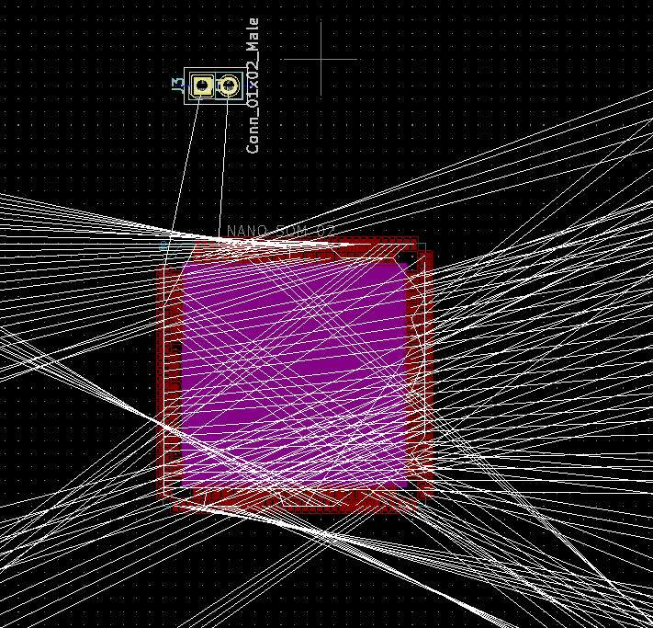
Board View of NanoSOM

Slide 7
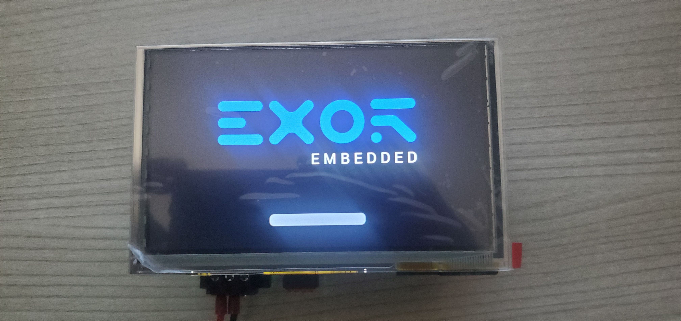
Phase 2
OpenHMI Development Kit​

