Slide 1
Phase 2 of Design

Slide 2
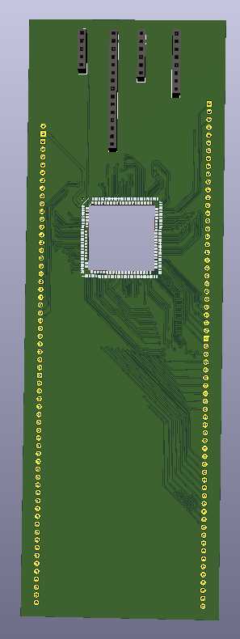
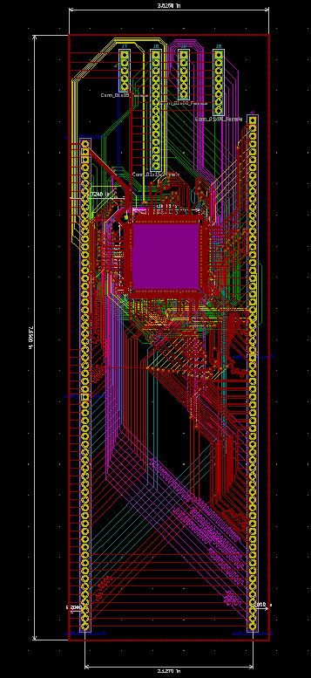
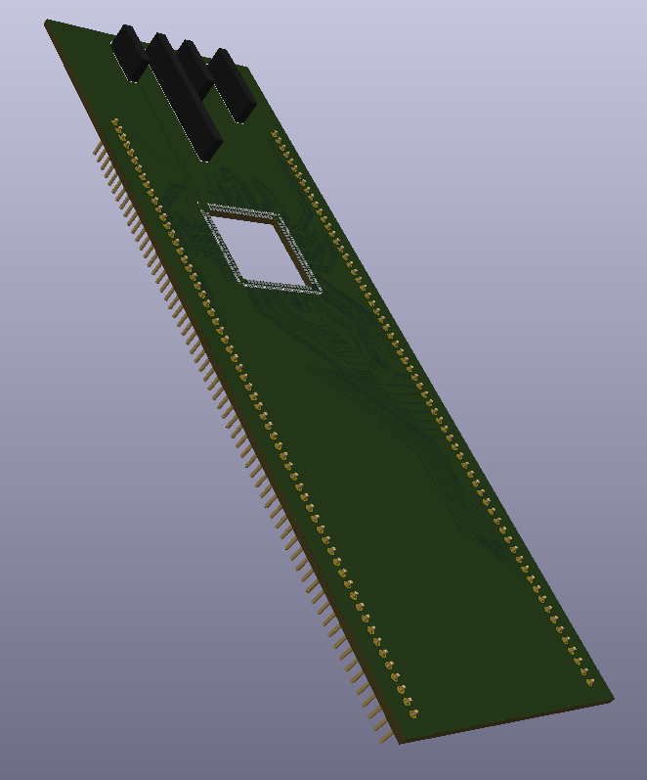
Phase 2
Board View of Test Board

Slide 3
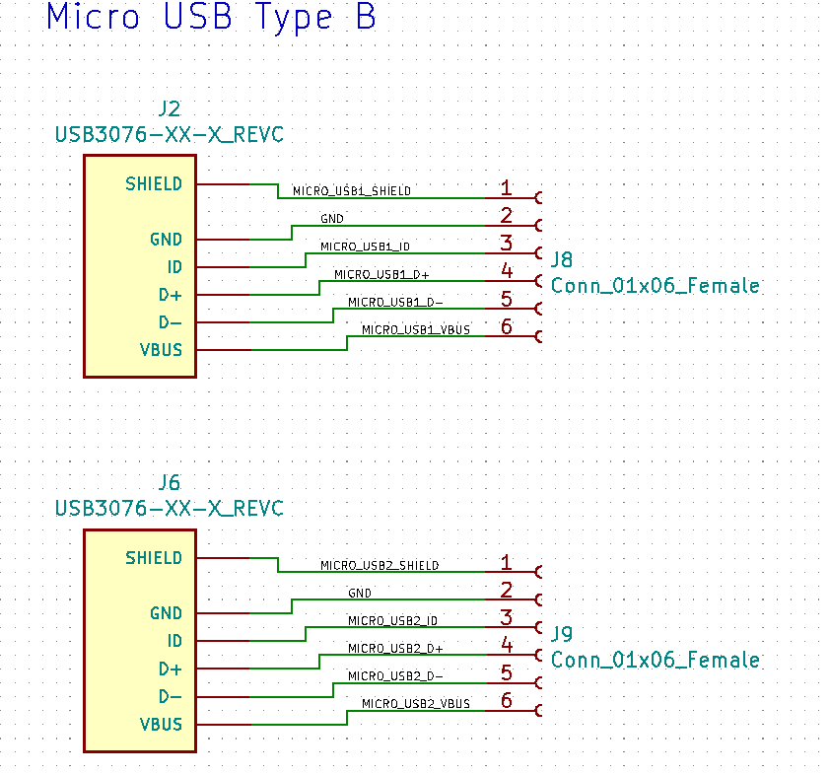
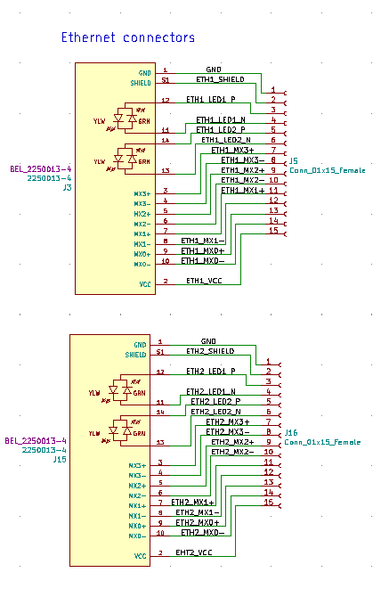
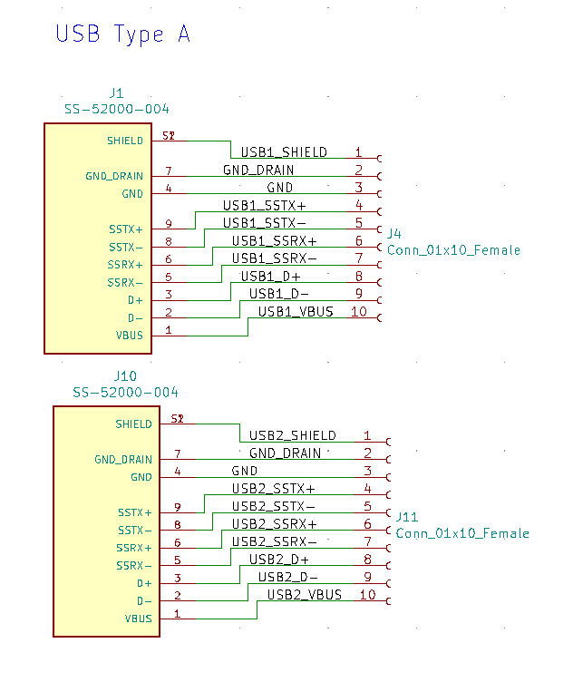
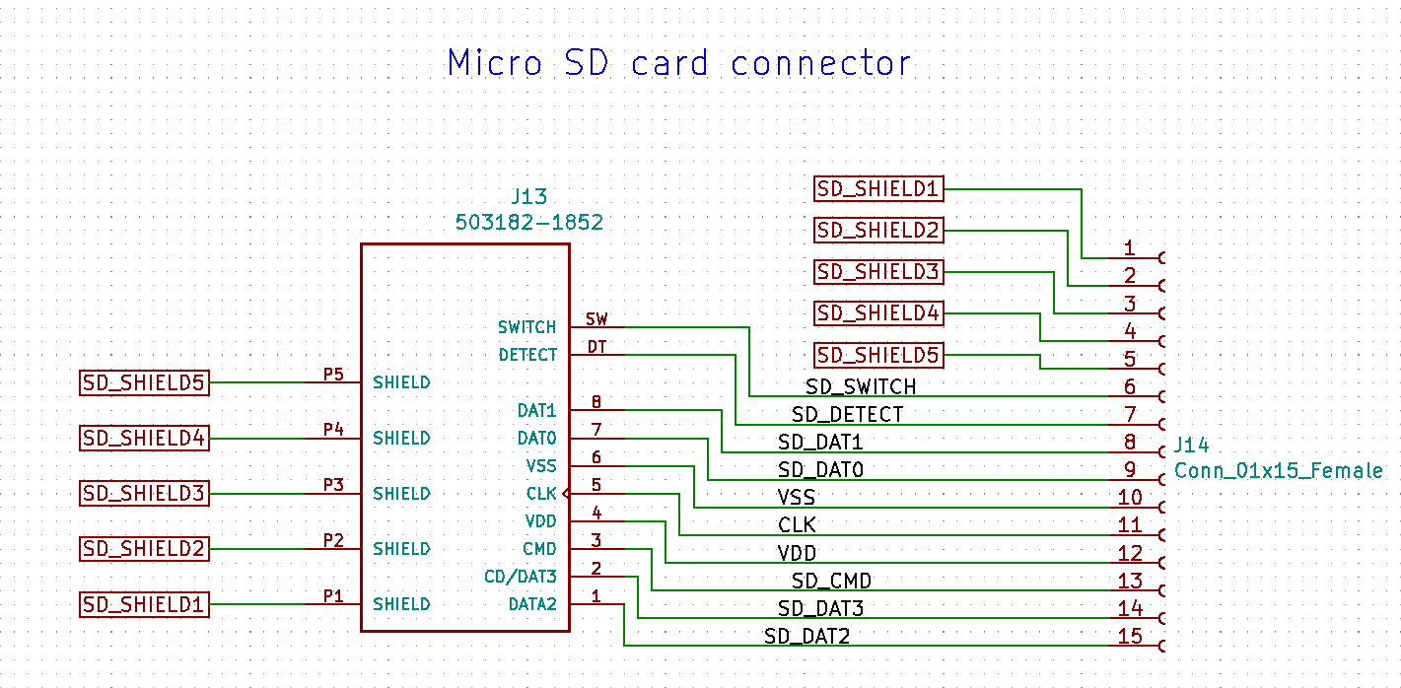
Phase 2

Slide 4
Phase 2

Slide 5
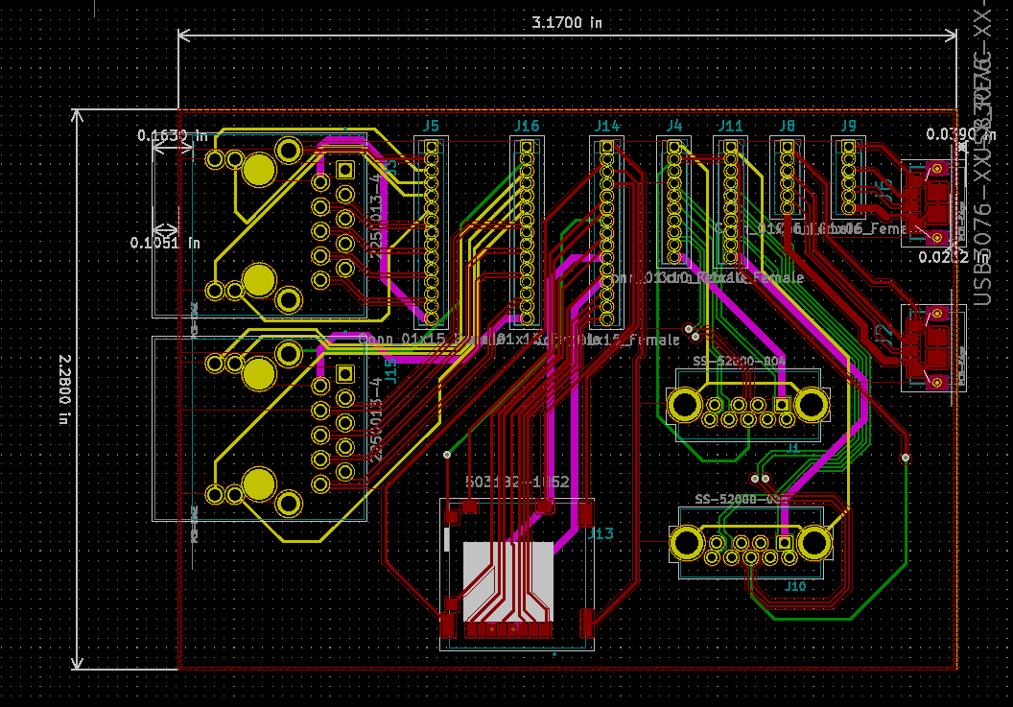
Phase 2
PCB Layout View of Interface Board

Slide 6
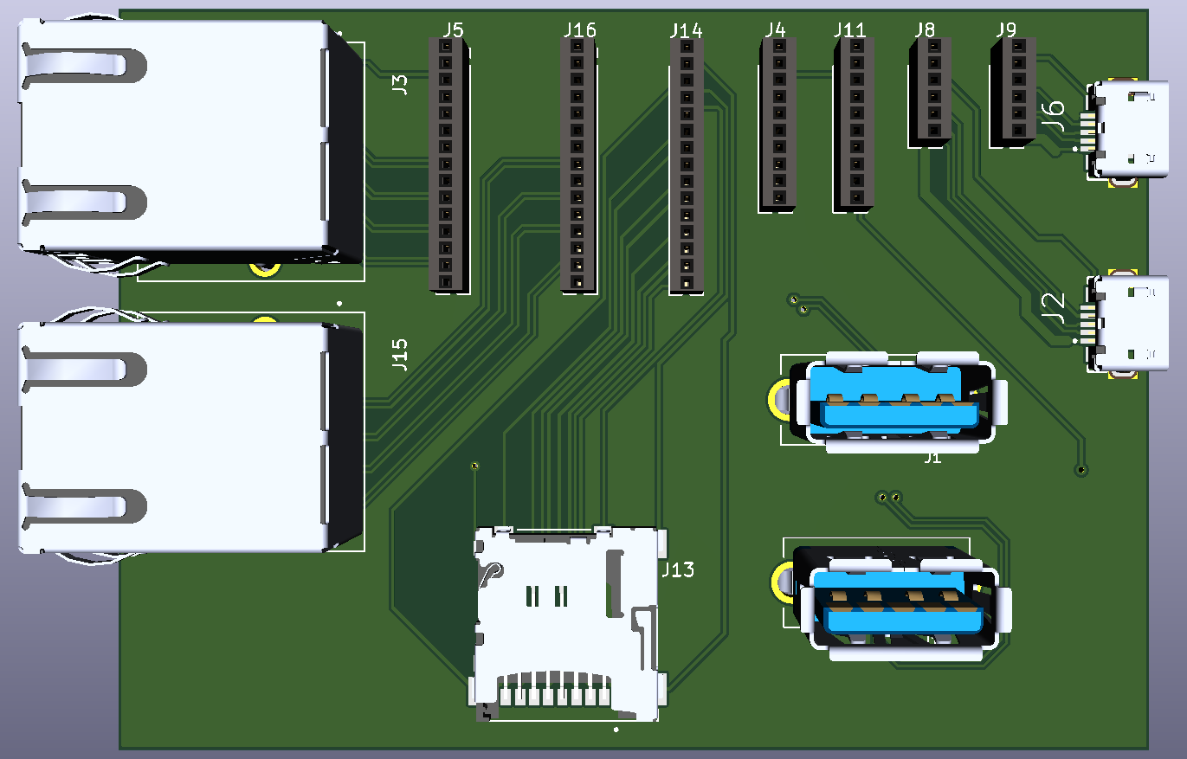
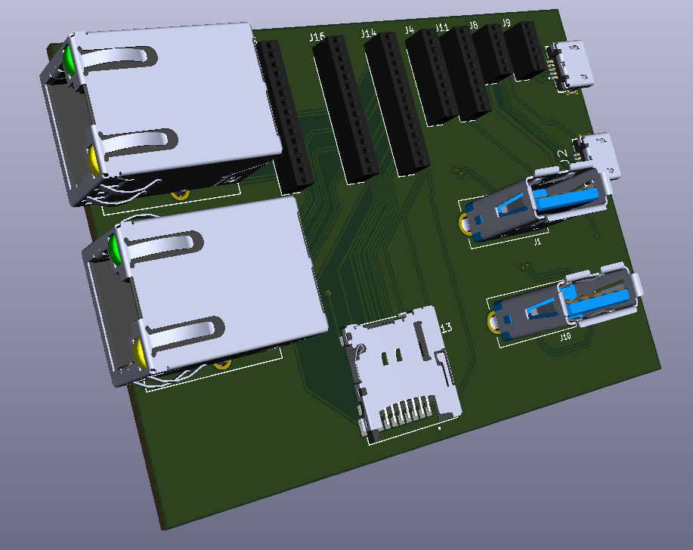
Phase 2
3D View of Interface Board

Slide 7
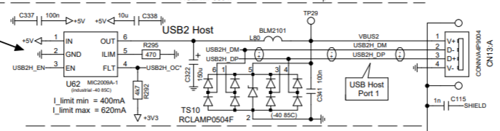
Phase 2
USB Wiring Schematic

Slide 8
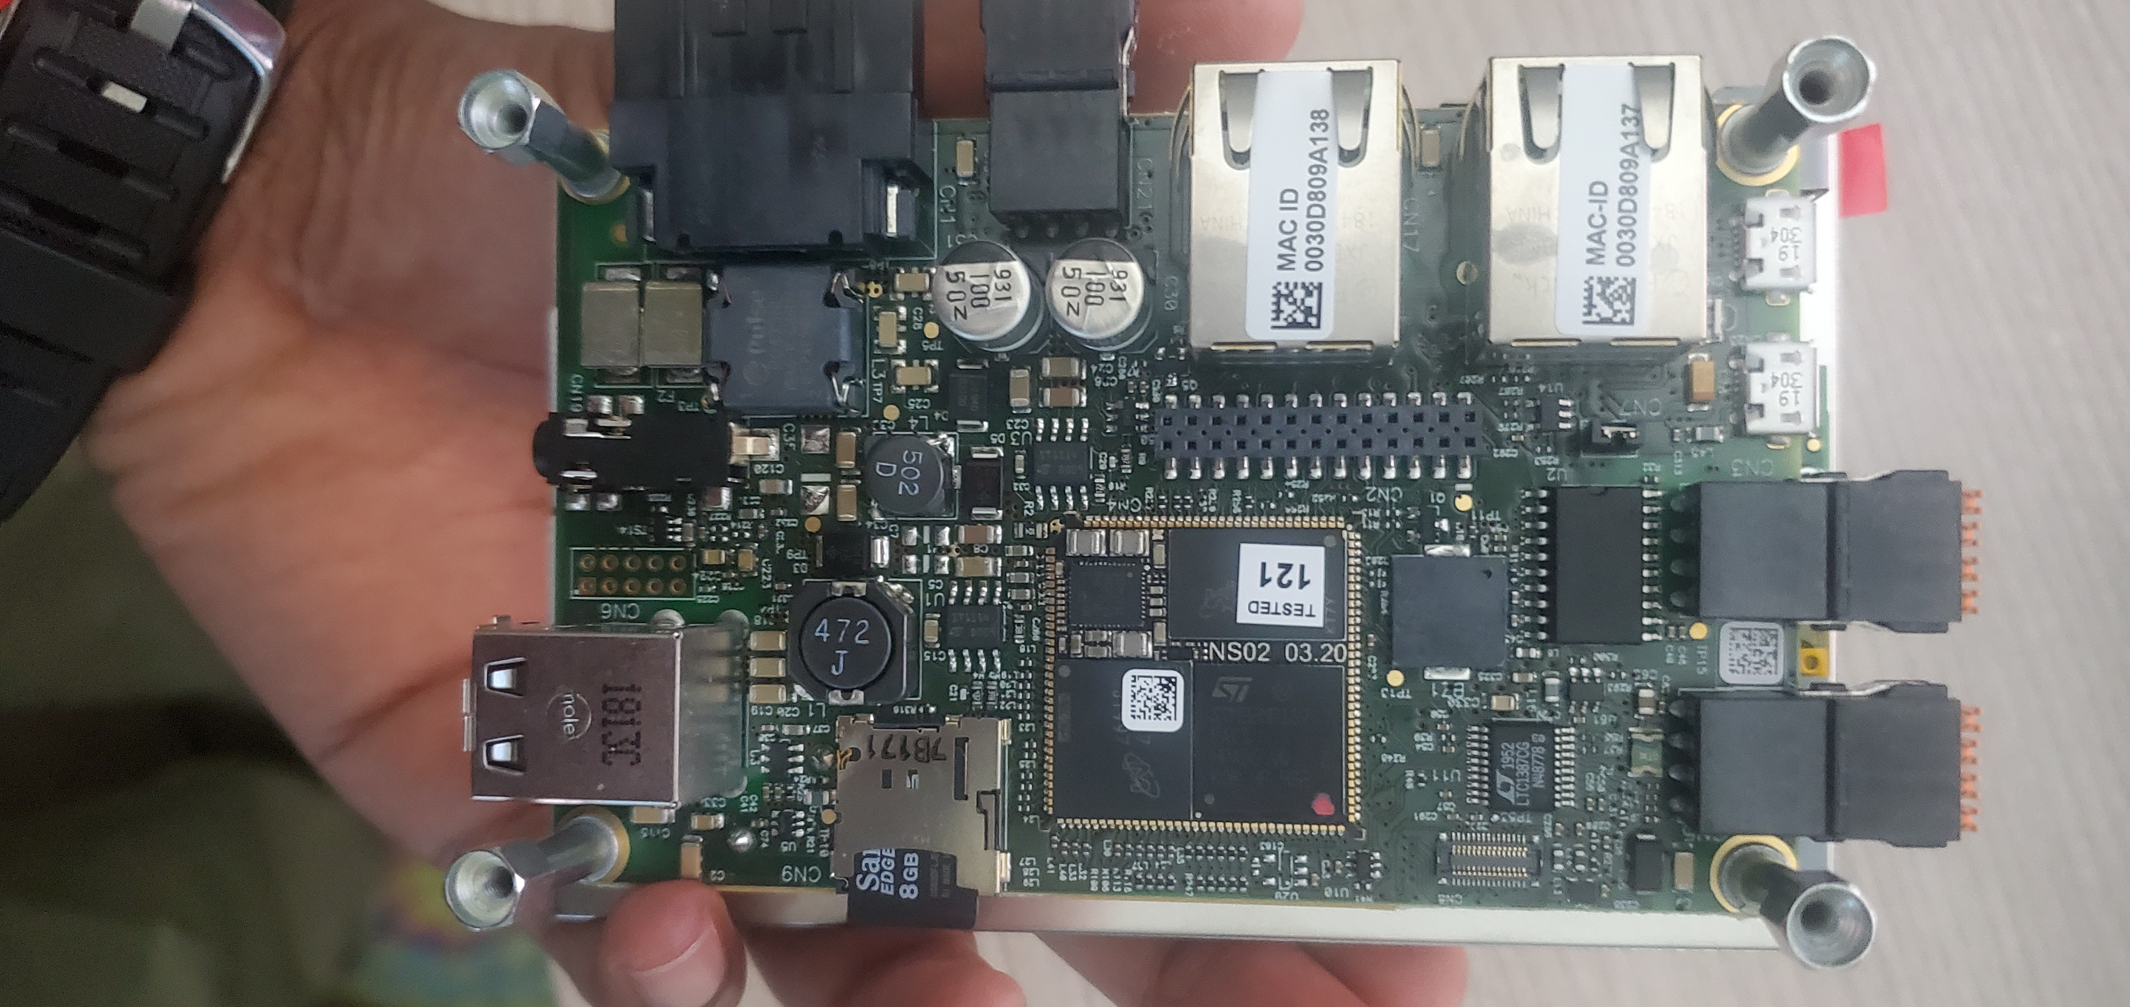
Phase 2
OpenHMI Board

Slide 9
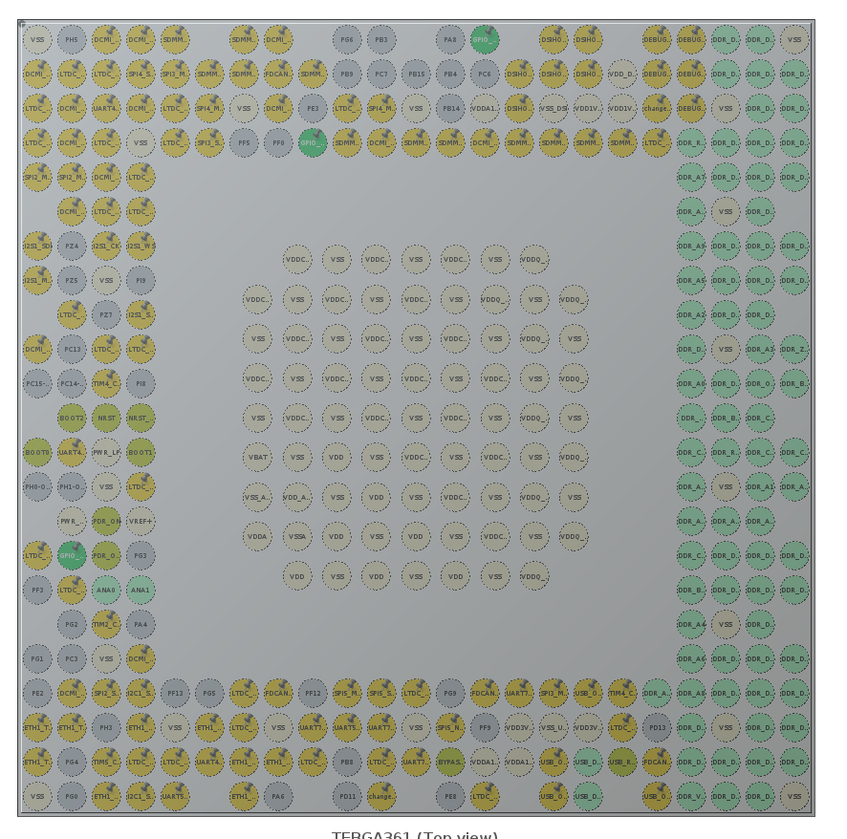
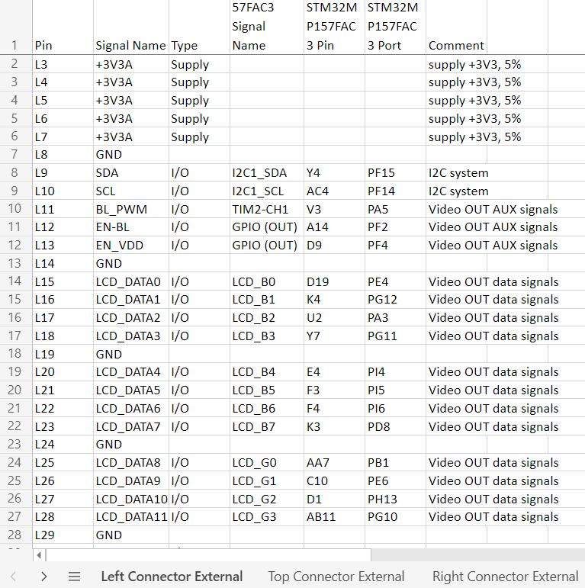
Phase 2
Pin Reprogramming
Notes:
Limited GPIO available is the reason we are reprograming the pins.

Slide 10
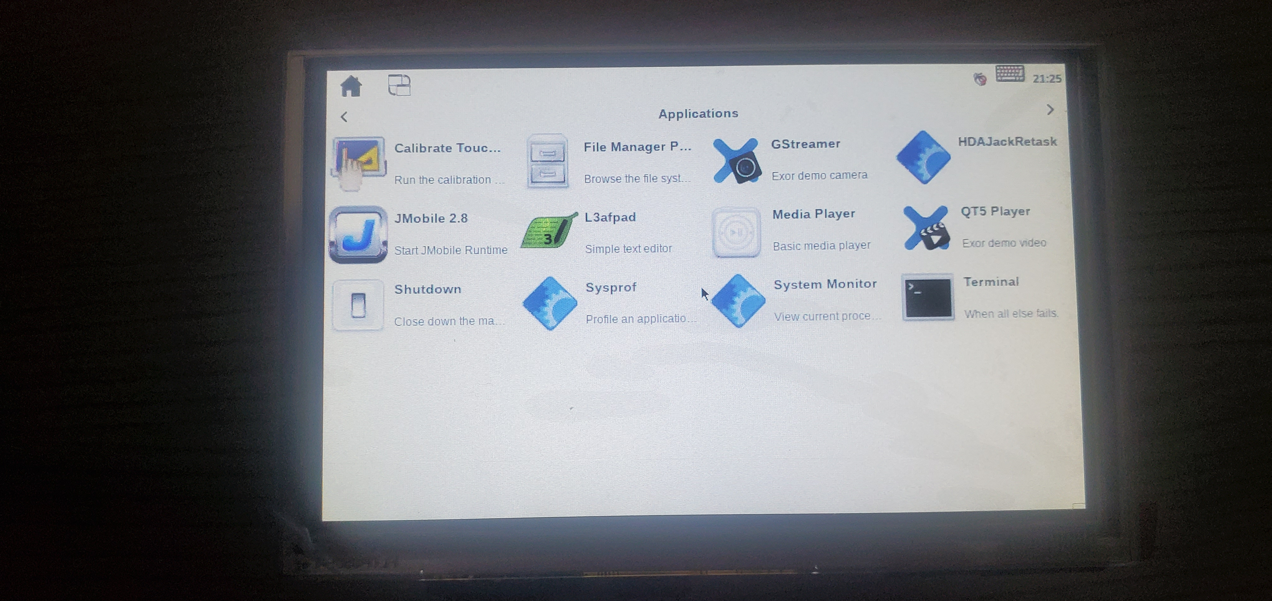
Phase 2
OpenHMI Development Kit​

