Slide 1
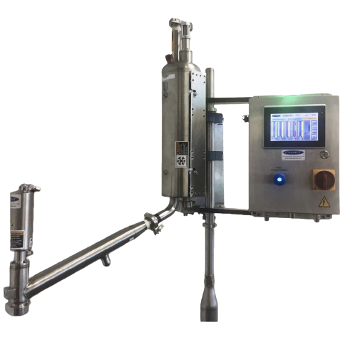
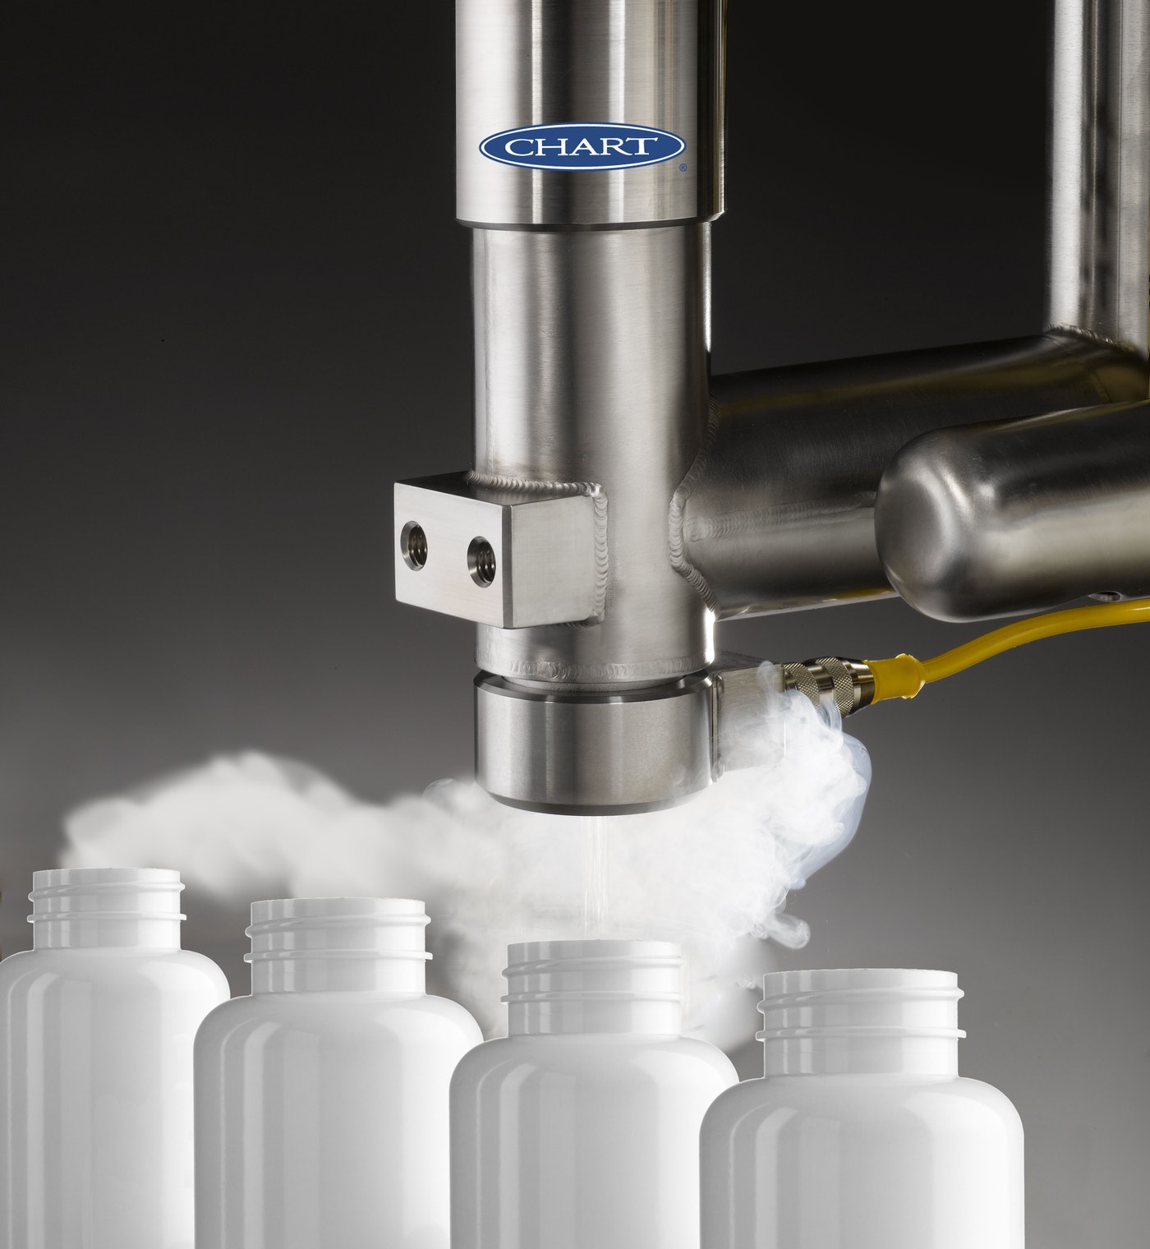

Liquid Nitrogen Doser
Smart Actuator
Sponsored by:
Team 2:
Hyram Pouncy
Matthew Barnett
George Polk
Bryce Lovejoy
Breon Holmes
Instructor: Mr. Turner
Team Sponsor: Paul Rybak
and David Fink
Team Facilitator: Mr. Hill

Slide 2



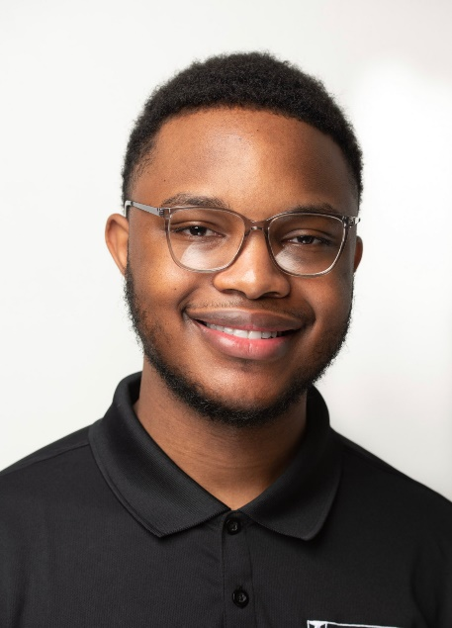

Team Overview
Hyram Pouncy
Team Lead
Scribe
C.E.
Matthew Barnett
Software Lead
Test Engineer
C.E.
Breon Holmes
Hardware Lead
E.E.
George Polk
Test Lead
Data Analyst
E.E.
Bryce Lovejoy
Purchasing Lead
Hardware engineer
E.E.
2

Slide 3
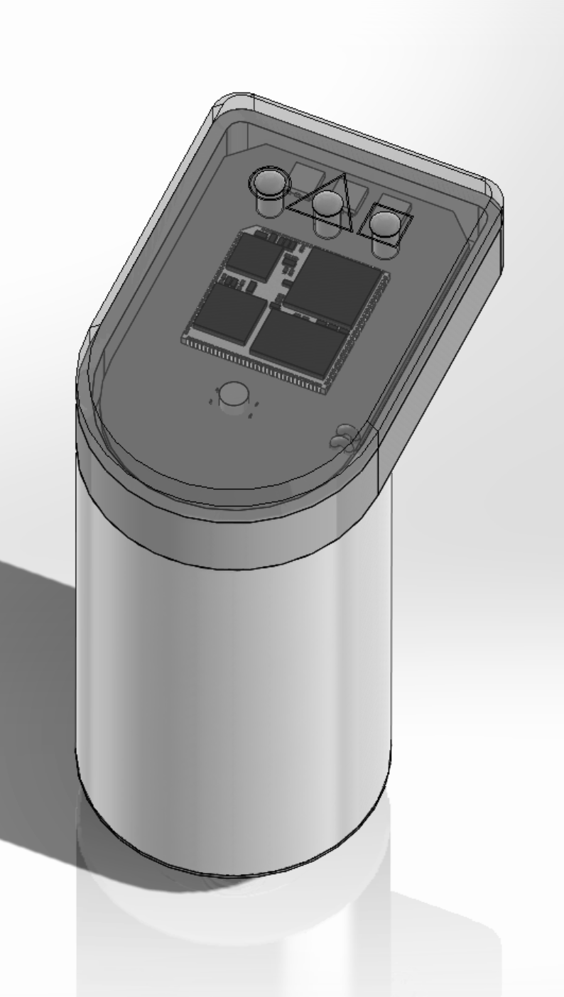
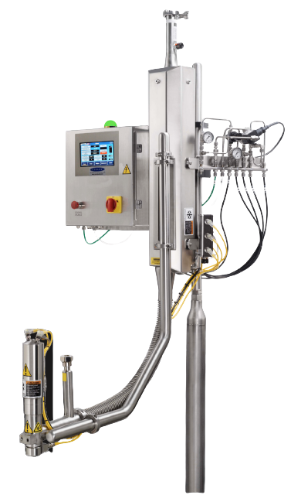
What is an Actuator?
Actuator
Doser
An actuator is a component of a machine that is responsible for moving and controlling a mechanism or system
Notes:
An actuator is a component of a machine that is responsible for moving and controlling a mechanism or system

Slide 4
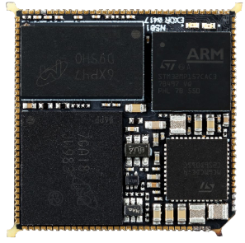
Introduction
nanoSOM
Problem Statement:
Traditionally, Chart’s Nitrogen Dosers use a central programmable controller (PLC) to handle all functions for an automated dosing application in which all remote inputs and outputs are wired back to the main controller.
Objective:
The goal of this project is to design a smart Internet of Things (IOT) controller for liquid nitrogen dosing actuators based on an Exor nano System-on-Module (nanoSOM), which will increase the number of actuators they can use in a system as well as line speed to go along with other factors

Slide 5
Marketing Requirements | Engineering Requirements | Justification
Actuators must be able to perform different tasks | Using the nanoSOM nS02 chip to assign the different tasks | Be more efficient and increase production
Actuators must be autonomous | Using nanoSOM nS02 chip to control each individual actuator | Cut cost and reduce system size
Interface for actuators should be user friendly | The HMI nS02 interface software will be used to control actuators | Easy to use for setting changes
Each actuator must be able to detect motion and read temperature | Photoelectronic sensors will be programed to detect motion and temperature | Actuator must provide proper dosing to each individual item
Actuators must have sensors to monitor inputs for line speed and part detection | ExacTrack technology. An encoder would be used for higher line speeds | To be able to efficiently dose each individual part.
Notes:
We just need Marketing Requirements for now
9/15/21

Slide 6
Project Impact Summary
Category | Project Applicability
Public Health, Safety, and Welfare
Global
Cultural
Social
Environmental
Economic Factors
Technical

Slide 7
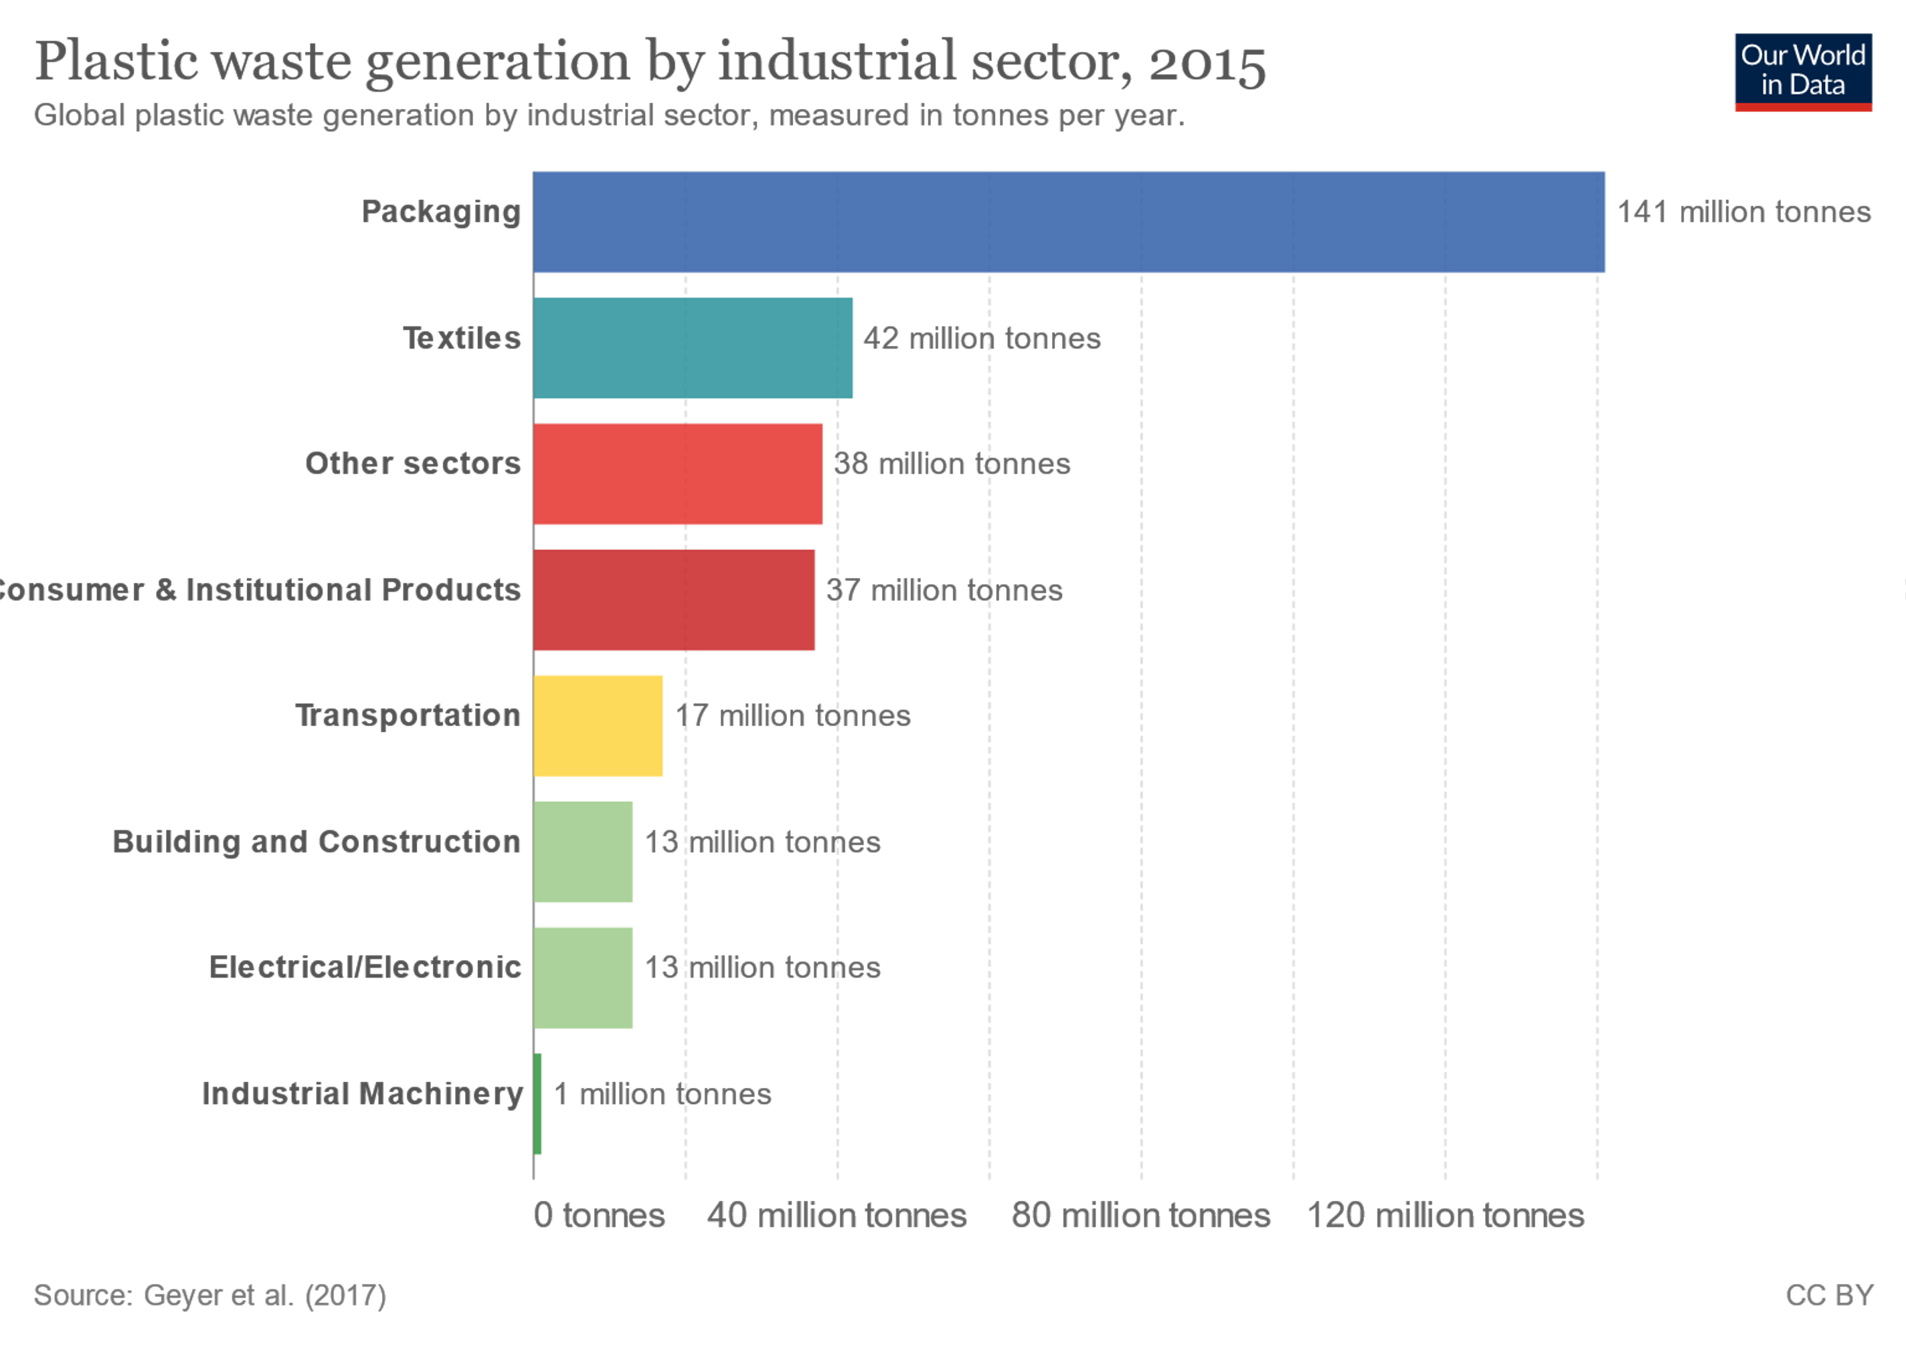
Project Impact : Environmental
Predicted that, by 2050, the mass of plastic in the world’s oceans will exceed the mass of all the fish that live there (Forbes, 2018)
The annual amount of plastic that will be saved using Chart’s LN2 MicroDose™ Technology in four filling operations in Brazil is close to 1.6 million pounds (726 thousand kg) which is the equivalent to 24 adult humpback whales
New packaging line utilizes lightweight 15 grams/900ml Polyethylene terephthalate (PET) bottles, operating at 36,000 bottles per hour which in turn reduces carbon footprint by using less plastic

Slide 8
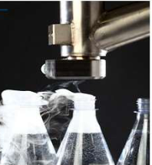
Project Impact: Economical
Currently each component within the dosing system is controlled with a single controller consisting of an independent Human Machine Interface (HMI) and independent PLC totaling $4,500
New IOT design will replace the HMI/PLC controller with a SOM module in each controlled device increasing the cost of the individual component $225 but reducing the overall system cost by at least $1,000
With the overall control system savings Chart will save an estimated $200,000 annually based on the sales of 200 units per year.

Slide 9
Project Impact:
Technical
Limitations within current system relate to the number of actuators in a system as well as the line speed and other factors.
By making each liquid nitrogen dosing actuator smart and independent, the system size is no longer an issue, and the overall cost is reduced

Slide 10
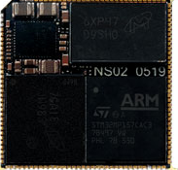

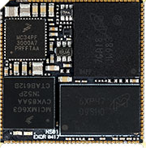
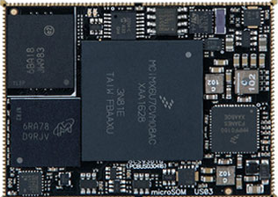
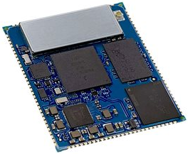
Parts Comparison
Design Options | Image | Pros | Cons | Selection | References
NanoSOM nSO2 |  | Compact Efficient Reliable | Limited inputs |  | https://www.cnx-software.com/2020/08/11/exor-nanosom-ns02-system-on-module-features-the-800mhz-version-of-stm32mp1-processor/
NanoSOM nSO1 |  | Compact | Limited inputs Less Reliable Less Efficient |  | https://www.exorint.com/en/product/nanosom-ns01
MicroSOM uSO1 |  | Efficient High Compatibility | Bigger in size Less Reliable |  | https://www.exorint.com/en/product/microsom-us01
Digi ConnectCore 8M Nano SOM |  | Reliable High Compatibility | Bigger in size Less Efficient |  | https://www.digi.com/products/embedded-systems/system-on-modules/i-mx-8m-nano-som
Notes:
Nitrogen Dosing | Chart Industries
Nitrogen Dosing - Keen Compressed Gas Co. (keengas.com)
Nitrogen Gas Generators | On-demand High-Purity | South-Tek Systems (southteksystems.com)
Nitrogen dosing - Application (stirlingcryogenics.eu)
Liquid Nitrogen Dosing Machine | LN2 Doser Machine Supplier - CSM (csm-cryogenic.com)

Slide 11
Codes & Standards
IEEE: Institute of Electrical and Electronics Engineers
IEEE 829-2008: IEEE Standard for Software and System Test Documentation
7.8 IEEE Code of Ethics
IEC: International Electrotechnical Commission
IEC 61010-2-202: Safety Requirements for Electrical Equipment For Measurement, Control and Laboratory Use
IPC: Interconnecting and Packaging Electronic Circuits
IPC-2221: Standards for the printed circuit board design, component mounting, and interconnections
IPC-A-600F: Standard for printed circuit boards
IPC-9701A: Performance Test Methods and Qualification Requirements for Surface Mount Solder Attachments
IPC- 7711C/7721C: Rework, Modification and Repair of Electronic Assemblies
IPC-A-610: Acceptability of Electronic Assemblies

Slide 12
Design Methodology

Slide 13
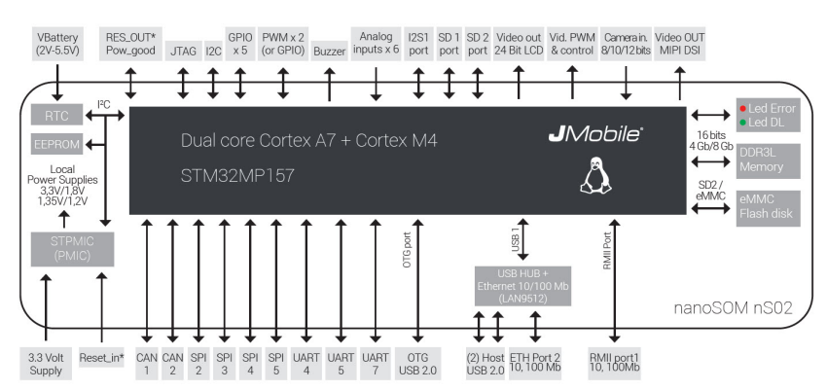
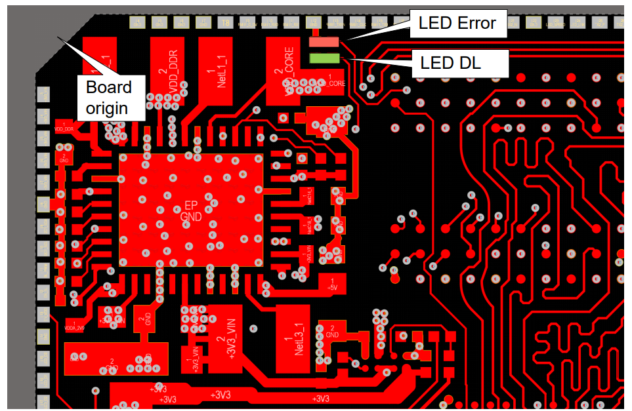
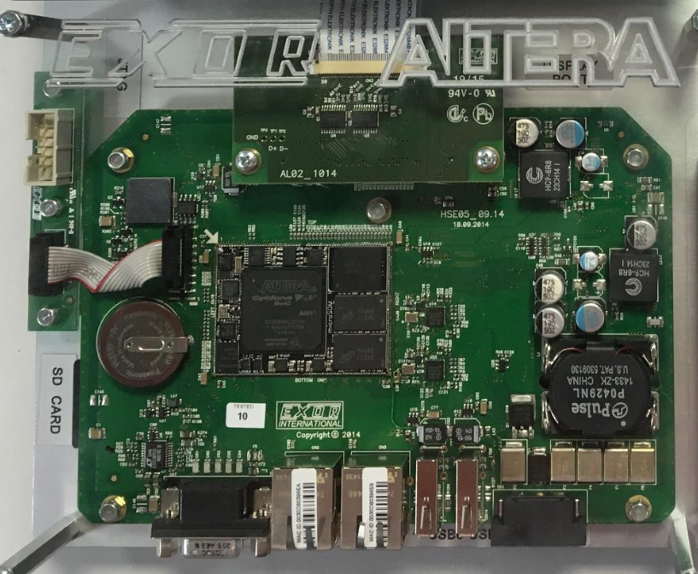
Hardware design process
Board Specifications
Block Diagram
Schematics
PCB Layout
File Release
PCB Fabrication and Assembly
Testing
Notes:
Explain what a Gerber file is

Slide 14
Phase 1 of Design

Slide 15
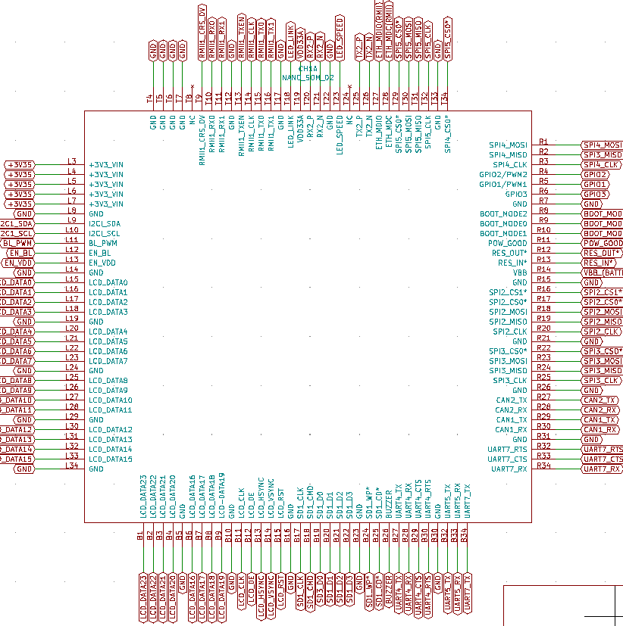
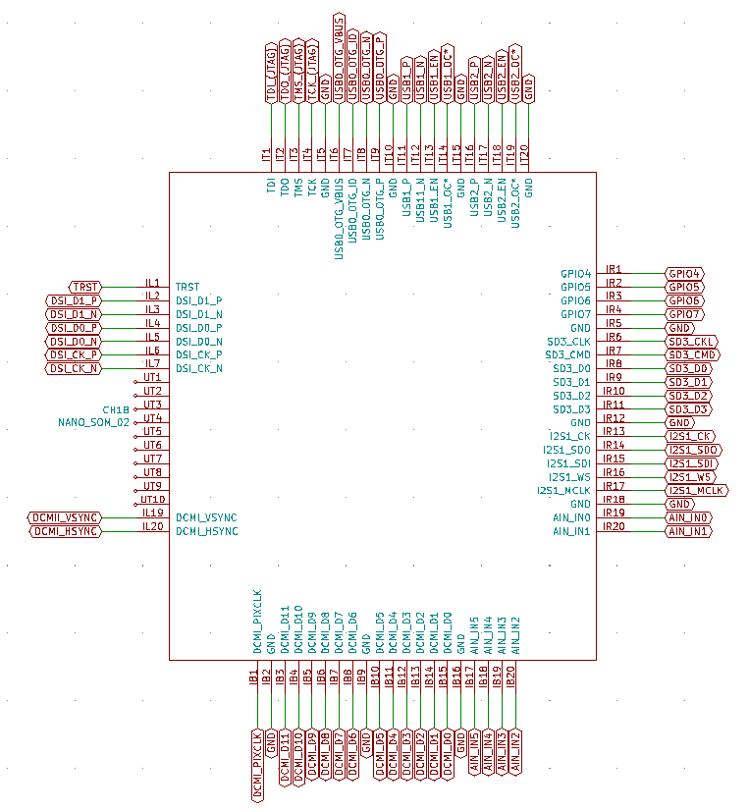
Phase 1
External Connector Pad of NanoSOM02
Internal Connector Pad of NanoSOM02

Slide 16
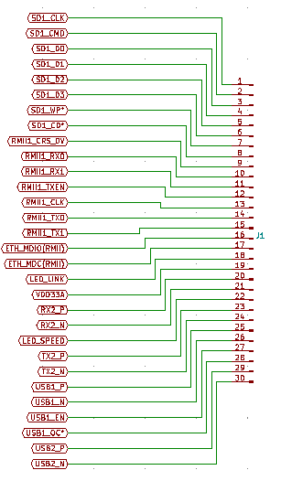
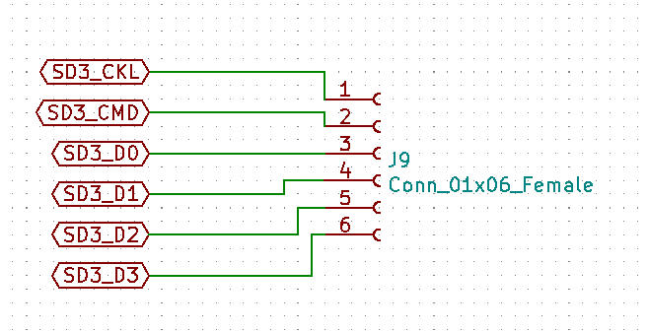
Phase 1
Male connectors
Female connectors

Slide 17
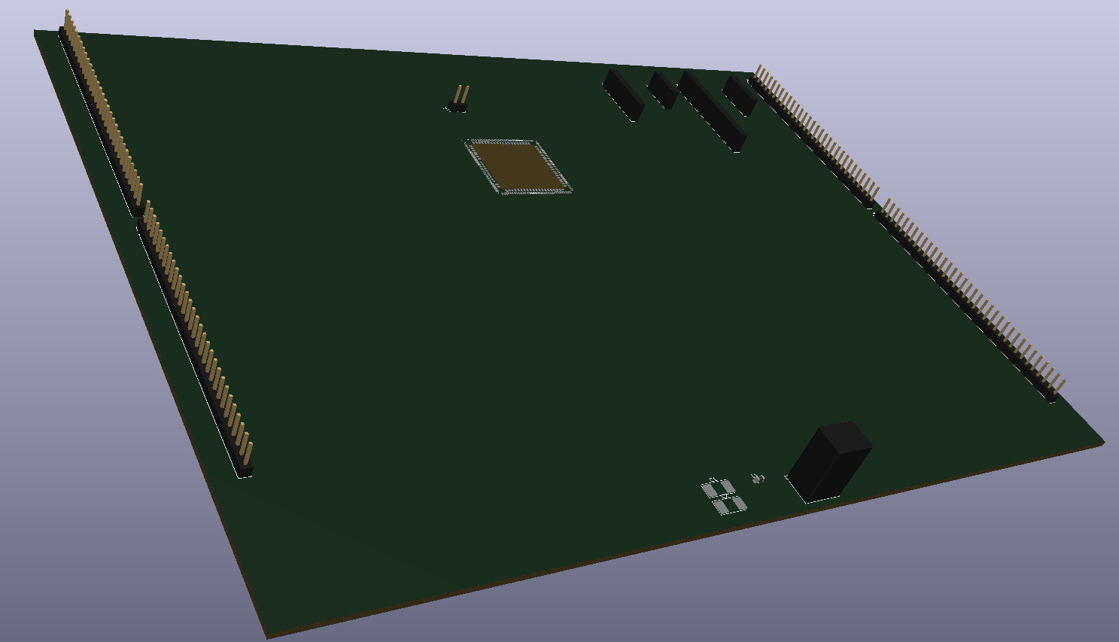
Phase 1
3D View of test board

