Slide 1
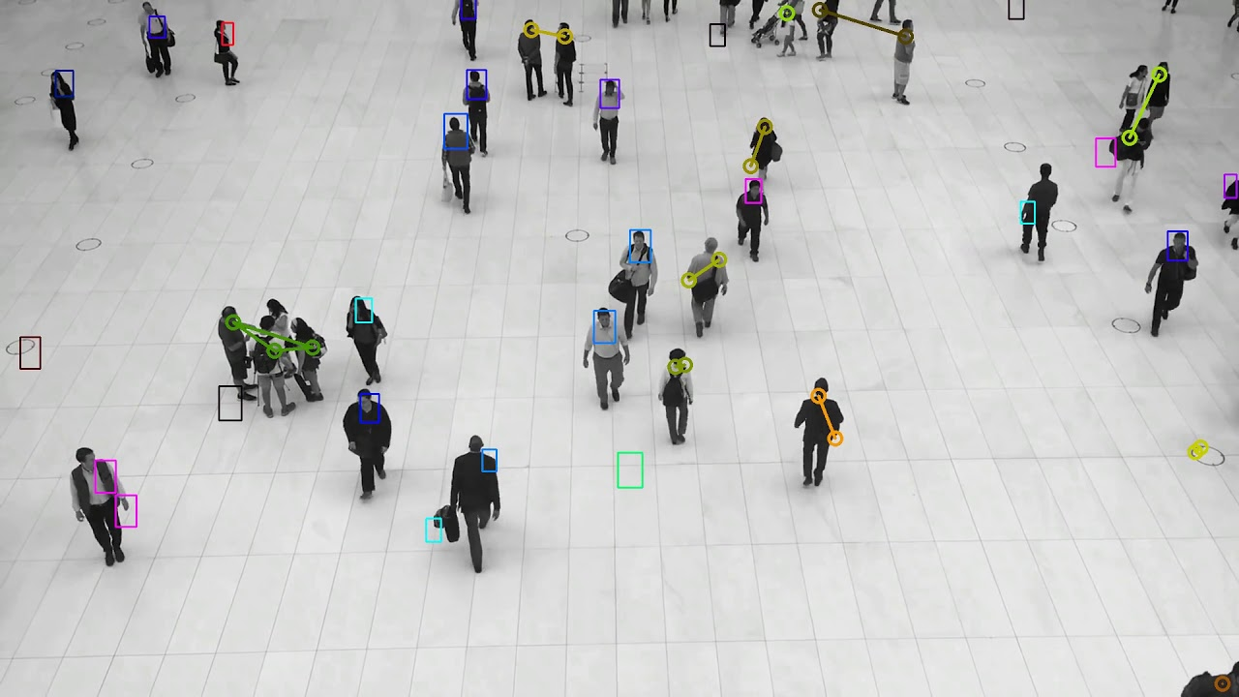

Crowd Detection System using Raspberry Pi and Deep Learning
Team #1
Alexis Hunter
Alyssa Reed
Deonna London
Gabriel Maxwell
Jalyn Beaty
Instructor : Professor Turner
Faculty Advisor/Sponsor: Dr. Lijun Qian (C.R.E.D.I.T Center)/Department of Defence
1
Notes:
Alexis

Slide 2
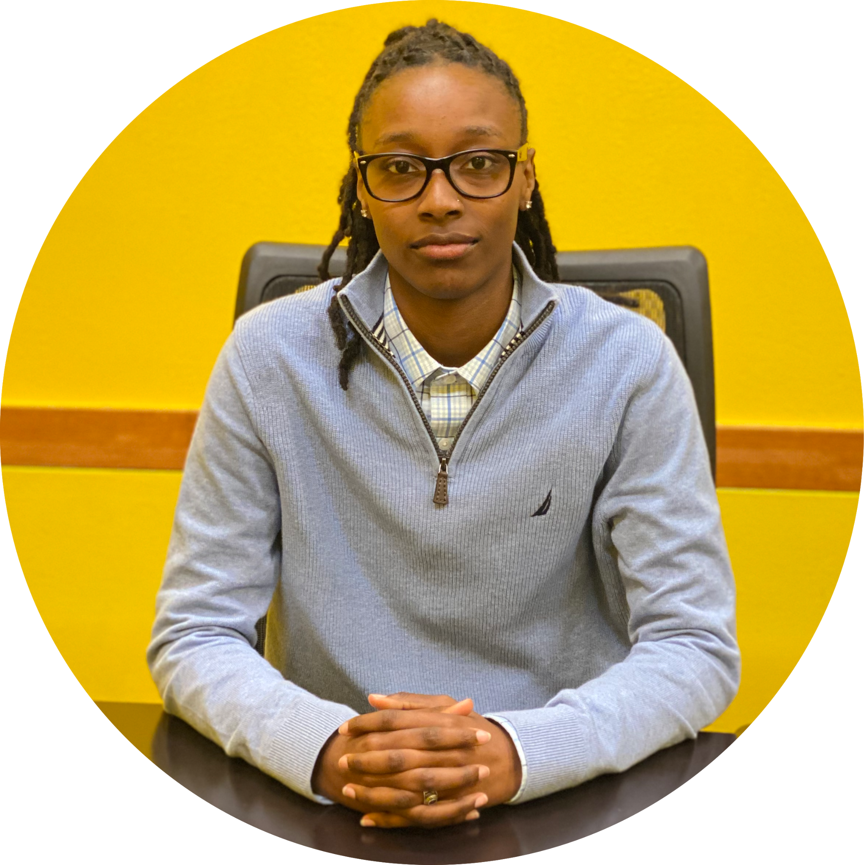
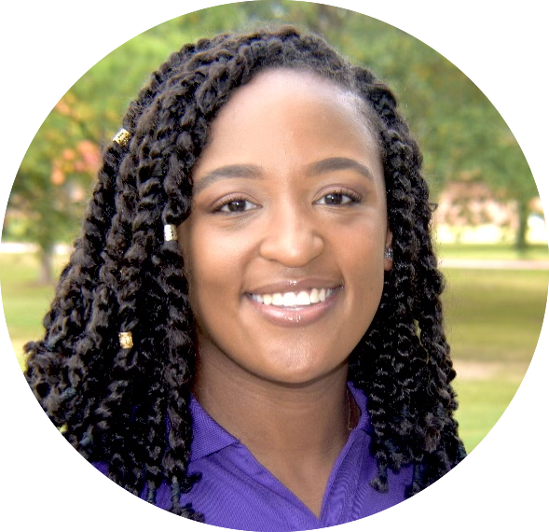

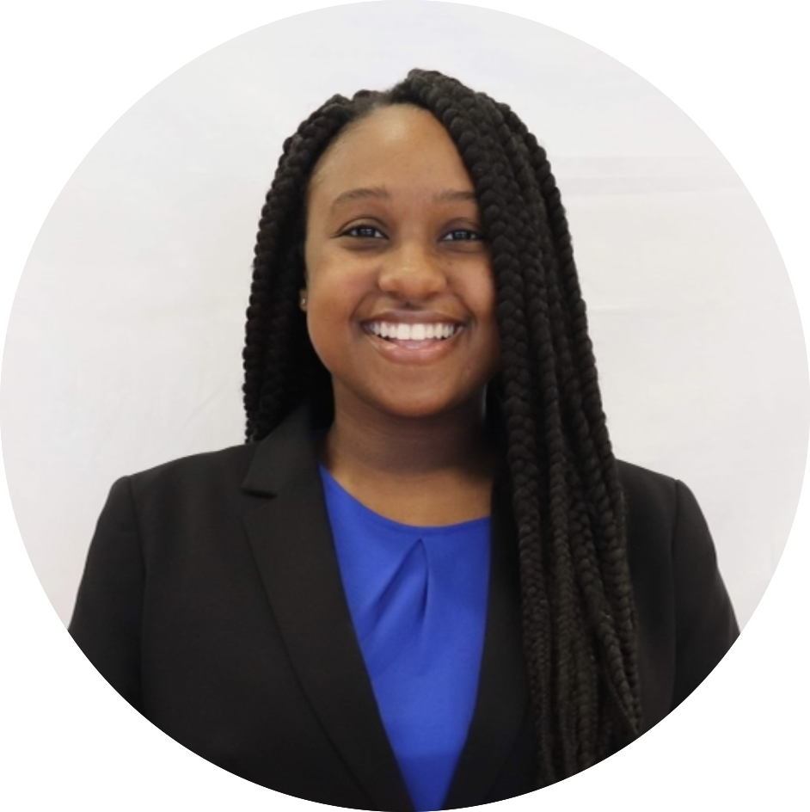

Prairie View A&M University
Roy G. Perry College of Engineering
Alyssa Reed
Software Developer Computer Engineering
Deonna London
Scribe
Computer Engineering
Alexis Hunter
Data Analyst
Electrical Engineering
Jalyn Beaty
Team Lead
Computer Engineering
Gabriel Maxwell
Procurement lead Computer Engineering
2
Notes:
Alexis

Slide 3
Problem Statement:
According to the World Health Organization, the risk of catching COVID-19 is higher in crowded and inadequately ventilated areas. As of September 2021, Harris County is at a level one (severe) threat level. Level one signifies the spread of COVID-19 is uncontrolled; outbreaks are worsening.
Objective:
The objective of this project is to design a device that will monitor large crowd gathering sizes to slow the spread of COVID-19. We will implement a crowd size detection and alarm system for violation reduction, so that people can go to necessary places, while still being as safe as possible.
Target Audience:
Our product is targeted at those who need to enforce strict Covid guidelines. (workplaces, schools, etc…)
3

Slide 4
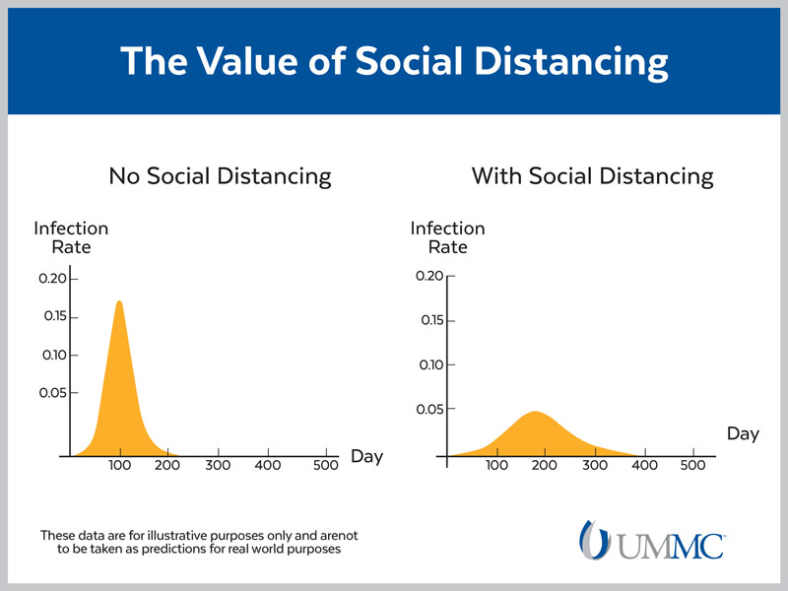
Proposed Solution
The rate in which COVID-19 is being spread can be greatly reduced with the application of social distancing.
Limiting crowd sizes and social distancing allows for people to be safer when they are in a public space.
We will be using a device that will detect and notify people when they are violating social distancing protocols.
4
Notes:
Jalyn

Slide 5
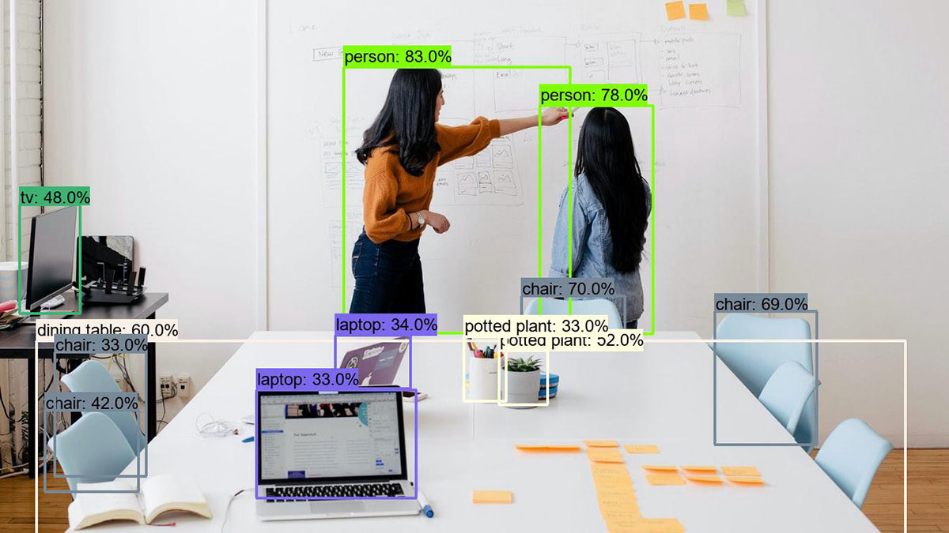
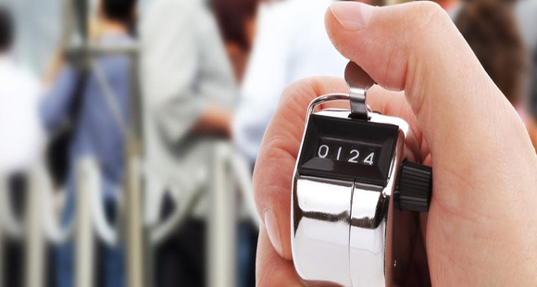
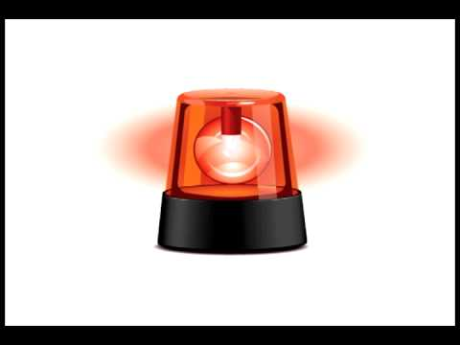
Proposed Deliverables
Capability to detect objects
Capability to detect people from other objects
Track number of people in area with counter
Alert when in violation of COVID protocols
5
Notes:
Deonna
Object Detection - distinguish between people and objects
People Counter- keep track of people in and out of given space
Crowd Detection- together, object detection and the people counter create the crowd detection

Slide 6
Marketing Requirements | Engineering Requirements | Justification
Fit in the top of a room facing the door | Raspberry Pi - 85x56x17mm Camera board v1.3 - 20x25x9mm Sound and light alarms | Device will need to take up minimum space and have easy mobility
Human recognition | Open Source Computer Vision Library (OpenCV) | Misidentified objects could result in inaccurate assumptions; false alarms
Light alarm system | Red light remains on until the spatial issue(s) are resolved Epilepsy seizure sensitive | Accessible for deaf users while taking into account of other safety risks 5-30 flashes per second may cause seizures
Sound alarm system | Concealed Adjustable volume (40-80 Decibels) | Accessible for blind users
Should be able to keep count of people in a given area | Create people tracker using: Python OpenCV Object tracking Algorithms | Number of people in a given area needs to be kept in order for the alarms to sound at the correct times
All added parts and enhancements must be compatible to Raspberry Pi | Camera Board v1.3 compatible with Model B+ | Parts need to be compatible to the Raspberry Pi 3 B+ in order for them to be programmed
Reliable and consistent | Test trials and Result Analysis 1080p | Unwarranted alarms can be alerted
6
Notes:
We chose red light because it’s known to be an attention getter.
User friendly
Cost effective
Alexis

Slide 7
Assumptions:
Constraints:
The area isn’t too noisy
Those involved are aware of the camera system and its purpose
People don’t enter in groups
System will observe the number of people in the given room
An alert will sound when violations occur
Wifi is required
Requires a constant power supply
Raspberry pi requires an external monitor
Camera must be positioned to catch those of varying heights
Camera must be mounted and cannot easily be moved
7

Slide 8
Project Impact Summary
Category | Project Applicability
Public Health, Safety, and Welfare
Global
Cultural
Societal
Environmental
Economic Factors
Technical
8
Notes:
Alyssa

Slide 9
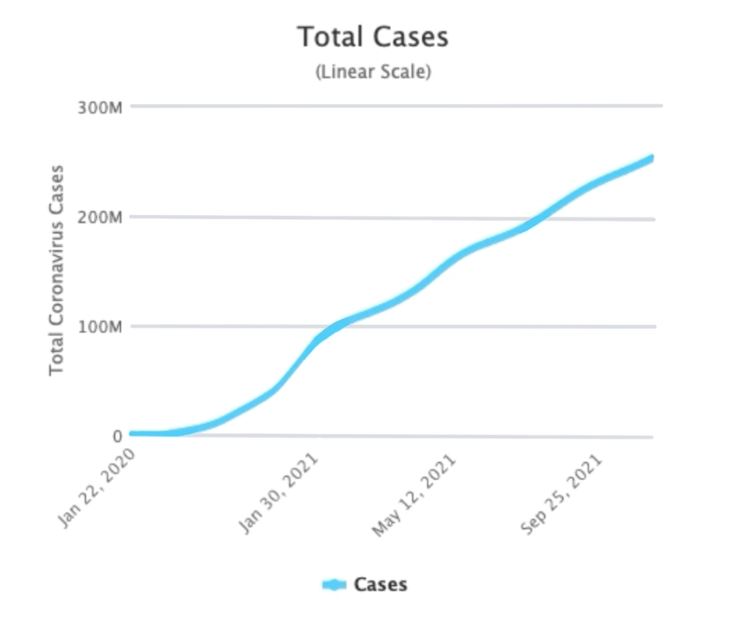
Public Health, Safety, and Welfare Impact
As of September 20, 2021 there have been 229,408,731 positive COVID-19 cases around the world.
Our project will limit the spread of COVID-19 by monitoring spatial issues within gatherings and preventing large gatherings.
9
Notes:
The pandemic has made our day to day activities such as going to class, work, or grocery store a real risk to our health.
As of Sept 2021 there have been about 230 million positive covid cases around the world
This graph is a linear representation of how the total number of covid cases have drastically multiplied. As of sept 2020 the case just below that 50 million mark while Sept of this year, we are closer to the 250 million mark.
Our project helps to reduce the risk of getting Covid 19 by monitoring spatial issues within gatherings
Our project will also help .prevent gatherings of such a large size that make it impossible to maintain the minimum 6 feet distance apart

Slide 10
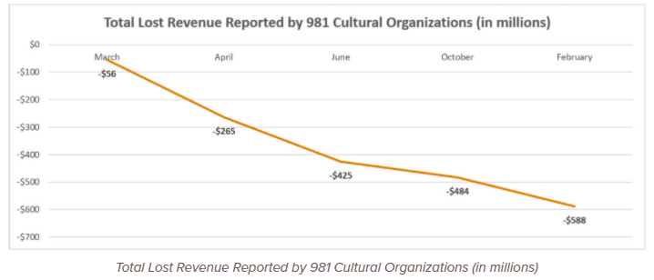
Cultural Impact
At COVID-19’s peak, 90% of countries closed their World Heritage site according to a World Bank article
Museums, art galleries, libraries, etc… have been closed
Reopening may not be an option as some forced out of business
Our device would help in reopening important places like this and keep businesses afloat
10
Notes:
At covid 19’s peak, 90% of countries closed their world heritage site.
COVID has changed the way populations go to work, school, entertain themselves and interact with societies and spread traditions.
This graph shows the loss of revenue by 981 cultural organizations. The higher the loss of revenue, the more likely the business will have to shut down.
(museums, art galleries, churches,
Our device will help reopen these important businesses

Slide 11
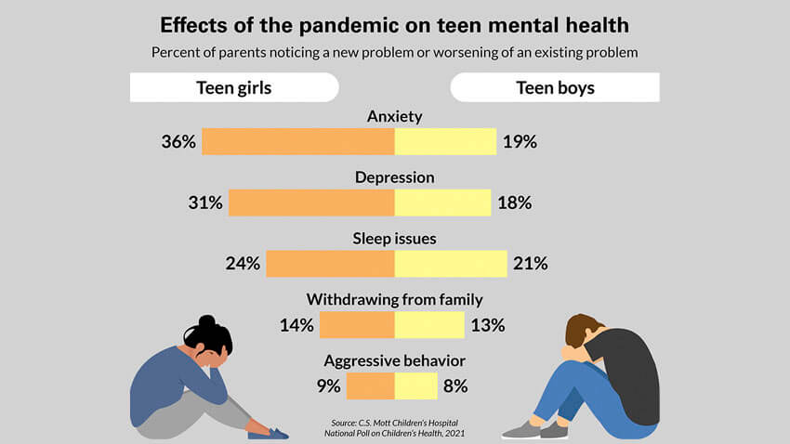
Societal Impact
The number of adults attempting to get a divorce has risen by 34% since 2019
According to Center for Disease Control and Prevention (CDC), “teens and adolescents social, emotional, and mental well-being has been impacted by the pandemic.”
With the use of our device, people will still be able to meet in group settings and adhere to social distancing regulations.
11
Notes:
The number of divorces have risen by 34% since 2019 due to forcing couples to spend a significant amount of time together and them realizing things about one another.
According to the CDC teens and adolescents are also impacted by the pandemic.
This survey was conducted based on responses from 977 parents with teens aging from 13-18 years old. Anxiety, depression, sleep issues, withdrawing from the family, and aggression were effects brought about by COVID isolation.
With the use of our device, we will ensure individuals can participate in needed socialization activities while still adhering to social distancing regulations

Slide 12
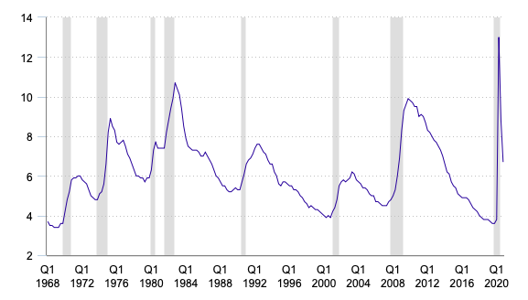
Economic Impact
The Gross Domestic Product (GDP) decreased by 3.5% in 2020. This is the lowest growth rate since 1946.
The average annual unemployment rate in 2020 was 8.1% higher than the annual averages during the Great Recession in 2009
Our economy took a major hit during the pandemic. This project will help mend our economy by reducing the number of covid cases.
hit during the pandemic. This project will hopefully help mend our economy by reducing the number of covid cases.
Quarterly Unemployment Rate
12
Notes:
In 2020 the unemployment rate reached 13% and the GDP decreased by 3.5%.
The unemployment rate was about 8% lower than the annual averages during the great recession, 2010 and 2011.
Our project will help mend our economy by reducing the spreading rate of COVID which will lead to businesses being able to reopen and thus jobs being available

Slide 13

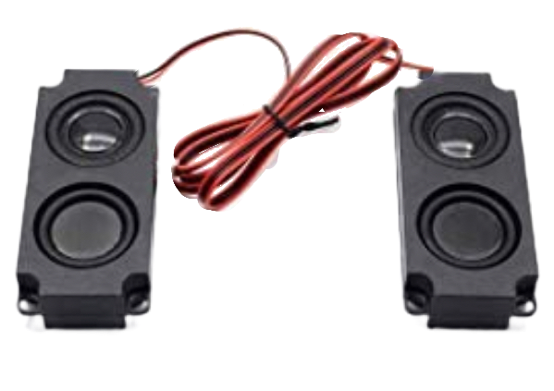
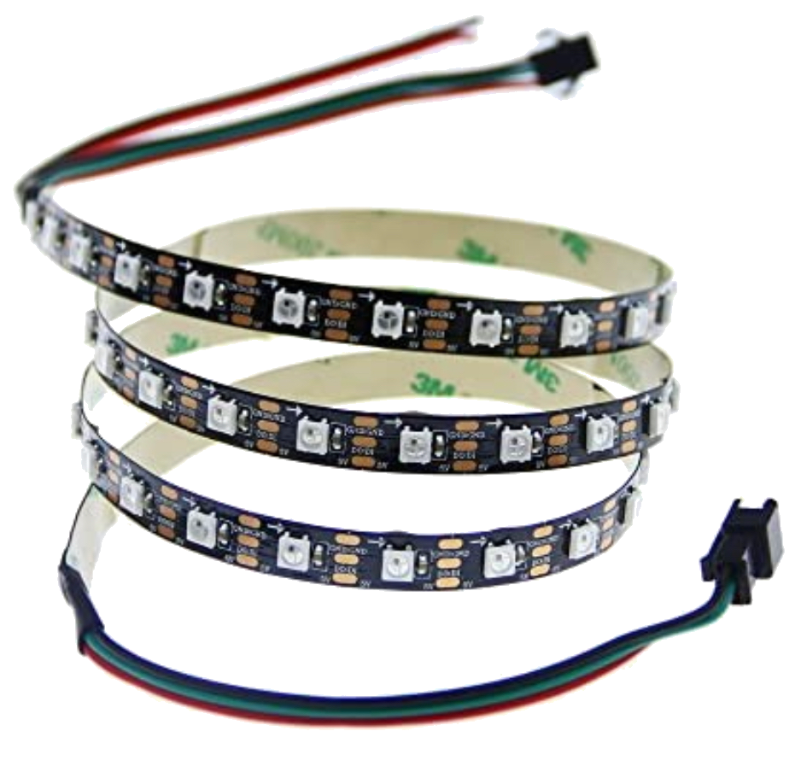
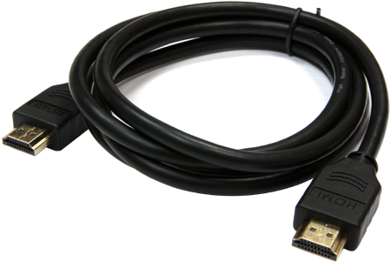
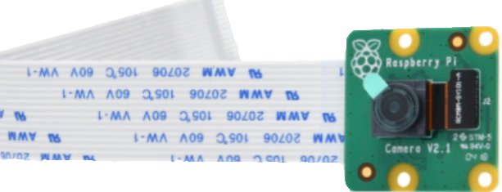
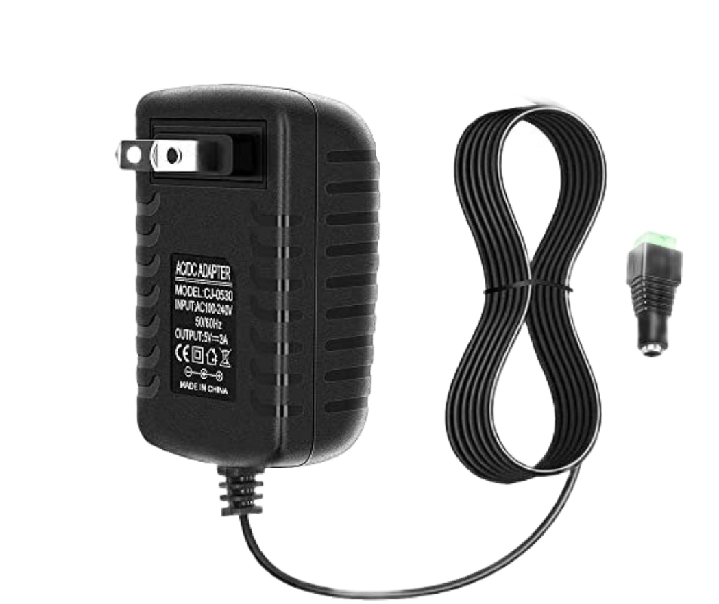
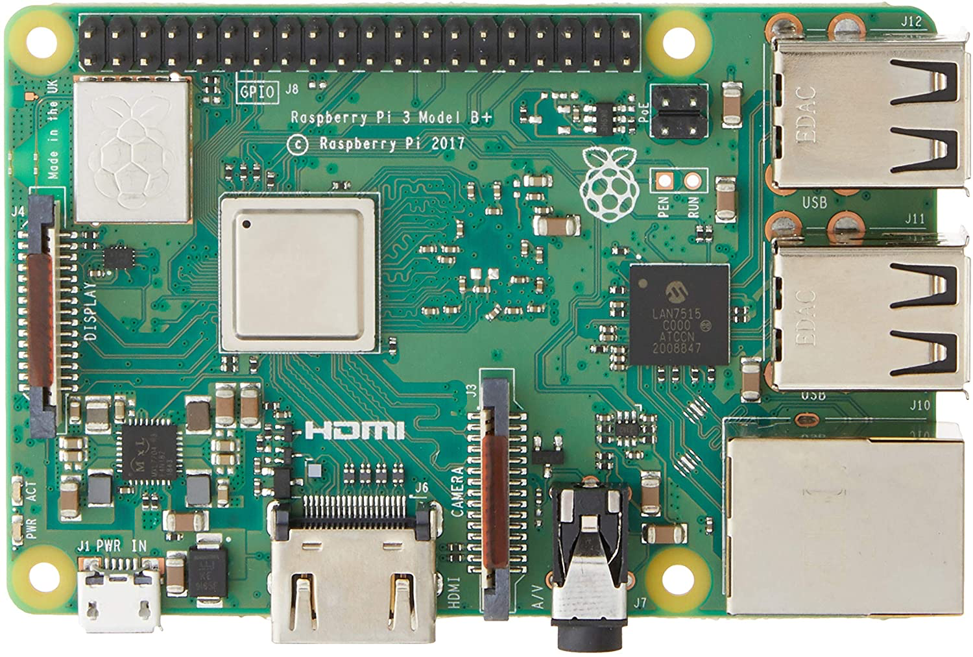
Preliminary Design Concept (Hardware)
Power Source:
Input - 100-240V
Output - 5V/2500mA
Raspberry Pi Camera, Lights, and Stereo System
Raspberry Pi 3 B+
13

Slide 14

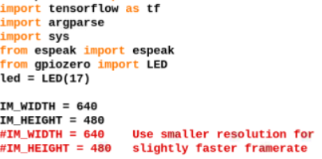

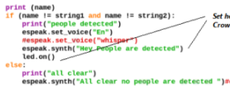
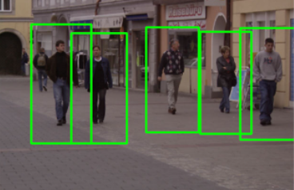
Preliminary Design Concept (Software)
1.Download necessary libraries in python; Numpy, Open ComputerVision, TensorFlow etc..
2. -Initialize the library
-Use camera for live video
- Identify objects frame by frame
Object Detection
to
Crowd Detection
3. Code the camera process captured video and identify objects, using the if(condition)
4. Once the Raspberry Pi is connected
Video processed frame-by-frame
Objects identified; alerts sound
14

Slide 15
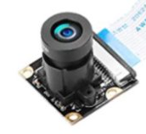
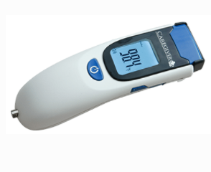


Project Comparison
Product | Design | Pros | Cons | Cost | Final Decision
Covid-19 Crowd Detector | Room camera for social distance | -People Counter -Alert System - controlled social gathering | - Requires wifi connection -system provides slow frame rates | $150 | ✔
Caregiver Touch Free Thermometer | Thermometer that measures temperature of person | -no-contact -instant results -can also measure room and skin temp | -Minimal social distancing effort -Not accurate detection of COVID | Starts at $240
Ultimaxx Wristband | Wristband with 6ft detection | -Size -Portability -App compatible | -Relies on battery life -Only works with 2 -Limited to participation | $20-40 per unit
Magnifier Tool | App used to identify objects and their distance | -Price -Audio and visual readout | -No android users -Limited to participation | Free for iOS users
15

Slide 16
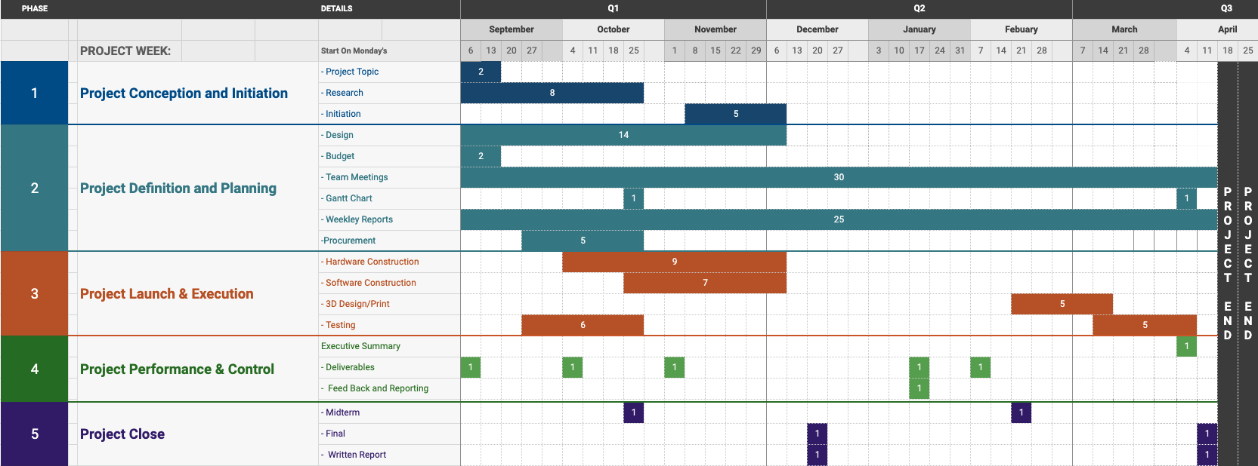
Project Schedule
16

Slide 17
Engineering Codes and Standards
IEEE 7.6: IEEE Protection of the Public: To maintain public safety with the creation of our engineering devices
IEEE 7.8: IEEE Code of Ethics 1.5: Seek and accept honest Criticism of technical work
IEEE 7.8: IEEE Code of Ethics 1.6: to maintain and improve our technical competence we also use this standard in our engineering methodology
IEEE C37.21-2017:Standard for Control Switchboards: Implemented to assure that the alarms work proper.
IEEE 829-2008:Software and System Test Documentation: Used to ensure that the device is working as intended
IEEE 802.11:Wireless Networking : the use of Wi-Fi on our Raspberry pi
17

Slide 18
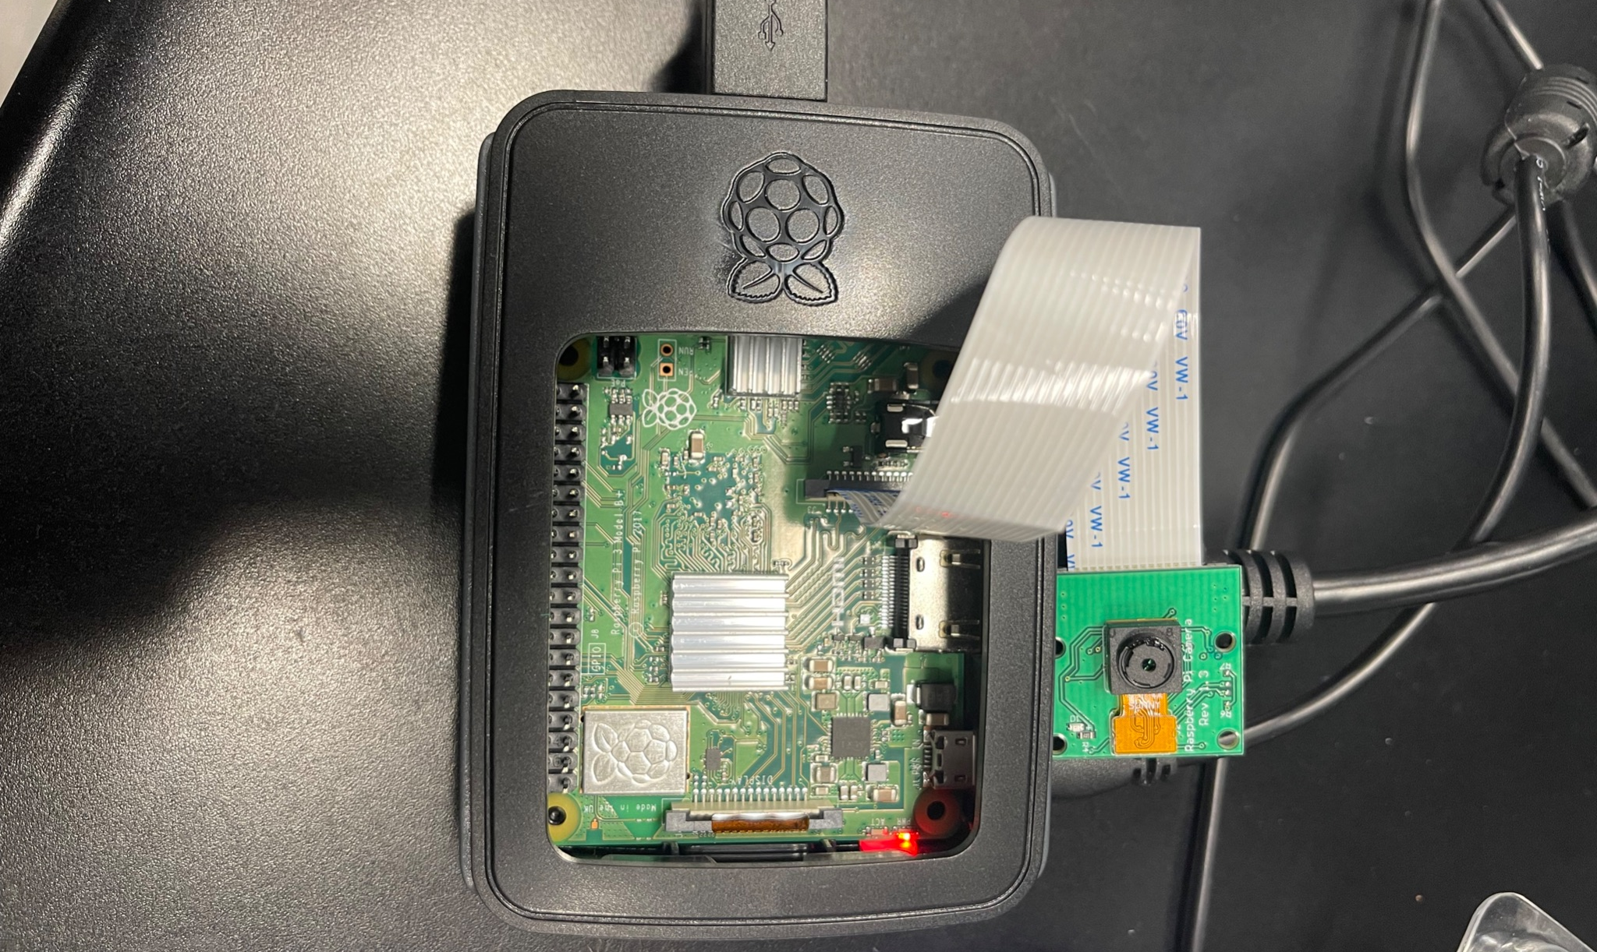
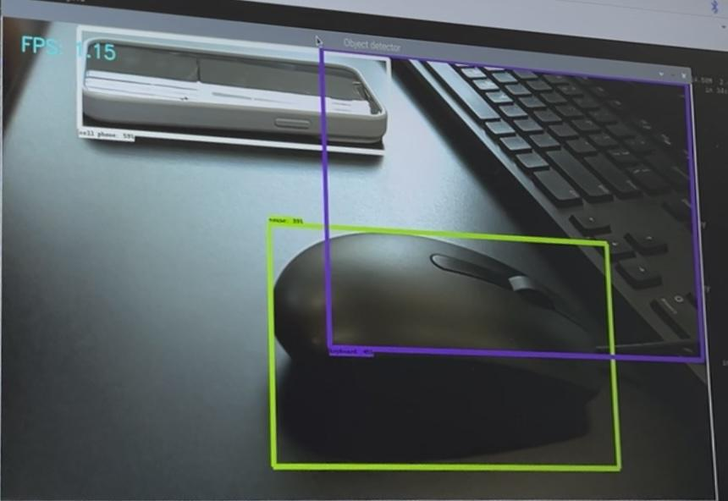
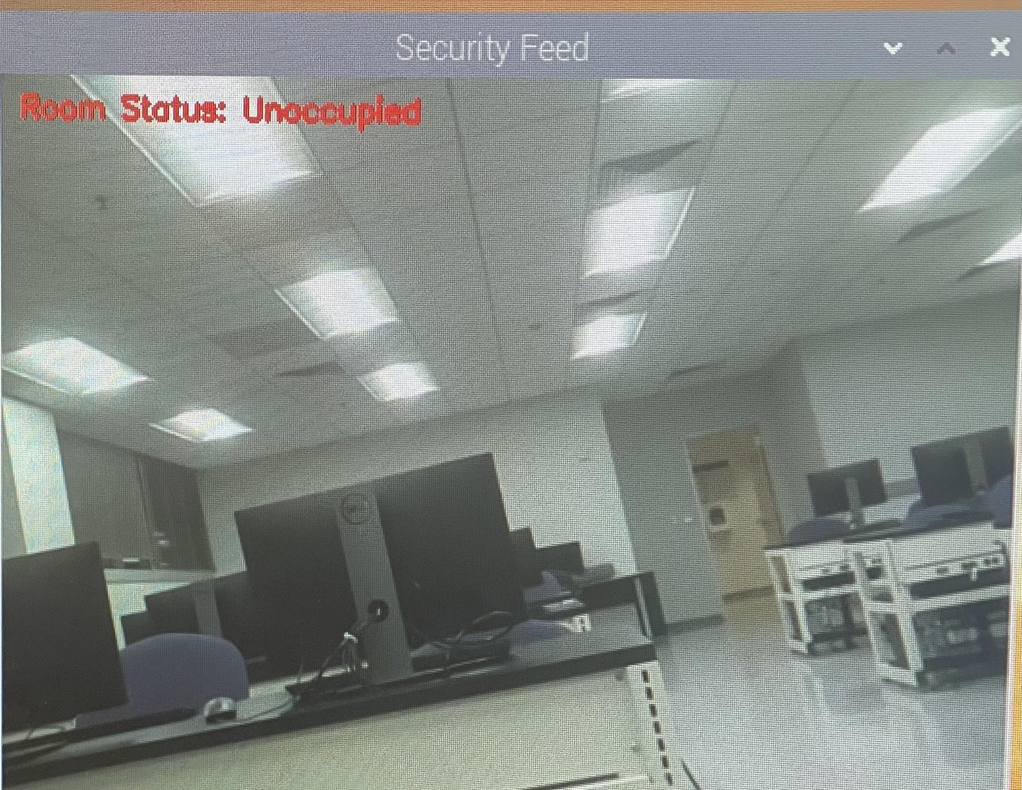
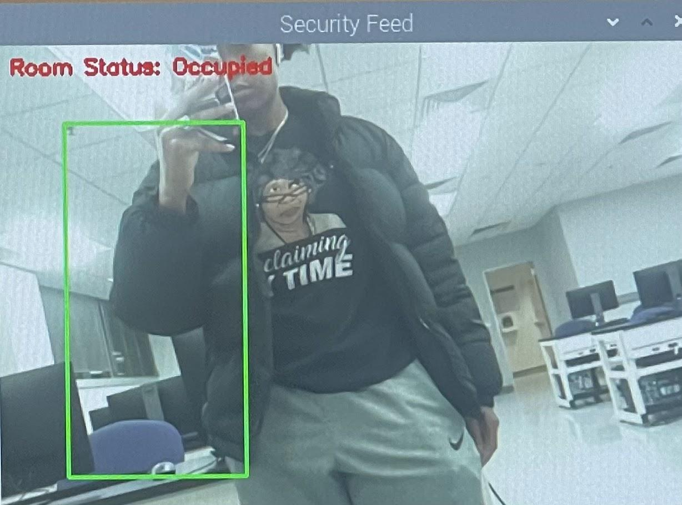
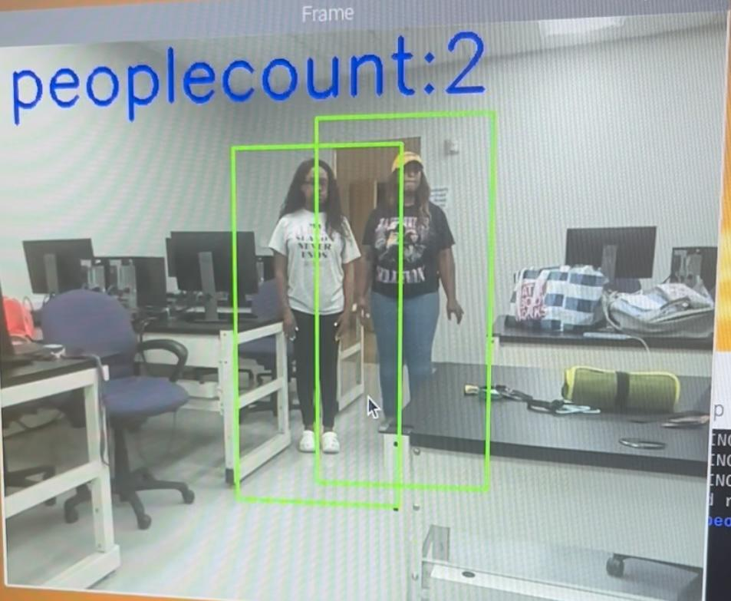
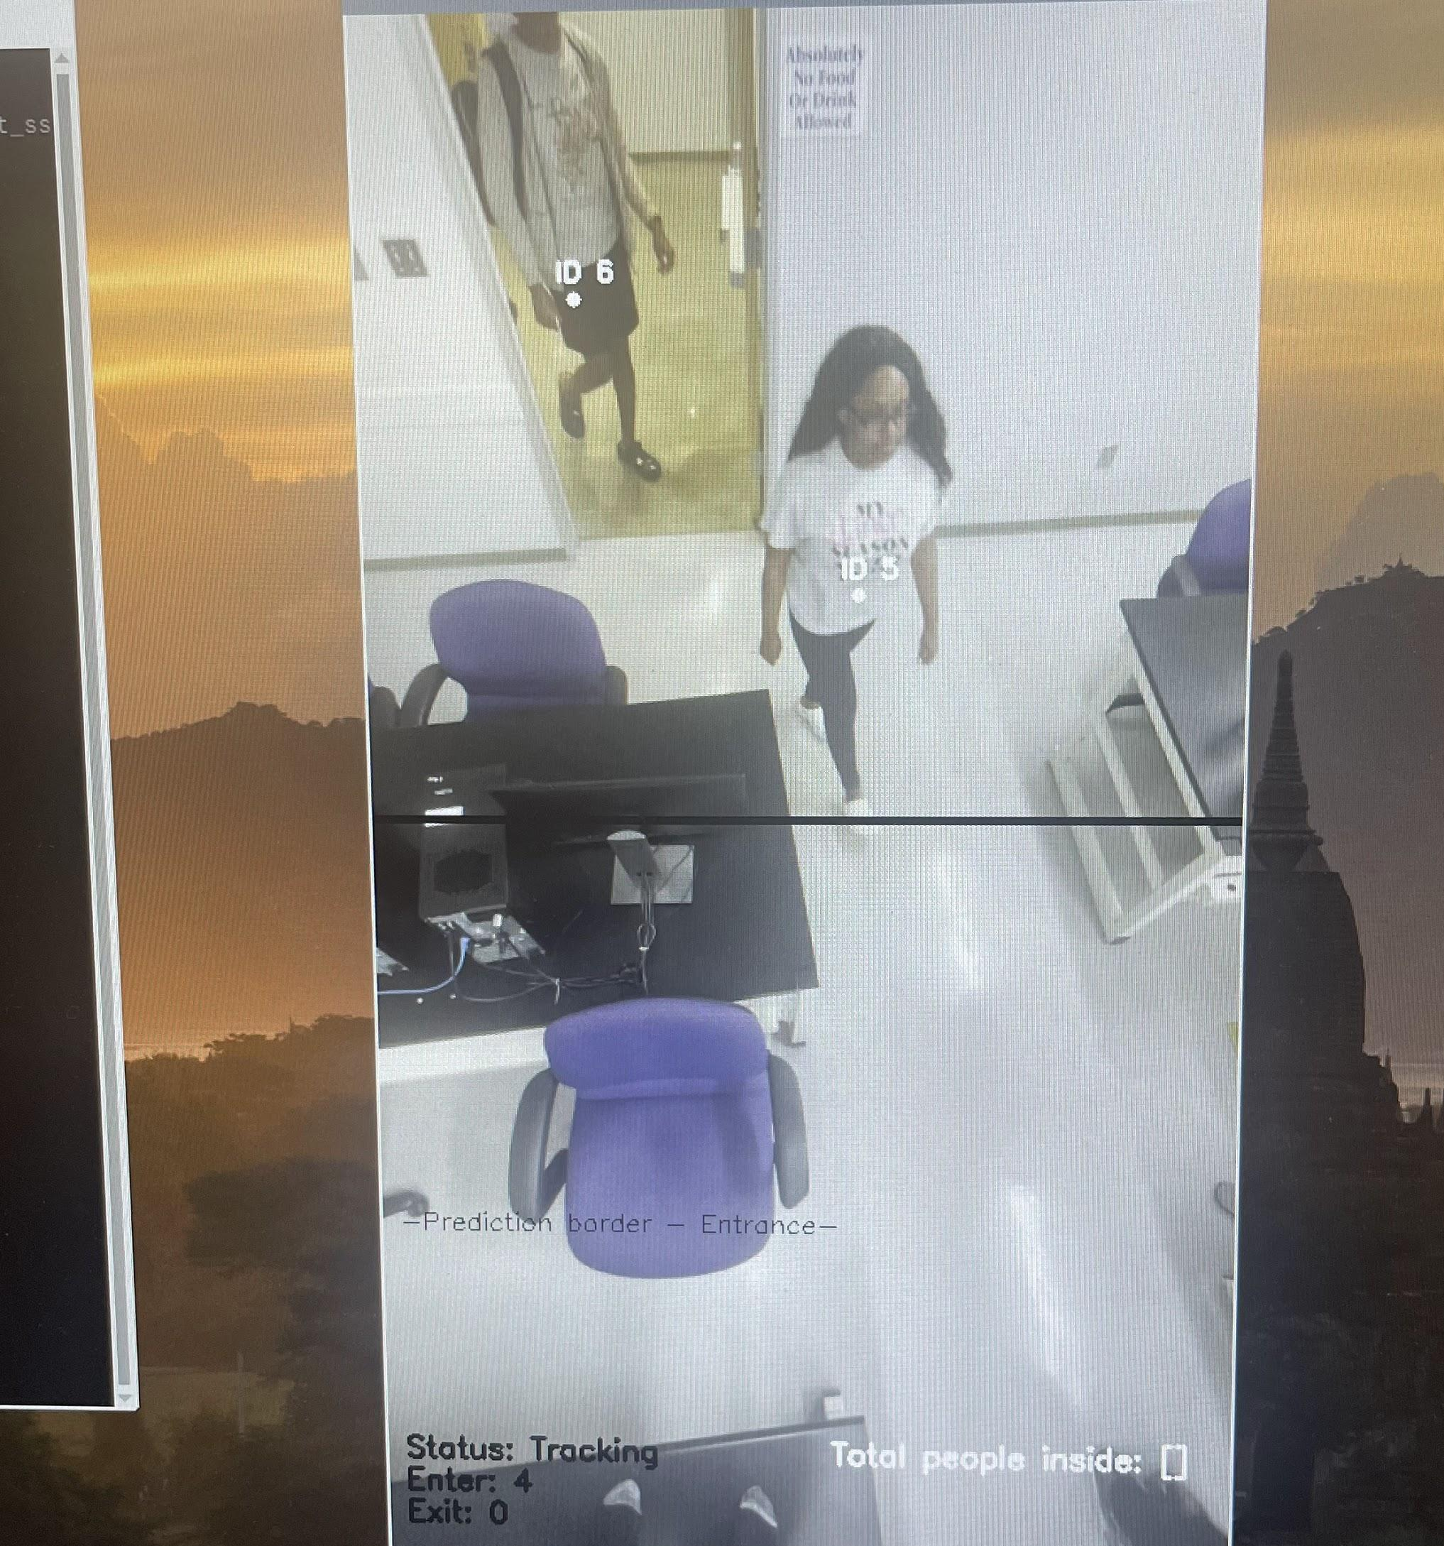
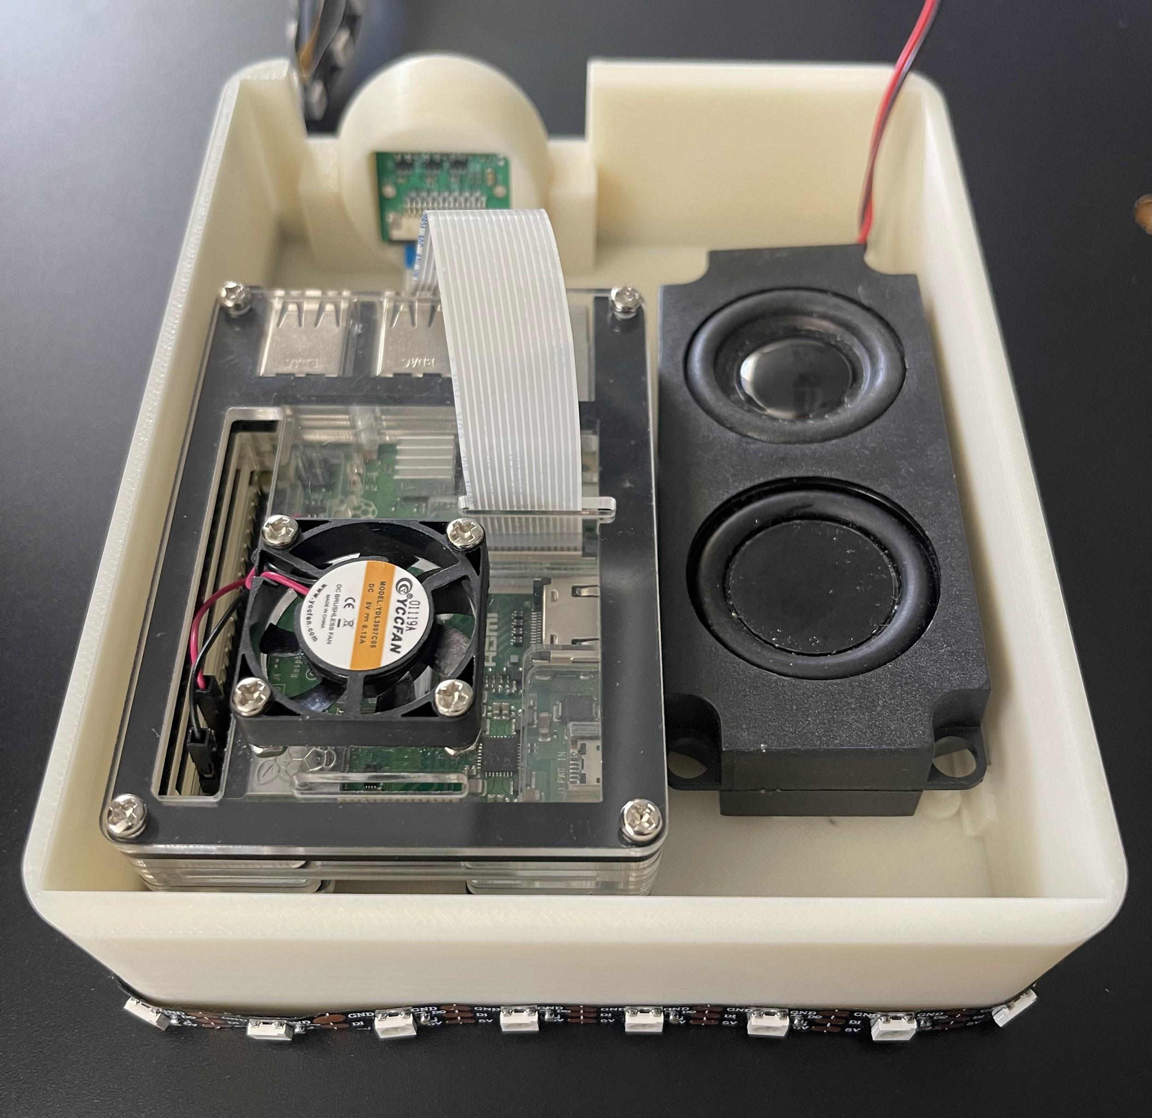
Project Milestones
Raspberry Pi 3B+ & Camera Connection
Object Detection Software Enabled
People Detection
People Counter
Crowd Detection
3D Print Housing Model
18

Slide 19
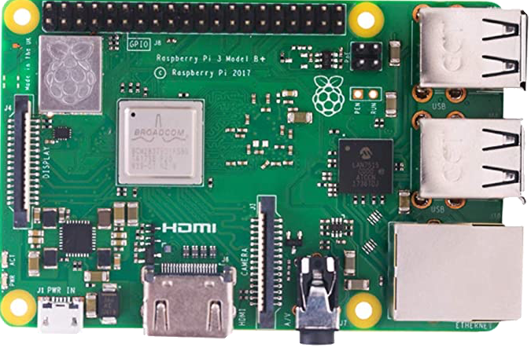
Detailed Final System Design
Pins for Cooling System
USB Input for Keyboard
USB Input for Mouse
Raspberry Pi Camera v1.3
Power Source
HDMI Port
19

Slide 20

Project Demonstration
20

Slide 21
Final Conclusions and Recommendations
Recommendations:
The software used should be Tensorflow and OpenCV.
The device should be positioned with clear sight of room entrance
A machine learning model will be used to train the device to recognize the difference between a person and an object
A later model of Raspberry Pi should be used
Conclusion:
Implementing real-time crowd detection on a Raspberry Pi 3 pushes the device to its limits. It is possible to perform object and people detection and a people counter live. Crowd detection combines all of these components and more can be done one Raspberry Pi, but at the cost of it being real-time.
21

Slide 22

Questions
Or
Comments?
22

Slide 23
Back Up
23

Slide 24
Project Parts Summary
Item Number | Equipment Name | Description | Unit Cost | Quantity
1 | Raspberry Pi 3B+ Kit | Computer | $69.99 | 1
2 | PC Monitor | Screen for display | University Provided | 1
3 | Intel Neutral Compute Stick | Upgrade the raspberry pi performance | $69.99 | 1
4 | GeekPi Raspberry Pi cooling fan | Prevents our computer from overheating | $19.99 | 1
5 | 3D printed camera case | Holds our device in the corner of a room | University Provided | 1
6 | LED Lights | Lights for the built in alarm system | $18.00 | 1
7 | Stereo System | Sound system for built in alarm | $9.99 | 1
24

Slide 25
Executive Summary- Crowd Detection
Mission Statement:
The mission of this project is to design a device that will monitor large crowd gathering sizes to slow the spread of COVID-19. We will implement a real time crowd size detection and alarm system for violation reduction, so that people can go to necessary places while still being as safe as possible.
Problem Statement:
According to the World Health Organization, the risk of catching COVID-19 is higher in crowded and inadequately ventilated areas. As of September 2021, Harris County is at a level one (severe) threat level. Level one signifies the spread of COVID-19 is uncontrolled; outbreaks are worsening.
25

Slide 26
Executive Summary- Crowd Detection
Proposed Deliverables:
Incorporate object detection
Incorporate a people detection
Perform people counting
Have alarm system
Budget
Project Budget: $500
Amount Spent: $200
26

Slide 27
Executive Summary- Crowd Detection
Customer Requirements & Engineering Solutions
Facial recognition software using Opencv
Sound and light alarms
Sound alarms will be between 40 and 80 decibels
Light alarm will be red and non-blinking to be courteous of those with epilepsy
People counter using Open CV, python, and object tracking algorithms
Distance detection using python code
Major Constraints
Wi-Fi and external monitor required
The room dimensions must be known and inputted by the user
A constant power supply is required for our system to function
27

Slide 28
Executive Summary- Crowd Detection
Benefits
Public, Health, Safety and Welfare: Reducing the spread of COVID-19
Cultural: Reopening of World Heritage Sites
Societal: Increased socialization thus reducing anxiety, depression, aggressive behavior, etc
Economic: Reopening of businesses thus more income for those businesses and lower unemployment rates
Recommendation
The software used should be TensorFlow and OpenCV
The device should be small enough to be positioned in the corner of a room
A machine learning model will be used to train the device to recognize the difference between a person and an object
Conclusion
Implementing the real time crowd detection system will greatly impact lives and will assist us on getting through this pandemic.
28

Slide 29
Targeted Audience
Our product is targeted at those who need to enforce strict COVID-19 Guidelines. These could include the following:
Workplaces
Schools
Hospitals
Airports
It is important to have restrictions and rules for the public’s safety. It is just as important to make sure those guidelines are being abide by on the regular.
29

Slide 30
Advantages and Disadvantages of Proposed Design
Advantages
Uses very low cost parts
Detection training as well as newer model
Small model for large concept of work
Has its on video source
Only added component is a display screen
Disadvantages
Uses an older model device with system inefficiencies
Components added risk slowing down the model
Frame rate improvement costs system
30

Slide 31
Acceptance Criteria
Device:
Small enough to fit in the corner of a room
Human recognition
People Counter
Implementation:
Raspberry pi, camera and alarms work together
Device is correctly programmed using Python
All components run properly
Alarm system:
Sound and light only activate upon violated regulations
Alarm turns off when violations are corrected
31
Notes:
Deonna

Slide 32
Engineering Design Methodology
Define and Identify
- Problem Statement
-Objective
-Assumptions and Constraints
-Public Impacts
1
Brainstorm and Select
-Proposed Solution
-Project Comparison
2
Prototype
-Build prototype
-3D Print Case
-Assemble Raspberry Pi 3 B+ with camera and alarm system
Test
-Test our software
-Test prototype
-Improve any bugs
3
4
Communicate
-Present our full idea
5
32

Slide 33
Project Comparison
Product | Design | Pros | Cons | Cost | Reference | Final Decision
Covid-19 Crowd Detector | Room camera for social distance | -People Counter -Alert System - controlled social gathering | - Requires wifi connection -system provides slow frame rates | $150 | htthttps://uk.pi-supply.com/products/raspberry-pi-camera-board-v1-3-5mp-1080p | ✔
Caregiver Touch Free Thermometer | Thermometer that measures temperature of person | -no-contact -instant results -can also measure room and skin temp | -Minimal social distancing effort -Not accurate detection of COVID | Starts at $240 | https://www.medicalequipmentresource.com/Caregiver-PRO-TF300-Non-Contact-Thermometer-p/pro-tf300.htm#:~:text=Our%20Price%3A%20%24240.00&text=This%20may%20be%20the%20most%20accurate%20non%2Dcontact%20thermometer%20available%20now!!
Ultimaxx Wristband | Wristband with 6ft detection | -Size -Portability -App compatible | -Relies on battery life -Only works with 2 -Limited to participation | $20-40 per unit | https://www.amazon.com/Electronic-Social-Distancing-Wristband-Proximity/dp/B08BKXBB7Y
Magnifier Tool | App used to identify objects and their distance | -Price -Audio and visual readout | -No android users -Limited to participation | Free for iOS users | https://www.imore.com/iphone-12-pros-people-detection-accessibility-feature-perfect-social-distancing
33

Slide 34
Resources
“Coronavirus Cases.” Worldometer, https://www.worldometers.info/coronavirus/?utm_campaign=homeAdUOA%3FSi.
Covid-19 parental resources kit – adolescence. (2021, July 27). Retrieved October 04, 2021, from https://www.cdc.gov/mentalhealth/stress-coping/parental-resources/adolescence/index.html
Culture in the COVID-19 recovery: Good for your wallet, good for resilience, and good for you. (n.d.). Retrieved October 04, 2021, from https://blogs.worldbank.org/sustainablecities/culture-covid-19-recovery-good-your-wallet-good-resilience-and-good-you
“Harris County / City of Houston Covid-19 Data Hub.” Harris County / City of Houston COVID-19 Data Hub, https://covid-harriscounty.hub.arcgis.com/.
NBC Chicago. (2020, June 23). What are the odds someone at a gathering has covid-19? Chicago health officials break down the math. Retrieved October 04, 2021, from https://www.nbcchicago.com/news/local/what-are-the-odds-someone-at-a-gathering-has-covid-19-chicago-health-officials-break-down-the-math/2294188/
Olson, P. (2020, May 15). Don't stand so close to me: Ai cameras police social distancing at work. Retrieved October 04, 2021, from https://www.wsj.com/articles/dont-stand-so-close-to-me-ai-cameras-police-social-distancing-at-work-11589452202
Rosner, E. (2020, September 02). US divorce rates skyrocket amid covid-19 pandemic. Retrieved October 04, 2021, from https://nypost.com/2020/09/01/divorce-rates-skyrocket-in-u-s-amid-covid-19/
Saladino, V., Algeri, D., & Auriemma, V. (2020, October 2). The psychological and social impact of covid-19: New perspectives of well-being. Retrieved October 04, 2021, from https://www.ncbi.nlm.nih.gov/pmc/articles/PMC7561673/#!po=12.2642
34

Slide 35
Resources
State of the US economy: GDP, unemployment, Jobs & More: 2021 State of the union facts. (2021, April 22). Retrieved October 04, 2021, from https://usafacts.org/state-of-the-union/economy/?gclid=CjwKCAjw4qCKBhAVEiwAkTYsPFMgXd_vhIkd1arBJjHS5kjdLP5wQZxKfkG5hl4GkeeHabrl9KFGfxoC16cQAvD_BwE
Scott, Katy. “Smart Sensors Could Track Social Distancing in the Office.” CNN, Cable News Network, 23 Oct. 2020, https://www.cnn.com/2020/10/23/tech/pointgrab-sensors-social-distancing-office-spc-intl/index.html.
35

