Slide 1

ECE Meeting
Feb 18, 2022

Slide 2
Agenda
OSP role and overview
Spring enrollment updates
ABET
Advising -CPOS, substitutions, etc
Preliminary Exam update
Summer budget
Summer/Fall course assignments
ASEE GSW Conference registration
Open Forum

Slide 3
OSP - Group

Slide 4
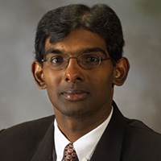
Position updates
Admin III re-posted
Department Head – re-posted filled by end of summer
If you are retiring, please provide letter now so that we can post the position.
Dr. Annamalai
Interim Head of ECE

Slide 5
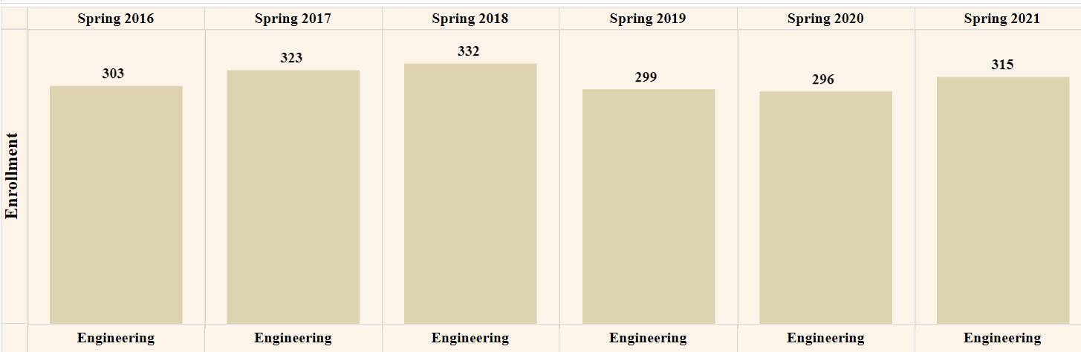
ECE Enrollment
Spr 22
272
-43
-13.7%

Slide 6
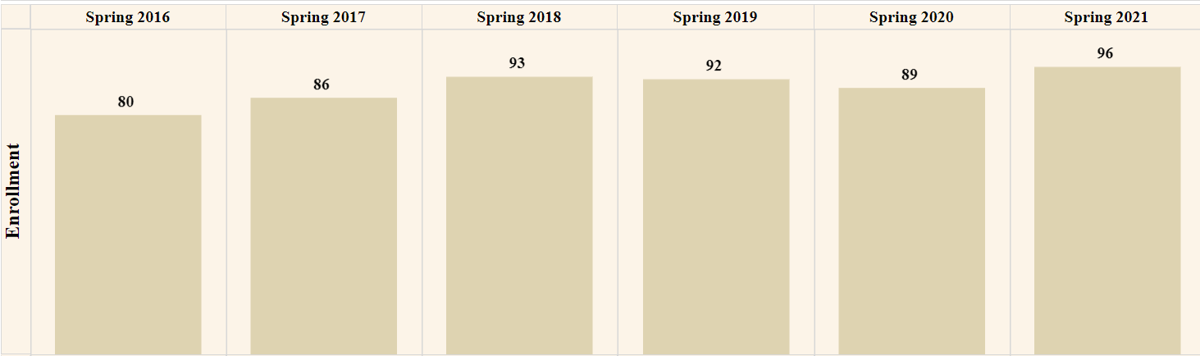
Computer Engineering
Spr 22
81
-15
-15.6%

Slide 7
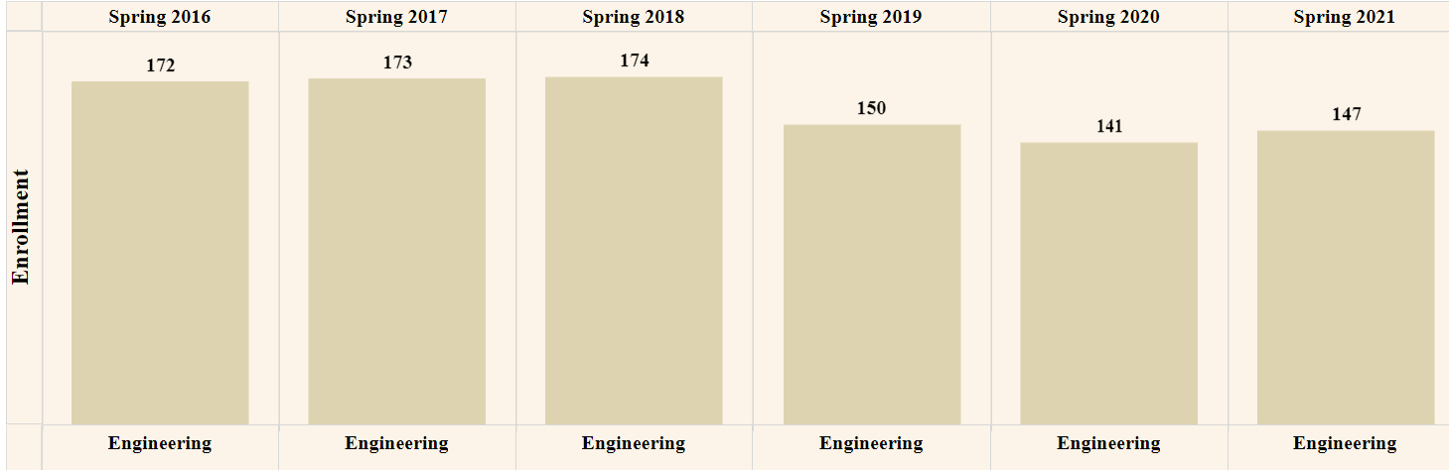
Electrical Engineering
Spr 22
124
-23
-15.6%

Slide 8
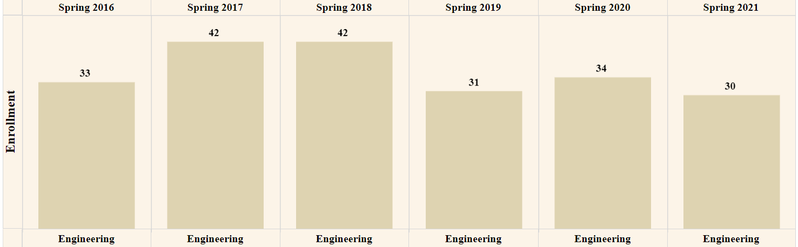
MS EE
Spr 22
31
-1
-3.3%

Slide 9
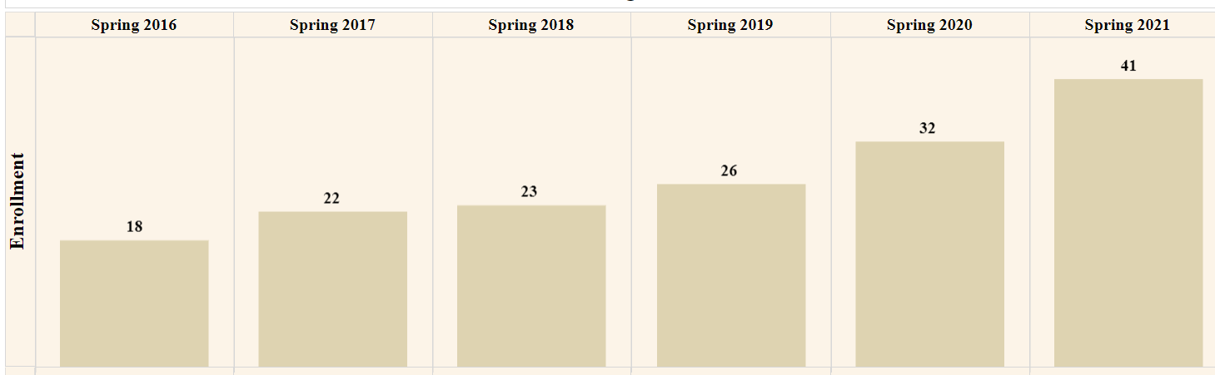
PhD EE
Spr 22
37
-5
-11.9%

Slide 10
ABET
Dr. Attia

Slide 11
Advising
CPOS
Substitutions
GNEG 1112 and GNEG 2021 8 week
GNEG 1010 new catalog – 8 week
GNEG 3061 –offered currently

Slide 12
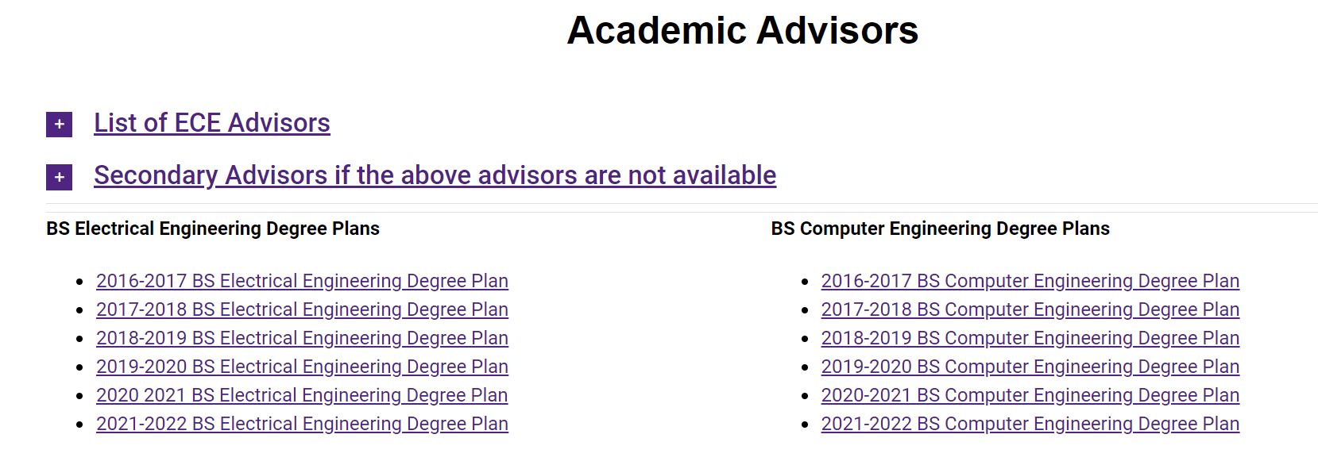
Advising

Slide 13
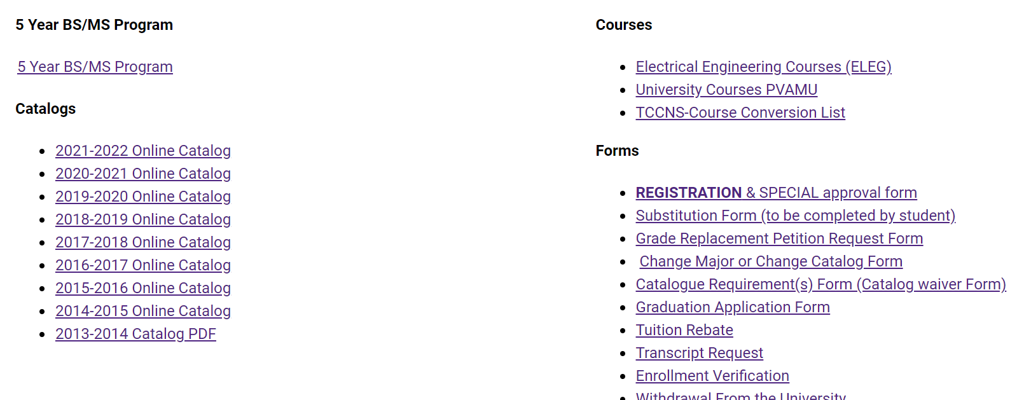

Slide 14
Preliminary Exam update
Previous Pass/Fail – update
Proposal: to take prelims once a year

Slide 15
Summer budget
Due to Francine
Submit research (even if don’t have an account yet)
Curriculum development – work on new courses

Slide 16
Summer/Fall course assignments
Submit all summer course requests
Need Thesis/Dissertation/Research Courses before March 1
Fall assignment – available March 1

Slide 17
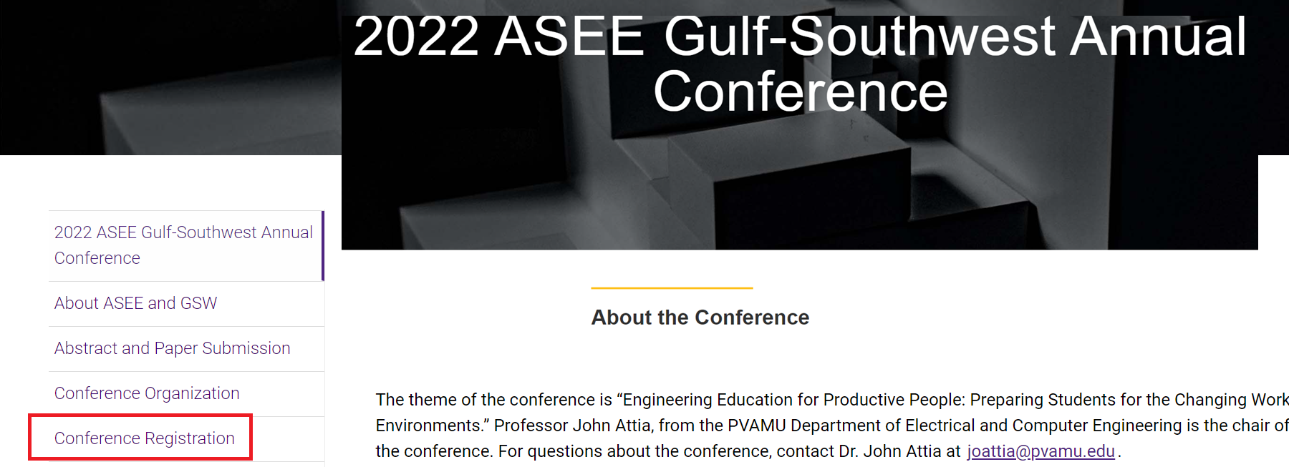
ASEE GSW Conference registration

Slide 18
Open Forum
Questions and Comments

