Slide 1

Project Impact Summary
Category | Project Applicability
Public Health. Safety, and Welfare
Global
Cultural
Social
Environmental
Economic Factors
Technical

Slide 2
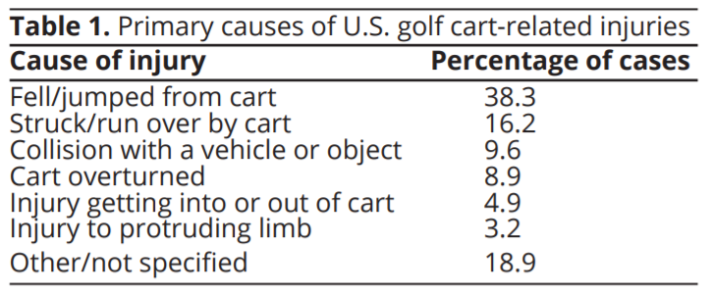
Project Impact - Safety
Golf carts being are a popular mode of transportation in outdoor areas, an increasing level of nonfatal injuries are occurring.
A study done from 1990 to 2015 "U.S. emergency departments visits for golf cart-related injuries tripled from 6,000 in 1990 to 18,000 in 2015".
Of these incidents, 9.6% were when collision occurred with a vehicle or object and could be due to gear shifting issues.
Having an electronic switch shifter would have less failure occurrence and lessen the number of cases.
Notes:
https://www.villages-news.com/wp-content/uploads/2014/10/Golf-Cart-Accident.jpg

Slide 3

Project Impact - Cultural/Social
1.) Due to low effort-shifting elderly will still be able to drive golf carts with no problem.
- There is a Village where most of the people are age 55+ and there is 65,000 golf carts reported in residence.
2.) Golf cart users will now be able to focus on enjoying the golf cart rather than getting the shifter fixed.
- A Mechanical Shifter on Amazon has 65 reviews for one year. Therefore, we estimate that around 65 – 200 shifters were sold within that year.

Slide 4
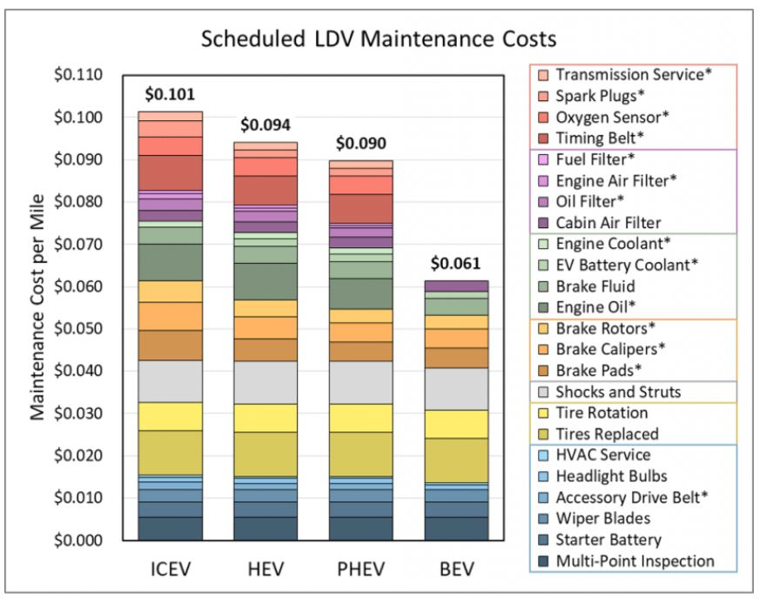
Project Impact - Economical
Maintenance cost for electric vehicles(EV) is lower because of less moving parts:
  no exhaust system
  less need for cooling
  less abrasive braking
According to study by U.S. Department of Energy:
  BEV(battery electric vehicle) are cheaper to maintain by $0.06 per mile
  ICEV (internal combustion engine vehicle) is $0.10 per mile
ICEV ( internal combustion engine vehicle)
BEV (battery-electric vehicle)
PHEV (plug in hybrid vehicle)
HEV (hybrid electric vehicle)
Notes:
https://www.energy.gov/eere/vehicles/articles/fotw-1190-june-14-2021-battery-electric-vehicles-have-lower-scheduled

Slide 5
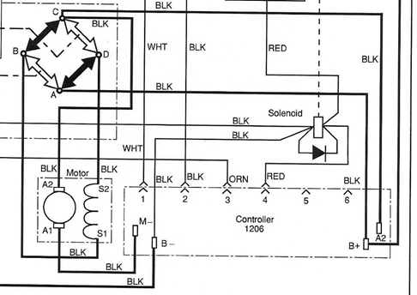
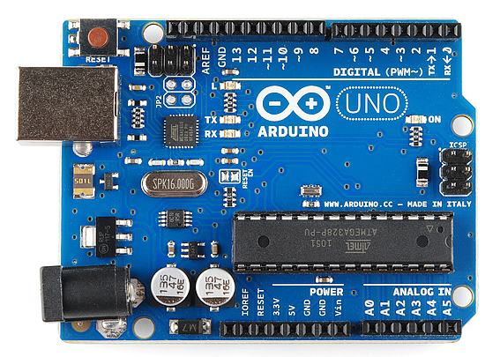
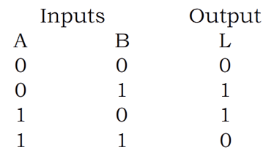
Project Impact - Technical
Based on the data analyst, low cost, safety improvement and low effort-shifting, we believe that controlling the golf cart by an electronic devices will make it cheaper and safe to operate compared to the mechanical operation which request a physical effort and load-bearing force applied on the armature.
00 Stop
B+ A D S2 S1 A C Armature A2 A1 = Forward 01 Motor forward
B+ A B S1 S2 D C Armature A2 A1 =Reverse 10 Motor reverse
11 Ambiguity

Slide 6
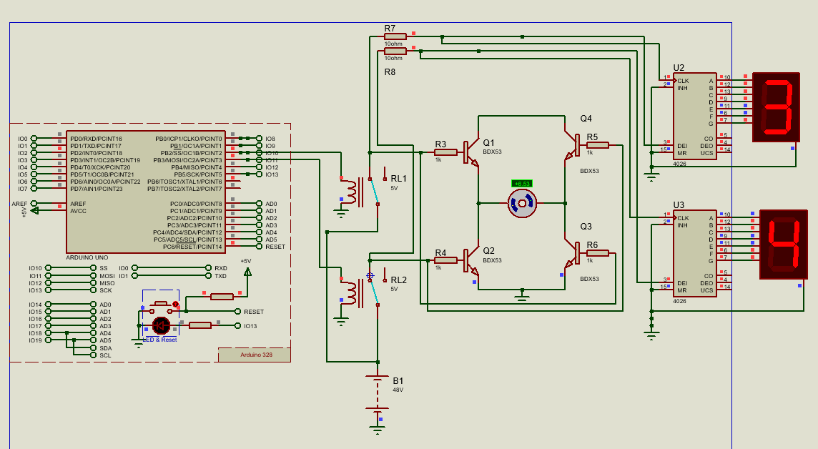
Design Concept
Schematic of proposed electronic switch system

Slide 7
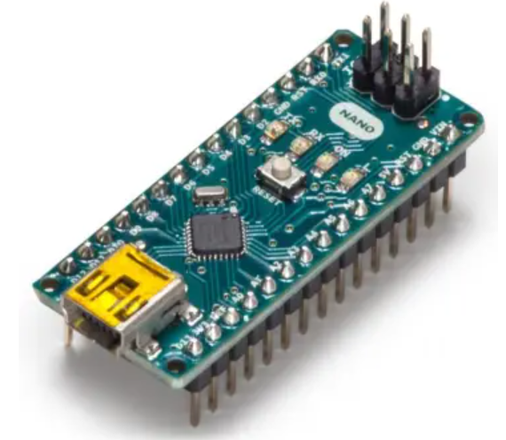
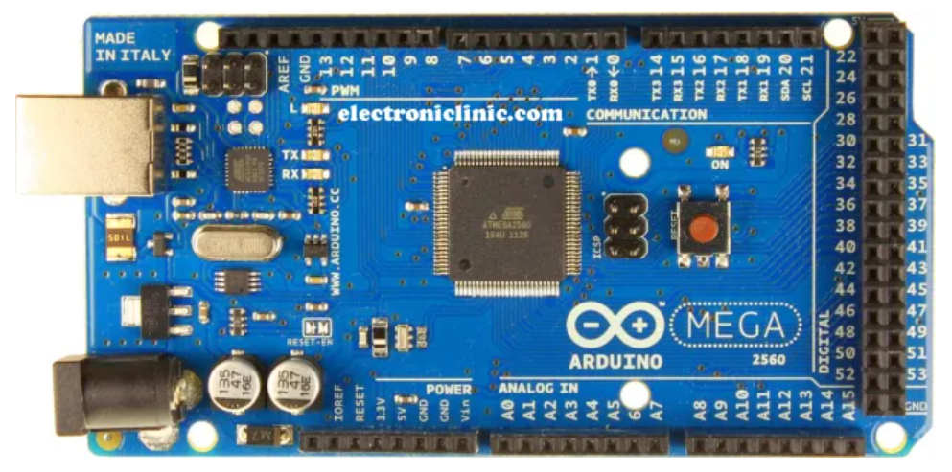
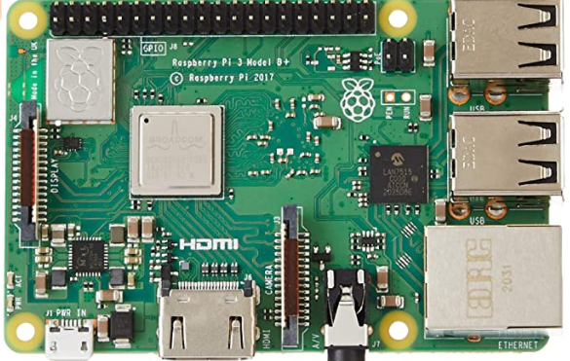
Project Comparison (Microcontrollers)
Product | Pros | Cons | Cost | Reference
Arduino Uno | User friendly More efficient within DC series motors | 6 Analog inputs | $23 | “Arduino Uno REV3.” Arduino Online Shop, https://store-usa.arduino.cc/products/arduino-uno-rev3?selectedStore=us.
Arduino Nano | 8 Analog inputs Small profile | Micro USB port Requires other components | $21 | “Arduino Nano.” Arduino Online Shop, https://store-usa.arduino.cc/products/arduino-nano?selectedStore=us.
Arduino Mega | 256 KB of flash memory High I/O requirements 16 Analog Pins | More costly Big profile | $41 | “Arduino Mega 2560 REV3.” Arduino Online Shop, https://store-usa.arduino.cc/products/arduino-mega-2560-rev3?selectedStore=us.
Raspberry Pi 3 | 26 Analog Pins Supports all types of codes Faster Processor | More expensive Tends to overheat | $85 | Amazon.com: Element14 Raspberry Pi 3 B+ Motherboard ... https://www.amazon.com/ELEMENT-Element14-Raspberry-Pi-Motherboard/dp/B07BDR5PDW.

