Slide 1
ECE Faculty Meeting
Update on Vacant Positions
Enrollment Data
Plans for Semester
Achievements
Open Discussion

Slide 2
Achievement: Justin Foreman and Sarhan Musa
Transforming the classroom into an active learning environment to improve comprehension, retention and graduation rates
National Science Foundation
$1.7 million

Slide 3
Achievement: John Attia
Shuza Binzaid
Suxia Cui
Kelvin Kirby
APPLE HBCU INNOVATION GRANT
$1,528,382

Slide 4
Achievement: Xishuang Dong John Fuller
Lei Huang
Seungchan Kim Xiangfang Li Lijun Qian
Acquisition of High-Performance Computing and Large Storage Instruments to Enhance Research and Education in Big Data Science and Artificial Intelligence at PVAMU
DOD Award
$487,587

Slide 5
Achievement: Qian, Lijun
Object Detection in Satellite Images using Deep Learning
NTESS, LLC - National Technology & Engineering Solutions of Sandia
$23,645.00
SWIFT: Collaborative Research: Data Driven Learning and Optimization in Reconfigurable Intelligent Surface Enabled Industrial Wireless Network for Advanced Manufacturing
National Science Foundation
$200,000.00

Slide 6
Achievements:
Wilkins, Richard
Radiation Effects Studies on Thermal Composites
NTESS, LLC - National Technology & Engineering Solutions of Sandia
$ 70,000

Slide 7
PhD Program Enrollment Increased
Increased by 55% from 2016
Increased by 12.5% from last year

Slide 8
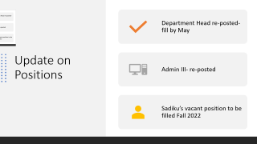

Update on Positions
Department Head re-posted- fill by May
Admin III- re-posted
Sadiku’s vacant position to be filled Fall 2022

Slide 9
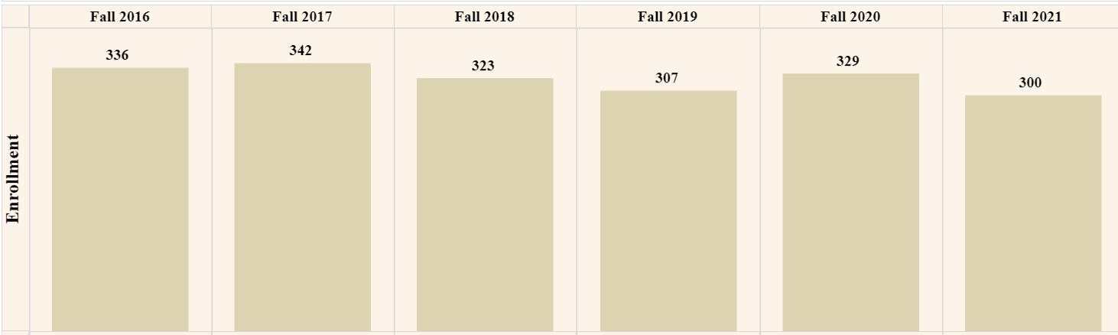
ECE Department Enrollment
Down 42 students from peak in 2017
Undergraduate enrollment decreased in 2021 this time by 3.2% from the year before, according to the National Student Clearinghouse Research Center. 5 charts breaking down fall 2021's college enrollment trends | Higher Ed Dive

Slide 10
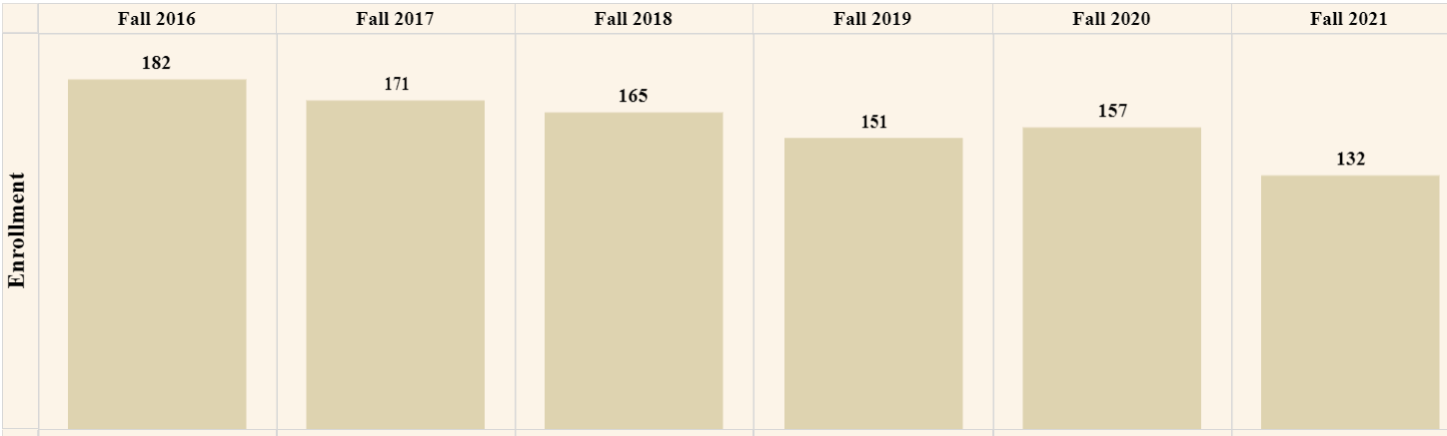
Undergraduate Enrollment
Down 50 students from peak in Fall 2016

Slide 11
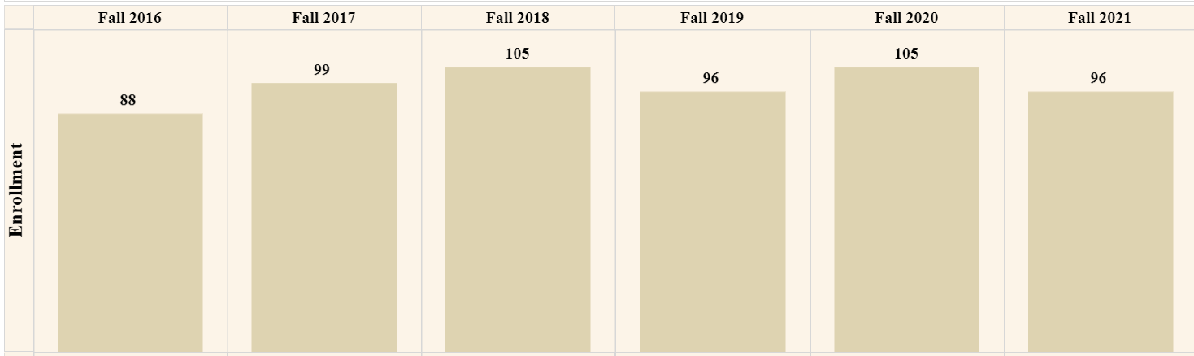
Computer Engr Enrollment Undergraduate
Down by 9 students from peak.

Slide 12
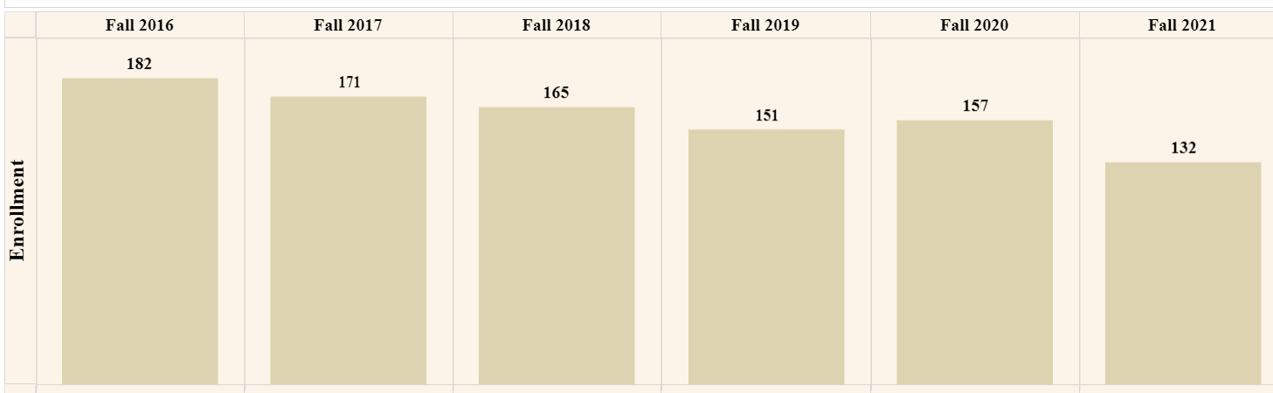
Electrical Engr Undergraduate Enrollment
Down by 25 students from peak.

Slide 13
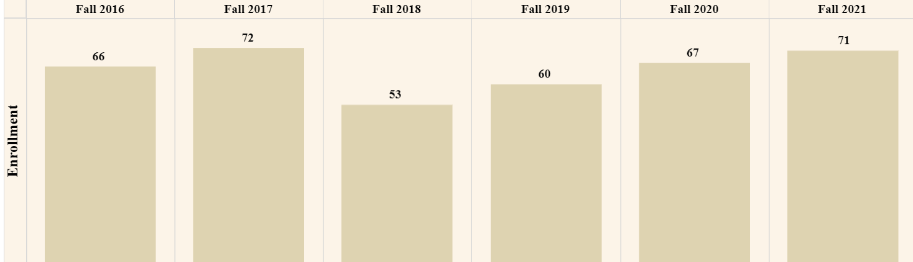
Graduate Enrollment
Down 1 student overall since peak in Fall of 2017.

Slide 14
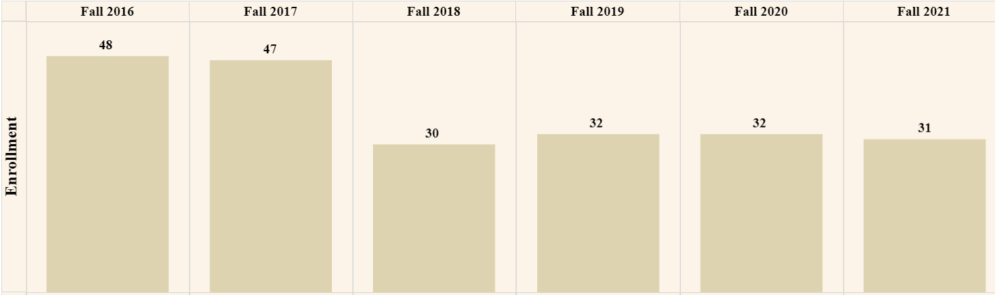
MS EE Enrollment
Down 17 students from peak in 2016.

Slide 15
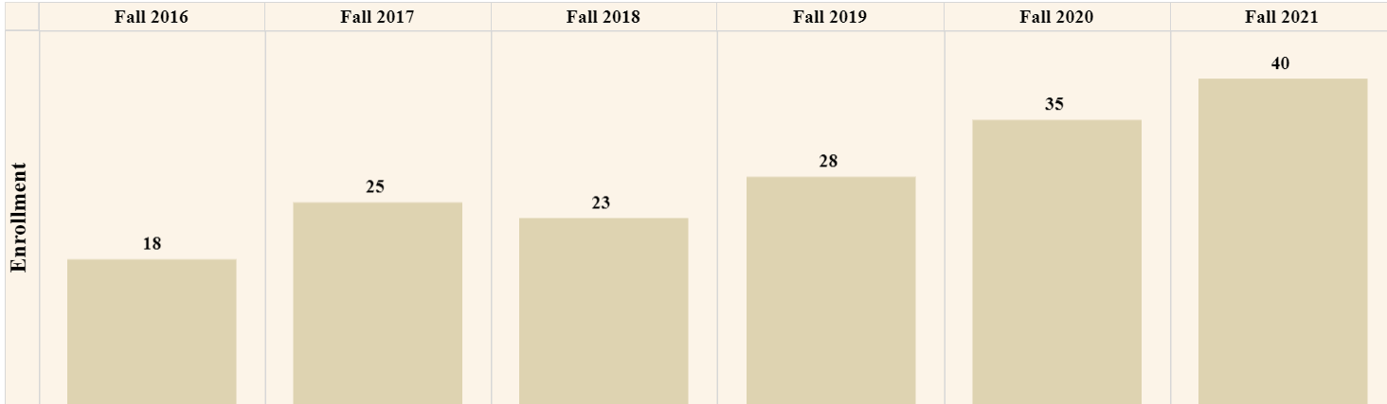
PhD EE Enrollment
Up 22 students from Fall 2016.

Slide 16
Plans for this Semester
Focus
  Fill vacant positions
  ABET re-accreditation
  Recruit top students and Community College students
  Review retention numbers
  Promote the 5 YR BS/MS program

Slide 17
Other Information
CPOS letters
Advising Website
New ABET Website under construction
Next meeting? Bi-weekly meetings or Meetings once a month?
Concern: New EE curriculum not enough technical elective labs in catalog

Slide 18
Open Discussion
The floor is open for discussion.

