Slide 1
APPLE NSI @ PVAMU
John O. Attia, Shuza Binzaid, Suxia Cui, and
Kelvin Kirby
ECE Faculty Meeting
January 11, 2022

Slide 2
Outline of Presentation
Impact of Apple NSI at PVAMU
Program Flowcharts
Course Descriptions
Apple NSI Scholarship

Slide 3
IMPACT OF APPLE NSI AT PVAMU (1)
All the undergraduate electrical and computer engineering students will be introduced to the basic VLSI Design by designing circuits with Cadence CAD tools.
The computer engineering students will be trained in VLSI implementation of projects in Digital Design and Computer Architecture
A new course with tentative title “Digital Systems and VLSI” will be developed to replace the course ELEG 4330 Digital Design.
A new graduate-level Advanced VLSI Design, Test and Characterization course will be developed.
ELEG 4339 Computer Organization and Design will be enhanced to include VLSI Design and tapeout.

Slide 4
IMPACT OF APPLE NSI AT PVAMU (2)
The expected outcomes of the Apple New Silicon Initiative (NSI) program are:
(i) VLSI Design Lab Development
(ii) Apple NSI Scholarships
(iii) Computer Hardware and VLSI Design Club at PVAMU
(iv) Lecture Series
(v) Faculty Development
(vii) Increase the number of projects designed, fabricated and tested.
(vi) Increased in enrollment of students with computer hardware and silicon engineering background.

Slide 5
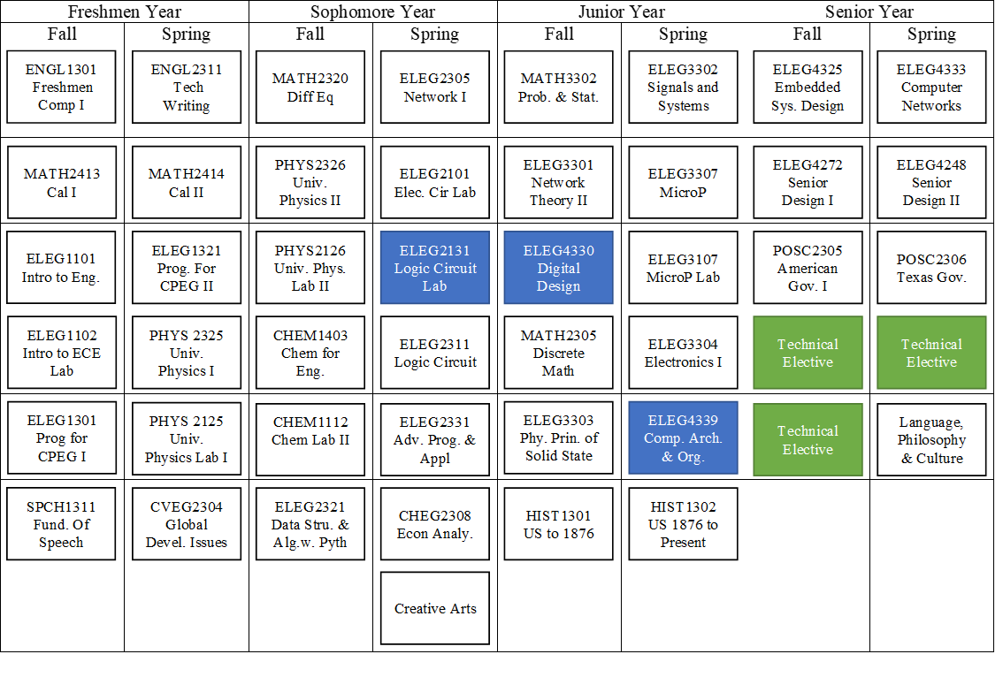
COMPUTER ENGINEERING PROGRAM FLOWCHART

Slide 6
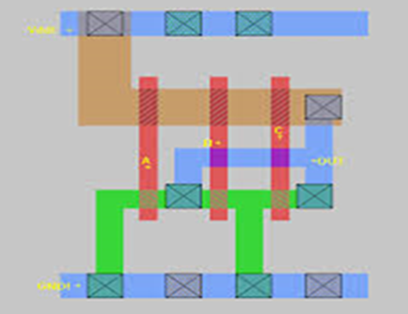
ELEG 2131 Logic Circuits Lab
Course Description (NEW)
Number systems and codes. Boolean algebra and logic minimization methods. Combinational and sequential design using logic gates and flip flops. Computer-aided design tools for digital design, simulation, and testing. Field Programmable Gate Array (FPGA) Devices and Verilog programming language, introduction to VLSI design tools.
Course Content
  Number Bases and Binary Arithmetic
  Basic Logic Gates an Circuit Simplification
  Logic Simplification using Karnaugh Maps
  Logic Gates Using (IC’s)
  Parity Generation and Detection
  Introduction to FPGA
  FPGA Half Adder and Full Adder
  3 to 8 Line Decoder with FPGA
  Multiplexer and Demultiplexer
  Sequential Logic Circuits
  VLSI CAD Tools and Design
Course Description (CURRENT)
Number systems and codes, Boolean algebra and logic minimization methods, combinational and sequential design using logic gates and flip flops, and computer-aided design tools for digital design, simulation, and testing

Slide 7
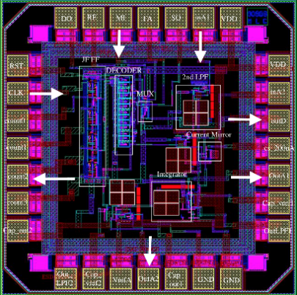
ELEG 4330 DIGITAL DESIGN AND VLSI by
Course Description (NEW)
The use of hardware description language and automated synthesis in design. hierarchical and modular design of digital systems. Control logic, synchronous and asynchronous sequential circuit design. Programmable logic devices and field programmable gate arrays. Circuit simulation for design verification and analysis. Timing-oriented design, HDL and VLSI Design Project.
Course Content
  Review of Logic Circuits: Combinational and Synchronous Sequential Circuits.
  Registers and Counters
  Memory and Programmable Logic
  Design and Register Transfer Level
  Design of Digital Systems Projects
  Project development and presentation
  HDL and VLSI Design Project
Course Description - CURRENT
The use of hardware description language and automated synthesis in design. Hierarchical and modular design of digital systems. Control logic, synchronous and asynchronous sequential circuit design. Programmable logic devices and FPGA. Circuit simulation for design verification and analysis. Timing oriented design

Slide 8
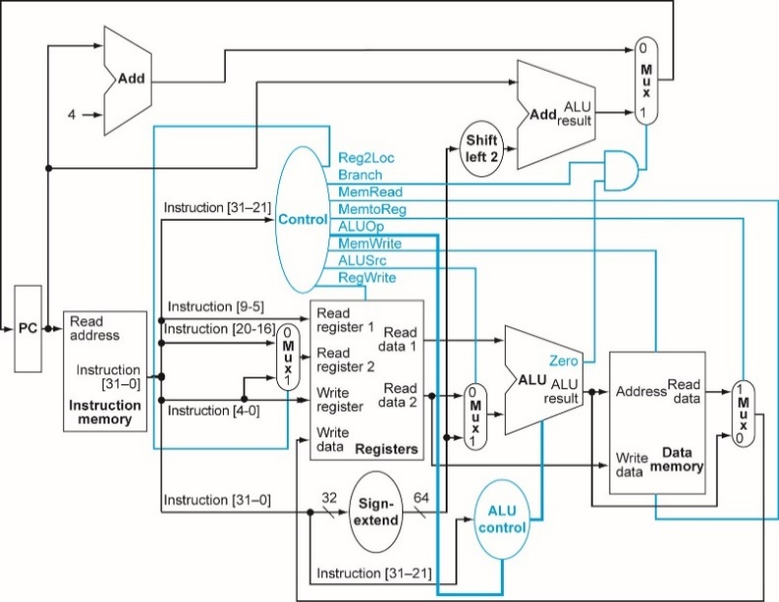
ELEG 4339 Computer Organization and Design
Course Description (NEW)
An introduction to computer organization using assembly and machine language. Number representation, computer arithmetic, instruction sets, l/O interrupts, and programming interrupts. Projects involve detailed study and use of a specific computer hardware and software system, VLSI design project..
Course Content
  Computer Abstractions and technology
  Instructions: Language and computer
  Arithmetic for computer
  The processor
  Large and Fast: Exploiting Memory Hierarchy
  Parallel processor from client to cloud
  VLSI Design Project and Tapeout
Course Description (CURRENT)
An introduction to computer organization using assembly and machine language. Number representation, computer arithmetic, instruction sets, I/O interrupts, and programming interrupts. Projects involve detailed study and use of a specific computer hardware and software system.

Slide 9
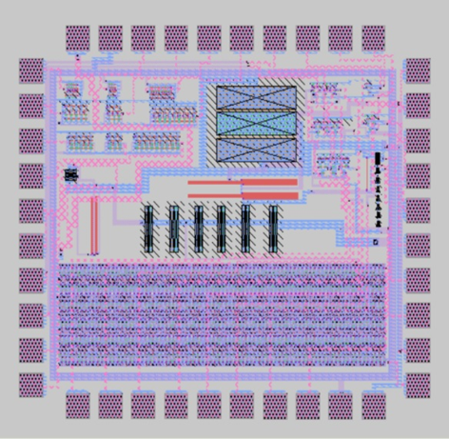
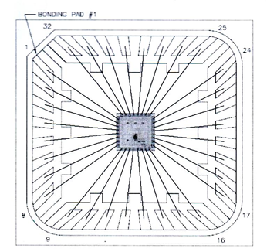
ELEG 6342 VLSI & ULSI Design
Course Description:
MOS transistor characteristics, CMOS inverter and transmission gates. Design of complex CMOS gates; combinational and sequential design techniques in VLSI and ULSI; issues in static transmission gate and dynamic logic design; CMOS technology and layout design rules. Use of CAD tools , . Design, layout and simulation of a small project.
Course Content
  CMOS Logic Circuits: MOS Inverter, NOR, NAND, complex logic implementation
  Pass transistors, Transmission Gates, Latches.
  MOS Transistor Theory: Non-ideal Characteristics and Parameters Extraction
  Scaling and CMOS Inverter Characteristics
  VLSI Processing Technology
  IC Fabrication Process Enhancement & Latchup
  Dynamic Logic
  CMOS Layout Design Rules and IC Layouts
  Circuit Design and Simulations
  Static and Dynamic Power
  Low Power Design Methods
  VLSI Design Project and Tapeout
Goals:
To provide students with VLSI design methodologies, computer aided design tools, and consequently create a foundation to design and fabricate VLSI and ULSI design circuits for various applications.

Slide 10
APPLE NSI SCHOLARSHIP
Apple NSI Scholarship Criteria: $6,000 per year for 3 students
Resume
Two letters of recommendation from faculty
Transcript required (Official or unofficial)
Applicant must be a junior or senior ELEG or CPEG Major
Applicant must have a minimum 3.0 cumulative GPA and maintain a 3.0 each semester
Applicant must be enrolled as a full-time student (12hours) each semester
Applicant must be a U. S. citizen/ Permanent resident, or have the right to work in U. S.
Applicant must be willing to complete summer internship(s) with Apple, if selected

