Slide 1
ABET EAC
UPDATES
ECE DEPARTMENT MEETING
John O. Attia, PhD, PE
Dept. of Electrical & Computer Engineering
January 11, 2022

Slide 2
General Criteria
Students
Program Educational Objectives
Student Outcomes
Continuous Improvement
Curriculum
Faculty
Facilities
Institutional Support

Slide 3
Criterion 2: Program Educational Objectives (Statement)
The program must have published program educational objectives that are consistent with the mission of the institution, the needs of the program’s various constituencies, and these criteria. There must be a documented, systematically utilized, and effective process, involving program constituencies, for the periodic review of these program educational objectives that ensures they remain consistent with the institutional mission, the program’s constituents’ needs, and these criteria.

Slide 4
Program Educational Objectives (PEOs)
ABET Definition of Program Educational Objectives:
Program Educational Objectives – broad statements that describe what graduates are expected to attain within a few years of graduation. Program educational objectives are based on the needs of the program’s constituencies.
Within a few years of graduation normally imply 3 to 5 years after graduation

Slide 5
Constituents of the Programs
The constituents of the Electrical Engineering Program are:
Electrical Engineering undergraduate students
Alumni of the Electrical Engineering Program
Electrical Engineering Program faculty
Employers of the graduates of the Program
The constituents of the Computer Engineering Program are:
Computer Engineering undergraduate students
Alumni of the Electrical Engineering Program
Computer Engineering Program faculty
Employers of the graduates of the Program

Slide 6
PEOs of Programs
The Program Educational Objectives of the Electrical Engineering Program are:
To produce graduates for successful careers in Electrical Engineering and other related fields.
To produce graduates who engage in self-development activities through professional study and personal research that will allow them to adapt to evolving technological challenges.
To produce graduates who can successfully complete graduate degrees in Electrical Engineering or other disciplines that they may choose.
The Program Educational Objectives of the Computer Engineering Program are:
To produce graduates for successful careers in Computer Engineering and other related fields.
To produce graduates who engage in self-development activities through professional study and personal research that will allow them to adapt to evolving technological challenges.
To produce graduates who can successfully complete graduate degrees in Computer Engineering or other disciplines that they may choose.

Slide 7
REVIEW OF THE PEOs
TIMELINES (RECOMMENDED)
October 2020 – November 2020 / Survey of Program Constituents (Horace St. Julian )
Electrical Engineering Students
Computer Engineering Students
Electrical and Computer Engineering Faculty
Alumni/Employer of Program Graduates
December 11, 2020
Approval of Revisions of PEOs by ECE faculty
January 2022 – February 2022 / Survey of Program Constituents
Electrical Engineering Students
Computer Engineering Students
Electrical and Computer Engineering Faculty
Alumni/Employer of Program Graduates
March 2022
Approval of Revisions of PEOs by ECE Faculty

Slide 8
STUDENT OUTCOMES VS. COURSES (ELECTRICAL ENGINEERING)
Approved 10/12/2018
Electrical Engineering Courses | 1 | 2 | 3 | 4 | 5 | 6 | 7
ELEG 1021 Intro Elect Lab
ELEG 1043 Comp Appl in Engr
ELEG 2011 Electric Circuit Lab
ELEG 2023 Network Theory I
ELEG 3013 Network Theory II |  |  |  |  |  | X
ELEG 3021 Logic Circuits Lab
ELEG 3023 Signals and Systems | X
ELEG 3033 Physical Princ. Solid State |  |  |  |  |  |  | X
ELEG 3043 Electronics I |  |  |  |  |  | X
ELEG 3063 Logic Circuits |  |  |  |  |  | X
ELEG 3071 Microproc. Sys. Lab
ELEG 3073 Microproc Sys. | X
ELEG 4003 Communication Theory | X
ELEG 4011 Electronics Lab
ELEG 4013 Energy Conversion |  |  |  |  |  | X
ELEG 4033 Electro Field Thr I |  |  |  |  |  |  | X
ELEG 4043 Electronics II |  | X
ELEG 4073 Control Systems |  | X
ELEG 4472 Senior Design I |  |  | X | X | X
ELEG 4482 Senior Design II | X | X | X | X | X

Slide 9
STUDENT OUTCOMES VS. COURSES (COMPUTER ENGINEERING)
Approved 10/12/2018
Comp. Engineering Courses | 1 | 2 | 3 | 4 | 5 | 6 | 7
ELEG 1021 Intro Elect Lab
ELEG 2011 Electric Circuit Lab
ELEG 2023 Network Theory I
ELEG 3013 Network Theory II |  |  |  |  |  | X
ELEG 3021 Logic Circuits Lab
ELEG 3023 Signals and Systems | X
ELEG 3033 Physical Princ. Solid State |  |  |  |  |  |  | X
ELEG 3043 Electronics I |  |  |  |  |  | X
ELEG 3063 Logic Circuits |  |  |  |  |  | X
ELEG 3071 Microproc. Sys. Lab
ELEG 3073 Microproc Sys. | X
ELEG 4253 Embedded Systems |  | X
ELEG 4303 Dig System Design |  | X
ELEG 4333 Computer Networks | X
ELEG 4393 Comp. Org. Arch |  |  |  |  |  |  | X
ELEG 4472 Senior Design I |  |  | X | X | X
ELEG 4482 Senior Design II | X | X | X | X | X

Slide 10
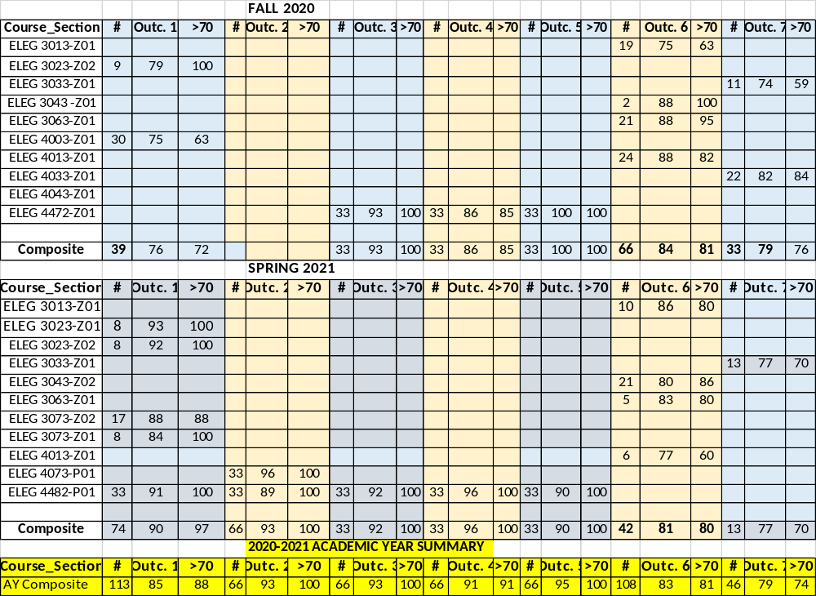
ASSESSMENT RESULTS / ELECTRICAL ENGINEERING

Slide 11
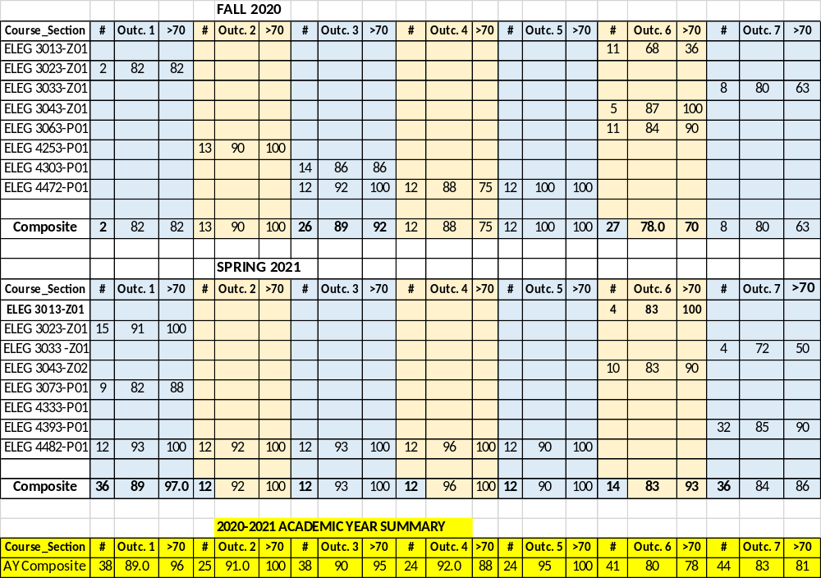
ASSESSMENT RESULTS / COMPUTER ENGINE ERING

Slide 12
STUDENT OUTCOMES (SUMMARY)
STUDENT OUTCOMES (ELECTRICAL ENGR. PROGRAM)
ACAD. YEAR | 1 | 2 | 3 | 4 | 5 | 6 | 7
2018-2019 | 82 | 78 | 89 | 93 | 83 | 75
2019-2020 | 85 | 87 | 91 | 93 | 94 | 85 | 91
2020-2021 | 76 |  | 93 | 86 | 100 | 84 | 80
STUDENT OUTCOMES (COMPUTER ENGR. PROGRAM)
ACAD. YEAR | 1 | 2 | 3 | 4 | 5 | 6 | 7
2018-2019 | 84 | 87 | 93 | 99 | 81 | 79
2019-2020 | 86 | 85 | 94 | 79 | 94 | 82 | 87
2020-2021 | 82 | 90 | 89 | 88 | 100 | 78 | 80

Slide 13
FALL 2021 ASSESSMENT RESULTS
(ELECTRICAL ENGR. PROGRAM)
Course_Section | # | Outc. 1 | >70 | # | Outc. 2 | >70 | # | Outc. 3 | >70 | # | Outc. 4 | >70 | # | Outc. 5 | >70 | # | Outc. 6 | >70 | # | Outc. 7 | >70
ELEG 3301-P01 |  |  |  |  |  |  |  |  |  |  |  |  |  |  |  | 16 | 83 | 87
ELEG 3302-P01 | 7 | 89 | 86
ELEG 3303-P01
ELEG 3303-P02
ELEG 3304-P01 |  |  |  |  |  |  |  |  |  |  |  |  |  |  |  | 7 | 87 | 100
ELEG 2311-P01
ELEG 4300-P01
ELEG 4301-P01 |  |  |  |  |  |  |  |  |  |  |  |  |  |  |  | 24 | 73 | 56
ELEG 4305-P01 |  |  |  |  |  |  |  |  |  |  |  |  |  |  |  |  |  |  | 28 | 82 | 89
ELEG 4304-P01 |  |  |  | 22 | 78 | 86
ELEG 4247-P01 |  |  |  |  |  |  | 26 | 86 | 96 | 26 | 97 | 96 | 26 | 90 | 100
Composite | 7 | 89.0 | 86.0 | 22 | 78.0 | 86.0 | 26 | 86 | 96 | 26 | 97 | 96 | 26 | 90 | 100 | 47 | 78 | 73 | 28 | 82 | 89

Slide 14
FALL 2021 ASSESSMENT RESULTS
(COMPUTER ENGR. PROGRAM)
Course_Section | # | Outc. 1 | >70 | # | Outc. 2 | >70 | # | Outc. 3 | >70 | # | Outc. 4 | >70 | # | Outc. 5 | >70 | # | Outc. 6 | >70 | # | Outc. 7 | >70
ELEG 3301-P01 |  |  |  |  |  |  |  |  |  |  |  |  |  |  |  | 7 | 69 | 57
ELEG 3302-P01 | 3 | 77 | 67
ELEG 3303-P01
ELEG 3303-P02
ELEG 2311-P01
ELEG 4325-P01 |  |  |  | 17 | 84 | 100
ELEG 4330-P01
ELEG 4247-P01 |  |  |  |  |  |  | 14 | 90 | 88 | 14 | 88 | 93 | 14 | 90 | 100
Composite | 3 | 77 | 67 | 17 | 73 | 71 | 14 | 90 | 88 | 14 | 88 | 93 | 14 | 90 | 100 | 7 | 69 | 57

Slide 15
END-OF-SEMESTER COURSE ASSESSMENT REPORTS – NOT AVAILABLE AS OF 1/10/2022
ELEG 2311 Logic Circuit
ELEG 3303 Phys. Princ. Of Solid State
ELEG 4300 Communication Theory
ELEG 4330 Digital System Design

Slide 16
C4 - CONTINUOUS IMPROVEMENT
(ELECTRICAL ENGR. PROGRAM)
# | Student Outcome | Course and Semester of Issue | Course and Semester of Improvement | Improvements Made
1 | 6 | ELEG 3043 Electronics I Spring 2019 Class Average | ELEG 3043 Electronics I Spring 2020 Class Average | Improvement Strategies
 |  | 75 | 83 | (i) Required all students to write reports describing in detail the experimental setup and how the experiments were conducted. (ii) , required the students to write project report with a format that address all aspects of Student Outcome 6.
2 | 1 | ELEG 3073 Microprocessor Systems Spring 2019 Class Average | ELEG 3073 Microprocessor Systems Spring 2020 Class Average | Improvement Strategies
 |  | 73 (section 1) 79 (Section 2) | 80 | Students were given guidance and sample topics from previous year’s students’ work. (ii) The use of microcontroller skills in the design was emphasized.

Slide 17
C4 - CONTINUOUS IMPROVEMENT
(ELECTRICAL ENGR. PROGRAM)
# | Student Outcome | Course and Semester of Issue | Course and Semester of Improvement | Improvements Made
3 | 2 | ELEG 4073 Servomechanism & Control Systems Spring 2019 Class Average | ELEG 4073 Servomechanism & Control Systems Spring 2020 Class Average | Improvement Strategies
 |  | 72 | 87 | .(i) The key concepts needed for the design project were emphasized. (ii) required students to perform literature survey on topics related to the design project.

Slide 18
C4 - CONTINUOUS IMPROVEMENT
(COMPUTER ENGR. PROGRAM)
# | Outcome | Course and Semester of Issue | Course and Semester of Improvement | Improvements Made
1 | 6 | ELEG 3043 Electronics I Spring 2019 Class Average | ELEG 3043 Electronics I Spring 2020 Class Average | Improvements made
 |  | 79 | 80 | Required all students to write reports describing in detail the experimental setup and how the experiments were conducted. In addition, required the students to write project report with a format that address all aspects of Student Outcome 6.
2 | 1 | ELEG 3073 Microprocessor Systems Spring 2019 Class Average | ELEG 3073 Microprocessor Systems Spring 2020 Class Average | Improvement Strategies
 |  | 77 | 81 | Students were given guidance and sample topics from previous year’s students’ work. (ii) The use of microcontroller skills in the design was emphasized.

Slide 19
SPRING 2022 COURSES TO BE ASSESSED
Course | Student Outcome
ELEG 2311 Logic Circuit | 6
ELEG 3301 Network Th. II | 6
ELEG 3302 Signals & Systems | 1
ELEG 3303 Phy. Princ. Of Solid Sta. | 7
ELEG 3304 Electronics I | 6
ELEG 3307 Microproc. System Design | 1
ELEG 4300 Comm. Theory | 1
ELEG 4301 Energy Conversion | 6
ELEG 4305 Electro. Field Thy | 7
ELEG 4304 Electronics II | 2
ELEG 4325 Embedded Systems | 2
ELEG 4330 Digital System Design | 2
ELEG 4333 Computer Networks | 1
ELEG 4339 Comp Arch and Organization | 7
ELEG 4248 Senior Design II | 1, 2, 3, 4, 5

Slide 20
CRITERIA 4 AND 5
DESIGN ORIENTED COURSES
Recommendation for Design-oriented courses
  The following factors should be considered and addressed if relevant: “apply engineering design to produce solutions that meet specified needs with consideration of public health, safety, and welfare, as well as global, cultural, social, environmental, and economic factors.”

Slide 21
CRITERION 5 CURRICULUM - NOTE
Math and Science: Parts of the following course are counted as part math & science courses. We should be ready to provide documentation to confirm math and science content
  ELEG 3302 Signals and Systems
  ELEG 3303 Physical Princ. Solid State
  ELEG 4305 Electro. Field Theory

Slide 22
PROGRAM CRITERIA
Applications of probability and statistics (Required by the Program Criteria for the Electrical, Computer, Communications, Telecommunication(s) and Similarly Named Engineering Programs)
We use materials from the following courses to satisfy this requirement:
ELEG 2101 Electric Circuits Lab
ELEG 3303 Physical Princ. Solid State
ELEG 4300 Communication Theory
ELEG 4333 Computer Networks

Slide 23
BINDERS SUBMITTED FOR FALL 2021 CLASSES AS OF 1/10/2022
Course | Submitted
ELEG 1101 Intro. Engr. Comp. Sci & Tech | NO
ELEG 1102 Intro. Engr. &Comp. Engr. Lab | YES
ELEG 1304 Comp. Appl. In Engr | NO
ELEG 2101 Electric Circuits Lab | YES
ELEG 2305 Network Theory I | YES
ELEG 2131 Logic Circuits Lab | NO
ELEG 2311 Logic Circuit | NO
ELEG 3301 Network Th. II | YES
ELEG 3302 Signals & Systems | YES
ELEG 3303 Phy. Princ. Of Solid State | NO
ELEG 3304 Electronics I | spr. 2022
ELEG 3307 Microproc. System Design | NO
ELEG 4101 Electronics Lab | YES
ELEG 4102 Power Lab | YES
ELEG 4300 Comm. Theory | NO
ELEG 4301 Energy Conversion | YES
ELEG 4305 Electro. Field Thy | YES
ELEG 4304 Electronics II | YES
ELEG 4325 Embedded Systems | YES
ELEG 4330 Digital System Design | NO
ELEG 4333 Computer Networks | spr. 2022
ELEG 4339 Comp Arch and Organization | spr. 2022
ELEG 4247 Senior Design I | YES
ELEG 4248 Senior Design II | spr. 2022

Slide 24
COURSE BINDERS
(Due Date: To be announced )
It is required that you submit a course binder for all the ECE classes you will teach during the Spring 2022 semester.
For courses with several sections, the Department Head will announce the name of the instructor who should submit the course binder
Sample course binder are available for your review.

Slide 25
PEOs -ACTION ITEMS AND RECOMMENDATIONS
Perform the second review of the PEOs of both the Electrical and Computer Engineering program during January to March 2022
Increase the number of survey participants during the 2022 PEOs review, especially for the Computer Engineering program
Educate program constituents about the ABET definition of Program Educational Objectives

Slide 26
ACTION ITEMS
(1) Faculty members needed to assist in performing surveys of students, faculty alumni, and employers regarding the review of the PEOs.
(2) A committee consisting of 3 faculty members is needed to review the course binders.
(3) Faculty volunteers are needed to assist in writing the self-study reports for the electrical and computer engineering programs

Slide 27
ACTION ITEMS (CONT’D)
(4) All the minutes of the ECE Department (faculty meetings and IAB meetings from Fall 2018 to present need to be written and put in a folder.
(5) Student worker is needed to organize (i) student outcome binders, (ii) course outcome binders, (iii) survey instruments

Slide 28

Questions & Answers
Prairie View A&M University
Department of Electrical and Computer Engineering
Prairie View, Texas 77446

