Slide 1

ECE Faculty Retreat
January 11, 2022
AGENDA
Send Message in Chat for Attendance
Mute Your Phone
1:00 - 1:40 Staffing, enrollment, retention, etc. - Dr. Obiomon
1:40 - 2:10 ECE ABET comments – Dr. Attia
2:10 - 2:30 Preliminary Exam Results – Dr. Wilkins
2:30 – 2:45 Apple New Silicon Initiative – Dr. Attia
2:45 - 3:30 RoundTable ad-hoc comments/concerns – All
Break included as needed

Slide 2
Dr Obiomon

Slide 3
ECE Faculty Meeting
Update on Vacant Positions
Enrollment Data
Plans for Semester
Achievements
Open Discussion

Slide 4
Achievement: Justin Foreman and Sarhan Musa
Transforming the classroom into an active learning environment to improve comprehension, retention and graduation rates
National Science Foundation
$1.7 million

Slide 5
Achievement: John Attia
Shuza Binzaid
Suxia Cui
Kelvin Kirby
APPLE HBCU INNOVATION GRANT
$1,528,382

Slide 6
Achievement: Xishuang Dong John Fuller
Lei Huang
Seungchan Kim Xiangfang Li Lijun Qian
Acquisition of High-Performance Computing and Large Storage Instruments to Enhance Research and Education in Big Data Science and Artificial Intelligence at PVAMU
DOD Award
$487,587

Slide 7
Achievement: Qian, Lijun
Object Detection in Satellite Images using Deep Learning
NTESS, LLC - National Technology & Engineering Solutions of Sandia
$23,645.00
SWIFT: Collaborative Research: Data Driven Learning and Optimization in Reconfigurable Intelligent Surface Enabled Industrial Wireless Network for Advanced Manufacturing
National Science Foundation
$200,000.00

Slide 8
Achievements:
Wilkins, Richard
Radiation Effects Studies on Thermal Composites
NTESS, LLC - National Technology & Engineering Solutions of Sandia
$ 70,000

Slide 9
PhD Program Enrollment Increased
Increased by 55% from 2016
Increased by 12.5% from last year

Slide 10
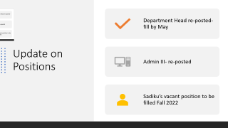
Update on Positions
Department Head re-posted- fill by May
Admin III- re-posted
Sadiku’s vacant position to be filled Fall 2022

Slide 11
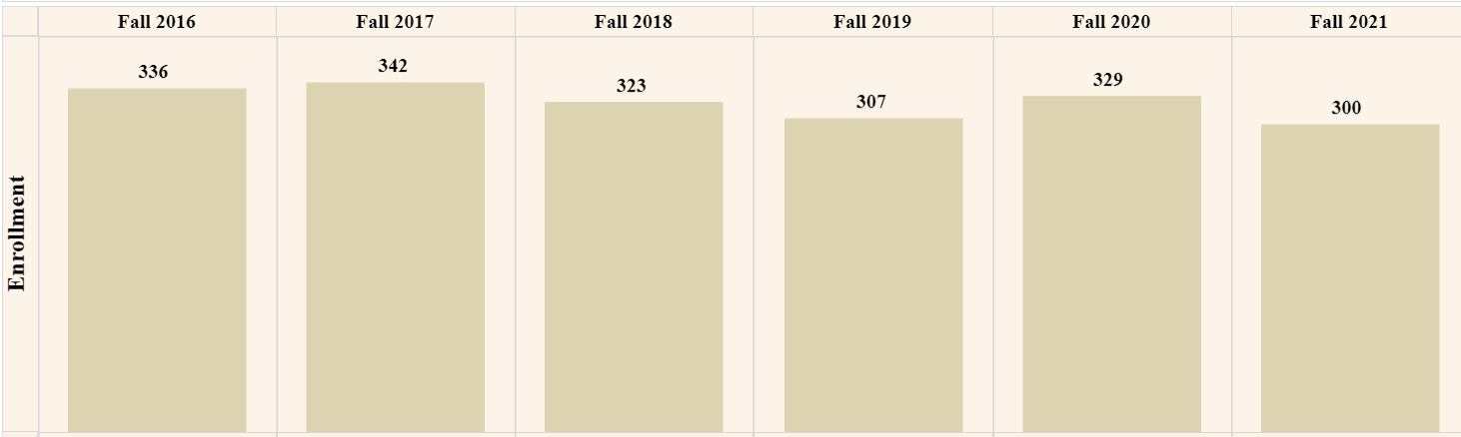
ECE Department Enrollment
Down 42 students from peak in 2017
Undergraduate enrollment decreased in 2021 this time by 3.2% from the year before, according to the National Student Clearinghouse Research Center. 5 charts breaking down fall 2021's college enrollment trends | Higher Ed Dive

Slide 12
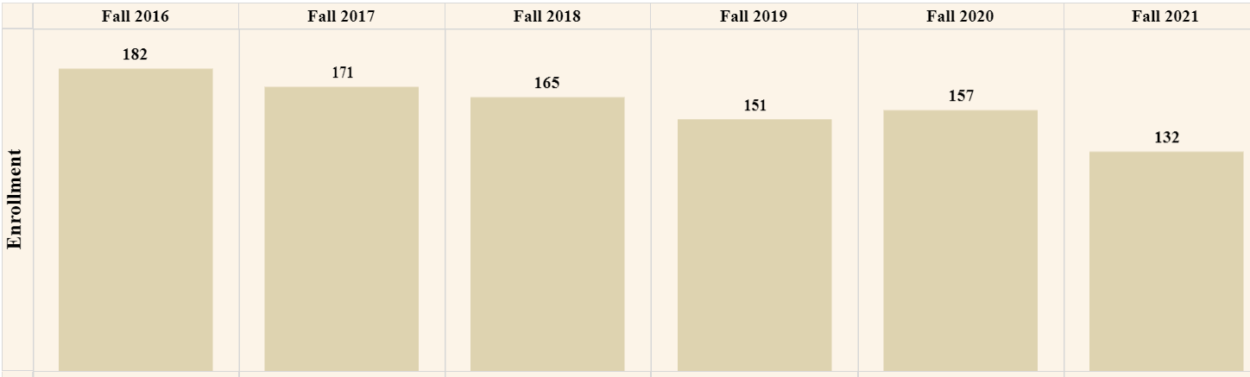
Undergraduate Enrollment
Down 50 students from peak in Fall 2016

Slide 13
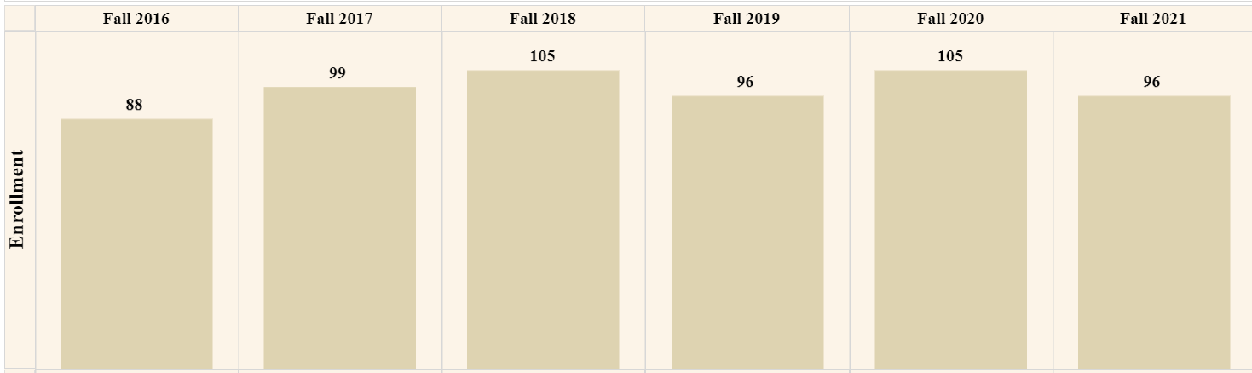
Computer Engr Enrollment Undergraduate
Down by 9 students from peak.

Slide 14
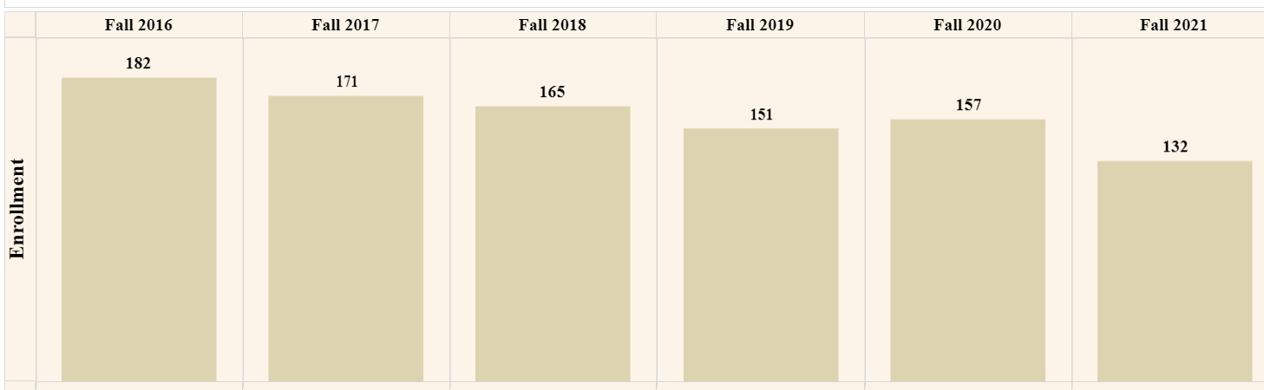
Electrical Engr Undergraduate Enrollment
Down by 25 students from peak.

Slide 15
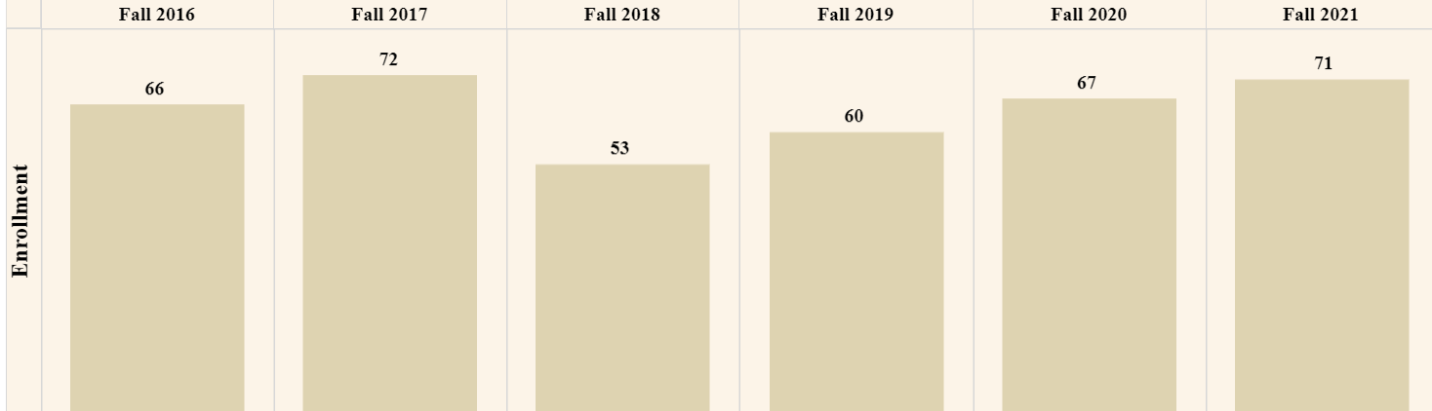
Graduate Enrollment
Down 1 student overall since peak in Fall of 2017.

Slide 16
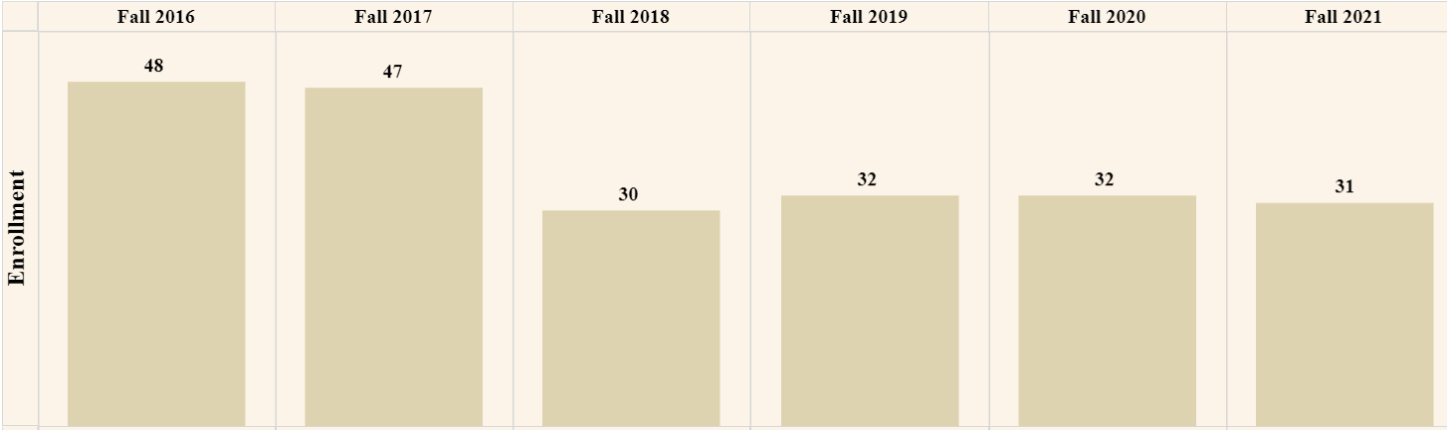
MS EE Enrollment
Down 17 students from peak in 2016.

Slide 17
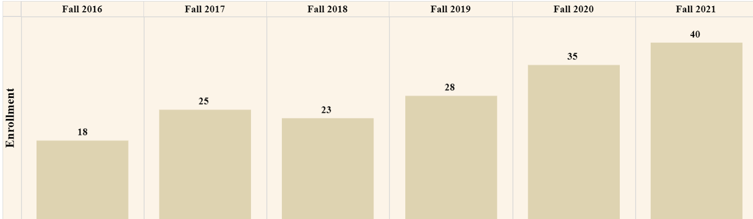
PhD EE Enrollment
Up 22 students from Fall 2016.

Slide 18
Plans for this Semester
Focus
  Fill vacant positions
  ABET re-accreditation
  Recruit top students and Community College students
  Review retention numbers
  Promote the 5 YR BS/MS program

Slide 19
Other Information
CPOS letters
Advising Website
New ABET Website under construction
Next meeting? Bi-weekly meetings or Meetings once a month?
Concern: New EE curriculum not enough technical elective labs in catalog

Slide 20
Open Discussion
The floor is open for discussion.

Slide 21
Dr. Attia

Slide 22
ABET EAC
UPDATES
ECE DEPARTMENT MEETING
John O. Attia, PhD, PE
Dept. of Electrical & Computer Engineering
January 11, 2022

Slide 23
General Criteria
Students
Program Educational Objectives
Student Outcomes
Continuous Improvement
Curriculum
Faculty
Facilities
Institutional Support

Slide 24
Criterion 2: Program Educational Objectives (Statement)
The program must have published program educational objectives that are consistent with the mission of the institution, the needs of the program’s various constituencies, and these criteria. There must be a documented, systematically utilized, and effective process, involving program constituencies, for the periodic review of these program educational objectives that ensures they remain consistent with the institutional mission, the program’s constituents’ needs, and these criteria.

Slide 25
Program Educational Objectives (PEOs)
ABET Definition of Program Educational Objectives:
Program Educational Objectives – broad statements that describe what graduates are expected to attain within a few years of graduation. Program educational objectives are based on the needs of the program’s constituencies.
Within a few years of graduation normally imply 3 to 5 years after graduation

Slide 26
Constituents of the Programs
The constituents of the Electrical Engineering Program are:
Electrical Engineering undergraduate students
Alumni of the Electrical Engineering Program
Electrical Engineering Program faculty
Employers of the graduates of the Program
The constituents of the Computer Engineering Program are:
Computer Engineering undergraduate students
Alumni of the Electrical Engineering Program
Computer Engineering Program faculty
Employers of the graduates of the Program

Slide 27
PEOs of Programs
The Program Educational Objectives of the Electrical Engineering Program are:
To produce graduates for successful careers in Electrical Engineering and other related fields.
To produce graduates who engage in self-development activities through professional study and personal research that will allow them to adapt to evolving technological challenges.
To produce graduates who can successfully complete graduate degrees in Electrical Engineering or other disciplines that they may choose.
The Program Educational Objectives of the Computer Engineering Program are:
To produce graduates for successful careers in Computer Engineering and other related fields.
To produce graduates who engage in self-development activities through professional study and personal research that will allow them to adapt to evolving technological challenges.
To produce graduates who can successfully complete graduate degrees in Computer Engineering or other disciplines that they may choose.

Slide 28
REVIEW OF THE PEOs
TIMELINES (RECOMMENDED)
October 2020 – November 2020 / Survey of Program Constituents (Horace St. Julian )
Electrical Engineering Students
Computer Engineering Students
Electrical and Computer Engineering Faculty
Alumni/Employer of Program Graduates
December 11, 2020
Approval of Revisions of PEOs by ECE faculty
January 2022 – February 2022 / Survey of Program Constituents
Electrical Engineering Students
Computer Engineering Students
Electrical and Computer Engineering Faculty
Alumni/Employer of Program Graduates
March 2022
Approval of Revisions of PEOs by ECE Faculty

Slide 29
STUDENT OUTCOMES VS. COURSES (ELECTRICAL ENGINEERING)
Approved 10/12/2018
Electrical Engineering Courses | 1 | 2 | 3 | 4 | 5 | 6 | 7
ELEG 1021 Intro Elect Lab
ELEG 1043 Comp Appl in Engr
ELEG 2011 Electric Circuit Lab
ELEG 2023 Network Theory I
ELEG 3013 Network Theory II |  |  |  |  |  | X
ELEG 3021 Logic Circuits Lab
ELEG 3023 Signals and Systems | X
ELEG 3033 Physical Princ. Solid State |  |  |  |  |  |  | X
ELEG 3043 Electronics I |  |  |  |  |  | X
ELEG 3063 Logic Circuits |  |  |  |  |  | X
ELEG 3071 Microproc. Sys. Lab
ELEG 3073 Microproc Sys. | X
ELEG 4003 Communication Theory | X
ELEG 4011 Electronics Lab
ELEG 4013 Energy Conversion |  |  |  |  |  | X
ELEG 4033 Electro Field Thr I |  |  |  |  |  |  | X
ELEG 4043 Electronics II |  | X
ELEG 4073 Control Systems |  | X
ELEG 4472 Senior Design I |  |  | X | X | X
ELEG 4482 Senior Design II | X | X | X | X | X

Slide 30
STUDENT OUTCOMES VS. COURSES (COMPUTER ENGINEERING)
Approved 10/12/2018
Comp. Engineering Courses | 1 | 2 | 3 | 4 | 5 | 6 | 7
ELEG 1021 Intro Elect Lab
ELEG 2011 Electric Circuit Lab
ELEG 2023 Network Theory I
ELEG 3013 Network Theory II |  |  |  |  |  | X
ELEG 3021 Logic Circuits Lab
ELEG 3023 Signals and Systems | X
ELEG 3033 Physical Princ. Solid State |  |  |  |  |  |  | X
ELEG 3043 Electronics I |  |  |  |  |  | X
ELEG 3063 Logic Circuits |  |  |  |  |  | X
ELEG 3071 Microproc. Sys. Lab
ELEG 3073 Microproc Sys. | X
ELEG 4253 Embedded Systems |  | X
ELEG 4303 Dig System Design |  | X
ELEG 4333 Computer Networks | X
ELEG 4393 Comp. Org. Arch |  |  |  |  |  |  | X
ELEG 4472 Senior Design I |  |  | X | X | X
ELEG 4482 Senior Design II | X | X | X | X | X

Slide 31
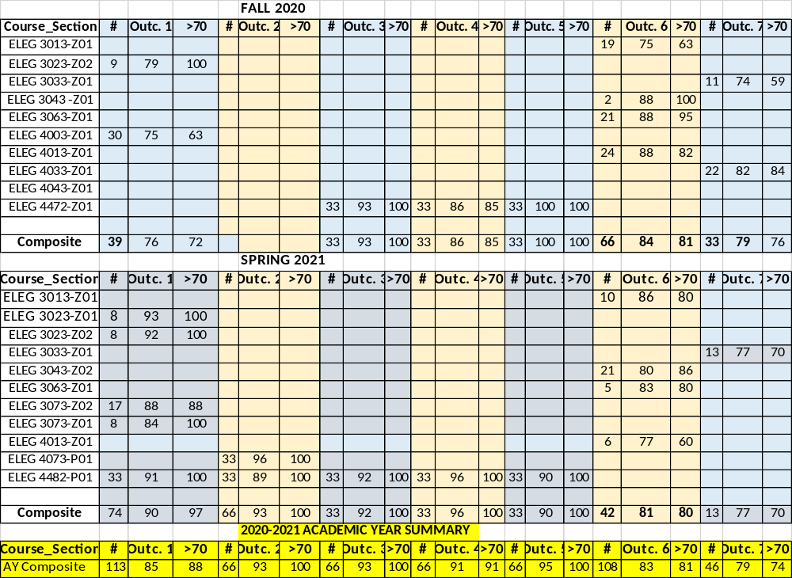
ASSESSMENT RESULTS / ELECTRICAL ENGINEERING

Slide 32
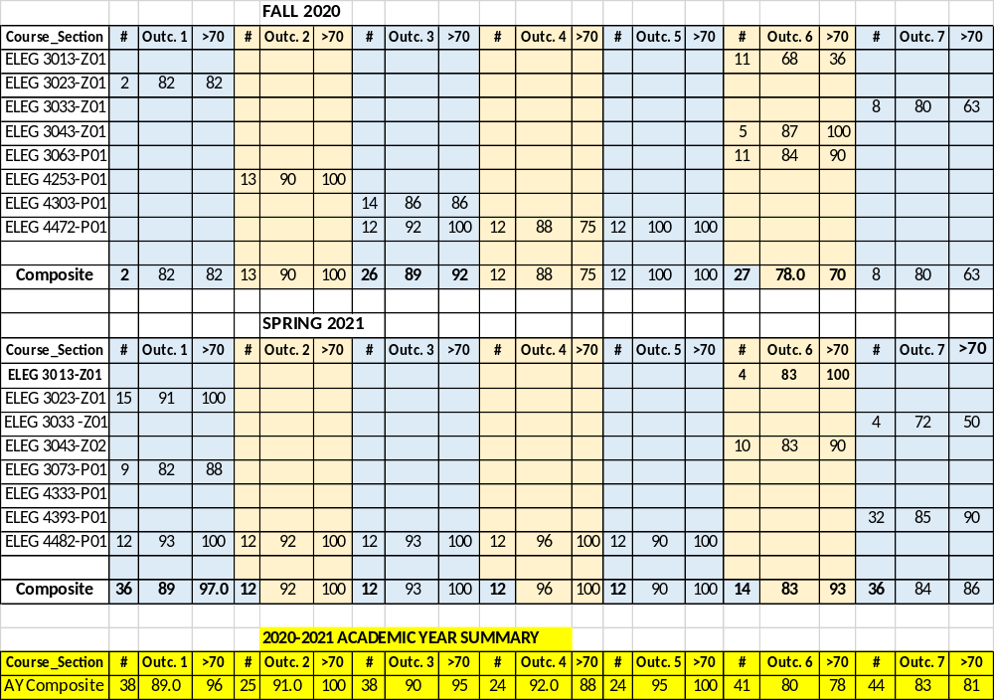
ASSESSMENT RESULTS / COMPUTER ENGINE ERING

Slide 33
STUDENT OUTCOMES (SUMMARY)
STUDENT OUTCOMES (ELECTRICAL ENGR. PROGRAM)
ACAD. YEAR | 1 | 2 | 3 | 4 | 5 | 6 | 7
2018-2019 | 82 | 78 | 89 | 93 | 83 | 75
2019-2020 | 85 | 87 | 91 | 93 | 94 | 85 | 91
2020-2021 | 76 |  | 93 | 86 | 100 | 84 | 80
STUDENT OUTCOMES (COMPUTER ENGR. PROGRAM)
ACAD. YEAR | 1 | 2 | 3 | 4 | 5 | 6 | 7
2018-2019 | 84 | 87 | 93 | 99 | 81 | 79
2019-2020 | 86 | 85 | 94 | 79 | 94 | 82 | 87
2020-2021 | 82 | 90 | 89 | 88 | 100 | 78 | 80

Slide 34
FALL 2021 ASSESSMENT RESULTS
(ELECTRICAL ENGR. PROGRAM)
Course_Section | # | Outc. 1 | >70 | # | Outc. 2 | >70 | # | Outc. 3 | >70 | # | Outc. 4 | >70 | # | Outc. 5 | >70 | # | Outc. 6 | >70 | # | Outc. 7 | >70
ELEG 3301-P01 |  |  |  |  |  |  |  |  |  |  |  |  |  |  |  | 16 | 83 | 87
ELEG 3302-P01 | 7 | 89 | 86
ELEG 3303-P01
ELEG 3303-P02
ELEG 3304-P01 |  |  |  |  |  |  |  |  |  |  |  |  |  |  |  | 7 | 87 | 100
ELEG 2311-P01
ELEG 4300-P01
ELEG 4301-P01 |  |  |  |  |  |  |  |  |  |  |  |  |  |  |  | 24 | 73 | 56
ELEG 4305-P01 |  |  |  |  |  |  |  |  |  |  |  |  |  |  |  |  |  |  | 28 | 82 | 89
ELEG 4304-P01 |  |  |  | 22 | 78 | 86
ELEG 4247-P01 |  |  |  |  |  |  | 26 | 86 | 96 | 26 | 97 | 96 | 26 | 90 | 100
Composite | 7 | 89.0 | 86.0 | 22 | 78.0 | 86.0 | 26 | 86 | 96 | 26 | 97 | 96 | 26 | 90 | 100 | 47 | 78 | 73 | 28 | 82 | 89

Slide 35
FALL 2021 ASSESSMENT RESULTS
(COMPUTER ENGR. PROGRAM)
Course_Section | # | Outc. 1 | >70 | # | Outc. 2 | >70 | # | Outc. 3 | >70 | # | Outc. 4 | >70 | # | Outc. 5 | >70 | # | Outc. 6 | >70 | # | Outc. 7 | >70
ELEG 3301-P01 |  |  |  |  |  |  |  |  |  |  |  |  |  |  |  | 7 | 69 | 57
ELEG 3302-P01 | 3 | 77 | 67
ELEG 3303-P01
ELEG 3303-P02
ELEG 2311-P01
ELEG 4325-P01 |  |  |  | 17 | 84 | 100
ELEG 4330-P01
ELEG 4247-P01 |  |  |  |  |  |  | 14 | 90 | 88 | 14 | 88 | 93 | 14 | 90 | 100
Composite | 3 | 77 | 67 | 17 | 73 | 71 | 14 | 90 | 88 | 14 | 88 | 93 | 14 | 90 | 100 | 7 | 69 | 57

Slide 36
END-OF-SEMESTER COURSE ASSESSMENT REPORTS – NOT AVAILABLE AS OF 1/10/2022
ELEG 2311 Logic Circuit
ELEG 3303 Phys. Princ. Of Solid State
ELEG 4300 Communication Theory
ELEG 4330 Digital System Design

Slide 37
C4 - CONTINUOUS IMPROVEMENT
(ELECTRICAL ENGR. PROGRAM)
# | Student Outcome | Course and Semester of Issue | Course and Semester of Improvement | Improvements Made
1 | 6 | ELEG 3043 Electronics I Spring 2019 Class Average | ELEG 3043 Electronics I Spring 2020 Class Average | Improvement Strategies
 |  | 75 | 83 | (i) Required all students to write reports describing in detail the experimental setup and how the experiments were conducted. (ii) , required the students to write project report with a format that address all aspects of Student Outcome 6.
2 | 1 | ELEG 3073 Microprocessor Systems Spring 2019 Class Average | ELEG 3073 Microprocessor Systems Spring 2020 Class Average | Improvement Strategies
 |  | 73 (section 1) 79 (Section 2) | 80 | Students were given guidance and sample topics from previous year’s students’ work. (ii) The use of microcontroller skills in the design was emphasized.

Slide 38
C4 - CONTINUOUS IMPROVEMENT
(ELECTRICAL ENGR. PROGRAM)
# | Student Outcome | Course and Semester of Issue | Course and Semester of Improvement | Improvements Made
3 | 2 | ELEG 4073 Servomechanism & Control Systems Spring 2019 Class Average | ELEG 4073 Servomechanism & Control Systems Spring 2020 Class Average | Improvement Strategies
 |  | 72 | 87 | .(i) The key concepts needed for the design project were emphasized. (ii) required students to perform literature survey on topics related to the design project.

Slide 39
C4 - CONTINUOUS IMPROVEMENT
(COMPUTER ENGR. PROGRAM)
# | Outcome | Course and Semester of Issue | Course and Semester of Improvement | Improvements Made
1 | 6 | ELEG 3043 Electronics I Spring 2019 Class Average | ELEG 3043 Electronics I Spring 2020 Class Average | Improvements made
 |  | 79 | 80 | Required all students to write reports describing in detail the experimental setup and how the experiments were conducted. In addition, required the students to write project report with a format that address all aspects of Student Outcome 6.
2 | 1 | ELEG 3073 Microprocessor Systems Spring 2019 Class Average | ELEG 3073 Microprocessor Systems Spring 2020 Class Average | Improvement Strategies
 |  | 77 | 81 | Students were given guidance and sample topics from previous year’s students’ work. (ii) The use of microcontroller skills in the design was emphasized.

Slide 40
SPRING 2022 COURSES TO BE ASSESSED
Course | Student Outcome
ELEG 2311 Logic Circuit | 6
ELEG 3301 Network Th. II | 6
ELEG 3302 Signals & Systems | 1
ELEG 3303 Phy. Princ. Of Solid Sta. | 7
ELEG 3304 Electronics I | 6
ELEG 3307 Microproc. System Design | 1
ELEG 4300 Comm. Theory | 1
ELEG 4301 Energy Conversion | 6
ELEG 4305 Electro. Field Thy | 7
ELEG 4304 Electronics II | 2
ELEG 4325 Embedded Systems | 2
ELEG 4330 Digital System Design | 2
ELEG 4333 Computer Networks | 1
ELEG 4339 Comp Arch and Organization | 7
ELEG 4248 Senior Design II | 1, 2, 3, 4, 5

Slide 41
CRITERIA 4 AND 5
DESIGN ORIENTED COURSES
Recommendation for Design-oriented courses
  The following factors should be considered and addressed if relevant: “apply engineering design to produce solutions that meet specified needs with consideration of public health, safety, and welfare, as well as global, cultural, social, environmental, and economic factors.”

Slide 42
CRITERION 5 CURRICULUM - NOTE
Math and Science: Parts of the following course are counted as part math & science courses. We should be ready to provide documentation to confirm math and science content
  ELEG 3302 Signals and Systems
  ELEG 3303 Physical Princ. Solid State
  ELEG 4305 Electro. Field Theory

Slide 43
PROGRAM CRITERIA
Applications of probability and statistics (Required by the Program Criteria for the Electrical, Computer, Communications, Telecommunication(s) and Similarly Named Engineering Programs)
We use materials from the following courses to satisfy this requirement:
ELEG 2101 Electric Circuits Lab
ELEG 3303 Physical Princ. Solid State
ELEG 4300 Communication Theory
ELEG 4333 Computer Networks

Slide 44
BINDERS SUBMITTED FOR FALL 2021 CLASSES AS OF 1/10/2022
Course | Submitted
ELEG 1101 Intro. Engr. Comp. Sci & Tech | NO
ELEG 1102 Intro. Engr. &Comp. Engr. Lab | YES
ELEG 1304 Comp. Appl. In Engr | NO
ELEG 2101 Electric Circuits Lab | YES
ELEG 2305 Network Theory I | YES
ELEG 2131 Logic Circuits Lab | NO
ELEG 2311 Logic Circuit | NO
ELEG 3301 Network Th. II | YES
ELEG 3302 Signals & Systems | YES
ELEG 3303 Phy. Princ. Of Solid State | NO
ELEG 3304 Electronics I | spr. 2022
ELEG 3307 Microproc. System Design | NO
ELEG 4101 Electronics Lab | YES
ELEG 4102 Power Lab | YES
ELEG 4300 Comm. Theory | NO
ELEG 4301 Energy Conversion | YES
ELEG 4305 Electro. Field Thy | YES
ELEG 4304 Electronics II | YES
ELEG 4325 Embedded Systems | YES
ELEG 4330 Digital System Design | NO
ELEG 4333 Computer Networks | spr. 2022
ELEG 4339 Comp Arch and Organization | spr. 2022
ELEG 4247 Senior Design I | YES
ELEG 4248 Senior Design II | spr. 2022

Slide 45
COURSE BINDERS
(Due Date: To be announced )
It is required that you submit a course binder for all the ECE classes you will teach during the Spring 2022 semester.
For courses with several sections, the Department Head will announce the name of the instructor who should submit the course binder
Sample course binder are available for your review.

Slide 46
PEOs -ACTION ITEMS AND RECOMMENDATIONS
Perform the second review of the PEOs of both the Electrical and Computer Engineering program during January to March 2022
Increase the number of survey participants during the 2022 PEOs review, especially for the Computer Engineering program
Educate program constituents about the ABET definition of Program Educational Objectives

Slide 47
ACTION ITEMS
(1) Faculty members needed to assist in performing surveys of students, faculty alumni, and employers regarding the review of the PEOs.
(2) A committee consisting of 3 faculty members is needed to review the course binders.
(3) Faculty volunteers are needed to assist in writing the self-study reports for the electrical and computer engineering programs

Slide 48
ACTION ITEMS (CONT’D)
(4) All the minutes of the ECE Department (faculty meetings and IAB meetings from Fall 2018 to present need to be written and put in a folder.
(5) Student worker is needed to organize (i) student outcome binders, (ii) course outcome binders, (iii) survey instruments

Slide 49

Questions & Answers
Prairie View A&M University
Department of Electrical and Computer Engineering
Prairie View, Texas 77446

Slide 50
Dr. Wilkins

Slide 51
Graduate Programs Department of Electrical and Computer Engineering
Dr. Richard Wilkins – Professor and Gradate Coordinator
Items for discussion:
Results of the 2021 Preliminary Exam for the PhD
Need for Catalog Changes with regards to Course Program of Study
Any addional catalog changes – new courses, etc.

Slide 52
2021 PhD Preliminary Exam Results Summary
The situation concerning the preliminary exams for 2021 was unprecedented:
COVID dictated delays during 2020 and an on-line exam in January 2021. November 2021 exam was face-to-face.
For the exams given in January 2021 and November 2021, there were 27 students (15 students in January and 12 new students in November.) Highest numbers in the history of the program.
# students that passed all three exams
January 2021 | 10
November 2021 | 5
# students taking the exam for the first time that failed one exam
January 2021 | 2
November 2021 | 5
# students taking the exam for the first time that failed more than one exam
January 2021 | 2
November 2021 | 2*
# students re-taking one or more exams for the second time
January 2021 | 2 (both passed)
November 2021 | 4† (all failed at least one exam)
This data indicates that 4/27 or about 15% of the students taking the exam in 2021 have been notified in December 2021 of dismissal from the program pending appeal.
The “most passed” exams are Digital Systems and Computer Networks.
Exams failed (not including exams not taken): Power Engineering (2 students twice and 1 1st time in November), Engineering Mathematics (1 student, twice) , Microelectronics (2, November), Computer Networks (1 student, twice, 3 students 1st time in November) and Control Systems (1, November, taken for the fist time in more than 6 years).
*One student in November missed the exams due to unverified illness.
† One student that failed all three in January passed two and failed 1 in November.

Slide 53
Discussion points:
1. Are the exams doing their jobs? Is 15%/year dismissal rate too large?
2. Do the exam areas topics need to be modified?
Base on past discussions, this seems to be fairly well agreed upon. This question runs in parallel with the need to revisit the “Tracks” for the MS and PhD.
3. Does the format of the exam need to change? Do we need the exams?
North Carolina A&T has a similar written exam and “tracks”. (https://www.ncat.edu/tgc/phd-electrical-engineering.php)
Florida A&M-Florida State has a 5 week topic specific exam based on a literature review. (https://www.eng.famu.fsu.edu/ece/graduate/phd-electrical-engineering)
Texas A&M has a written exam based on eight fundamental undergraduate classes. Student must complete 6 of 18 questions. (https://engineering.tamu.edu/electrical/academics/degrees/graduate/phd-qualifying-exams/index.html}
University of Houston: Project based, different research groups have different requirements. “The project should be assigned no later than the beginning of the semester in which the exam is to take place, and should be designed to test the candidate's ability to independently conduct research at a level commensurate with their education.” (https://www.ece.uh.edu/graduate/procedures-requirements-standards#QualifyingExam)
4. Do the exam results reflect weaknesses in our undergraduate curriculum?

Slide 54
Need for Catalog Changes with regards to Course Program of Study
Students cannot receive financial aide for courses not required for their “Program of Study”
Basic problem (as far as I can tell) is that Degree Works (DW) is used to determine what courses qualify. DW works well for clear cut undergraduate degree programs. DW is less effective (at least to date) for more flexible graduate programs.
Additional issues adding to the problem:
Classes related to the various ECE tracks have changed significantly in recent years. Many new classes, some older classes (still shown as “track classes”) have not been offered for many years.
Many new “Special Topics” classes relevant to the tracks recently introduced. These are not taken into account in DW.
PVAMU (and thus DW) differentiates between “graduate” (5000 level) and “doctorate” (6000 level) classes. This has lead to confusion in that our MS students take 6000 classes in our department.
Apparently, this last point is a serious problem that seems to be difficult to resolve by modifying the relevant software (at least this is what we have been told by the registrar’s office). Do we need to cross list each ECE graduate class with a 5XXX and 6XXXX designation for MS and PhD students respectively?
Short term solution is to do substitution forms. Long term solution?
In December 2021, I worked with Dr. Obiomon and Dr. Martin to modify the MS and PhD requirement to take into account the new course numbers and available courses (as they appear in the last available catalog) that can satisfy track and elective requirements for MS-EE and PhD-EE. Document can be made available.

Slide 55
Any addional catalog changes for Fall 2022 – new courses, etc.
Dr. Kim has provided documents for one class.
Documents (complete with needed signatures) need to be in Academic Affairs Sharepoint site by January 27, 2022
Thank you!

Slide 56


Send a message in chat – this will serve to record attendance

Slide 57
Dr. Attia

Slide 58
APPLE NSI @ PVAMU
John O. Attia, Shuza Binzaid, Suxia Cui, and
Kelvin Kirby
ECE Faculty Meeting
January 11, 2022

Slide 59
Outline of Presentation
Impact of Apple NSI at PVAMU
Program Flowcharts
Course Descriptions
Apple NSI Scholarship

Slide 60
IMPACT OF APPLE NSI AT PVAMU (1)
All the undergraduate electrical and computer engineering students will be introduced to the basic VLSI Design by designing circuits with Cadence CAD tools.
The computer engineering students will be trained in VLSI implementation of projects in Digital Design and Computer Architecture
A new course with tentative title “Digital Systems and VLSI” will be developed to replace the course ELEG 4330 Digital Design.
A new graduate-level Advanced VLSI Design, Test and Characterization course will be developed.
ELEG 4339 Computer Organization and Design will be enhanced to include VLSI Design and tapeout.

Slide 61
IMPACT OF APPLE NSI AT PVAMU (2)
The expected outcomes of the Apple New Silicon Initiative (NSI) program are:
(i) VLSI Design Lab Development
(ii) Apple NSI Scholarships
(iii) Computer Hardware and VLSI Design Club at PVAMU
(iv) Lecture Series
(v) Faculty Development
(vii) Increase the number of projects designed, fabricated and tested.
(vi) Increased in enrollment of students with computer hardware and silicon engineering background.

Slide 62
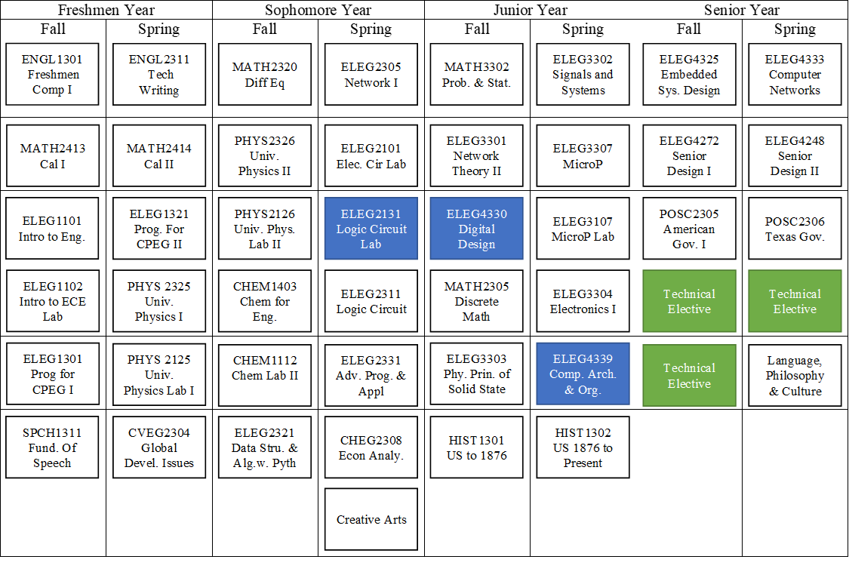
COMPUTER ENGINEERING PROGRAM FLOWCHART

Slide 63
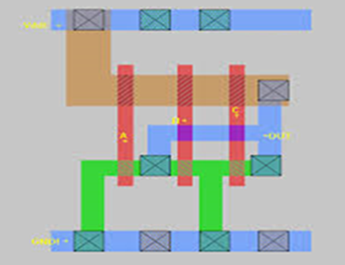
ELEG 2131 Logic Circuits Lab
Course Description (NEW)
Number systems and codes. Boolean algebra and logic minimization methods. Combinational and sequential design using logic gates and flip flops. Computer-aided design tools for digital design, simulation, and testing. Field Programmable Gate Array (FPGA) Devices and Verilog programming language, introduction to VLSI design tools.
Course Content
  Number Bases and Binary Arithmetic
  Basic Logic Gates an Circuit Simplification
  Logic Simplification using Karnaugh Maps
  Logic Gates Using (IC’s)
  Parity Generation and Detection
  Introduction to FPGA
  FPGA Half Adder and Full Adder
  3 to 8 Line Decoder with FPGA
  Multiplexer and Demultiplexer
  Sequential Logic Circuits
  VLSI CAD Tools and Design
Course Description (CURRENT)
Number systems and codes, Boolean algebra and logic minimization methods, combinational and sequential design using logic gates and flip flops, and computer-aided design tools for digital design, simulation, and testing

Slide 64
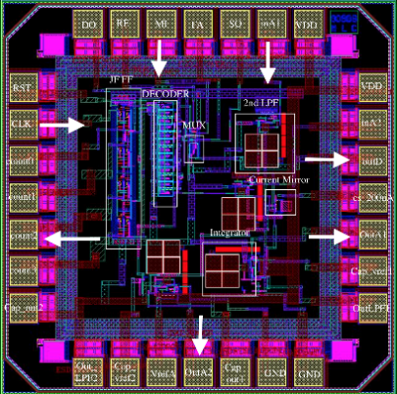
ELEG 4330 DIGITAL DESIGN AND VLSI by
Course Description (NEW)
The use of hardware description language and automated synthesis in design. hierarchical and modular design of digital systems. Control logic, synchronous and asynchronous sequential circuit design. Programmable logic devices and field programmable gate arrays. Circuit simulation for design verification and analysis. Timing-oriented design, HDL and VLSI Design Project.
Course Content
  Review of Logic Circuits: Combinational and Synchronous Sequential Circuits.
  Registers and Counters
  Memory and Programmable Logic
  Design and Register Transfer Level
  Design of Digital Systems Projects
  Project development and presentation
  HDL and VLSI Design Project
Course Description - CURRENT
The use of hardware description language and automated synthesis in design. Hierarchical and modular design of digital systems. Control logic, synchronous and asynchronous sequential circuit design. Programmable logic devices and FPGA. Circuit simulation for design verification and analysis. Timing oriented design

Slide 65
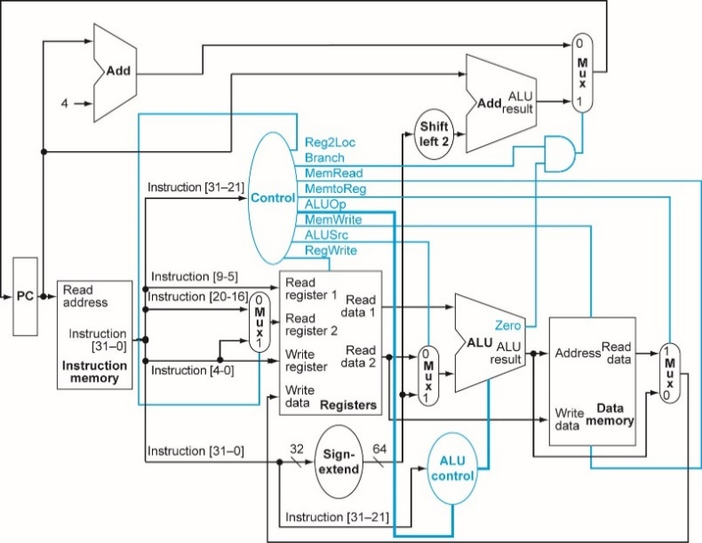
ELEG 4339 Computer Organization and Design
Course Description (NEW)
An introduction to computer organization using assembly and machine language. Number representation, computer arithmetic, instruction sets, l/O interrupts, and programming interrupts. Projects involve detailed study and use of a specific computer hardware and software system, VLSI design project..
Course Content
  Computer Abstractions and technology
  Instructions: Language and computer
  Arithmetic for computer
  The processor
  Large and Fast: Exploiting Memory Hierarchy
  Parallel processor from client to cloud
  VLSI Design Project and Tapeout
Course Description (CURRENT)
An introduction to computer organization using assembly and machine language. Number representation, computer arithmetic, instruction sets, I/O interrupts, and programming interrupts. Projects involve detailed study and use of a specific computer hardware and software system.

Slide 66
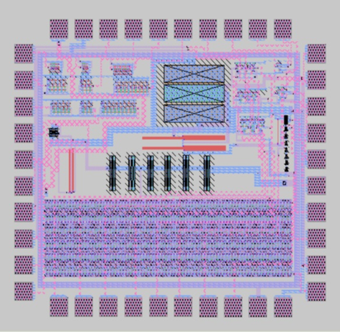
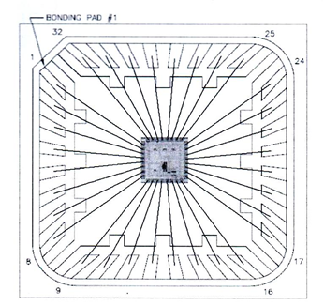
ELEG 6342 VLSI & ULSI Design
Course Description:
MOS transistor characteristics, CMOS inverter and transmission gates. Design of complex CMOS gates; combinational and sequential design techniques in VLSI and ULSI; issues in static transmission gate and dynamic logic design; CMOS technology and layout design rules. Use of CAD tools , . Design, layout and simulation of a small project.
Course Content
  CMOS Logic Circuits: MOS Inverter, NOR, NAND, complex logic implementation
  Pass transistors, Transmission Gates, Latches.
  MOS Transistor Theory: Non-ideal Characteristics and Parameters Extraction
  Scaling and CMOS Inverter Characteristics
  VLSI Processing Technology
  IC Fabrication Process Enhancement & Latchup
  Dynamic Logic
  CMOS Layout Design Rules and IC Layouts
  Circuit Design and Simulations
  Static and Dynamic Power
  Low Power Design Methods
  VLSI Design Project and Tapeout
Goals:
To provide students with VLSI design methodologies, computer aided design tools, and consequently create a foundation to design and fabricate VLSI and ULSI design circuits for various applications.

Slide 67
APPLE NSI SCHOLARSHIP
Apple NSI Scholarship Criteria: $6,000 per year for 3 students
Resume
Two letters of recommendation from faculty
Transcript required (Official or unofficial)
Applicant must be a junior or senior ELEG or CPEG Major
Applicant must have a minimum 3.0 cumulative GPA and maintain a 3.0 each semester
Applicant must be enrolled as a full-time student (12hours) each semester
Applicant must be a U. S. citizen/ Permanent resident, or have the right to work in U. S.
Applicant must be willing to complete summer internship(s) with Apple, if selected

Slide 68
Ece Faculty – Open Time for Questions/Comments

Slide 69
Closing Comments – Dr. Obiomon

Slide 70
Meeting ADJOURNED

