Slide 1
ECE - Graduate Programs – Fall 2021 – Dr. Richard Wilkins, Coordinator
Summary: Overall, the graduate programs are strong and weathered the Covid situation fairly well.
Below are some items to address or re-address to go forward:
PhD tuition waivers: This turned into a serious problem earlier this year. The problem originated from the account used for funding these ran out of money. Graduate Studies worked with many within the university to meet obligations, but there is still lingering issues.
The matter of Fall 2021 still needs to be addressed.
For your PhD students, at minimum to qualify, they will need to be full time and have either RA ot TA support. I will keep you updated on developments.

Slide 2
Items in need of re-visiting:
Modernize the “tracks” in the graduate programs to better reflect the current state of ECE. This was started but not completed in the fall before Covid.
This will be a “non-substinative” change for the program, but it should be addressed early in the semester so it can go through the process and be in place for Fall 2022. I will be asking for input!
Review content and methods for the PhD qualifying exam.
Please note: The website that describes the PhD qualifying exam seems to have been lost. I will ask those of you who have been authoring the exams lately for content for a replacement page.

Slide 3
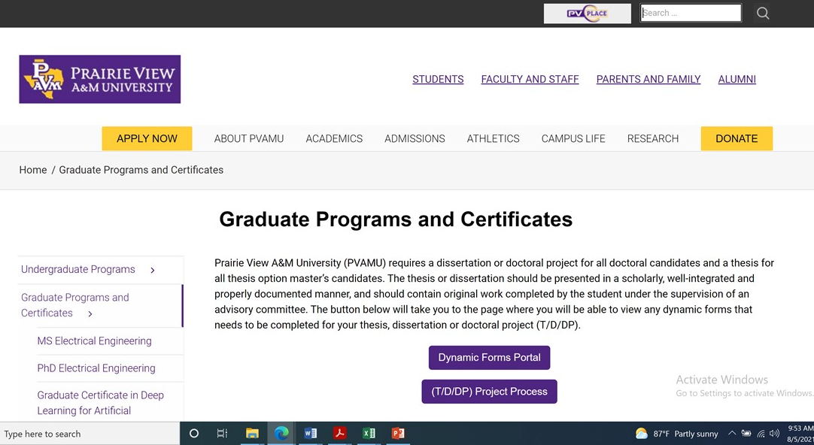
Graduate Studies Dynamic Forms System. This system was adopted in Spring 2021 and had some glitches. The thesis/dissertation process and the dynamic forms portal can be found at:
Thesis, Dissertation and Doctoral (T/D/DP) Project Process - Graduate Studies (pvamu.edu)
Please let me know of problems you may have.
At the suggestion of Dr. Obiomon, links were placed on the ECE website. This should help faculty access these items more easily:

Slide 4
Other items to address:
We are getting more applicants for the MS and PhD from students with backgrounds in computer information systems, computer science, and other disciplines were mathematics beyond basic calculus are not required. To date, these have been handled on a case by case basis, but the department may want to consider how best to handle this issue.
There is a need for better record keeping for the graduate program. Considering the size of the program this is beyond the capability of just the coordinator.
There needs to be better ways to communicate with current and potential students via our website and perhaps other social media.
There is a need to look at organized methods for recruiting.
There is a need to find more and better ways to fund graduate students at both the MS and PhD levels.
Please let me know what else we can do to improve our graduate programs!

