Slide 1

ECE Faculty Meeting
Thursday August 19, 2021
AGENDA
Send a message in chat to track attendance
1:00 – 1:15 Dr Obiomon– Opening Comments
1:15 - 2:45 Various Topics from
Dr Attia – ECE ABET Mock Visit
Dr Kirby – Undergrad Curriculum
Dr Wilkins – Grad Curriculum
Break
3:00 – 4:00 Open Discussion Faculty and Dean

Slide 2
Dr Obiomon
Opening Comments

Slide 3
Dr Attia

Slide 4
ABET EAC
SUMMARY OF MOCK REVIEW OF ECE PROGRAMS &
PREPARATION FOR 2022 ABET VISIT
ECE DEPARTMENT MEETING
John O. Attia, PhD, PE
Dept. of Electrical & Computer Engineering
August 19, 2021

Slide 5
General Criteria
Students
Program Educational Objectives
Student Outcomes
Continuous Improvement
Curriculum
Faculty
Facilities
Institutional Support

Slide 6
Program Criteria
Requirements in addition to General Criteria for specific program types, such as
  Chemical engineering
  Civil engineering
  Computer engineering
  Computer science
  Computer engineering technology
  Electrical engineering
  Electrical engineering technology
  Mechanical engineering

Slide 7
MOCK REVIEW OF ECE PROGRAMS –C1 STUDENTS
No comments

Slide 8
MOCK REVIEW OF ECE PROGRAMS –C2 PROGRAM EDUCATIONAL OBJECTIVES
We should review the PEOs during the 2021-2022 academic year
We should consider removing students as one of the constituents
  Program Educational Objectives – broad statements that describe what graduates are expected to attain within a few years of graduation. Program educational objectives are based on the needs of the program’s constituencies.
  Within a few years of graduation normally imply 3 to 5 years after graduation
  Students may not know what expected to achieve within a few years after graduation.

Slide 9
MOCK REVIEW OF ECE PROGRAMS –C2 PROGRAM EDUCATIONAL OBJECTIVES
Currently:
The constituents of the Electrical Engineering Program are:
Electrical Engineering undergraduate students
Alumni of the Electrical Engineering Program
Electrical Engineering Program faculty
Employers of the graduates of the Program
The constituents of the Computer Engineering Program are:
Computer Engineering undergraduate students
Alumni of the Electrical Engineering Program
Computer Engineering Program faculty
Employers of the graduates of the Program

Slide 10
ACTION ITEMS AND RECOMMENDATIONS
Approved to keep unchanged the PEOs of both the Electrical and Computer Engineering Programs on Friday, Dec. 11, 2020
Perform the second review of the PEOs of both the Electrical and Computer Engineering program during January to March 2022
Increase the number of survey participants during the 2022 PEOs review, especially for the Computer Engineering program
Educate program constituents about the ABET definition of Program Educational Objectives

Slide 11
C3 - STUDENT OUTCOMES
Student outcomes are outcomes (1) through (7) plus any additional outcomes that may be articulated by the program.
1. an ability to identify, formulate, and solve complex engineering problems by applying principles of engineering, science, and mathematics
2. an ability to apply engineering design to produce solutions that meet specified needs with consideration of public health, safety, and welfare, as well as global, cultural, social, environmental, and economic factors
3. an ability to communicate effectively with a range of audiences
4. an ability to recognize ethical and professional responsibilities in engineering situations and make informed judgments, which must consider the impact of engineering solutions in global, economic, environmental, and societal contexts
5. an ability to function effectively on a team whose members together provide leadership, create a collaborative and inclusive environment, establish goals, plan tasks, and meet objectives
6. an ability to develop and conduct appropriate experimentation, analyze, and interpret data, and use engineering judgment to draw conclusions
7. an ability to acquire and apply new knowledge as needed, using appropriate learning strategies.

Slide 12
STUDENT OUTCOMES VS. COURSES (ELECTRICAL ENGINEERING)
Approved 10/12/2018
Electrical Engineering Courses | 1 | 2 | 3 | 4 | 5 | 6 | 7
ELEG 1021 Intro Elect Lab
ELEG 1043 Comp Appl in Engr
ELEG 2011 Electric Circuit Lab
ELEG 2023 Network Theory I
ELEG 3013 Network Theory II |  |  |  |  |  | X
ELEG 3021 Logic Circuits Lab
ELEG 3023 Signals and Systems | X
ELEG 3033 Physical Princ. Solid State |  |  |  |  |  |  | X
ELEG 3043 Electronics I |  |  |  |  |  | X
ELEG 3063 Logic Circuits |  |  |  |  |  | X
ELEG 3071 Microproc. Sys. Lab
ELEG 3073 Microproc Sys. | X
ELEG 4003 Communication Theory | X
ELEG 4011 Electronics Lab
ELEG 4013 Energy Conversion |  |  |  |  |  | X
ELEG 4033 Electro Field Thr I |  |  |  |  |  |  | X
ELEG 4043 Electronics II |  | X
ELEG 4073 Control Systems |  | X
ELEG 4472 Senior Design I |  |  | X | X | X
ELEG 4482 Senior Design II | X | X | X | X | X

Slide 13
STUDENT OUTCOMES VS. COURSES (COMPUTER ENGINEERING)
Approved 10/12/2018
Comp. Engineering Courses | 1 | 2 | 3 | 4 | 5 | 6 | 7
ELEG 1021 Intro Elect Lab
ELEG 2011 Electric Circuit Lab
ELEG 2023 Network Theory I
ELEG 3013 Network Theory II |  |  |  |  |  | X
ELEG 3021 Logic Circuits Lab
ELEG 3023 Signals and Systems | X
ELEG 3033 Physical Princ. Solid State |  |  |  |  |  |  | X
ELEG 3043 Electronics I |  |  |  |  |  | X
ELEG 3063 Logic Circuits |  |  |  |  |  | X
ELEG 3071 Microproc. Sys. Lab
ELEG 3073 Microproc Sys. | X
ELEG 4253 Embedded Systems |  | X
ELEG 4303 Dig System Design |  | X
ELEG 4333 Computer Networks | X
ELEG 4393 Comp. Org. Arch |  |  |  |  |  |  | X
ELEG 4472 Senior Design I |  |  | X | X | X
ELEG 4482 Senior Design II | X | X | X | X | X

Slide 14
MOCK REVIEW OF ECE PROGRAMS –C3 STUDENT OUTCOMES
Recommend we make Student Outcome 8: Applications of probability and statistics
Which is required by the Program Criteria for the Electrical, Computer, Communications, Telecommunication(s) and Similarly Named Engineering Programs
We have used materials from the following courses to satisfy this requirement:
ELEG 2011 Circuits Lab
ELEG 3033 Physical Princ. Solid State
ELEG 4003 Communication Theory
ELEG 4333 Computer Networks

Slide 15
MOCK REVIEW OF ECE PROGRAMS –C4 CONTINUOUS IMPROVEMENT
All changes in the curriculum should be added in the self-study report
All major changes in the Department should be added as part of continuous improvement
Limit our student outcomes assessments to student outcomes 1 to 7, and not add the results of student outcomes a to k

Slide 16
MOCK REVIEW OF ECE PROGRAMS –C5 CURRICULUM
Math and Science: Parts of the following course are counted as part math & science courses. We should be ready to provide documentation to confirm math and science content
  ELEG 3033 Physical Princ. Solid State
  ELEG 3023 Signals and Systems
  ELEG 4033 Electro. Field Theory

Slide 17
MOCK REVIEW OF ECE PROGRAMS –C6 FACULTY
In the faculty resume, the faculty members should not leave any of the following parts blank:
  Service activities
  Publications and Presentations
  Professional Development

Slide 18
MOCK REVIEW OF ECE PROGRAMS –C7 FACILITIES
No comments or write-up on facilities

Slide 19
MOCK REVIEW OF ECE PROGRAMS –C8 INSTITUTIONAL SUPPORT
From team chair’s point of opinion, having interim Department Heads should not be a shortcoming

Slide 20
MOCK REVIEW OF ECE PROGRAMS – OTHER GENERAL COMMENTS
From the composite student outcomes assessment data, if the program satisfies the minimum score of the criterion (set at 70%), we should still improve courses that lower the average of a particular student outcome
The list of courses in the self-study report that satisfy the various requirements of the program criteria was good and will simplify the work of a program evaluator
The Electrical Engineering self-study report is an excellent document and the team chair asked the Dean’s permission to share the report with other institutions
Dr. Kirby was very responsive to the requests from the team chair/program evaluator

Slide 21
DESIGN ORIENTED COURSES
JOHN ATTIA’S RECOMMENDATIONS
Design Oriented Courses
  The following factors should be considered and addressed if relevant: “apply engineering design to produce solutions that meet specified needs with consideration of public health, safety, and welfare, as well as global, cultural, social, environmental, and economic factors.”

Slide 22
FALL 2021 COURSES ASSESSED
(using previous course numbers)
Faculty | Course | Student Outcome
 | ELEG 3013 Network Th. II | 6
 | ELEG 3033 Phy. Princ. Of Solid Sta. | 7
 | ELEG 3063 Logic Circuit | 6
 | ELEG 4003 Comm. Theory | 1
 | ELEG 4013 Energy Conversion | 6
 | ELEG 4033 Electro. Field Thy | 7
 | ELEG 4043 Electronics II | 2
 | ELEG 4253 Embedded Systems | 2
 | ELEG 4303 Digital System Design | 2
 | ELEG 4472 Senior Design I | 3, 4, 5

Slide 23
END-SEMESTER COURSE ASSESSMENT REPORT
(Due Date: To be announced)
(i) cover page,
(ii) table of content,
(iii) course syllabus,
(iv) end-of-semester class assessment report,
(v) grade sheet showing student and class performance in outcomes,
(vi) outcome specific assignment used to assess the outcome, and
(vii) sample of student work.

Slide 24
COURSE BINDERS
(Due Date: To be announced )
It is required that you submit a course binder for all the ECE classes you will teach during the fall 2021 semester.
For courses with several sections, the Department Head will announce the name of the instructor who should submit the course binder
Sample course binder are available for your review.

Slide 25
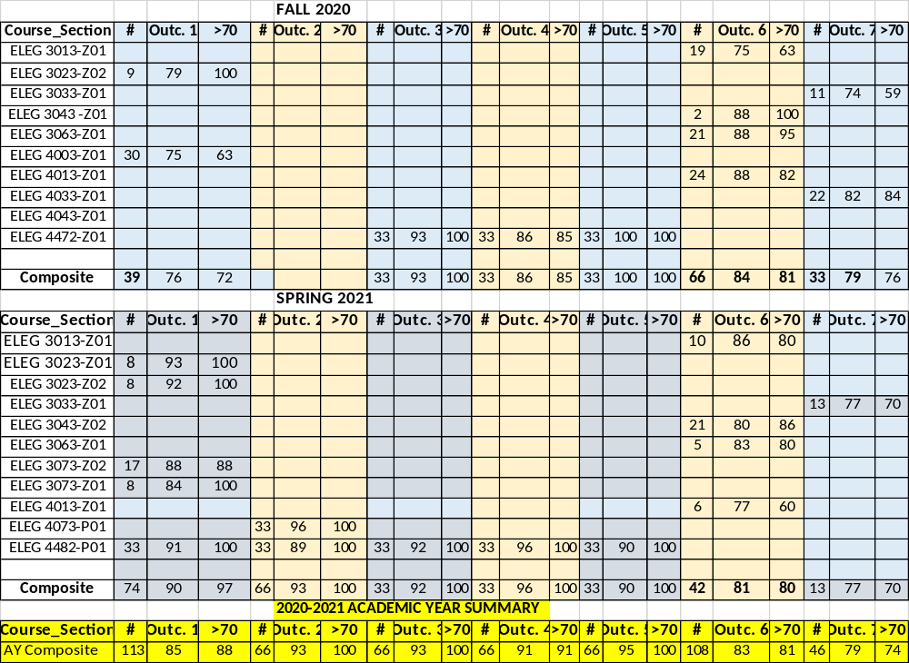
ASSESSMENT RESULTS / ELECTRICAL ENGINEERING

Slide 26
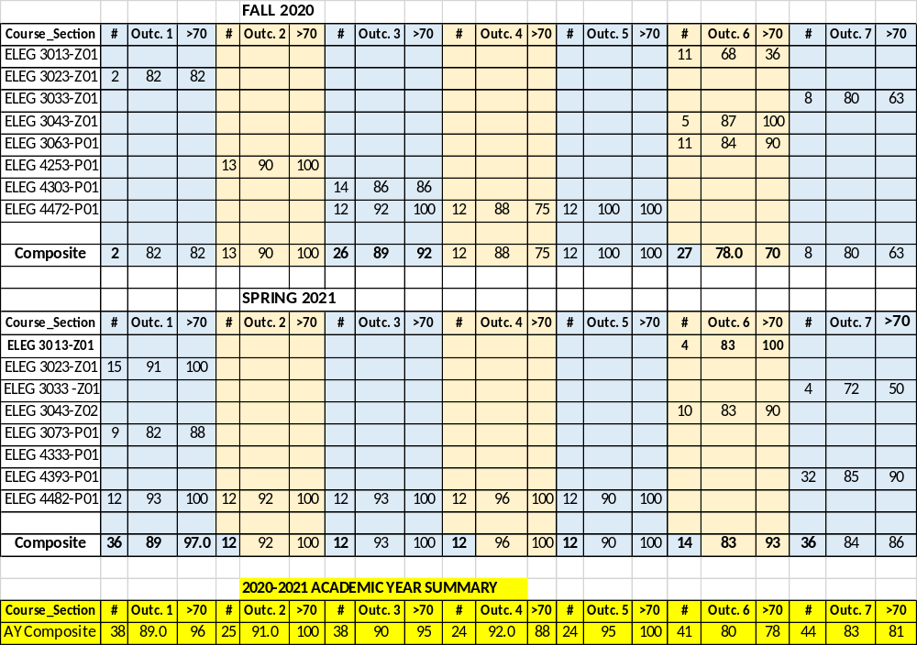
ASSESSMENT RESULTS / COMPUTER ENGINE ERING

Slide 27

Questions & Answers
Prairie View A&M University
Department of Electrical and Computer Engineering
Prairie View, Texas 77446

Slide 28
Dr Kirby

Slide 29
Electrical and computer Engineering
August 19, 2021
Faculty Meeting
Curriculum Updates

Slide 30
Courses Added to Inventory
Eleg 1301 Programming for Computer Engineering i
ELEG 1321 programming for computer engineering ii
ELEG 2321 data structure and algorithm with python
Eleg 2331 advanced programming and applications
ELEG 4100 communications lab
Eleg 4313 broadband communication systems I
Eleg 4323 broadband communication systems ii

Slide 31
Courses Added to Inventory (Con’t)
Eleg 4326 vlsi circuit design
Eleg 4361 design of digital system applications using field programmable gate array
Eleg 4371 foundation and application of internet of things
Eleg 4372 computer and network security
E;eg 4374 introduction to cryptography
Eleg 4377 machine learning for engineering applications
Eleg 4378 mobile edge computing

Slide 32
Courses Modified
ELEG 2131 Logic Circuits Lab
ELEG 2311 Logic Circuits
Courses still listed in catalog
ELEG 3102 Logic circuits laboratory
Eleg 3306 logic circuits

Slide 33
Degree plan updates
Computer engineering
Electrical Engineering

Slide 34
Dr Wilkins

Slide 35
ECE - Graduate Programs – Fall 2021 – Dr. Richard Wilkins, Coordinator
Summary: Overall, the graduate programs are strong and weathered the Covid situation fairly well.
Below are some items to address or re-address to go forward:
PhD tuition waivers: This turned into a serious problem earlier this year. The problem originated from the account used for funding these ran out of money. Graduate Studies worked with many within the university to meet obligations, but there is still lingering issues.
The matter of Fall 2021 still needs to be addressed.
For your PhD students, at minimum to qualify, they will need to be full time and have either RA ot TA support. I will keep you updated on developments.

Slide 36
Items in need of re-visiting:
Modernize the “tracks” in the graduate programs to better reflect the current state of ECE. This was started but not completed in the fall before Covid.
This will be a “non-substinative” change for the program, but it should be addressed early in the semester so it can go through the process and be in place for Fall 2022. I will be asking for input!
Review content and methods for the PhD qualifying exam.
Please note: The website that describes the PhD qualifying exam seems to have been lost. I will ask those of you who have been authoring the exams lately for content for a replacement page.

Slide 37
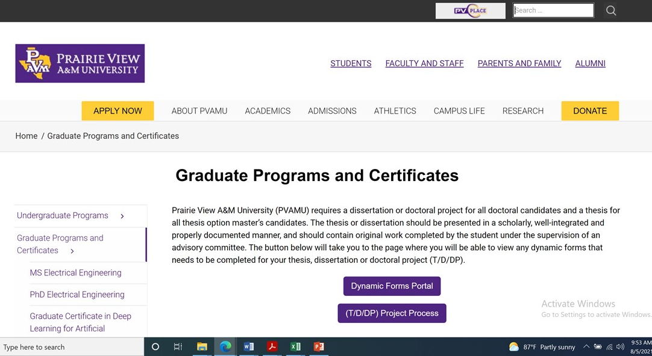
Graduate Studies Dynamic Forms System. This system was adopted in Spring 2021 and had some glitches. The thesis/dissertation process and the dynamic forms portal can be found at:
Thesis, Dissertation and Doctoral (T/D/DP) Project Process - Graduate Studies (pvamu.edu)
Please let me know of problems you may have.
At the suggestion of Dr. Obiomon, links were placed on the ECE website. This should help faculty access these items more easily:

Slide 38
Other items to address:
We are getting more applicants for the MS and PhD from students with backgrounds in computer information systems, computer science, and other disciplines were mathematics beyond basic calculus are not required. To date, these have been handled on a case by case basis, but the department may want to consider how best to handle this issue.
There is a need for better record keeping for the graduate program. Considering the size of the program this is beyond the capability of just the coordinator.
There needs to be better ways to communicate with current and potential students via our website and perhaps other social media.
There is a need to look at organized methods for recruiting.
There is a need to find more and better ways to fund graduate students at both the MS and PhD levels.
Please let me know what else we can do to improve our graduate programs!

Slide 39
Send a Message in CHAT
Reminder to send a message in chat so we can track attendance

Slide 40
Ece Faculty – Open Time for Questions/Comments

Slide 41
Meeting ADJOURNED

