Slide 1


Roy G. Perry College of Engineering
Updates
Retired
  Anne Robinson- Admin III
  Mr. Dwivedi – Lecture II
New hire
  Admin III - posted
  Lecture I - posted
  Department Head - search
Out
  Mrs. Kennerson is out sick

Slide 2
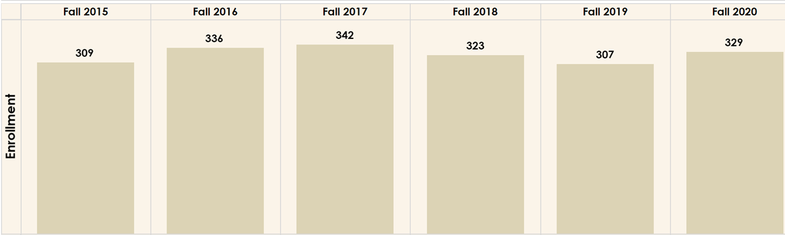
ECE Overall Enrollment

Slide 3
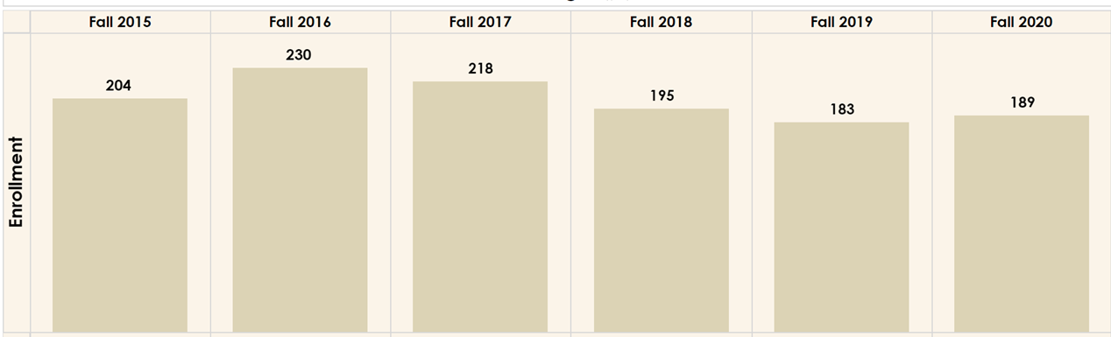
Electrical Engineering

Slide 4
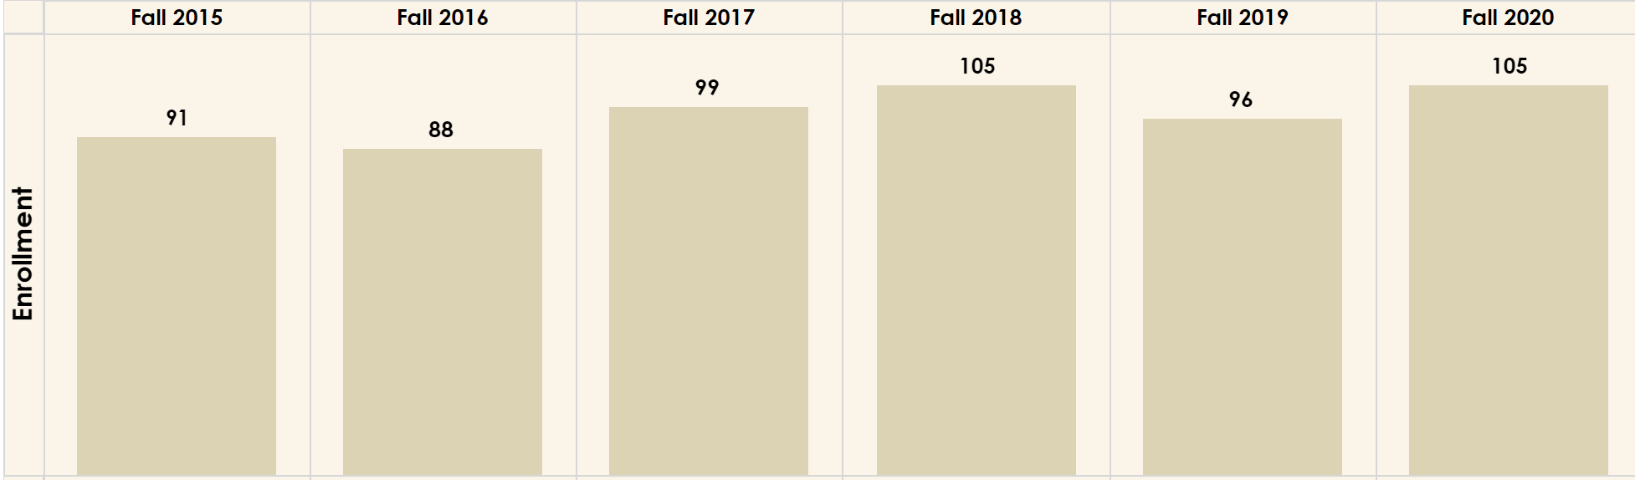
Computer Engineering

Slide 5
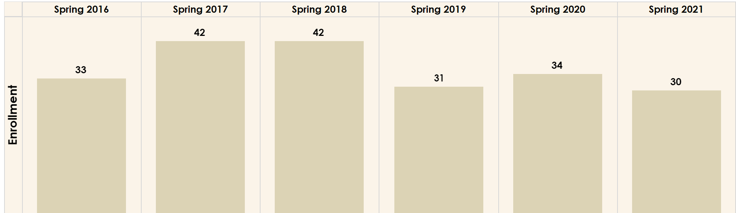
MSEE Engineering

Slide 6
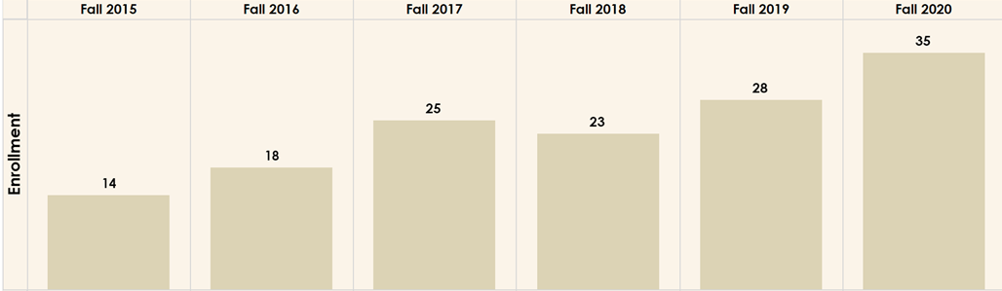
PhD Electrical Engineering

Slide 7
Roy G. Perry College of Engineering
Future of Research
The next Carnegie update will be in Jan 2022, and we expect to become a Doctoral granting and R2 institution with newly reported research and doctoral data from AY21.

Slide 8
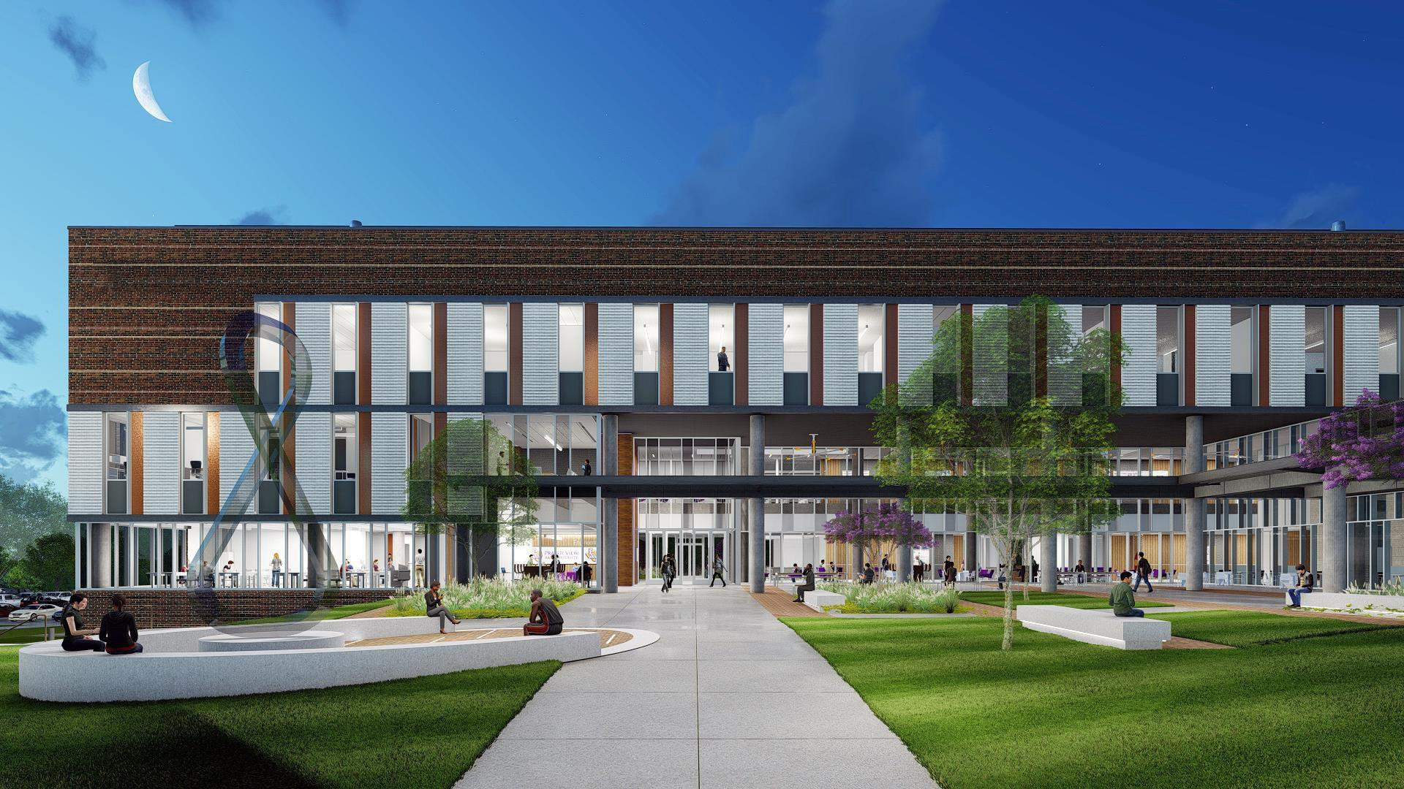

Slide 9

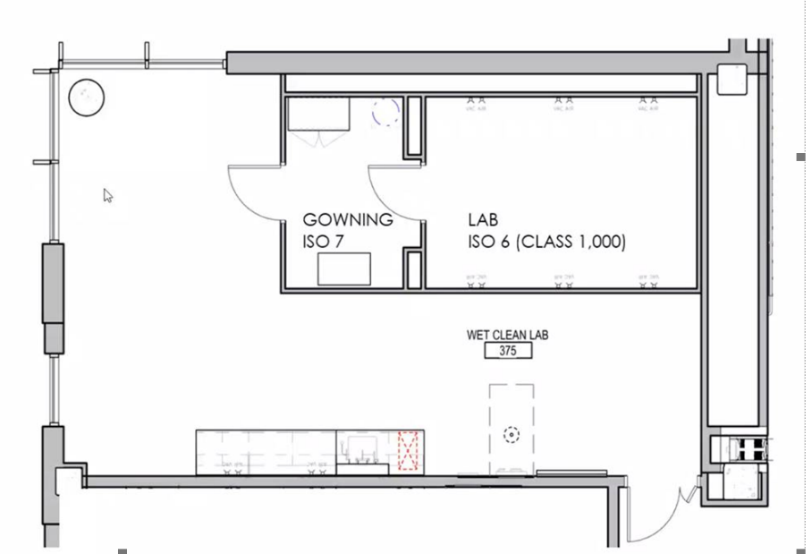
Roy G. Perry College of Engineering
Research Labs in New Building
Big Data Analytics
Robotics / UAV
Microelectronics/Clean Room Lab-Class 1000 Clean Room

