Slide 1
ABET EAC
SUMMARY OF MOCK REVIEW OF ECE PROGRAMS &
PREPARATION FOR 2022 ABET VISIT
ECE DEPARTMENT MEETING
John O. Attia, PhD, PE
Dept. of Electrical & Computer Engineering
August 19, 2021

Slide 2
General Criteria
Students
Program Educational Objectives
Student Outcomes
Continuous Improvement
Curriculum
Faculty
Facilities
Institutional Support

Slide 3
Program Criteria
Requirements in addition to General Criteria for specific program types, such as
  Chemical engineering
  Civil engineering
  Computer engineering
  Computer science
  Computer engineering technology
  Electrical engineering
  Electrical engineering technology
  Mechanical engineering

Slide 4
MOCK REVIEW OF ECE PROGRAMS –C1 STUDENTS
No comments

Slide 5
MOCK REVIEW OF ECE PROGRAMS –C2 PROGRAM EDUCATIONAL OBJECTIVES
We should review the PEOs during the 2021-2022 academic year
We should consider removing students as one of the constituents
  Program Educational Objectives – broad statements that describe what graduates are expected to attain within a few years of graduation. Program educational objectives are based on the needs of the program’s constituencies.
  Within a few years of graduation normally imply 3 to 5 years after graduation
  Students may not know what expected to achieve within a few years after graduation.

Slide 6
MOCK REVIEW OF ECE PROGRAMS –C2 PROGRAM EDUCATIONAL OBJECTIVES
Currently:
The constituents of the Electrical Engineering Program are:
Electrical Engineering undergraduate students
Alumni of the Electrical Engineering Program
Electrical Engineering Program faculty
Employers of the graduates of the Program
The constituents of the Computer Engineering Program are:
Computer Engineering undergraduate students
Alumni of the Electrical Engineering Program
Computer Engineering Program faculty
Employers of the graduates of the Program

Slide 7
ACTION ITEMS AND RECOMMENDATIONS
Approved to keep unchanged the PEOs of both the Electrical and Computer Engineering Programs on Friday, Dec. 11, 2020
Perform the second review of the PEOs of both the Electrical and Computer Engineering program during January to March 2022
Increase the number of survey participants during the 2022 PEOs review, especially for the Computer Engineering program
Educate program constituents about the ABET definition of Program Educational Objectives

Slide 8
C3 - STUDENT OUTCOMES
Student outcomes are outcomes (1) through (7) plus any additional outcomes that may be articulated by the program.
1. an ability to identify, formulate, and solve complex engineering problems by applying principles of engineering, science, and mathematics
2. an ability to apply engineering design to produce solutions that meet specified needs with consideration of public health, safety, and welfare, as well as global, cultural, social, environmental, and economic factors
3. an ability to communicate effectively with a range of audiences
4. an ability to recognize ethical and professional responsibilities in engineering situations and make informed judgments, which must consider the impact of engineering solutions in global, economic, environmental, and societal contexts
5. an ability to function effectively on a team whose members together provide leadership, create a collaborative and inclusive environment, establish goals, plan tasks, and meet objectives
6. an ability to develop and conduct appropriate experimentation, analyze, and interpret data, and use engineering judgment to draw conclusions
7. an ability to acquire and apply new knowledge as needed, using appropriate learning strategies.

Slide 9
STUDENT OUTCOMES VS. COURSES (ELECTRICAL ENGINEERING)
Approved 10/12/2018
Electrical Engineering Courses | 1 | 2 | 3 | 4 | 5 | 6 | 7
ELEG 1021 Intro Elect Lab
ELEG 1043 Comp Appl in Engr
ELEG 2011 Electric Circuit Lab
ELEG 2023 Network Theory I
ELEG 3013 Network Theory II |  |  |  |  |  | X
ELEG 3021 Logic Circuits Lab
ELEG 3023 Signals and Systems | X
ELEG 3033 Physical Princ. Solid State |  |  |  |  |  |  | X
ELEG 3043 Electronics I |  |  |  |  |  | X
ELEG 3063 Logic Circuits |  |  |  |  |  | X
ELEG 3071 Microproc. Sys. Lab
ELEG 3073 Microproc Sys. | X
ELEG 4003 Communication Theory | X
ELEG 4011 Electronics Lab
ELEG 4013 Energy Conversion |  |  |  |  |  | X
ELEG 4033 Electro Field Thr I |  |  |  |  |  |  | X
ELEG 4043 Electronics II |  | X
ELEG 4073 Control Systems |  | X
ELEG 4472 Senior Design I |  |  | X | X | X
ELEG 4482 Senior Design II | X | X | X | X | X

Slide 10
STUDENT OUTCOMES VS. COURSES (COMPUTER ENGINEERING)
Approved 10/12/2018
Comp. Engineering Courses | 1 | 2 | 3 | 4 | 5 | 6 | 7
ELEG 1021 Intro Elect Lab
ELEG 2011 Electric Circuit Lab
ELEG 2023 Network Theory I
ELEG 3013 Network Theory II |  |  |  |  |  | X
ELEG 3021 Logic Circuits Lab
ELEG 3023 Signals and Systems | X
ELEG 3033 Physical Princ. Solid State |  |  |  |  |  |  | X
ELEG 3043 Electronics I |  |  |  |  |  | X
ELEG 3063 Logic Circuits |  |  |  |  |  | X
ELEG 3071 Microproc. Sys. Lab
ELEG 3073 Microproc Sys. | X
ELEG 4253 Embedded Systems |  | X
ELEG 4303 Dig System Design |  | X
ELEG 4333 Computer Networks | X
ELEG 4393 Comp. Org. Arch |  |  |  |  |  |  | X
ELEG 4472 Senior Design I |  |  | X | X | X
ELEG 4482 Senior Design II | X | X | X | X | X

Slide 11
MOCK REVIEW OF ECE PROGRAMS –C3 STUDENT OUTCOMES
Recommend we make Student Outcome 8: Applications of probability and statistics
Which is required by the Program Criteria for the Electrical, Computer, Communications, Telecommunication(s) and Similarly Named Engineering Programs
We have used materials from the following courses to satisfy this requirement:
ELEG 2011 Circuits Lab
ELEG 3033 Physical Princ. Solid State
ELEG 4003 Communication Theory
ELEG 4333 Computer Networks

Slide 12
MOCK REVIEW OF ECE PROGRAMS –C4 CONTINUOUS IMPROVEMENT
All changes in the curriculum should be added in the self-study report
All major changes in the Department should be added as part of continuous improvement
Limit our student outcomes assessments to student outcomes 1 to 7, and not add the results of student outcomes a to k

Slide 13
MOCK REVIEW OF ECE PROGRAMS –C5 CURRICULUM
Math and Science: Parts of the following course are counted as part math & science courses. We should be ready to provide documentation to confirm math and science content
  ELEG 3033 Physical Princ. Solid State
  ELEG 3023 Signals and Systems
  ELEG 4033 Electro. Field Theory

Slide 14
MOCK REVIEW OF ECE PROGRAMS –C6 FACULTY
In the faculty resume, the faculty members should not leave any of the following parts blank:
  Service activities
  Publications and Presentations
  Professional Development

Slide 15
MOCK REVIEW OF ECE PROGRAMS –C7 FACILITIES
No comments or write-up on facilities

Slide 16
MOCK REVIEW OF ECE PROGRAMS –C8 INSTITUTIONAL SUPPORT
From team chair’s point of opinion, having interim Department Heads should not be a shortcoming

Slide 17
MOCK REVIEW OF ECE PROGRAMS – OTHER GENERAL COMMENTS
From the composite student outcomes assessment data, if the program satisfies the minimum score of the criterion (set at 70%), we should still improve courses that lower the average of a particular student outcome
The list of courses in the self-study report that satisfy the various requirements of the program criteria was good and will simplify the work of a program evaluator
The Electrical Engineering self-study report is an excellent document and the team chair asked the Dean’s permission to share the report with other institutions
Dr. Kirby was very responsive to the requests from the team chair/program evaluator

Slide 18
DESIGN ORIENTED COURSES
JOHN ATTIA’S RECOMMENDATIONS
Design Oriented Courses
  The following factors should be considered and addressed if relevant: “apply engineering design to produce solutions that meet specified needs with consideration of public health, safety, and welfare, as well as global, cultural, social, environmental, and economic factors.”

Slide 19
FALL 2021 COURSES ASSESSED
(using previous course numbers)
Faculty | Course | Student Outcome
 | ELEG 3013 Network Th. II | 6
 | ELEG 3033 Phy. Princ. Of Solid Sta. | 7
 | ELEG 3063 Logic Circuit | 6
 | ELEG 4003 Comm. Theory | 1
 | ELEG 4013 Energy Conversion | 6
 | ELEG 4033 Electro. Field Thy | 7
 | ELEG 4043 Electronics II | 2
 | ELEG 4253 Embedded Systems | 2
 | ELEG 4303 Digital System Design | 2
 | ELEG 4472 Senior Design I | 3, 4, 5

Slide 20
END-SEMESTER COURSE ASSESSMENT REPORT
(Due Date: To be announced)
(i) cover page,
(ii) table of content,
(iii) course syllabus,
(iv) end-of-semester class assessment report,
(v) grade sheet showing student and class performance in outcomes,
(vi) outcome specific assignment used to assess the outcome, and
(vii) sample of student work.

Slide 21
COURSE BINDERS
(Due Date: To be announced )
It is required that you submit a course binder for all the ECE classes you will teach during the fall 2021 semester.
For courses with several sections, the Department Head will announce the name of the instructor who should submit the course binder
Sample course binder are available for your review.

Slide 22
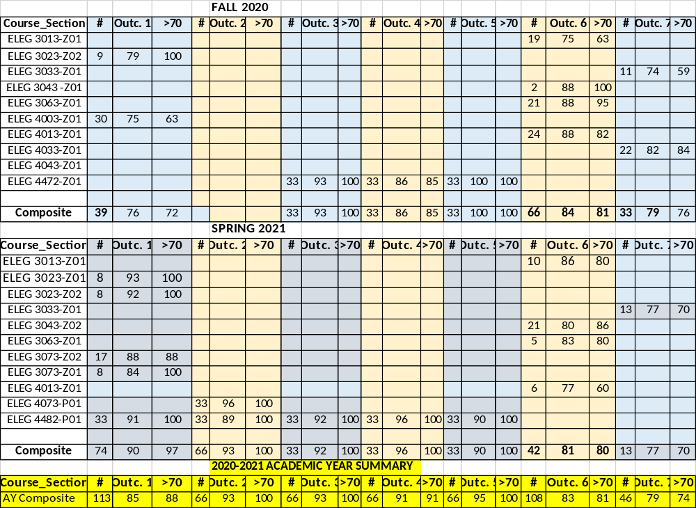
ASSESSMENT RESULTS / ELECTRICAL ENGINEERING

Slide 23
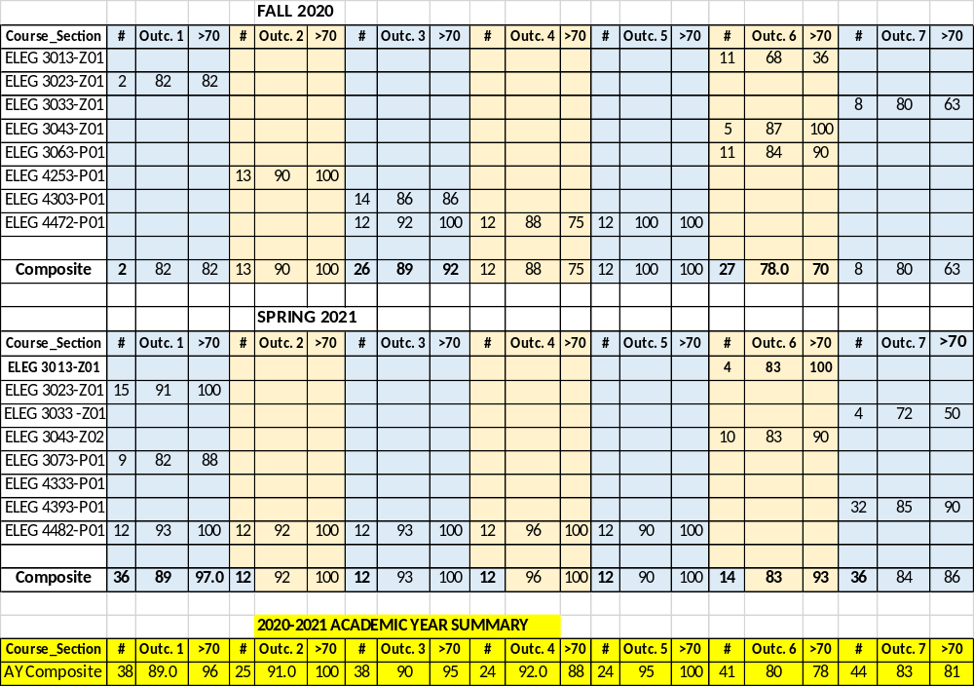
ASSESSMENT RESULTS / COMPUTER ENGINE ERING

Slide 24

Questions & Answers
Prairie View A&M University
Department of Electrical and Computer Engineering
Prairie View, Texas 77446

