Slide 1
ECE Department Head Meeting
April 12, 2021

Slide 2
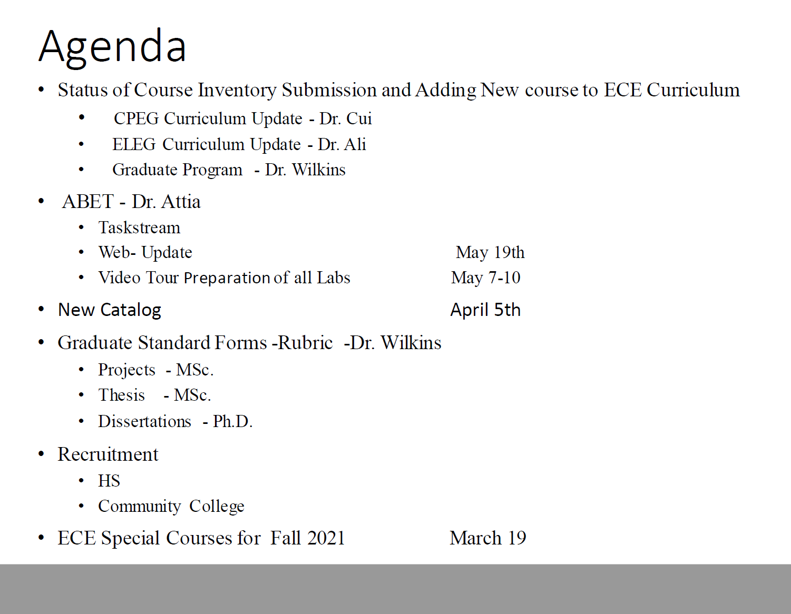

Slide 3
Cyber-attack - update
Summer Bridge Program – Dr. Kirby
FPGA Training – Anthony Hill
Open Forum

Slide 4
Deadlines
Summer Faculty Budget- deadline passed March 5, 2021
Special topic courses and research courses for Summer and Fall due (March 19, 2021)
Midterm Examination (March 22-23, 2021)
Midterm Grades due (March 23, 2021)
Annual Faculty Evaluation (April 1, 2021)
ECE Webpage updated (ABET) April 5, 2021
Advisement for Priority Registration (April 5, 2021)
Priority Registration (April 19- 23, 2021)
Industrial Advisory Board Mtg April 23, 2021
IP Grades Due (Monday, May 3rd)
ECE Lab Tour Videos (May 7th)
ABET Binders due (Tuesday, May 30, 2021)
Senior Design Projects (August 21, 2021)

