Slide 1

Center of Excellence in Cybersecurity Research and Education
SECURE@PVAMU https://securecenter.pvamu.edu/
Status Update/Activities
Presentation for IAB
April 30th 2021
Mohamed Chouikha, PhD

Slide 2

Chief Scientist and Executive Director: Dr. Mohamed Chouikha
SECURE MISSION
MISSION
Promote research & education in cybersecurity through multidisciplinary and integrative initiatives.
Build a well-trained workforce in cybersecurity and related disciplines.

Slide 3
Chief Scientist and Executive Director: Dr. Mohamed Chouikha
ORGANIZATION & PARTNERSHIPS
University
of Florida
Norfolk State
University
SECURE
(Faculty + STUDENTS)
TAMUS
GaTech, UTSA,
Fordham
National Labs
Government
Industry
Executive Committee
Chair: M. Chouikha
Advisory Committee
Chair: M. Tehranipoor

Slide 4
Chief Scientist and Executive Director: Dr. Mohamed Chouikha
Current Research & Education Focus
Cybersecurity Research
  Machine/deep learning based data analysis for network intrusion detection (collaboration with TAMU)
  Cyber-Physical Systems, IoT & Manufacturing Security Solutions (collaboration with TAMU Secure America Institute)
  Securing Autonomous Systems (e.g., Secure AI for Precision Agriculture – collaboration with College of Agriculture & U of Florida)
  Hardware Security and Trust (collaboration with U of Florida)
Cybersecurity Education
  Prepare for NSA/DHS CAE designation
  Develop a multidisciplinary cybersecurity curriculum and certificate programs for skilled cyber workforce development
  Biweekly SECURE student seminar series, CompTIA seminar series

Slide 5
Chief Scientist and Executive Director: Dr. Mohamed Chouikha
Sponsored Research Activities
NSA CEDI: Developing and Promoting Cybersecurity Programs in Non-STEM Curriculum at PVAMU, 10/2020 – 09/2022, $300,000
NSA OnRamp II: Advancing Data Analytics Engines for Large Scale Autonomous Cyber Defense, 12/2020 – 12/2021, $112,000
NSF CyberCorps Scholarship for Service: UF/FIU/PVAMU SURPASS, 09/2019 - 12/2022, $466,987
NSF CISE/CIF: Mathematical Tools for Unifying and Simplifying the Analysis and Optimization of Wireless Network, 10/2019 – 08/2022, $420,878
DoD: Acquisition of Spirent CF20 CyberFlood for Cybersecurity Research and Teaching for Multidisciplinary Engineering at PVAMU, 08/2019 – 08/2021, $432,854

Slide 6
Chief Scientist and Executive Director: Dr. Mohamed Chouikha
Focused Educational Activities
4 ECE cybersecurity courses (3 + Hardware security )
3 new courses added to the EE/CE curricula (not yet certified)
Develop on-site and virtual labs (Spirent, InfoSec learning modules)
Planned Labs Development for Hands-on Training
  Virus and Malware (Lab A)
  Virtual Environments (Lab B)
  Wireless Security (Lab C)
  IoT & Cloud Security (Lab D)*
  IP Networking Exploits (Lab E)*
  Hardware Security *
  Cyber-Physical Systems*
  * Not fully supported by InfoSec cyber ranges

Slide 7
Chief Scientist and Executive Director: Dr. Mohamed Chouikha
Graduate/Undergraduate Students (AY 2020 – 2021)
Graduate Students: PhD – 7, MS – 4
  3 NSF CyberCorps SFS Scholars
Undergraduate Students: 17
  10 NSA/CEDI Scholars
MS Theses Defended:
Toya Acharya, Efficacy of Machine Learning Based Classifiers for Binary and Multi-Class Network Intrusion Detection
Paul Murphy, Low-Power GPS Tracker utilizing MQTT to Provide Secure Data Transmission and Smartphone Notifications
ECE Senior Design Projects: 3 Teams
Established the Society of Underwater Technology Chapter at PVAMU
SECURE students also participated in the both the National Cyber League Challenge & Winter Classic Invitational Cluster Competition

Slide 8
Chief Scientist and Executive Director: Dr. Mohamed Chouikha
NEW INITIATIVES
Develop a graduate certificate in cybersecurity
Securing Cyber-Physical Systems: Study cyber-attacks on industrial control systems (ICS) & operational technology (OT) from first principle (observability and controllability (collaboration with U of Florida)
Securing ICs: Trojan Intrusion Detection using AI and computer vision (collaboration with U of Florida)
REU site in cybersecurity
Cybersecurity Workshop (in collaboration with College of Business & College of Juvenille Justice)

Slide 9
Project Overview
Student Project: Charles Stewart Ben Le Nguyen
Objectives:
Construct a “small” autonomous drone capable of carrying a payload of 3-5 pounds.
MAVLink vulnerability analysis and penetration testing
Implement defensive measures

Slide 10
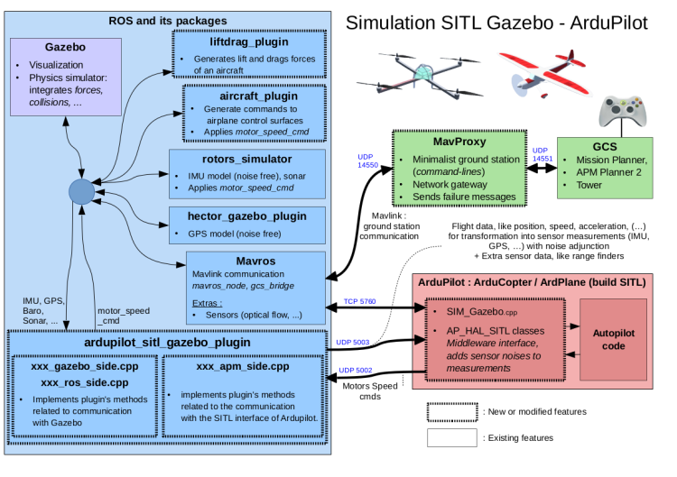

Slide 11
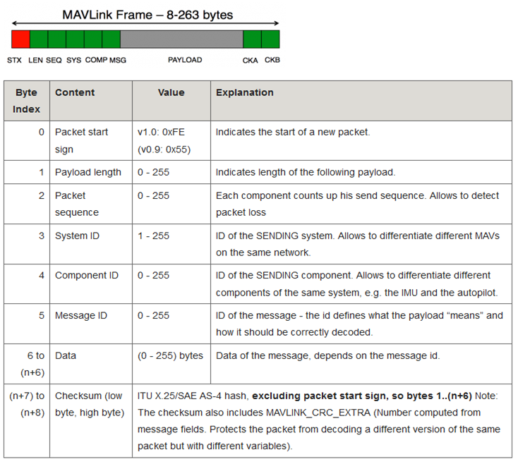
MAVLink in a
nutshell
A lightweight (8-263 bytes) messaging protocol for communicating with drones and between onboard components
Defined within extensible markup language (XML) data files.
Over 400 distinct mavlink commands
Up to 254 drones can be managed by one ground control station
Can be transmitted through wifi, ethernet, or serial telemetry low bandwidth channels operating at sub GHz frequencies like 433MHz, 868MHz, or 915 MHz
Autonomous Mission Commands: Missions are stored on the flight controller eeprom and executed one-by-one when the vehicle is switched to autonomous mode.

Slide 12
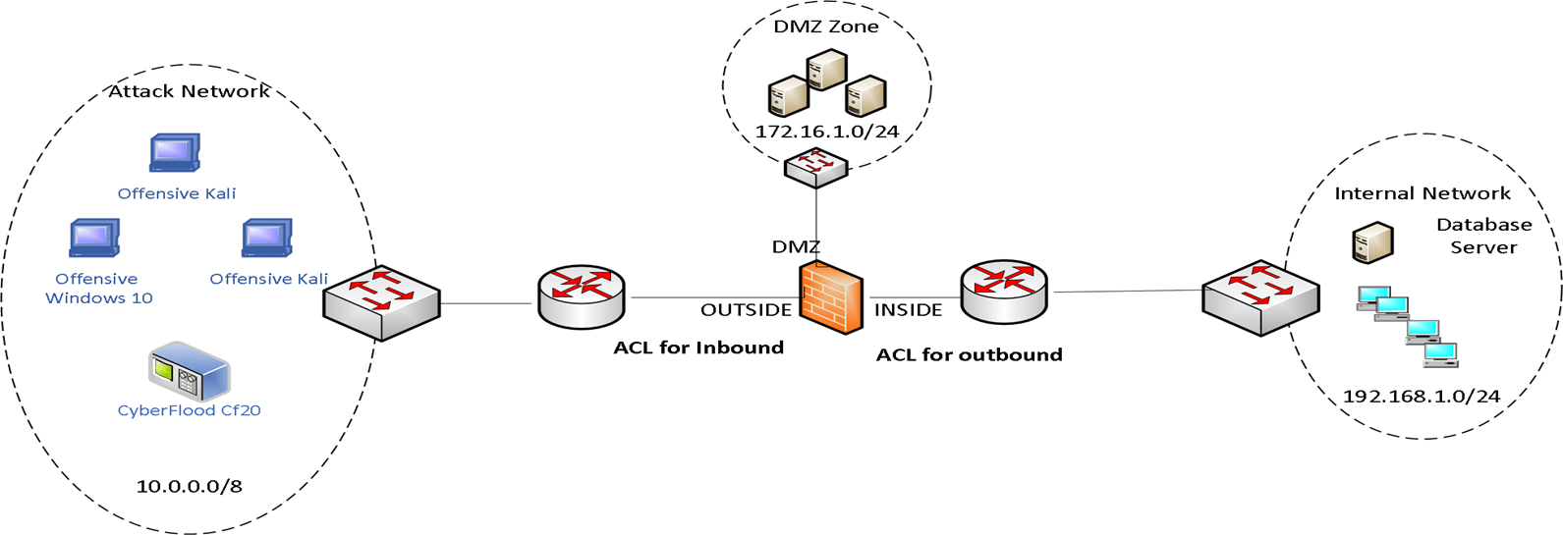
Research Project: Data-Driven Network Analysis and Discovery of System Vulnerabilities (Shumon Alam, Justin Foreman)
Objectives:
Develop IDS datasets for various attack/use cases using CyberFlood CF20 emulator and other attack tools
Develop/enhance algorithms to extract features from raw or labelled IDS datasets
Develop machine-learning algorithms to detect anomalies behavior and identify/predict attacks

Slide 13
Chief Scientist and Executive Director: Dr. Mohamed Chouikha
COVID-19
go away !!

