Slide 1
Curriculum Updates
Electrical and Computer Engineering Department

Slide 2
BS Computer Engineering
BS Computer Engineering
BS Computer Engineering –Technical Electives
ELEG 1XXX Programming for Computer Engineering I
ELEG 1XXX Programming for Computer Engineering II
ELEG 2XXX Data Structures and Algorithms with Python
ELEG 2XXX Logic Circuits
ELEG 2XXX Logic Circuits Lab
ELEG 2XXX Advanced Programming and Applications
ELEG 4XXX Machine Learning for Engineering Applications
ELEG 4XXX Foundations and Applications of IOT
ELEG 4XXX Design Using FPGA's
ELEG 4XXX Mobile Edge Computing

Slide 3
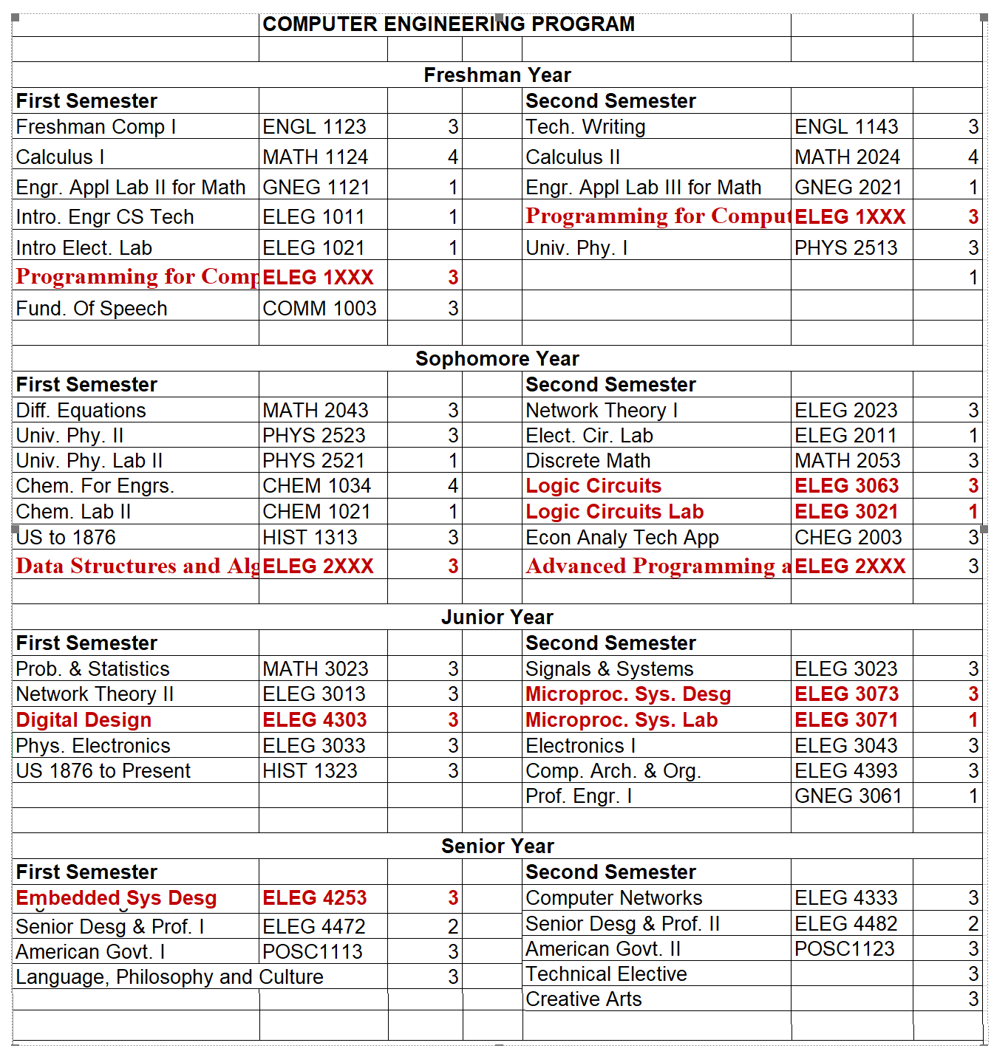

Slide 4
BS Computer Engineering – Technical Electives
ELEG 4XXX Machine Learning for Engineering Applications
ELEG 4XXX Foundations and Applications of IOT
ELEG 4XXX Design Using FPGA's
ELEG 4XXX Mobile Edge Computing

Slide 5
BS Electrical Engineering
Technical Elective Reactivated
New Technical Electives
ELEG 4263 VLSI Circuit Design
ELEG 4053 Digital Signal Processing I
ELEG 4163 Digital Signal Processing II
ELEG 4313 Broadband Communication Systems I
ELEG 4323 Broadband Communication Systems II
ELEG 4031 Communications Lab
ELEG 4051 Digital Signal Processing Lab
ELEG 4273 Analog and Mixed Signal Techniques I
ELEG 4293 Analog and Mixed Signal Techniques II
ELEG 4291 Mixed Signal Techniques Lab
ELEG 4283 Reliability Analysis of Electric Facilities
ELEG 4XXX Introduction to Bioinformatics
ELEG 4XXX Digital Imaging Processing I
ELEG 4XXX Digital Imaging Processing II
ELEG 4XXX Introduction to Wireless Communications
ELEG 4XXX Computer and Network Security
ELEG 4XXX Introduction to Cryptography
ELEG 4XXX Cyber Physical Security

Slide 6
MS - PHS Electrical Engineering
Graduate Certificate in Smart Electric Power Grid: Sources, Devices and Systems
ELEG 6XXX Fundamentals of Power Electronics and Motor Drives
ELEG 6XXX Renewable Energy Sources
ELEG 6XXX Smart Grid: Fundamentals of Design and Analysis
ELEG 6XXX Smart Sensors Technology: Design & Implementation
ELEG 6XXX Computational Systems Biology
ELEG 6XXX Computational Modeling of Biological Systems
ELEG 6XXX Advanced Bioinformatics

Slide 7
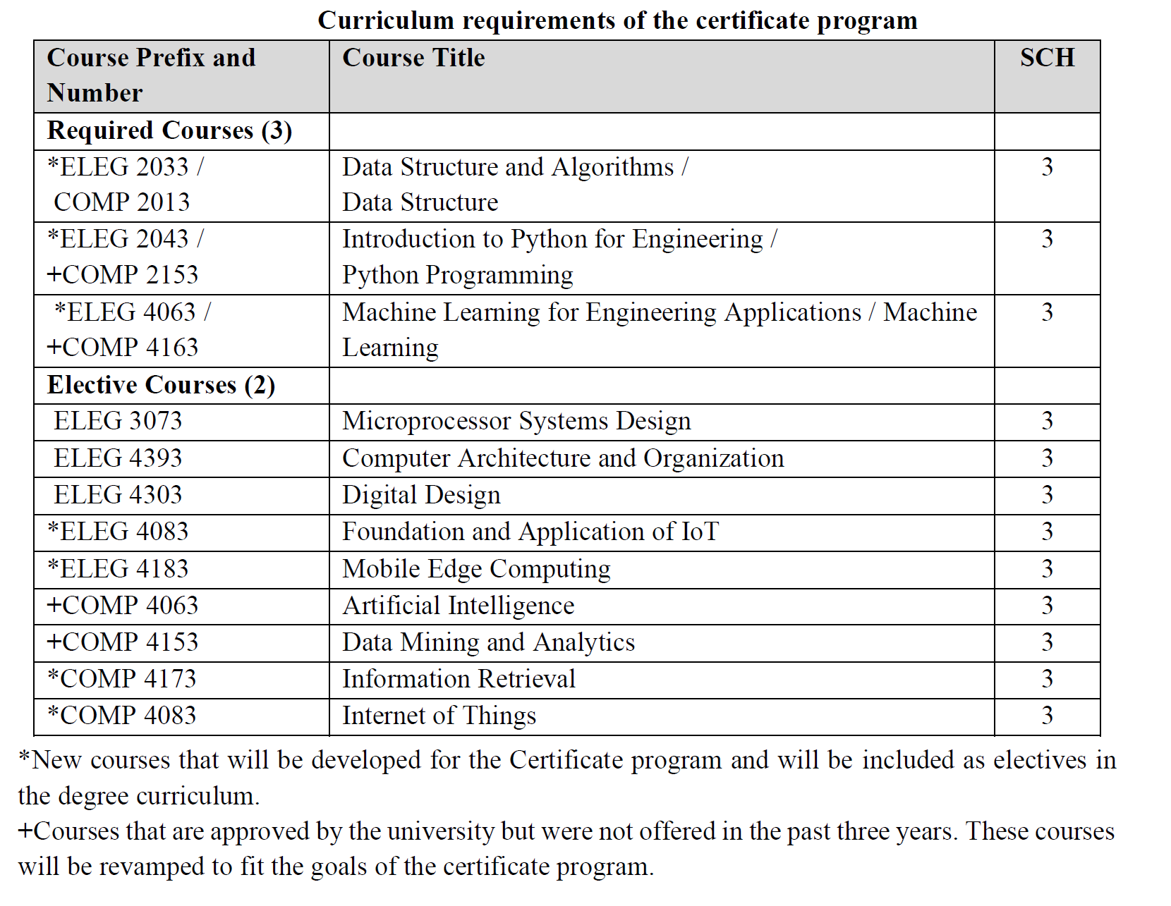
Undergraduate Data Science Certificate Program
Five courses (3 credit hours each) for a total of 15 credit hours of coursework.

Slide 8
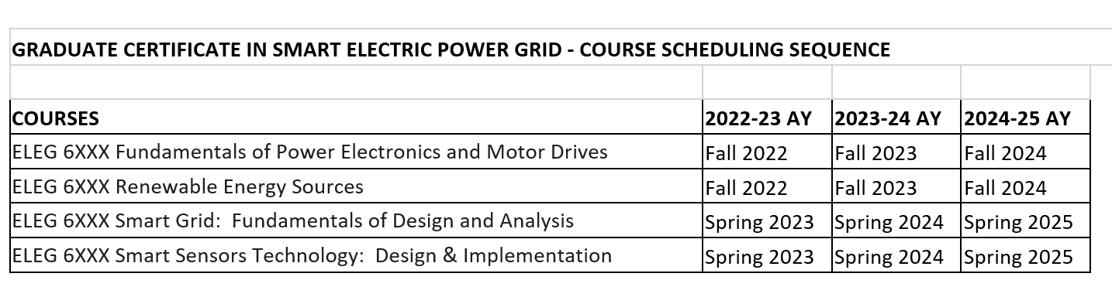
Graduate Certificate in Smart Electric Power Grid: Sources, Devices and Systems

Slide 9
Graduate Certificate in Deep Learning for Artificial Intelligence
Required Courses
ELEG 6163 | Statistical Learning for Big Data | 3
ELEG 6183 | Deep Learning | 3
ELEG 6603 | Modern Artificial Intellegence | 3
Elective Courses (choose 3 below): |  | 9
COMP 5143 | Advanced Database Management System
COMP 5153 | Design and Analysis of Algorithms
COMP 5273 | Data Mining
COMP 5283 | Machine Learning
COMP 5293 | Text Mining
CINS 5173 | Information Storage and Retrieval
ELEG 6113 | Computer Architecture & Advanced Logic Design
ELEG 6123 | The Internet: Design and Implementation
ELEG 6153 | Information Networks
ELEG 6203 | Wireless Networks
ELEG 6313 | Stochastic Processes
ELEG 6613 | Advanced Artificial Intelligence
ELEG 6703 | Selected Topics in Deep Learning
Total Hours |  | 18

