Slide 1
AGENDA
IAB Agenda Friday, April 30 th, 2021
8:00am-8:10am | Zoom meeting room: Arrival, Sign in and Welcome- 10 min - Obiomon
8:10am-10:10am | Department status report and highlights- 15 min Obiomon
 | ABET Program Educational Objectives reviewed- 15 min - Attia
 | ABET Outcomes reviewed - 15 min- Attia
 | ECE Curriculum Updates (Undergraduate and Graduate) 20 min - Obiomon
 | Open Discussion –45 min- Group Break - 10 min
10:00am – 11:00am | Industry Roundtable Trends and Skills
11:00am-12:15pm | Research Center Presentations -10 min presentation + 3 min questions each Computational Systems Biology: 11:00am- Kim CESTR – 11:15 am - Akujoubi SECURE – 11:30 am - Chouikha Smart Grid – 11:45pm - Attia CREDIT - 12:00pm - Qian
12:15 -12:30pm | Wrap up

Slide 2
Welcome Industrial Advisory Board Members
10 New Board Members:
First Name | Last Name | Company
Jason | Bell | Perspecta
Frederick | Davis | Goodman Manufacturing Company, L.P.
Kameron | Drawhorn | Qualcomm
David | Gibson | IBM
Michael | Handy | Advanced Productization and Integration
Brandon | Johnson | Ford Motor Company
Angie | Newsome-Gray | NAVSEA
Tarique | Rashaud | NRG Energy Inc.
Elna | Reid | Ford Motor Company
Jessica | Smith | Bechtel
First Name | Last Name | Company
Andre | Craft | Texas Instruments
Jimmie | Finister | Baker Hughes
William | Fisher | DuPont
Shirley | Holland-Hunt | NASA
Vera | Lewis | Galveston College
Shannon | Booty | Raytheon
Billy | Dennie | Intel
Anthony | Sanders | National Sandia Laboratorie
Jerin | Varkey | Shell

Slide 3


Electrical and Computer Engineering Department
Undergraduate Certificate program in Data Science
Graduate Certification Program: Deep Learning for Artificial Intelligence
Graduate Certification in Smart Grid (for all majors)
Graduate Certification in Cybersecurity (in progress)
Computer Engineering
Electrical Engineering
Master of Science in Electrical Engineering
Ph.D. in Electrical Engineering
Areas of concentration
  Communications and Signal Processing
  Computer Engineering
  Microelectronics
  Power Systems and Control

Slide 4

Electrical and Computer Engineering Deparmtent
College Programs
Master of Science in Electrical Engineering
Ph.D. in Electrical Engineering
Graduate Certification Program: Deep Learning for Artificial Intelligence
Graduate Certification in Smart Grid (for all majors)
Graduate Certification in Cybersecurity (in progress)

Slide 5
Department Updates
ECE Faculty
Administrative Assistants
1 | Cajetan | Akujuobi
2 | Warsame | Ali
3 | Annamalai | Annamalai
4 | John | Attia
5 | Mohamed | Chouikha
6 | Penrose | Cofie
7 | Suxia | Cui
8 | Xishuang | Dong
9 | Ramesh | Dwivedi
10 | Justin | Foreman
11 | John | Fuller
12 | Anthony | Hill
13 | Mohan | Ketkar
14 | Seungchan | Kim
15 | Kelvin | Kirby
16 | Siew | Koay
17 | Abburi | Kumar
18 | Xiangfang | Li
19 | Sarhan | Musa
20 | Pamela | Obiomon
21 | Olusegun | Odejide
22 | Lijun | Qian
23 | Horace | StJulian
24 | Charlie | Tolliver
25 | Vewiser | Turner
26 | Richard | Wilkins
Anne | Robinson
Sandra | Kennerson
New hires:
Xishuang | Dong
Mohan | Ketkar
Sarhan | Musa
Horace | StJulian
Lab Technician
Anthony | Hill

Slide 6
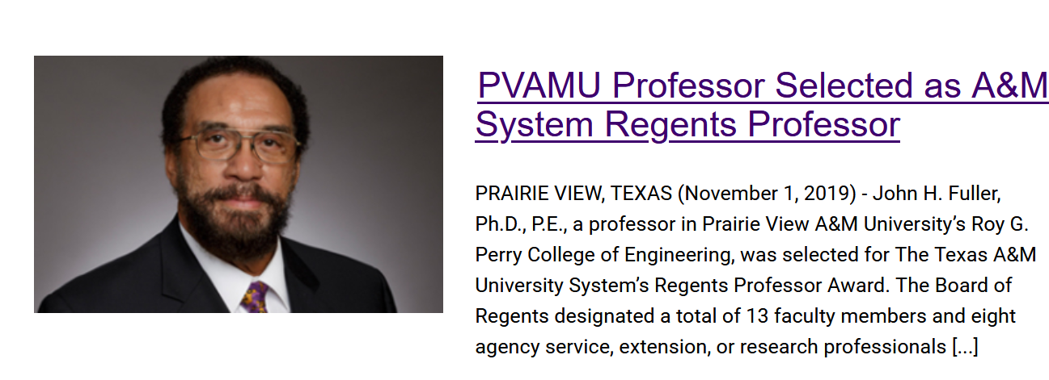
Achievements

Slide 7
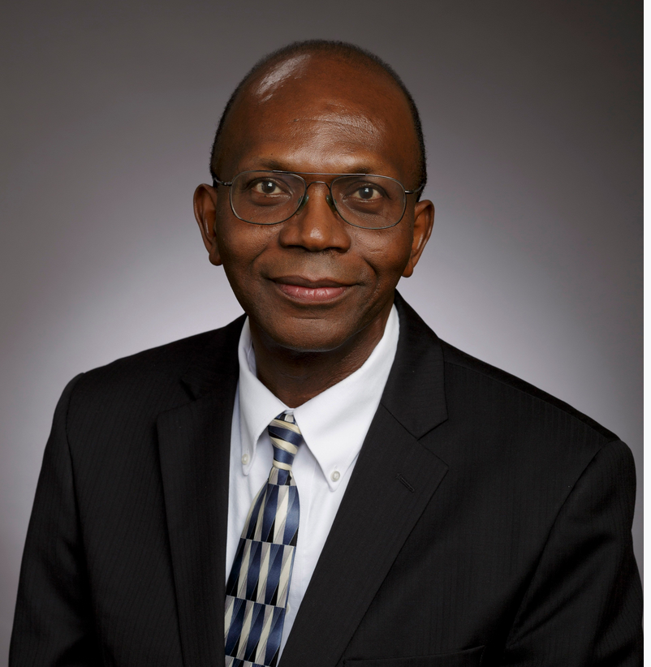
Achievement
Named: TI Endowed Professor

Slide 8
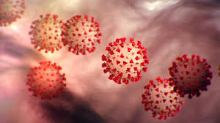
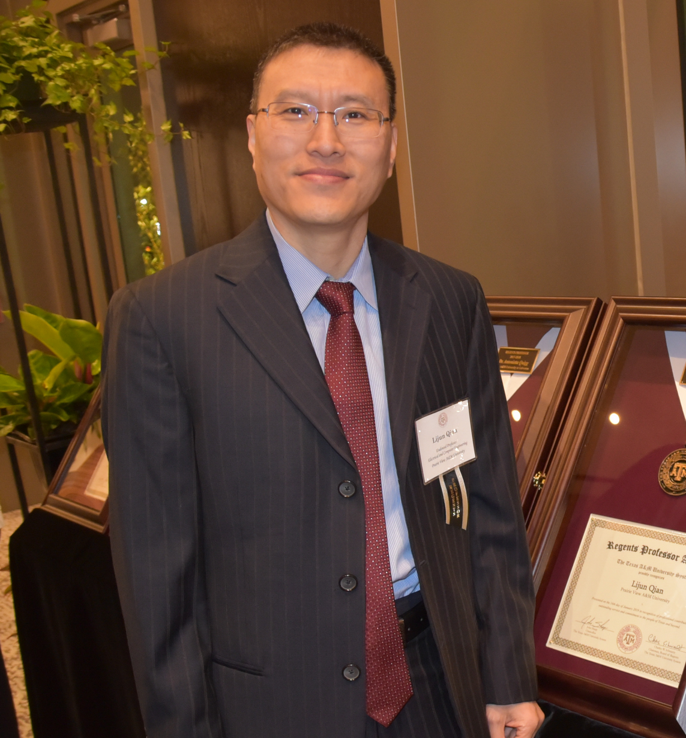
Achievement
A&M System’s Regents Professor Lijun Qian
COVID-19 research in the CREDIT Center
Texas Higher Education Coordinating Board approved the Graduate Certificate in Deep Learning for Artificial Intelligence.
Awarded $1M extension of AFRL Credit Center and $487,587.00 DoD Instrumentation Grant
National Academy of Engineering taps ECE Dr. Qian for prestigious symposium

Slide 9
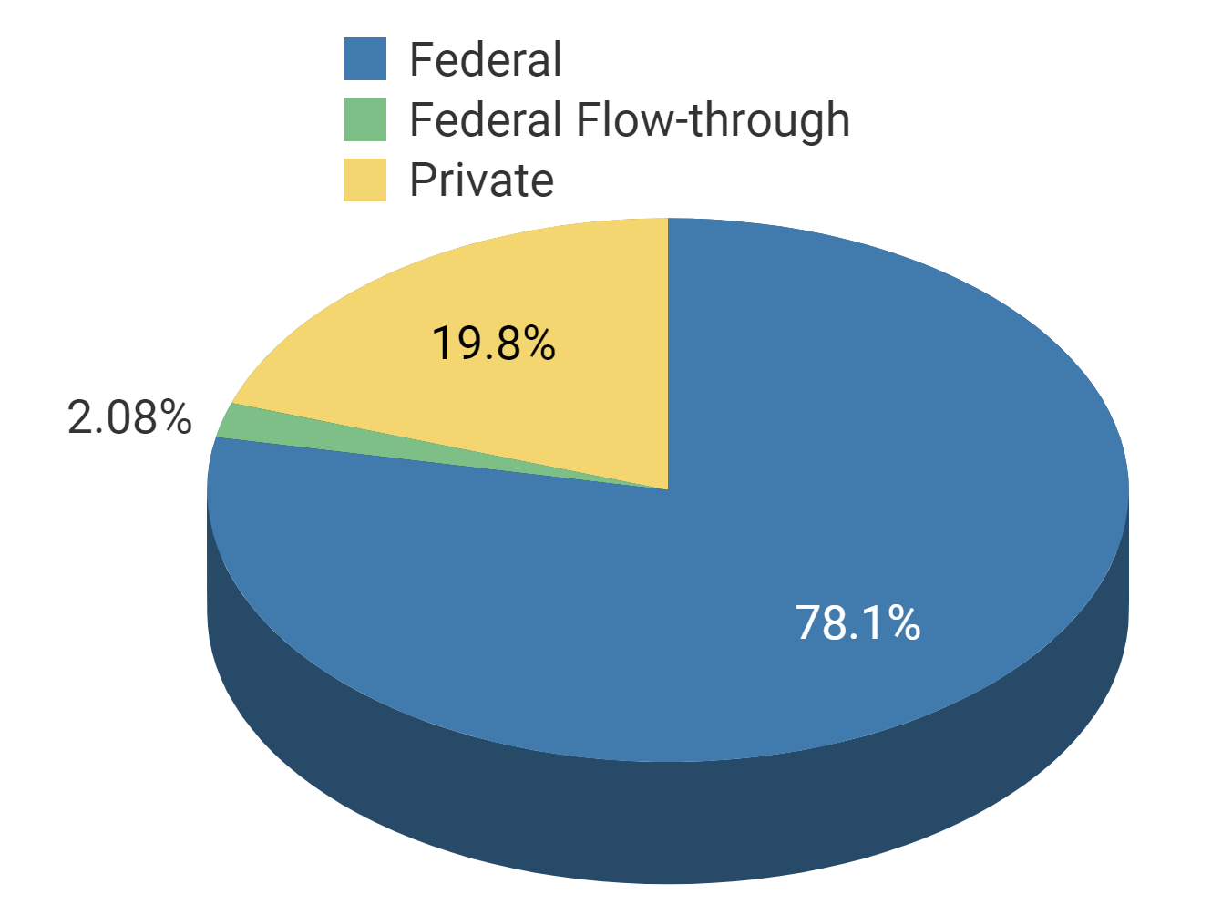
Research
Fiscal Year | Award Amount | Award Count
2018 | 1,767,324.67 | 8
2019 | 2,091,016.58 | 8
2020 | 849,854.00 | 4
2021 | 3,754,084.00 | 13

Slide 10
ECE Enrollment Trend

Slide 11
Computer Engineering Undergraduate Enrollment

Slide 12
Electrical Engineering Undergraduate Enrollment

Slide 13
Master’s Electrical Engineering

Slide 14
Electrical Engineering PhD

Slide 15
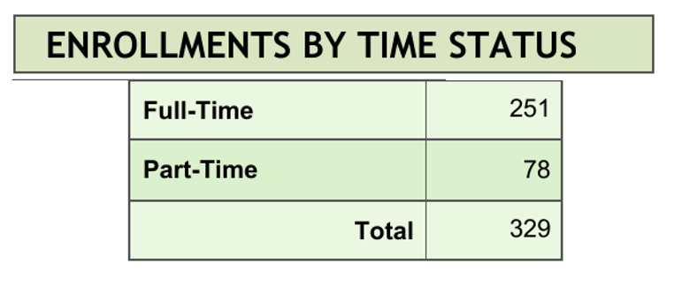
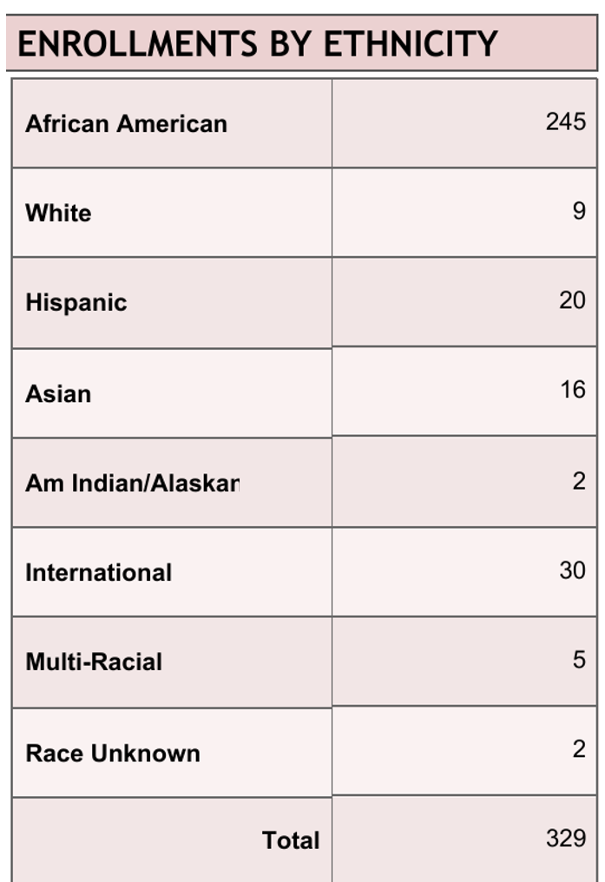
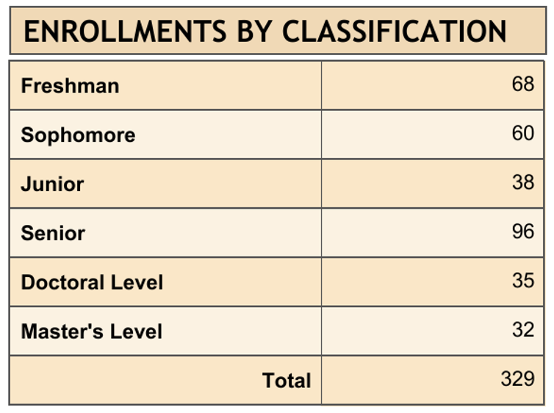
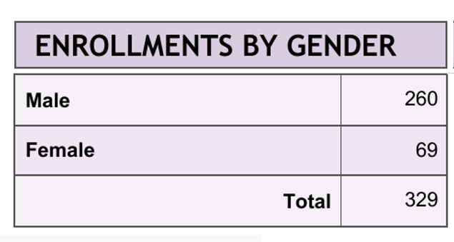
Enrollment Student Profile 2020
74% AA
76% Full-time
20% Female

Slide 16
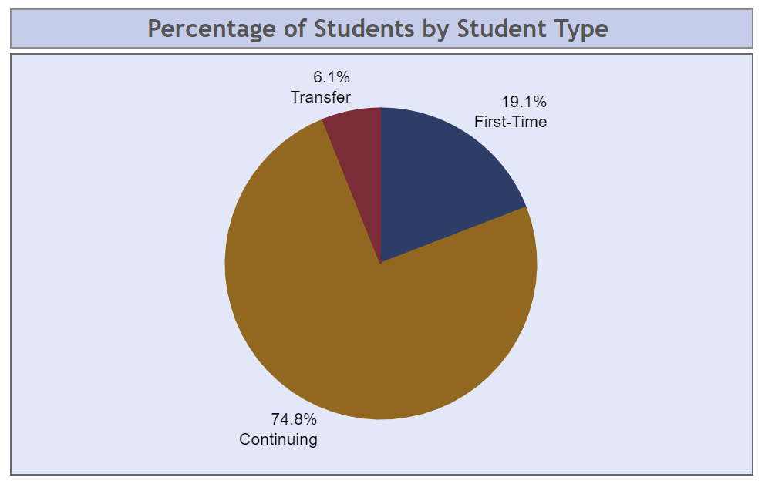

Slide 17
Degrees Awarded
Year | Degrees Awarded
2014-2015 | 61
2015-2016 | 38
2016-2017 | 51
2017-2018 | 69
2018-2019 | 58
2019-2020 | 55

Slide 18
Undergraduate Degrees Awarded

Slide 19
Master’s Degrees Awarded

Slide 20
PhD Degrees Awarded

