Slide 1

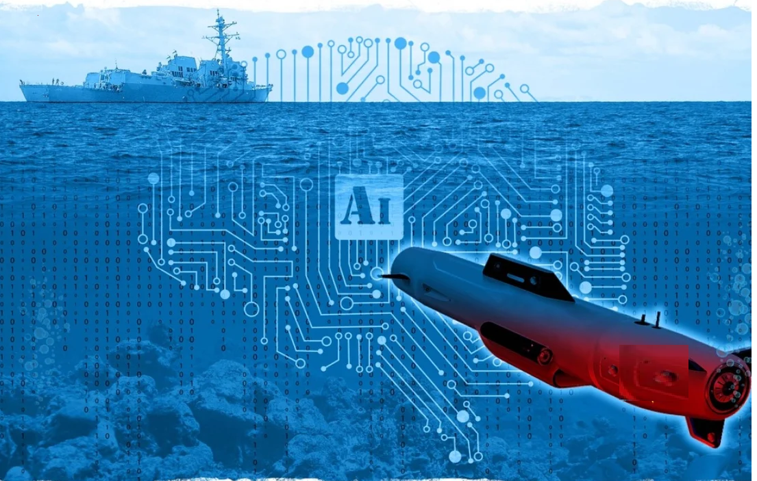
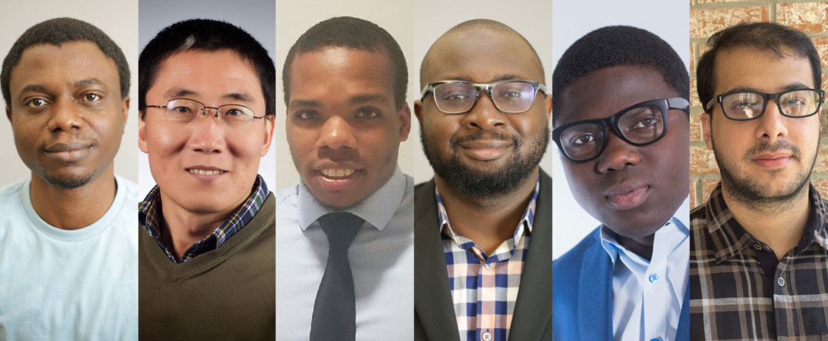
1st Place Winners
The Prairie View A&M University Artificial Intelligence Team won 1st place in the Office of Naval Research Artificial Intelligence (AI) Tracks at Sea challenge. The Team beat 31 universities including top tier research universities and Ivy League Schools
Navy has announced it officially on their website:
https://www.challenge.gov/challenge/AI-tracks-at-sea/#description

Slide 2
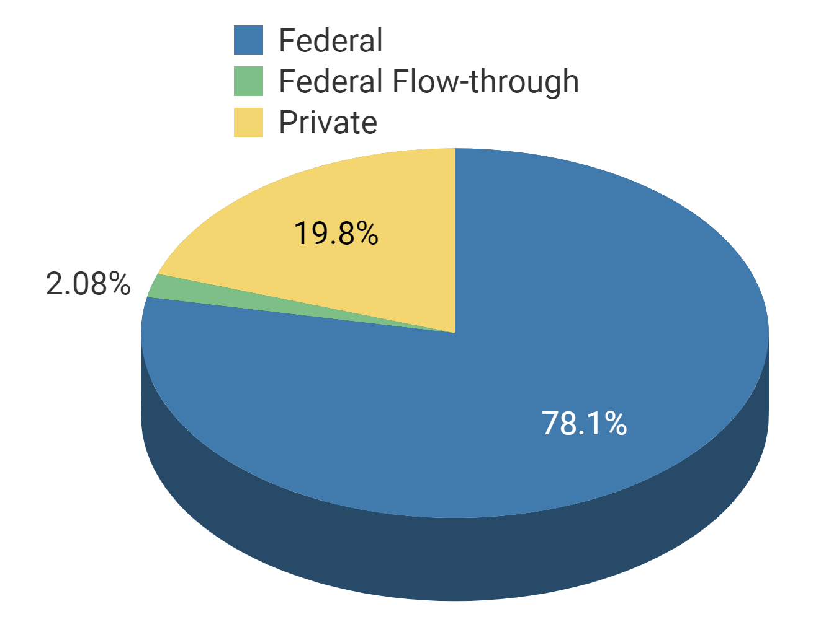
Research
Fiscal Year | Award Amount | Award Count
2018 | 1,767,324.67 | 8
2019 | 2,091,016.58 | 8
2020 | 849,854.00 | 4
2021 | 3,754,084.00 | 13

Slide 3

Achievements

Slide 4
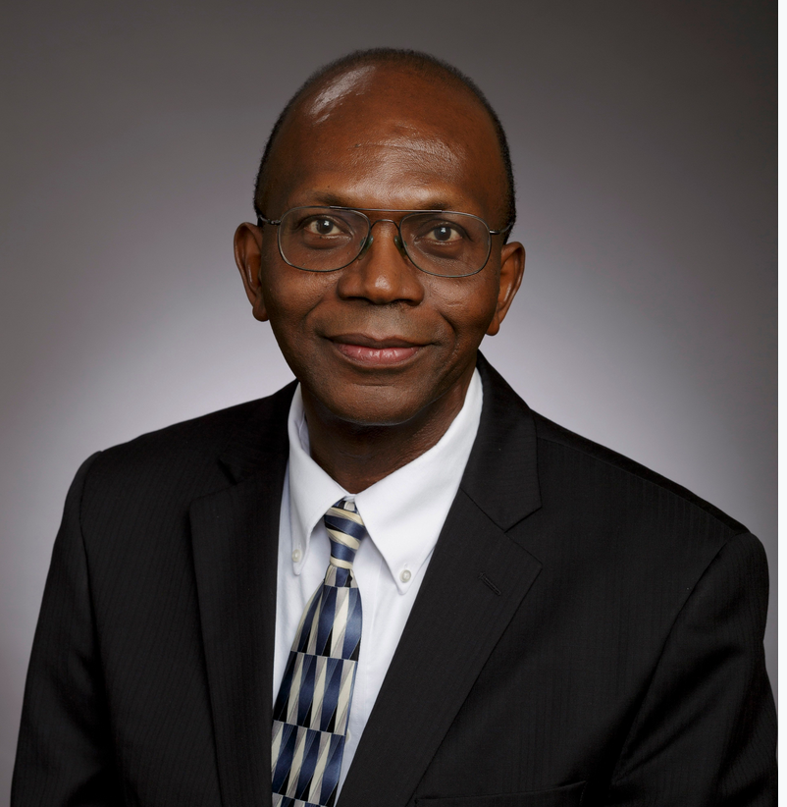
Achievement
Named: TI Endowed Professor

Slide 5

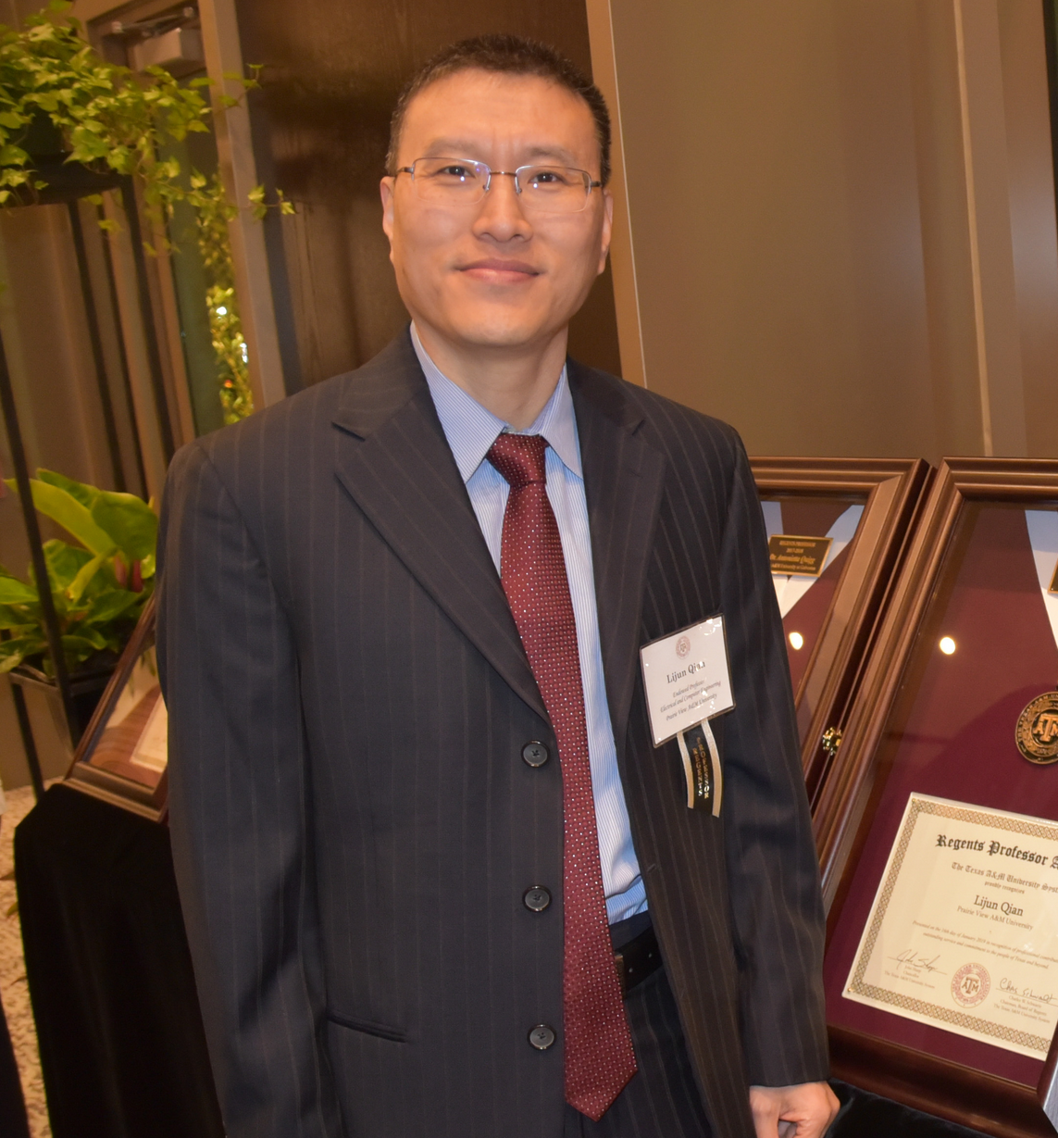
Achievement
A&M System’s Regents Professor Lijun Qian
COVID-19 research in the CREDIT Center
Texas Higher Education Coordinating Board approved the Graduate Certificate in Deep Learning for Artificial Intelligence.
Awarded $1M extension of AFRL Credit Center and $487,587.00 DoD Instrumentation Grant
National Academy of Engineering taps ECE Dr. Qian for prestigious symposium

Slide 6
Other News
Computational Systems Biology Center established a Bi-weekly Technical Speaker Series
Cybersecurity Center established a Speaker Series
Cybersecurity Center won an NSA grant with the College of Business
Dr. Dong won a grant with Nvidia to build a lab
Dr. Foreman conducted a Blockchain seminar and several students will receive digital badges from IBM
Dr. Attia will be hosting an ASEE South West Conference
AI Team won 1st place in a national Navy Competition

Slide 7
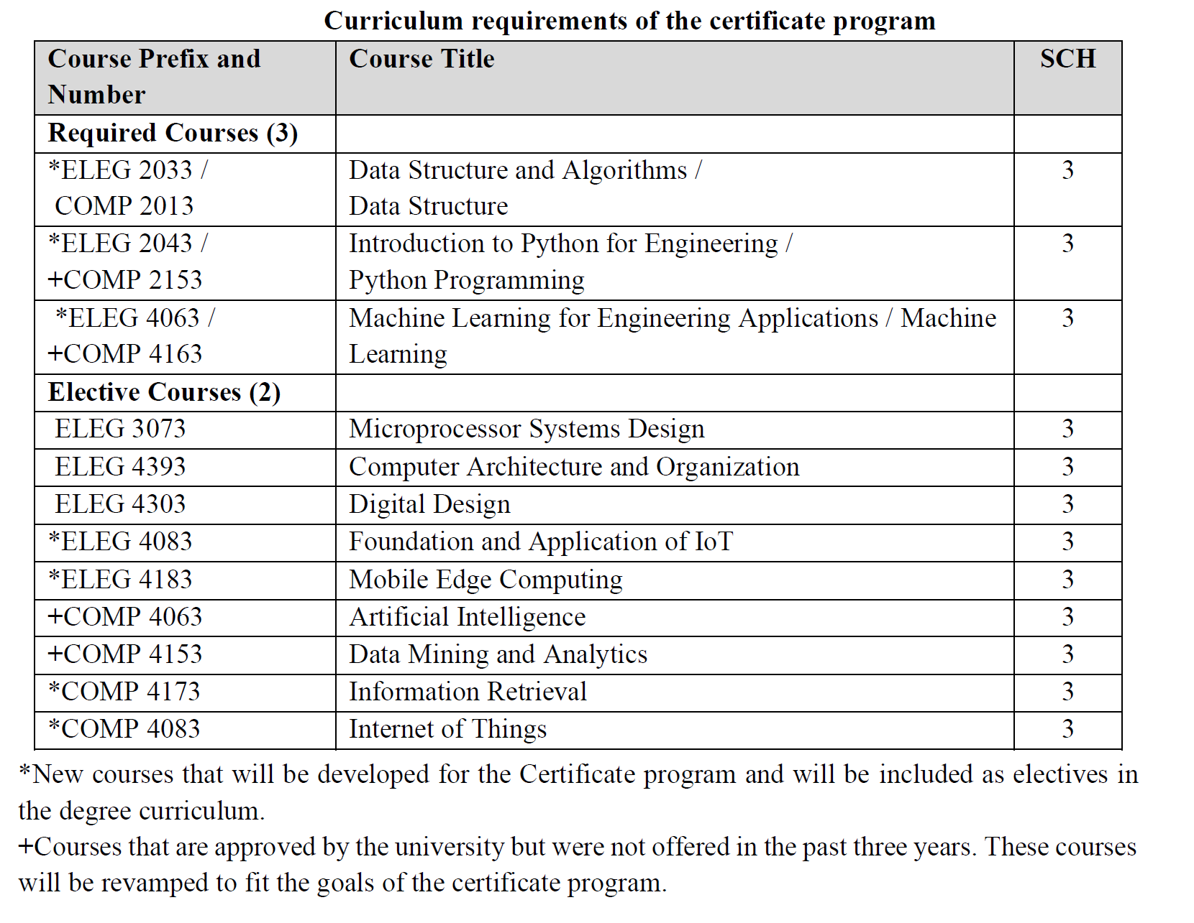
Established the Undergraduate Data Science Certificate Program
Five courses (3 credit hours each) for a total of 15 credit hours of coursework.

Slide 8
Established the : Graduate Certificate in Deep Learning for Artificial Intelligence
Required Courses
ELEG 6163 | Statistical Learning for Big Data | 3
ELEG 6183 | Deep Learning | 3
ELEG 6603 | Modern Artificial Intellegence | 3
Elective Courses (choose 3 below): |  | 9
COMP 5143 | Advanced Database Management System
COMP 5153 | Design and Analysis of Algorithms
COMP 5273 | Data Mining
COMP 5283 | Machine Learning
COMP 5293 | Text Mining
CINS 5173 | Information Storage and Retrieval
ELEG 6113 | Computer Architecture & Advanced Logic Design
ELEG 6123 | The Internet: Design and Implementation
ELEG 6153 | Information Networks
ELEG 6203 | Wireless Networks
ELEG 6313 | Stochastic Processes
ELEG 6613 | Advanced Artificial Intelligence
ELEG 6703 | Selected Topics in Deep Learning
Total Hours |  | 18

Slide 9
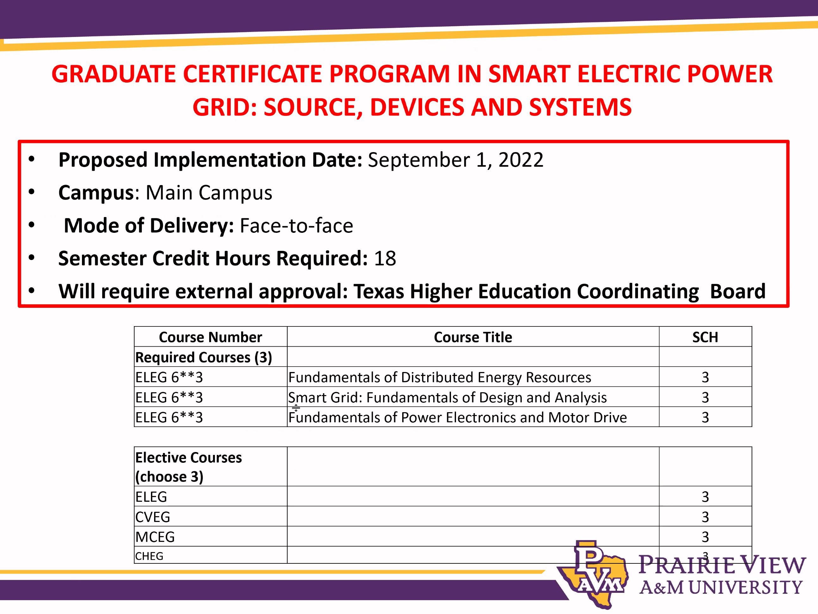
Establishing the Graduate Cirtificate in Electric Power

