Slide 1
CRI – SMART CENTER
(Smart Microgrid Advanced Research Technology Center)
John O. Attia, PhD, PE
Presentation to
ECE INDUSTRIAL ADVISORY BOARD MEETING
April 30, 2021

Slide 2
Outline of Presentation
Investigators
Thesis, Projects and Dissertation Completed
Senior Design Projects Completed
Funded Projects
Ongoing or Recently Completed Projects
Collaborators
Graduate Certificate Program
Apple HBCU Innovation Grant Proposal
Semtech Research Proposal

Slide 3
INVESTIGATORS
FACULTY
J. Attia, S. Binzaid, W. Ali, P. Cofie, L. Qian, X. Dong, (ECE Department).
N. Shamin, J. Gabitto (Chemical Engr. Department)
PhD STUDENTS:
Samir Abood
Yogita Akhare
Olatunde Adeoye
MS STUDENTS:
Temisan Boyo
Mohammad Ahmed
UNDERGRADUATE STUDENTS
Dalton Jorge
Alberto Sanchez

Slide 4
MS THESIS, MS PROJECT AND PHD DISSERTATION COMPLETED
PHD STUDENT:
Ali Husainat, “Modeling and Simulation of Low Cost and High Efficiency Solar Cells Using Perovskite Material,” PhD, Dissertation, May 2020
MS STUDENTS:
1. Nafisa Isam, “Cost Optimization of integrated renewable energy sources using Smart Grid,” MS thesis, May 2021.
2. Yusuf Isa-Yusuf, “Thermal energy harvesting application in vaporized-liquid powered closed-loop-turbine for solar electric power generation,” MS thesis, May 2021.
3. Bede C. Eze, “Cost Optimization for a Multisource Renewable Energy Microgrid Systems by Means of Particle Swarm Optimization,” MS Project, Dec. 2020.

Slide 5
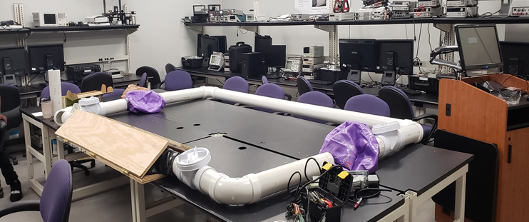
SENIOR DESIGN PROJECTS COMPLETED
1. Marissa Goode, Guessim Kafando, Stefan Drawsand, Byan Vincent, Stan, “Smart Meters on PVAMU Campus: Data Collection and Anaysis,” Faculty sponsors: Completed in April 2021, Faculty sponsors: Dr. S. Binzaid and Dr. J. Attia
2. Michael Daley, Trang Nguyen, Andre Johnson, Savana Sargent, “Road Bump Renewable Energy,” Completed in May 2020. Faculty sponsors: Dr. S. Binzaid and Dr. J. Attia
3. Orobosa Aguebor, Ashley Hunter, Dame Diop, Lewis Saruzi, Kamaluddin Hussein, “Solar District Cup Competition,” Completed in May 2020, Faculty sponsor: Dr. W. Ali

Slide 6
Funded Projects
1. “MRI: Acquisition and Development of Mobile Edge Computing Equipment for Research and Education of Big Data Analytics with Applications in Smart Grid at PVAMU”. PI: Dr. Qian, Co-PI: Drs. Attia, Binzaid, Dong, Fuller, This project was funded by NSF, - $358,970 (2020-2023)
2. The Sustainable Energy Bike Lanes with Applications in the City of Kuala Lumpur, Malaysia This project is collaborative project between PVAMU and UNITEN, Malaysia, This project was funded by NSF - $250,000 (2020-2022)
3. Accelerating the Development and Deployment of Emission-Free Smart Infrastructure. Three universities are involved with this project. Universities are TAMU-Commerce, PVAMU, and Santa Clara University. Theis project is funded by TAMU Energy Institute - $40,00 (2021)

Slide 7
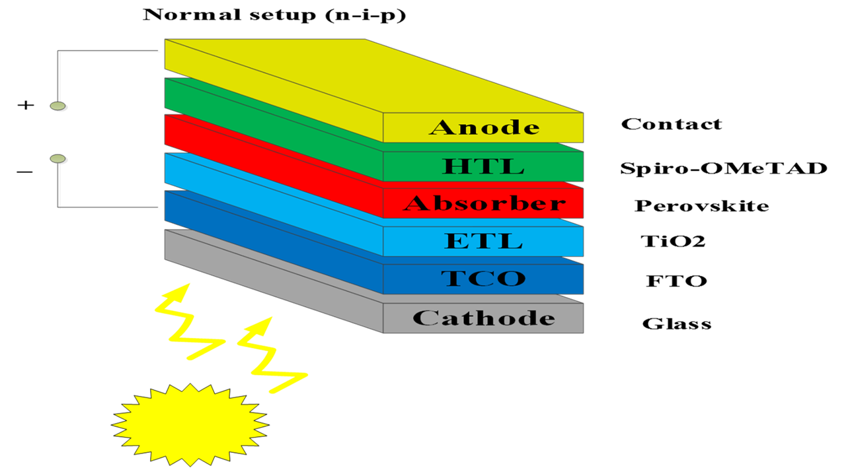
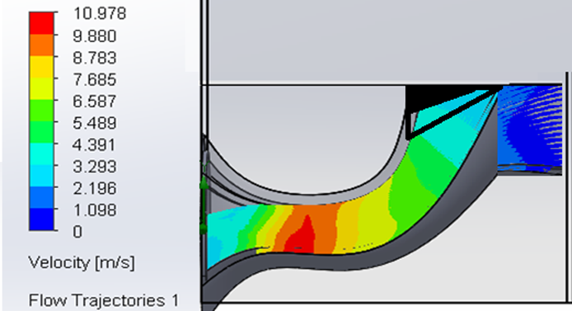
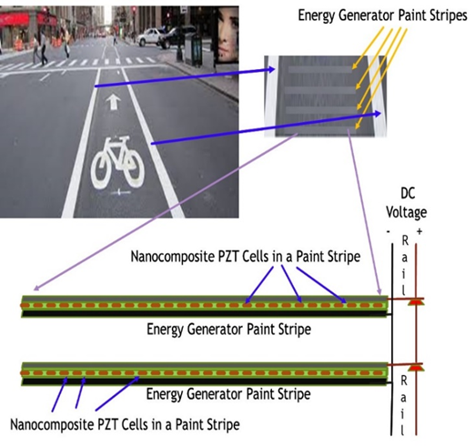
Ongoing or Recently Completed Projects (1)
1. Simulation and Design Implementation of Low-Cost and High-Efficiency Perovskite Solar Cells
2. Amplifying the natural low wind speed in-field wind tunnel using Bernoulli’s principle.
3. The Sustainable Energy Bike Lanes with Applications in the City of Kuala Lumpur, Malaysia.
4. Accelerating the Development and Deployment of Emission-Free Smart Infrastructure
5. Forecasting and Clustering Residential Energy Consumption using Machine Learning and Stochastic Processes

Slide 8

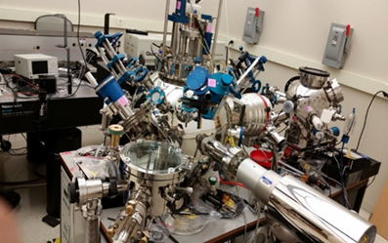
Ongoing or Recently Completed Projects (2)
6. Carbon Capture and Energy Storage (Battery)
7. Microgrid Optimum Identification Location Using Standard and Accelerated Particle Swarm Optimization Techniques
8. Novel Model Predictive Control for Electrical Machine Drives Considering Circuit Faults
9. Smart Grid Connectivity with Renewable Energy System Management Using SCADA
10. Harnessing solar thermal energy for closed loop vapor turbine application
11. Renewable Energy Generation from a Speed Bump
12. Smart Meters on PVAMU Campus: Data Collection and Analysis

Slide 9





SMART Center Collaborators
Cooperative Agricultural Research Center at PVAMU
Dillard University,
Texas A&M University – Corpus Christi,
Texas A&M University – Commerce,
Santa Clara University
UNITEN Malaysia

Slide 10
GRADUATE CERTIFICATE PROGRAM IN SMART ELECTRIC POWER GRID: SOURCE, DEVICES AND SYSTEMS
Proposed Implementation Date: September 1, 2022
Campus: Main Campus
Mode of Delivery: Face-to-face
Semester Credit Hours Required: 18
Will require external approval: Texas Higher Education Coordinating Board
Course Number | Course Title | SCH
Required Courses (3)
ELEG 6**3 | Fundamentals of Distributed Energy Resources | 3
ELEG 6**3 | Smart Grid: Fundamentals of Design and Analysis | 3
ELEG 6**3 | Fundamentals of Power Electronics and Motor Drive | 3
Elective Courses (choose 3)
ELEG |  | 3
CVEG |  | 3
MCEG |  | 3
CHEG |  | 3

Slide 11
APPLE HBCU INNOVATION GRANT PROPOSAL (1)
Proposal Written by: Dr. Attia, Dr. Binzaid, Dr. Cui and Dr. Kirby
We propose:
All the undergraduate electrical and computer engineering students will be introduced to the basic VLSI Design by designing circuits with Cadence CAD tools.
A new course with tentative title “Digital Systems and VLSI” will be developed to replace the course ELEG4303 Digital Design,
A new graduate-level Advanced VLSI Design, Test and Characterization course will be developed.
ELEG 4303 Digital Design and ELEG 4393 Computer Architecture and Organization will be enhanced.
The computer engineering students will be trained in VLSI implementation of projects in Computer Architecture, and Digital Design.

Slide 12
APPLE HBCU INNOVATION GRANT PROPOSAL (2)
The Apple Innovation Grant will provide funds for
(i) training of faculty and students,
(ii) purchase of Cadence license,
(iii) procurement of digital test equipment,
(iv) workstations to run the Cadence software package,
(v) procurement of color plotter,
(vi) PCB printer and laser engraving and etching machine,
(vii) teaching assistants to help implement the project.
(viii) The VLSI Design Laboratory will be established
(ix) Aa makerspace will be developed for testing of the fabricated VLSI chips.
Some Additional Activities of the program are:
(i) lecture series,
(ii) Computer Hardware and VLSI Design Club,
(iii) Apple Scholars program, and
(iv) Faculty Development

Slide 13
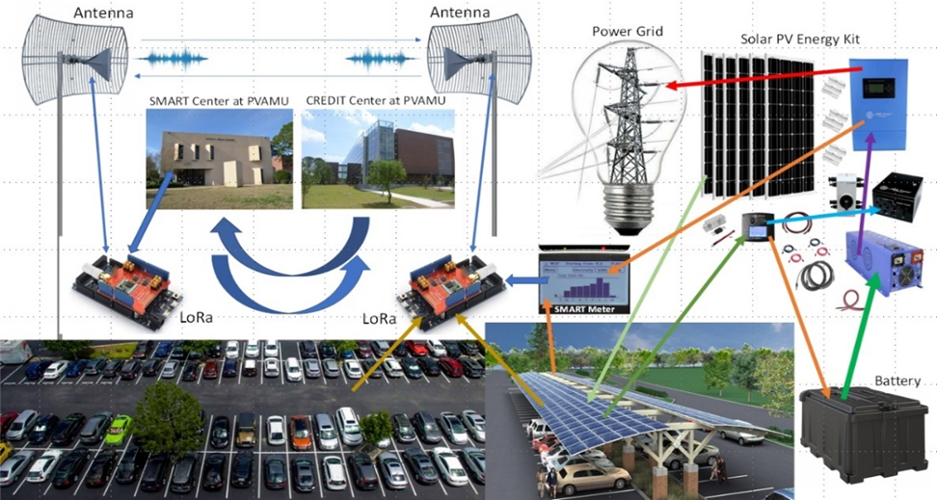
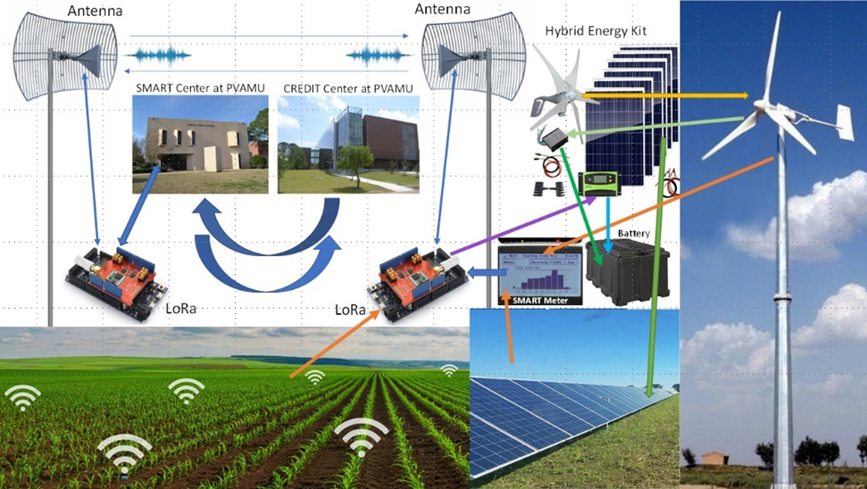
SEMTECH – RESEARCH PROPOSAL
Initiation of a Study and Implementation of Semtech Lora Technologies for Engineering Systems: Pertinent to Advances in Power, Communications and Artificial Intelligence: Educational and Research Proposal Submitted to Semtech Corporation
Proposal written by:
Dr. Qian, Dr. Fuller, Dr. Binzaid and Dr. Attia
Year 1 (2021 -2022) Canopy, Solar Photovoltaic and Parking system
Year 2 (2022 – 2023) Solar Home and Farm System
Year 3 (2023 – 2024) Wind-power Tower and Remote Hybrid-Energy System:
Year 4 (2024 – 2025) Big Data Analytics for LoRaWAN supported Smart Microgrid

Slide 14
Acknowledgements
Grants that supported the research/scholarly activity
The bike lane project work is supported by the National Science Foundation under grant with Federal Award # 2025641
The MRI Instrumentation project work is supported by the National Science Foundation grant number 2018945.
The emission-free smart infrastructure is supported by TAMU Energy Institute grant.
Other Projects are supported by funds from the Chancellor’s Research Initiative for the Smart Microgrid

