Slide 1

Established
Founding Executive Director CECSTR: Cajetan M. Akujuobi, M.B.A., Ph.D.E.E, P.E., FIAAM
Founder & PI of the SECURE Cybersecurity Center of Excellence
Professor of Electrical & Computer Engineering in the Roy G. Perry College of Engineering. Former Vice President for Research, Innovations and Sponsored Programs
Former Dean of Graduate Studies at PVAMU
Chair, IEEE Houston Section Life Members Affinity Group (LMAG).
Prairie View A&M University
Electrical & Computer Engineering Department
P. O. Box 519, Mail Stop 2800
Gilchrest Engineering Building, Suite 123
Prairie View, TX 77446
936-261-1668 (Office)
936-261-9991 (Direct)
cmakujuobi@pvamu.edu.
http://www.pvamu.edu/cecstr

Slide 2
OUTLINE
Introduction
Vision & Mission
Brief Overview & Key Researchers
Research Tracks
CECSTR Programs
Selected Research Topics
CECSTR Senior Design Student Projects
Major CECSTR Research Activities
Collaboration Research Interests
Conclusion with CECSTR’s Contributions to ECE Dept., College & PVAMU

Slide 3
CECSTR’s Vision: To be a State and National resource in the selected aspects of Communication Systems research and education for the State of Texas, the Nation, our industry sponsors, government agencies and academia.
CECSTR’S MISSION: CECSTR’S mission is to conduct comprehensive research in the selected aspects of communication systems, Wavelets and Wavelet Transforms, Smart & Connected Cities Technologies, Cybersecurity, Internet of Things (IoT), Compressed Sensing/Compressive Sampling Systems, DSP Solutions, Signal/Image/Video Processing, Mixed Signal Systems, and High Speed (Broadband) Communication Systems by way of algorithm developments, modeling, simulation, analysis, design, testing and performance evaluation and to support technology transfer to our sponsors.
Develop and suggest new curriculum for the Electrical Engineering Program as required by industry and emerging technologies needs.
Support and train students by recruiting talented students, awarding assistantships and creating pipeline with the industry partners for students’ placements.

Slide 4
CECSTR’S Key People: Multi-Disciplinary and Integrative Effort
Cajetan M. Akujuobi, Ph.D., M.B.A., P.E., FIAAM, Professor, Electrical & Computer Engineering
C. L. Tolliver, Ph.D., P.E., Professor, Electrical & Computer Engineering
Justin Foreman, Ph.D., Assistant Professor, Electrical & Computer Engineering
Matthew Sadiku, Ph.D., P.E., Professor Emeritus, Electrical & Computer Engineering
Suxia Cui, Ph.D., Associate Professor, Electrical & Computer Engineering
Musa Sarhan, Ph.D., Professor, Electrical & Computer Engineering
Jerrel Moore, Ph.D., Research Associate, College of Nursing
Noel Estwick, Ph.D., Research Scientist, College of Agriculture
Emmanuel Opara, D.B.A., Professor, College of Business
Brief Overview
Established in 1999
Approved on July 25, 2003 by Board of Regent, Texas A&M University System.
Established major research tracks: Broadband (High Speed) Communication Systems, IoTs, Mixed Signal Systems, DSP and Communication Systems.
Conducts Comprehensive Research
Provide student assistantships at all levels (Undergraduate & Graduate).
Supports & promotes ECE Dept.’s, College of Engineering’s & PVAMU’s missions and visions.

Slide 5
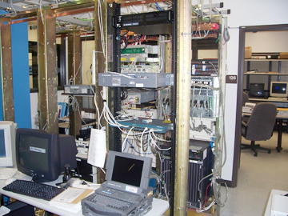
Current Research Tracks
Smart & Connected City Technologies Research
Communication Systems & Signal/ Image/Video Processing
Internet of Things (IoTs)
Wavelet & Wavelet Transform-based Research
Wireless Communications (cellular, ad-hoc and sensor nets)
Broadband Telecommunication Interoperability & Verification Research
Compressed Sensing/Compressive Sampling Systems
Analog & Mixed Signal Test and Evaluation
Cybersecurity Security Systems (cyber-physical systems)
Communication Security
The broadband lab has DSLAM, Wireline Simulator, Traffic generator, Network analyzer, Spectrum Analyzer and other various testing equipments for Broadband testing and verifications.

Slide 6
Programs
1. Communication Systems
2. Digital Signal Processing
3. Analog & Mixed Signal Systems
4. Broadband Communication Systems
In each program CECSTR offers
  Graduate & Undergraduate Assistantships
  Curriculum Enhancement
  Research
Center of Excellence for Communication Systems
Technology Research (CECSTR)
Research & Instruction Laboratories
TI Mixed
Signal Comm.
Systems Lab
TI Signal /Image /Video Processing Lab
Sprint
Broadband
Technology Lab
Comm. Control
Systems
Lab

Slide 7
CECSTR STUDENT RESEARCHERS
21 Student Researchers (9 Ph.Ds., 7 MS, 5 BS)
DOCTORAL STUDENTS
  Kelechi Eze, (Ph.D. Candidate)
  Odinaka Ekwonnah, (Ph.D. Student)
  Faith Nwokoma, (Ph.D. Student)
  Blessing Dike, (Ph.D. Student)
  Bruno Kemen, (Ph.D. Student)
  Dominic Okeke (Ph.D Student)
  Lujun Zhai (Ph.D. Student)
  Damon Elsup (Ph.D. Student)
  Ekele Arthur Asonye, (to Graduate in May 2021), Working with Microsoft
UNDERGRADUATE STUDENTS
  Shemar T. Hunter, (Undergraduate)
  Marvin O. Berrios, (Undergraduate)
  LSAMP STUDENTS
  Kevin McDonald
  Ramon Whitaker
  Young Ellis
MS STUDENTS
  Qamiyon Marshall, (MS)
  Busayo F. Oluwakuse (MS)
  Ayodeji Olanite (MS)
  Moutz Quassi (MS)
  Malon Atchison (MS)
  Joel Wandji (MS), Recently Graduated – Working with Northrop Grumman in Florida
  Pankaj Chhetri, (MS), Recently Graduated – Working at UT Austin

Slide 8
SELECTED RESEARCH TOPICS
Design and simulation of a Coded Orthogonal Frequency Division Multiplexing (COFDM) for broadband (high-speed) wireless digital communication system.
Scalable Decentralized Security Framework for Efficient Resource Sharing in Internet of Things
System-Wide Security for the Internet of Things: A Blockchain Approach
IoT Enabled Smart Parking System.
Comparative Analysis of Rayleigh and Rician Multipath Fading Channels for 4-QAM and 8-QAM Modulation and the Security Vulnerabilities of the Systems
BER Comparison of the FFT vs DWT in Different Channels in a WIMAX System
A Dynamic Predictive Control and Machine Learning Technique to Optimize the QoS Performance of ZigBee-Based Home Area Network in the Internet of Things.
Energy Monitoring Data Acquisition System and Sensor Data Analysis Using Machine Learning for Industrial IoT.
Planning and Scheduling of Corrugated Cardboard Manufacturing Process in IoT.

Slide 9
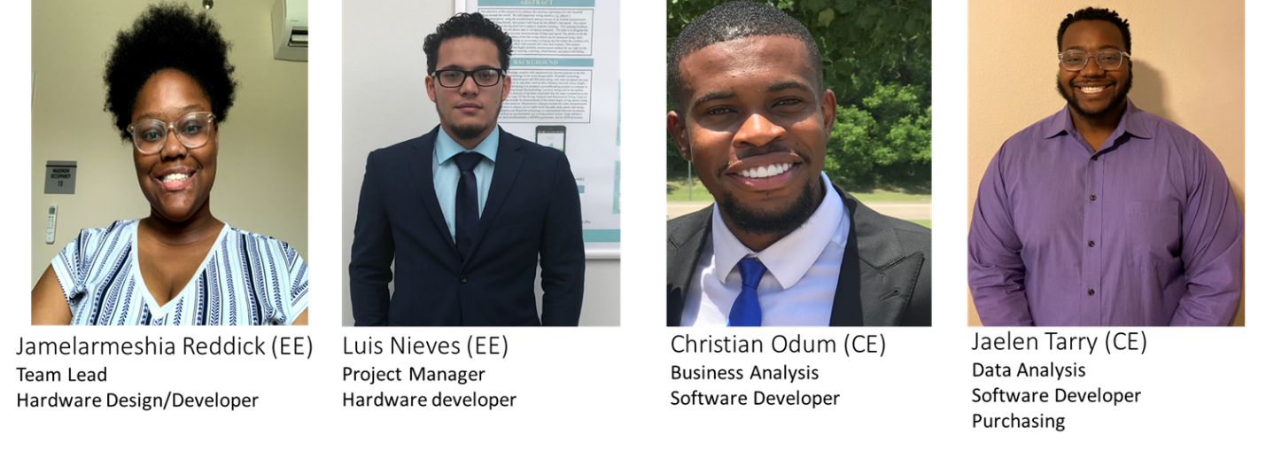
Senior Design Project Students: Jamelarmeshia Reddick (Team Lead), Christian Odum, Jaelen Tarry, and Luis Nieves.
Topic: “Voice Operated Security Lock”.

Slide 10
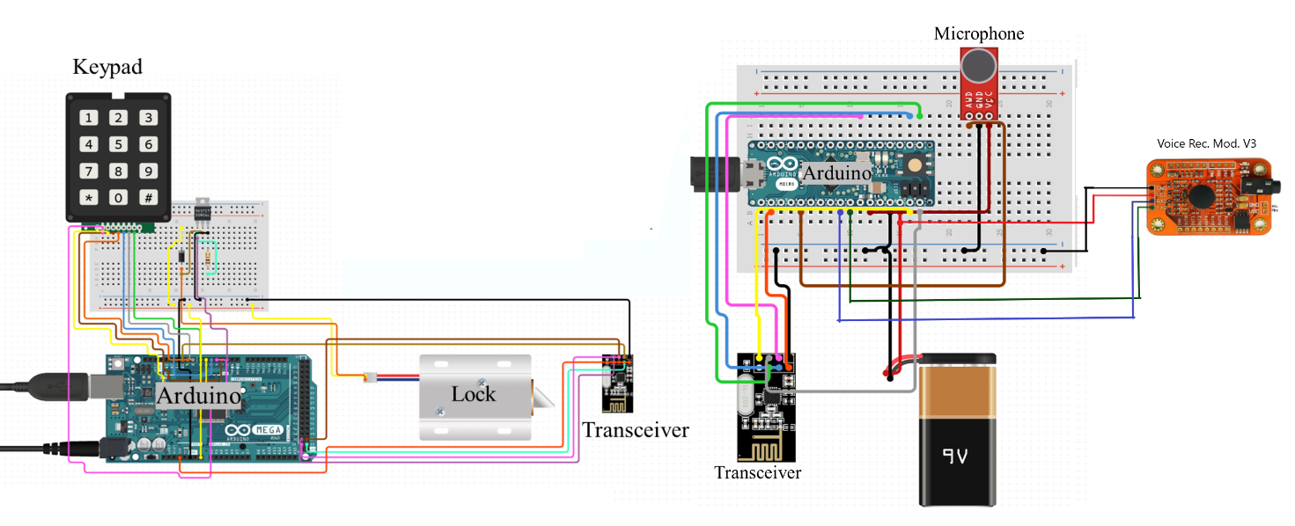
Final Layout and Detailed Drawings – Voice Operated Security Lock

Slide 11
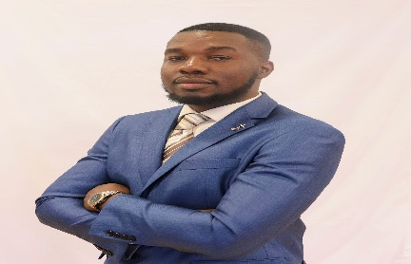
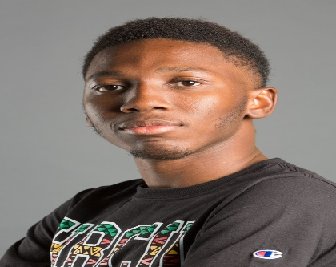
CECSTR Students Experiences on Senior Design Projects Contd.
My name is Racine McLean. I'm a senior at Prairie View A&M University, pursuing a Bachelor's degree in Computer Engineering. In this project we focused on Machine Learning specifically, we use deep learning and computer vision to develop a face recognition attendance tracking system. The purpose of this project is to reduce the amount of time used to process attendance and to also increase the accuracy of the reporting. Every day, advancements are being made in the field of machine learning. I would advise everyone who is interested in technologies of the future to get involved with AI and machine learning, for this is the future.
My name is Kobi Tioro and I'm a senior undergraduate student majoring in Computer Engineering at Prairie View A&M University. My research topic is “Machine Learning Based Job Scheduling Strategies on Cloud Computing.” The goal of this project is to improve the job scheduler resource management using Deep Reinforcement Learning resource allocation algorithms to perform better than traditional resource allocation algorithms in a variety of complicated environments.

Slide 12
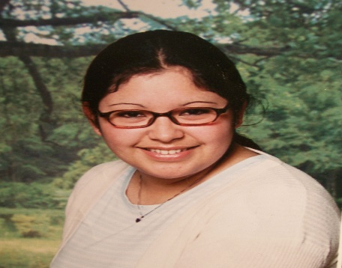
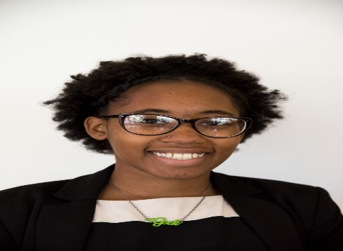
CECSTR Students Experiences on Senior Design Projects Contd.
My name is Virgie Leyva, I am a senior at Prairie View A&M University, pursuing a bachelor’s degree in Computer Engineering. In this project, we will use deep learning to restore old photos. Most of these photos have suffered from severe degradation such as scratches, blemishes, color alteration or blurriness. Previously, conventional restoration required supervised learning and professional skills to restore old photos. Utilizing deep learning, anyone has the capabilities to restore old photos back to their former glory.
My name is Chara Tatum, I am a senior in Computer Science department at Prairie View A&M University. This research project is focused on the use of an IBM High Performance Computing (HPC) cluster through Dr. Suxia Cui’s National Science Foundation Major Research Instrumentation grant (Award number: OCA 1229744). I am going to test some open-source weather prediction programming packages on the cluster to gain knowledge of data collection and analysis. As an XSEDE student Campus Champion, I’d like to teach other students to get familiar with an HPC cluster environment.

Slide 13
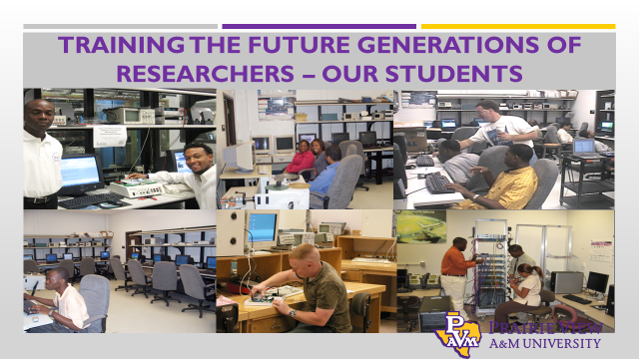
Signal generator: Model-Agilent 33120A
Power supply: Model-Agilent E3631A
Multimeter: Model-Agilent 34401A
Oscilloscope: Model-Agilent 54622D
Spectrum analyzer: Model-Agilent E4411B & 4407B
Pattern generator: Model-Agilent 8110A
Pulse generator: Model-Agilent 8133A
The research labs have each 10 complete work stations for testing and measurement and research works. The DSP lab is equipped with TI 6000 series DSPs. Each station has following equipments:

Slide 14
Major CECSTR Research Activities
Activities | 2017 | 2018 | 2019 | 2020 | 2021
# of Proposals Submitted | 5 | 5 | 7 | 10 | 3
# of Proposals Funded | 2 | 2 | 3 | 3 | 1
Total Amount of Funds | $200,000 | $1,192,202 | $2,049,281 | $341,427 | $177,922
Total Pending Proposals | x | x | x | 3($484,000) | 3($2,234,000)
Total Amount not Funded | $1,099,895 | $3,282,266 | $5,542,260 | $6,987,029 | N/A
# of Graduate Students | 5 | 5 | 12 | 13 | 16
# of Undergraduate students | 3 | 3 | 8 | 11 | 5
#of Students Graduated | 3 | 6 | 10 | 14 | 1
Publications | 14 | 12 | 17 | 11 | 5 (3 pending)
Invited Talks/Presentations | 4 | 6 | 3 | 2 | 3

Slide 15
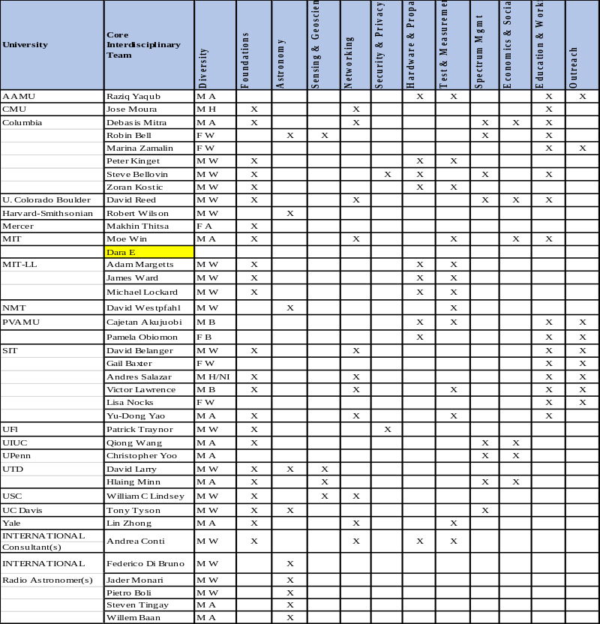
SII-Center: SPECTRA (Spectrum Policies, Economics, Coexistence, and Technological Research Advancement)
NSF- $25M/5Years – CECSTR in Collaborative Research with Over 20 Institutions, Organizations, Government Agencies, etc.
In working with SPECTRA in this NSF project, PVAMU located in rural Texas, a heavily agricultural area, specifically, will work in the following areas:
Analysis, testing, measurement and optimization of dynamic spectrum access.
Exploring other possibilities of extending this work to other areas of testing and measurement
Because of PVAMU’s rural location, ideal in investigating the following:
  Comprehensive/fair broadband service coverage in rural environments
  Interplay between terrestrial, satellite and movable (drone-supported) platforms, and
  Coexistence of cognitive radio networks on TV spaces for rural connectivity and
  Minimizing interference based on a centralized access control for cognitive radio wireless network.
Working with SPECTRA to build educational programs and relevant experimentations that will
  Train teams of students in experimental research and practical measurement and testing
  Run measurement campaigns, and
  Help organize field trips to run experiments in targeted science-heavy sites

Slide 16
Contributions & Conclusion
CECSTR will continue to Support & promote ECE Dept., College of Engineering & PVAMU’s missions and visions.
CECSTR was instrumental for the establishment of ECE PhD Program.
CECSTR established Texas Instruments (TI) Endowed Chair ($1 Million) and TI Undergraduate & Graduate Assistantship Endowment ($600,000).
Research Grants- More than $25M since 2000
PUBLICATION: Over 300 journals & peer-reviewed papers published from the funded projects for the period of 2004-2021, and numerous books & book chapters, published by the center researchers.
PATENT: Motor Control Method and Apparatus with Multi-Objective Observer for Disturbance Rejection, 2004.
Student impacted- Over 35 PhD Students, Over 80 MS Students and Over 400 undergraduate students since 2000.
CECSTR is currently seeking for Industry Advisory Members – We Welcome your Suggestions!
Thank you!!!

