Slide 1




Roy G. Perry College of Engineering at
Prairie View A&M University

Slide 2
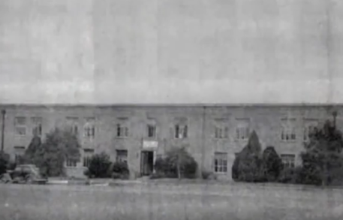
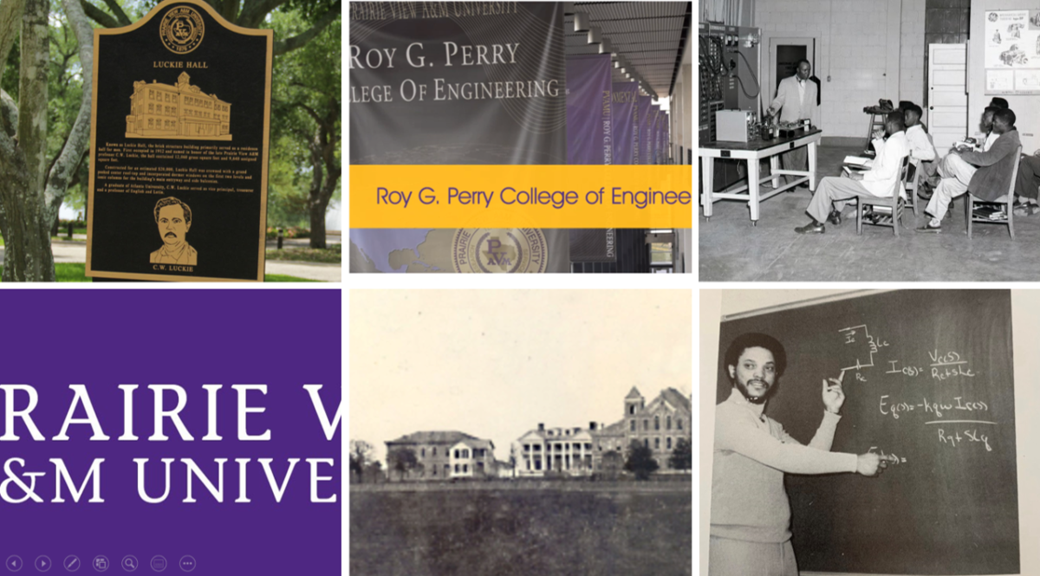

Prairie View A&M University is the 2nd oldest public university in the state of Texas. Approximately 150 years old.
In 1947 the university started offering engineering courses.

Slide 3
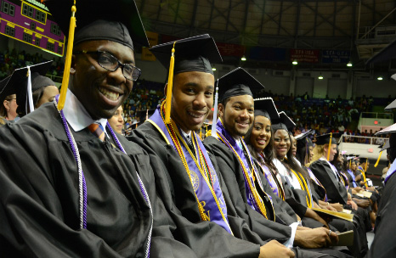



Roy G. Perry College of Engineering
National Rankings
#1 in producing African American males with bachelor’s degrees in engineering.
#3 in producing African American females with bachelor’s degrees in engineering.
#11 in producing African American with graduate degrees in engineering.
(Diverse: Issues in Higher Education)

Slide 4
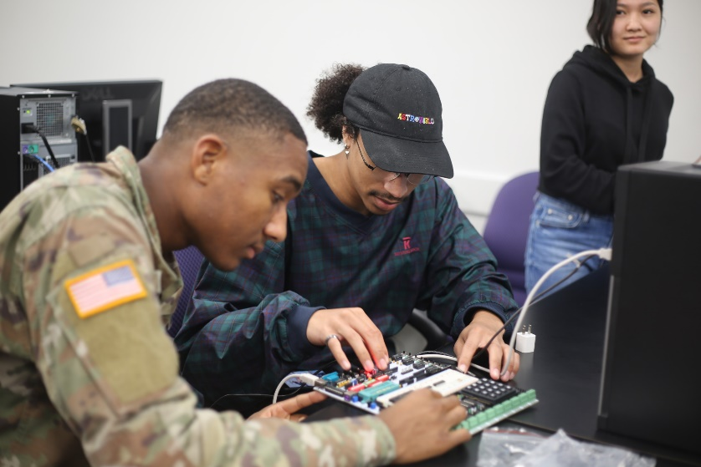
Roy G. Perry College of Engineering
College Programs
Six Bachelor of Science programs:
Civil Engineering
Chemical Engineering
Computer Engineering
Electrical Engineering
Mechanical Engineering
Computer Science
Certificate program in Data Science
Certificate in Engineering Leadership
Certified Associates in Project Management Certification training
Certificates in Health, Safety and Environment (HSE) – PetroED
Digital Badges from IBM in Design Thinking, Artificial Intelligence, and Block Chain, Quantum Computing

Slide 5

Roy G. Perry College of Engineering
College Programs
Five Graduate Degrees:
Master of Science in General Engineering
Master of Science in Computer Science
Master of Science in Computer Information System
Master of Science in Electrical Engineering
Ph.D. in Electrical Engineering
Graduate Certification Program: Deep Learning for Artificial Intelligence
Graduate Certification in Smart Grid (for all majors)
Graduate Certification in Cybersecurity (in progress)

Slide 6
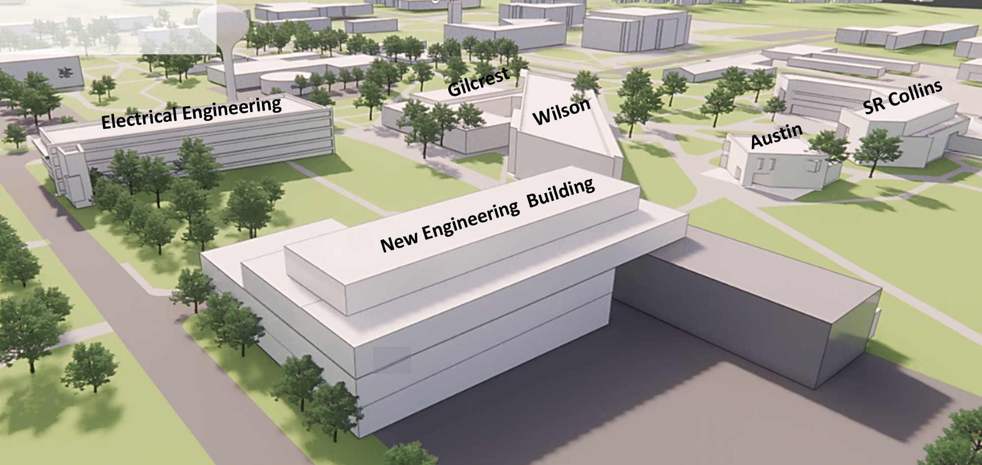

Roy G. Perry College of Engineering
Home
A six-building complex
1,317 students
95 faculty, researchers, and staff
11 state-of-the art Research Centers

Slide 7

Disruptive technologies significantly influencing the future
Artificial Intelligence
3D Printing
5G
The Internet of Things (IoT)
Virtual/ Augmented reality
Automation and Robotics
Blockchain

Slide 8
Preparing students for next-generation careers
Hire top faculty and research talent in the fields of AI, IoT, virtual reality (VR), data science, a machine learning, and advance manufacturing
Establish research centers in the areas
Develop new courses that integrate the disruptive technologies: AI, ML, Deep Learning, VR/AR, IoT, data science
Launch new concentrations and graduate programs
Launch graduate certificates
Establish credentialed certificate programs
Collaborate with industry partners
Take advantage of online courses industry courses and credentialing
Take advantage of internships

Slide 9
Preparing students for next-generation careers
Ensure that students have good fundamental: hard skills in engineering, software architecture, coding, algorithms, data structures, data analysis/data science, and machine architecture/design
Strong emphasis on life long learning- knowledge becomes obsolete very quickly / Stay continuously informed about the upgrades in technology
Nurture creativity/open-ended projects

Slide 10
Roy G. Perry College of Engineering
Curriculum Improvements
  Hire stellar faculty
  Strengthened Corporate Relationships
  Established a cybersecurity concentration fall 2020
Revamped Electrical and Computer Engineering Curriculum
Established a Certificate program in Data Science
Established a Certificate in Engineering Leadership
Established a Certified Associate in Project Management program
Established a program with IBM credentialing our students with digital badges in Design thinking, AI, Blockchain, and Cybersecurity
Curriculum Improvements
Proposing a degree in cybersecurity in Comp sci
Proposing a big data analytics concentration in Comp Sci
Proposing an undergraduate certification in AI. Machine learning , deep learning
Quantum computing
IoT
  MS Mechanical Engineering fall 2022
Launched the Intel Innovation Center: Nurture creativity/open-ended projects

Slide 11
Closing the gap when students transition to the workplace
Continuing Internships and Co-ops
Corporate partners support
  Added more industrial advisory board members – assist in curriculum development
  Working with corporate partners in developing and upgrading labs
  Tech talk – Lecture Series
  Research stipends – to conduct research on real business challenges
  Senior projects– corporate partners co-mentor
  Undergraduate research- students work on real-world challenges/gain soft skills and technical skills - corporate partners co-mentor
  Fund and sponsor MS/PhD students
  Partner with Research Centers and faculty

Slide 12
Roy G. Perry College of Engineering
11 Outstanding Research Centers
The Center of Excellence in Research and Education for Big Military Data Intelligence (CREDIT)
Center of Excellence for Cyber security (SECURE)
The Smart MicroGrid Advanced Research and Technology Center (SMART)
The Center for Computational Systems Biology (CCSB@PVAMU)
Center for High Pressure Combustion in Mircrogravity
The Center for Energy and Environmental Sustainability (CEES)
The Center of Excellence for Communication Systems Technology Research (CECSTR)
The Center for Radiation Engineering and Science for Space Exploration (CRESSE)
The Future Aerospace, Science and Technology (FAST)
The Texas Gulf Coast Environmental Data (TEXGED)
The Thermal Science Research Center (TSRC)

Slide 13
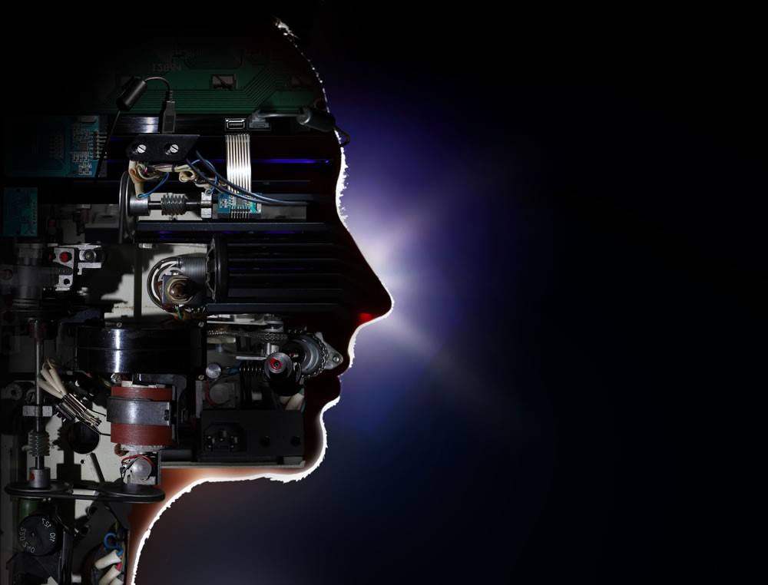

The Center of Excellence in Research and Education for Big Military Data Intelligence (CREDIT)
Research Labs
Big Data / Machine Learning / Artificial Intelligence

Slide 14

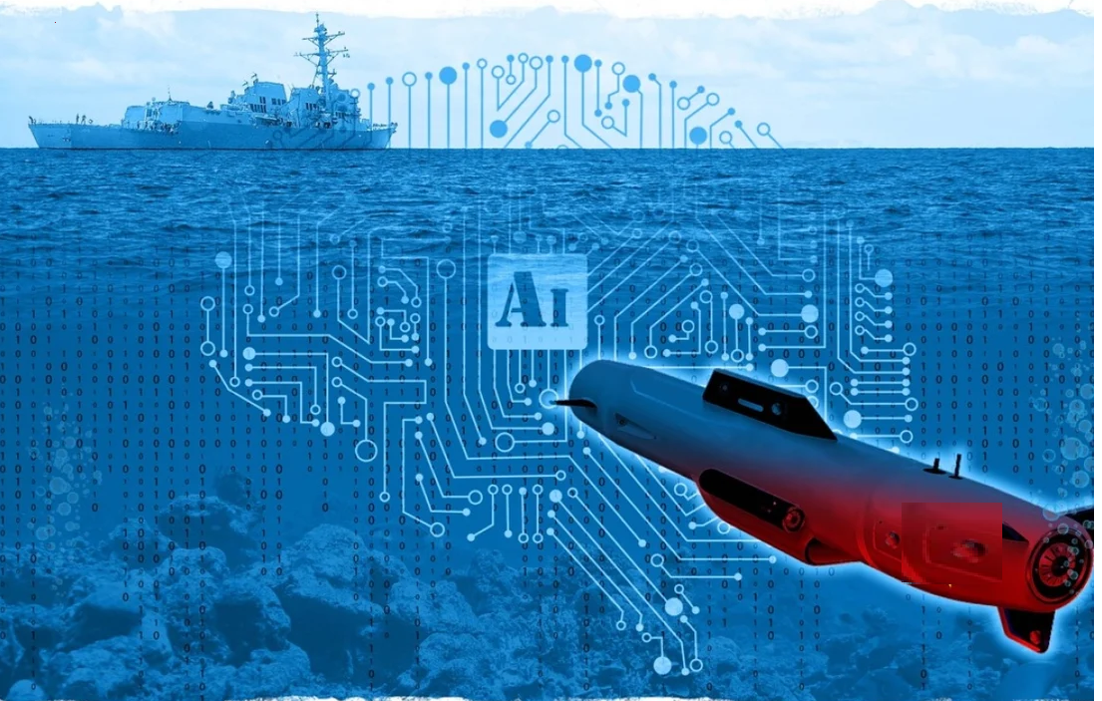
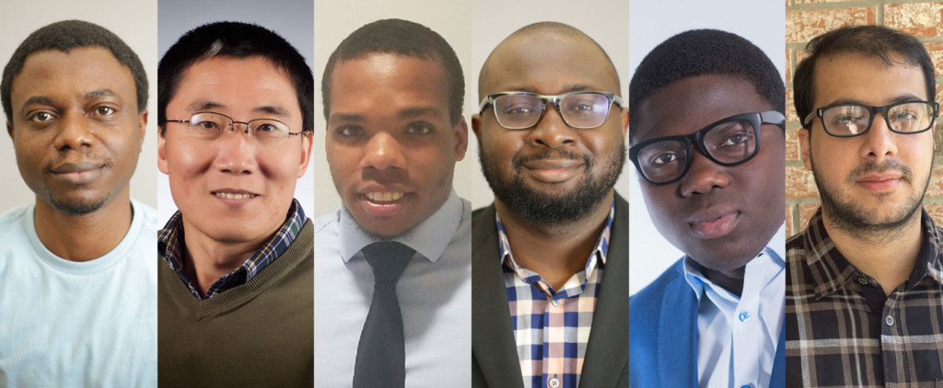
1st Place Winners
The Prairie View A&M University Artificial Intelligence Team won 1st place in the Office of Naval Research Artificial Intelligence (AI) Tracks at Sea challenge. The Team beat 31 universities including top tier research universities and Ivy League Schools
Navy has announced it officially on their website:
https://www.challenge.gov/challenge/AI-tracks-at-sea/#description

Slide 15
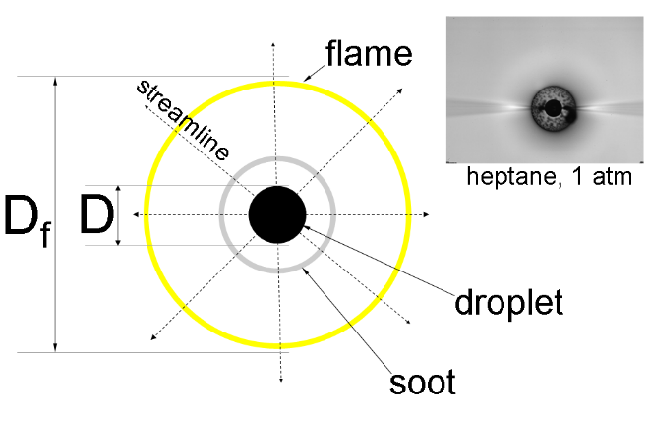
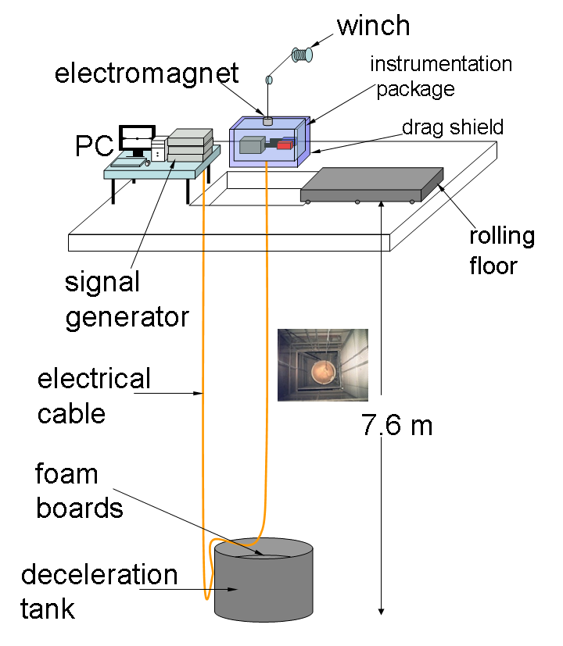
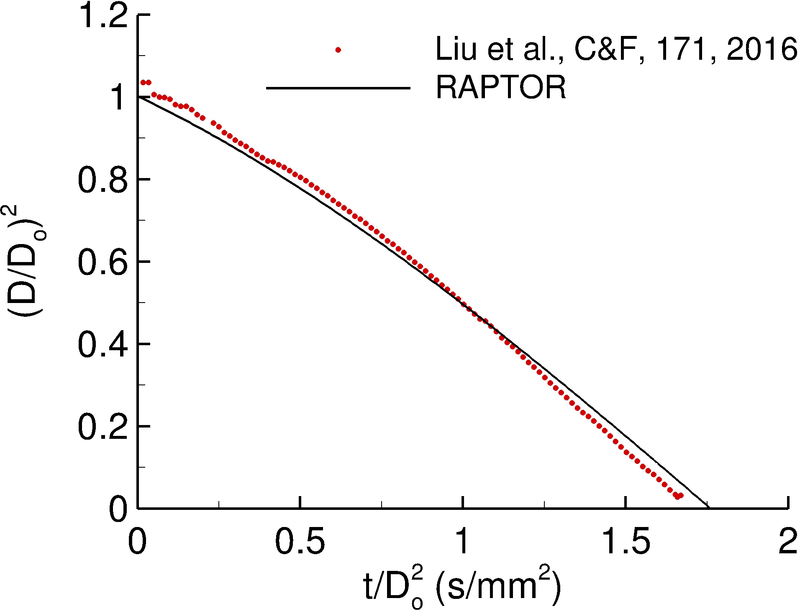
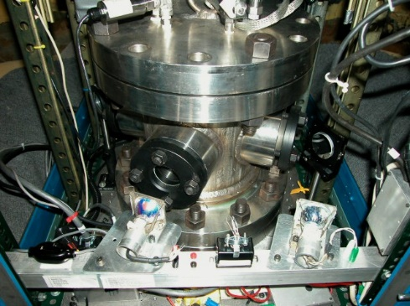
Center for High Pressure Combusiton in Mircrgravity
Droplet combustion of decance, butanol, and their mixtures
(Collaborate with Cornell University)
Detailed numerical modeling
(Collaborate with Georgia Tech)
Schematic of idealized spherically symmetric droplet burning configuration
Preliminary data for n-decane droplet burning at 1 atm
Biofuel production
(Collaborate with Auburn)
Enhanced butanol production with optimized fermentation process using the engineered C. tyrobutyricum strain
Schematic of the 1.2-s drop tower facility at Cornell
The high-pressure chamber at Cornell

Slide 16
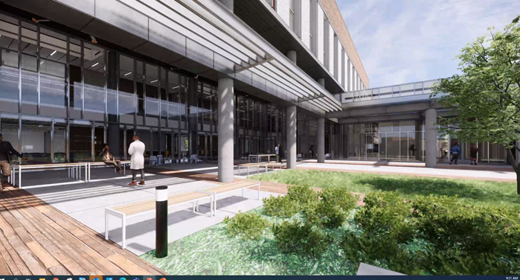
Roy G. Perry College of Engineering
$70M Research Building (2022)
    Engage/invite/encourage other majors/teams to collaborate in research

Slide 17
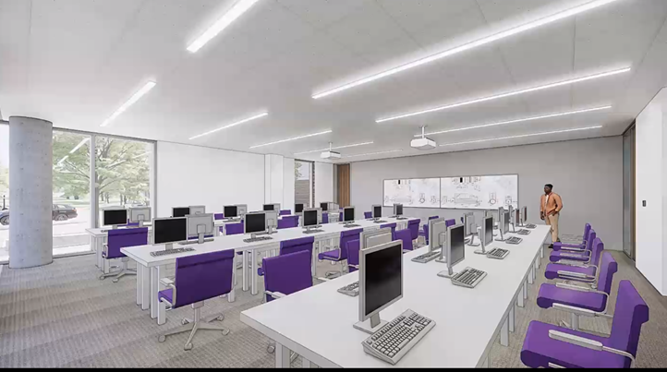
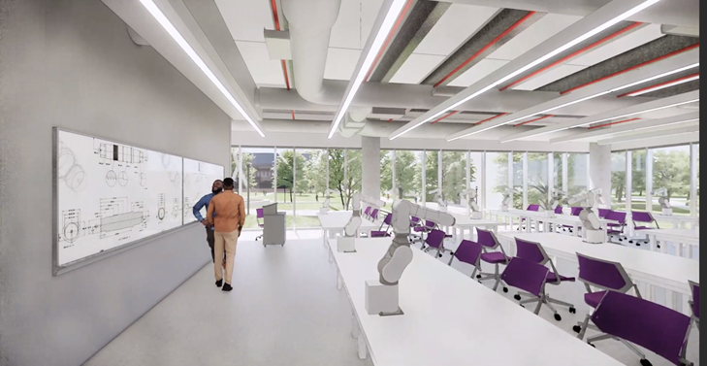
Roy G. Perry College of Engineering
Instructional Labs
Transportation Lab
Hydraulics Lab
Geotechnical Lab
Materials Lab
Structures Lab
Unit Operation/Kinetics/Separations Lab
Instructional Labs
Process Controls
Thermal Science Lab
Robotics Lab
Fluids Mechanics Lab
Manufacturing Processes Lab

Slide 18

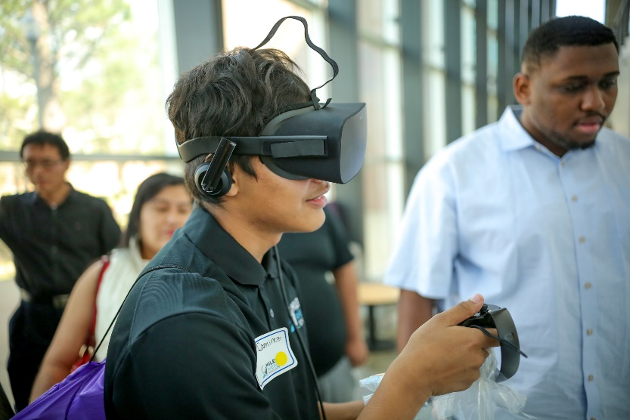
Roy G. Perry College of Engineering
Research Labs
High Performance CAD + Virtual Prototyping Computing

Slide 19
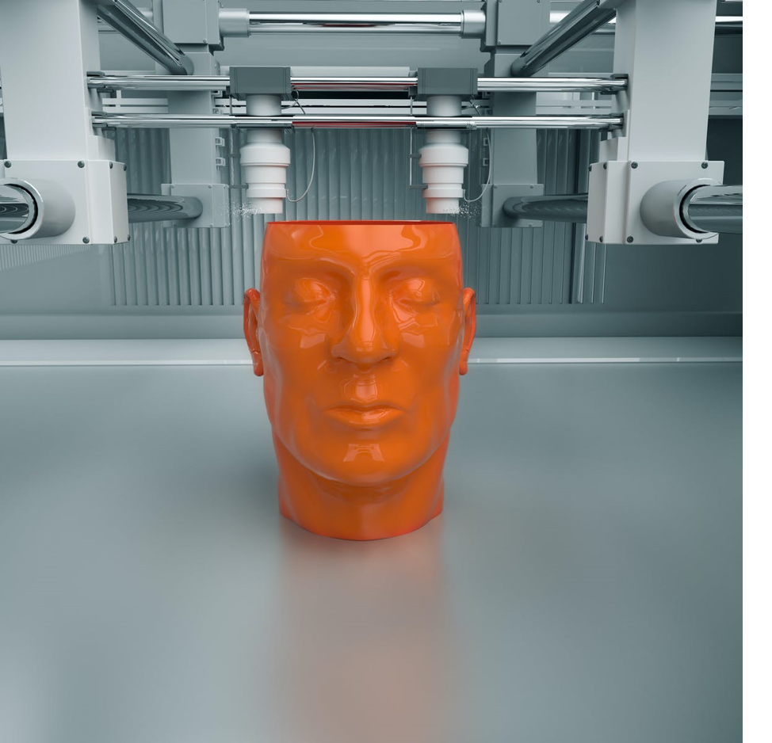
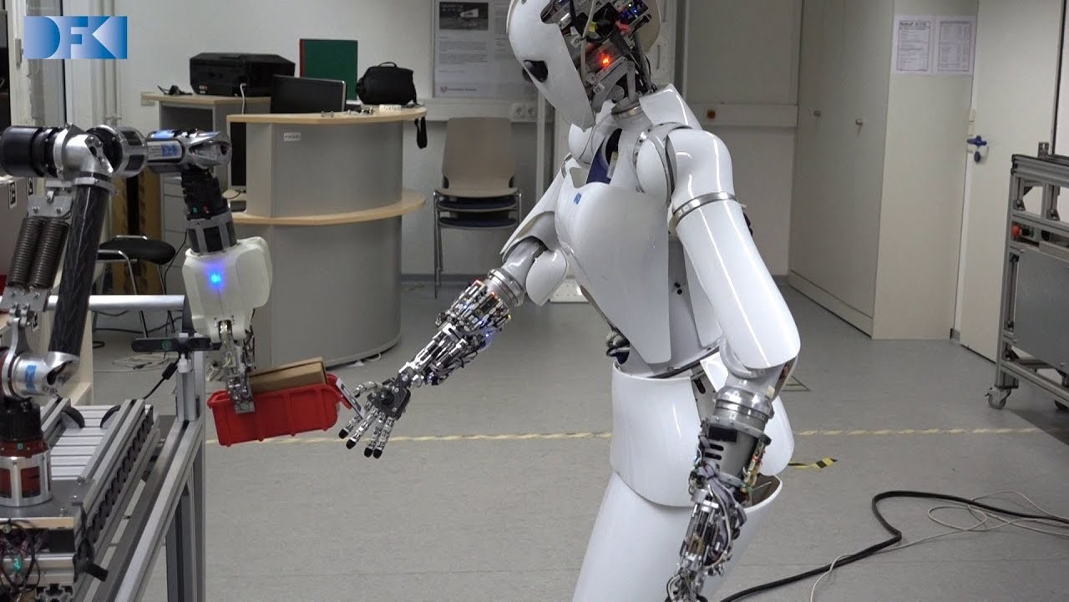
Roy G. Perry College of Engineering
Research Labs
Advanced Manufacturing
Robotics / UAV
Microelectronics/Clean Room Lab
Energy Systems / Environmental Sustainability

Slide 20
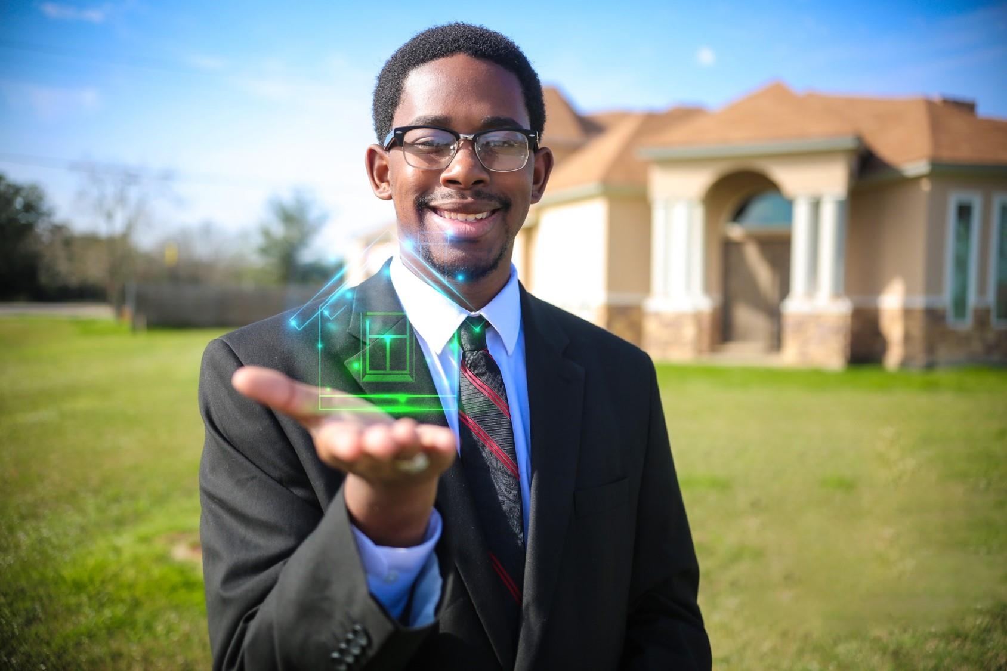
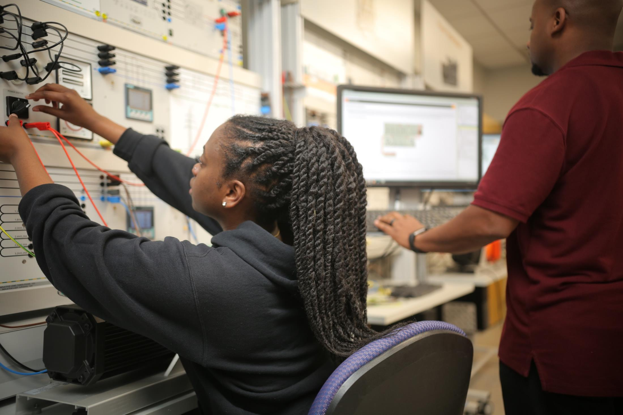
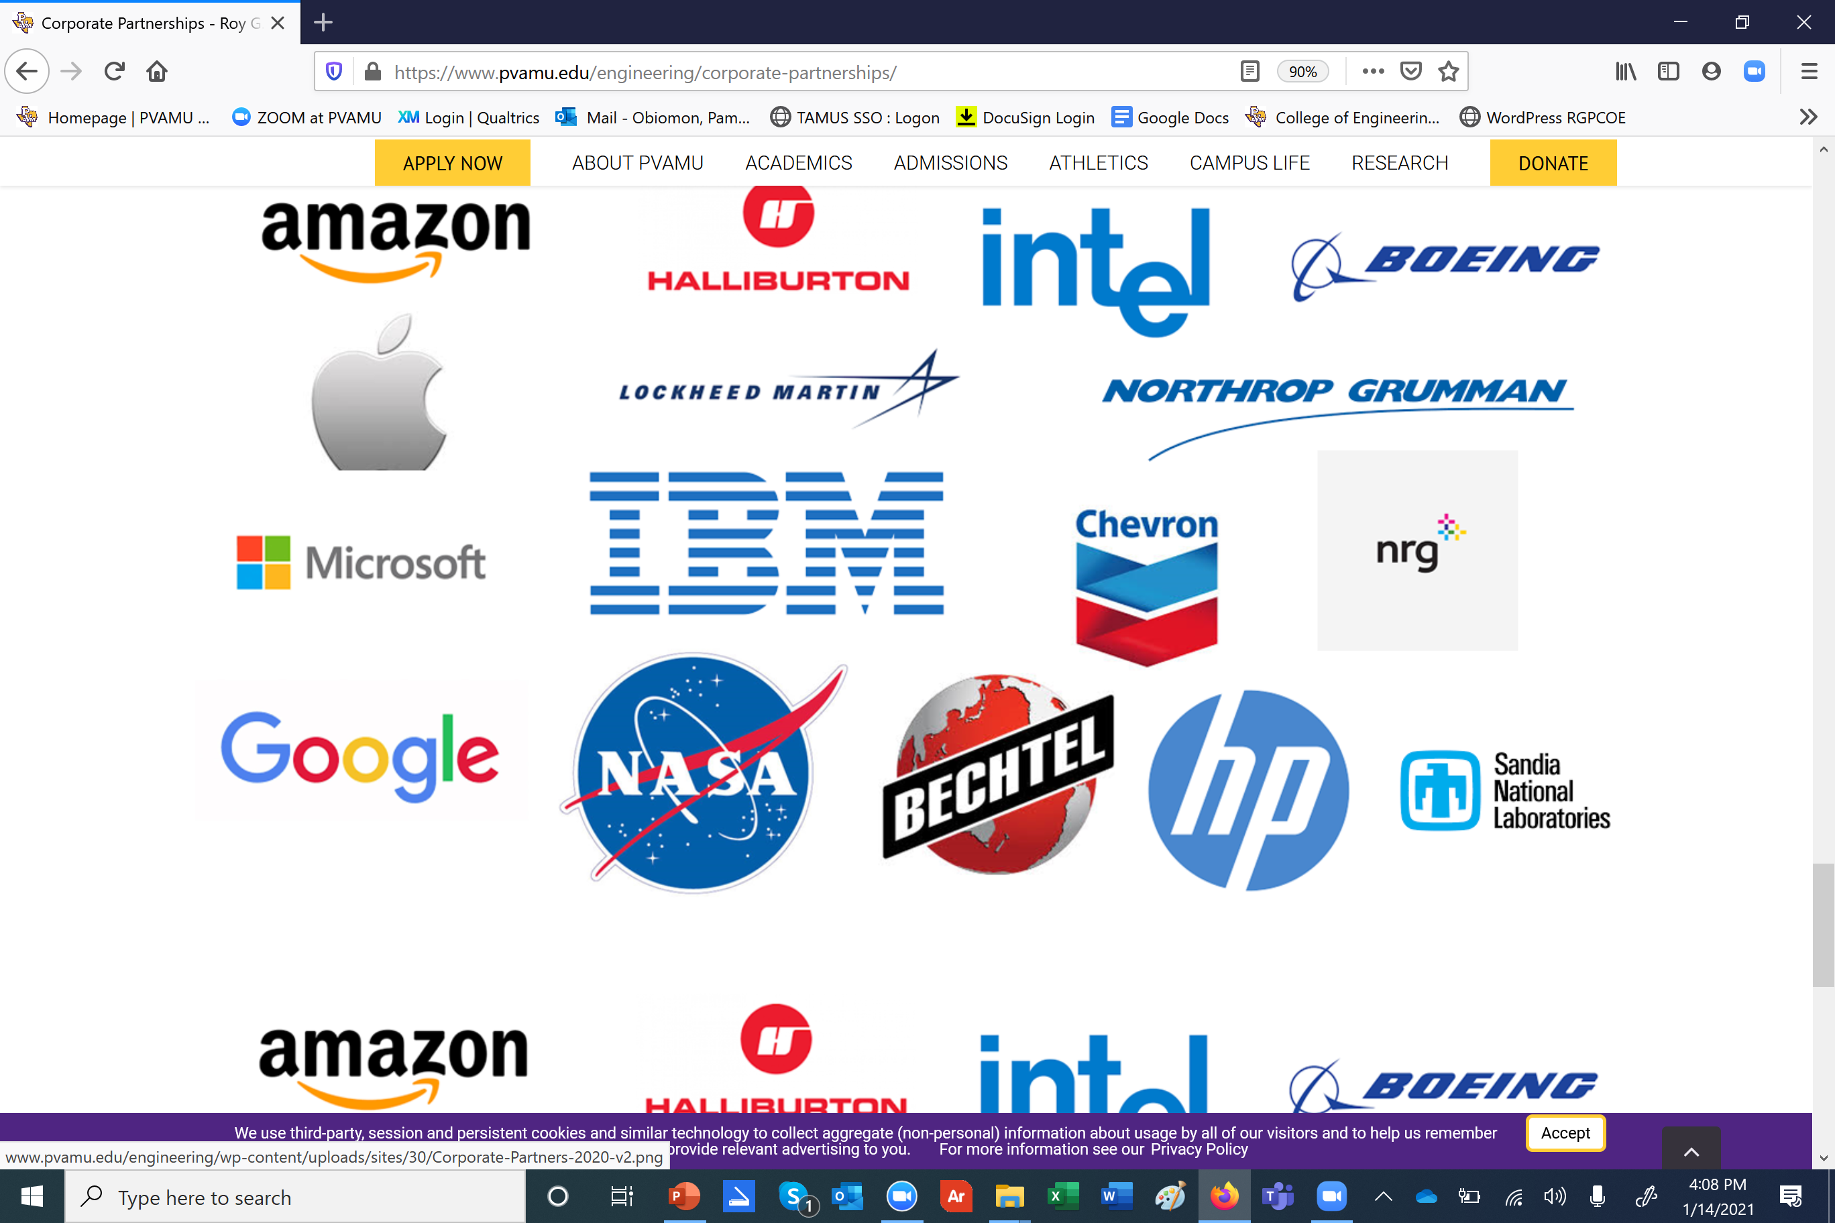





Roy G. Perry College of Engineering

Slide 21
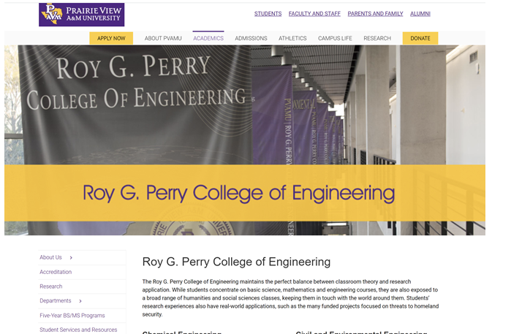
Visit our website for more ways to engage
www.pvamu.edu/engineering

