Slide 1
ECE Engineering Meeting
Friday December 11, 2020

Slide 2
AGENDA
Course Inventory Submission Process - Dr. Carter/Gabitto
Graduation Rates
ABET - Dr. Attia
CPEG Curriculum Update - Dr. Cui
ELEG Curriculum Update - Dr. Ali
Deadlines
Open Forum

Slide 3
Course Inventory Submission Process - Dr. Carter/Gabitto
https://intranet.pvamu.edu/spaces/100/curricular-services/home
Deadline department curriculum committee submits department head via Docusign is January 7, 2021
Deadline department submits to Dr. Gabitto, chair of the College Committee, is January 14, 2021.
Deadline committee submit to the dean via Docusign is January 21, 2021
Deadline the department submit to the University council via website upload is January 21, 2021

Slide 4

Graduation Rates

Slide 5
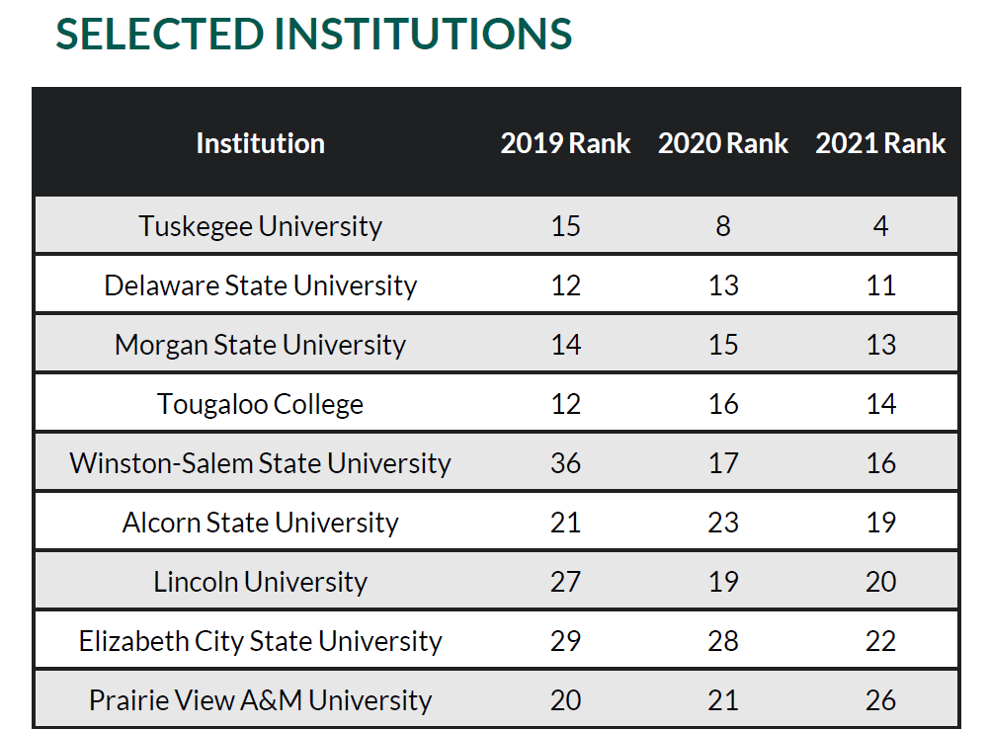
Hanover Report

Slide 6
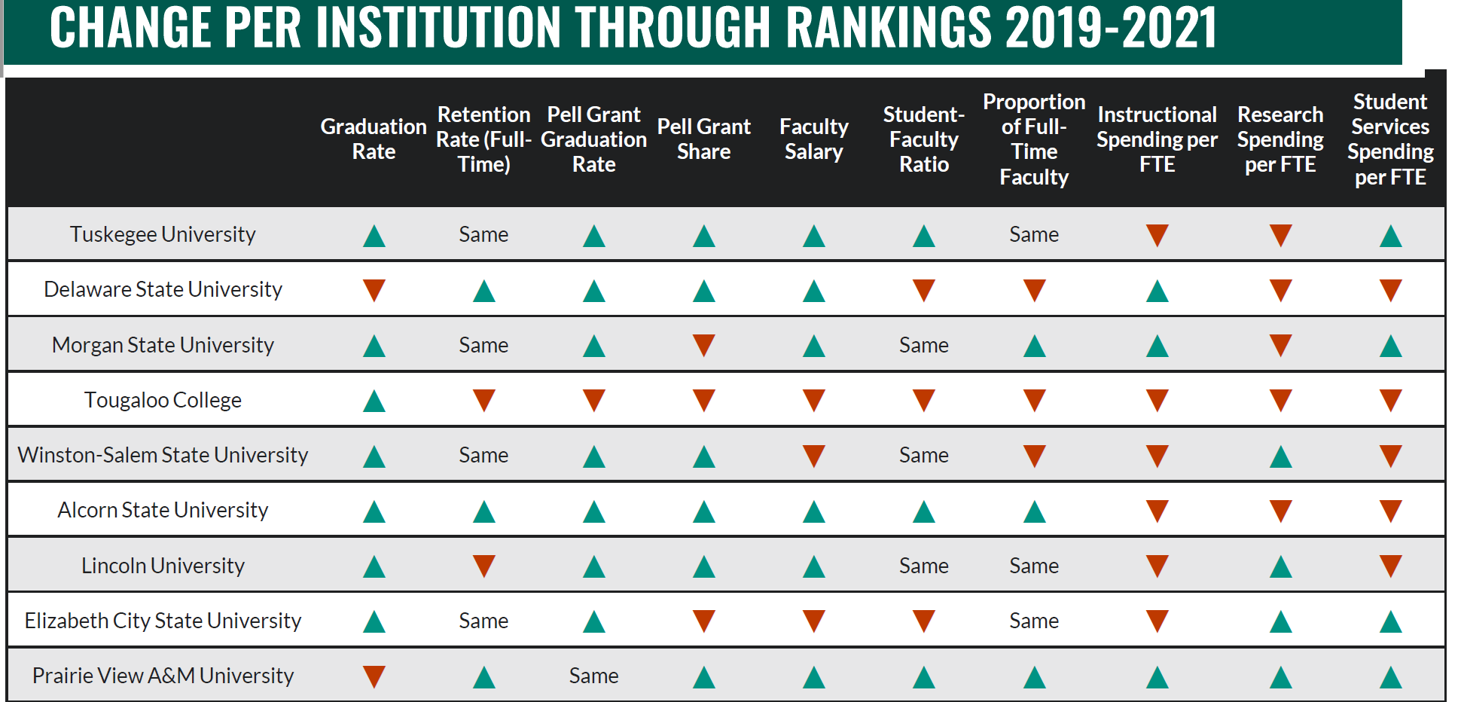

Slide 12
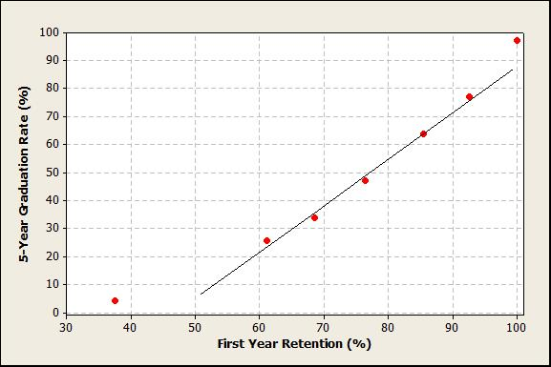
5-Year Graduation Rate = - 79.22 + 1.676 First- Year Retention

Slide 16
ABET – Dr. Attia
Prepare for Virtual Mock Visit around June
Fall 2020 Uploads
ABET Website
  Upload updated CVs
  Upload Assessment Reports
  Upload Course Binders
Due Monday December 21, 2020
ABET PEO results presented by Dr. Attia (see next slide)
PEOs approved by faculty (vote 18 approved - 20 faculty present).
Will review again Jan-March 2022

Slide 17
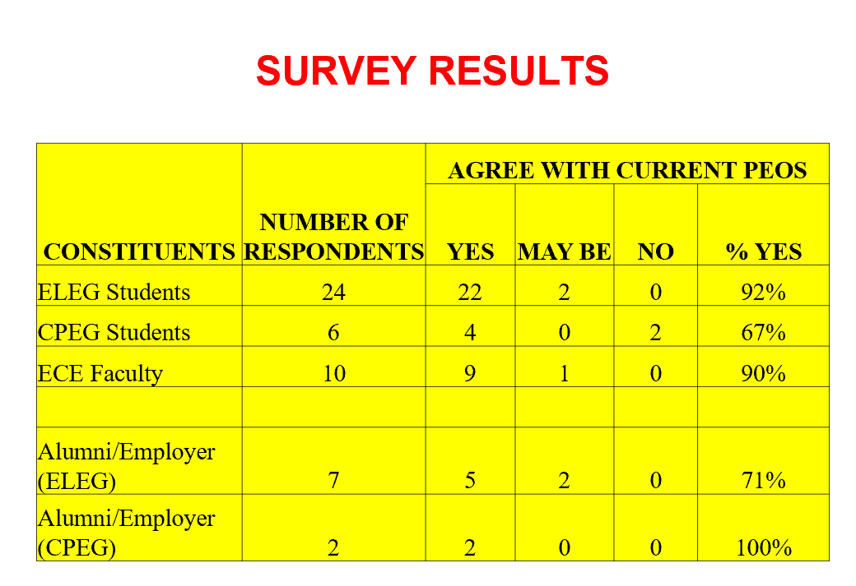

Slide 18
SACS
TaskStream Update
Team visit in March
  Faculty SACS evaluations due at the end of January 2021

Slide 19
CPEG/ELEG Curriculum Update - Dr. Cui/Ali
CPEG suggested degree plan approved.
EE suggested degree plan approved.
College Department Heads will need to review Chem 1034 because of the pre-requisite Chem 1013. The course may need to be modified.

Slide 20
Course Inventory List can be found at the link below.
CIPFund CoDE: 1410010006
http://www.txhighereddata.org/interactive/UnivCourse/

Slide 21
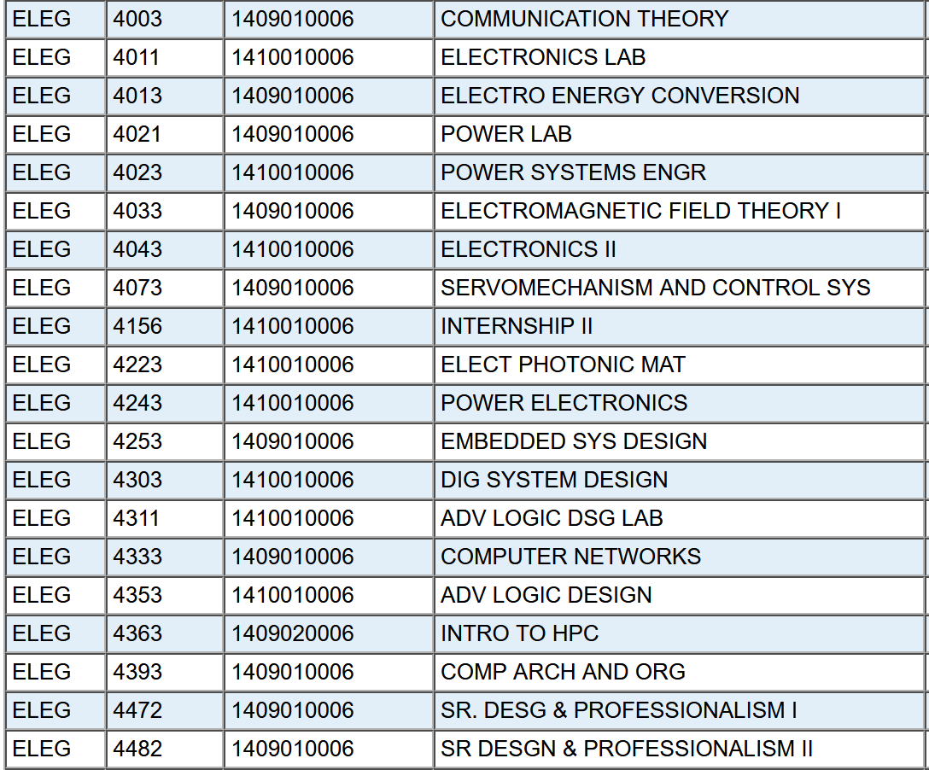
4000 level courses in the THECB inventory

Slide 22
End of Semester Deadlines
Thursday, Dec 10th Final Grades Due for Graduation Candidates (Noon)
Saturday, Dec 12th Virtual Commencement
Mon, Dec 14th Final Grades due for all other students (Noon)
Mon, Dec 21 st, ABET CVs, Assessment Reports and Binders uploaded
End of Jan 2021, SACs course evaluations completed in TaskStream

Slide 23
Open Forum
Questions

