Slide 1
ECE Faculty Meeting
October, 2, 2020

Slide 2
ECE Meeting Agenda, Friday, Oct 7th
Updates
SACs
ABET
Advisement
Enrollment
Graduation rates
Curriculum updates
Open forum - Question?

Slide 3
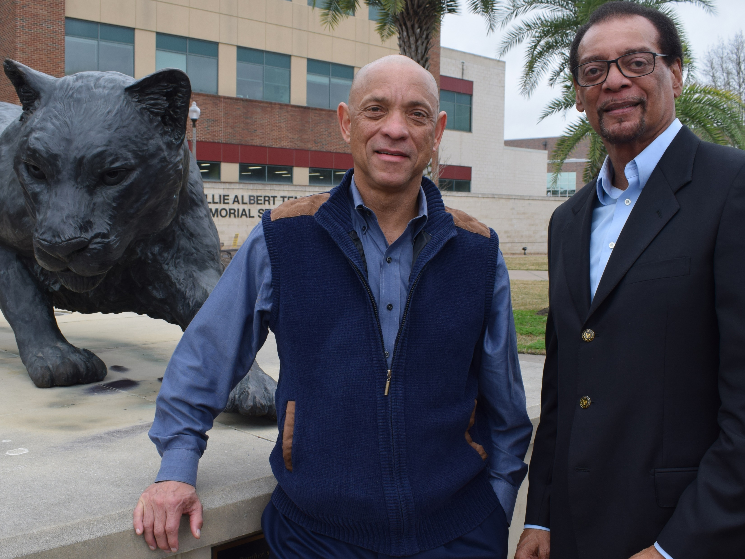
Updates
Interim Head
Coordinator – Horace St. Julian
Horace St. Julian (’71). St. Julian has over four decades of experience from working at companies like AT&T, IBM, Cooper Industries, and Raytheon. Prior to his time in corporate America, St. Julian taught classes at PVAMU.
Alumni Use Decades of Industry Experience to Teach Younger Generations

Slide 4
SACs
Work in progress
BS, MS, and PhD program

Slide 5
ABET - Highlights from Mock Review
Facilities
  Labs used for teaching
  Technician stretched
  Labs for senior design
Institutional Support
  Permanent Head
PEO
Need to be evaluated by stakeholder
  Students and alumni need to review
Website ABET
ABET information need to be updated
Outdated and inaccurate

Slide 6
Advisement
Begins – Thursday after grades are posted
Registration from - Nov 9 - Jan 20, 2021

Slide 7
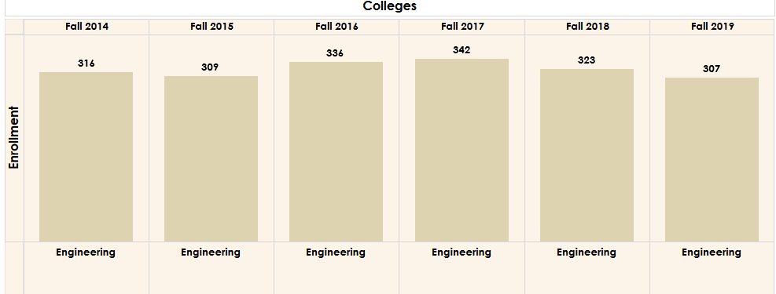
Enrollment

Slide 8
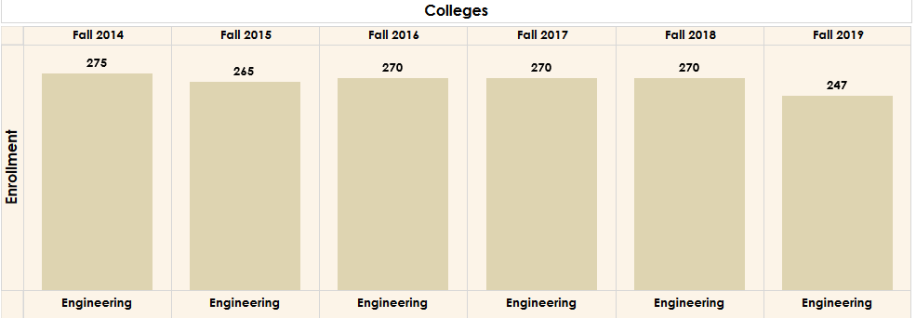
Enrollment UG EE and CPEG

Slide 9
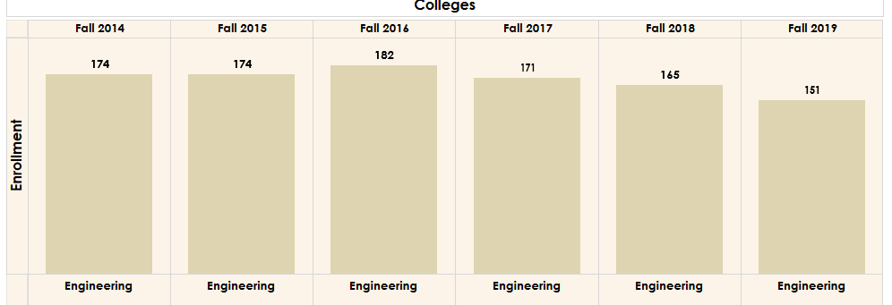
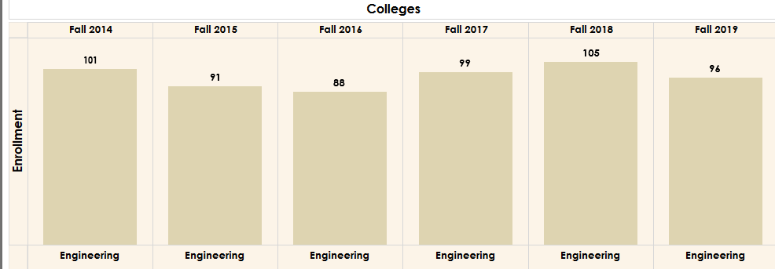
EE and CPEG Enrollment

Slide 10
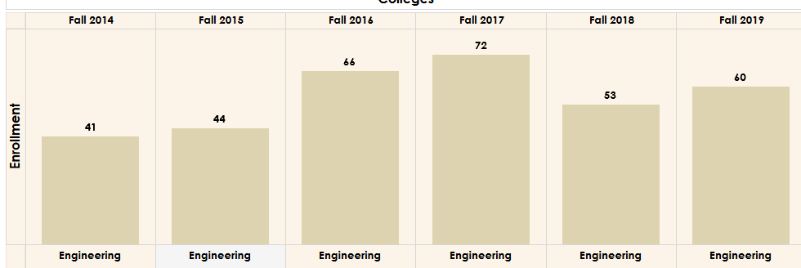
Graduate

Slide 11
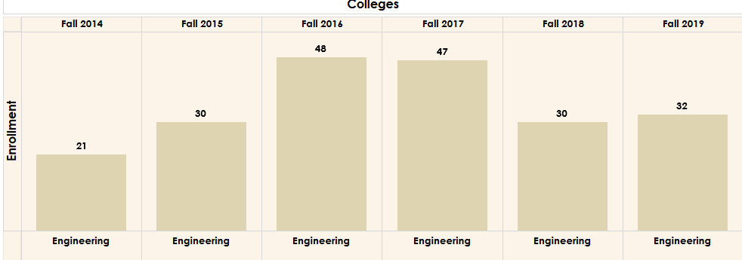
MS

Slide 12
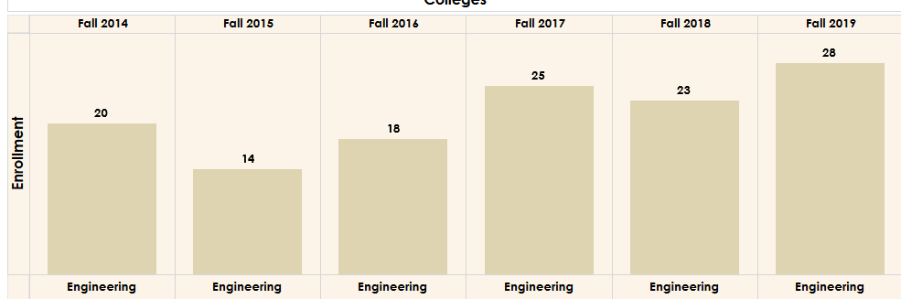
PhD

Slide 13
Graduation rates
Increased

Slide 14
Curriculum updates
Updates from Faculty

Slide 15
Open forum

