Slide 1
ECE IAB Meeting
Pamela Obiomon
April 27, 2018

Slide 2
Agenda
8:30 am Welcome from the Dean and Department Head
8:45 am Department Overview and Highlights
9:00 am Instructional programs and curriculum modifications
10:00 am Intel presentation
10:30 am - break
11:00 - 12pm: Board provides recommendations
12-1 pm - Lunch
1-2 pm – break
2- 5pm Senior Design Project Presentations

Slide 3
Welcome
New members
Vewiser Turner | ECE Faculty | Exxon Mobile (RET 35 yrs) Executive manager
Billy Dennie | Engineering Manager Modem Hardware Group—RTL Emulation | Intel
Frederick Davis | Compliance Manager | Goodman Manufacturing Co.
Dale Woodfork | Director Production Engineering & CAPEX Planning | Goodman Manufacturing Co.
Jessica Smith | Control Systems Engineer | Bechtel
Kameron Drawhorn | Campus Recruiting Team | Qualcomm

Slide 4
Enrollment

Slide 5
Degrees Awarded

Slide 6
Four core areas:
ECE Department has the ability to effectively address and solve many complex problems in:
  Communications and Signal Processing
  Computer Engineering
  Microelectronics
  Power Systems and Control

Slide 7
About US
Faculty
  22 faculty
    17 tenured and tenure-track (18 currently hiring)
    5 adjuncts
Staff
    Technician
    Administrative Assistants
    Position opening - 2nd Administrative Assistant

Slide 8
Faculty Expertise
The faculty has expertise, conducts research and is well published in cutting edge topics such as:
  Big data analytics
  Machine learning and artificial intelligence
  High performance computing
  Computational biology
  Cybersecurity
  Computer Networking
  Smart microgrid
  Smart sensing with FPGA based systems
  Space Radiation Effects on Electronics

Slide 9





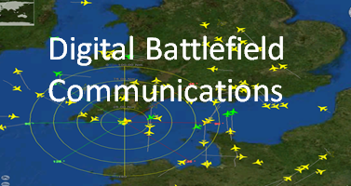
7 Research Centers

Slide 10
Research
7 Research Centers
9 Research Labs
  3 research scientists
  4 post-doctoral researchers
  23 PhD Graduate Research Assistants
  41 MSEE Graduate Research Assistants
  30 Undergraduate students
$24M in research funding over the past 5 yrs
240 Publications

Slide 11
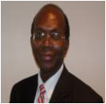
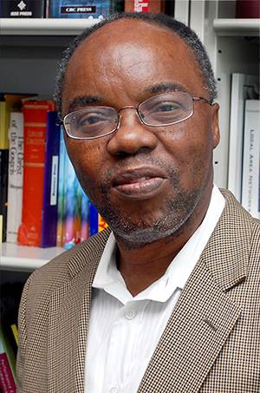
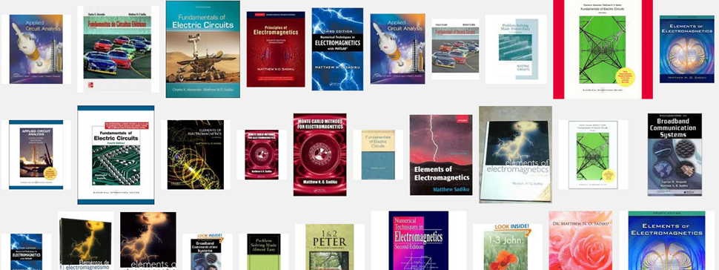
New book:
Circuits and Electronics
Two new books:
Powerful Quotes for Scientists and Engineers
Elements of Electromagnetics 7th Edition

Slide 12
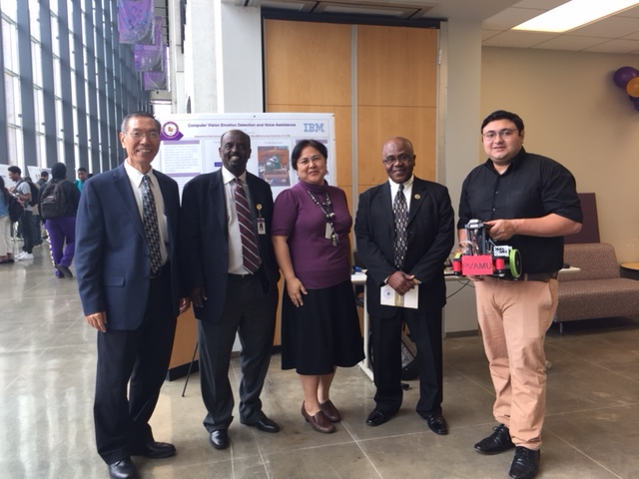
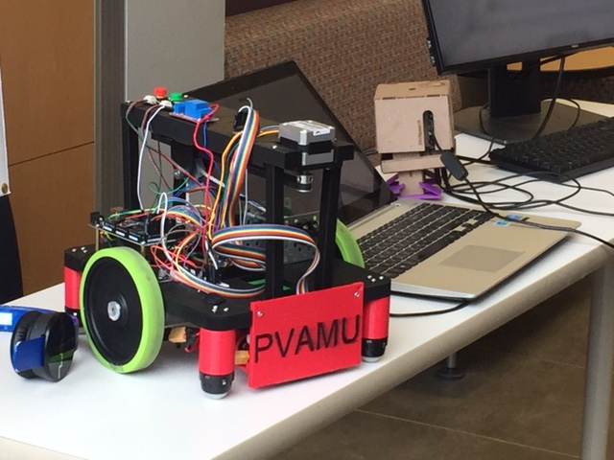
IEEE Competition

Slide 13
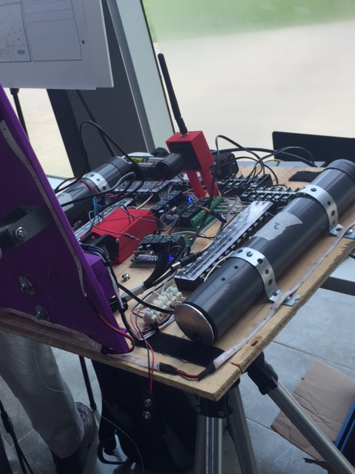
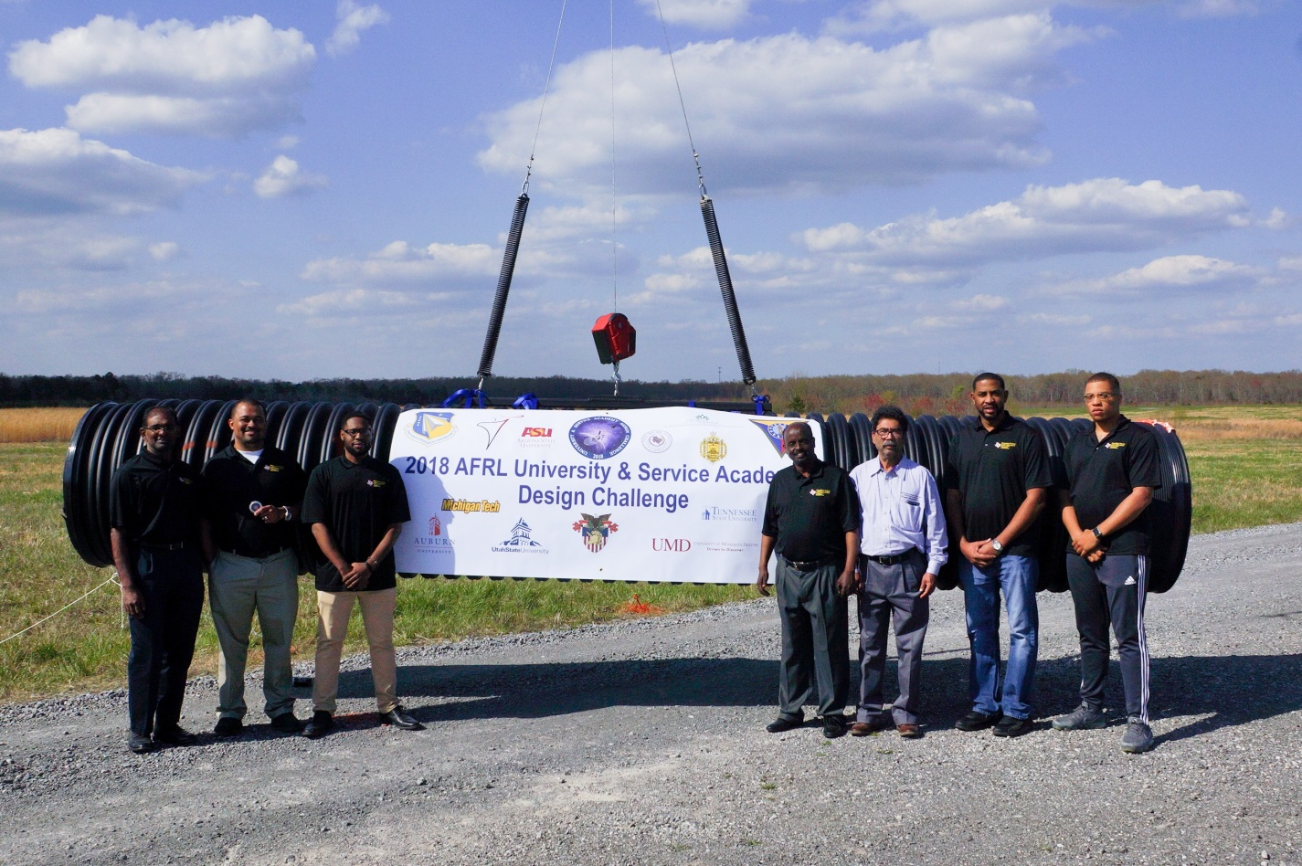
Airforce Competition

Slide 14

Equipment in Data Analytics and Computational Biology Centers

Slide 15
Curriculum Improvement
$600, 000 Intel – increase underrepresented minorities in ECE and Computer Scinece
  20 Scholarships
  Undergraduate REU program
  Develop Project-Based Courses at the Lower Level
  Develop Embedded Systems lab
  Faculty Development

Slide 16
Curriculum
Machine Learning Certification-(Fall 18)
New courses:
  ELEG 4001-Workplace Professionalism Skills for Engr Grads
  ELEG 4013 – Special Topic- Machine Learning
  ELEG 4363 - HPC
  ELEG 6713 - HPC
  ELEG 6193 - Modern Artificial Intelligence

Slide 17
Training
PLC programming (Fall and Spring Semester)
Python Training
HP- FPGA Training (April)
IBM Faculty Training - Machine Learning and Artificial Intelligence Basics (June)
Intel - FPGA Workshop (August)

Slide 18
Upcoming Events
Mission-Critical Big Data Analytics workshop (MCBDA 2018) May 16 and 17th
SUMMER CAMP 2018

