Slide 1
ECE Faculty Meeting
April 13, 2018

Slide 2
Agenda
Updates
Tenure-Track Faculty Hiring Needs of the Department
Program Review, April 15th
Presidential Inauguration, April 20th
IAB meeting April 27th
Taskstream
ABET Assessment Reports
Surveys

Slide 3
Updates
Dr. Cofie -Assistant Tenure Track Faculty (Fall 18)
Dr. Dong – Assistant Tenure Track Faculty (Fall 2018)
Machine Learning Certification-(Fall 18)
New courses:
  ELEG 4001-Workplace Professionalism Skills for Engr Grads
  ELEG 4363 - HPC
  ELEG 6713 - HPC
  ELEG 6193 - Modern Artificial Intelligence

Slide 4
Training and Development
Workshops
  IBM Training- Machine Learning Basics – May 14-16th
  Intel – FPGA training and course material for Digital Design, Embedded Systems and Computer Architechture

Slide 5
Updates
Special Topics
ELEG 6913 Rapid Prototyping with FPGAs
ELEG 6913- Emerging Internet -Based Technologies
ELEG 6913 – IT/Cybersecturity

Slide 6
Tenure-Track Faculty Hiring Needs
Discussion:
  Concentration Areas:
    Power? Power is the fastest growing unit
    Computer Engineering? – (NOTE: Dr. Dong Hired)
    Telecommunication and Signal Processing?
    Microelectronics?

Slide 7
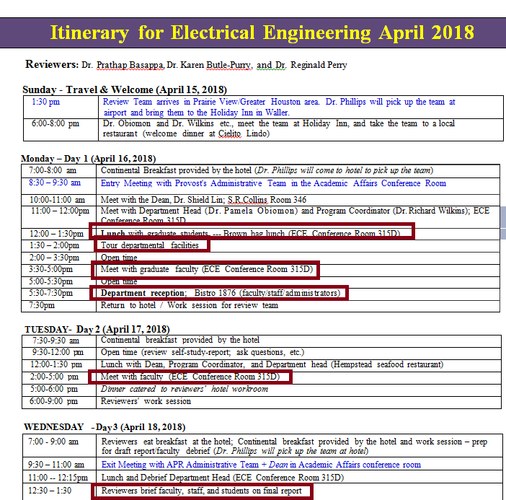
Program Review, April 15th

Slide 8
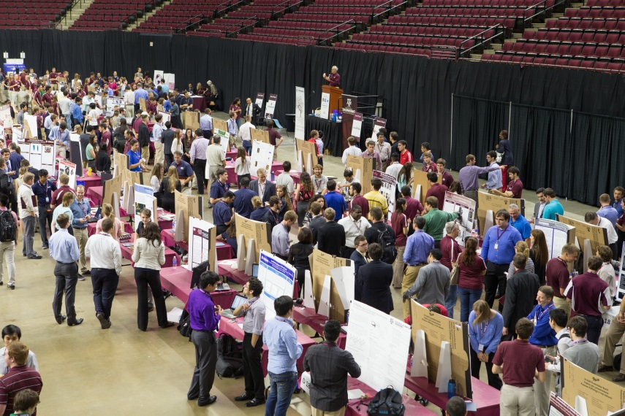
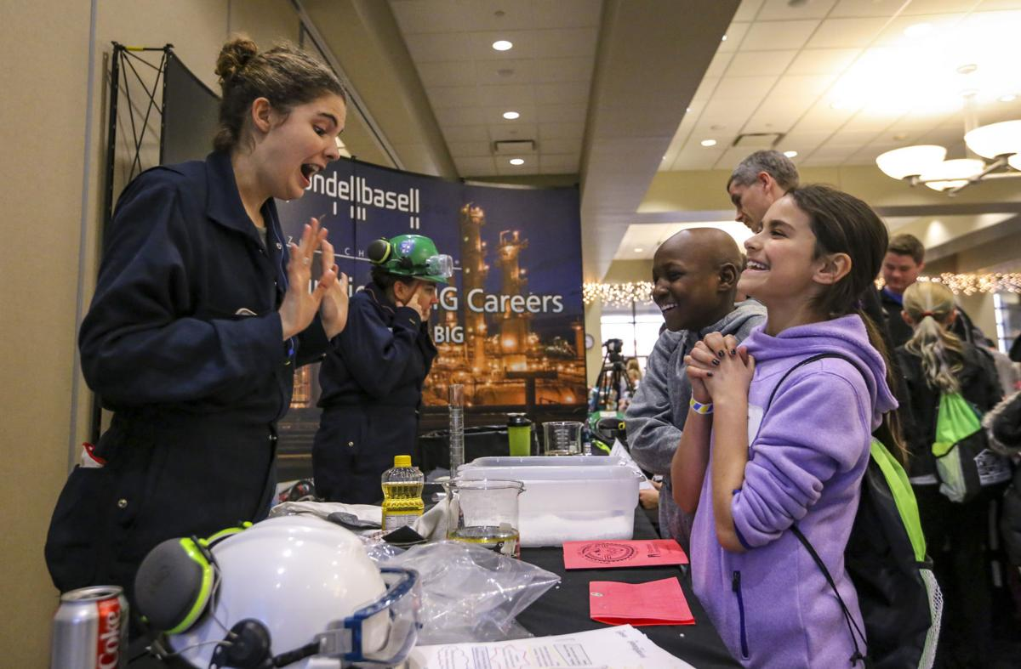
Presidential Inauguration, April 20th
Theme: Innovation: Engineers Solving Real-World Problems
  SUSTAINABILITY
  SECURITY
  HEALTH
  JOY OF LIVING
Link: Engineering Showcase Poster
IAB meeting April 27th

Slide 9
Announcements
IAB meeting April 27th
Taskstream
ABET Assessment Reports
Surveys

