Slide 1
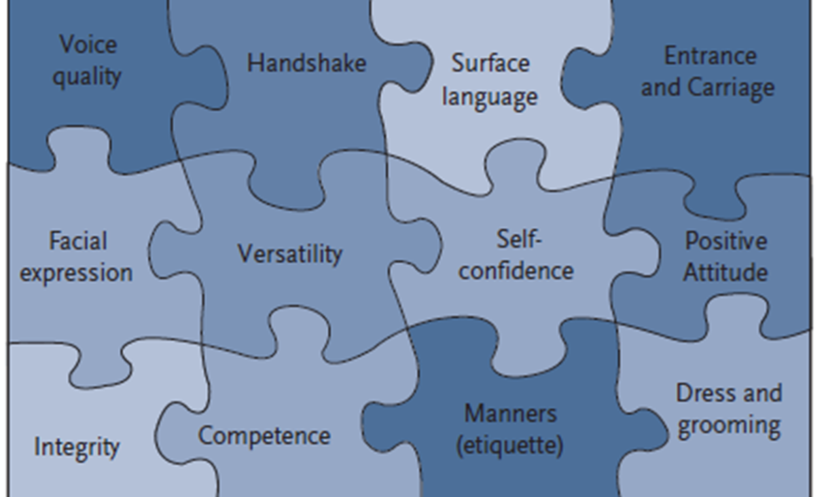
Good is not enough
The doors of Corporate America have opened wider than ever for minorities but the competition is brutal
Our students are “Technically “ as prepared and competent as any other
Career success is like a puzzle and often times minority students are never told of the pieces nor the inter connects
An Executive in a large corporation stated
“ I allow 3 to 4 minutes for a person to establish creditability. The three-part criterion is simple : appearance, communications skills, and value. If the appearance and the communications skills are poor then I have already stopped listening” .
We want our students to not only graduate but have successful careers
Prior ECE Advisory Board feedback is for more training on Professionalism type skills
Page 1

Slide 2

Proposed for Fall 2018 this new course offering in ECE
This course prepares students for a professional career in engineering upon graduation.
Students learn the keys to surviving in today’s challenging, competitive, and uncertain workplace.
The primary emphasis is on soft skills and expected workplace behaviors.
Exercises and activities in this class help students immediately apply concepts and materials for transitioning from the classroom to a workplace
Student Learning Outcomes
Understand the influence professionalism has on career success
Recognize the importance of making positive first impression
Gain knowledge of the impact communications has on career success
Review concepts and qualities of a successful leader
Explain various conflict management styles and appropriate use
Course : Workplace Professionalism Skills for Engineering Graduates
Credit Hours – 1
ECE Course number – ELEG 4001
Time : Wednesday 1:00 to 1:50pm
Summary of Topics
SELF-MANAGEMENT
Attitude and Goal Setting
Personal Financial Management
Time and Stress Management and Organization Skills
Etiquette/Dress
WORKPLACE BASICS
Ethics, Politics, and Diversity
Accountability and Workplace Relationships
Quality Organizations and Service
Human Resources and Policies
RELATIONSHIPS
Communications i.e. :
Verbal Communication and Listening
Non-Verbal Communication
Electronic Communications
Motivation, Leadership, and Teams
Conflict and Negotiation
CAREER PLANNING TOOLS
Job Search Skills
Résumé Package
Interview Techniques
Career Changes

