Slide 1


Prairie View A&M University
April 27th , 2018
IAB
#YoureWhatsNext
Notes:
John:
Welcome to an introduction to Intel. We are honored to have you here today. My name is John Zeiter , and these are my co-speakers Billy Dennie (Ann Bynum?) and Chris Siems. We are here to today to welcome you and make you think about the possibilities of a career at our great company. We hope by the end of your time with us today, you will consider not just a job but a career at Intel.

Slide 2

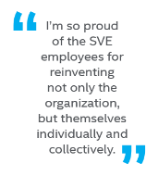
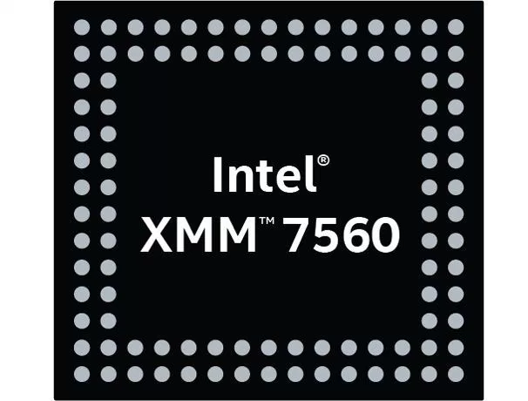
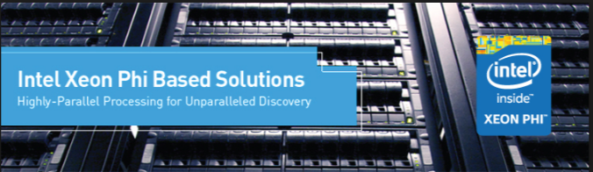
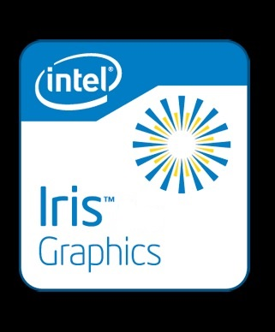
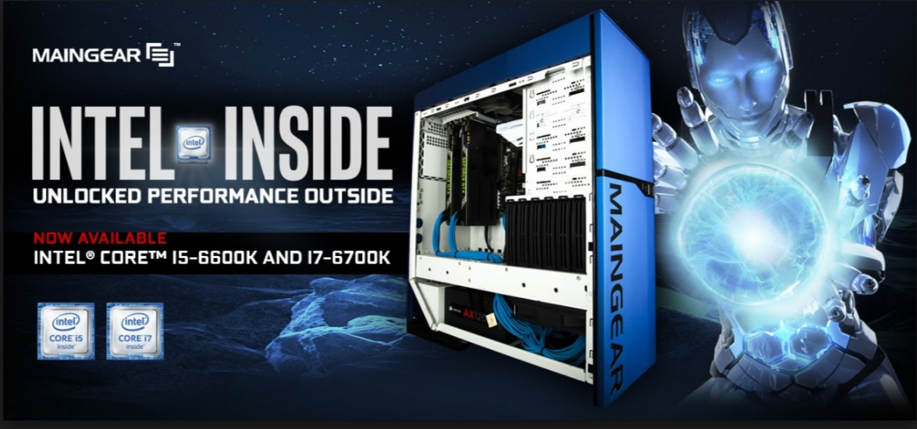
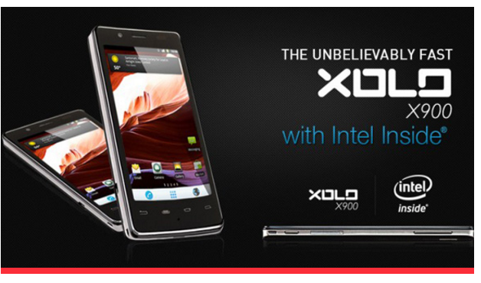




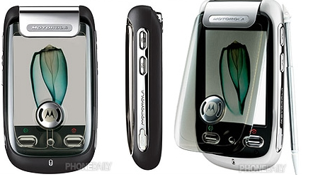

Billy J Dennie
INTEL COMMUNICATION AND DEVICES GROUP
Current Position: Director and Engineering Manager
Current Manager: Sven Engleitner |  | Intel Start Date: August 2000
Career Journey | Aspirations | Additional Information
2016:iCDG-PST Director PRE-Si Emulation Cellular Basebands | My Personal Mission: Inspiring Engineers to achieve their full potential in the process realizing value for Intel Focus: Delight our customers by ensuring Intel Si product quality and timely delivery, providing Pre-Si prototypes to accelerate HW&SW development and verification. Passions: Driving innovation and transformation in the computer industry to help Intel win and achieve the virtuous cycle of growth Life Purpose: A Servant leader with a love for God-People-Music!!! Proud Vincentian | IBLC Council member Austin ERG site leadership team Prairie View A&M Universit Industry Advisory Board NIA TX IBLC Rep.
2015 Intel IQA Winner!!
2015:PEG-director Engineering Manager
Pre-SI Emulation Server, Clients, GFX and Mobile SoC
201o: IAG SR Engineering Manager
PRE-SI Emulation ATOM Mobile SoCs
2008: IAG Staff Systems Engineer
OS-Based Validation AndrioD OS/ WinDows OS/SVOS
2006:CHG staff sw TME
Mobile Products
2000: CHG -os Software Engineer
Motorola A100
Notes:
2
Career objective
Education.

Slide 3
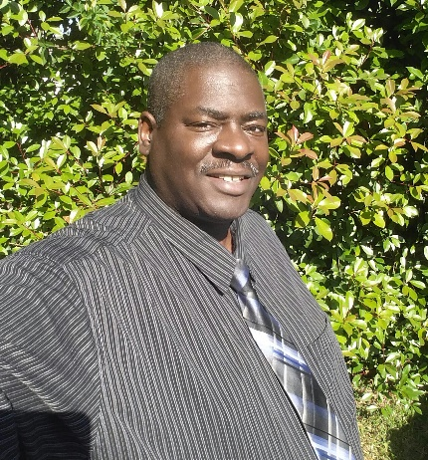


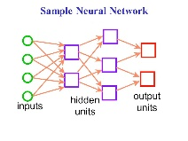
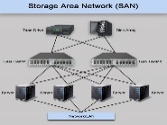




Everett Edgar
INTEL COMMUNICATION AND DEVICES GROUP
Current Position: Sr. Lead SoC Emu Eng
Current Manager: Billy Dennie |  | Intel Start Date: Dec 2016
Career Journey | Aspirations | Additional Information
2008-2015:CEO / Lead Consultant ASIC / FPGA design, Flow design, training | My Personal Mission: To inspire young people to pursue non-traditional yet rewarding careers such as Engineering and Aviation. To help INTEL create the next big THING… again! Focus: Continue to lead design teams in the successful completion of highly complex Si designs and to prototype those designs before silicon fabrication. This role saves customers millions. Passions: To be a shining example of to my colleagues and mentees as we lead INTEL in achieving the virtuous cycle of growth | MS-EE California State University, Long Beach (some course work at CalTech) Former member of NSBE-AP (AE-SVC) Board member of Bay Area Black Pilots Org. Mentoring three youth locally (Math, Science, Computers / Coding) INTEL NIA TX Member and significant contributor
2016-Now: Sr Lead Emulation Engr
High Perf. Modems
Education
2002-2008:Sr Lead SoC Er
More networks, LONs, Laser pringineenters, emulators
1998-2002: ASIC Eng’g Manager
Storage area networks, irda
1995-2000: Sr Eng - Cog Eng (ASIC)
Boards, complex CPUs, ASICs / FPGAs / Emulation (ikos)
1985-1995: Staff / Sr ENg
High Perf Computers, complex nwrks
Pre-1985: Inventer (Board Design)
Notes:
3
Career objective
Education.

Slide 4

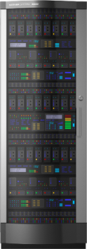
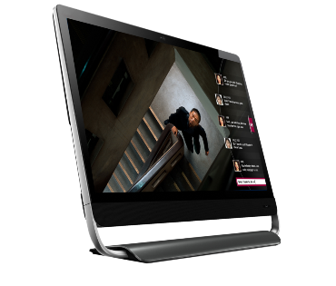
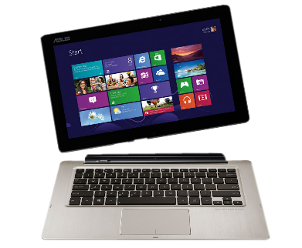
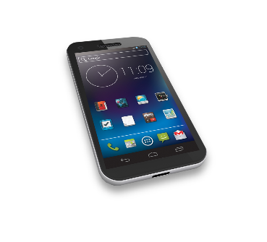

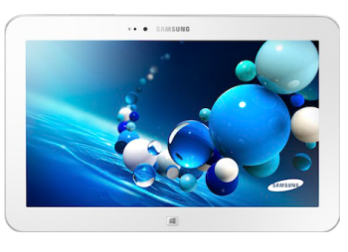

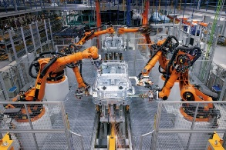

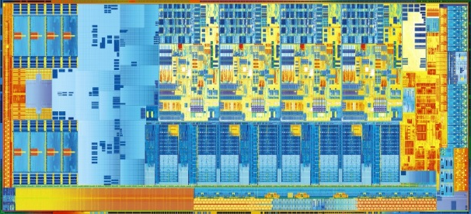
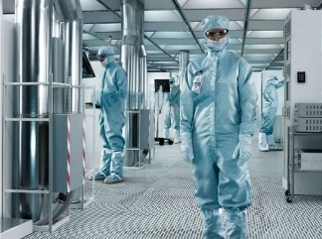

Intel’s Vision
If it is smart and connected, it is best with Intel.
Intel is evolving.
To a company that powers the data center
and billions of smart, connected devices
Server
Client
IoT
Notes:
Our vision is simple and direct. If it computes, it does it best with Intel. We embrace all aspects of computing. Our processors are inside a wide range of devices, from servers, PCs, tablets, phones, wearables, even in the Internet of Things. Intel provides a complete solution, with both hardware and software solutions for our users. Our goal is to continue growing in each segment and ensure that Intel technology remains the best choice and experience for each segment.

Slide 5
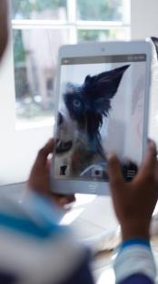




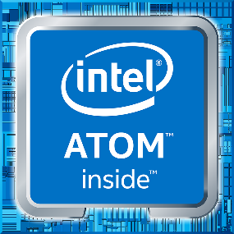
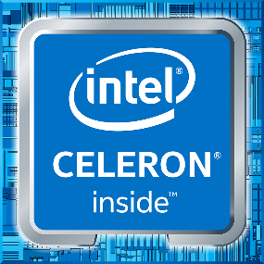

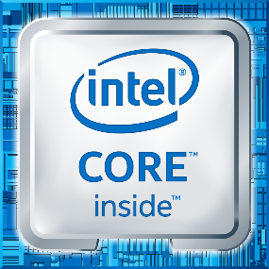
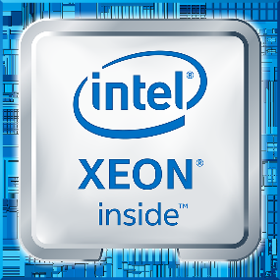
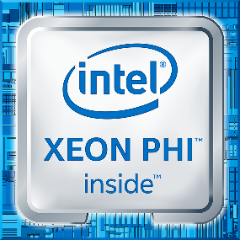
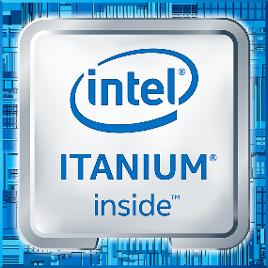
Intel delivers end to end solutions
New
Technologies
Memory
Solutions
Programmable
Solutions
Client
IOT
Data Center
Security
Notes:
From the things, into the network, and into the cloud… Intel is the only company whose solutions expand across these segments
To successfully serve market segments, we have developed a broad range of processors
We have several business units that focus on delivering solutions to our customers using our leading edge processors
Client Computing Group – focuses on delivering innovation to users through enhanced computing experiences based on Intel architecture-based products
Internet of Things Group – delivers the leading spectrum of solutions from things through gateway and network infrastructure to the cloud
Data Center Group - addresses the breadth of opportunity and diverse requirements of our increasingly digital world and provides foundational components across server, storage and network
New Technologies Group – heart of innovation at Intel with the goal to shape the future of computing through the strategies of enabling sensification, building new ecosystems, and fostering emerging customers. This group is comprised of Intel Labs, Perceptual Computing, New Devices Group, New Business Initiatives, and the Maker and Innovator Group.
Non-Volatile Memory Solutions Group – delivers cutting edge memory and storage solutions in client and server businesses using NAND, 3DNAND, SSD, and 3D Cross Point technologies
Intel Security Group - unites the previously disparate security groups under a single vision – to deliver universal security to individuals and business on all computing devices
Programmable Solutions Group – formerly Altera, focused on Field Programmable Gate Array (FPGA) technology delivery and implementation
Intel is unique because we can deliver solutions across these business units and produce integrated, complete results rather than segmented or partial solutions that only solve part of the customer’s issues.
As data drives the need for accelerated cloud build out and users become more and more reliant on the analytics that data will provide, the virtuous cycle becomes prevalent in our world. The power of Intel is our ability to transcend boundaries across our business units to collaborate and provide the most robust, innovative solutions
We have a very large software development organization; in fact if it was a separate company, it would be one of the largest in the world.

Slide 6
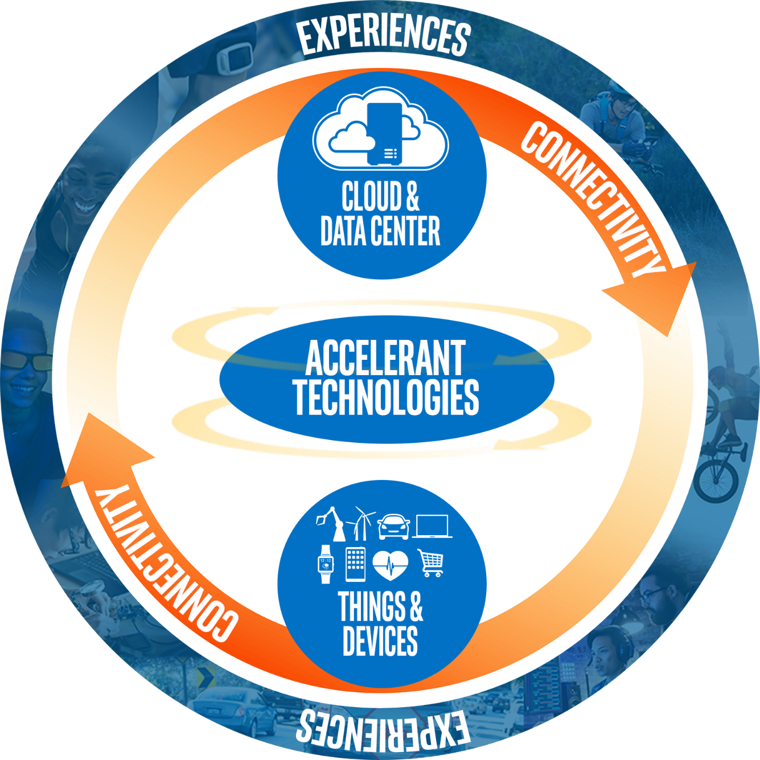
Virtuous Cycle of Growth: our technology drives experiences
Notes:
Why is this Virtuous Cycle of Growth so important?
As our world becomes smart and connected, no activity happens in isolation
The app on your phone, the turbine in jet, the building in the city, the shopping mall… all are connected to the cloud which gathers data, interprets the data, and provides valuable insights and enables services
This is happening across multiple products & industries: The car, the assembly line, the retail experience… all experiences are being dramatically improved by the cloud
By introducing accelerant technologies like Memory, FPGAs, Software, Security and others to this constant data cycle, its value increases greatly.
And for Intel… by providing integration across the elements of this virtuous cycle we are best positioned to create the best experiences possible. Our technology, driven by this cycle, gives rise to new, different, and exciting experiences for our customers.
And given market trends… there is a lot of excitement around what the future holds for Intel and the industry

Slide 7
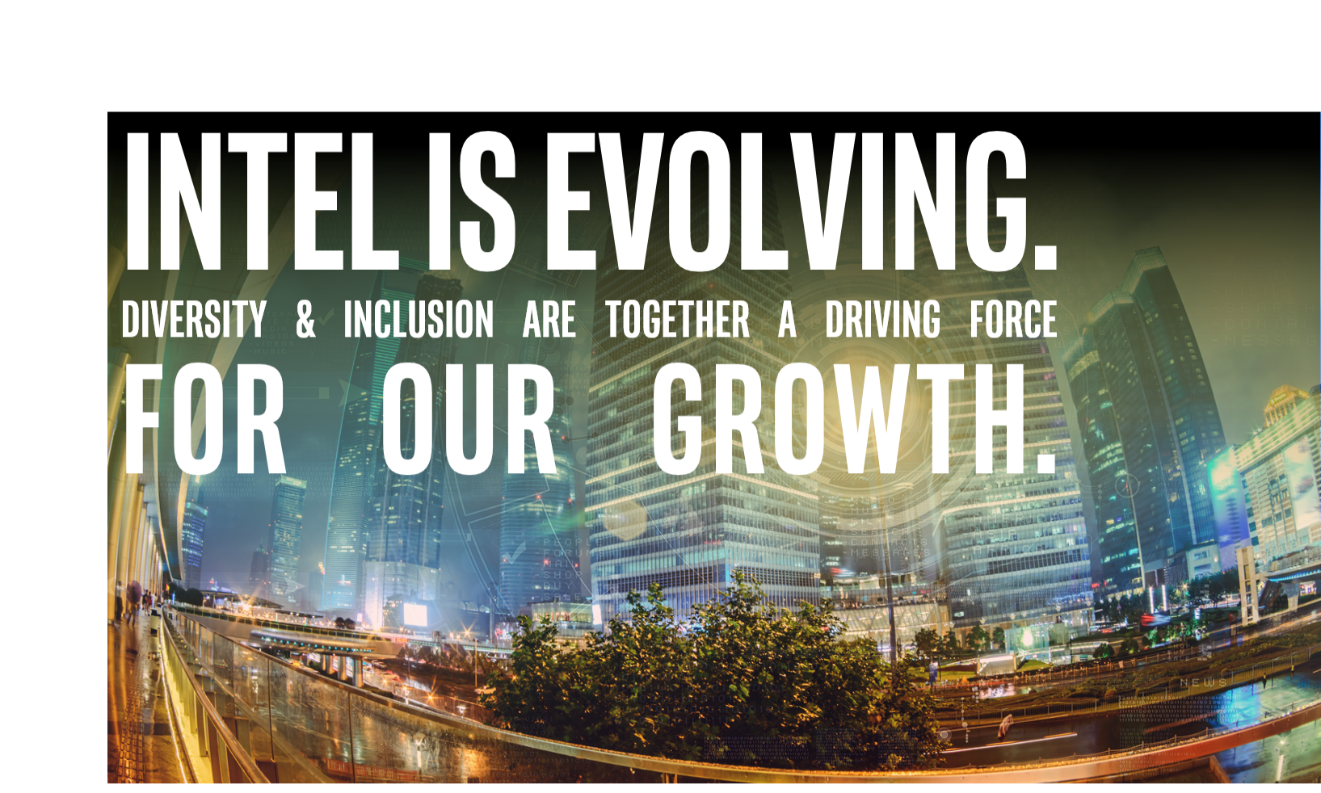

Intel Is Evolving.
Diversity & Inclusion Are together A Driving Force
for our GROWTH.
Notes:
Our Vision: Diversity Leadership
Intel’s vision is to become the high tech industry leader in diversity. Each employee’s unique perspective, experience, thoughts, and ideas contribute to our vision to help make our company what we are today.
We will continue to invest in our leadership position to maintain and advance diversity at Intel with the same determination that has brought the most powerful and revolutionary products to the planet, and we will not be satisfied until we’re the best in our industry.
“Without a workforce that more closely mirrors the population, we are missing opportunities, including not understanding and designing for our own customers.” BK

Slide 8
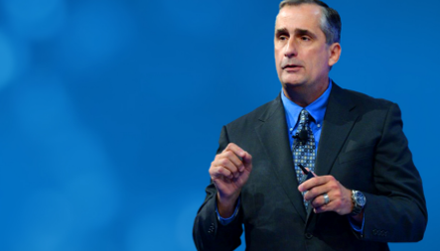
Role of Diversity
ROLE OF DIVERSITY & Inclusion
“We believe that creating a fully diverse and inclusive workplace is fundamental to how we deliver business results.
As technology and markets continue to evolve, building and growing a workforce that is fully representative of the customers we serve and communities in which we operate is paramount to our success”
- Brian Krzanich, CEO, Intel
Notes:
In January of this year, our CEO, Brian Krzanich, stood on stage at the biggest gathering of our industry in the world, the Consumer Electronics Show, and shared his vision for what diversity means for Intel. In his view, a fully diverse and inclusive workplace is fundamental to how we deliver results. That is powerful!
He set a bold goal to achieve full workforce representation by 2020. And he committed $300 million to fund programs that accelerate the work in diversity and inclusion for Intel and the tech industry at large.
Brian was the first CEO to set an aggressive goal in changing the face of his workforce in a defined period of time. He also invested substantially to make it happen. And he set Intel on a path that no other high tech company – and very few companies overall – have achieved in their lifetime.
Let’s talk about WHY Brian took this challenge, head-on…

Slide 9


Slide 10
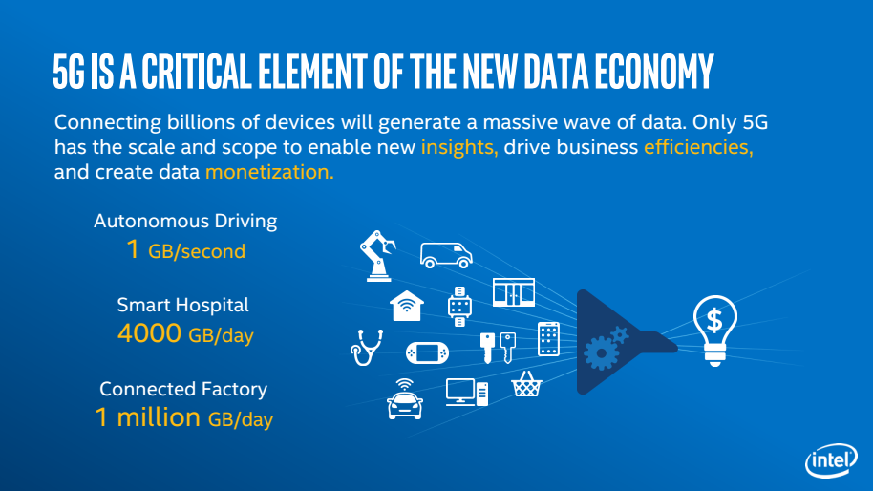

Slide 11
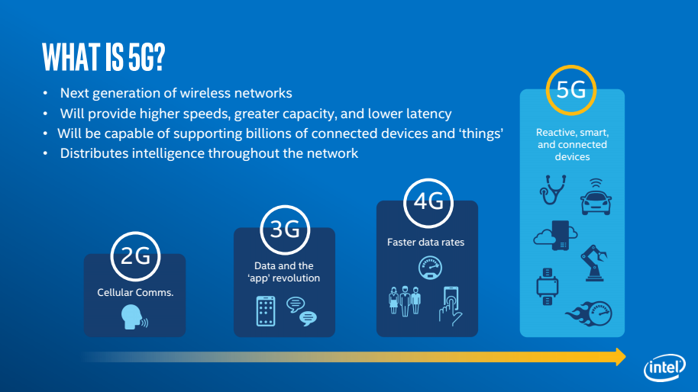

Slide 12
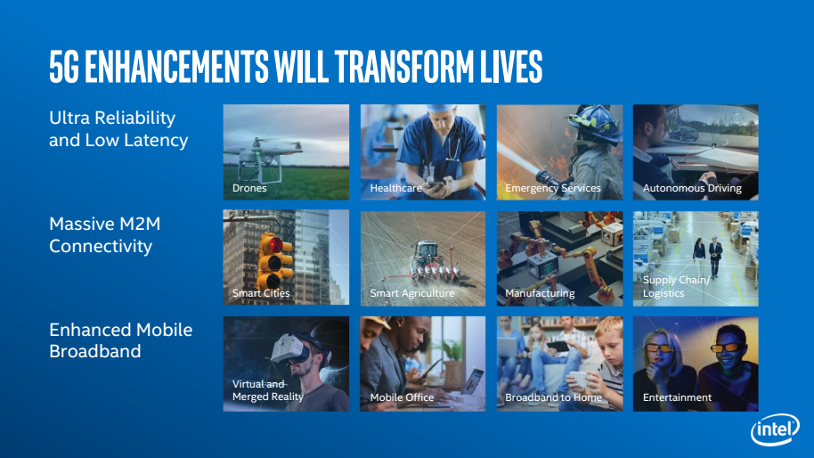

Slide 13
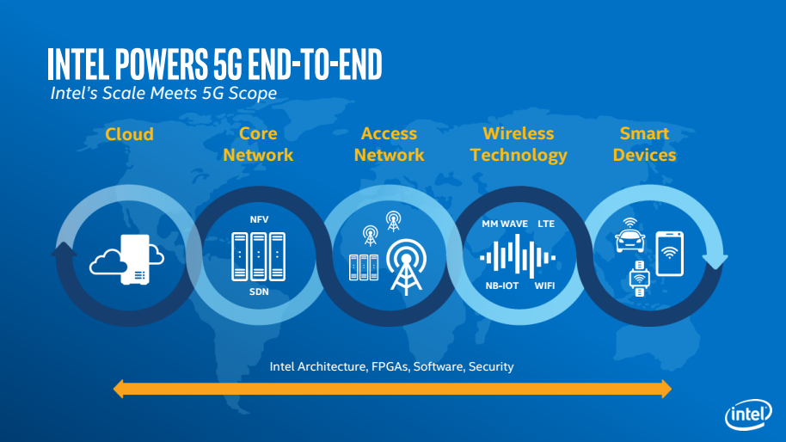

Slide 14
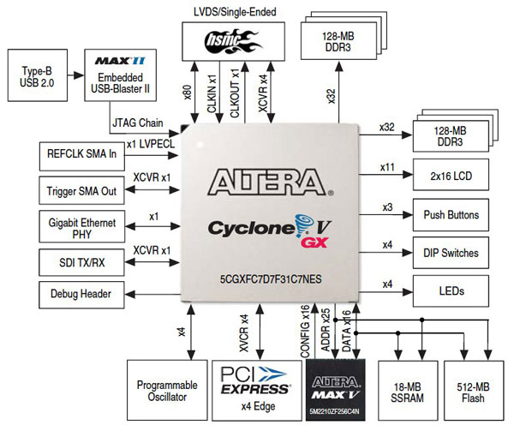
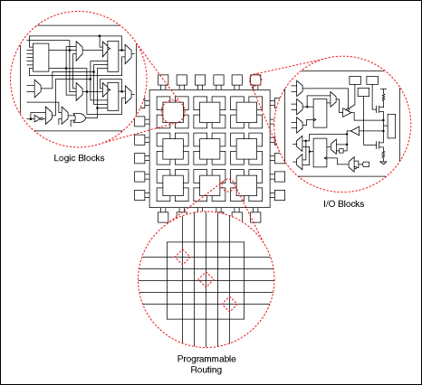
What is an FPGA?
FPGA = Field Programmable Gate Array
  Have all the logic and interconnect, the engineer selects the resources to use by compiling his/her RTL code and targeting the FPGA technology
  Circuitry can be changed easily (minutes)
  Excellent vehicle for prototyping and emulation
  They come with system resources like CPUs, Radios, and interfaces like PCIe, USB, SATA, LVDS,…
Challenges
  Are expensive per device so cannot replace SoCs for volume needs
  Resources are fixed, so some designs could exceed limits

Slide 15
What is Hardware Acceleration / Pre-Si Emulation:
Hardware Acceleration:
Provide a vehicle to “simulate” a systems of large designs faster than tool-based simulators
Acts on a model of the HW and SW (The original designs with minor alterations)
Can contain digital hardware designs and behavioral solutions
Requires less prep-work to be accelerated
Usually started during middle stages of Design and Verification
In addition to speed up, can observe and analyze interactions of the whole “system”
Hardware accelerators: ZeBu Enterprise Server, IKOS NSIM, Veloce, Tharas Hammer

Slide 16
Intel Global Student Center:
http://www.intel.com/content/www/us/en/jobs/student-center.html
Internships
ALP – Accelerated Leadership Programs
Rotation Programs
ELP – Engineering Leadership Programs
Additional information regarding: Job Alerts, Working at Intel and Jobs@Intel Blog

Slide 17
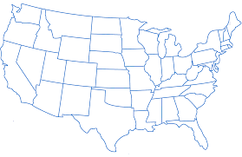
Intel is Looking For:
U.S. Sites
Bachelor, Master and PhD graduates
  Electrical Engineering
  Computer Engineering
  Computer Science
  Mechanical Engineering
  Chemical Engineering
Interns? Yes!!
  Summer and year-around opportunities
Hillsboro
Hudson
Folsom
Allentown
Santa Clara
Ft. Collins
Phoenix
Rio Rancho
San Diego
Austin

Slide 18

Q&A
Notes:
Speakers stand together at the front of the room, and answer questions from the audience.

Slide 20




We increased hiring of underrepresented minorities by 31% to a total of 11.8% in 2015
We exceeded our annual hiring goal, achieving 43.1% diverse hiring against a goal of 40%—up 1.8x hires over 2014.
Ambitious Goals, Amazing Progress: 2015 Annual Report
We increased our hiring of women by nearly 43% to a total of 35% in 2015.
Intel Discloses Diversity Data, Challenges Tech Industry To Follow Suit
Diversity in Tech: Intel's Diversity Report Shows Imperfect Progress, Sets a Standard for Depth and Transparency

Slide 21
Career Openings at Intel:
Engineering:
Networking, Wireless, Communications, Flash Memory, CPU, Chipsets, Motherboards, and more
Software:
Write code that gets used by millions of people around the world!
Information Technology:
Design and support Intel's information technology architecture
Sales & Marketing:
Develop and deploy world-class sales and marketing support
Notes:
Engineering
There are opportunities in networking, wireless communications, flash memory, chipsets, motherboards, and more.
Software
Write code that gets used by millions of people around the world! Intel is one of the few software companies that touch the entire software ecosystem.
Information Technology
Design and support Intel's information technology architecture, as well as hardware, software, Web and e-Commerce solutions.
Sales & Marketing
Develop and deploy sound strategies to provide world-class sales and marketing support at the OEM, developer and end-user levels

Slide 22

Barron’s. World’s Most Respected Companies
Corporate Knights. Global 100 Most Sustainable Corporations
Corporate Responsibility Magazine. 100 Best Corporate Citizens (17th year)
Diversity MBA magazine. 50 Out Front Best Places for Women & Diverse Managers to Work
Dow Jones’ Sustainability Indices. (Listed on North America & World Indices for 17th consecutive year)
Ethisphere Institute. 2016 World’s Most Ethical Companies
Forbes. World’s Most Reputable Companies & Most Valuable Brand (#17 - 2016)
Fortune magazine. Change the World List & World’s Most Admired Companies
FTSE Group. Listed on the FTSE4Good Index (15th year)
Gartner. Top 25 Supply Chains - 4th overall (global)
Human Rights Campaign. Corporate Equality Index (14th year)
Interbrand. Best Global Brands (#14 in 2015)
National Association of Female Executives. Top Companies for Executive Women
Newsweek. 2016 Top 500 Green Companies in America and the World
U.S. EPA’s 100% Green Power Users List and Sustained Excellence in Green Power Award
Working Mother magazine. 100 Best Companies for Working Mothers (U.S.)
Doing the Right
Things Right
Notes:
At Intel, we never stop looking for bold ideas in technology, business, manufacturing, and corporate responsibility. We strive to ignite imaginations and enable positive change, making people’s lives better and more interesting.
Third-party recognition gives us valuable feedback on our programs and practices, and helps drive continuous improvement over time. This list is a selection of recent awards and recognitions that Intel has received.

Slide 23



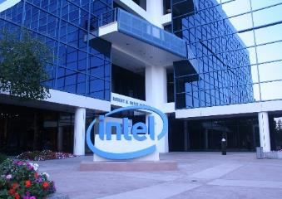
Our Journey So Far
Hiring
Progression
& Retention
Pipeline
Industry Leadership
Notes:
As I said before, Intel has taken a broad view of diversity and inclusion as a way to drive better business results and improve the tech industry overall.
Hiring, Progression and Retention are critical as we endeavor to have a workforce representative of the talent we need to hire and more reflective of the changing face of the country.
Grow the Tech Pipeline is all about investing in programs that will grow the student population in engineering and computer science. Those are the disciplines we need to keep our business vibrant and growing.
And Industry Leadership is about investing in diverse entrepreneurs, supporting women in gaming, and driving diversity in our global supply chain.
Let’s talk about each of these in some detail.

Slide 24
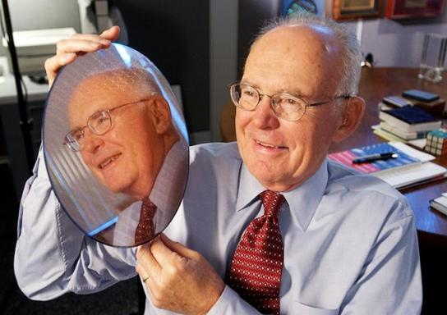
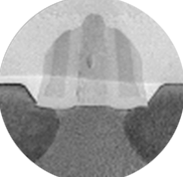
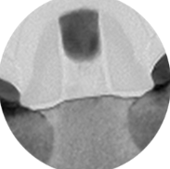
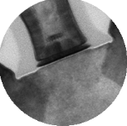
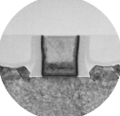


Executing to Moore’s Law
Enabling new devices with higher
functionality and complexity while
controlling power, cost, and size
Strained Silicon
Hi-K Metal Gate
3D Transistors
90 nm
65 nm
45 nm
32 nm
22 nm
14 nm
10 nm
7 nm
Notes:
As Gordon Moore predicted in 1965, increasing complexity of integrated circuits will result in a reduction in cost of transistors – the fundamental building block of the digital age – at a steady, exponential rate. This decrease in cost as well as transistor size has also led to dramatic increases in compute power and energy efficiency and transformed our world with ever-more powerful smart phones, tablets, personal computers and data centers. But Moore’s Law is not a scientific principle. Rather, it’s an observation of the pace at which the industry is able to deliver more computing functionality at ever lower cost. And almost from the very moment of Moore’s Law being posed and becoming understood, there has been speculation that it will someday end. Yet each time, Intel engineers have found a way to innovate, go past, around, and through perceived obstacles, using new materials and inventing new technologies along the way.

