Slide 1
ECE Bi-Weekly Faculty Meeting
November 17, 2017

Slide 2
Agenda
Updates
Registration
Office Hours
eCourse/Tasktream
Course Inventory
Senior Projects for next Fall
Budget (plans for hiring)
Challenges in ECE

Slide 3
Updates from last meeting
Space in SR Collins
SOP – still working
Spring 2018 Courses – rolled out
Homecoming Open House - good
Giving Campaign 75% participation
Taskstream – EE avail. CPEG next week
Summer Contracts – continue to plan
Fall 2018 Courses – starting to plan

Slide 4
Updates Academic Affairs , Business and Graduate offices
One Graduation Dec. 16 start at 10am
Office hours posted- need spread sheet
Grade sheets from each class must be kept
Document Retention : Shred (1998-2006)
Fall 2018 – GRE no longer required

Slide 5
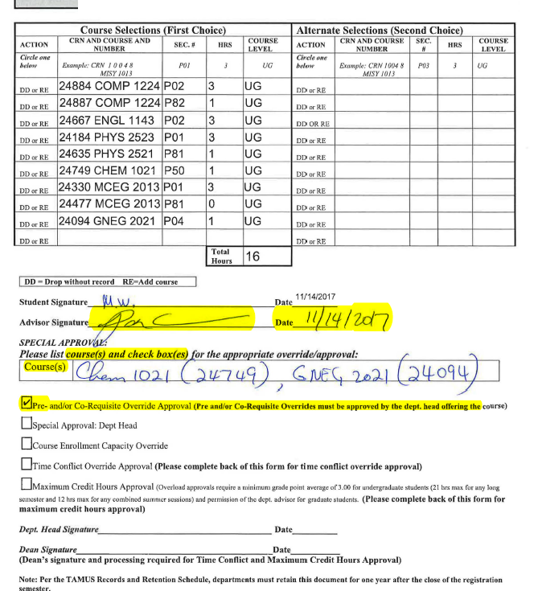
Registration
PIN Request (face to face or online)
No Pins for Continuing Graduate Students
Coordinators will give missing PINs
Overrides (100% online)
  Chem and Phys overrides
  Math has a new admin

Slide 6
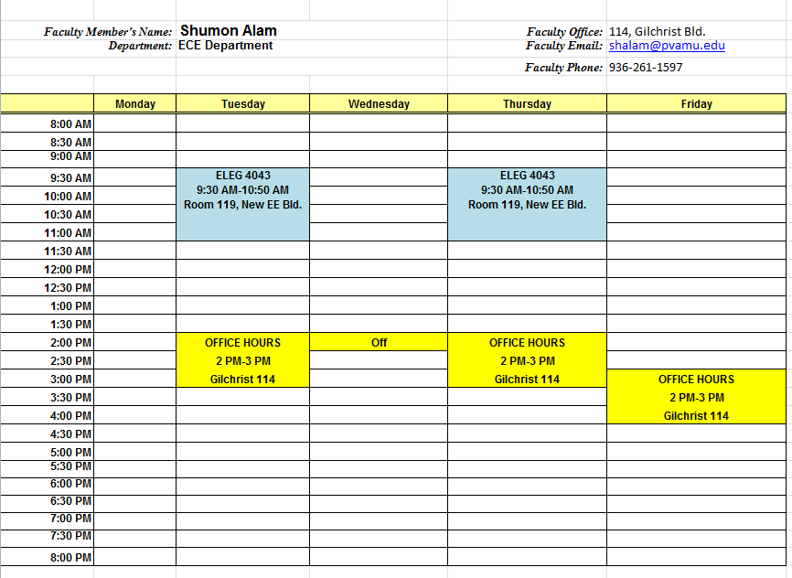
Office Hours
Dept must maintain a Spreadsheet
  Send me an email

Slide 7
Course Inventory
January and February meeting
ELEG 4001
ELEG 4331
ELEG 2XX3
ELEG 2XX3

Slide 8
Senior Projects for next Fall
Please submit now to the professors

Slide 9
Budget
2 Instructors -2018
1 Tenure Track - 2019

Slide 10
Challenges in ECE
Support
GAT hiring

