Slide 1
ECE Faculty Meeting
October 20, 2017
Pamela Obiomon

Slide 2
Agenda
Updates
Space in SR Collins
Standard Operating Procedure Manual (SOP)
Homecoming Open House
Giving Campaign
Taskstream
Spring 2018 Courses
Fall 2018 Courses
Summer Contracts
Academic Advising – for Priority Registration
Deadlines

Slide 3

Updates
Graduate Coordinator- Dr. Wilkins
  Graduate Council Meeting
Undergraduate Coordinator- Dr. Kirby
  Degree audits complete- comments sent to faculty.
  My Degree works Training next Friday at 12-1pm
  New Office Hour Policy

Slide 4
Space in SR Collins- Kureshi
Riaz took a group over to look at the Space and equipment.

Slide 5
Standard Operating Procedure Manual
Committee Members:
  Kirby
  Cui
  Annamalai
  Foreman
Committee met and delivered the 1st draft
  Faculty will be able to review after editing next week

Slide 6

Homecoming Open House
Saturday , October 27, 2017
After the parade which starts at 9:00am

Slide 7

Faculty and Staff Giving Campaign
link: Donate to the Electrical and Computer Engineering.
The ECE account number is 552082.
Thanks to those who have already donated !!
Your gift is on its way.
Thanks to those who are considering donating!

Slide 8
Taskstream
Students should be uploading assignments in eCourse now
Faculty should evaluate
  Last year about 4 faculty members completed the tasks

Slide 9
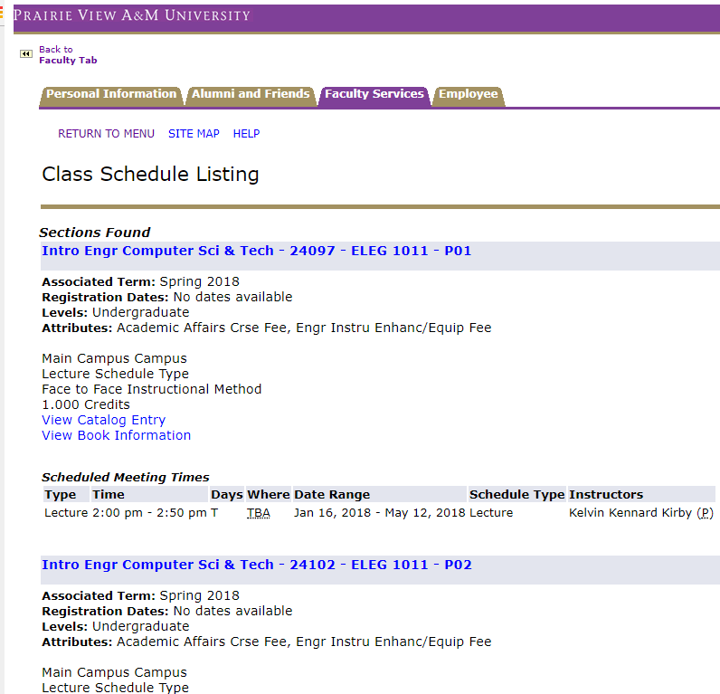
Spring Courses
Faculty can view Spring 2018 courses in PantherTracks
  Review and give feedback as soon as possible
  Students will view Nov 4th
Visit PantherTracks

Slide 10
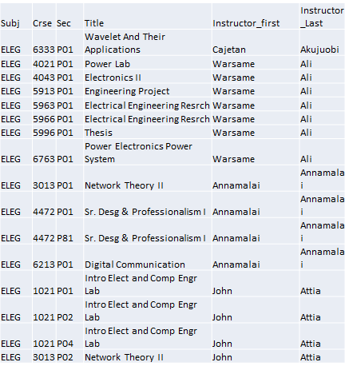
Fall 2018 Courses
Preparing Fall 2018 Courses
Please submit courses you would like to teach.
Course inventory available on Faculty Resource website.
See Handout

Slide 11
Summer Contracts
Start preparing for summer research and summer contracts
  1st Call Oct
  2nd Call February

Slide 12
Academic Advising for Priority Registration
November 4th – students are able to see schedule
PINs should be available
  proposal to eliminate PINs
Office hours should be posted

Slide 13
Deadlines
Midterm Grades Posted – Tues, Oct 24
Graduate Student Deadlines
October 23, Last day to Defend the Thesis/Project/Dissertation
Nov 3, Deadline for Thesis, Project and Dissertation Draft to be submitted to the Department
Nov 27, Deadline to submit bound Thesis/ Dissertation
Nov 27, Submit IP Grades
Dec 16 Commencement

