Slide 1
Faculty Meeting
October 6, 2017

Slide 2
Agenda
Updates
Spring Schedule
  Special Topics
  Research Courses
  Faculty Assignments
Standard Operating Procedures Manual (SOP)
Critical Deadlines

Slide 3
Update from Coordinators
Undergraduate – Dr. Kirby
  Labs
Graduate – Dr. Wilkins
  New forms from Graduate School
  MSEE is 30 hours for both the Project and Thesis

Slide 4
Updates
Prairie View A&M University - Faculty Workload Policy Manual
  Workload Requirements PVAMU has established a minimum contact hour teaching load of 12 hours (Graduate and/or Undergraduate) for tenured or tenure-track faculty; and, 15 hours for non-tenure track faculty. Teaching loads above or below the established minimum must be explained in official reports submitted to the Office of Institutional Research & Effectiveness. PVAMU has established a maximum teaching workload of 18 contact hours per semester for all full-time faculty. ➢ PVAMU has established a maximum teaching workload of 6 contact hours per semester for all adjunct or part-time faculty.
PVAMU Faculty Workload Policy Manual

Slide 5
College of Engineering Workload Policy
9 teaching + 3 additional duties is our College of Engineering practice.
  18 total teaching hours for Fall and Spring
Additional Duties approved by the College
  EE Undergraduate Coordinator
  CPEG Undergraduate Coordinator
  Graduate Coordinator
  Freshman Coordinator
  ABET Coordinator
  EE Curriculum Coordinator
  CPEG Curriculum Coordinator
  See the PVAMU Faculty Workload Policy Manual for additional duties
  *SACS Coordinator
  *Transfer Coordinator
  *5YR MS BS Coordinator

Slide 6
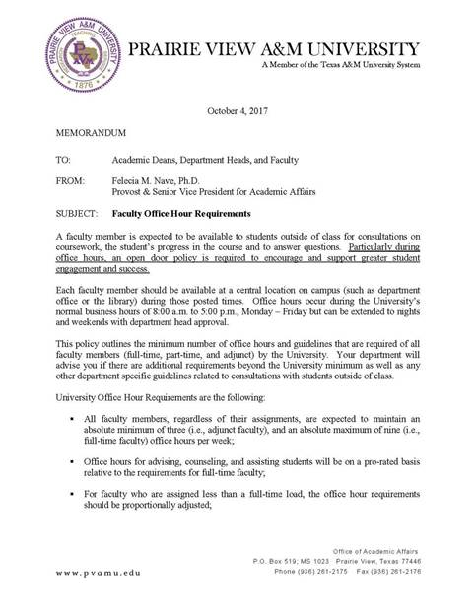
Office Hour Requirements
On campus
Normal business hours (8-5pm)
Min. of 3 office hours (adjuncts included)
Max of 9 for full-time faculty
Office hours for advising, counseling and assisting students will be on a prorated basis.

Slide 7
Changes to deadlines for Participation in Commencement and Degree Conferral
The deadline for applying to graduate and participate in the commencement ceremony will be October 13, 2017
After that date, students will be allowed to apply for degree conferral through December 5, 2017; however, they will not qualify to participate in the commencement ceremony
Students who missed the deadline to participate in commencement, can have until the last day of each semester to request to have their degree conferred.

Slide 8
Updates Cont.
Dean approved usage of space in SR Collins- equipment similar to ours

Slide 9
SOP
Roy G. Perry College of Engineering
Department of Electrical and Computer Engineering
Standard Operating Procedures Manual
At Prairie View A&M University
Date
October 13, 2017
The purpose of this document is to provide faculty and staff with a reference manual containing policies and procedures established for the department.
Need a Committee

Slide 10
Mission Statement
PVAMU Mission Statement
ECE Purpose and Goals in Catalog align with ABET objectives
ECE Mission Statement on Website

Slide 11
Spring Schedule
Currently building the schedule –Tuesday, October 10th
    Monday, Nov 6th students can view- advising can start
    Early Registration Begin Tues, Nov 14th
Special Topic Courses have been removed
  Special Topics Request Form
  Syllabus University HB2504 Template
Independent Study courses
  Independent Study Request Form
Research courses
  complete form emailed to you
Faculty Assignments

Slide 12
Impt Dates October
Attendance reporting in Panther Tracks – Oct 6
2nd wave of TAs start Oct 16 – few buyouts
Post Attendance Dates thru Oct 6
Homecoming Open House
Midterms, Thur, Oct 19^{th -} required if on syllabus
All Thesis/Dissertation defense complete, Mon Oct 23

Slide 13
November
Priority Registration. Nov 14
Surveys to classes, Nov 14
Ensure SOS is posted in Nov in eCourse
1 Week after Thanksgiving to lecture
Dec 4-5 Review Days

Slide 14
Links
PVAMU Faculty Workload Policy Manual
Course Inventory –Course Inventory Form
Special Topics- Special Topics Request Form Syllabus University HB2504 Template
Independent Study courses – Independent Study Request Form
Deadlines- Academic Calendars
ECE Deadlines for Graduate Students

