Slide 1
Faculty Meeting Notes
September 22, 2017

Slide 2
Agenda
Updates
eCourse
Degree Audits
Spring Courses
Curriculum and Course Inventory Changes
Critical Deadlines

Slide 3
Lab Presentation by Riaz Kureshi
Meeting NOTES: Problem – Lab Instructors are allowing student to leave the labs disorganized.
  Lab instructors should ensure that the labs are clean before leaving each lab.
  Riaz will email a lab presentation that should be presented to the students each semester. The presentation will also include the safety material.
  The lab safety material should be updated. Information is on the page that does not apply to ECE.
  The lab instructors should lock the labs each time after use after 5 pm.
  ECE will hire student workers to keep the computer lab in room 125 open with the same hours as the library.
  The lab printer will be placed in the server room outside of the computer lab.
  Students will have a limit to print. After a limit is reached it will be 5 cents per printed page.

Slide 4
Space and Room Issues
Meeting notes:
Engineering Technology has two very large rooms that ECE may be able to occupy. Dr. Kirby will check on the space for senior design before someone outside of the college gets it.
ECE should claim the space as soon as possible.
ECE needs 2 to 4 rooms.
ECE will check to see if Distance Learning has Laptops for students to use in the C++ class.
Senior Design has 58 students.
ECE will investigate if the Success Center can be used for senior design. The students may be able to keep projects in the lockers.
ELEG 1011 no longer needs room 137 it will be open.

Slide 5
Undergraduate Coordinator
4.0 program off to a good start
43 courses taught
1,218 students in the classes
SUMMARY BY APPLICANT STATUS
Student Type | Lvl | Col | Major | Inquired | Applied | Admitted | Enrolled
Freshmen | UG | EN | Computer Engineering | 167 | 78 | 66 | 19
Freshmen | UG | EN | Electrical Engineering | 158 | 77 | 55 | 13

Slide 6
Intel Grant $650K for ECE and Comp Sci
ECE – Lead received $350,000
  5 Juniors Intel Scholars ($100K)
  5 Intel Scholars 5yr BS/MS Program ($100K)
  5 Undergraduate Researchers ($47.5K)
  Lab equipment for Embedded Systems ($35K )
  Equipment for project-based lower level courses($25K)

Slide 7
Graduate Coordinator
Meeting Notes:
There are new graduate forms.
ECE needs a new faculty member for Power.
Power is the most concentration area now.
PhD review is coming spring of 2017. Dr. Wilkins may be asking for written qualifying exams.
30 Graduate Courses Taught
156 students in all classes
New forms coming.
SUMMARY BY APPLICANT STATUS
Student Type | Lvl | Col | Major | Inquired | Applied | Admitted | Enrolled
Masters | GR | EN | Electrical Engineering | 39 | 21 | 19 | 15
Masters | GR | EN | Electrical Engineering-Ph.D. | 2 | 0 | 0 | 0
Doctoral | DR | EN | Electrical Engineering-Ph.D. | 11 | 8 | 6 | 3

Slide 8
FA17 Courses
74 courses and labs
1,374 students in classes
 | CRN | Subj | Crse | Sec | Title | Instructor | Enrolled
1 | 10035 | ELEG | 1011 | P01 | Intro Engr Computer Sci & Tech | Kelvin Kirby | 19
2 | 10110 | ELEG | 1011 | P02 | Intro Engr Computer Sci & Tech | Kelvin Kirby | 20
3 | 10122 | ELEG | 1011 | P03 | Intro Engr Computer Sci & Tech | Kelvin Kirby | 18
4 | 10147 | ELEG | 1021 | P01 | Intro Elect and Comp Engr Lab | John Attia | 21
5 | 10157 | ELEG | 1021 | P02 | Intro Elect and Comp Engr Lab | John Attia | 22
6 | 10165 | ELEG | 1021 | P03 | Intro Elect and Comp Engr Lab | Mahamadou Tembely | 18
7 | 13151 | ELEG | 1021 | P04 | Intro Elect and Comp Engr Lab | Mahamadou Tembely | 21
8 | 10182 | ELEG | 1043 | P01 | Comp. Appl. in Engr. | Kelvin Kirby | 48
9 | 10194 | ELEG | 1043 | P02 | Comp. Appl. in Engr. | Kelvin Kirby | 47
10 | 10217 | ELEG | 1043 | P03 | Comp. Appl. in Engr. | Kelvin Kirby | 44
11 | 10223 | ELEG | 1043 | P04 | Comp. Appl. in Engr. | Justin Foreman | 43
12 | 13829 | ELEG | 1043 | P05 | Comp. Appl. in Engr. | Ramesh Dwivedi | 42
13 | 14484 | ELEG | 1043 | P06 | Comp. Appl. in Engr. | Penrose Cofie | 13
14 | 13830 | ELEG | 1043 | P81 | Comp. Appl. in Engr. | Kelvin Kirby | 48
15 | 13832 | ELEG | 1043 | P82 | Comp. Appl. in Engr. | Kelvin Kirby | 47
16 | 10253 | ELEG | 1043 | P83 | Comp. Appl. in Engr. | Kelvin Kirby | 44
17 | 10261 | ELEG | 1043 | P84 | Comp. Appl. in Engr. | Justin Foreman | 43

Slide 9
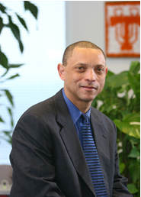
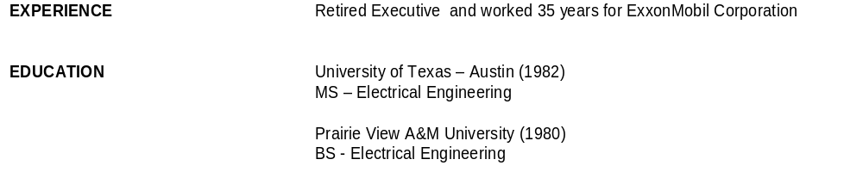
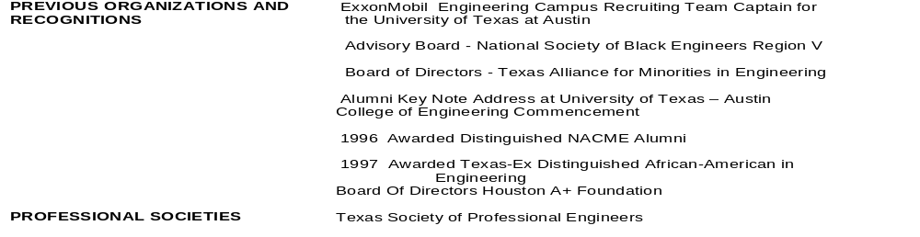
About the Instructor
Vewiser (V.J.) Turner Jr, P.E.
During my career at ExxonMobil I have managed associates all over the world. I’ve led teams with staff members in the United States, Canada, Brazil, Argentina, Singapore, Malaysia and Europe.
It’s been my observation that early job success is vital to long term career growth and development.
The topics covered in this course will help jumpstart student awareness of what it takes and how to be successful when they enter the workplace.
In my opinion these are skills that students need exposure and awareness just like their technical training.
Meeting notes:
Looking forward to having our EE Alumni, Mr. Vewiser Turner as a part of the Department. He will 1) teach our student how to have careers in engineering and not just jobs and 2) teach a Special Topics course on Engineering Professionalism and Ethics.
He will also play a role as an industry representative and work with our Alumni.
The faculty will review the final course description of the Special Topics class in the next meeting and decide if this should be a technical elective or regular Special Topics course.
Will the class be open to sophomores as well?
We will consult Mr. Turner to see if he would like to add technical content to the class so that it can be used as a technical elective.

Slide 10

Coming Spring 2018 new course offering in ECE Department
For Senior Students about to enter the workplace
Background and Objectives
Prepares students for their first professional job, providing career planning tools, expected behaviors, and soft skills essential for career success.
Ample exercises and activities help students immediately apply
concepts and materials for transitioning from the classroom to a work environment.
Three pillars for professional success–life planning, workplace skills, and career planning–are emphasized throughout.
Students learn to connect personal, professional, and financial goals and understand how these goals ultimately contribute to career success through the creation of a life plan that addresses short- and long-term personal, professional/career, and financial goals.
Recognizing that attitude, communication, and human relations are the keys to surviving in today’s challenging, competitive, and uncertain workplace, students will develop practical human relations skills with a primary emphasis on soft skills and expected workplace behaviors.
Provided detailed career planning tools that focus on job search strategies, résumé package development, and interview techniques.
Course Title – Workplace Professionalism
Credit Hours – TBD
ECE Course number - TBD

Slide 11

eCourse
Meeting Notes:
All ECE courses should be on eCourse.
The student Opinion Survey should be moved to the 3rd week in November.
In all ECE classes, an assignment should be added forcing students to complete the survey (see sample below.
Dr. Obiomon will send a tutorial.

Slide 12
Degree Audits
Student Name | Degc
Alsup, Damon | BSEE
Gilbert, Terry | BSEE
Liggins, Brittany | BSEE
Ali, Abdikarim | MSEE
Ali, Shukri | MSEE
Alli, Joshua | MSEE
Eno-Ibanga, Aniekan | MSEE
Ivory, Stephen | MSEE
James, Adeiah | MSEE
Khatri, Ishan | MSEE
Murillo, Ludwig | MSEE
Olokodana, Ibrahim | MSEE
Paladugu, Sasmitha | MSEE
Sobayo, Remilekun | MSEE
Zhai, Lujun | MSEE
Zhang, Yan | PHEE
Meeting notes:
Degree Audits are due Monday, October 2, 2017.
The deadline for students to submit an application for the Fall graduation had passed.
Any students who missed the deadline now has to re-apply for graduation in the Spring.

Slide 13
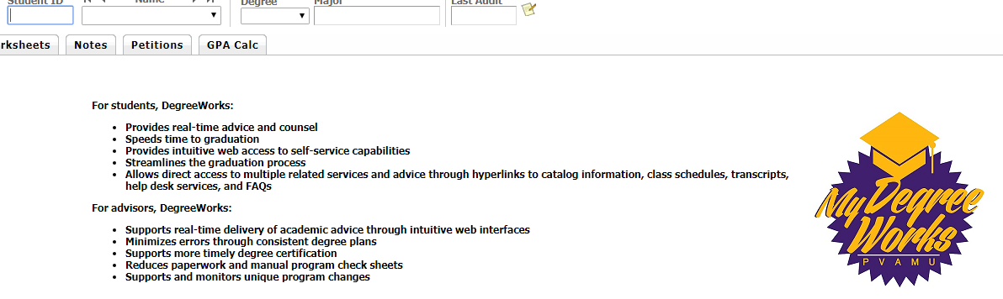
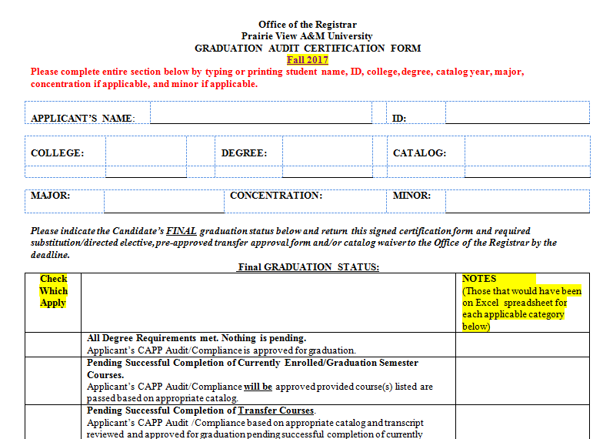
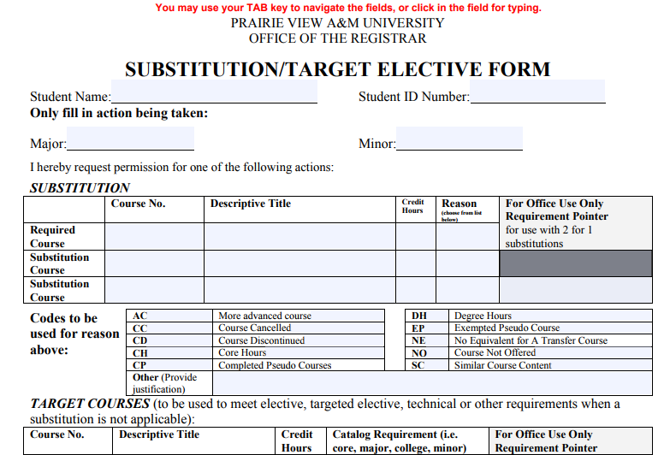
Undergraduates
Meeting notes:
Forms required from advisors for undergraduate degree audits due Monday, October 2, 2017.
My Degree works printed
All substitution forms completed by the advisor and signed by the student and advisor.
Completed Certification form.

Slide 14
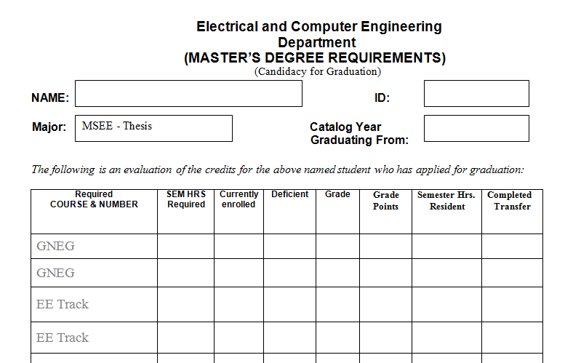
Graduate Forms for a Degree Audit
Meeting notes:
Forms required from advisors for graduate degree audits due Monday, October 2, 2017.
Graduate Degree Audit form found on ECE Website
Completed Certification form.

Slide 15
Spring Courses
Meeting notes:
Proposed spring courses handed out
Some faculty submitted course to be taught
Dr. Obiomon will send out a request for additional courses such as thesis, special topics etc. by next week.
Student begin priority registration , November 14, 2017. All courses need to be posted before the end of October.
Dr. Wilkins mentioned a need for more graduate level Microelectronics courses to be offered this Spring.
Subj | Crse | Sec | Title | Instructor Assignment | Spring 2017 Enrolled
ELEG | 2053 | P04 | Intro Electrical Engineering | Abburi Kumar | 22
ELEG | 4482 | P81 | Sr Desgn & Professionalism II | Annamalai Annamalai | 37
ELEG | 6303 | P01 | Signal Det Estimation | Annamalai Annamalai | 5
ELEG | 2023 | P02 | Network Theory I | Charlie Tolliver | 18
ELEG | 2053 | P01 | Intro Electrical Engineering | Charlie Tolliver | 30
ELEG | 2053 | P02 | Intro Electrical Engineering | Charlie Tolliver | 16
ELEG | 1021 | P01 | Intro Elect and Comp Engr Lab | John Attia | 26
ELEG | 1021 | P03 | Intro Elect and Comp Engr Lab | John Attia
ELEG | 3043 | P01 | Electronics I | John Attia | 52
ELEG | 6423 | P01 | VLSI and ULSI Design | John Attia | 9
ELEG | 2011 | P01 | Electric Circuits Lab | John Fuller | 17
ELEG | 2023 | P01 | Network Theory I | John Fuller | 13
ELEG | 1043 | P01 | Comp. Appl. in Engr. | Justin Foreman | 22
ELEG | 1043 | P81 | Comp. Appl. in Engr. | Justin Foreman | 22
ELEG | 1011 | P01 | Intro Engr Computer Sci & Tech | Kelvin Kirby | 25
ELEG | 1011 | P05 | Intro Engr Computer Sci & Tech | Kelvin Kirby
ELEG | 1011 | P06 | Intro Engr Computer Sci & Tech | Kelvin Kirby
ELEG | 1043 | P02 | Comp. Appl. in Engr. | Kelvin Kirby | 31
ELEG | 1043 | P04 | Comp. Appl. in Engr. | Kelvin Kirby | 37
ELEG | 1043 | P05 | Comp. Appl. in Engr. | Kelvin Kirby
ELEG | 1043 | P82 | Comp. Appl. in Engr. | Kelvin Kirby | 31
ELEG | 1043 | P84 | Comp. Appl. in Engr. | Kelvin Kirby | 37
ELEG | 6021 | P01 | Graduate Seminar II | Lijun Qian | 10
ELEG | 4011 | P01 | Electronics Lab | Mahamadou Tembely | 44
ELEG | 3023 | P02 | Signals And Systems | Matthew Sadiku | 34

Slide 16
Course Inventory Changes
Lower-Level computing courses
Logic Circuits to lower-level?
Meeting notes:
Dr. Obiomon will be re-submitting the project based lower-level courses again this year.
Several faculty members have made a request to move Logic Circuits a lower-level courses
ECE faculty will discuss course inventory changes in more detail at the next meeting.

Slide 17
Deadlines
20-Sep | Deadline to Apply Late for Fall 2017 Graduation
 | Wednesday
20-Sep | Deadline for Undergraduate Graduating Students for Fall 2017 to submit Application for Tuition Rebate
 | Wednesday
Sep 21 - Nov 06 | Withdrawal from Courses with Academic Records (“W”) Period
 | Thursday through Monday
2-Oct | 20th Class Day
 | Monday
Oct 19 - Oct 21 | Mid-Semester Examination Period
 | Thursday through Saturday
24-Oct | Mid-Semester Grades Due
 | Tuesday
7-Nov | 60% of Term
 | Tuesday
Nov 14 - Jan 10 | Priority Registration Period for Spring 2018 semester
 | Tuesday through Wednesday
17-Nov | Deadline to Apply for Spring 2018 Graduation
 | Friday
Nov 23 - Nov 25 | Thanksgiving Holiday (University Closed)
 | Thursday through Saturday
27-Nov | Classes Resume
 | Monday

