Slide 1
Faculty Meeting
August 7, 2017

Slide 2
Agenda
Faculty Update
Summer contracts
Fall schedule
Graduate Coordinator
Office Help
Fall Deadlines
Next Meeting

Slide 3
Faculty
This fall enrollment is up 9,500 students and 2,200 Freshmen.
Retention is still very important (advising).
  May get rid of PINs
  Academic Advising- Mr. Tanner handle students with 2.5 and below, time conflict and course overloads
Graduate Program Review
  See how we manage graduate students
  Looking at the infrastructure of the program
Thesis cannot be submitted to the Dean’s office the day before it is due to the graduate school

Slide 4
Summer Contract
Need to be in by April 1.
Budget equires Provost signature for all contracts.

Slide 5
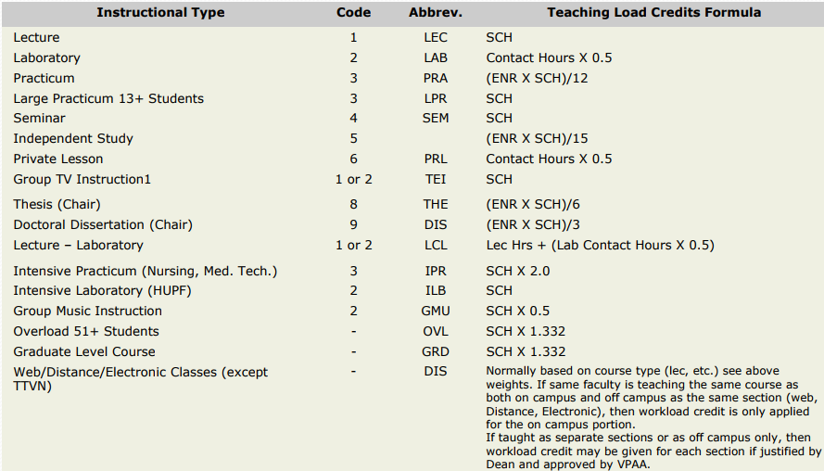
Fall Course Assignments
Workload 9-10 hours (10 if grad courses)
Buyouts early -

Slide 6
Graduate Coordinator
Course Inventory changes
Non-MSEE students can obtain MSEE degree when prelims fail.

Slide 7
Administrative Help
Mrs. Harris
Work study
Graduate Student
Mrs. Wedeking (Qian and Kim)
Submit a request at front desk appropriate routing.

Slide 8
Important Dates
Aug 8, Submit IPs
Aug 18, Guaranteed 4.0 program (9-5pm) – FA17 Freshman class
August 19, Graduate School Orientation
August 21, University Faculty Conference MSC
August 21, Small class reports due (<10 grad. And <15 undergrad)
August 23, Faculty Retreat
August 24, HB2504 syllabi posted
August 24-26, Regular Registration
August 24, New Faculty Orientation
August 28, First day of class
August 28, 2017 Faculty Prerequisite Verification due
August 28- Sept 2 Late registration and Add/drop period
August 31, Ruth is having a reception at the Hilton America in Houston

Slide 9
Calendar Continued
September 6, Student Assembly, release at 9:30 am- resume noon
Sept 11, Career Fair
Sept 13 no more changes (adding students to classes) to classes
Sept 22: Deadline for Graduate students to Apply for Thesis/Dissertation Defense
Oct- One time –bonus cost of living increase (no longer get Merit raises)
Oct 2: Deadline PhD EE students Register for Preliminary Exam
Oct 19-Oct 21, Midterm Exams
October 23, Last day to Defend the Thesis/Project/Dissertation
October 27, Preliminary Exam Test Date

Slide 10
Nov 3, Deadline for Thesis Draft routed to Graduate School
Nov 14-Jan 10, Priority Registration New Course Titles (ELEG to ENGR)
Nov 23-25, Thanksgiving Holiday
Nov 27, Deadline to submit bound Thesis/ Dissertation
Nov 27, Submit IP Grades
Dec 6 Final exam Period
Dec 16 Commencement
Dec 19 Final grades due
Spring 2018 – New Course Titles (ELEG to ENGR)
Spring 2018 Updates to Tenure and Promotion Manual
Spring 2018 MSEE and PhD EE reviewed

Slide 11
Next meeting
Every two weeks.

