Slide 1
IAB Meeting
April 28, 2017

Slide 2
Today’s Schedule
8:30am Welcome
8:45am Highlights
9:00 am Instructional Programs
9:45am Department Goals (12 mth and 3 yr)
10:30am Break
11-12pm Board Recommendations
12-1pm Lunch
1-2pm Break
2-5pm Senior Design Presentations

Slide 3
Welcome Board Members
MEMBERS |  | TITLE | COMPANY
Mr. Roderick | Crowder | Faculty and Chair, Engineering, Richland College | Richland College
Mr. Royle | King | Program Manager | Raytheon
Mrs. Shannon | Booty | Sr. Principal Systems Engineer | Raytheon
Mr. Russell | Carter | Team Lead NTDD | CenterPoint Energy
Jimmie | Finister | Engineering Manager | GE Oil & Gas
Mr. William | Fisher | Plant Manager | DuPont
Mrs. Shirley | Holland-Hunt | Business Manager | NASA
Mr. Gerald | Miles | Technical Manager | Pico Technologies LLC
Mr. Anthony | Sanders | Manager | Sandia Laboratories
Ms. Gayla | Spivey | Electronics Engineer Outreach & Diversity Program Manager | U.S. Army Aviation & Missile Research, Development, and Engineering Center
Mr. Saint | St. Julian | Senior Council | Raytheon
Mr. Jarin | Varkey | Manager | Shell

Slide 4
Highlights

Slide 5
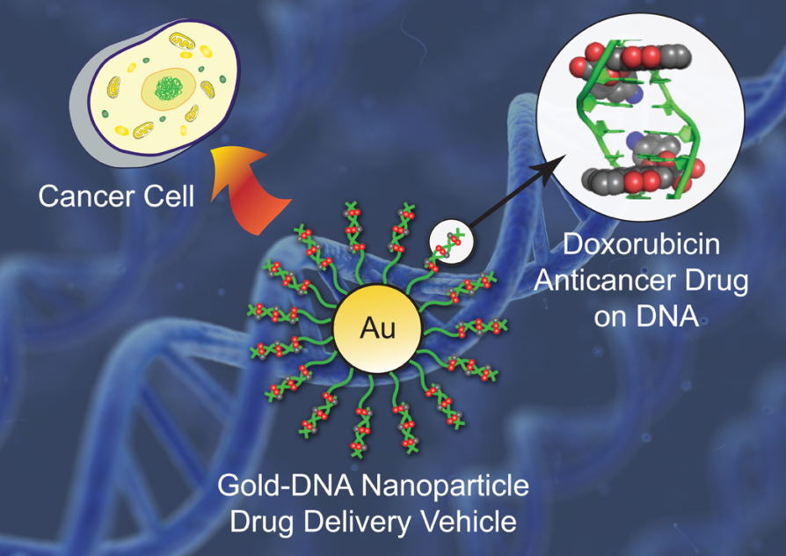


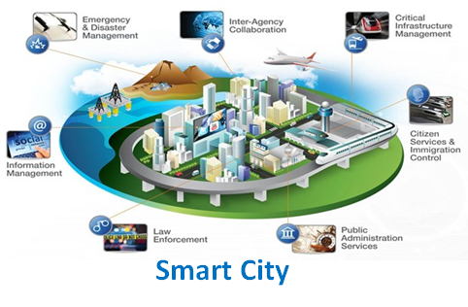
The ECE Department at Prairie View A&M University is tackling some of the world's biggest problems.

Slide 6
4 Programs in ECE
BS Electrical Engineering
BS Computer Engineering
MSEE Electrical Engineering
PhD Electrical Engineering

Slide 7
Four core areas:
Communications and Signal Processing
Computer Engineering
Microelectronics
Power Systems and Control

Slide 8
About US
19 faculty, 2 research scientists, 4 post-doctoral researchers, 22 P.hD. , 42 master and 300 undergraduate students and 2 staff members.
7 Research Centers
9 Research Labs
$24M in research funding

Slide 9
Faculty Expertise
The faculty has expertise, conducts research and is well published in cutting edge topics such as:
  Big data analytics
  Machine learning and artificial intelligence
  High performance computing
  Computational biology
  Cybersecurity
  Computer Networking
  Smart microgrid
  Smart sensing with FPGA based systems
  Space Radiation Effects on Electronics

Slide 10





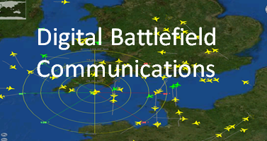
7 Research Centers

Slide 11
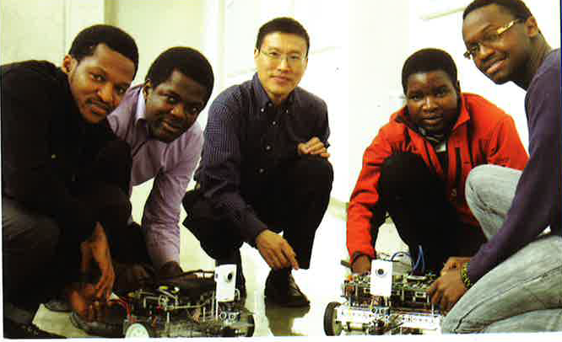
Center of excellence in Research and Education for big military Data InTelligence (CREDIT)
5 faculty members
4 post docs
5 PhD students
12 MS students
20 Undergraduate students

Slide 12
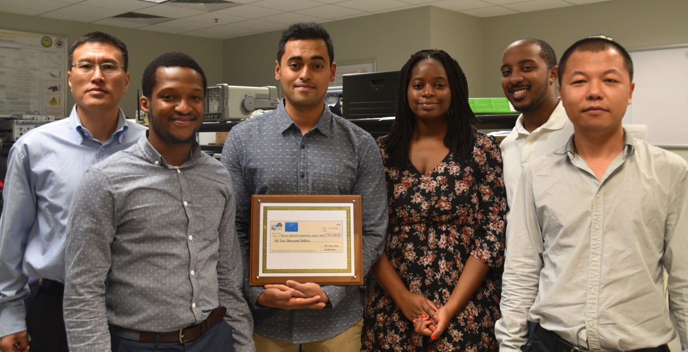
The student team of the CREDIT Center won the CyberC 2016 IEEE Big Data Analytics Competition organized by the IEEE Big Data Initiative held in Chengdu, China, on Oct 13-14, 2016

Slide 13
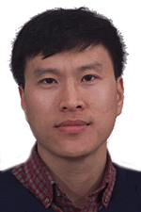

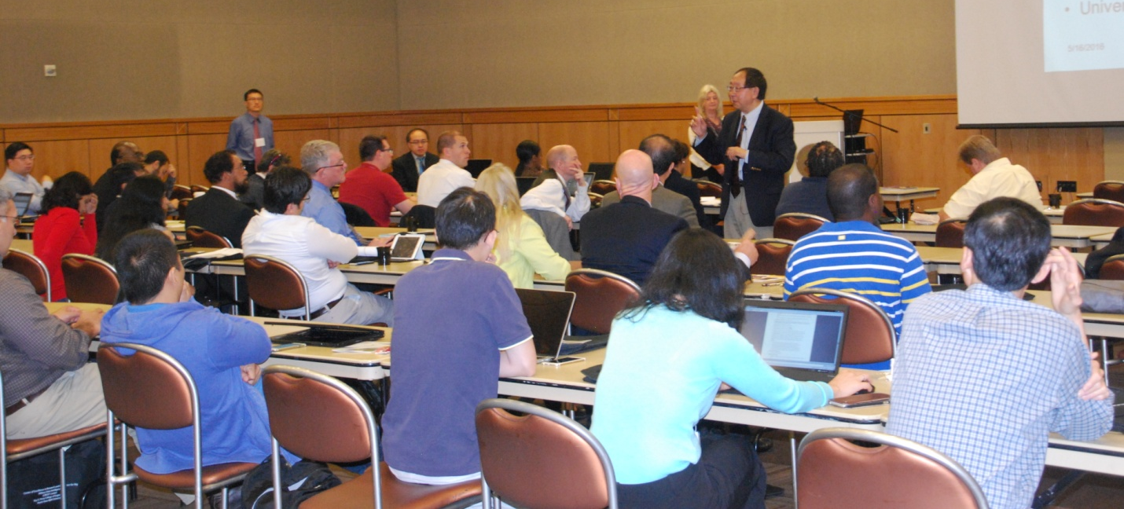
Dr. Qian
IEEE Workshop on Big Data Metadata and Management
(BDMM '2016)
Washington DC, USA
Mission-Critical Big Data Analytics workshop

Slide 14
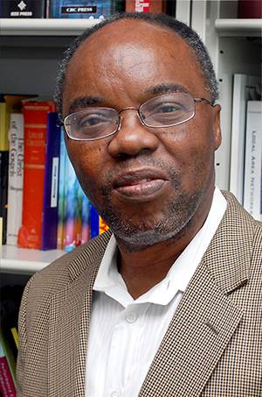
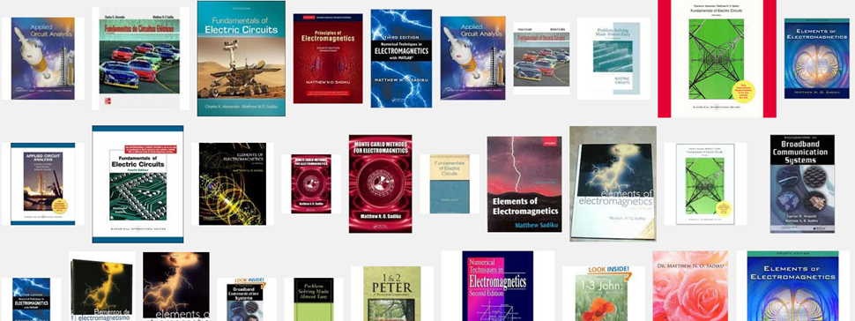
Dr. Matthew N. O. Sadiku
Author of over 240 professional articles and over 50 books including “Communications Theory”

Slide 15
Instructional Programs

Slide 16

ELECTRICAL ENGINEERING PROGRAM
No Deficiency, Weakness, Concern, or Observation.
COMPUTER ENGINEERING PROGRAM
No Deficiency, Weakness, or Concern
Program Observation

Slide 17
Strengths
Faculty are directors of university research centers. The centers and programs provide enhanced educational opportunities for the undergraduates.
The Industrial Advisory Board plays and active role with the department assisting and providing internships for the undergraduates

Slide 18
CPEG Observation
The computer engineering and electrical engineering curricula require ELEG-3023, Signals and Systems, in the spring of the junior year. The electrical engineering curriculum requires MATH- 4173, Advance Math for Engineers, in the fall of the junior year. There are topics in MATH- 4173, such as Fourier Series, that are directly relevant to ELEG-3023. The computer engineering curriculum does not require the MATH- 4173 course. It appears that electrical engineering students are better prepared for ELEG-3023 as a result of the MATH-4173 course.

Slide 19
Survey of Students

Slide 22
Student Survey
60% of the students felt EE had advantage (40% did not)
CPEG students are not willing to take MATH 4173
CPEG students not willing to take a class with the LaPlace transform and Fourier series topics
Instructors who taught ELEG 3023 and some of the computer engineering students who completed the course, the only mathematics Differential Equations

Slide 23
Suggested Solution
Fourier series covered in ELEG 3013, Network Theory but LaPlace transform is covered in MATH 4173 but is not covered in other courses in the CPEG curriculum.
Department will rearrange the electrical engineering suggested degree plan such that MATH 4173 and ELEG 3023 are taken during the same semester
ELEG 3023 instructors will be asked to spend more time while covering Fourier series and LaPlace transform.

Slide 24
SUGGESTED PROGRAM OF STUDY 2016-2017
First Semester |  |  |  | Second Semester
Freshman Comp I | ENGL 1123 | 3 |  | Tech. Writing | ENGL 1143 | 3
Calculus I | MATH 1124 | 4 |  | Calculus II | MATH 2024 | 4
Engr. Appl Lab II for Math | GNEG 1121 | 1 |  | Engr. Appl Lab III for Math | GNEG 2021 | 1
Intro. Engr CS Tech | ELEG 1011 | 1 |  | Comp. Sci. II & Lab | COMP 1224 | 4
Intro Elect. Lab | ELEG 1021 | 1 |  | Univ. Phy. I | PHYS 2513 | 3
Comp. Sci. I | COMP 1213 | 3 |  | Univ. Phy. Lab I | PHYS 2511 | 1
Comp. Sci I Lab | COMP 1211 | 1
Fund. Of Speech | COMM 1003 | 3
removed
First Semester |  |  |  | Second Semester
Freshman Comp I | ENGL 1123 | 3 |  | Tech. Writing | ENGL 1143 | 3
Calculus I | MATH 1124 | 4 |  | Calculus II | MATH 2024 | 4
Engr. Appl Lab II for Math | GNEG 1121 | 1 |  | Engr. Appl Lab III for Math | GNEG 2021 | 1
Intro. Engr CS Tech | ELEG 1011 | 1 |  | Comp. Sci. II & Lab | COMP 1224 | 4
Intro Elect. Lab | ELEG 1021 | 1 |  | Univ. Phy. I | PHYS 2513 | 3
Comp. Appl. Engr | ELEG 1043 | 3 |  | Univ. Phy. Lab I | PHYS 2511 | 1
Fund. Of Speech | COMM 1003 | 3

Slide 25
SUGGESTED PROGRAM OF STUDY 2017-2018
First Semester |  |  |  | Second Semester
Freshman Comp I | ENGL 1123 | 3 |  | Tech. Writing | ENGL 1143 | 3
Calculus I | MATH 1124 | 4 |  | Calculus II | MATH 2024 | 4
Engr. Appl Lab II for Math | GNEG 1121 | 1 |  | Engr. Appl Lab III for Math | GNEG 2021 | 1
Intro. Engr CS Tech | ELEG 1011 | 1 |  | Comp. Sci. II & Lab | COMP 1224 | 4
Intro Elect. Lab | ELEG 1021 | 1 |  | Univ. Phy. I | PHYS 2513 | 3
Comp. Appl. Engr | ELEG 1043 | 3 |  | Univ. Phy. Lab I | PHYS 2511 | 1
Fund. Of Speech | COMM 1003 | 3
Senior Year
First Semester |  |  |  | Second Semester
Embedded Sys Desg | ELEG 4253 | 3 |  | Computer Networks | ELEG 4333 | 3
Digital Design | ELEG 4303 | 3 |  | Computer Networks Lab | ELEG 4331 | 1
Senior Desg & Prof. I | ELEG 4472 | 2 |  | Senior Desg & Prof. II | ELEG 4482 | 2
American Govt. I | POSC1113 | 3 |  | American Govt. II | POSC1123 | 3
Language, Philosophy and Culture |  | 3 |  | Technical Elective |  | 3
 |  |  |  | Creative Arts |  | 3
 |  | 14 |  |  |  | 15

Slide 26
SUGGESTED PROGRAM OF STUDY 2018-2019
First Semester |  |  |  |  | Second Semester
Freshman Comp I | ENGL 1123 | 3 |  |  | Tech. Writing |  | ENGL 1143 | 3
Calculus I | MATH 1124 | 4 |  |  | Calculus II |  | MATH 2024 | 4
Engr. Appl Lab II for Math | GNEG 1121 | 1 |  |  | Engr. Appl Lab III for Math |  | GNEG 2021 | 1
Intro. Engr CS Tech | ELEG 1011 | 1 |  |  | Advanced Programing Concepts and Engr Applications |  | ELEG 2153 | 3
Intro Elect. Lab | ELEG 1021 | 1 |  |  | Univ. Phy. I |  | PHYS 2513 | 3
Comp. Appl. Engr | ELEG 1043 | 3 |  |  | Univ. Phy. Lab I |  | PHYS 2511 | 1
Fund. Of Speech | COMM 1003 | 3
 |  | 16 |  |  |  |  |  | 16
Sophomore Year
First Semester |  |  |  |  |  | Second Semester
Diff. Equations | MATH 2043 | 3 |  |  |  | Network Theory I | ELEG 2023 | 3
Univ. Phy. II | PHYS 2523 | 3 |  |  |  | Elect. Cir. Lab | ELEG 2011 | 1
Univ. Phy. Lab II | PHYS 2521 | 1 |  |  |  | Discrete Math | MATH 2053 | 3
Chem. For Engrs. | CHEM 1034 | 4 |  |  |  | Thermodynamics I | MCEG 2013 | 3
Chem. Lab II | CHEM 1021 | 1 |  |  |  | Statics & Dynamics | CVEG 2454 | 4
US to 1876 | HIST 1313 | 3 |  |  |  | Econ Analy Tech App | CHEG 2003 | 3
Data Structures WITH Engr Applications | ELEG 2163 | 3

Slide 27
Department 12 month Goals

Slide 28
ECE Department 12 Month Goals
Increase the Retention and Graduation Rate
Increase Enrollment
Increase External Funding
Increase Faculty, Staff and Student Development
Develop a strategic plan base on this feedback

Slide 29
Increase Retention and Graduation Rates
  Track retention and graduation rates get a baseline
  Establish an early intervention system
  Establish a curriculum review committee to revisit the curriculum
  Project-based freshman and sophomore level curriculum

Slide 30
EE Retention

Slide 31
CPEG Retention

Slide 32
Increase Enrollment
Undergraduate
  Target schools
Transfer students
  Articulation agreements
  Faculty teach at the community colleges
Graduate
  Encourage participation in 5yr BS/MS
  Recruit at other HBCUs

Slide 38
5YR BS/MS
38

Slide 42
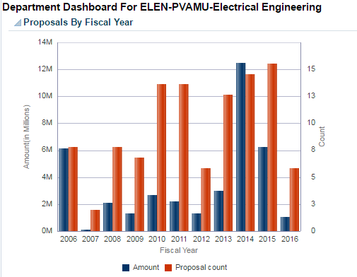
Increase External Funding
Increase faculty research $3M/yr
New Partnerships
Increase # of Proposal Written and Awarded

Slide 43
Increase Faculty, Staff and Student Development
Seminars and workshops on Fridays
Robotics club
Internships and undergraduate research

Slide 44
Strategic Plan
Develop a good strategic plan with faculty, industry partners and students in the next year

Slide 45
Department 3 yr Goals

Slide 46
Increase the Retention and Graduation Rate
Increase Enrollment by 6%
Increase External Funding
Increase Faculty, Staff and Student Development

Slide 47
Increase the Retention and Graduation Rate
Make program more attractive
  More undergraduate courses in
  Cyber Security
  Data analytics
  Machine Learning
  Virtual Reality
Offer Certifications
Undergraduate Research Experiences
Scholarships for Juniors and Seniors
Industry partners in the class rooms

Slide 48
Increase Enrollment by 6%
Focus on retention
Scholarships
Recruit more
Offer attractive classes more in tuned with industry needs
  Systems Engineering
  Cybersecurity
  Machine Learning
  Java Script
  Algorithms
  Python
  Linux

Slide 49
Increase External Funding
Subcontract opportunities
STTRs
SBIRS
MSI HBCU set asides for defense contractors

Slide 50
Increase Faculty, Staff and Student Development
Workshops
Seminars
Weekly seminars in house
Less teaching load
Encourage faculty to take sabbaticals

Slide 51
Board Recommendations

Slide 52
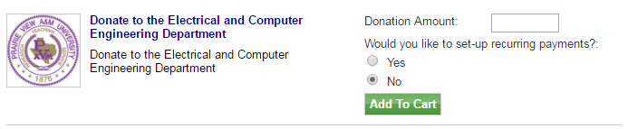
Giving
With your help, the ECE Programs can continue to grow and succeed. Please consider supporting the students in our program and helping ensure their continued success.
PANTHER MARKET PLACE

Slide 53
Future IAB meetings
Academic year | Dates of IAB Meetings | Frequency of Meeting
2016-2017 | Spring 2017, April 28, 2017 | Once a year
2017-2018 | Spring 2018, April 27, 2018 | Once a year
2018-2019 | Spring 2019, April 26, 2019 | Once a year
2019-2020 | Spring 2020, April 24, 2020 | Once a year
2020-2021 | Fall 2020 and Spring 2021 | Twice a year
2021-2022 | Fall 2021 and Spring 2022 | Twice a year
Fall 2022 | No meeting Fall 2022 semester because of the ABET Visit
2022-2023 | Spring 2023 | Once a year (cycle repeats)

