Slide 1
ECE Faculty Meeting

Slide 2
Accomplishments
Goals
ABET
Workload
Advising
Taskstream
Coordinators
Calendar

Slide 3
Accomplishments
University met enrollment goal of 1200 by Fall 2016
  ~1,800 freshmen
Two new CPEG courses ELEG 2153 and 2163 approved by UAC roll out Fall 2017
CRIs moving forward
  Cyber Security
  Smart Grid
  Computational Biology

Slide 4
Summer Camps
Big Military Data Analytics Camp
SEEC Camps

Slide 5
Goals
Increase number of Undergraduate and Graduate students
Improve Retention
Increase External Funds
Funding Improve Curriculum

Slide 7
Comp. Engineering Courses | a | b | c | d | e | f | g | h | i | j | k
ELEG 1021 Intro Elect Lab |  |  |  | 92 |  | 96 |  |  |  |  | 85
ELEG 2011 Electric Circuit Lab |  | 84 |  | 100 |  |  | 80
ELEG 2023 Network Theory I | 75 |  |  |  | 76 |  |  |  |  |  | 95
ELEG 3013 Network Theory II | 82 |  | 88 |  |  |  |  |  |  |  | 87
ELEG 3021 Logic Circuits Lab |  | 99 |  | 89 |  |  | 93
ELEG 3033 Physical Princ. Solid State | 71 |  |  |  |  |  |  |  | 80 | 75
ELEG 3063 Logic Circuits | 86 |  | 91 |  |  | 89
ELEG 4253 Embedded Systems |  | 88 | 92 |  | 88 |  |  | 84 |  | 82
ELEG 4303 Dig System Design |  |  | 86 |  | 81 |  |  |  | 92 | 92
ELEG 4472 Senior Design I |  | 90 | 86 | 91 |  | 89 | 90 |  |  |  | 90
Average | 79 | 90 | 89 | 93 | 82 | 91 | 88 | 84 | 86 | 83 | 89
Minimal Acceptable Average | 70 | 70 | 70 | 70 | 70 | 70 | 70 | 70 | 70 | 70 | 70

Slide 9
Electrical Engineering Courses | a | b | c | d | e | f | g | h | i | j | k
ELEG 1021 Intro Elect Lab |  |  |  | 87 |  | 93 |  |  |  |  | 83
ELEG 1043 Comp Appl in Engr |  |  |  |  | 62 |  |  |  |  |  | 65
ELEG 2011 Electric Circuit Lab |  | 87 |  | 77 |  |  | 87
ELEG 2023 Network Theory I | 77 |  |  |  | 75 |  |  |  |  |  | 92
ELEG 3013 Network Theory II | 89 |  | 88 |  |  |  |  |  |  |  | 87
ELEG 3021 Logic Circuits Lab |  | 95 |  | 89 |  |  | 93
ELEG 3023 Signals and Systems | 79 |  |  |  | 65 |  |  |  |  |  | 93
ELEG 3033 Physical Princ. Solid State | 71 |  |  |  |  |  |  |  | 80 | 75
ELEG 3043 Electronics I | 81 |  |  | 90 |  |  |  |  |  |  | 91
ELEG 3063 Logic Circuits | 89 |  | 90 |  |  | 79
ELEG 3071 Microproc. Sys. Lab |  |  |  | 93 |  |  | 97 |  |  |  | 91
ELEG 3073 Microproc Sys. |  |  | 90 |  |  | 84 |  | 88
ELEG 4003 Communication Theory
ELEG 4011 Electronics Lab |  | 73 |  | 92 |  |  | 93
ELEG 4013 Energy Conversion | 75 |  |  |  |  |  |  | 76 |  | 86
ELEG 4033 Electro Field Thr I |  |  |  |  |  |  |  | 89 |  | 85
ELEG 4043 Electronics II
ELEG 4073 Control Systems | 75 |  |  |  |  | 81 |  |  | 85 | 77
ELEG 4472 Senior Design I |  | 88 | 85 | 93 |  | 86 | 90 |  |  |  | 90
ELEG 4482 Senior Design II |  | 92 |  | 96 | 90 | 96 | 91 | 97 | 96 | 97
Average | 80 | 87 | 88 | 90 | 73 | 87 | 92 | 88 | 87 | 84 | 87
Minimal Acceptable Average | 70 | 70 | 70 | 70 | 70 | 70 | 70 | 70 | 70 | 70 | 70

Slide 10
ABET Accreditation
Sept 18-20 (Sunday- Tuesday)
  All faculty staff must be present on all three days.
    Sunday 12-6pm
    Monday 7:30-5:30 pm
    Tuesday 8-1pm
No travel from Sept 12-21st

Slide 11
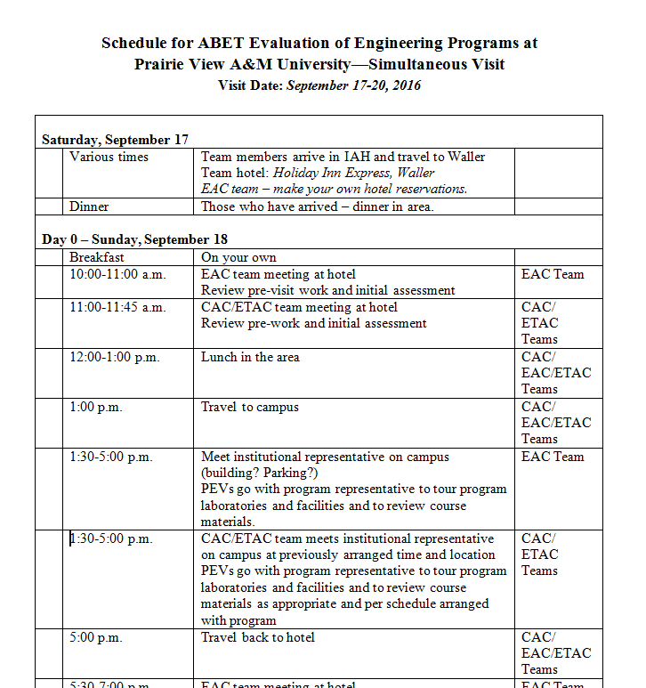

Slide 12
Advising
Make sure that all students complete a Degree planning worksheet
Post advisement hours
ECE Website

Slide 13
Taskstream
Make sure students upload assignments to Taskstream

Slide 14
Coordinators
Dr. Ali – Undergraduate Coordinator
Dr. Wilkins- Graduate Coordinator
Dr. Attia – ABET Coordinator

Slide 15
ECE Calendar
ECE Faculty Calendar

