Slide 1
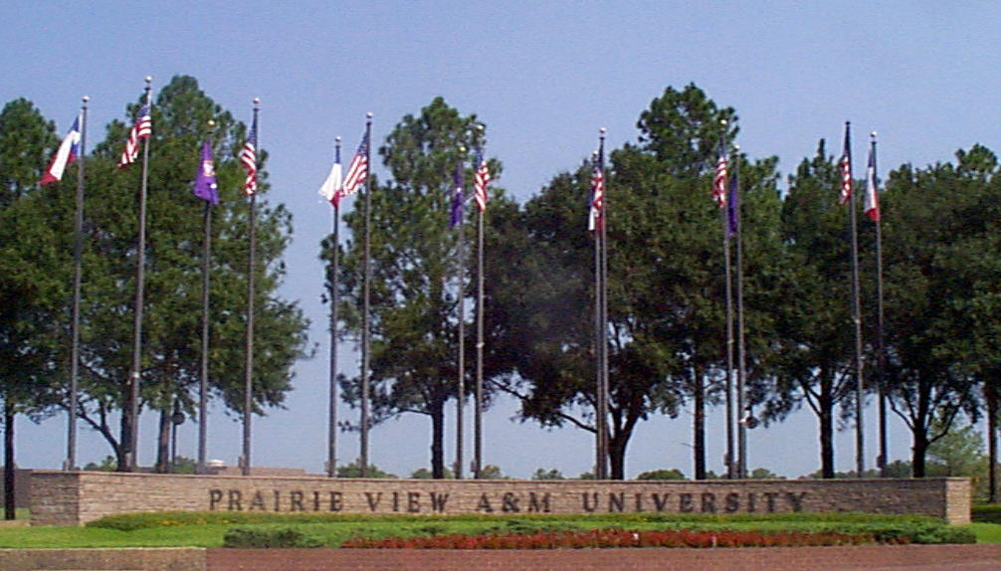


Sam Massie Chair of Excellence
Prairie View A&M University
Funded by the Department of Energy/NNSA
ECE Advisory Board Meeting April 29, 2016
Presentation Outline
Massie Chair History
Internships
Outreach Activities
Research
Teaching

Slide 2


Slide 3
The idea for the Chairs of Excellence was conceived at the campus of Tennessee State University (TSU) in Nashville, Tennessee in the fall of 1993. Meeting of the Deans of HBCUs with Engineering Programs.
This idea was presented to Thomas Grumbly, then Assistant Secretary for Environmental Management.
This idea centered around assisting the institutions (HBCUs) in producing top-level graduates and groundbreaking research in the environmental disciplines.
Secretary O'Leary chose to name the Chairs of Excellence Program after Dr. Samuel P. Massie, an African-American chemist of national reputation for championing the cause of minority education.
Mr. Grumbly awarded the Dr. Samuel P. Massie Chairs of Excellence to nine HBCUs. In late 1995, another Chair was awarded to a Hispanic Serving Institution (HIS), Turabo University, in Puerto Rico, increasing the number of Chairs to ten. Ms. Malika Hobbs became the DOE program manager of the Chairs of Excellence Program.
http://doe-hbcu-massie-chair.com/history.htm

Slide 4
In September 1994, the U.S. Department of Energy's Office of Environmental Management (EM) committed $14.7 million in grants over a five-year period to establish the Dr. Samuel P. Massie Chairs of Excellence Program.
This national program, which now (1994) comprises nine Historically Black Colleges and Universities (HBCUs) and one Hispanic Serving Institution (HIS), is named after Dr. Samuel P. Massie, an African-American chemist of national reputation who was a leader in championing the cause of minority education in the United States.
Prairie View A&M University
Dr. Ing Chang selected as Massie Chair at PVAMU with an expertise in thermal and environmental research
Dr. John Fuller (Interim Dean at PVAMU) named in 1996 as Principal Investigator

Slide 5
Through the efforts of Prairie View A&M University, Houston's Chinquapin School students are being exposed to engineering, environmental issues and the use of solar powered vehicles.
Prairie View A&M University is also assisting the Agricultural Extension Service of Waller County in Houston, Texas to provide computer literacy and computer access for its residents.
Texas farmers have received technical assistance from the Chairs to better understand the conversion in the units from U.S. standards to the metric system
Establishment of a small engines exhaust test station within the mechanical engineering department
Design and development of a solar car that participated in the 1995 solar car competition and continued in the 1997 solar car competition (shown on next slide)

Slide 6
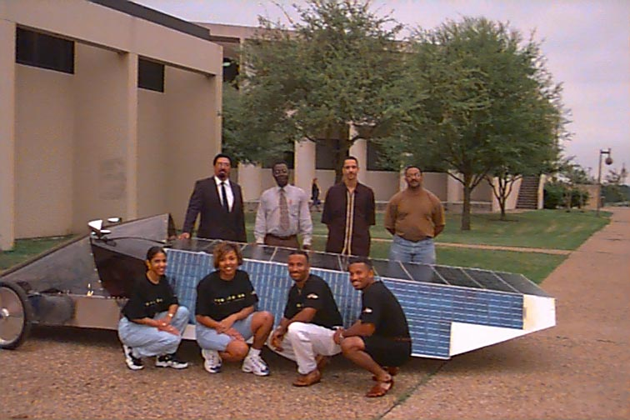

Slide 7
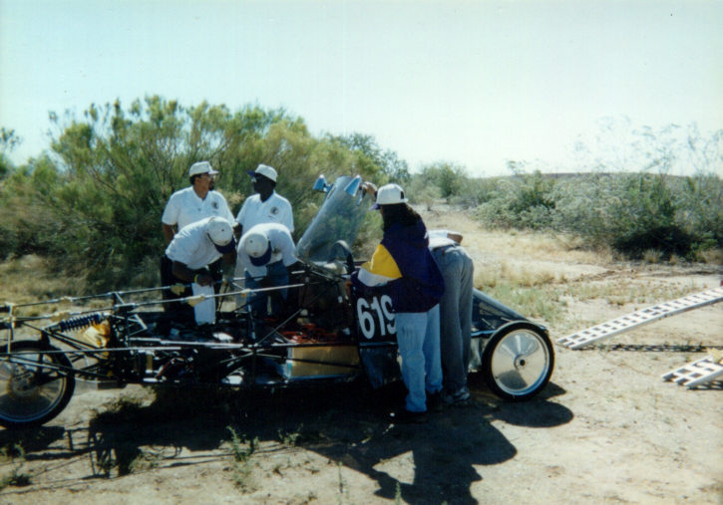

Slide 8
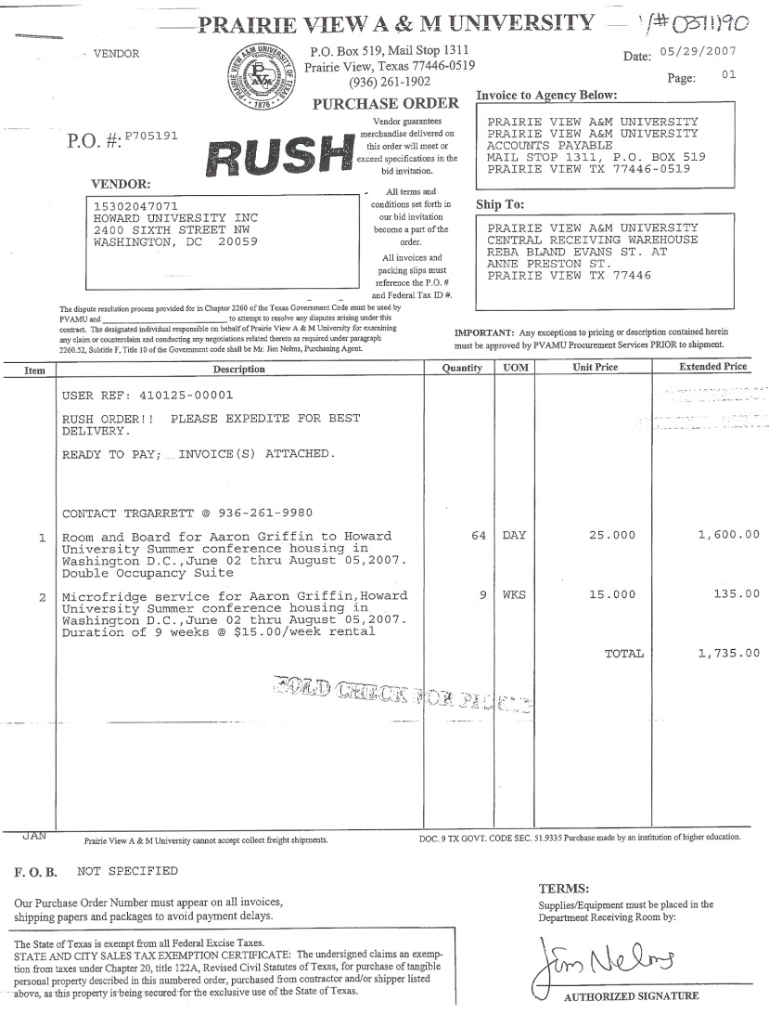
Sam Massie Internships
When it started
Aaron Griffin summer 2007
Internship with DOE in
Washington, DC
Housed at Howard University
For the summer internship
Registered at PVAMU in a
Summer Internship Class

Slide 9
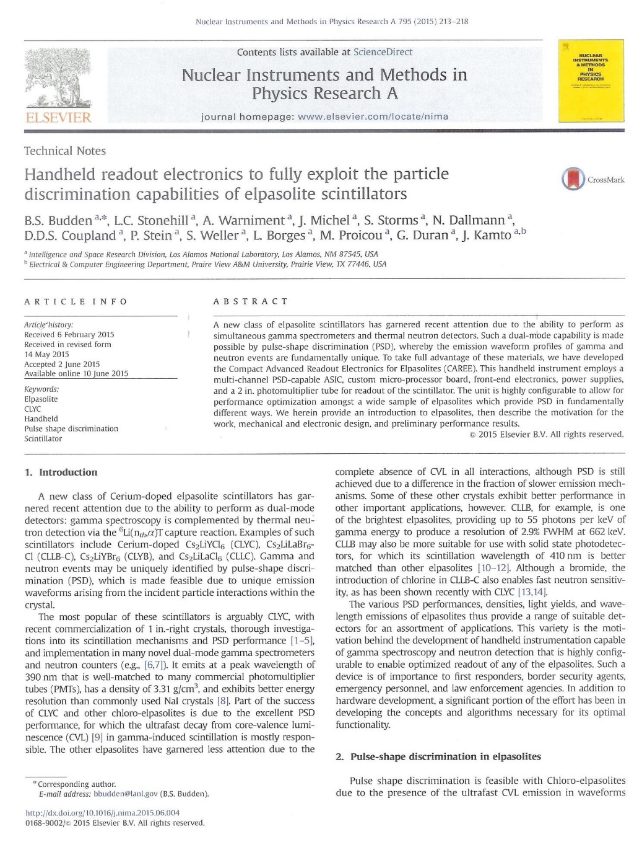
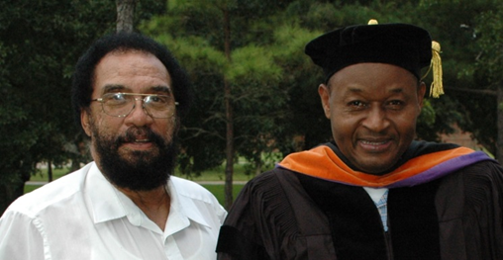
National Laboratory Internship
Professor John Fuller and Joseph Kamto
Joseph Kamto completed the PhD degree in
Electrical Engineering from Prairie View A&M
University and did an Internship at Los Alamos
National Laboratories (Sponsored by DOE)
before graduation. As a result of the internship
he was co-author of a paper published in
Fall 2015 by the laboratory as shown.

Slide 10
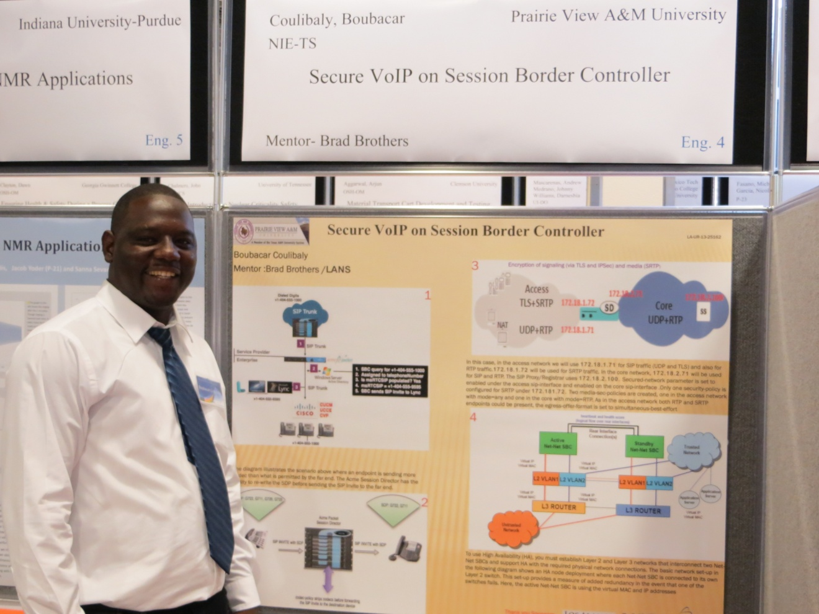
Mr. Boubacar Coulibaly completed his Summer Internship assignment at Los Alamos National Laboratory in August 2013.
After completing the Masters in EE degree at PVAMU Mr. Coulibaly was hired by Los Alamos National Laboratory as a permanent employee

Slide 11
Summer 2014 Internships
Two undergraduate students from the Roy G. Perry College of Engineering did a summer internship at Los Alamos National Laboratory in Los Alamos, New Mexico’ The two students were
Christian Guzman an Undergraduate Electrical Engineering Major and
Jermaine Chambers an Undergraduate Mechanical Engineering Major were interns for the Summer 2014

Slide 12
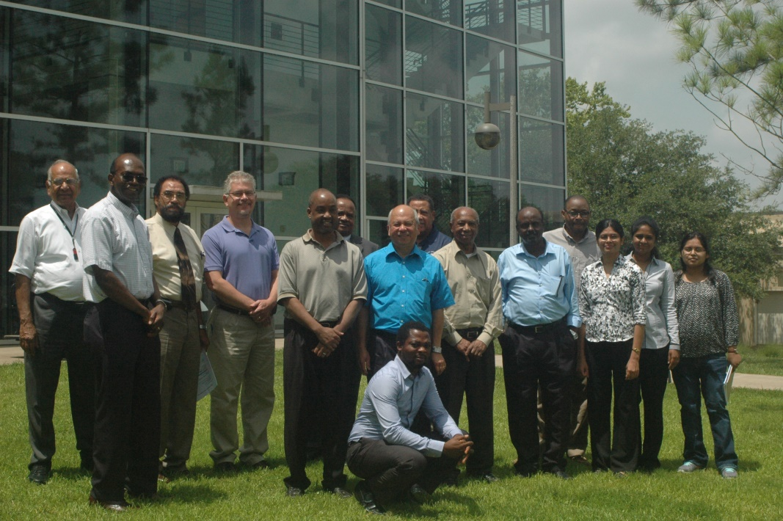
Summer Workshops
A major contribution of the Massie Program has been the availability of Professors funded from the Massie Program that were researching the use of FPGAs for nuclear detection. Professors were already part of a structured research program and could use part of their allotted release time to assist with conducting summer workshops and to give presentations on their research efforts. The picture that follows shows workshop participants.

Slide 13
FPGA Workshop Participants
University Affiliation
Alabama A&M University
Trent Montgomery
Andrew Scott
Southern University Baton Rouge
Jim Cross
Walter Craig
Fred Lacey
Prairie View A&M University
Massie Chair Research Professors
Faculty from various Departments
A second FPGA workshop was conducted at Alabama A&M University

Slide 14
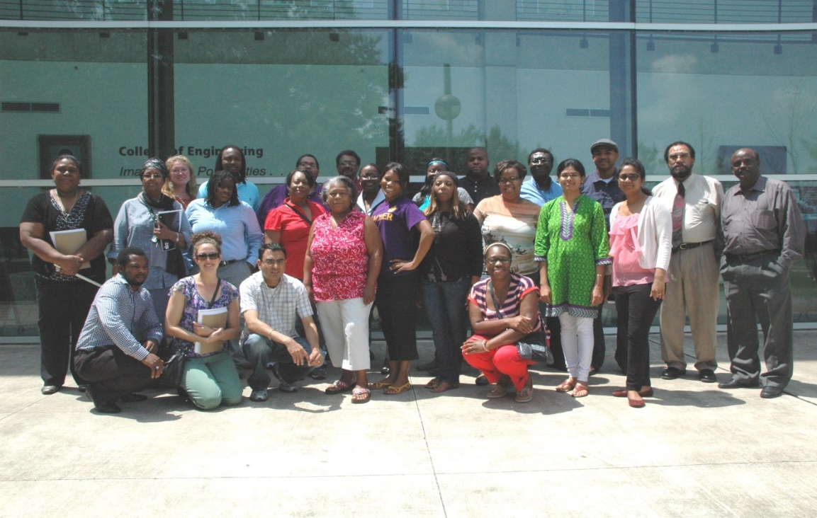
Prairie View A&M University sponsored with DOE support a Math/Science Teacher Workshop on the Campus of Prairie View A&M University.
The workshop was a success and the Teachers received technical as well as non-technical presentations. We had very good participation from the College of Engineering and as was the situation with the other summer outreach programs Massie funded Professors were major participants in the workshop. This was a PVAMU initiative with the support foundation being laid by support of Professors, Presenters and Graduate Students who were Massie funded Team members.

Slide 15
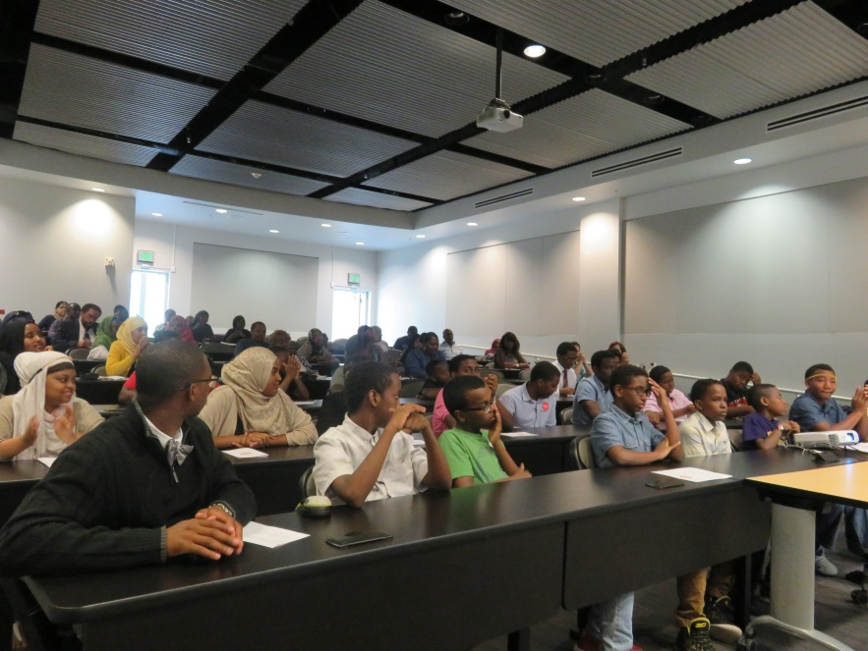
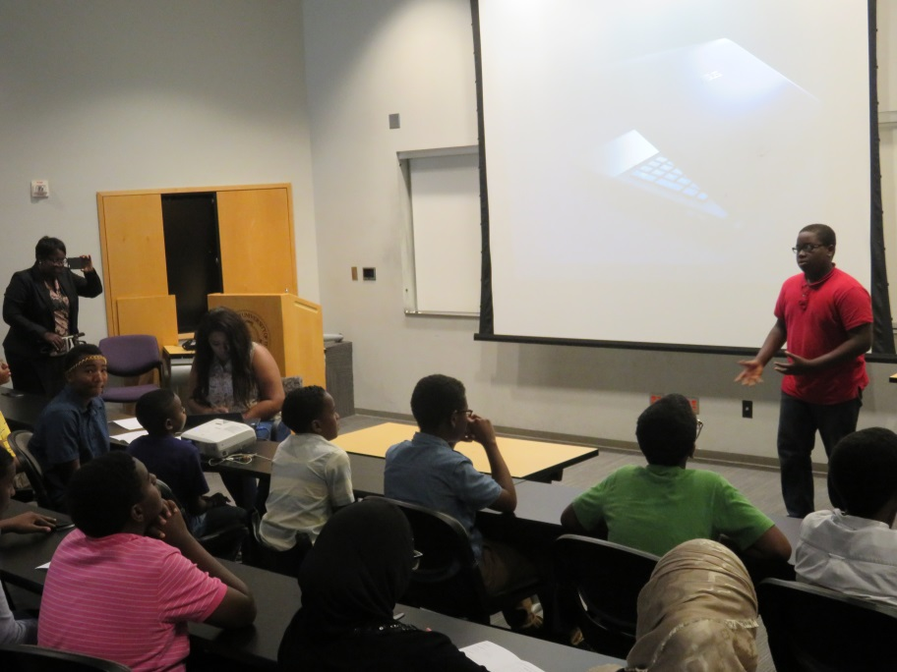
The Massie Team members were directors and presenters at the 2015 Summer Engineering Education Camp (SEEC). Dr. Ali was director of the summer camp and along with Dr. Cofie were supported by Massie funding for the summer workshop.
The summer camp was open to Middle School and High School Students and the camp provided them the opportunity to experience college life by staying on the campus of PVAMU, living with roommates, interacting with College students and being a part of the collegiate environment. The students also attended lectures on current engineering topics and did laboratory experimentation and computer simulation. The following are pictures of the attendants at the summer workshop.

Slide 16
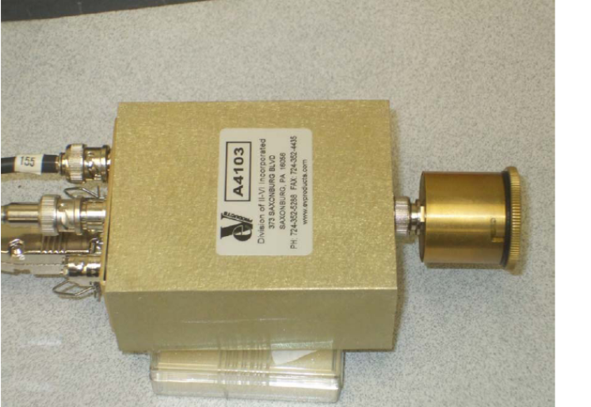
RESEARCH
The Massie Team recognizes the current need of the Department of Energy for the application of engineering expertise to the solution of early detection of nuclear activity and nuclear security. Ongoing research work at Prairie View and the Massie Schools in general have been in accordance with research efforts ongoing at NNSA managed laboratories. We continue to build expertise at our institutions to assist and leverage ongoing research and design activities at National Laboratories in accordance with the mission of NNSA.

Slide 17
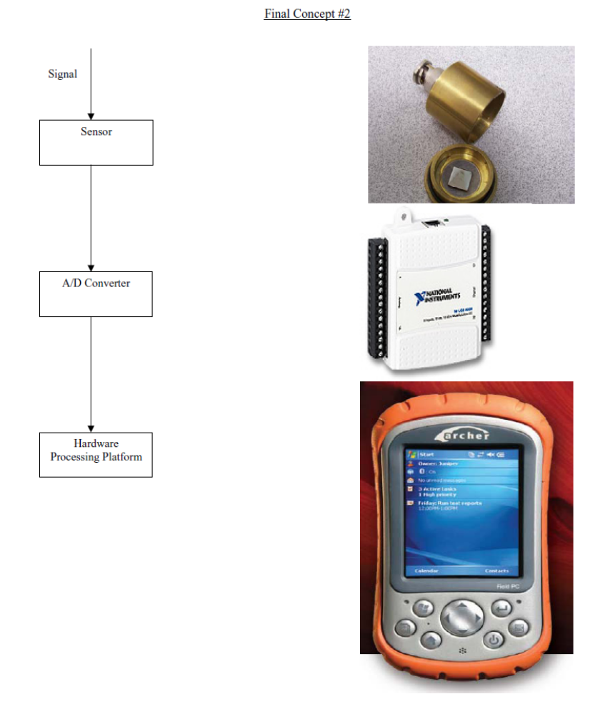
Massie Research at PVAMU
‘Where it Started’

Slide 18
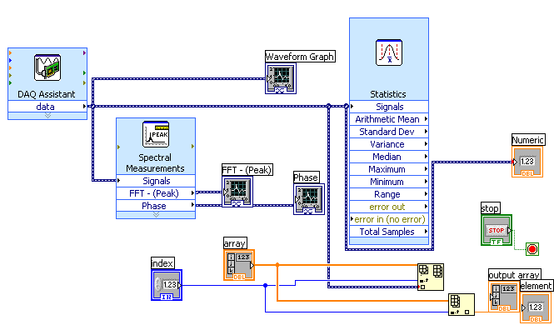
Using National Instruments LabView software for signal detection and analysis

Slide 19
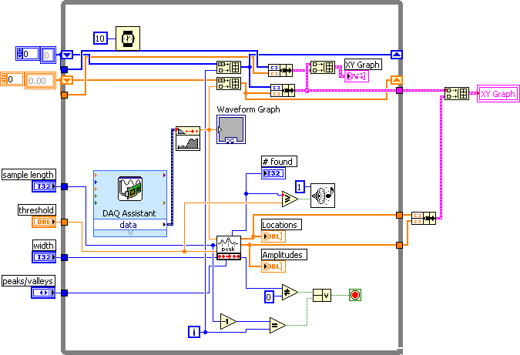
2007 - 2011
Using LabView on a desktop PC to develop a detection program and downloading the required subprograms to the Field PC to run on a mobile module of Labview. The LabView subprogram that was developed is shown in the following diagram.

Slide 20
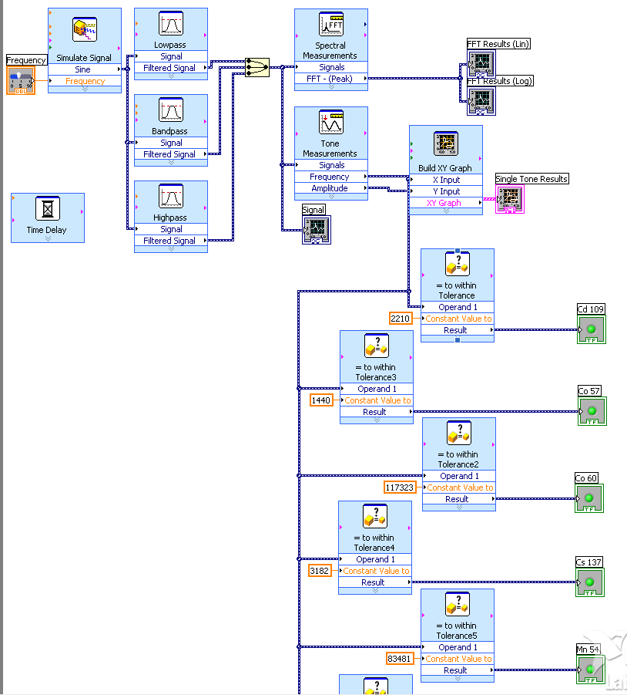
The following LabView program was developed by the senior project students to identify different radiation sources based upon determined characteristics.

Slide 21
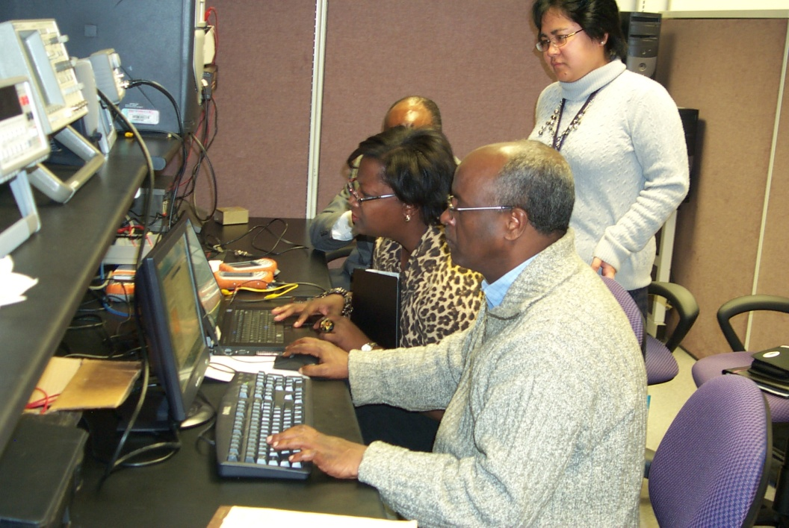
PVAMU Faculty researchers in the Sensor/Detection laboratory
During the 2005 period of time, research emphasis shifted from environmental research to radiation detection.

Slide 22
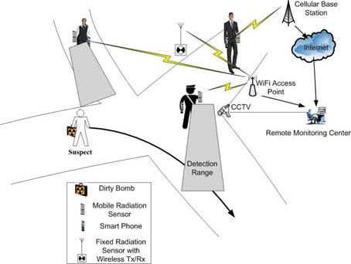
Research has been conducted on remote sensors, coordinating with a central computer for reliable detection of a nuclear device with attention to the reception and identification of false alarms. Presented in the following diagram is a pictorial layout of the developed detection method. Research was coordinated with Los Alamos National Laboratory.
L. Qian, J. Fuller, Cheslan Simpson (2013), “A Community Sensing Framework for Threat Detection in Metropolitan Area”, IEEE Conference on Homeland Security Technologies, November 11-14, 2013, Westin Hotel 70 Third Avenue, Waltham, MA 02154 US.

Slide 23
CZT DETECTION EXPERIMENTATION
Spear detector connected to preamplifier with connection shown for high voltage source and leads for connection to computer. Using LabView Analysis

Slide 24
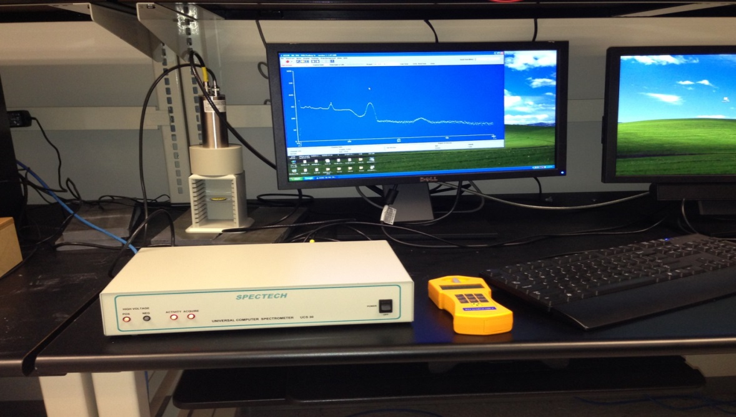
NAI(TI) DETECTION SYSTEM

Slide 25
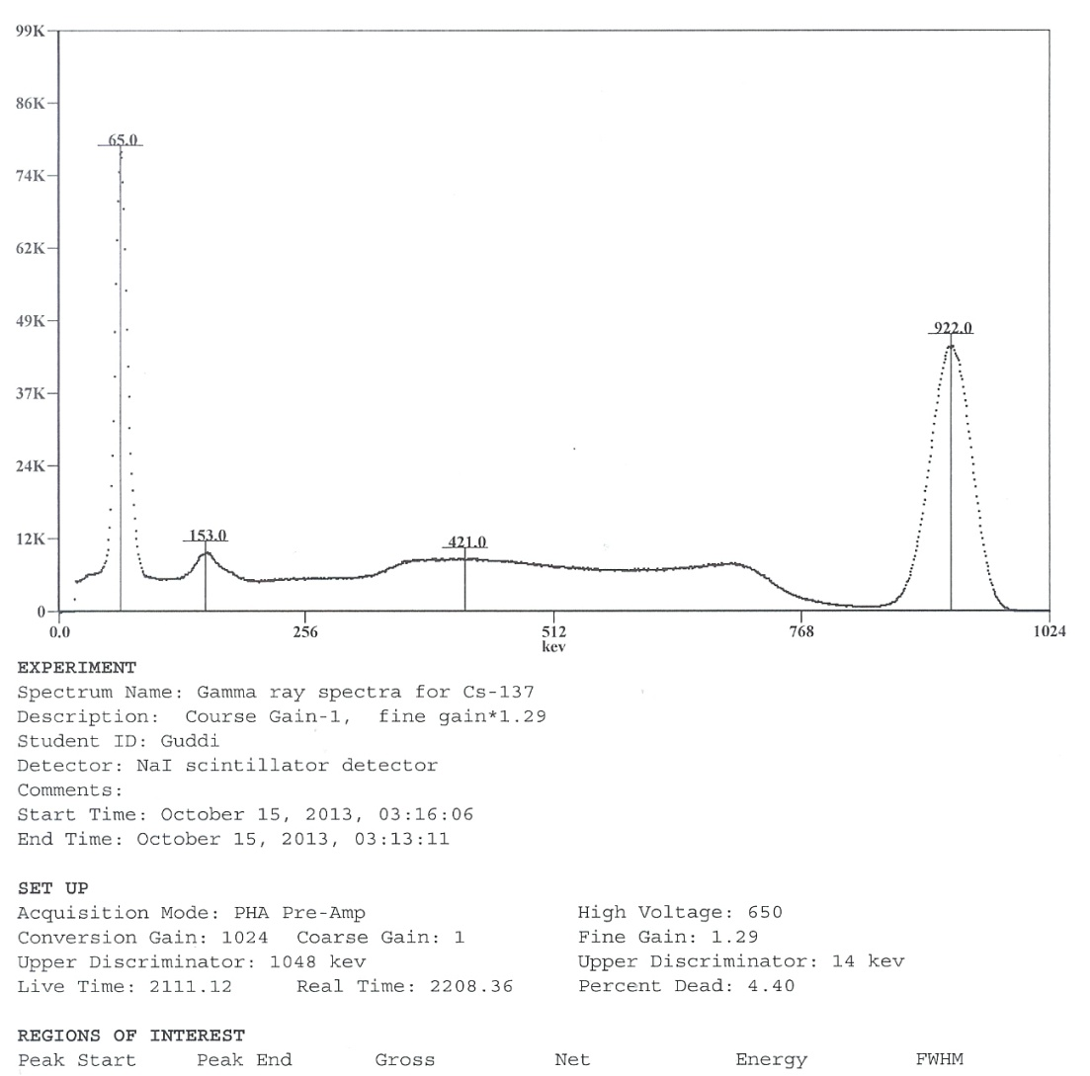

Slide 26
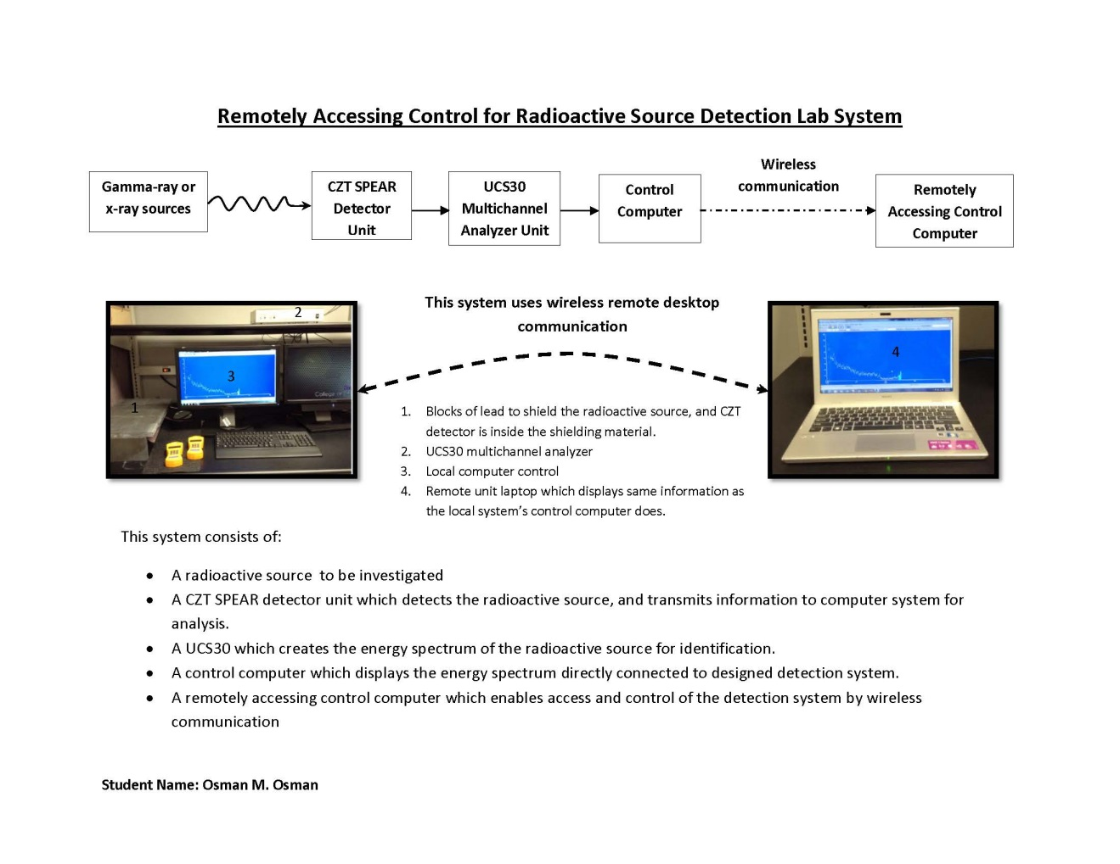

Slide 27
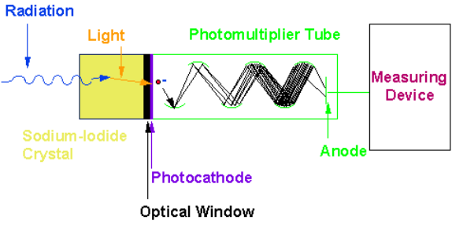
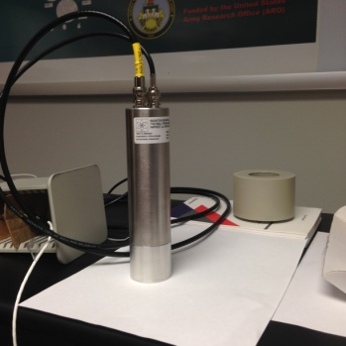
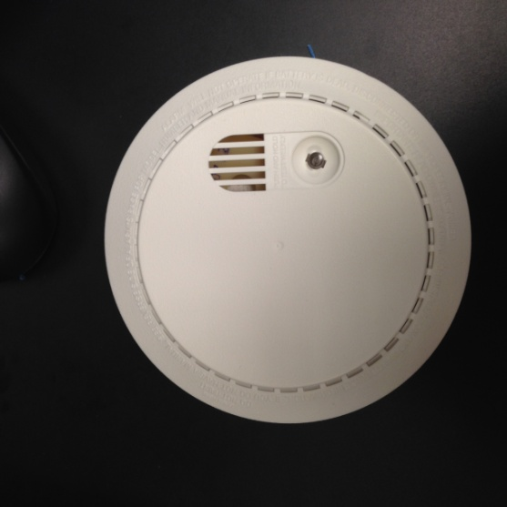
Radiation detection using NaI(TI) scintillation detector and CZT detector from family Guard Smoke Alarm
Fig.1 Measurement of radiation, Sodium Iodide Detector [1]
The NaI(Ti) scintillation detector used for the experiment is shown in Fig.2
Fig.2 NaI(Ti) scintillation detector

Slide 28
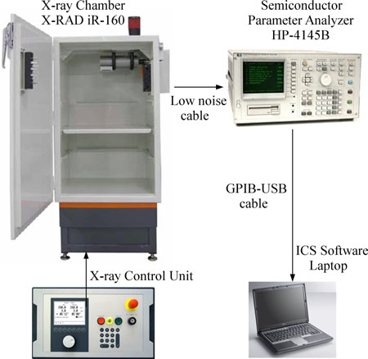
Total Ionizing Dose X-ray Radiation Effects on MWCNT/PMMA Thin Film Composites
Shubha Kyatsandra, Member, IEEE, and Richard Wilkins, Member, IEEE

Slide 29
Conclusion from Wilkins/Shuba’s published paper
VII. CONCLUSION
We have demonstrated in this study that MWCNT/PMMA
based thin film composites have a repeatable quasi-linear decrease
in resistance response to increasing ionizing radiation
doses in the form of X-rays. The thin film composites also
exhibited a repeatable accelerated change in the reduction of resistance
to increased radiation dose rates.
The studies reported here indicate that the MWCNT thin film composites may be applicable for the detection of other forms of ionizing radiation
which are more relevant to terrestrial and space environments

Slide 30
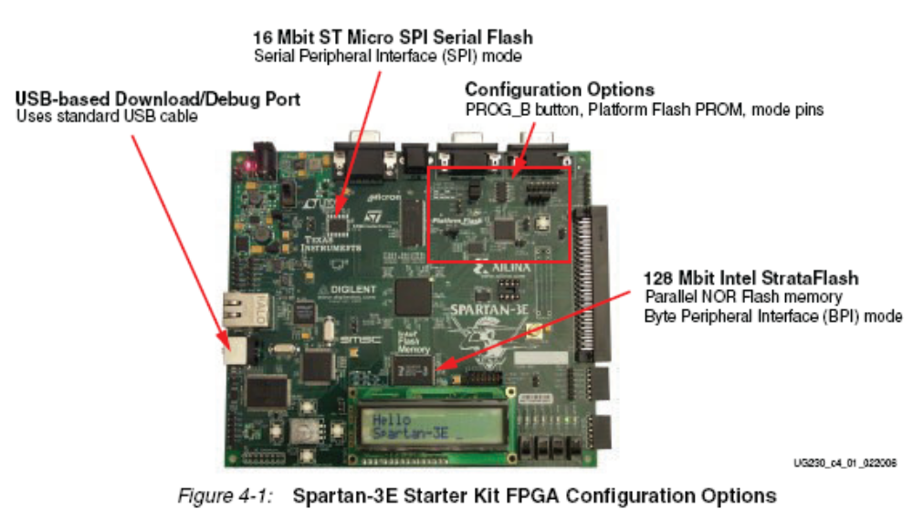
Spartan 3E FGPA
Second FPGA that was used for signal detection and characterization

Slide 31
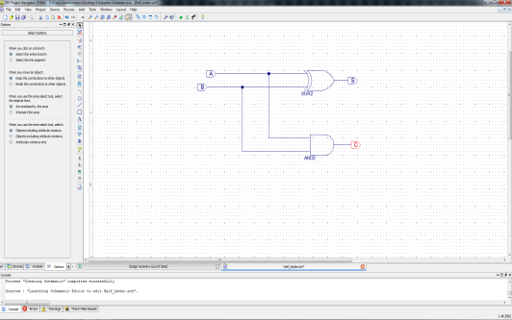
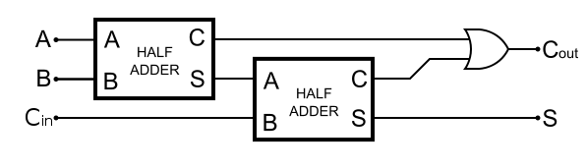
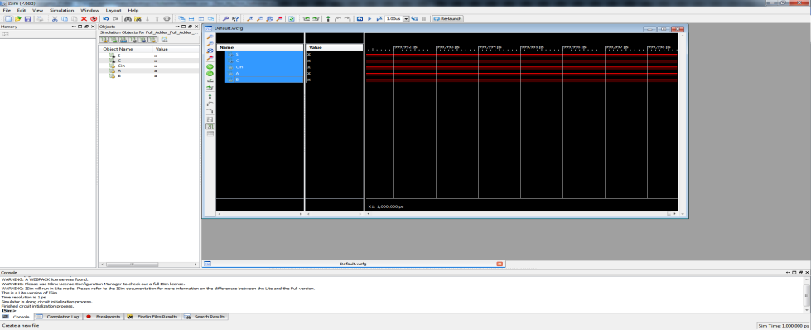
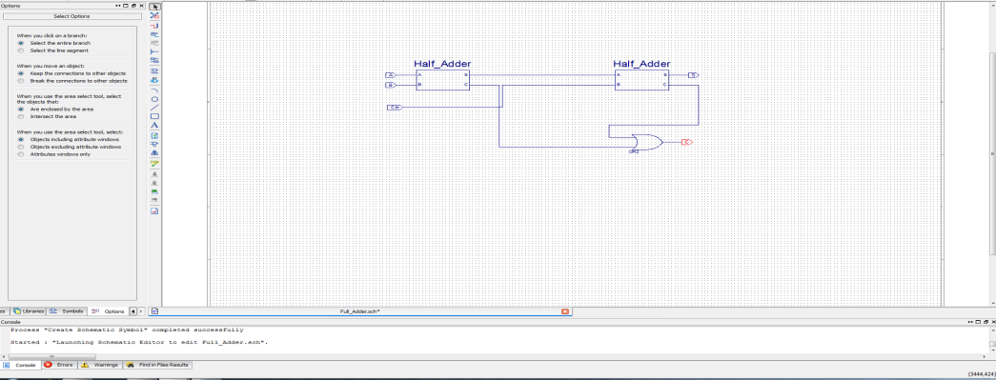
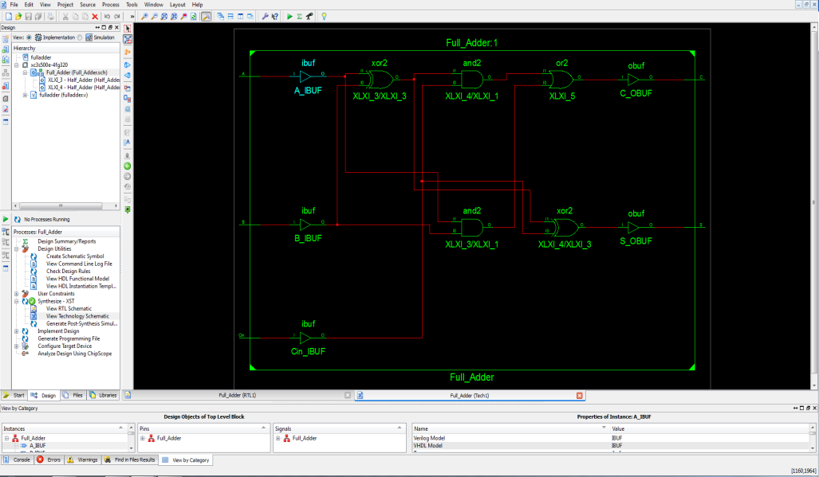
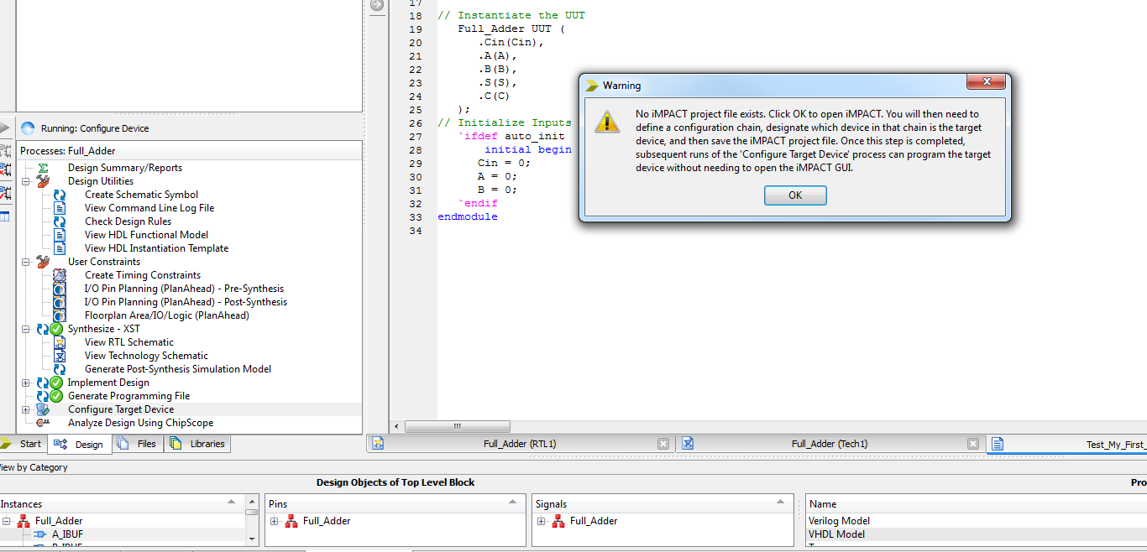
Creating a Verilog module which describes the below shown full adder circuit using ISE Design Suite Project Navigator.
Download to an FPGA
Download design to the Spartan 3E FPGA board.
Notice: Now connect FPGA to Computer
In the process pane double click on Configure Target Device
Click ok to open IMPACT application. NOTE: This may take a while.

Slide 32

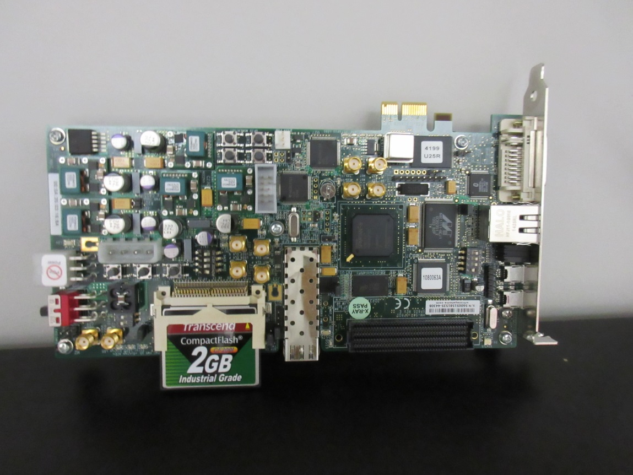
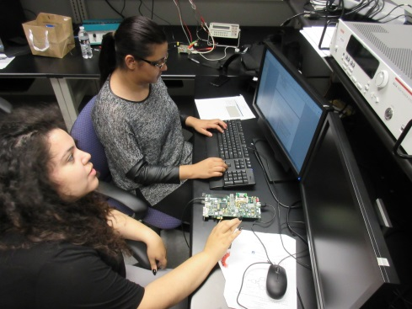
Spartan – 6 FPGA
Just recently acquired in September 2015 and presently being tested for capabilities of previous FPGAs (execution of established FPGA programs) and for the added features of advanced in/out programming and signal capture
Undergraduate Students
Adrianna Hinojosa and
Sabrina Iqbal

Slide 33
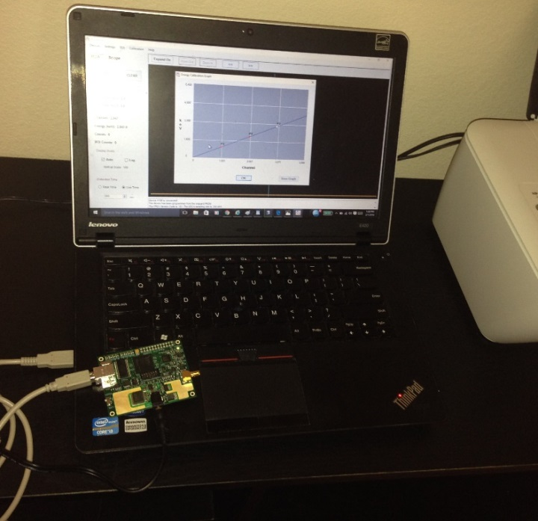
The following photo shows the experimental setup in the Sensor/Detector laboratory using the new RX1200 FPGA.

Slide 34
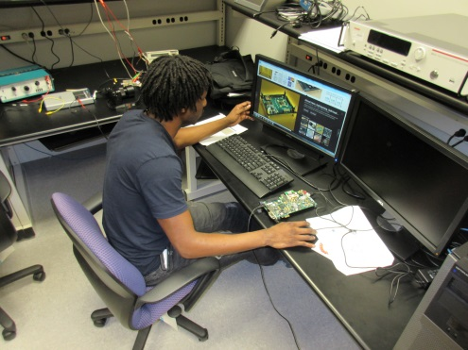

Investigation of New Technology
IBM’s True North Chip
This recently developed IBM chip is presently used to run "deep learning" algorithms, the same algorithms that drive the internet's latest AI services, including the face recognition on Facebook and the instant language translation on Microsoft's Skype. But the promise is that IBM's chip can run these algorithms in smaller spaces with considerably less electrical power, letting us shoehorn more AI onto phones and other tiny devices, including hearing aids and, well, wristwatches. Companies like Google and Facebook and Microsoft are now running their algorithms on machines backed with GPUs (chips originally built to render computer graphics), and they're moving towards FPGAs (chips you can program for particular tasks)
We are investigating the use of this chip for nuclear detection with it requiring less power, a compact device and fast algorithmic abilities.
IBM cracks open a new era of computing with brain-like chip: 4096 cores, 1 million neurons, 5.4 billion transistors
Undergraduate student Troy Clark
Investigating True North Chip

Slide 35
Other results of DOE Research and Outreach Funding
Over the consortium funding cycle PVAMU has established a basis for new technology research with initiatives on LabView , Matlab and FPGA research as applied to nuclear detection. We have published our results and have received follow up requests from readers of published work and continue to investigate new technology that is applicable to the objectives of DOE. An example of DOE‘s overall contribution to PVAMU is the following recently published paper as written by one of our PhD students with faculty guidance.
Emmanuel S. Kolawole, Warsame H. Ali, Penrose Cofie, John Fuller, C. Tolliver, Pamela Obiomon, ‘Design and Implementation of Low-Pass, High-Pass and Band-Pass Finite Impulse Response (FIR) Filters Using FPGA,’ Circuits and Systems, 2015, 6, 30-48, Published Online February 2015 in SciRes. http://www.scirp.org/journal/cs http://dx.doi.org/10.4236/cs.2015.62004
S. Kyatsandra and R. Wilkins, “Total ionizing dose x-ray radiation effects on MWCNT/PMMA thin film composites”, IEEE Transaction on Nanotechnology, Vol. 14 152-158 (2015).

Slide 36
Teaching

Slide 37
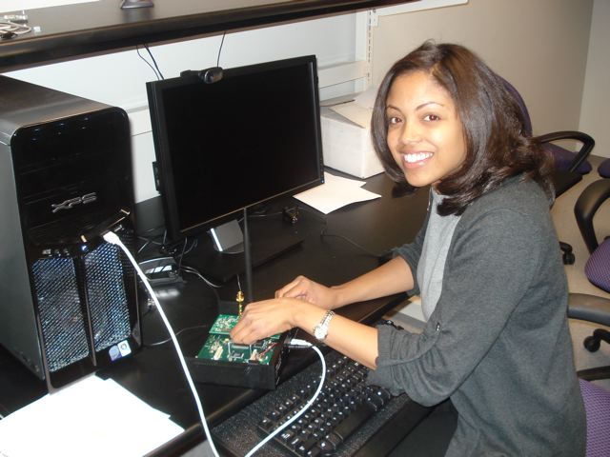
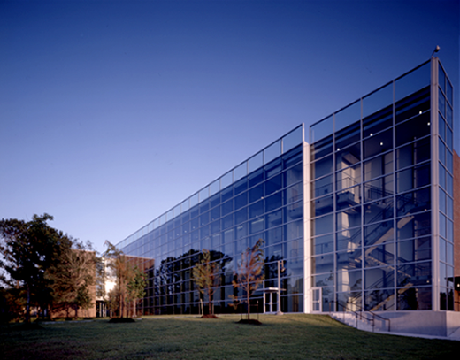
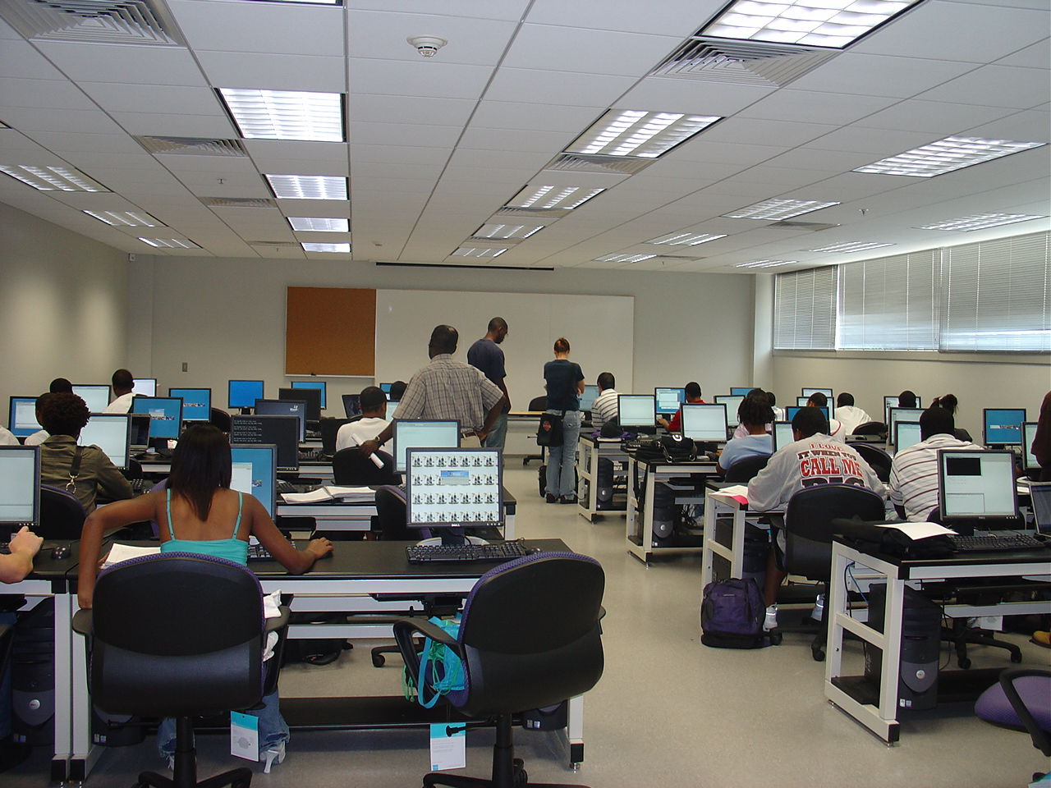
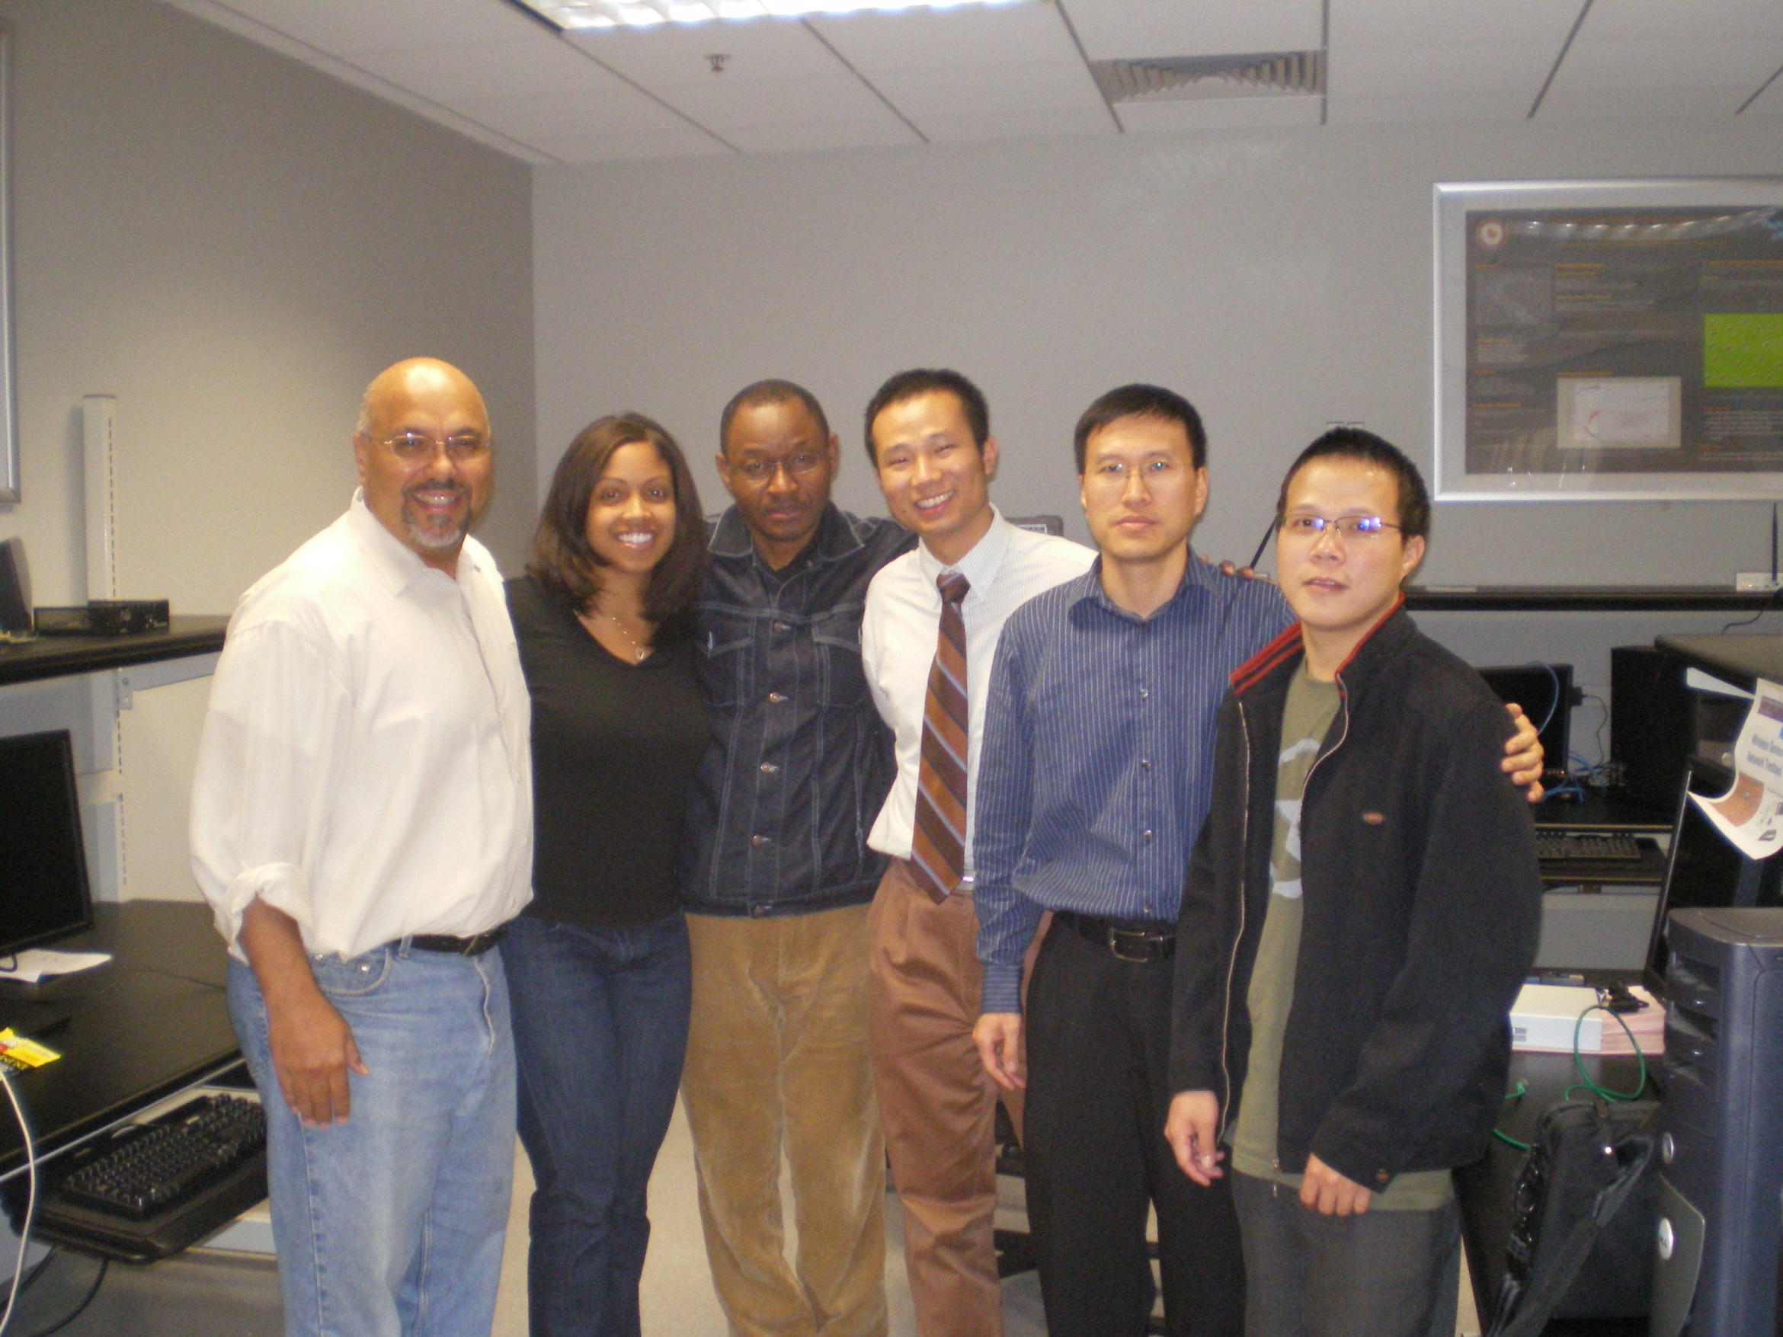
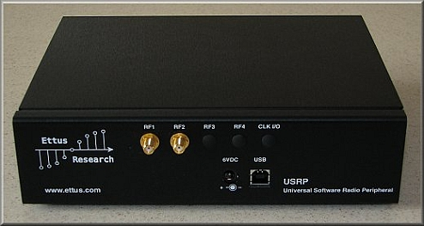
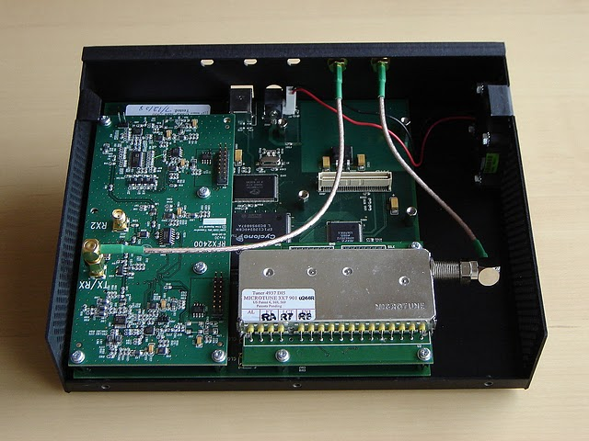
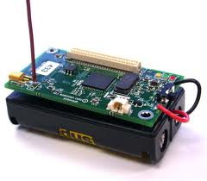
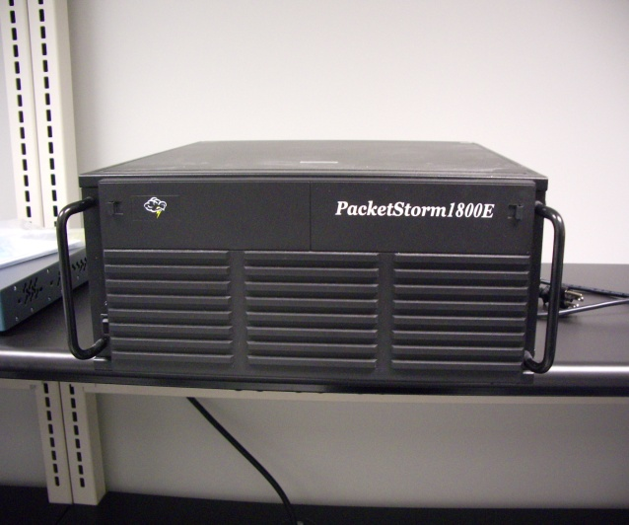
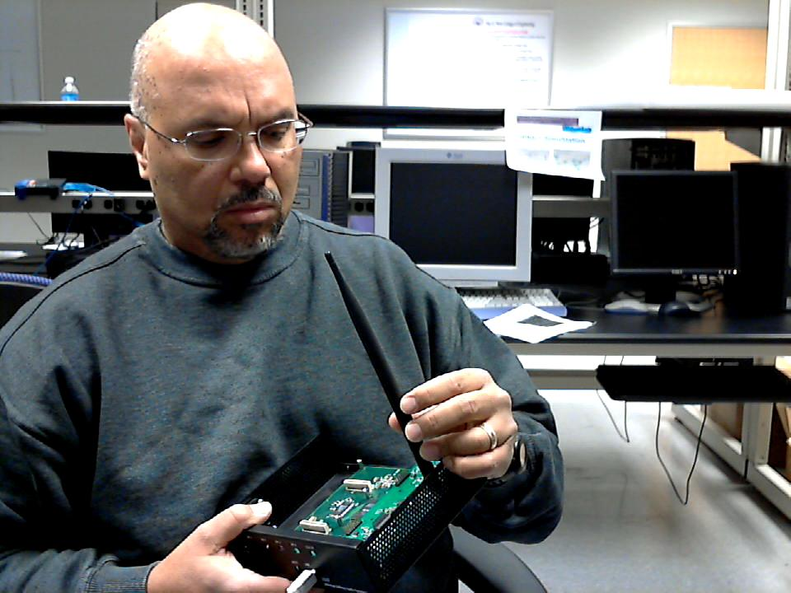
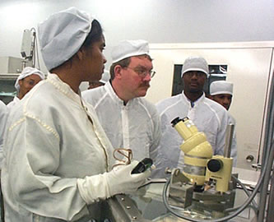
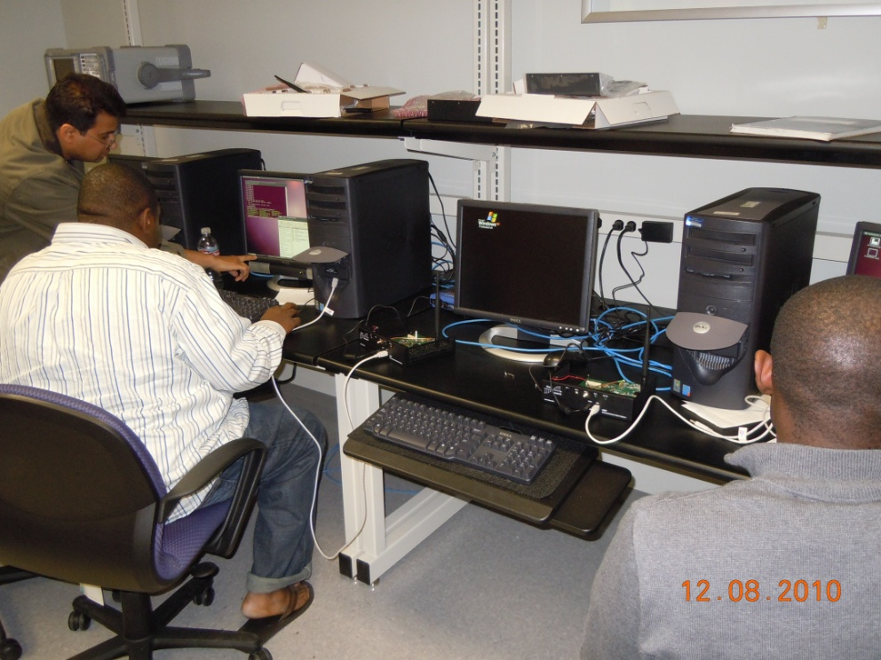
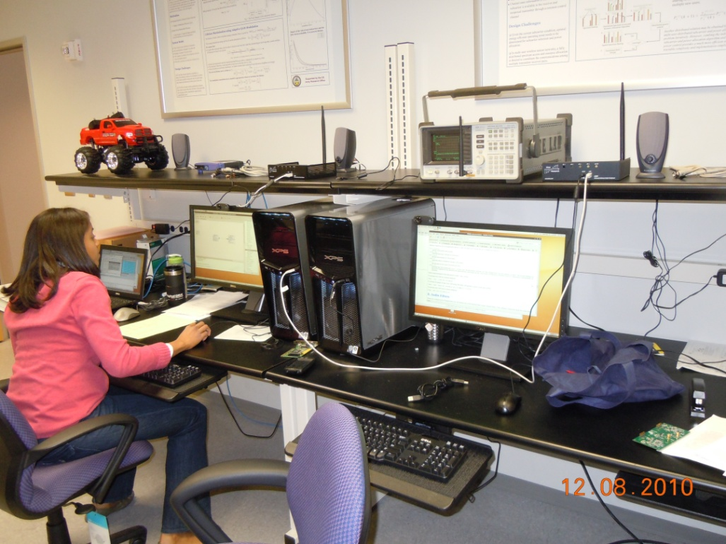
PRAIRIE VIEW A&M UNIVERSITY
Doctor of Philosophy in Electrical Engineering
Department of Electrical & Computer Engineering
0 %
RESEARCH CENTERS
Center of Excellence for Communication Systems Technology Research (CECSTR)
  Wavelets & Wavelet Transform-Based Research
  Broadband Communication Systems Studies
  Adaptive Smart Scheme for Vibration Detection of Aerodynamic Systems
  Testing of Mixed Signal Systems & Devices
  Real-time solutions using DSPs
Center for Battlefield Communications (CEBCOM)
  Digital Battlefield Network Architecture Design (Mobile Ad Hoc Wireless Network topology).
  Power Control for Efficient Sensor Network Architecture Design.
  Embedded Transform Coding for Efficient Use of Available Bandwidth.
  Design & Implementation of Seamless Application QoS for Secure Multi-service Applications.
Center for Radiation Engineering and Science for Space Exploration (CRESSE)
  Carbon Nanotubes and Quantum Devices
  Radiation Testing of COT Electronics and Photonics Materials
  Human Radiation Protection
  Spacecraft Charging
FACILITIES
OBJECTIVE
The Doctor of Philosophy (PhD) program in Electrical Engineering is a research oriented degree program. Its purpose is to advance the knowledge in the fields of Electrical Engineering and enable students of exceptional ability to undertake advanced study and original research. It prepares students for a research and/or teaching career in industry, research institutions, universities, and government. The program has a focus on state-of-the-art technology issues that cross boundaries of Computer Engineering, Microelectronics, and Communications & Signal Processing.
Electrical Engineering Building Completed in August 2005.
About $1.5M spent on Laboratory Equipment
ADMISSION REQUIREMENTS
Bachelor’s Degree GPA
Master’s Degree GPA
GRE Scores
Recommendation
SAMPLE RESEARCH TOPICS
Intrusion detection and prevention of jamming attacks for cognitive radio ad hoc networks using cross-layer design.
Dynamic spectrum management for cognitive radio ad hoc networks.
Cybersecurity for smart grid.
Emerging CMOS Technology.
Carbon nanotubes and quantum device.
AREAS OF SPECIALIZATION
Computer Engineering
Communications/Signal Processing
Microelectronics
Electric Power and Energy Systems
TEAM AT WORK
SAMPLE RESEARCH TOOLS
STATISTICS
GRADUATION RATES | 80%
AVERAGE TIME TO DEGREE | 4.2 YEARS
EMPLOYMENT WITHIN 1ST YEAR OF GRADUATION | 100%
FULL-TIME STUDENT WITH FINANCIAL SUPPORT | 100%
AVERAGE FINANCIAL SUPPORT PROVIDED | $24,000/year
AVERAGE PUBLICATION PER STUDENT PER YEAR | 2.9
EXTERNAL GRANTS (2009-2010) | $1,940,000
    Universal Software Radio Peripheral (USRP)
    Crossbow Sensors with Zigbee Radio
    SPIRENT channel emulator
    NI spectrum analyzer
    PacketStorm Network Emulator
    Matlab, OPNET & Labview Software
    Windows and Linux Servers & Clients
FUNDING AGENCIES
    NATIONAL SCIENCE FOUNDATION (NSF)
    DEPARTMENT OF DEFENSE
    DEPARTMENT OF ENERGY
    NASA
    TEXAS INSTRUMENTS
    SPRINT
    NORTHROP GRUMMAN
    RAYTHEON
    BOEING
    L-3 COMMUNICATIONS
Contact:
Dr. John Attia, Department Head joattia@pvamu.edu

Slide 38
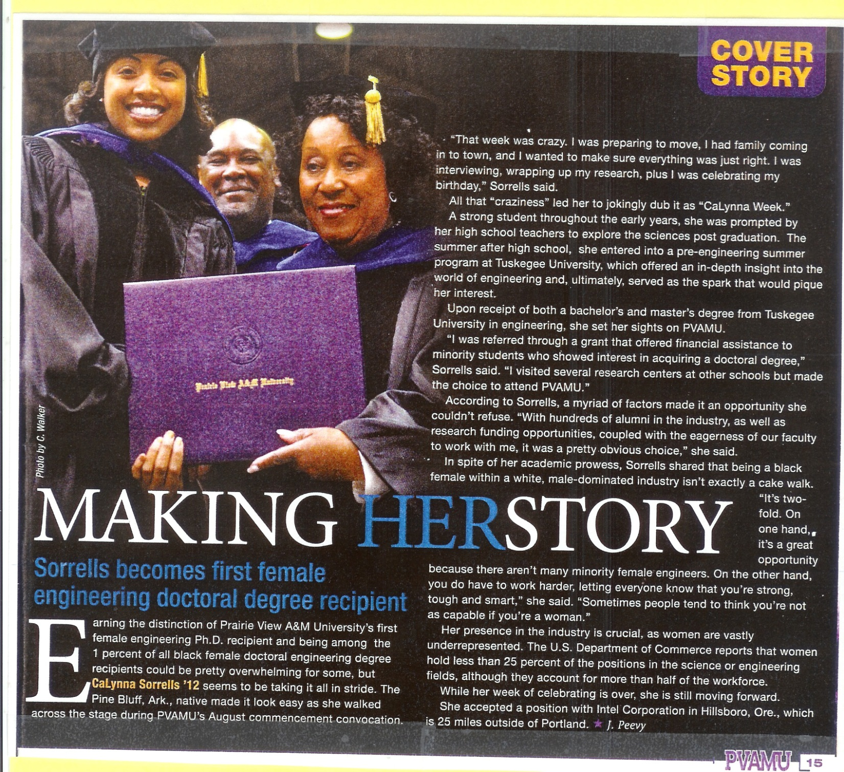

Slide 39
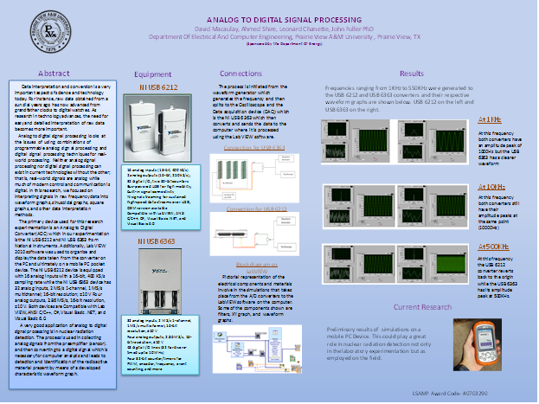

Slide 40
PVAMU Faculty Involved in the DOE Research Effort (2010 – 2016)
Dr. John Fuller, Professor and P.I. Electrical and Computer Engineering Department
Dr. Ing Chang, Professor and Massie Chair, Mechanical Engineering Department
Dr. Sukesh Aghara, Assistant Professor, Chemical Engineering Department (Specialty-Nuclear Engineering)
Dr. Pamela Obiomon, Associate Professor and Interim Department Head, Electrical and Computer Engineering Department
Dr. Warsame H. Ali, Associate Professor, Electrical and Computer Engineering Department
Dr. Penrose Cofie, Instructor, Electrical and Computer Engineering Department
Dr. Justin Foreman, Adjunct Professor, Electrical and Computer Engineering Department
Dr. Lijun Qian, Professor, Electrical and Computer Engineering Department
Dr. Richard Wilkins, Professor, Electrical and Computer Engineering Department
Dr. Suxia Cui, Associate Professor, Electrical and Computer Engineering Dept.

Slide 41
Presentations, Publications and Patents (August, 2011 – Fall, 2015)
Kamto, Attia, Qian, Fuller('Light-Weight Key Distribution and Management for Advanced Metering Infrastructure') Accepted for presentation at the IEEE International Workshop on Smart Grid Communications and Networks. December 2011, Houston, Texas
Augustine Ajuzie, John Fuller, Yangpeng Zhang, Warsame Ali, Jian Zhang, refereed paper “Network-Induced Delay Compensation with Digital Redesigned PAM/PWM Controller”, 2012 International Conference on Power Systems Operation and Planning, January 15-19, 2012 Jomo Kenyatta University of Agriculture and Technology Nairobi, Kenya.
Jian Zhang, Yongpeng Zhang, Leang-san Shieh and Warsame Ali “Linearization Modeling or Non-smooth Dynamical Systems with Approximated Scalar sign Function,” at the 2012 International Conference on Power Systems Operation and Planning, January 15-19, 2012, Jomo Kenyatta University of Agriculture and Technology Nairobi, Kenya.
Lijun Qian, John Fuller, Ing Chang, “Quickest Detection of Nuclear Radiation using a Sensor Network”, 2012 IEEE International Conference Technologies for Homeland Security, November 13-15, 2012, Waltham, Massachusetts.
Babajide Kareem, Warsame H. Ali, Dhadesugoor Vaman, John H. Fuller, Penrose Cofie, “Dynamic Movement of Reference Nodes, for Improved Tracking Accuracy of Indoor Situational Awareness Systems”, ICGST International Conference on Computer Science and Engineering, Dubai, United Arab Emirates, July 16-18, 2012.
L. Qian, J. Fuller, Cheslan Simpson (2013), “A Community Sensing Framework for Threat Detection in Metropolitan Area”, IEEE Conference on Homeland Security Technologies, November 11-14, 2013, Westin Hotel 70 Third Avenue, Waltham, MA 02154 US.
Mamatha Gowda, Warsame H. Ali, Penrose Cofie, John Fuller, "Design Implementation of Speed Controller Using Extended Kalman Filter for PMSM" International Journal of Engineering Research & Technology, Volume. 3, Issue. 04 , April - 2014
Mamatha Gowda, Warsame H. Ali, Penrose Cofie, John Fuller, "Design of a Speed Controller Using Extended Kalman Filter for PMSM" IEEE 57th International Midwest Symposium on Circuits and Systems, 2014 (under review)

Slide 42
Publications Continued
Lijun Qian, Nan Zou, Husheng Li, "Auxiliary Frequency and Voltage Regulation in Microgrid via Intelligent Electric Vehicle Charging", accepted for publication and presentation at the IEEE International Conference on Smart Grid Communications (SmartGridComm 2014).
Presentations at the FPGA Workshop by Massie and PVAMU Faculty held on June 30-July 1, 2014 at Prairie View A&M University are as follows
Mathematical Applications Using Matlab/Simulink: Dr. Warsame Ali/Dr. John Attia
Fundamentals of Programmable Devices and FPGAs: Dr. Pamela Obiomon
Transitioning from K-12 to the University Level: Dr. Kelvin Kirby
Circuit Analysis Using Multisim Software/NI Elvis: Dr. Warsame Ali/Dr. John Attia/Dr. Penrose Cofie
Energy Conversion Fundamentals and Applications: Dr. John Fuller
Shubha Kyatsandra, Member, IEEE, and Dr. Richard Wilkins, Member, IEEE, “Total Ionizing Dose X-ray Radiation Effects on MWCNT/PMMA Thin Film Composites”, IEEE TRANSACTIONS ON NANOTECHNOLOGY, VOL. 14, NO. 1, JANUARY 2015
B.S. Budden, L.C. Stonehill, A. Warniment, J. Michel, S. Storms, N. Dallmann, D.D.S. Coupland, P. Stein, S. Weller, L. Borges, M. Proicou, G. Duran, J. Kamto, “Handheld readout electronics to fully exploit the particle discrimination capabilities of elpasolite scintillators,” Elsevier Publishing, Nuclear Instruments and Methods in Physics Research A (2015) 213-218, http://dx.doi.org/10.1016/j.nima.2015.06.004

Slide 43

Contribution of DOE/PVAMU Sam Massie Funding
Key contributor to the establishment and development of the Masters
and PhD programs in Electrical Engineering at PVAMU
Supporting Faculty research that leads to improved instruction and
instructing our students on current government and industrial
engineering topics and issues
Development of faculty expertise that has lead to new funded projects
and development of research centers such as the recently funded
Department of Defense Center for “Center of Excellence in Research and Education for Big Military Data Intelligence (CREDIT)”
at PVAMU headed by Dr. Lijuan Qian and Co-PIs Dr. Fuller and Dr. Obiomon.

