Slide 1


Center for Advancing Innovations in Smart Microgrid
PRAIRIE VIEW A&M UNIVERSITY
DEPARTMENT OF ELECTRICAL AND COMPUTER ENGINEERING
INDUSTRIAL ADVISORY BOARD MEETING
JOHN O. ATTIA
APRIL 29, 2016

Slide 2

Center for Advancing Innovations in Smart Microgrid - researchers
RESEARCH TEAM CURRENTLY AT PVAMU
John Attia (PI),
Warsame Ali (Co-PI),
Penrose Cofie (Co-PI),
Matthew Sadiku (Co-PI),
Lijun Qian (Co-PI).
ADDITIONAL RESEARCHERS
Chief Scientist and Executive Professor
Research Engineers (2)
PhD Students (4)
MS Students(2)

Slide 3
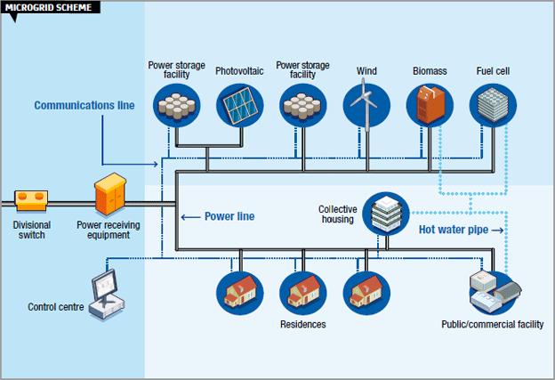
Center for Advancing Innovations in Smart Microgrid - MAIN QUESTIONS
What are the electromagnetic compatibility issues of the Microgrid?
What are the effects of large distributed and intermittent energy sources on the power quality of the Microgrid?
How do we make the Microgrid communication networks reliable and secured from malicious intrusion into the Microgrid?
What fault detection and protection schemes will be optimal for the reliable operation of the Microgrid?
From Z. Bo, Alston Grid, Spring 20111

Slide 4
Center for Advancing Innovations in Smart Microgrid – research plan (1)
Task 1: Enhance the Power Quality of the Microgrid (Drs. Attia and Ali)
Objective 1: Characterize Power Quality of Simulated Microgrids with Various Loads, Energy Sources and Storage Devices
Objective 2: Design Electronic Circuits for Improving Power Quality through Filtering and Storage Devices
Task 2: Minimize Electromagnetic Compatibility of Electronic Devices in Microgrid (Drs. Sadiku, Attia)
Objective # 1: Create EMI/EMC Models for Microgrids.
Objective # 2: Minimize EMI/EMC in Microgrids

Slide 5
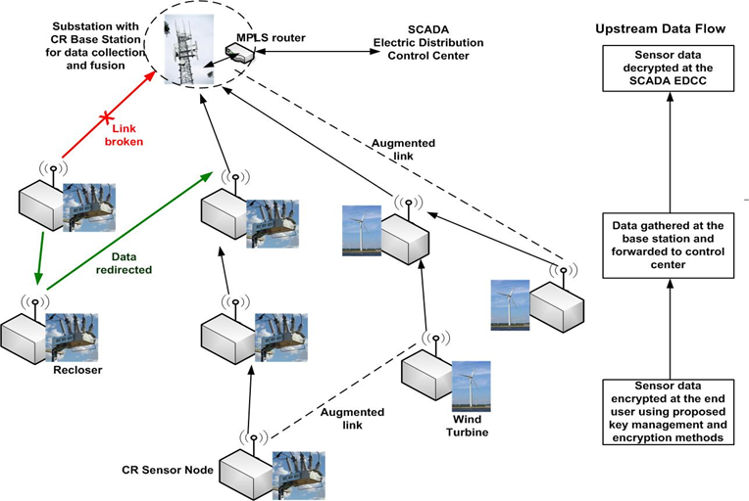
Center for Advancing Innovations in Smart Microgrid – research plan(2)
Task 3: Provide Secure and Robust Data Collection and Exchange (Drs. Qian and Sadiku)
Objective 1. Reliability Maximizing Channel Assignment
Objective 2. Design λ-augmented Tree for Robust Data Retrieval
Objective 3. Key Deployment and Management for Secure Data Collection
Task 4: Design Novel Fault Detection Protection and Control of Microgrids (Drs. Cofie, Ali)
Objective 1: Design a Microgrid that Includes Photovoltaics, Wind, Battery Storage and Micro-alternator.
Objective 2: Implement a pilot protection scheme employing PLCs

Slide 6
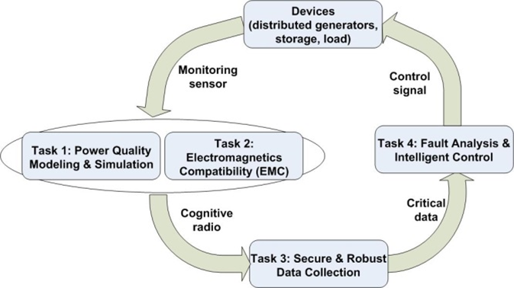
Center for Advancing Innovations in Smart Microgrid – research plan(3)
Synergistic Task 5: Test Bed Design and Experimental Validation (Ali, Cofie, Qian, Attia, Sadiku)
Tasks 1&2 directly model and study the changes taken place in microgrid and monitor the transient effects;
while task 3 collects data in a secure and robust fashion using cognitive radio sensor networks, and in turn feed the data to task 4 to detect and analyze faults and design intelligent control schemes to mitigate the faults.
The resulted changes in microgrid again will be monitored by tasks 1&2. This is a continuing process and the tasks will interact with each other during the process.
In task 5, a microgrid prototype, PVµGrid will be built to validate the results from tasks 1,2,3 &4.

Slide 7
Center for Advancing Innovations in Smart Microgrid - FUNDING
Total Funding Amount: $6,412,201
  Renovations: $2,000,000
  Equipment: $1,544,525
  Other Costs: $2,867,676
Sponsors:
  Texas A&M University System – Chancellor’s Office
  Prairie View A&M University – Business Affairs Office
Funding Period: 2016 to 2019

Slide 8
Center for Advancing Innovations in Smart Microgrid - PROGRESS (1)
Authorization Received from Texas A&M University System to start project (November 3, 2015)
Accounts for the Projects have been established:
  Renovation
  Equipment
  Personnel
The hiring process for the Chief Scientist and Executive Professor is ongoing.

Slide 9

Center for Advancing Innovations in Smart Microgrid - PROGRESS (2)
Letter of Intent has been submitted to submit a proposal on Smart Microgrid to NSF on June 10, 2016
Proposal to NSF is being written
Four senior students will be completing a Senior Design Project on Monitoring Power Sources on the Smart Microgrid
MS Student is currently working on Power Quality Issues on the Smart Microgrid

Slide 10
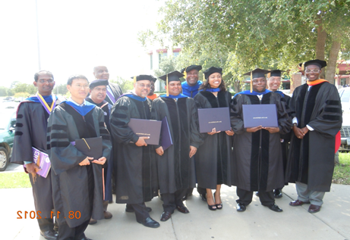
Center for Advancing Innovations in Smart Microgrid – SOCIETAL IMPACT
The results of the project will be useful to small towns, college campuses, manufacturing facilities, and military installations,.
Industries and organizations will have more secured and reliable Microgrid through the use of the results of this work.
Develop and maintain a state-of-the-art academic program in the area of electric power engineering.
Provide hands-on educational and practical knowledge to undergraduates via senior design projects, M.S. and Ph.D. students via graduate level research.

Slide 11

Center for Advancing Innovations in Smart Microgrid - ACKNOWLEDGEMENT
We acknowledge our sponsors:
The Office of the Chancellor, Texas A&M University System, and
The Office of Business Affairs of Prairie View A&M University.

