Slide 1
Electrical and Computer Engineering
Spring 2016 Industrial Advisory Board Meeting
April 29, 2016

Slide 2
ECE IAB Meeting Agenda, April 29, 2016
8:30 am Breakfast- 3 rd floor EE Bldg
9:00 am Welcome from the Dean and Department Head – ECE Conference room
9:15 am Review Minutes
9:20 am Highlights of the 2015-2016– ECE Conference room
9:30 am Presentation about our instructional programs - ECE Conference room
10:30 am – break
11:00 – 12pm: Board provides commendations, concerns and recommendations - ECE Conference room
12-1 pm – Lunch ECE Conference room
1-2 pm – Design showcase/faculty give presentations on their work / informational talks-EE/Hallway/Room 137 EE Bldg
2- 5pm Senior Design Project Presentations-Room 137 EE Bldg

Slide 3
Introductions -New Members
Mr. Anthony Sanders | Manager | National Sandia Laboratories
Mrs. Shannon Booty | Sr. Program System Engineer | Raytheon
Mr. Jerin Varkey | Manager | Shell

Slide 4
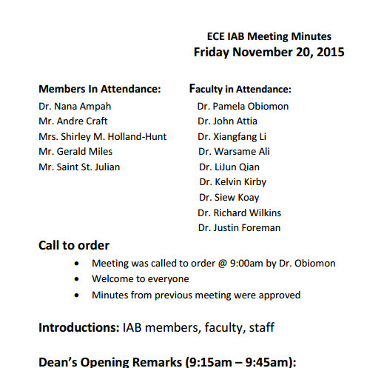
Previous Meeting Minutes

Slide 5
Highlights

Slide 6

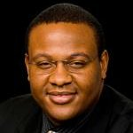
News: Alumni Speaks to Students
Alumni Mr. Jimmie Finister
Engineering Manager-Electrical Products
Drilling and Surface
GE Oil & Gas
Mr. Jimmie Finister, GE Oil & Gas Engineering Manager of Electrical Products spoke to the ECE Senior Design Class. Mr. Finister graduated from Prairie View A&M University in 2005.

Slide 7
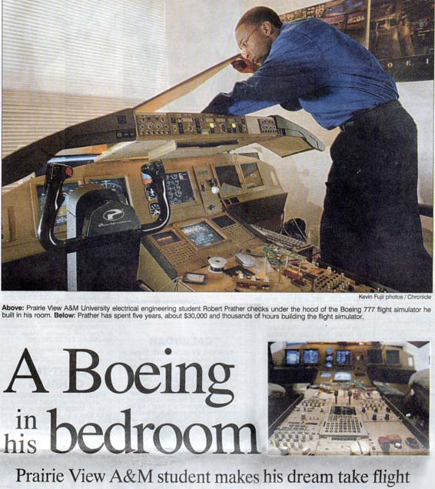


News: Alumni Speaks to Students
Alumni Mr. Robert Prather
Manager, Information Technology - SCADA US at Spectra Energy

Slide 8
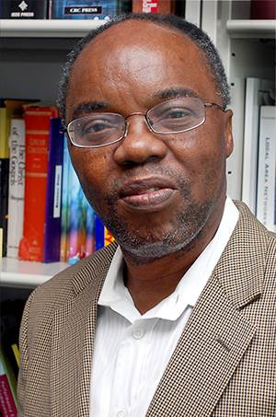
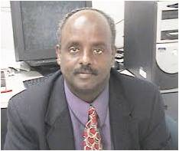
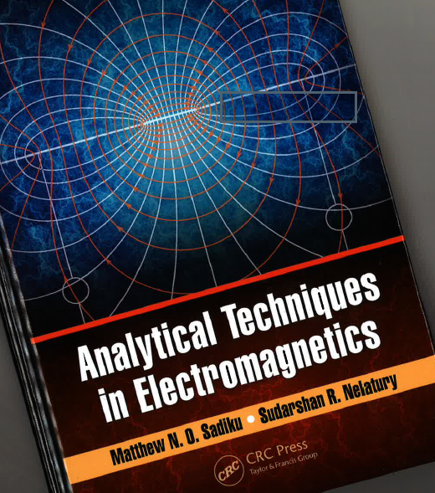
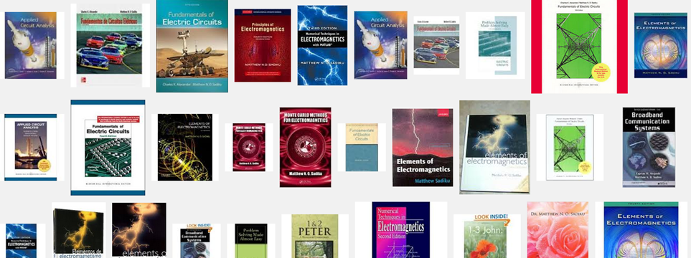

News: Faculty Publish New Books

Slide 9
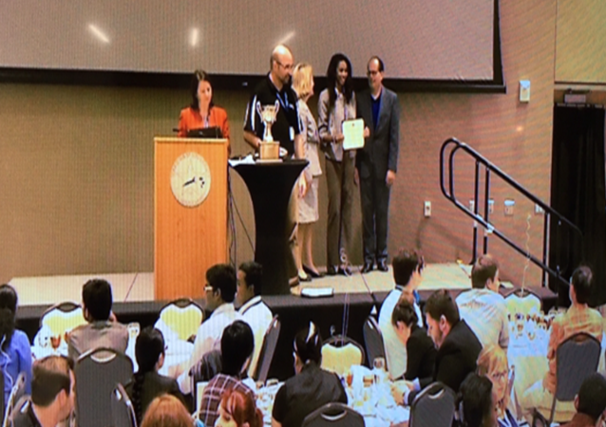
News: 2 Students win 1st Place Doctoral Student Award
1st Place Doctoral Student Award, Pathways Symposium, Ashley Kelsey and Samuel Bamgbose

Slide 10
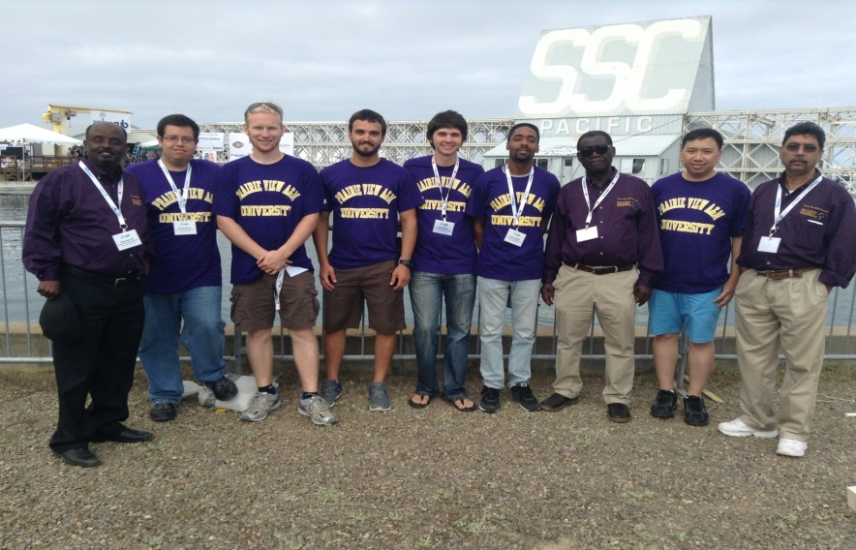
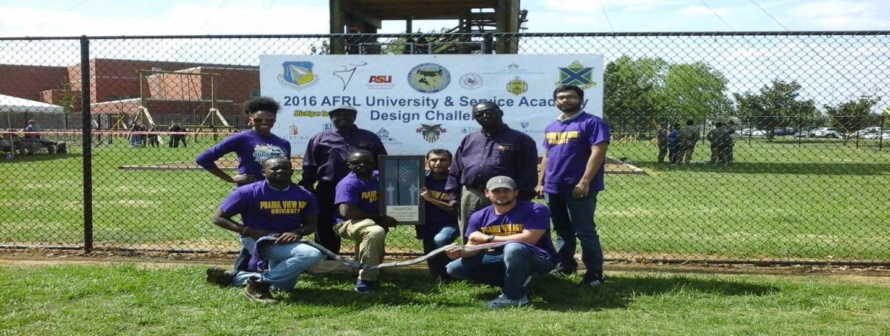
Student News
NAVSEA Robotics Contest in San Diego
2016 AFRL University Design & Service Academy Challenge

Slide 11
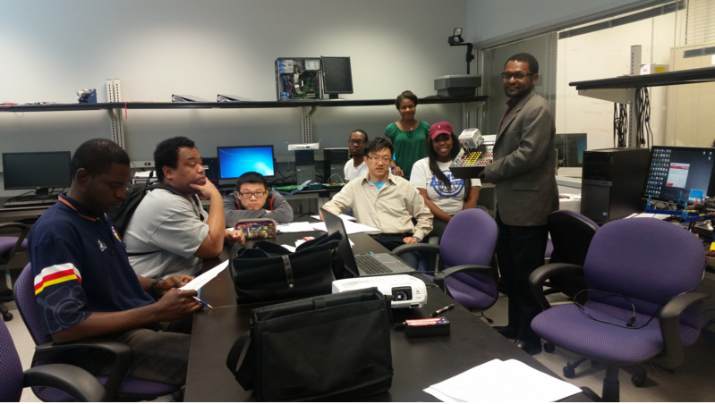
PLC Training Workshops

Slide 12

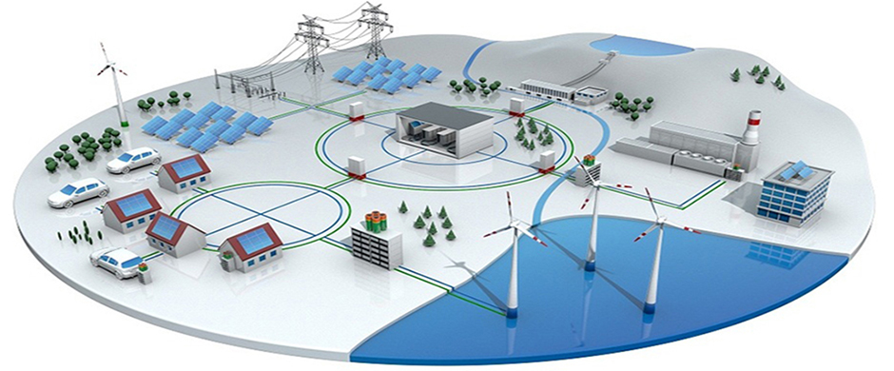


Four New Centers
Computational Biology - $6M
Smart Grid- $6M
Cyber Security-$6M
Center of Excellence in Research and Education for Big Military Data Intelligence Center (CREDIT) -$5M
Smart Grid
Computational Biology

Slide 13
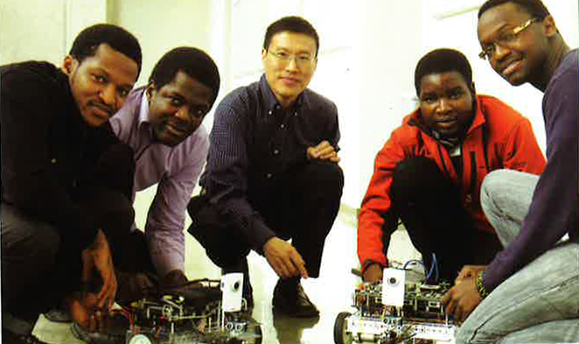

Center of Excellence in Research and Education for Big Military Data Intelligence Center (CREDIT)
Hired Undergraduates and sponsored senior design projects
Summer Camp
Website: credit.pvamu.edu

Slide 14
Center Papers
Journal Papers
Joseph Kamto, Lijun Qian, Wei Li, and Zhu Han, “λ-Augmented Tree for Robust Data Collection in Advanced Metering Infrastructure”, International Journal of Distributed Sensor Networks, Hindawi publishing corp., 2015.
Yuzhong Yan, Mahsa Hanifi, Liqi Yi, and Lei Huang, “Building a Productive Domain-Specific Cloud for Big Data Processing and Analytics Service.” Journal of Computer and Communications, published in Vol. 3, Issue 5, pp. 107-117. 2015
Conference Papers
Chao Chen , Yuzhong Yan , Xishuang Dong and Lei Huang, “A Scalable and Productive Workflow-based Cloud Platform for Big Data Analytics,” 2016 IEEE International Conference on Big Data Analysis, (ICBDA 2016) Hangzhou, China, March 12-14, 2016
Y. Yang and L. Li, “A smart sensor system for air quality monitoring and massive data collection,” Proc. International Conference on ICT convergence 2015, Oct. 27-30, 2015.
David Zhou, Y. Yang, and H. Yan, “A Smart Virtual Eye Mobile System for the Visually Impaired”, IEEE Potentials, accepted for publication.
Suxia Cui, Lin Li, Lei Huang, Yonghui Wang, “Enhance Computing Curricula with High-Performance Computing Teaching and Research,” ASEE’s 122nd Annual Conference & Exposition, June 14-17, 2015, Seattle, WA
Wasiu Opeyemi Oduola, Nnaemeka Okafor, Oluwaseyi Omotere, Lijun Qian, and Deepak Kataria, “Experimental Study of Hierarchical Software Defined Radio Controlled Wireless Sensor Network”, in Proceedings of the IEEE Sarnoff Symposium, Newark, NJ, Sep 21-23, 2015.
Hossein Jafari, Xiangfang Li, Lijun Qian, and Yuanzhu Chen, “Community Based Sensing: A Test Bed for Environment Air Quality Monitoring using Smartphone paired Sensors”, in Proceedings of the IEEE Sarnoff Symposium, Newark, NJ, Sep 21-23, 2015.
Yuzhong Yan, Lei Huang, and Liqi Yi, “Is Apache Spark Scalable to Seismic Data Analytics and Computations”, IEEE International Conference on Big Data, Santa Clara, CA, Oct 29 – Nov 1, 2015.
Yuzhong Yan, Chao Chen, and Lei Huang, “A Productive Cloud Computing Platform Research for Big Data Analytics”, 7th IEEE International Conference on Cloud Computing technology and Science (IEEE CloudCom 2015), Vancouver, Canada, Nov 30 – Dec 3, 2015.
Thesis/Dissertation
Yuzhong Yan, “A Template-based Seismic Data Analytics Cloud Platform”, MS Thesis, Dec 2015.

Slide 15
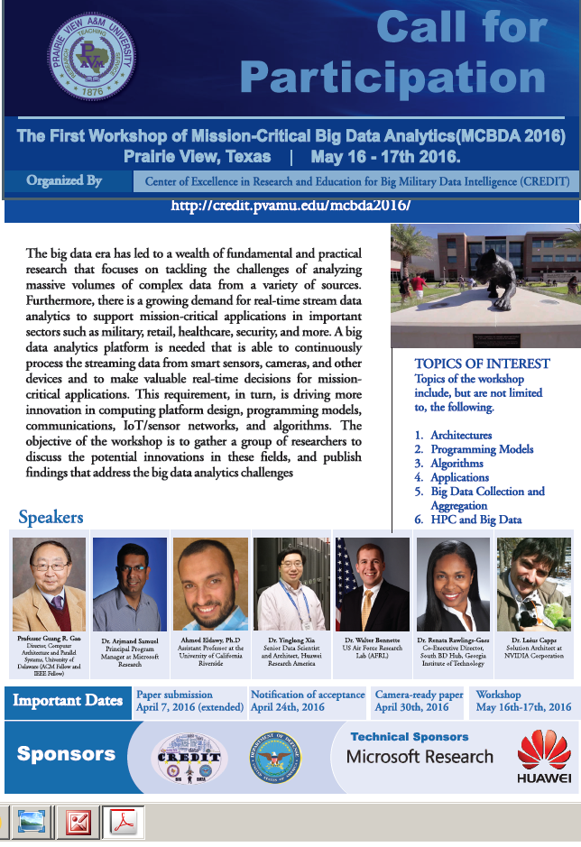
Workshop of Mission-Critical Big Data Analytics on May 16-17 at PVAMU

Slide 16
Enrollment

Slide 17
University Enrollment Increase to 9,500 Students

Slide 18
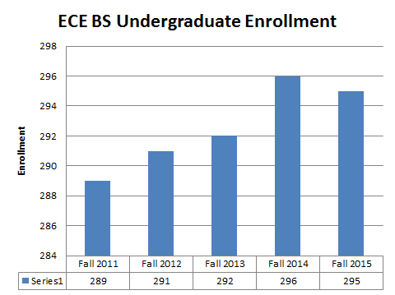
Enrollment

Slide 19
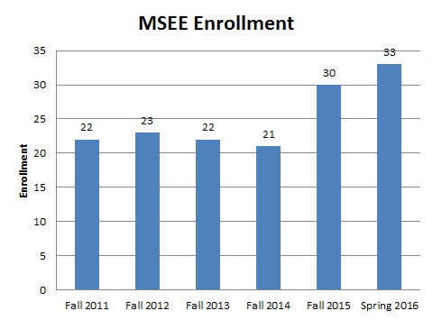
Enrollment

Slide 20
Degrees Awarded

Slide 21
Undergraduate Degrees

Slide 22
Graduate Degrees

Slide 23
Curriculum and Instruction

Slide 24
ABET: Changes to Electrical Engineering Program Objectives
The Current Program Educational Objectives of the Electrical Engineering Program are:
To produce graduates for successful careers in Electrical Engineering and other related fields.
To produce graduates who can secure employment within the State of Texas, the nation, and the world.
To produce graduates who engage in self-development activities through professional study and personal research that will allow them to adapt to evolving technological challenges.
To produce graduates who can successfully complete graduate degrees in Electrical Engineering or other disciplines that they may choose.
New Program Educational Objectives (PEOs) of the Electrical Engineering program are:
To produce graduates for successful careers in Electrical Engineering and other related fields.
To produce graduates who engage in self-development activities through professional study and personal research that will allow them to adapt to evolving technological challenges.
To produce graduates who can successfully complete graduate degrees in Electrical Engineering or other disciplines that they may choose.

Slide 25
ABET: Changes to Electrical Engineering Program Objectives
The Current Program Educational Objectives of the Electrical Engineering Program are:
To produce graduates for successful careers in Electrical Engineering and other related fields.
To produce graduates who can secure employment within the State of Texas, the nation, and the world.
To produce graduates who engage in self-development activities through professional study and personal research that will allow them to adapt to evolving technological challenges.
To produce graduates who can successfully complete graduate degrees in Electrical Engineering or other disciplines that they may choose.
New Program Educational Objectives (PEOs) of the Electrical Engineering program are:
To produce graduates for successful careers in Electrical Engineering and other related fields.
To produce graduates who engage in self-development activities through professional study and personal research that will allow them to adapt to evolving technological challenges.
To produce graduates who can successfully complete graduate degrees in Electrical Engineering or other disciplines that they may choose.

Slide 26
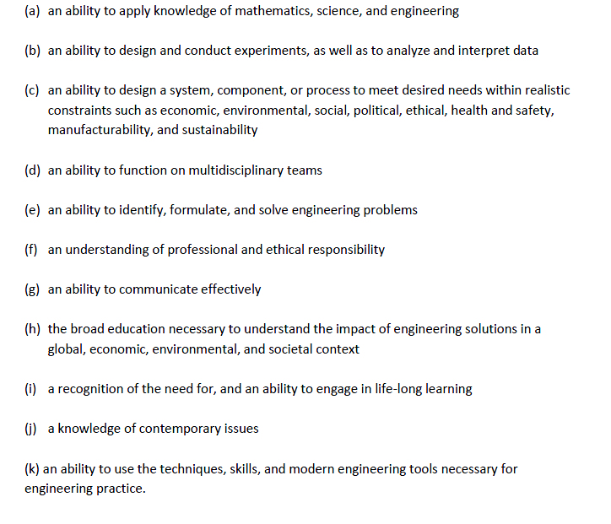
Student Outcomes

Slide 27
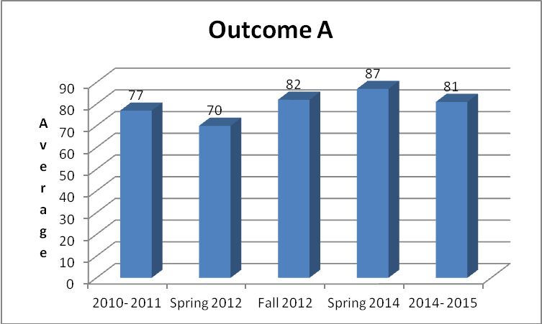
Program Student Outcomes
  Outcome A - an ability to apply knowledge of mathematics, science, and engineering

Slide 28
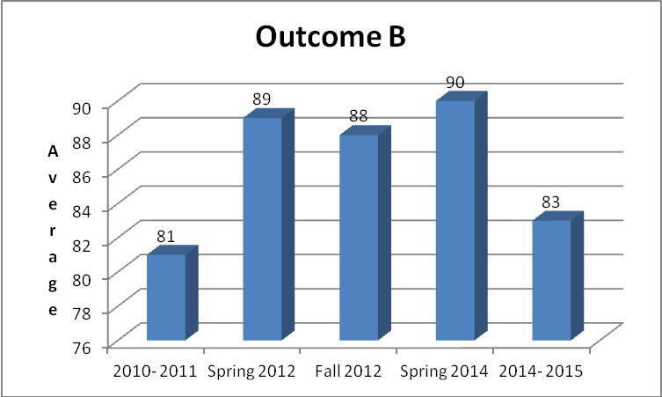
Outcome B
  Outcome B: an ability to design and conduct experiments, as well as to analyze and interpret data

Slide 29
Outcome C
  Outcome C: an ability to design a system, component, or process to meet desired needs within realistic constraints such as economic, environmental, social, political, ethical, health and safety, manufacturability, and sustainability

Slide 30
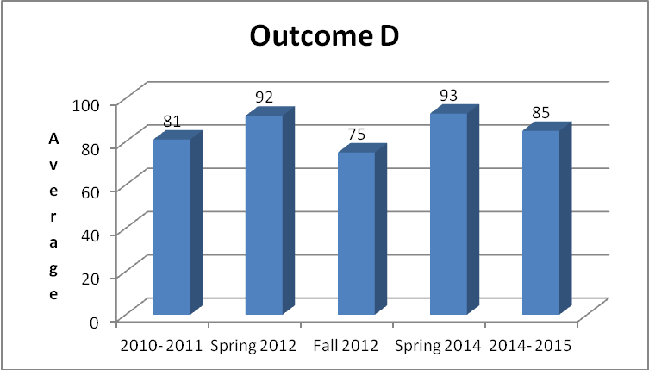
Outcome D
  Outcome D: an ability to function on multidisciplinary teams

Slide 31
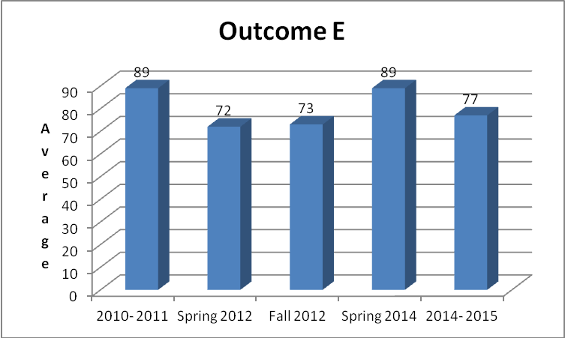
Outcome E
  Outcome E: an ability to identify, formulate, and solve engineering problems

Slide 32
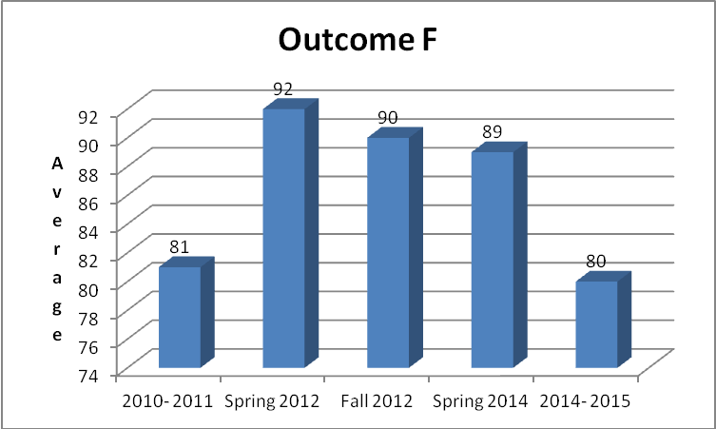
Outcome F
  Outcome F: an understanding of professional and ethical responsibility

Slide 33
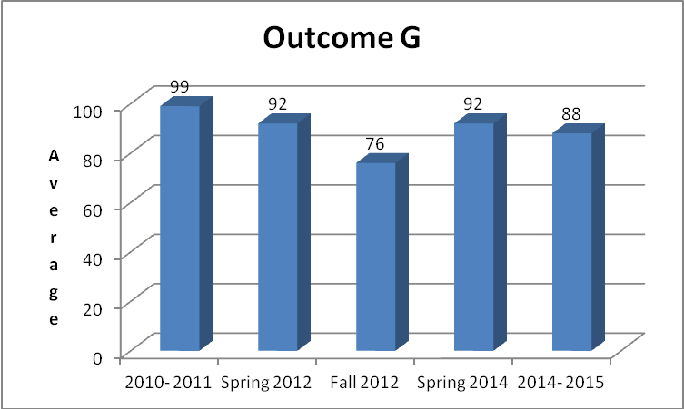
Outcome G
  Outcome G: an ability to communicate effectively

Slide 34
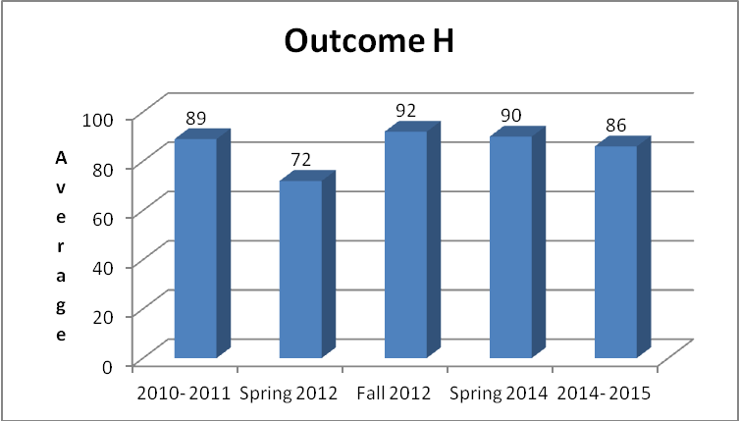
Outcome H
  Outcome H: the broad education necessary to understand the impact of engineering solutions in a global, economic, environmental, and societal context

Slide 35
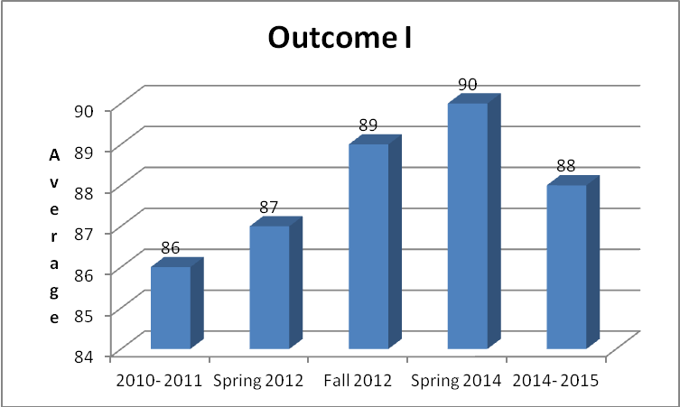
Outcome I
  Outcome I: a recognition of the need for, and an ability to engage in life-long learning

Slide 36
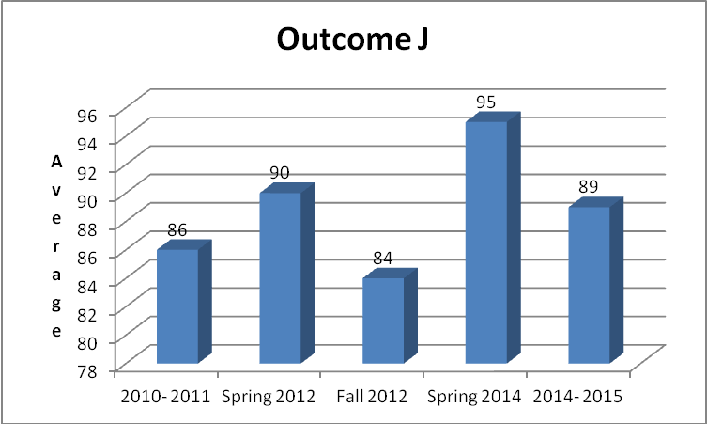
Outcome J
  Outcome J: a knowledge of contemporary issues

Slide 37
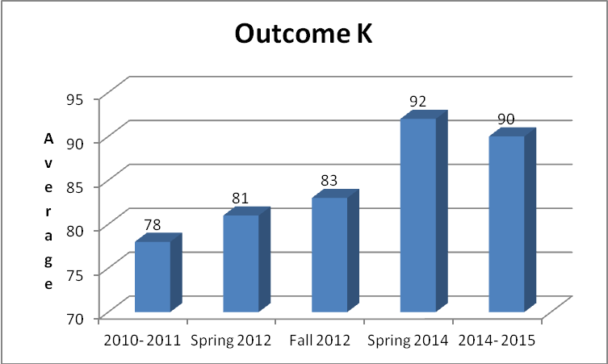
Outcome K
  Outcome K: an ability to use the techniques, skills, and modern engineering tools necessary for engineering practice

Slide 38
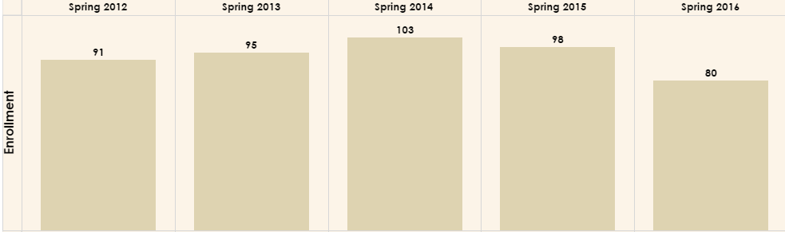
Computer Engineering Enrollment

Slide 39
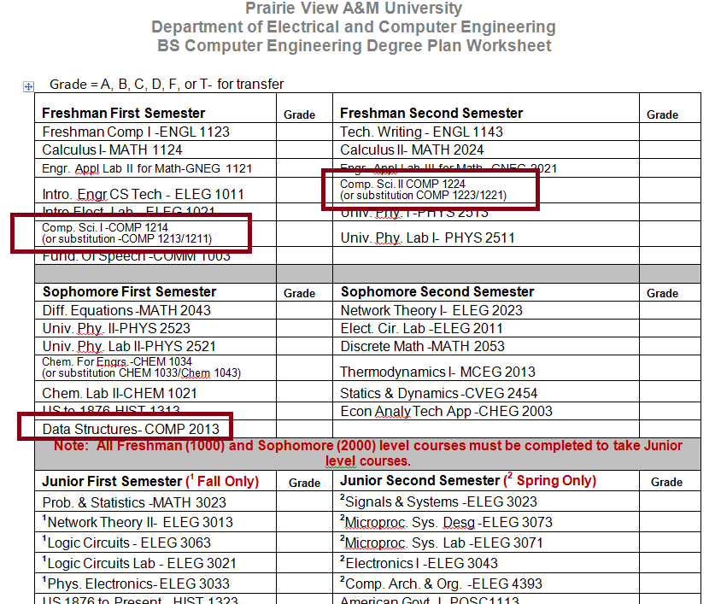
Computer Engineering Degree Plan

Slide 40
Curriculum Changes to Computer Engineering Program
Mission: Increase enrollment
Goal:
  Get students excited about the major
  To provide our students with a solid background upper division.

Slide 41
Curriculum Changes for CPEG
Courses
  ELEG 1043- Computer Applications Lab (2-2)
  ELEG 2153- Programming Concepts with Engr Applications (2-2)
  ELEG 2163 – Introduction to Microcontrollers (2-2)

Slide 42
Software and Hardware
C ++ Programming – Arduino Board
C ++ Programming and Python – Microcontrollers and Rasberry Pi
Verilog and VHDL– FPGAs
Microprocessors –Microntrollers (ATMEL and ARM)
Embedded Systems and Computer Networks: Microprocessors -Micontrollers

Slide 43
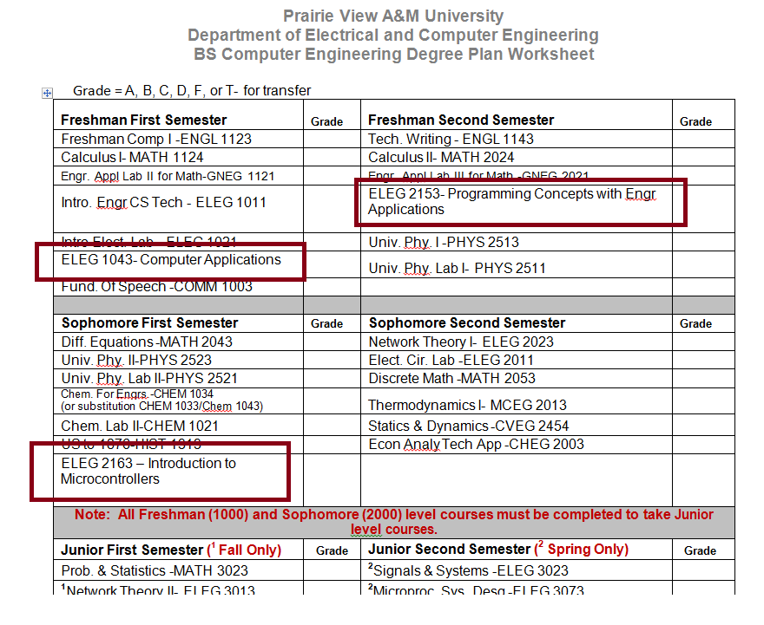
New Plan

Slide 44
Board Commendations, Concerns and recommendations

Slide 45
Next Meeting
When is a good time for the Fall meeting?

