Slide 1

Northwest Houston Center Fall 2026 Information Session/Orientation
Canvas (eCourses) Orientation
Major Stewart
Instructional Designer III
Prairie View A&M University
Center for Instructional Innovation
and Technology Services
(CIITS)
Notes:
Greet the viewers. Introduce yourself

Slide 2
Canvas Orientation
Accessing Canvas
Technical Support
Navigating Canvas
Notes:
After going over the slide, say, "I'm going to jump out out of the presentation for a moment to go to microsoft.com and show how to find more resources about accessibility."
Do a search on accessibility and point out "Accessibility settings"

Slide 3
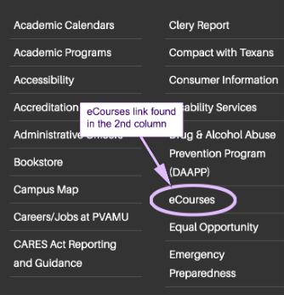

Accessing Canvas
https://ecourses.pvamu.edu
Link at the bottom of every page on the PV website
Link in PV Place
Notes:
After going over the slide, say, "I'm going to jump out out of the presentation for a moment to go to microsoft.com and show how to find more resources about accessibility."
Do a search on accessibility and point out "Accessibility settings"

Slide 4
Technical Support
  Password reset
    https://mypassword.pvamu.edu/
    Link on the PV Place web page
  eCourses issues
    936-261-3280
    ciits@pvamu.edu
    Resources button in Canvas Menu
  Technology issues not related to eCourses
    936-261-2525
    servicedesk@pvamu.edu
    https://www.pvamu.edu/cite/

Slide 5
Canvas Orientation
Q & A
Major Stewart
Instructional Designer III
PVAMU CIITS
mjstewart@pvamu.edu
Notes:
After going over the slide, say, "I'm going to jump out out of the presentation for a moment to go to microsoft.com and show how to find more resources about accessibility."
Do a search on accessibility and point out "Accessibility settings"

