Slide 1
www.maintenanceconnection.com
First Time User Login

Slide 2
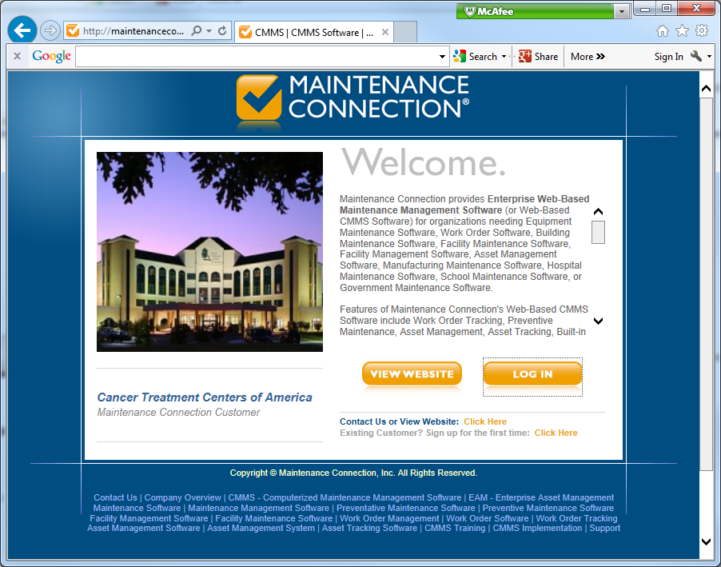
Click here

Slide 3
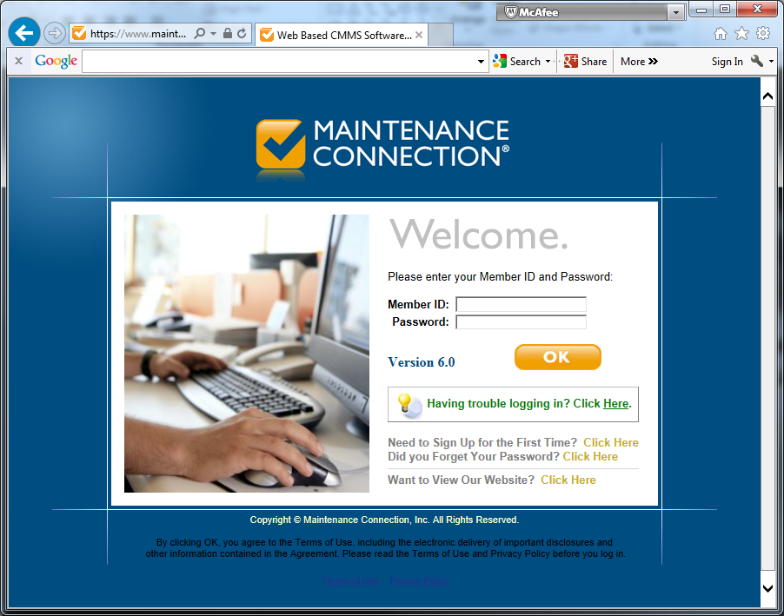

Slide 4
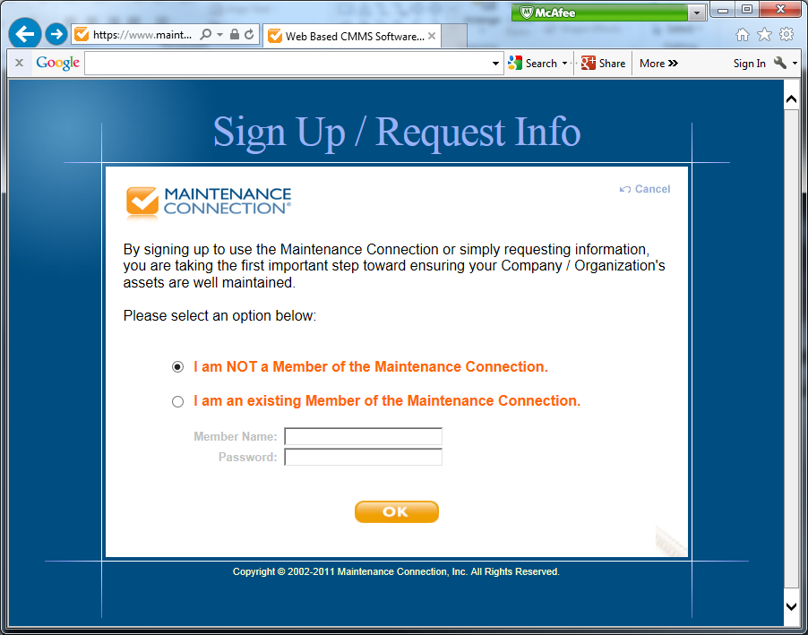
SELECT THIS
THEN CLICK HERE

Slide 5
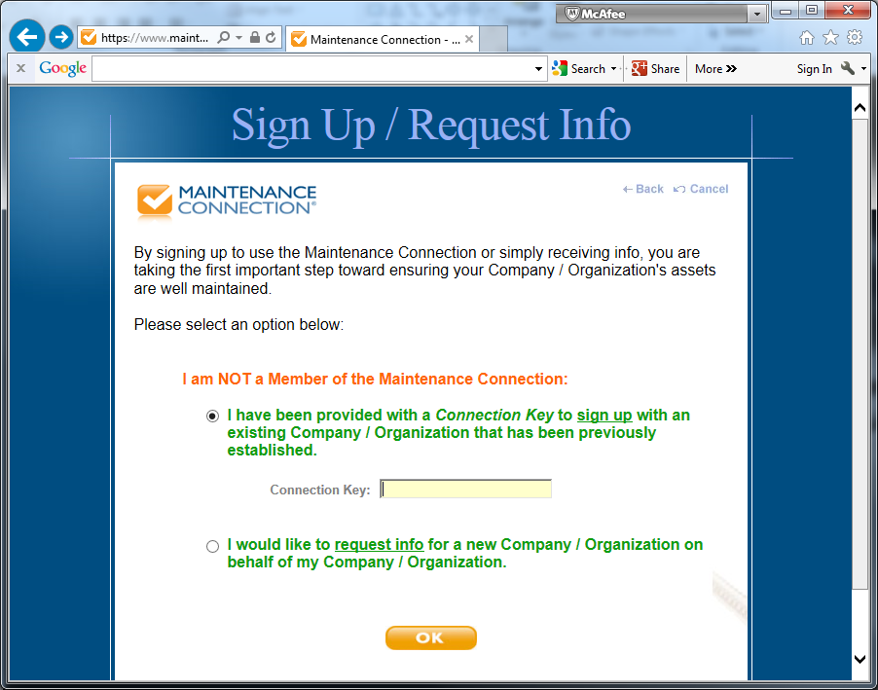
PV AMU code
C701188
THEN CLICK HERE

Slide 6
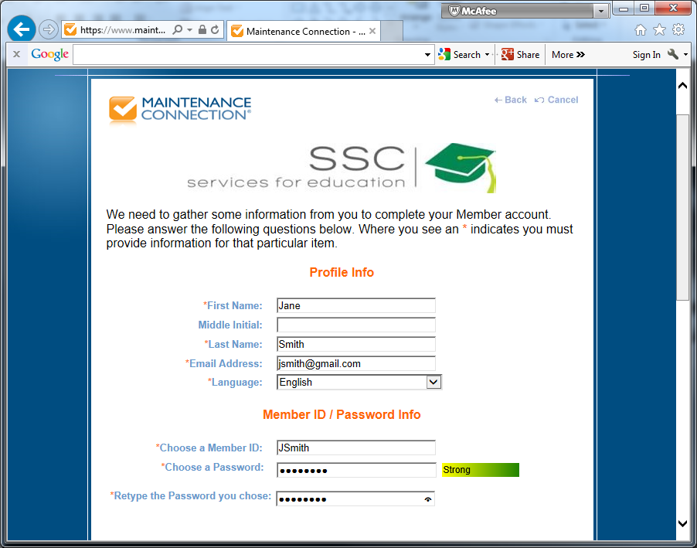
YOUR INFORMATION HERE
FIRST INITIAL THEN LAST NAME
PASSWOR : AT LEAST 6 CHARATERS LONG
SCROLL DOWN AND CONTINUE

Slide 7
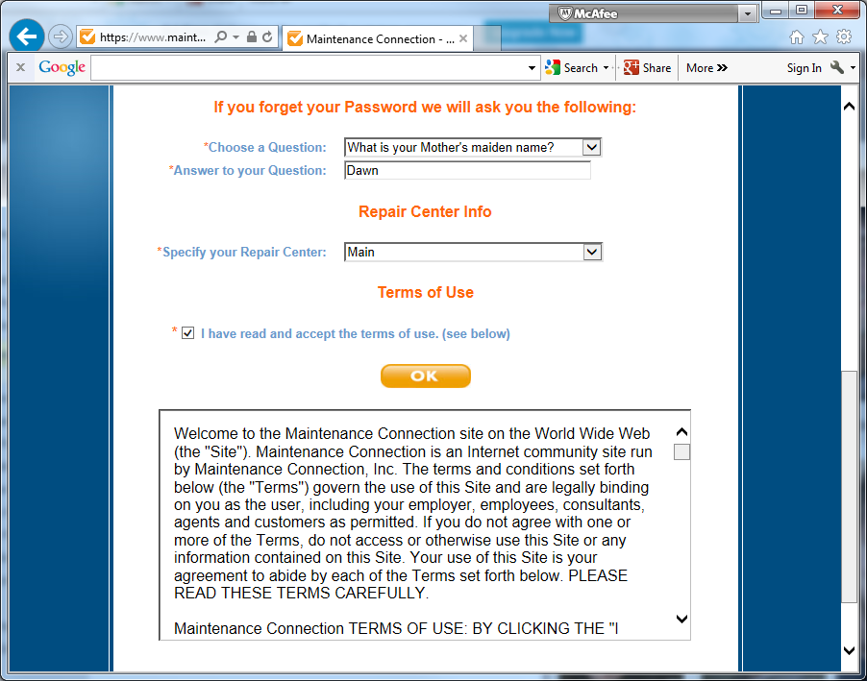
ANSWER SECURITY QUESTION
SELECT MAIN
READ BELOW THEN CLICK HERE

Slide 8
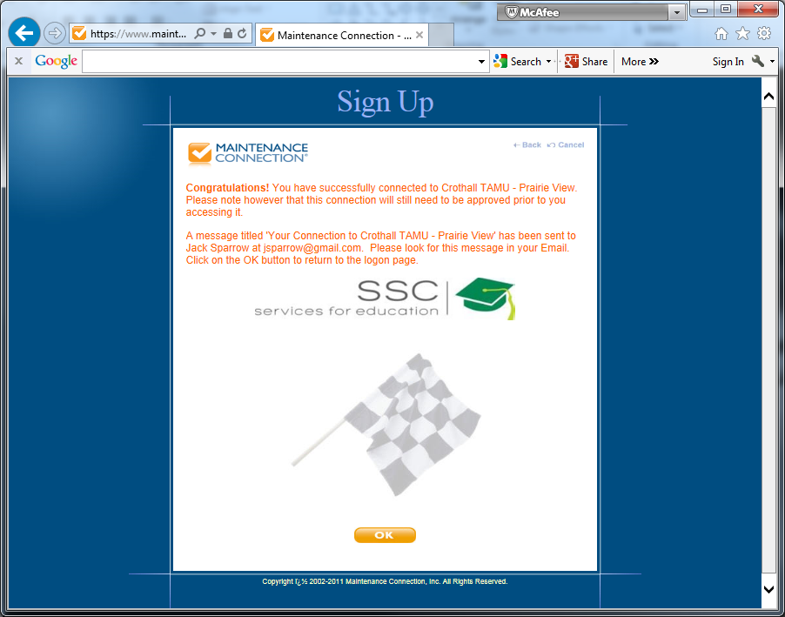
CLICK HERE

